Slide 1
Module 1 Nowadays
Lesson A

Slide 2
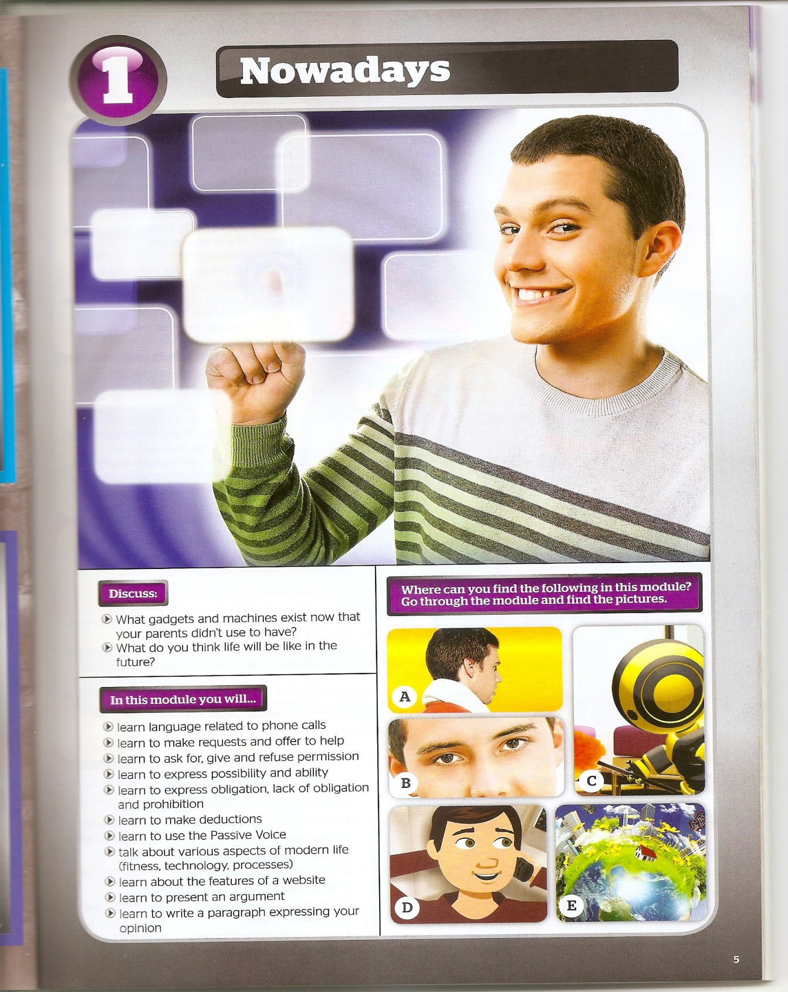
P.8
Picture A
Picture B
Picture C
Picture D
Picture E
P.14
P.12
P.6
P.10

Slide 3
Give me a call

Slide 4
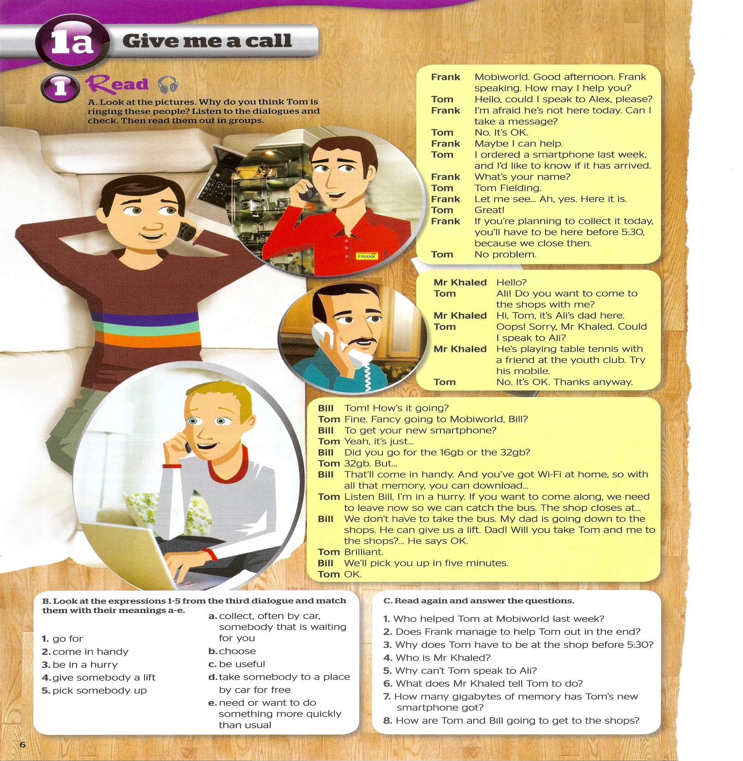

Slide 5
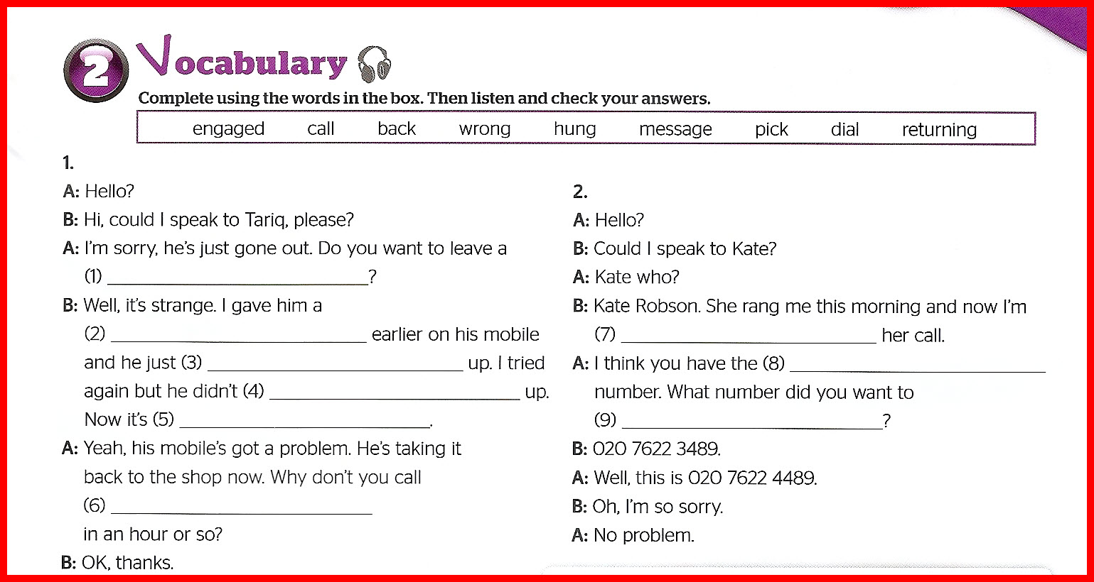
message
call
returning
hung
wrong
pick
engaged
dial
back

Slide 6
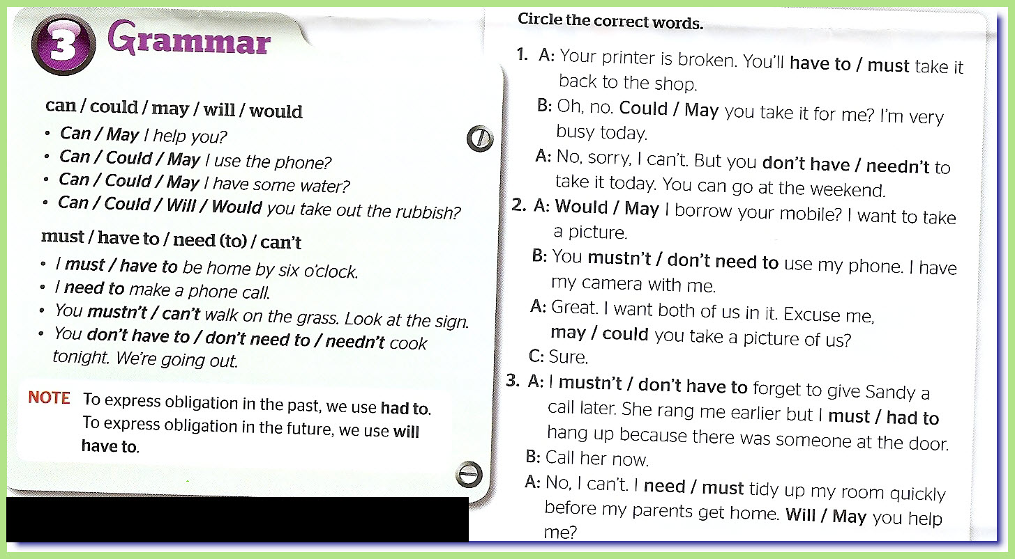

Slide 10
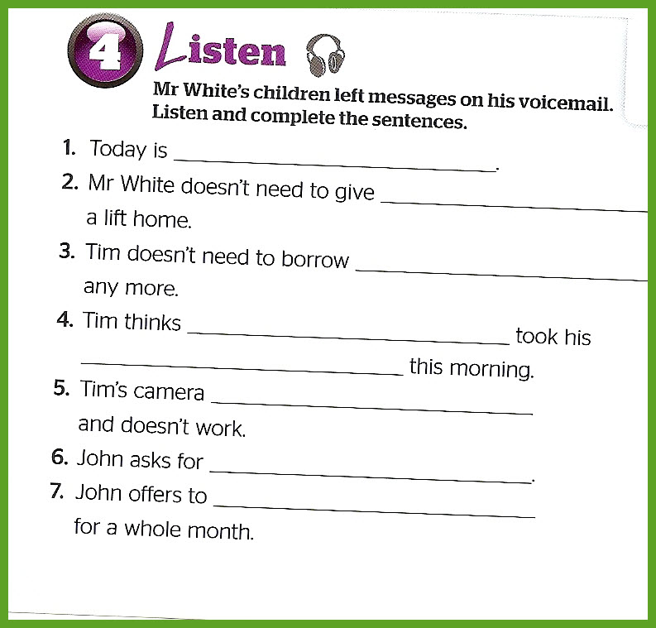
Tuesday
Mark
money
John
camera
got wet ( in the rain )
some money / a favor
wash the car

Slide 11
New vocabulary:
go for
= choose
come in handy
= be useful
be in a hurry
give somebody a lift
Pick somebody up

Slide 12
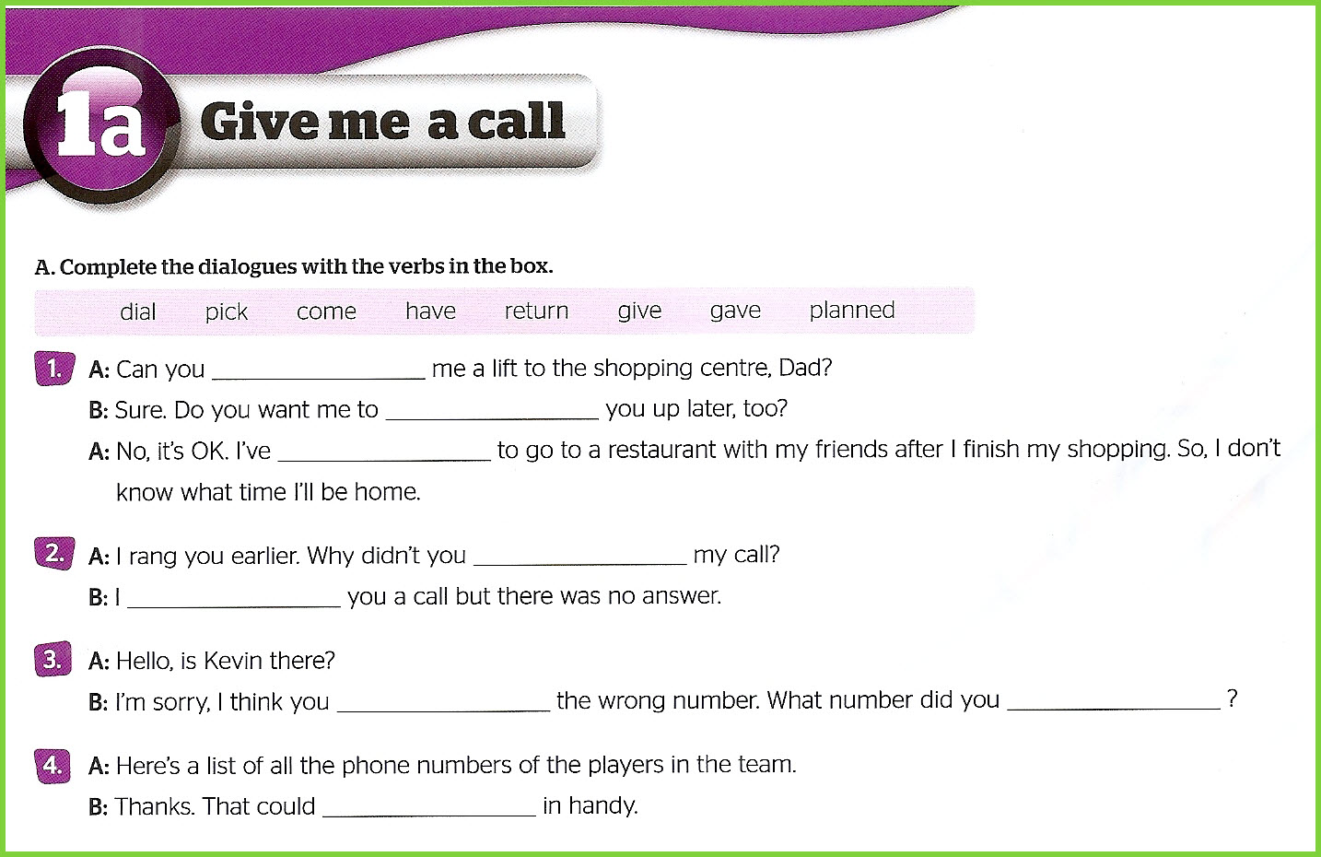
give
pick
planned
return
gave
have
dial
come

Slide 13
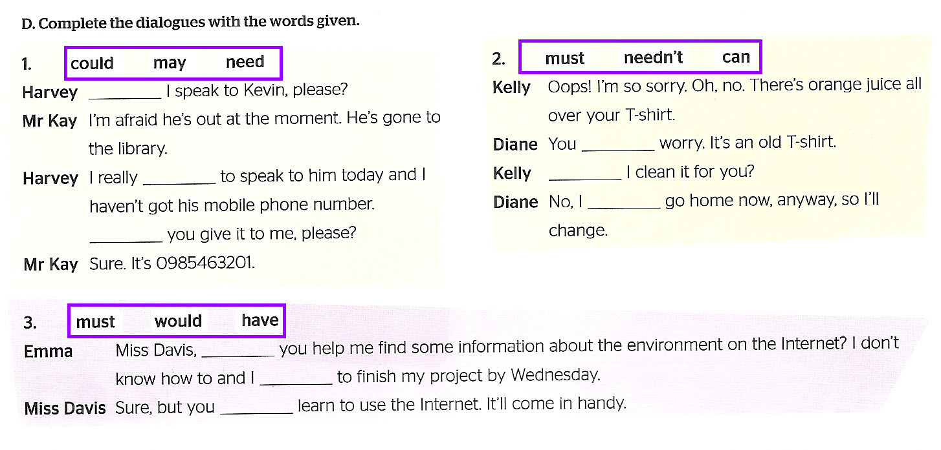
May
needn’t
need
Can
must
Could
would
have
must

Slide 14
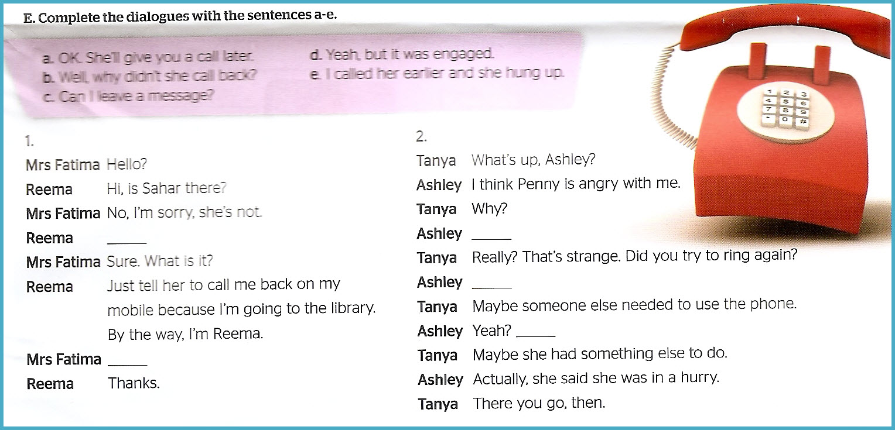
c
e
d
b
a

