Slide 1
Chapter 6
Electric Fields

Slide 2
Properties of Electric Charges
What is happening after you rubbing a balloon with wool on a dry day and approach the balloon to bits of paper?
The balloon attracts bits of paper
Such these materials called
electrified (electrically charged)
There are two kinds of electric charges:
Positive (+) and Negative (-)
Electrons are negative charge
Protons are positive charge

Slide 3
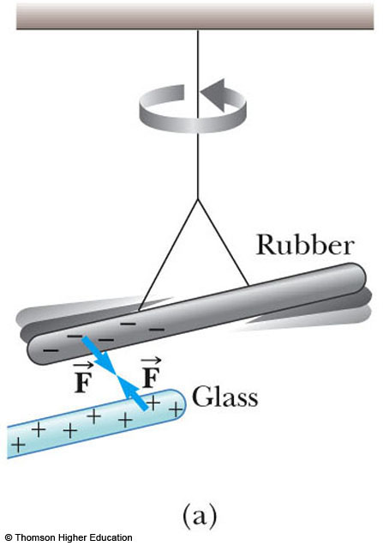
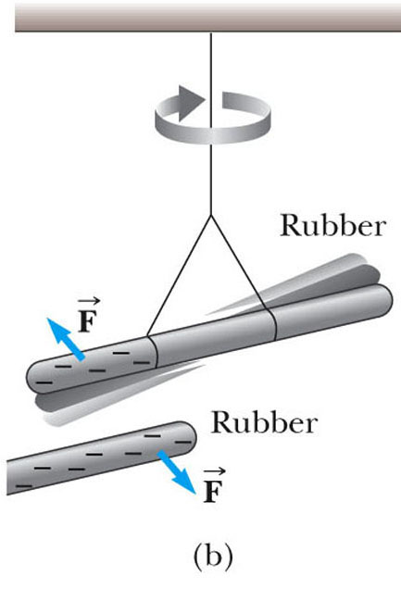
Properties of Electric Charges
The electric charge has the following important properties:
There are two kinds of charges in nature
Charges of the same sign repel one another
Charges with opposite signs attract one another
The rubber rod is negatively charged
The glass rod is positively charged
The two rods will attract
The rubber rod is negatively charged
The second rubber rod is also negatively charged
The two rods will repel

Slide 4
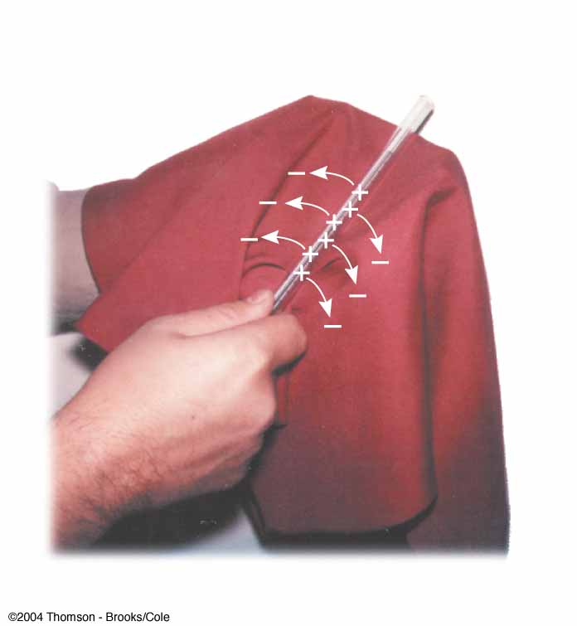
Electric charge is always conserved in an isolated system
When one object is rubbed against another, charge is not created in the process. The electrified state is due to a transfer of charge from one object to the other.
One object gains some amount of negative charge while the other gains an equal amount of positive charge.
uncharged matter contains as many positive charges (protons within atomic nuclei) as negative charges (electrons).

Slide 5
The electric charge quantized.
That is, electric charge (q ) exists as discrete “packets,”
and we can write
q =Ne
N is some integer
e is the fundamental unit of charge
|e| = 1.6 x 10⁻¹⁹ C
The electron has a charge -e (q = -e)
The proton has a charge of equal magnitude but opposite sign +e
. (q = +e)
Some particles, such as the neutron, have no charge.

Slide 6
Charging Objects by Induction
materials in terms of the ability of electrons to move through the material:
Conductors
Electrical conductors are materials in which some of the electrons are free electrons that are not bound to atoms and can move freely through the material
Examples : copper, aluminum and silver
Insulators
Electrical insulators are materials in which all electrons are bound to atoms and cannot move freely through the material. Examples : glass, rubber and wood.
Semiconductors
The electrical properties of semiconductors are somewhere between those of insulators and conductors.
Examples: silicon and germanium.

Slide 7
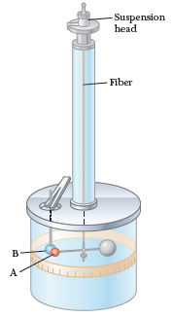
Coulomb’s Law
Charles Coulomb measured the magnitudes of the electric forces between charged objects using the torsion balance,
is inversely proportional to the square of the separation r between the particles and
directed along the line joining them;
• is proportional to the product of the charges q₁ and q₂ on the two particles;
• is attractive if the charges are of opposite sign and repulsive if the charges have the same sign
• is a conservative force.

Slide 8
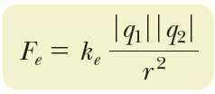
Coulomb's law
The electric force (sometimes called the Coulomb force) between two point charges:
Eclectic force is vector quantity
Coulomb constant is
Unit of eclectic force is Newton (N)
Unit of charge is coulomb (C)
Distance between two charges is measured by meter (m)

Slide 9
Coulomb constant sometime is written by as:
is called permittivity of free space
Coulomb used for point charge only (refers to a particle of zero size that carries an electric charge).
Coulomb law used only for static charge .
Electron charge (e) is the smallest negative (-) charge.
Proton charge (p) is the smallest positive (+) charge.

Slide 10
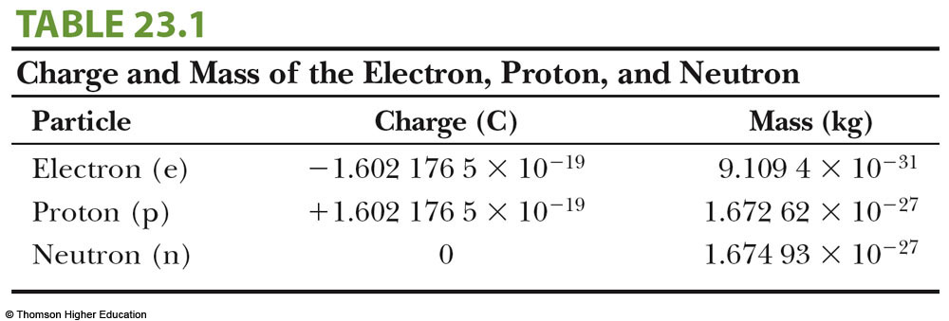
The smallest unit of charge known in nature is the charge on an electron (-e) or a proton (+e) and has a magnitude

Slide 11
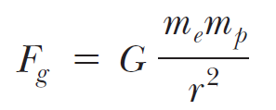
Newton’s law of universal gravitation
Universal gravitation

Slide 12
Example 23.1 The Hydrogen Atom
The electron and proton of a hydrogen atom are separated
(on the average) by a distance of approximately 5.3 x10⁻¹¹ m. Find the magnitudes of the electric force and the gravitational force between the two particles.
The gravitational force between charged atomic particles is negligible when compared with the electric force.

Slide 13
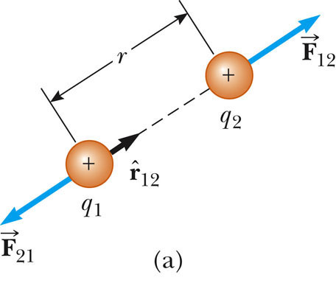
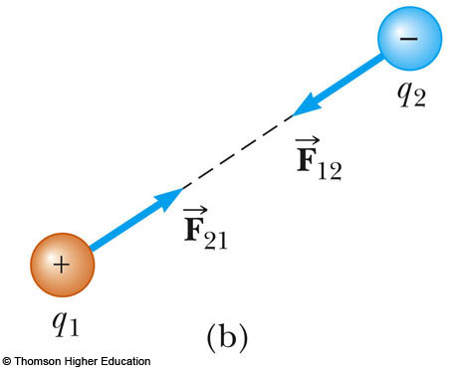
Vector Nature of Electric Forces
The electric force in vector form for the
is a unit vector directed from q₁ toward q₂
The electric force obeys Newton’s third law
If q₁ and q₂ have the same sign, (a)
the product q₁q₂ is positive.
the electric force is a repulsive force
the electric force on one particle is directed away from the other particle.
If q₁ and q₂ are of opposite sign, (b)
the product q₁q₂ is negative.
the electric force is an attractive force,
the electric force on one particle is directed toward the other particle.

Slide 14
These signs describe the relative direction of the force but not the absolute direction.
The absolute direction of the force in space is in the positive or negative direction on a coordinate axis depends on the location of the other charge.
For example, if an x axis lies along the two charges in, the product q₁q₂ is positive, but F₁₂ points in the +x direction and F₂₁ points in the -x direction.

Slide 15
When more than two charges are present the resultant force on any one of them equals the vector
sum of the forces exerted by the various individual charges.
For example, if four charges are present, then the resultant force exerted by particles 2, 3, and 4 on particle 1 is

Slide 16
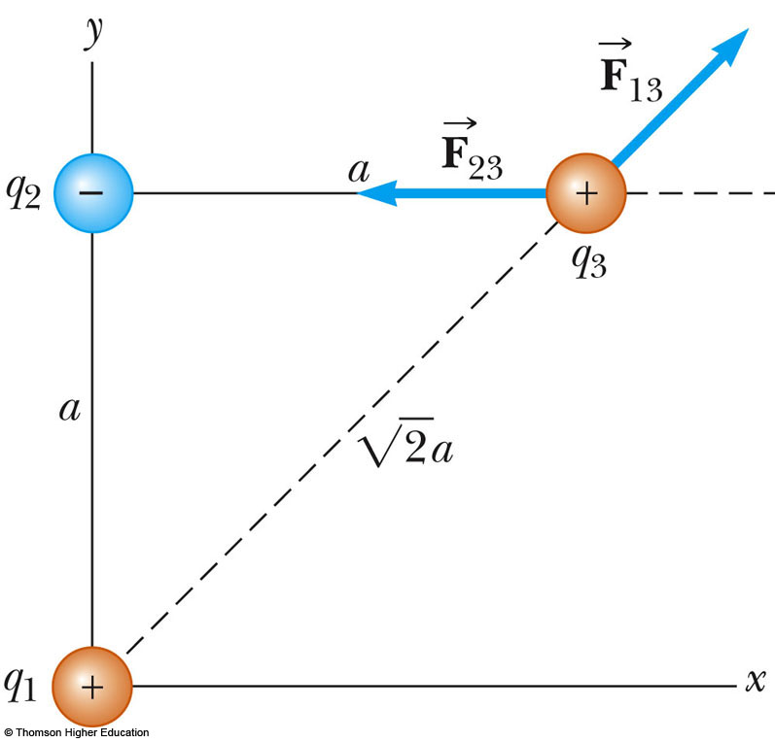
Example 23.2 Find the Resultant Force
=
The magnitude of
The x and y components of F₁₃ are
The x and y components of the resultant force acting on q₃
The resultant force acting on q₃ in unit vector form as

Slide 17
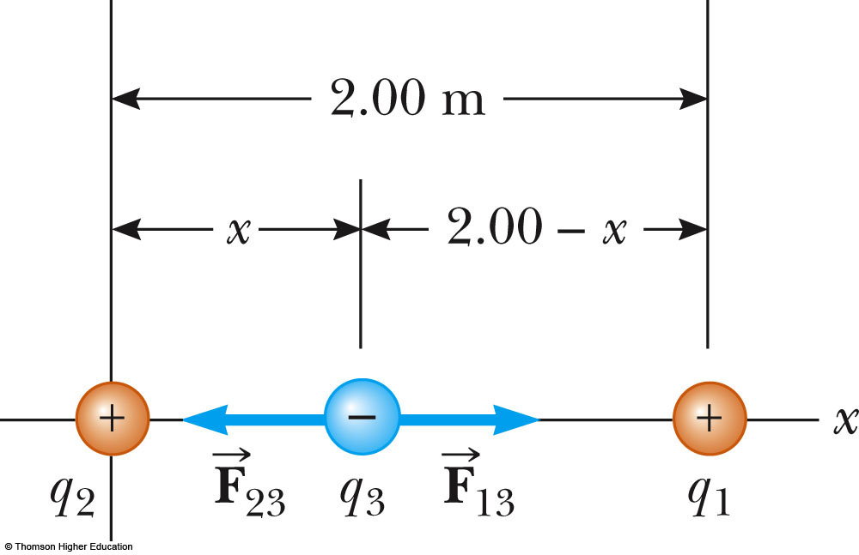

Slide 18
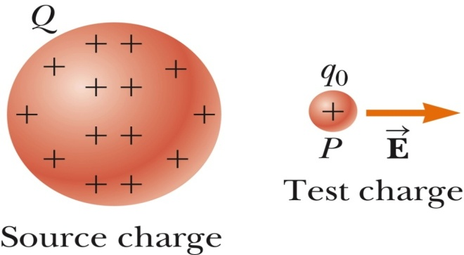
Electric Field – Introduction
The field forces can act through space, producing an effect even when no physical contact occurs between interacting objects.
The gravitational force
The gravitational field at a point in space to be equal to the gravitational force acting on a test particle of mass m divided by that mass:
The electric forces
The electric field is said to exist in the region of space around a charged object(the source charge). When another charged object (the test charge) enters this electric field, an electric force acts on it.

Slide 19
Electric Field – Definition
The electric field vector , at a point in space is defined as The electric force acting on a positive test charge q_{o}
placed at that point divided by the test charge:
Electric field is a vector quantity and has unit of newtons per coulomb (N/C)
The electric field to be the electric force on the test charge per unit charge
positive test charge
Note that,
E is the field produced by some charge or charge distribution(source) separate from the test charge(it is not the field produced by the test charge itself).the presence of the test charge is not necessary for the field to exist. The test charge serves as a detector of the electric field.

Slide 20
Relationship Between F and E
The force on a charged particle placed in an electric field
If q is positive, the force and the field are in the same direction
If q is negative, the force and the field are in opposite directions
An electric field exists at a point if a test charge at that point experiences an electric force.
The corresponding equation for a particle with mass placed in a gravitational field

Slide 21
Electric Field, Vector Form
According to Coulomb’s law, the force exerted by q on the test charge q_{o} is
is a unit vector directed from q toward q₀
The electric field at P created by q is
Q16 What is the magnitude of the electric field caused by positive charge Q=1.62×10⁻⁶ C at point P, a distance d =1.53 m from the charge?

Slide 22
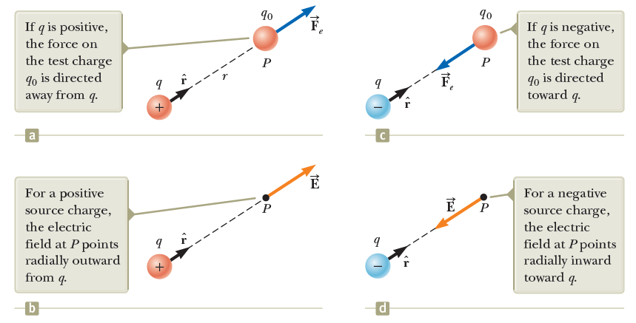
The direction of an electric field
The direction of , is the direction of the force a positive test charge placed in the field.
The test (point) charge q_{o} is always positive

Slide 23
The electric field at a point P due to a group of point charges
At any point P, the total electric field due to a group of source charges equals the vector sum of the electric fields of all the charges
where r_{i} is the distance from the i th source charge q_{i} to the point P and is a unit vector directed from q_{i} toward P.

Slide 24
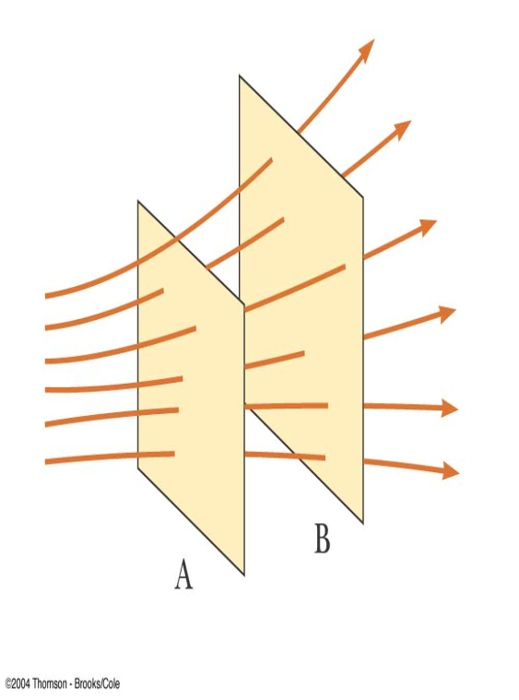
Electric Field Lines
An electric field line is an imaginary line or curve drawn through a region of empty space so that its tangent at any point is in the direction of the electric field vector at that point, indicated by an arrowhead.
The number of lines per unit area through a surface perpendicular to the lines is proportional to the magnitude of the electric field in that region
The field lines are close together where the electric field is strong and far apart where the field is weak.
Example
The density of lines through surface A is greater than through surface B
Therefore, The magnitude of the electric field is greater on surface A than B
The lines at different locations point in different directions. This indicates the field is nonuniform

Slide 25
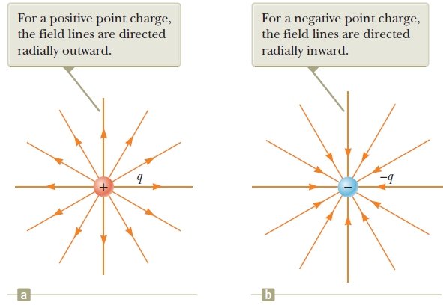
The electric field lines for a point charge
For a positive point charge, The lines are directed away (outward) from the source charge. For a negative point charge, the lines are directed toward (inward) the source charge
In either case, the lines are along the radial direction and extend all the way to infinity.
The lines become closer together as they approach the charge; this indicates that the strength of the field increases as we move toward the source charge.

Slide 26
The rules for drawing electric field lines
• The lines must begin on a positive charge and terminate on a negative charge.
In the case of an excess of one type of charge, some lines will begin or end infinitely far away.
• The number of lines drawn leaving a positive charge or approaching a negative charge is proportional to the magnitude of the charge.
• No two field lines can cross.
If object 1 has charge Q₁ and object 2 has charge Q₂, then the ratio of number of lines is.

Slide 27
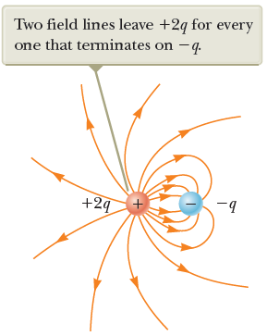
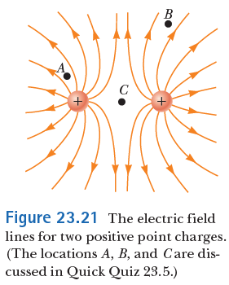
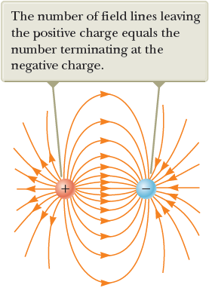
The electric field lines associated with
two point charges of equal magnitude but opposite signs(an electric dipole)
two equal positive point charges
The same number of lines emerge from each charge because the charges are equal in magnitude.
the number of lines that begin at the positive charge must equal the number that terminate at the negative charge.
Unequal Charges
a positive charge +2q and a negative charge -q.
The number of lines leaving +2q is twice the number terminating at -q.
only half of the lines that leave the positive charge reach the negative charge.
The remaining half terminate on a negative charge we assume to be at infinity.

Slide 28
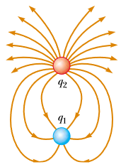
Quick Quiz 23.7 Rank the magnitudes of the electric field at points A, B, and C shown in Figure a (greatest magnitude first).
Q20. A Figure below shows the electric field lines for two point charges separated by a small distance. Determine the ratio q₁/q₂, and the signs of q₁ and q₂:
q₁ negative and q₂ positive

Slide 29
Motion of Charged Particles in a Uniform Electric Field
When a particle of charge q and mass m is placed in an electric field E, the electric force exerted on the charge is
If this is the only force exerted on the particle, it must be the net force and causes the particle to accelerate according to Newton’s second law.
If E is uniform (constant in magnitude and direction),
then the acceleration is constant.
If the particle has a positive charge, its acceleration is in the direction of the electric field.
If the particle has a negative charge, its acceleration is in the direction opposite the electric field.
Since the acceleration is constant, the kinematic equations can be used

Slide 30
Q17: A very small ball has a mass of 5.00×10⁻³kg and a charge of 4.00 μC. What magnitude electric field directed upward will balance the weight of the ball so that the ball is suspended motionless above the ground?

Slide 31
Example 23.10 An Accelerating Positive Charge
The initial position of the charge as x_{i} =0 and starts from rest (v_{i} =0)
The acceleration is constant and is given by
The motion is simple linear motion along the x axis.
Therefore, we can apply the equations of kinematics in one dimension
The position of the particle as a function of time is
The speed of the particle is given by
The third kinematic equation gives us
The kinetic energy of the charge after it has moved a distance ∆x = x_{f} -xi
The work done by the electric force

Slide 32
Q18: An electron, initially moving with a velocity of 3.0 ×10⁴(m/s), enters a region of a uniform electric field that is parallel to the x axis. The electron comes to rest after travelling a distance of 2.5 cm in the field. What is the electric field? Ignore gravity. ( e = 1.6 x 10⁻¹⁹C , mass of electron m_{e}= 9.11 x 10⁻³¹Kg)

Slide 33
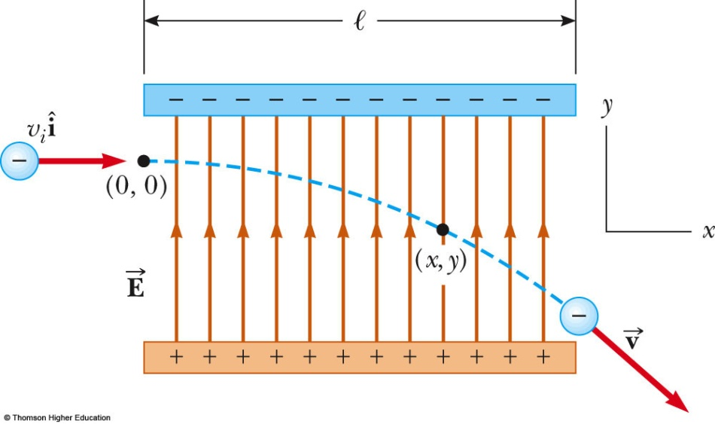
Electron in a Uniform Field, Example
The electron is projected horizontally into a uniform electric field from the origin with an initial velocity at time t =0.
The charge of electron of –e, Because the electric field E in figure is in the positive y direction, the acceleration of the electron is in the negative y direction.

Slide 34
Example 23.11 An Accelerated Electron
An electron enters the region of a uniform electric field as shown in Figure with and E =200 N/C. The horizontal length of the plates is
(A) Find the acceleration of the electron while it is in the electric field.

