Slide 1


Introduction to organic chemistry- Part I

Slide 2


Where Would We Be without Chemistry?
Introduction
NO chemical reactions
No leather or rubber
No Paint or coatings
No metals
No you
No Fabrics

Slide 3
Learning objectives:
Introduction
By the end of this lecture the student will know:
What is Organic Chemistry?
How are organic compounds are made from indiviual elements?
Types of bond in organic compounds and their significan
Different methods of representing chemical bonding
Dipole Moment & inductive effect.

Slide 4
What is organic chemistry?
Introduction
The word Organic can be a biological or chemical term.
In Biology it means any thing that is living or has lived. The opposite is Non-Organic.
In Chemistry, an Organic compound is one containing Carbon atoms. The opposite term is Inorganic.
Organic compounds can may contain in addition to C & H other elements such as O, S, N, Cl,--
Thus organic chemistry is the science explaining how are organic molecules are made, their physical and chemical properties

Slide 5
Examples of organic compounds
Introduction
1) DNA: the giant molecules that contain all the genetic information for a given species.
2) Proteins: blood, muscle, and skin.
3) Enzymes: catalyze the reactions that occur in our bodies.
4) Petroleum: furnish the energy that sustains life.
5) Polymers: Cloths, cars, plastic, kitchen appliances.
6) Medicine

Slide 6
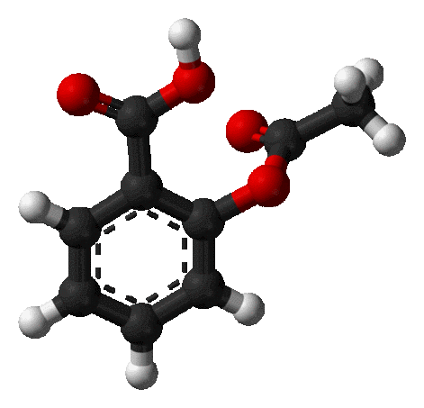
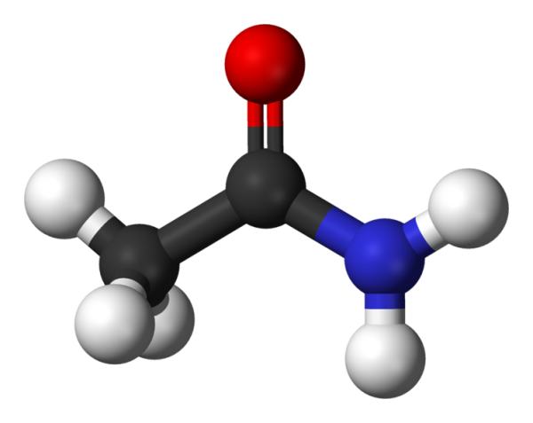
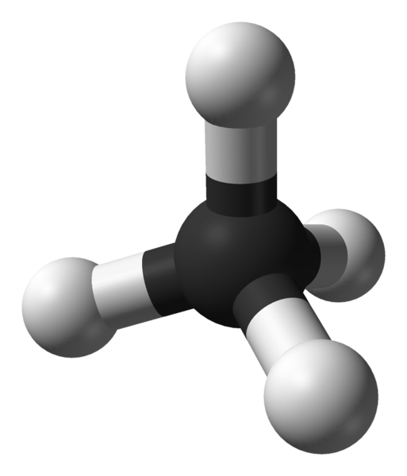
CHEMICAL BONDING
Introduction
Notes:
To play the movies and simulations included, view the presentation in Slide Show Mode.

Slide 7
Chemical Bonding
Introduction
Problems and questions:
How is a molecule or polyatomic ion held together?
Why are chemical bonds important?

Slide 8
Introduction
Important concepts in chemical bonding
The attractive force which holds together the constituent particles (atoms, ions or molecules) in chemical species is known as chemical bond.
Each bond is made up of two electrons
Tendency of atoms of various elements to attain stable configuration of eight electrons in their valence shell is the cause of chemical combination.
The principle of attaining a maximum of eight electrons in the valence shell or outermost shell of atoms is known as octet rule.
The tendency of an atom to take part in chemical combination is determined by the number of valence electrons (electrons in the outermost shell of an atom).
The atoms acquire the stable noble gas configuration of having eight electrons in the outermost shell (called octet rule) by mutual sharing (covalent bond which is usually between two non metals) or by transfer of one or more electrons (ionic bonds which is usually between a metal and a nonmetal). N.B.: there are other minor types of chemical bonding that will not be discussed here.
The valency of an element is (number of electrons an atom loses, gains or mutually shares to attain noble gas configuration).

Slide 9
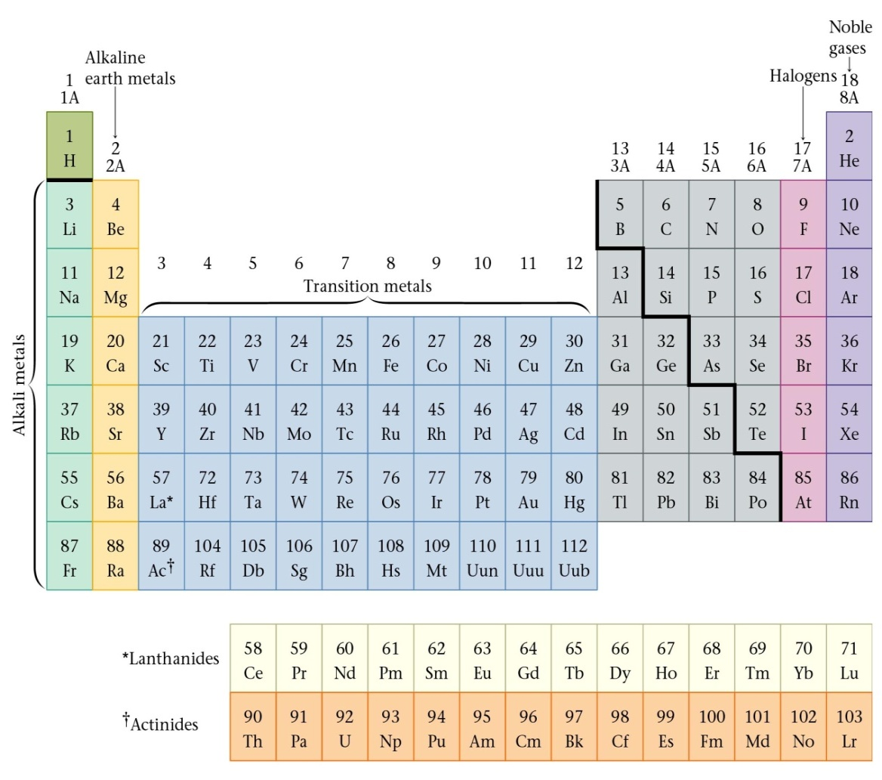
Review of Valence Electrons
Introduction
Number of valence electrons of a main (A) group atom = Group number

Slide 10
Introduction
Two Main Types of Chemical Bonding
Covalent Bonds;
single or multiple
polar or non polar
Ionic Bonds

Slide 11
Characteristics of Covalent Compounds
Introduction
Covalent compounds results when two atoms share valence electrons between them.
The covalent compounds do not exist as ions but they exist as neutral molecules:
This is due to there is no transfer of electrons from one atom to another and therefore no charges are created on the atom.
Covalent bonds are rigid and directional therefore different shapes of covalent molecules are seen e.g. HCl is linear.
Most of the covalent molecules are non polar and are soluble in nonpolar solvents like benzene, ether etc and insoluble in polar solvents like water. Carbon tetrachloride (CCl₄) is a covalent nonpolar molecule and is soluble in benzene.
Some of them are polar due to sometimes in a covalent bond the electrons are not shared equally between the two atoms thus, one of the atoms partially "pulls" the bonding electrons toward itself, creating an unequal sharing of those bonding electrons. This is called a POLAR COVALENT BOND.

Slide 12
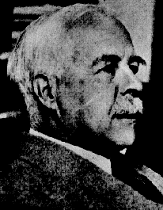
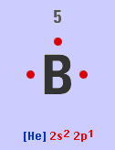
Chemical bonding in Molecules by Lewis (electron dot) structures
Introduction
Rules:
The symbol of the element is written first. This represents the nucleus of the element with all the inner electrons that do not take part in the bond formation.
The valence electrons (electrons in the OUTERMOST energy level ) are then written as dots or small cross marks around the symbol. They are spread in a pair on four sides of the symbol.
In case of ions the charge is shown with the symbol
Examples:
B⁵ its electronic configuration is 1s² 2s² 2p¹;
so the outer energy level is 2,
with 3 valence electrons These can be
represented by Lewis structure.
Q1:Draw Lewis structure for Cl
G. N. Lewis
1875 - 1946

Slide 13
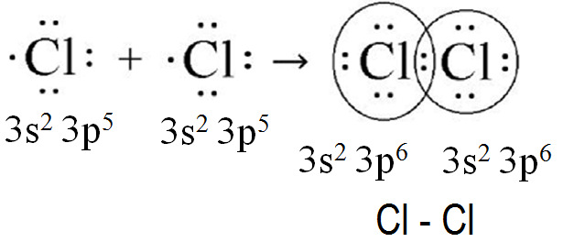
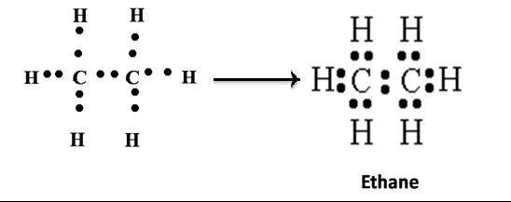
Introduction
Covalent bonds can be visualized with the aid of Lewis dot structures
If two atoms share one electron pair, bond is known as single covalent bond and is represented by one dash (–).
If two atoms share two electron pairs, bond is known as double covalent bond and is represented by two dashes (=).
If two atoms share three electron pairs, bond is known as triple covalent bond and is represented by three dashes ( ).
13

Slide 14
Types of valence electrons
Introduction
Valence electrons of an atom which are shared with others are called BOND PAIRS and those are unshared are called LONE PAIRS.
••
H
Cl
•
•
••
lone pair (LP)
shared or
bond pair

Slide 15
Bond Formation
Introduction
A bond can result from an overlap of atomic orbitals on neighboring atoms.
••
••
H
+
Cl
•
H
Cl
•
•
•
••
••
Overlap of H (1s) and Cl (3p)
Note that each atom has a single, unpaired electron.

Slide 16
Electronegativity Difference: types of bonds and polarity
Introduction
If the difference in electronegativities (usually called ΔEN) between the atoms in a molecule as follows:
ΔEN greater than 2 & up 4.0: the bonding in this molecule is Ionic
ΔEN between 1.6 and 2.0 and if a metal is involved, then the bond is considered ionic. If only nonmetals are involved, the bond is considered polar covalent.
ΔEN between 0.5 and 1.6 the bonding in this molecule is Covalent and Polar
ΔEN between 0.0 to 0.5: the bonding in this molecule is Covalent and it is Non-Polar

Slide 17
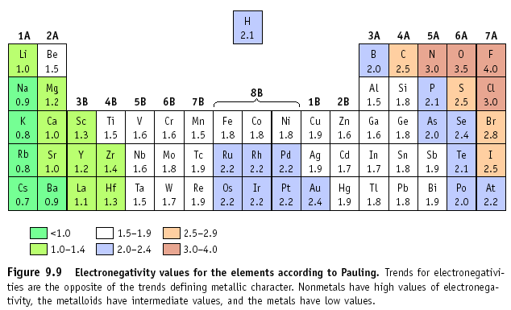
The type of bond can usually be calculated by finding the difference in electronegativity of the two atoms that are going together.
Introduction

Slide 18
Introduction
  Example 1: NaCl
  EN_{Na} = 0.8, EN_{Cl} = 3.0, Difference ΔEN is 2.2, so this is an ionic bond
Example 2: HCl
The difference in electronegativity between H & Cl atoms = 0.9
thus HCl is Covalent & POLAR because it has a positive end and a negative end due to difference in electronegativity where;

Slide 19
Introduction
Cl has a greater share in bonding electrons than does H.
Cl has slight negative charge (-δ) and H has slight positive charge (+ δ)
Example 3
Molecules such as Cl₂, H₂, F₂ are covalent non polar since the difference in electonegativity is zero

Slide 20
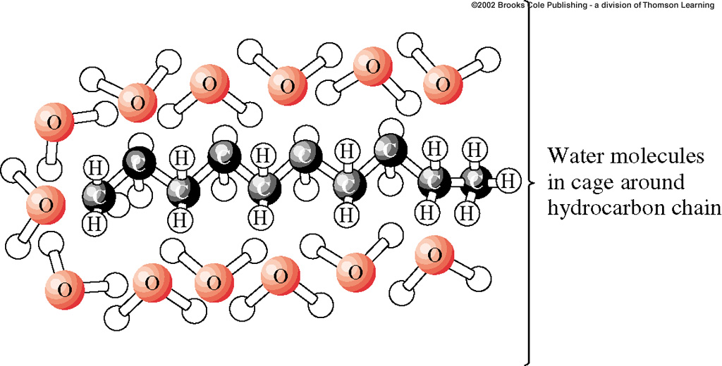
Introduction
Bond Polarity and physical properties:
This is why oil and water will not mix! Oil is nonpolar, and water is polar.
The two will repel each other, and so you can not dissolve one in the other
“Like Dissolves Like”
Polar dissolves Polar
Nonpolar dissolves Nonpolar

Slide 21
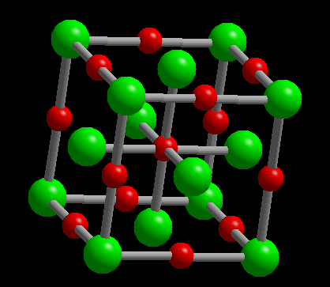
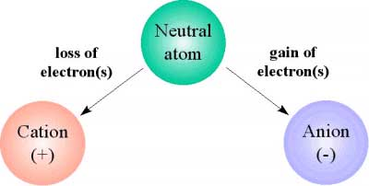
Introduction
General Properties of Ionic Compounds
Ionic compounds are formed when one atom gains a valence electron from a different atom, forming a negative ion (anion) and a positive ion (cation) respectively. These oppositely charged ions are attracted to each other, forming an ionic bond. Therefore ionic bonds are usually between metals and nonmetals ; opposite ends of the periodic table.
They do not exist as separate molecules . Rather, they form ionic solids, three dimension networks in which each cation is surrounded by anions and each anion is surrounded by cations.
They have high melting and boiling points and this ionic compounds are generally soluble in water and other polar solvents
Ionic compounds are good conductors of electricity in the solutions or in their molten states.

Slide 22
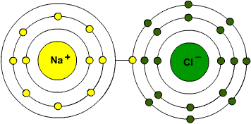
Introduction
Sodium chloride
Sodium Chloride (NaCl) is a bonding of the Na⁺ ion and the Cl⁻ ion.
Sodium lets Chlorine use its valance electron

Slide 23
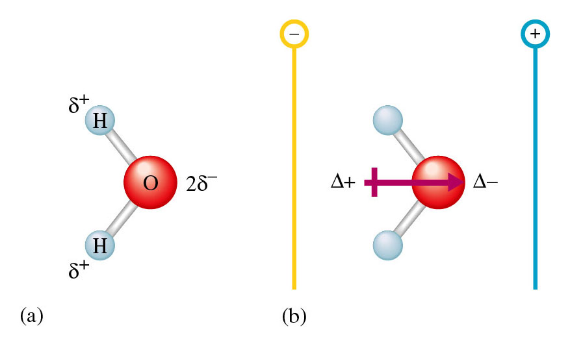
Dipole Moments
Introduction
A substance possesses a dipole moment if its centers of positive and negative charge do not coincide.
It means When the centers of negative and positive charge are separated, we say that the molecule has a dipole moment.

Slide 24
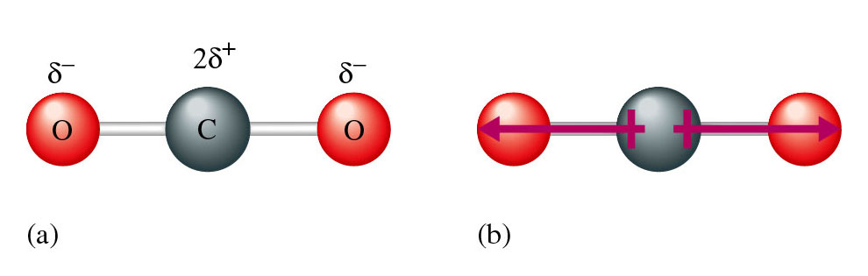
Introduction
O
C
O
O is more electronegative, therefore there is a dipole
between C and both O atoms. But does the overall molecule have a dipole?
CO₂ is a linear molecule and the dipoles are in opposite direction,
the net effect is that they cancel each other.
Thus, Carbon dioxide has no dipole moment

Slide 25
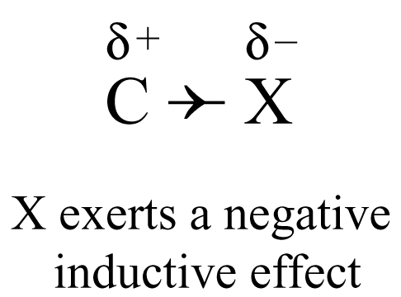
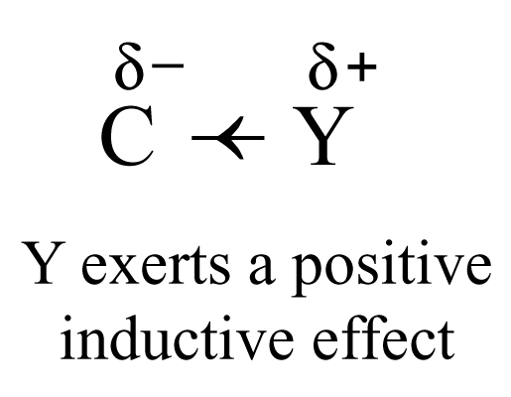
Inductive effect
Introduction
Inductive effect is represented by an arrow head in the middle of the covalent bond pointing in the direction of the displacement of electrons.
Electron-withdrawing group (X) exerts a negative inductive effect.
Electron-donating group (Y) exerts a positive inductive effect.

Slide 26
Introduction
Groups which exert negative inductive effects (i.e. electron-withdrawing groups)
e.g.
–NO₂ > –F > –COOH > –Cl > –Br > –I
2. Groups which exert positive inductive effects (i.e. electron-releasing groups)
e.g.
alkyl groups like –CH₃, –C₂H₅, –C₃H₇ – NH₂ – OH

Slide 27
Introduction
Bond Polarisation and Inductive Effects
-
-I Inductive Effects
+I Inductive Effects
δ+
δ-
δ-
δ+
δ+
δ-
δ-
δ+

Slide 28
Thank You for your kind attention !
Introduction
Questions?
Comments

