Slide 1
Record a Presentation
Use the Camtasia Add-in to record your presentations. Start by going to the Add-ins tab.

Slide 2
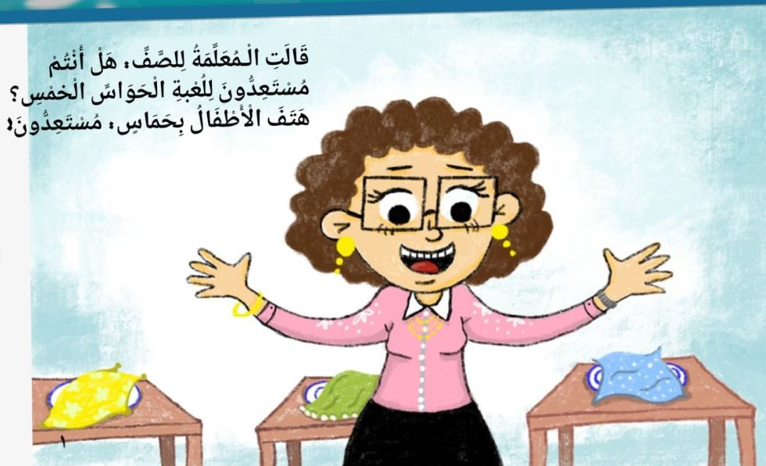
Record a Presentation
Use the Camtasia Add-in to record your presentations. Start by going to the Add-ins tab.

Slide 3
Record a Presentation
Use the Camtasia Add-in to record your presentations. Start by going to the Add-ins tab.

Slide 4
Record a Presentation
Use the Camtasia Add-in to record your presentations. Start by going to the Add-ins tab.

Slide 5
Record a Presentation
Use the Camtasia Add-in to record your presentations. Start by going to the Add-ins tab.

Slide 6
Record a Presentation
Use the Camtasia Add-in to record your presentations. Start by going to the Add-ins tab.

Slide 7
Record a Presentation
Use the Camtasia Add-in to record your presentations. Start by going to the Add-ins tab.

Slide 8
Record a Presentation
Use the Camtasia Add-in to record your presentations. Start by going to the Add-ins tab.

Slide 9
Record a Presentation
Use the Camtasia Add-in to record your presentations. Start by going to the Add-ins tab.

Slide 10
Record a Presentation
Use the Camtasia Add-in to record your presentations. Start by going to the Add-ins tab.

Slide 11
Record a Presentation
Use the Camtasia Add-in to record your presentations. Start by going to the Add-ins tab.

Slide 12
Record a Presentation
Use the Camtasia Add-in to record your presentations. Start by going to the Add-ins tab.

Slide 13
Record a Presentation
Use the Camtasia Add-in to record your presentations. Start by going to the Add-ins tab.

Slide 14
Record a Presentation
Use the Camtasia Add-in to record your presentations. Start by going to the Add-ins tab.

Slide 15
Record a Presentation
Use the Camtasia Add-in to record your presentations. Start by going to the Add-ins tab.

Slide 16
Record a Presentation
Use the Camtasia Add-in to record your presentations. Start by going to the Add-ins tab.

