Slide 1
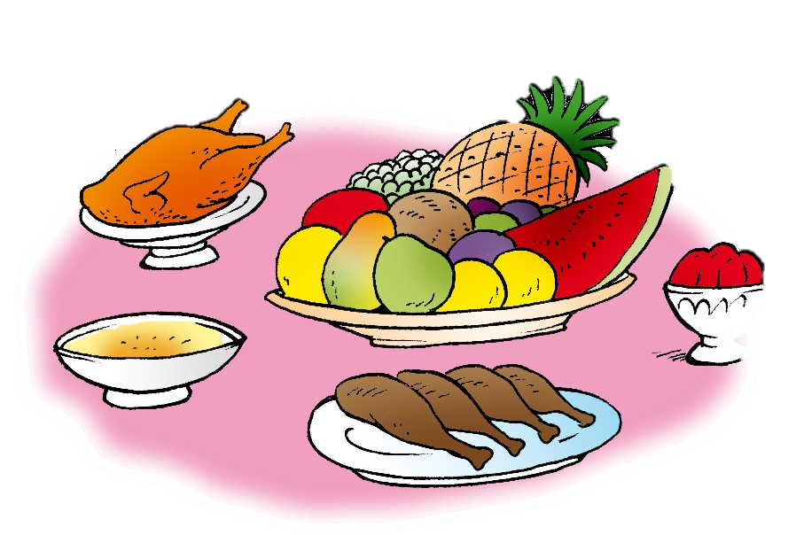
Unit 7- Lesson 1 P 64
Dinnertime!
Family and Friend 2
Grade 2

Slide 2
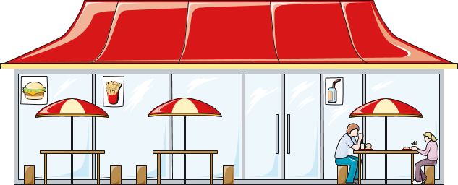
Think!
What’s your favourite restaurant?
Why do you like it?
_________________________________________________________________________________________________________________________________________________
Ministry of Education-2020

Slide 3
Objectives
1- Name six food items.
2- Recognise six food items.
_________________________________________________________________________________________________________________________________________________
Ministry of Education-2020

Slide 4
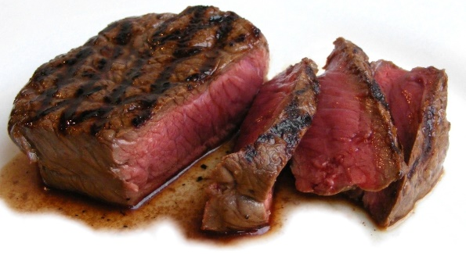
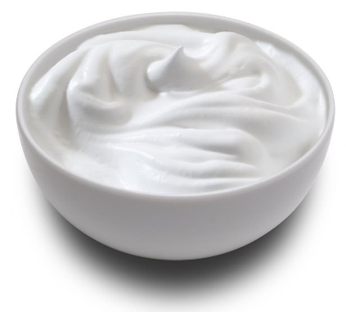
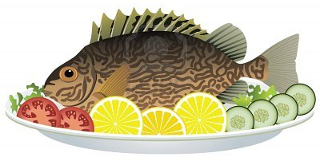
Listen, point and repeat.
meat
carrots
rice
yogurt
fish
bread
_________________________________________________________________________________________________________________________________________________
Ministry of Education-2020

Slide 5
Read, point and repeat.
rice
_________________________________________________________________________________________________________________________________________________
Ministry of Education-2020

Slide 6
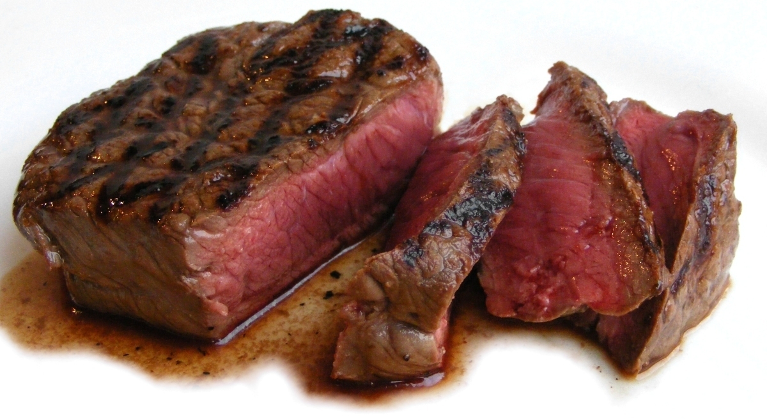
Read, point and repeat.
meat
_________________________________________________________________________________________________________________________________________________
Ministry of Education-2020
Notes:
If you have got short hair stand up.

Slide 7
Read, point and repeat.
carrots
_________________________________________________________________________________________________________________________________________________
Ministry of Education-2020

Slide 8
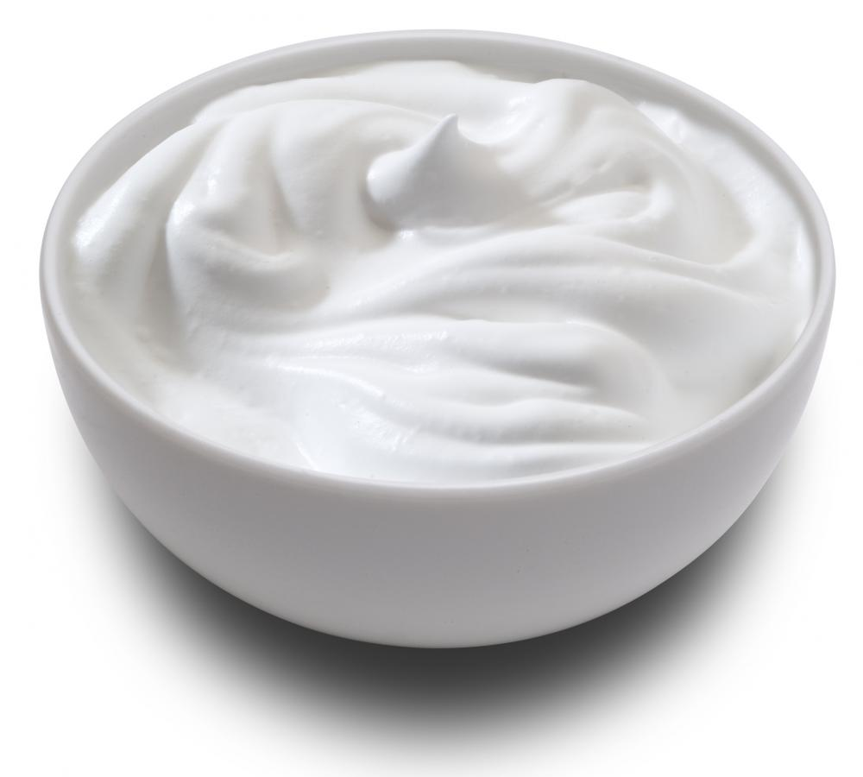
Read, point and repeat.
yogurt
_________________________________________________________________________________________________________________________________________________
Ministry of Education-2020

Slide 9
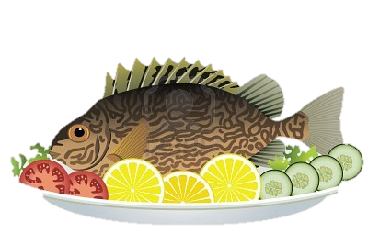
Read, point and repeat.
fish
_________________________________________________________________________________________________________________________________________________
Ministry of Education-2020
Notes:
If you have got curly hair stand up.

Slide 10
Read, point and repeat.
bread
_________________________________________________________________________________________________________________________________________________
Ministry of Education-2020

Slide 11
Get your white boards and markers!
Let’s Play!
_________________________________________________________________________________________________________________________________________________
Ministry of Education-2020

Slide 12
Look at the picture and write the correct word on your board.
carrots
rice
_________________________________________________________________________________________________________________________________________________
Ministry of Education-2020

Slide 13
Look at the picture and write the correct word on your board.
meat
bread
_________________________________________________________________________________________________________________________________________________
Ministry of Education-2020

Slide 14
Look at the picture and write the correct word on your board.
fish
carrots
_________________________________________________________________________________________________________________________________________________
Ministry of Education-2020

Slide 15
Look at the picture and write the correct word on your board.
rice
yogurt
_________________________________________________________________________________________________________________________________________________
Ministry of Education-2020

Slide 16
Look at the picture and write the correct word on your board.
fish
meat
_________________________________________________________________________________________________________________________________________________
Ministry of Education-2020

Slide 17
Look at the picture and write the correct word on your board.
bread
carrots
_________________________________________________________________________________________________________________________________________________
Ministry of Education-2020

Slide 18
Question 1
Let’s practice!
Open page 62 in your workbook. Answer the questions.
click and check your answers
bread | rice | carrots | fish | yogurt | meat
x | √ | √ | x | x | √
√ | x | x | √ | √ | x
_________________________________________________________________________________________________________________________________________________
Ministry of Education-2020

Slide 19
Question 2
Let’s practice!
Open page 62 of your workbook. Answer the questions.
click and check your answers
I like meat and rice.
I don’t like yogurt.
I like fish and carrots.
I don’t like chicken.
_________________________________________________________________________________________________________________________________________________
Ministry of Education-2020

Slide 20
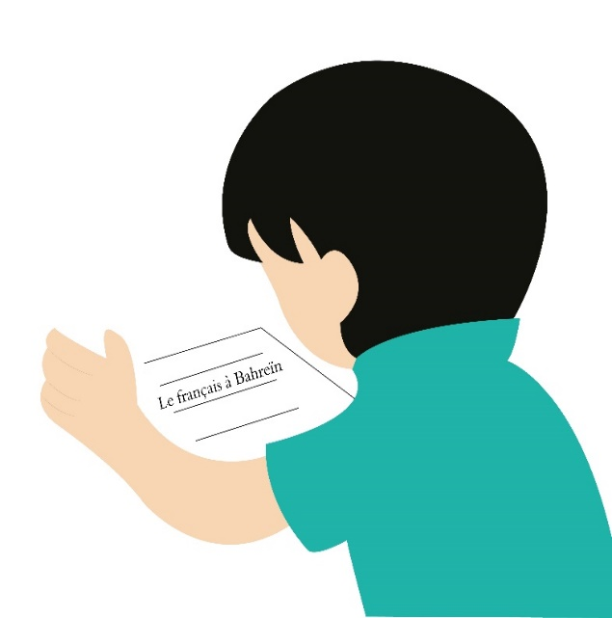
Don’t forget to answer the questions
in Unit 7 practice PPT for L1.
_________________________________________________________________________________________________________________________________________________
Ministry of Education-2020

Slide 21
Write and draw the six words that you have learned today in your notebook.
_________________________________________________________________________________________________________________________________________________
Ministry of Education-2020

Slide 22
End of the
lesson!
_________________________________________________________________________________________________________________________________________________
Ministry of Education-2020

