Slide 1
KINETICS of PARTICLES
Newton’s 2nd Law &
The Equation of Motion
Lecture VIII
Or

Slide 2
Newton’s 2nd Law &
The Equation of Motion
Kinetics is the study of the relations between the unbalanced forces and the changes in motion that they produce.
Newton’s 2nd law states that the particle will accelerate when it is subjected to unbalanced forces. The acceleration of the particle is always in the direction of the applied forces.
Newton’s 2nd law is also known as the equation of motion.
To solve the equation of motion, the choice of an appropriate coordinate systems depends on the type of motion involved.
Two types of problems are encountered when applying this equation:
  The acceleration of the particle is either specified or can be determined directly from known kinematic conditions. Then, the corresponding forces, which are acting on the particle, will be determined by direct substitution.
  The forces acting on the particle are specified, then the resulting motion will be determined. Note that, if the forces are constant, the acceleration is also constant and is easily found from the equation of motion. However, if the forces are functions of time, position, or velocity, the equation of motion becomes a differential equation which must be integrated to determine the velocity and displacement.
In general, there are three general approaches to solve the equation of motion: the direct application of Newton’s 2nd law, the use of the work & energy principles, and the impulse and momentum method.

Slide 3
Newton’s 2nd Law &
The Equation of Motion (Cont.)
F₂
F_{R} = ΣF
ma
=
F₁
P
P
Free-body Diagram
Kinetic Diagram
Note: The equation of motion has to be applied in such way that the measurements of acceleration are made from a Newtonian or inertial frame of reference. This coordinate does not rotate and is either fixed or translates in a given direction with a constant velocity (zero acceleration).

Slide 4
Newton’s 2nd Law &
The Equation of Motion (Cont.)
Curvilinear Motion
Rectilinear Motion
Rectangular Coordinates
n-t Coordinates
Polar Coordinates

Slide 5
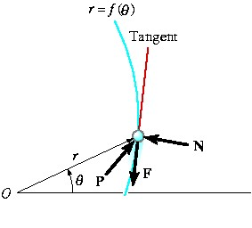
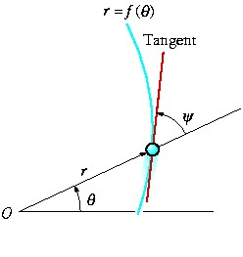
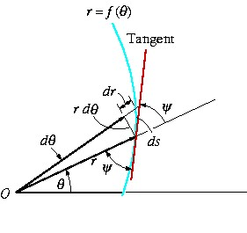
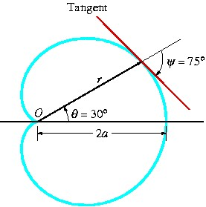
In Polar Coordinates
Consider the force P that causes the particle to move along a path r = f(θ).
The normal force N which the path exerts on the particle is always perpendicular to the tangent of the path.
Frictional force F always acts along the tangent in the opposite direction of motion.
The directions of N and F can be specified relative to the radial coordinate by using the angle ψ, which is defined between the extended radial line and the tangent to the curve.
If ψ is positive, it is measured from the extended radial line to the tangent in a CCW sense or in the positive direction θ.
If it is negative, it is measured in the opposite direction to positive θ.

Slide 6
Newton’s 2nd Law &
The Equation of Motion Exercises

Slide 7
Exercise # 1
If P = 400 N and the coefficient of kinetic friction between the 50-kg crate and the inclined plane is μ_{k} = 0.25, determine the velocity of the crate after it travels 6 m up the plane. The crate starts from rest.

Slide 8
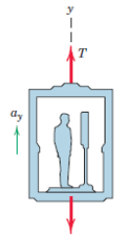
Exercise # 2
A 75-kg man stands on a spring scale in an elevator. During the first 3 seconds of motion from rest, the tension T in the hoisting cable is 8300 N. Find the reading R of the scale in newtons during this interval and the upward velocity v of the elevator at the end of the 3 seconds. The total mass of the elevator, man, and scale is 750 kg.

Slide 9
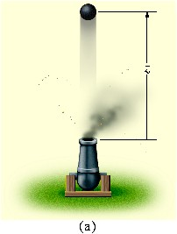
Exercise # 3
A 10-kg projectile is fired vertically upward from the ground, with an initial velocity of 50 m/s. Determine the max height to which it will travel if (a) atmospheric resistance is neglected. (b) atmospheric resistance is measured as F_{D} = (0.01v²) N, where v is the speed at any instant, measured in m/s

Slide 10
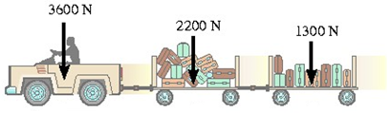
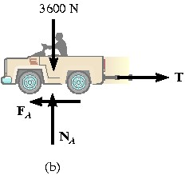
Exercise # 4
x
The baggage truck A has a weight of 3600 N and tows a 2200 N cart B and a 1300 N cart C. For a short time the driving frictional force developed at the wheels is F_{A} = (160t) N where t is in seconds. If the truck starts from rest, determine its speed in 2 seconds. What is the horizontal force acting on the coupling between the truck and cart B at this instant?

Slide 11
Exercise # 5
The 50-kg block A is released from rest. Determine the velocity of the 15-kg block B in 2 s.

Slide 12
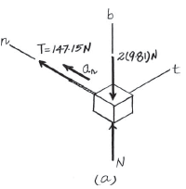
Exercise # 6
x
The 2-kg block B and 15-kg cylinder A are connected to a light cord that passes through a hole in the center of the smooth table. If the block travels along a circular path of radius r = 1.5 m, determine the speed of the block.

Slide 13
Exercise # 7
x
The 5-kg collar A is sliding around a smooth vertical guide rod. At the instant shown, the speed of the collar is v = 4 m/s, which is increasing at 3 m/s². Determine the normal reaction of the guide rod on the collar, and force P at this instant.

Slide 14
Exercise # 8
A 5-Mg airplane is flying at a constant speed of 350 km/h along a horizontal circular path of radius r = 3000 m. Determine the uplift force L acting on the airplane and the banking angle θ. Neglect the size of the airplane.

Slide 15
Exercise # 9
Determine the magnitude of the resultant force acting on a 5-kg particle at the instant t = 2 s, if the particle is moving along a horizontal path defined by the equations r = (2t + 10)m and θ = (1.5t² - 6t) rad, where t is in seconds.

Slide 16
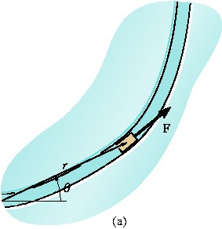
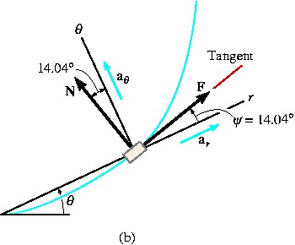
Exercise # 10
The 2-kg block moves on a smooth horizontal track such that its path is specified in polar coordinates by the parametric equations r = (3t²) m and θ = (0.5t) rad where t is in seconds. Determine the magnitude of the tangential force F causing the motion at the instant t = 1 s.

Slide 17

Exercise # 11
The boy of mass 40 kg is sliding down the spiral slide at a constant speed such that his position, measured from the top of the chute, has components r = 1.5 m, θ = (0.7t) rad, and z = (- 0.5t) m, where t is in seconds. Determine the components of force F_{r} , F_{θ} , and F_{z} which the slide exerts on him at the instant t = 2 s. Neglect the size of the boy.

