Slide 1
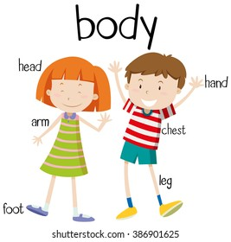
Day
Sunday
Date
3rd Oct 2021
Subject
We can 1
Unit
2 My Body
Lesson
4 Phonics
Page
18 - 19

Slide 2
objectives
*Pair work
*Role play
*Problem solving
strategies

Slide 3
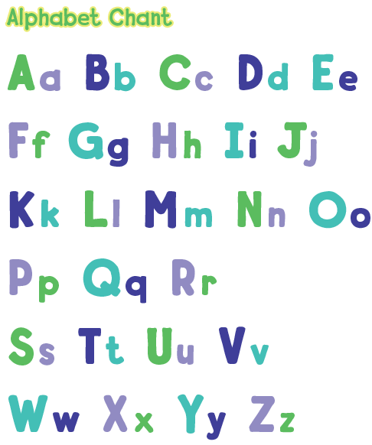
1
Chant and point at the big letters

Slide 4
2
Chant again and point at the big letters.

Slide 6
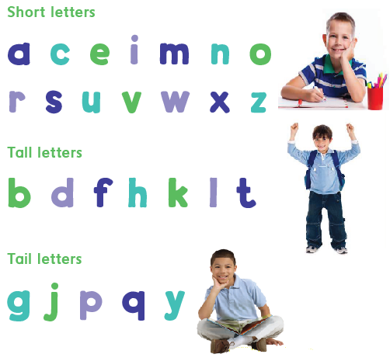
3
Short , Tall , and Tail letters
Listen and do .

Slide 7
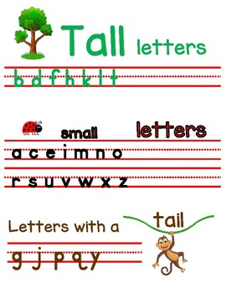

Slide 8
Short Letters

Slide 10
Tail Letters

Slide 11
Tall
Short
Tail

Slide 12
Tall
Short
Tail

Slide 13
Tall
Short
Tail

Slide 14
Tall
Short
Tail

Slide 15
Tall
Short
Tail

Slide 16
Tall
Short
Tail

Slide 18
Pg. 77-78

Slide 20
O O O O O O

Slide 23
P P P P P P P P

