Slide 1
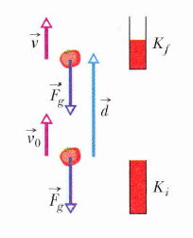
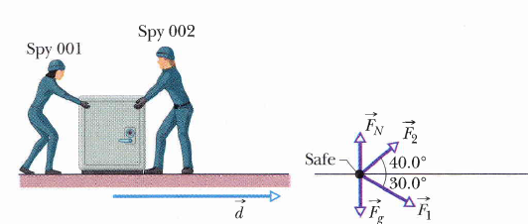

Slide 4
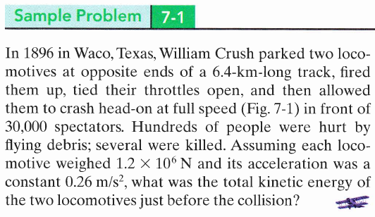

Slide 5
Work is a Scalar Quantity
+ve Work
-ve Work
energy transferred to the object
energy transferred from the object

Slide 6
- Work has unit of energy ( Joule J)
Work
Work Done
Doing Work
energy transferred to the object by the force
Is the act of transferring the energy

Slide 7
Wire
Bead

Slide 8
Wire
Bead

Slide 9
Work done by a constant force is

Slide 10
- Work has another unit

Slide 11
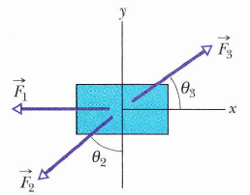
How to find the net Work done by several forces?
Find the work done by each force and then sum those works
Find the net force then

Slide 12
Finding another expression for Work

Slide 14
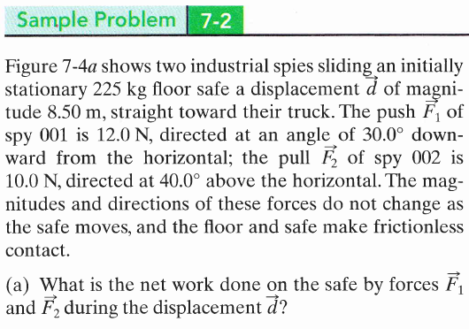
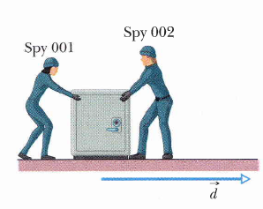

Slide 15
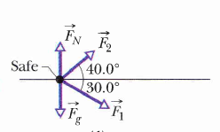

Slide 16
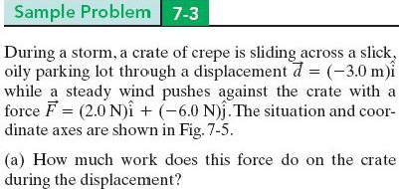

Slide 18
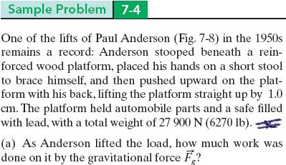
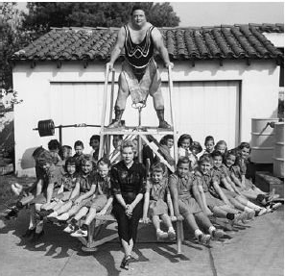

Slide 19
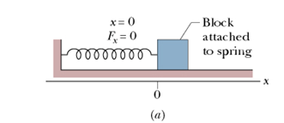
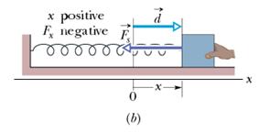
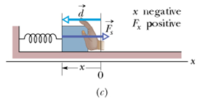

Slide 20
-
-
-

Slide 21
x
O
(a)
x
O
(b)
x
O
(c)

Slide 24
Power
Average Power
Instantaneous Power
=

Slide 25
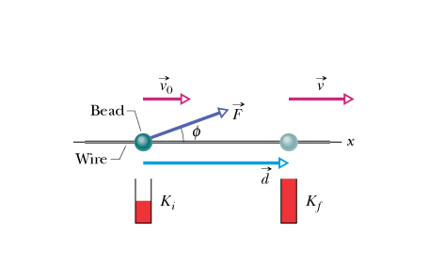
but
v
or
then
⇒
or

Slide 26
