Slide 1
Practical General Physics Review

Slide 2
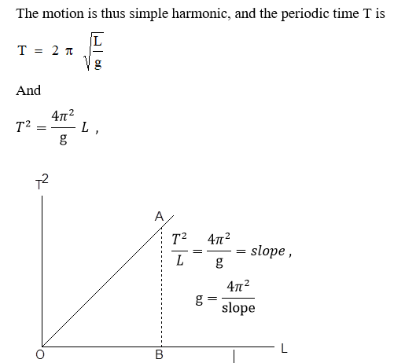
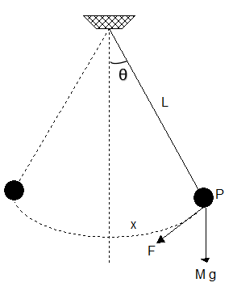

Slide 3
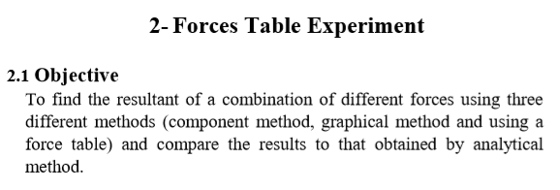
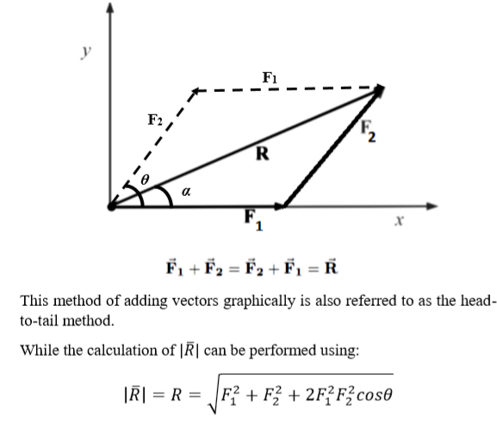
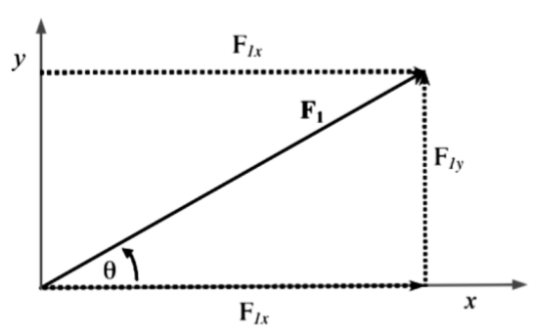
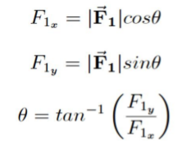
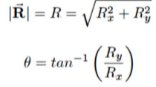

Slide 4
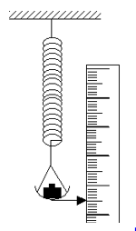
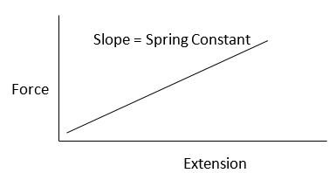
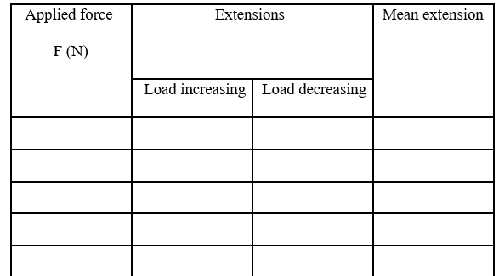

Slide 5
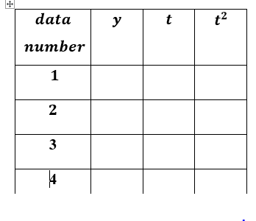
plot of $y\left(t\right) vs{ t}^{2}$, and then calculate the slope in order to find $g$.

Slide 6
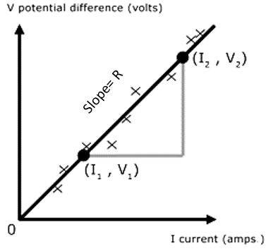
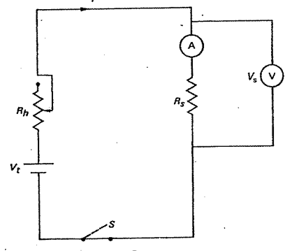
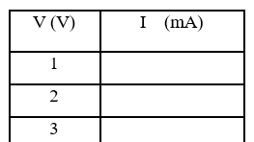
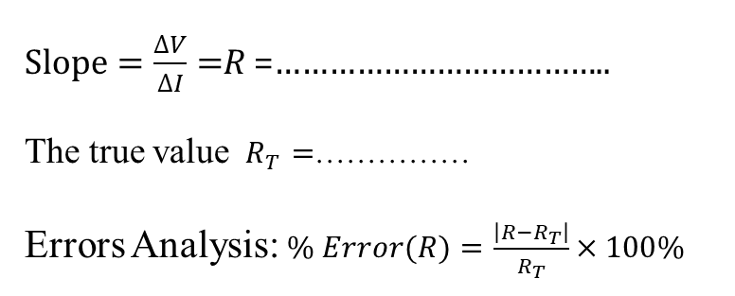
Ohm's law experiment
Objective: Study the relationship between electrical current, voltage, known as Ohm's Law V = IR
Plot the relation between I (on x axis) and V ( on y axis)
$Slope=\frac{∆V}{∆I}=$R =………………………………..
The true value $R_{T}=$……………
Errors Analysis:$\% Error(R)=\frac{\left|R−R_{T}\right|}{R_{T}}×100\%$

Slide 7
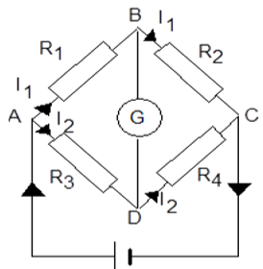
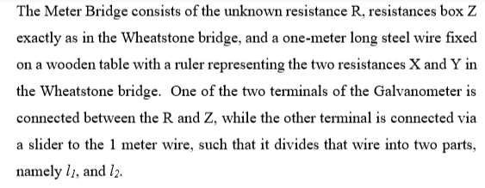
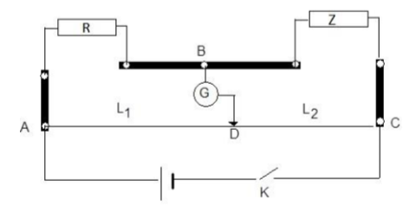
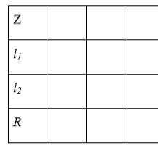
Meter Bridge Experiment
Objective:

Slide 8
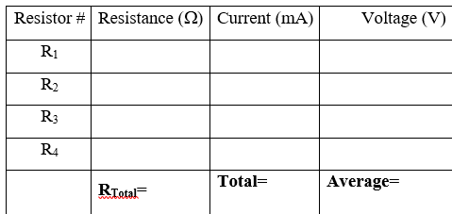
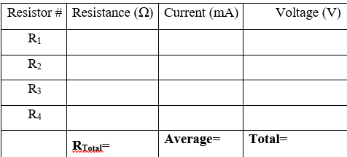
Series and Parallel connections of resistors
Object: determine the equivalent resistances of two resistors in series and in parallel.
resistors in parallel
resistors in series

Slide 9
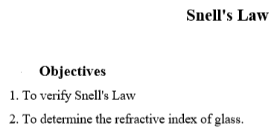
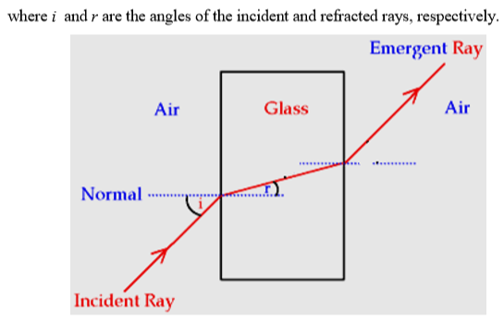
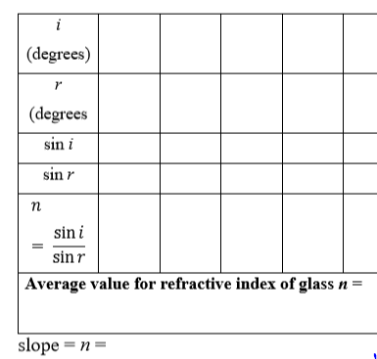

Slide 10
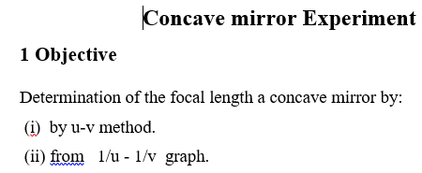
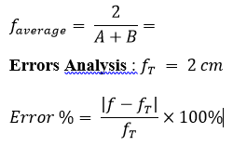
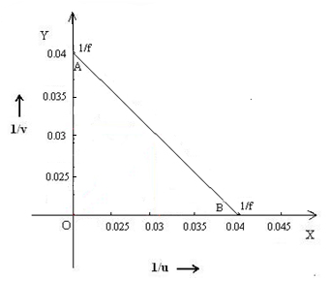
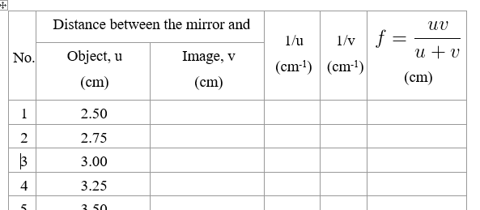
Focal length by a graphical method
From 1/u – 1/v graph
- distance between mirror and object (u)
- distance between mirror and image (v)
- focal length of the mirror (f)

Slide 11
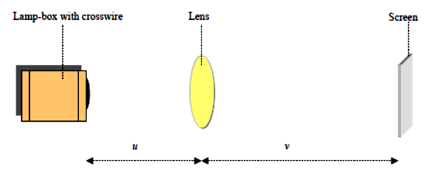
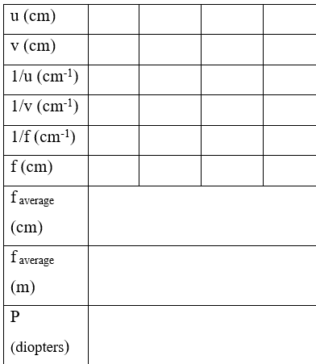
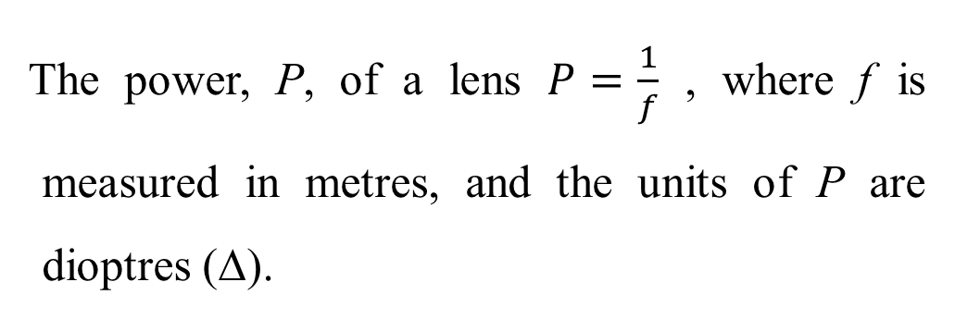
the object distance, u and the image distance, v. These two variables are related to the focal length, f, by the lens equation:$\frac{1}{f}=\frac{1}{u}+\frac{1}{v}$
The power, P, of a lens $P=\frac{1}{f}$ , where f is measured in metres, and the units of P are dioptres (Δ).

Slide 12
Good luck for your exam

