Slide 1
Lecture Slides
Elementary Statistics Eleventh Edition
and the Triola Statistics Series
by Mario F. Triola

Slide 2
Chapter 12 Analysis of Variance
12-1 Review and Preview
12-2 One-Way ANOVA
12-3 Two-Way ANOVA

Slide 3
Section 12-1
Review and Preview

Slide 4
Review
In chapter 9, we introduced methods for comparing the means from two independent samples.
Notes:
This method to test if more than two population means are equal is similar to the way we tested two population means equal in Chapter 9.

Slide 5
Preview
Analysis of variance (ANOVA) is a method for testing the hypothesis that three or more population means are equal.
For example:
H₀: µ₁ = µ₂ = µ₃ = . . . µ_{k}
H₁: At least one mean is different
Notes:
This method to test if more than two population means are equal is similar to the way we tested two population means equal in Chapter 9.

Slide 6
ANOVA Methods Require the F-Distribution
1. The F- distribution is not symmetric; it is skewed to the right.
2. The values of F can be 0 or positive; they cannot be negative.
3. There is a different F-distribution for each pair of degrees of freedom for the numerator and denominator.
Critical values of F are given in Table A-5
Notes:
Because the procedures used in this chapter require complicated calculations, the use and interpretation of computer software or a TI-83 Plus calculator is strongly encouraged.

Slide 7
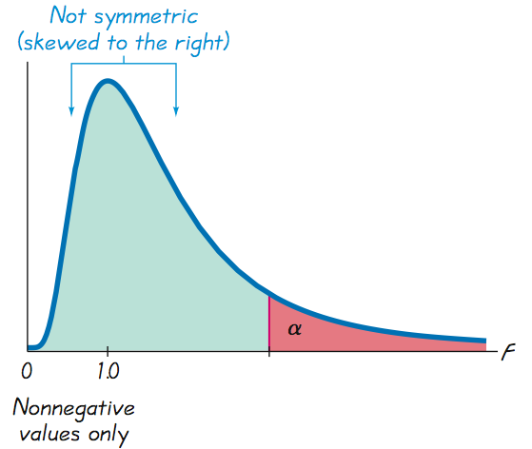
F-Distribution
Notes:
Because the procedures used in this chapter require complicated calculations, the use and interpretation of computer software or a TI-83 Plus calculator is strongly encouraged.

Slide 8
Section 12-2
One-Way ANOVA

Slide 9
Key Concept
This section introduces the method of one-way analysis of variance, which is used for tests of hypotheses that three or more population means are all equal.

Slide 10
F - distribution
Figure 12-1

Slide 11
One-Way ANOVA
An Approach to Understanding ANOVA
Understand that a small P-value (such as 0.05 or less) leads to rejection of the null hypothesis of equal means.
With a large P-value (such as greater than 0.05), fail to reject the null hypothesis of equal means.
Develop an understanding of the underlying rationale by studying the examples in this section.
Notes:
The method used is called one-way analysis of variance because we use a single property, or characteristic, for categorizing the populations.

Slide 12
Part 1: Basics of One-Way Analysis of Variance

Slide 13
Definition
One-way analysis of variance (ANOVA) is a method of testing the equality of three or more population means by analyzing sample variances. One-way analysis of variance is used with data categorized with one treatment (or factor), which is a characteristic that allows us to distinguish the different populations from one another.

Slide 14
One-Way ANOVA
Requirements
1. The populations have approximately normal distributions.
2. The populations have the same variance σ ² (or standard deviation σ ).
3. The samples are simple random samples.
4. The samples are independent of each other.
5. The different samples are from populations that are categorized in only one way.
Notes:
The requirements of normality and equal variances are somewhat relaxed, because the methods in this section work reasonably well unless a population has a distribution that is very nonnormal or the population variances differ by large amounts.

Slide 15
Procedure for testing H₀: µ₁ = µ₂ = µ₃ = . . .
1. Use STATDISK, Minitab, Excel, or a
TI-83/84 Calculator to obtain results.
2. Identify the P-value from the display.
3. Form a conclusion based on these
criteria:

Slide 16
Procedure for testing H₀: µ₁ = µ₂ = µ₃ = . . .
If the P-value ≤ α, reject the null hypothesis of equal means and conclude that at least one of the population means is different from the others.
If the P-value > α, fail to reject the null hypothesis of equal means.

Slide 17
Caution
When we conclude that there is sufficient evidence to reject the claim of equal population means, we cannot conclude from ANOVA that any particular mean is different from the others.
There are several other tests that can be used to identify the specific means that are different, and some of them are discussed in Part 2 of this section.

Slide 18
Example:
Use the chest deceleration measurements listed in Table 12-1 and a significance level of α = 0.05 to test the claim that the three samples come from populations with means that are all equal.

Slide 19
Example:
Requirements are satisfied: distributions are approximately normal (normal quantile plots); population variances appear to be about the same; simple random samples; independent samples, not matched; categorized according to a single factor of size
H₀: μ₁ = μ₂ = μ₃
H₁: At least one of the means is different from the others
significance level is α = 0.05

Slide 20
Example:
Step 1: Use technology to obtain ANOVA results

Slide 21
Example:
Step 1: Use technology to obtain ANOVA results

Slide 22
Example:
Step 2: Displays all show P-value = 0.28 when rounded
Step 3: Because the P-value of 0.028 is less than the significance level of α = 0.05, we reject the null hypothesis of equal means.
There is sufficient evidence to warrant rejection of the claim that the three samples come from populations with means that are all equal.

Slide 23
Example:
Based on the samples of measurements listed in Table 12-1, we conclude that those values come from populations having means that are not all the same. On the basis of this ANOVA test, we cannot conclude that any particular mean is different from the others, but we can informally note that the sample mean is smallest for the large cars. Because small measurements correspond to less trauma experienced by the crash test dummies, it appears that the large cars are safest, but this conclusion is not formally justified by this ANOVA test.

Slide 24
P-Value and Test Statistic
Larger values of the test statistic result in smaller P-values, so the ANOVA test is right-tailed. Figure 12-2 shows the relationship between the F test statistic and the P-value. Assuming that the populations have the same variance σ ² (as required for the test), the F test statistic is the ratio of these two estimates of σ ²: (1) variation between samples (based on variation among sample means); and (2) variation within samples (based on the sample variances).

Slide 25
Test Statistic for One-Way ANOVA

Slide 26
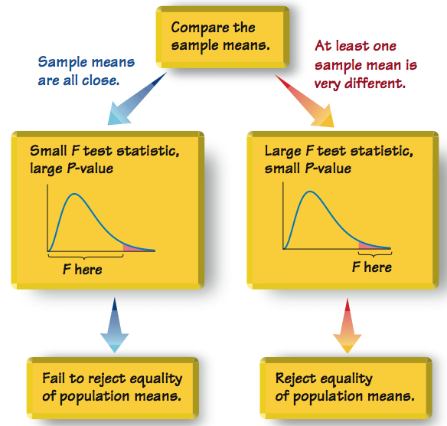
Relationship Between F Test Statistic / P-Value

Slide 27
Caution
When testing for equality of three or more populations, use analysis of variance. Do not use multiple hypothesis tests with two samples at a time.

Slide 28
Part 2: Calculations and Identifying Means That Are Different

Slide 29
ANOVA Fundamental Concepts
Estimate the common value of σ ²:
1. The variance between samples (also called variation due to treatment) is an estimate of the common population variance σ ² that is based on the variability among the sample means.
2. The variance within samples (also called variation due to error) is an estimate of the common population variance σ ² based on the sample variances.
Notes:
Even with heavy use of technology with this topic, it is important to have a basic understanding of underlying principles.

Slide 30
ANOVA Fundamental Concepts
Test Statistic for One-Way ANOVA
F =
variance between samples
variance within samples
An excessively large F test statistic is
evidence against equal population means.

Slide 31
Calculations with Equal Sample Sizes
s_{x}
Variance between samples = n
2
s_{x}
where = variance of sample means
2
Variance within samples = s_{p}
2
where s_{p} = pooled variance (or the mean of the sample variances)
2

Slide 32
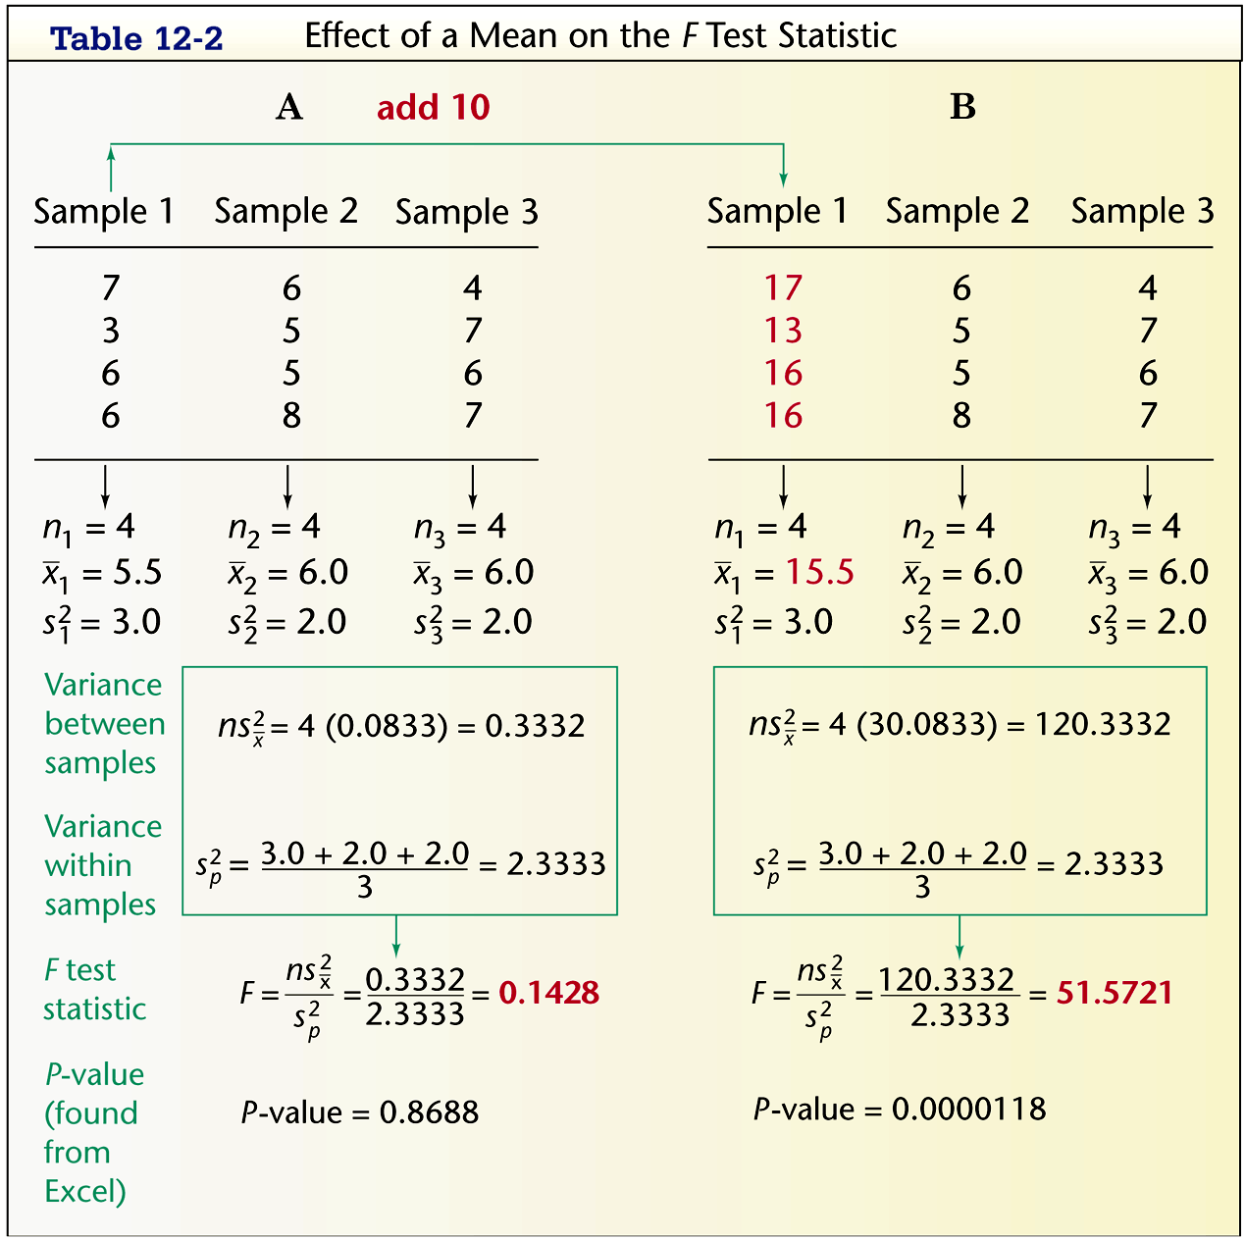
Example: Sample Calculations

Slide 33
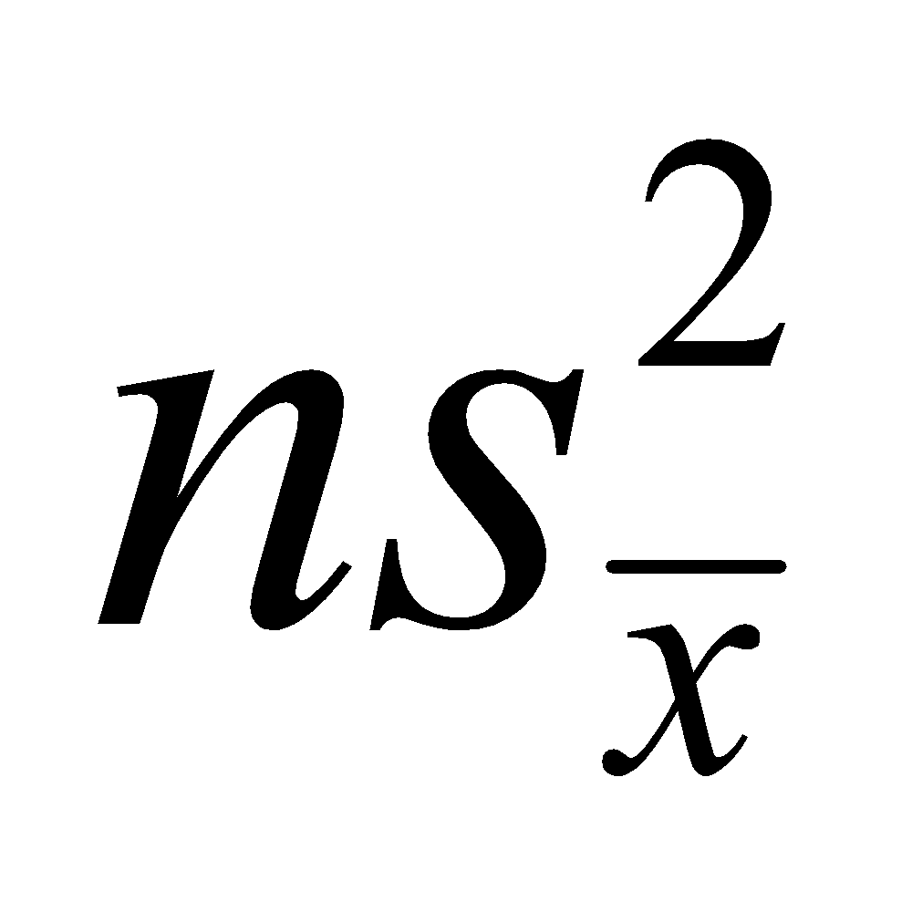
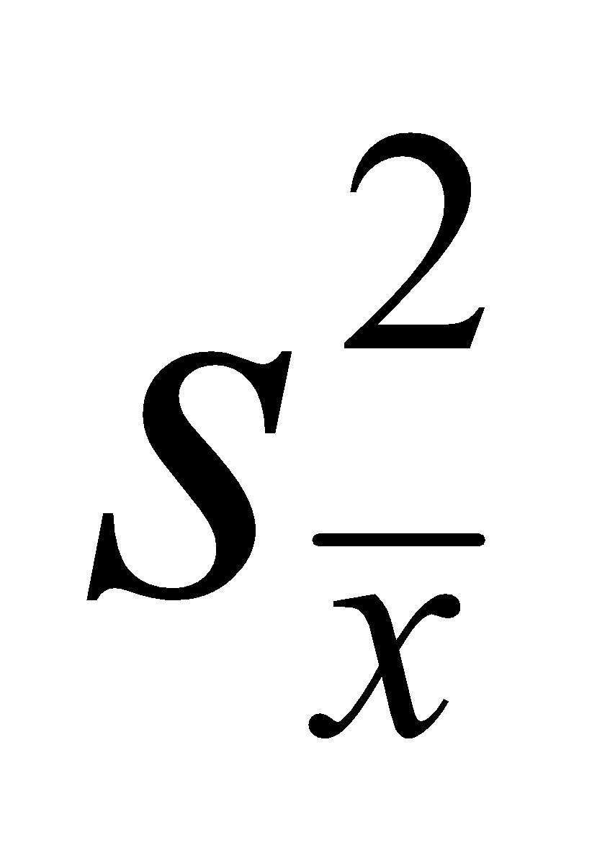
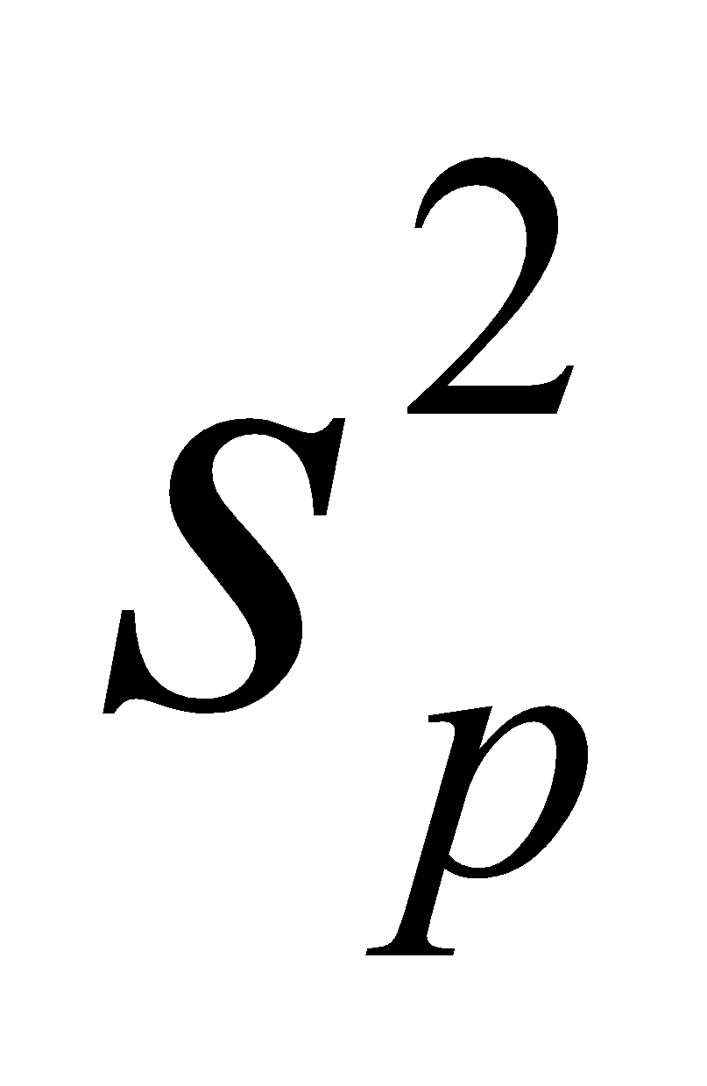
Example: Sample Calculations
Use Table 12-2 to calculate the variance between samples, variance within samples, and the F test statistic.
1. Find the variance between samples = .
For the means 5.5, 6.0 & 6.0, the sample variance is
= 0.0833
= 4 X 0.0833 = 0.3332
2. Estimate the variance within samples by calculating the mean of the sample variances. .
3.0 + 2.0 + 2.0
3
= = 2.3333

Slide 34
Example: Sample Calculations
Use Table 12-2 to calculate the variance between samples, variance within samples, and the F test statistic.
3. Evaluate the F test statistic
F =
F = = 0.1428
variance between samples
variance within samples
0.3332
2.3333
Notes:
page 642 of Elementary Statistics, 10th Edition

Slide 35
Critical Value of F
Right-tailed test
Degree of freedom with k samples of the same size n
numerator df = k – 1
denominator df = k(n – 1)

Slide 36
Calculations with Unequal Sample Sizes
Σn_{i}(x_{i} – x)²
variance within samples
k –1
F = =
variance between samples
Σ(n_{i} – 1)s_{i}
2
Σ(n_{i} – 1)
where x = mean of all sample scores combined
k = number of population means being compared
n_{i} = number of values in the ith sample
x_{i} = mean of values in the ith sample
s_{i} = variance of values in the ith sample
2

Slide 37
Key Components of the ANOVA Method
SS(total), or total sum of squares, is a measure of the total variation (around x) in all the sample data combined.
Formula 12-1

Slide 38
Key Components of the ANOVA Method
SS(treatment), also referred to as SS(factor) or SS(between groups) or SS(between samples), is a measure of the variation between the sample means.
Formula 12-2

Slide 39
Key Components of the ANOVA Method
SS(error), also referred to as SS(within groups) or SS(within samples), is a sum of squares representing the variability that is assumed to be common to all the populations being considered.
Formula 12-3

Slide 40
Key Components of the ANOVA Method
Given the previous expressions for SS(total), SS(treatment), and SS(error), the following relationship will always hold.
Formula 12-4
SS(total) = SS(treatment) + SS(error)

Slide 41
Mean Squares (MS)
MS(treatment) is a mean square for treatment, obtained as follows:
Formula 12-5
SS (treatment)
MS(treatment) =
k – 1
MS(error) is a mean square for error, obtained as follows:
Formula 12-6
MS(error) =
SS (error)
N – k
N = total number of values in all samples combined

Slide 42
Mean Squares (MS)
MS(total) is a mean square for the total variation, obtained as follows:
Formula 12-7
SS(total)
MS(total) =
N – 1
N = total number of values in all samples combined

Slide 43
Test Statistic for ANOVA with Unequal Sample Sizes
Formula 12-8
MS (treatment)
F =
MS (error)
Numerator df = k – 1
Denominator df = N – k

Slide 44
Identifying Means That Are Different
After conducting an analysis of variance test, we might conclude that there is sufficient evidence to reject a claim of equal population means, but we cannot conclude from ANOVA that any particular mean is different from the others.

Slide 45
Identifying Means That Are Different
Informal methods for comparing means
Use the same scale for constructing boxplots of the data sets to see if one or more of the data sets are very different from the others.
Construct confidence interval estimates of the means from the data sets, then compare those confidence intervals to see if one or more of them do not overlap with the others.

Slide 46
Bonferroni Multiple
Comparison Test
Step 1. Do a separate t test for each pair of samples, but make the adjustments described in the following steps.
Step 2. For an estimate of the variance σ² that is common to all of the involved populations, use the value of MS(error).

Slide 47
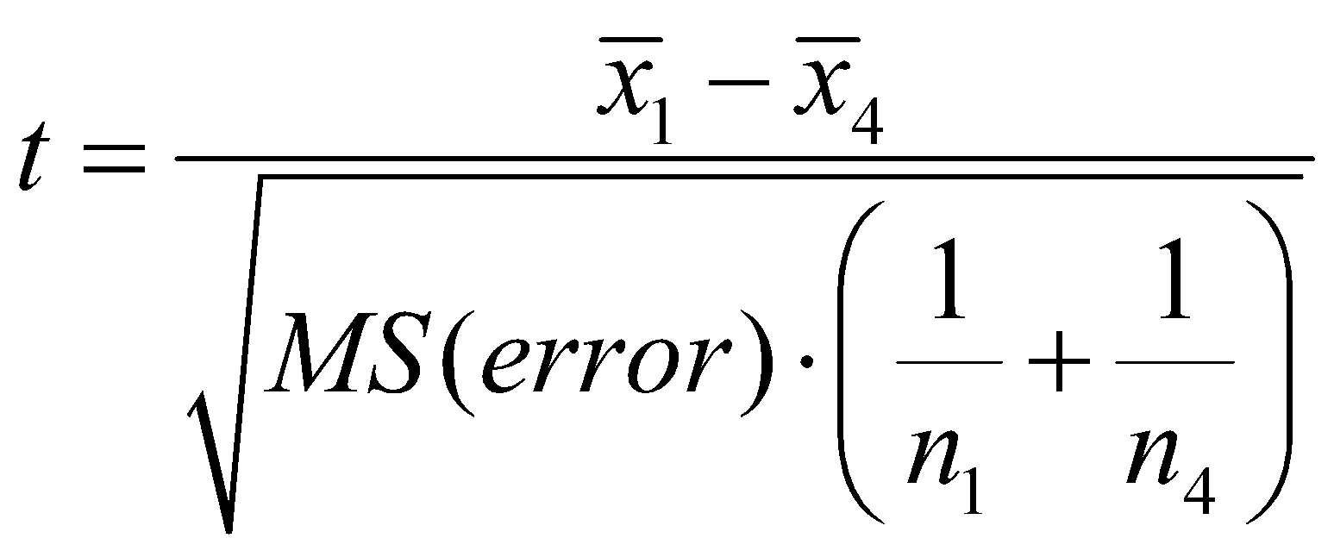
Bonferroni Multiple
Comparison Test
Step 2 (cont.) Using the value of MS(error), calculate the value of the test statistic, as shown below. (This example shows the comparison for Sample 1 and Sample 4.)

Slide 48
Bonferroni Multiple
Comparison Test
Step 2 (cont.) Change the subscripts and use another pair of samples until all of the different possible pairs of samples have been tested.
Step 3. After calculating the value of the test statistic t for a particular pair of samples, find either the critical t value or the P-value, but make the following adjustment:

Slide 49
Bonferroni Multiple
Comparison Test
Step 3 (cont.) P-value: Use the test statistic t with df = N – k, where N is the total number of sample values and k is the number of samples. Find the P-value the usual way, but adjust the P-value by multiplying it by the number of different possible pairings of two samples.
(For example, with four samples, there are six different possible pairings, so adjust the P-value by multiplying it by 6.)

Slide 50
Bonferroni Multiple
Comparison Test
Step 3 (cont.) Critical value: When finding the critical value, adjust the significance level α by dividing it by the number of different possible pairings of two samples.
(For example, with four samples, there are six different possible pairings, so adjust the significance level by dividing it by 6.)

Slide 51
Example:
Using the data in Table 12-1, we concluded that there is sufficient evidence to warrant rejection of the claim of equal means. Use the Bonferroni test with a 0.05 significance level to identify which mean is different from the others.
The Bonferroni test requires a separate ttest for each different possible pair of samples. Here are the null hypotheses to be tested:

Slide 52
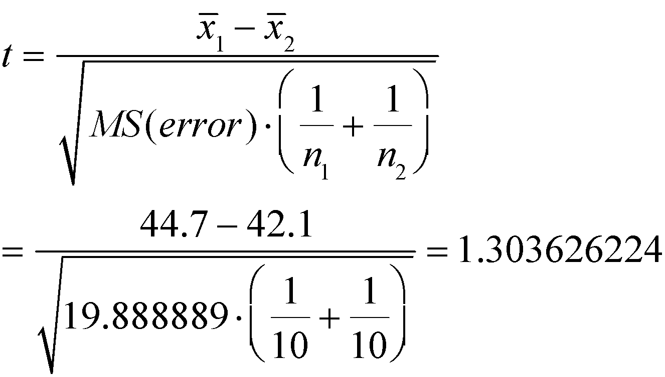
Example:
Begin with
From Table 12-1:
MS(error) = 19.888889 (from technology)

Slide 53
Example:
The number of degrees of freedom is df = N – k = 30 – 3 = 27. With a test statistic of t = 1.303626244 and with df = 27, the two-tailed P-value is 0.203368, but we adjust this P-value by multiplying it by 3 (the number of different possible pairs of samples) to get a final P-value of 0.610. Because this P-value is not small (less than 0.05), we fail to reject the null hypothesis. It appears that Samples 1 and 2 do not have significantly different means.

Slide 54
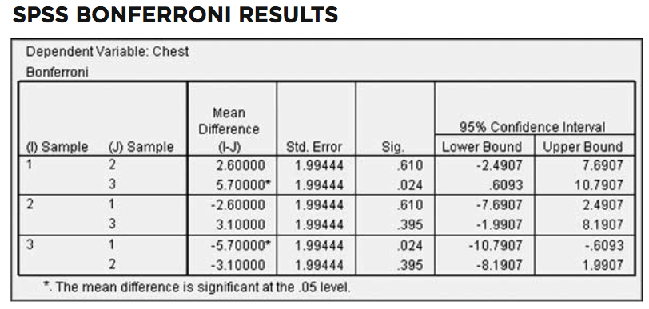
Example:
Here are ALL the Bonferroni test results:

Slide 55
Example:
The display shows that the mean for Sample 1 (small cars) is significantly different from the mean for Sample 3 (large cars). Based on the Bonferroni test, it appears that the measurements from small cars have a mean that is significantly different from the mean for large cars.

Slide 56
Recap
In this section we have discussed:
One-way analysis of variance (ANOVA)
Calculations with Equal Sample Sizes
Calculations with Unequal Sample Sizes
Identifying Means That Are Different
Bonferroni Multiple Comparison Test

Slide 57
Section 12-3
Two-Way ANOVA

Slide 58
Key Concepts
The analysis of variance procedure introduced in Section 12-2 is referred to as one-way analysis of variance because the data are categorized into groups according to a single factor (or treatment).
In this section we introduce the method of two-way analysis of variance, which is used with data partitioned into categories according to two factors.

Slide 59
Two-Way Analysis of Variance
Two-Way ANOVA involves two factors.
The data are partitioned into subcategories called cells.

Slide 60
Definition
There is an interaction between two factors if the effect of one of the factors changes for different categories of the other factor.
Notes:
It is important to consider the interaction rather than just conducting another one-way ANOVA test on another factor.

Slide 61
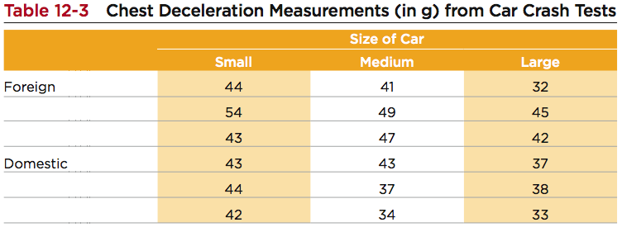
Example:
Let’s explore the data in Table 12-3 by calculating the mean for each cell and by constructing a graph.

Slide 62
Example:
The individual cell means are shown in Table 12-4. Those means vary from a low of 36.0 to a high of 47.0, so they appear to vary considerably.

Slide 63
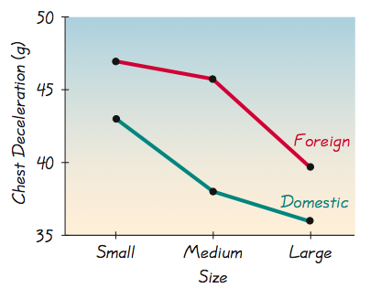
Example:
Figure 12-3 is an interaction graph, which shows graphs of those means, and that figure has two very notable features:

Slide 64
Example:
Larger means: Because the line segments representing foreign cars are higher than the line segments for domestic cars, it appears that foreign cars have consistently larger measures of chest deceleration.
Interaction: Because the line segments representing foreign cars appear to be approximately parallel to the line segments for domestic cars, it appears that foreign and domestic cars behave the same for the different car size categories, so there does not appear to be an interaction effect.

Slide 65
Example:
In general, if a graph such as Figure 12-3 results in line segments that are approximately parallel, we have evidence that there is not an interaction between the row and column variables.
These observations are largely subjective.
Let’s proceed with a more objective method of two-way analysis of variance.

Slide 66
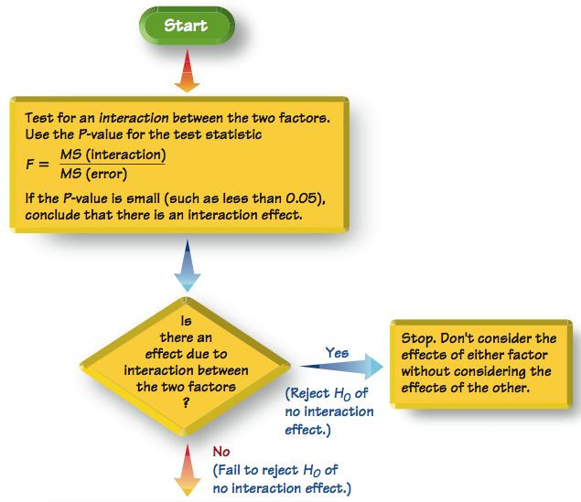
Figure 12- 4 Procedure for Two-Way ANOVAS

Slide 67
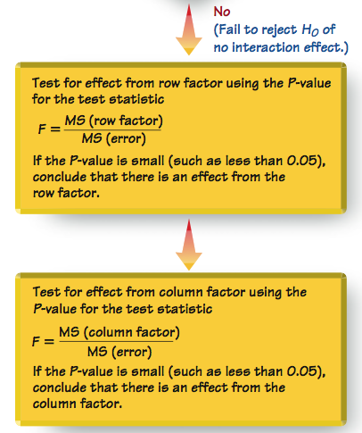

Slide 68
Requirements
1. For each cell, the sample values come from a population with a distribution that is approximately normal.
2. The populations have the same variance σ².
3. The samples are simple random samples.
4. The samples are independent of each other.
5. The sample values are categorized two ways.
6. All of the cells have the same number of sample values.

Slide 69
Technology and Two-Way ANOVA
Two-Way ANOVA calculations are quite involved, so we will assume that a software package is being used.
Minitab, Excel, TI-83/4 or STATDISK can be used.

Slide 70
Procedure for Two-Way ANOVA
Step 1: Interaction Effect - test the null hypothesis that there is no interaction
Step 2: Row/Column Effects - if we conclude there is no interaction effect, proceed with these two hypothesis tests
Row Factor: no effects from row
Column Factor: no effects from column

Slide 71
Example:
Given the chest deceleration measurements in Table 12-3, use two-way analysis of variance to test for an interaction effect, an effect from the row factor of type of car (foreign, domestic), and an effect from the column factor of car size (small, medium, large). Use a 0.05 significance level.

Slide 72
Example:
Requirements are satisfied: sample values from normally distributed population; variances vary considerably but not extremely, we’ll keep this in mind; simple random samples; independent samples, not matched; categorized two ways (foreign-domestic, small-medium-large; all cells has same number of samples (3)
Here’s the Minitab results:

Slide 73
Example:
Step 1: Interaction Effect
P-value = 0.717, so fail to reject the null hypothesis of no interaction between the two factors
Step 2: Row/Column Effects
H₀: There is no effect from the row factor (the row means are equal)
H₀: There is no effect from the column factor (the column means are equal)

Slide 74
Example:
Row Factor:
P-value = 0.038 < 0.05, so reject the null hypothesis of no effects from the type of car
Column Factor:
P-value = 0.060 > 0.05, so fail to reject the null hypothesis of no effects from the size of car

Slide 75
Example:
Based on the sample data in Table 12-3, we conclude that chest deceleration measurements appear to be affected by whether the car is foreign or domestic, but those measurements do not appear to be affected by the size of the car.

Slide 76
Caution
Two-way analysis of variance is not one-way analysis of variance done twice.
Be sure to test for an interaction between the two factors.

Slide 77
Special Case: One Observation per Cell and No Interaction
If our sample data consist of only one observation per cell, we lose MS(interaction), SS(interaction), and df(interaction).
If it seems reasonable to assume that there is no interaction between the two factors, make that assumption and then proceed as before to test the following two hypotheses separately:
H₀: There are no effects from the row factors.
H₀: There are no effects from the column factors.
Notes:
page 659 of Elementary Statistics, 10th Edition

Slide 78
Recap
In this section we have discussed:
Two- way analysis of variance (ANOVA)
Special case: One observation per cell and no interaction

