Slide 2
Unit 5
That’s incredible

Slide 4
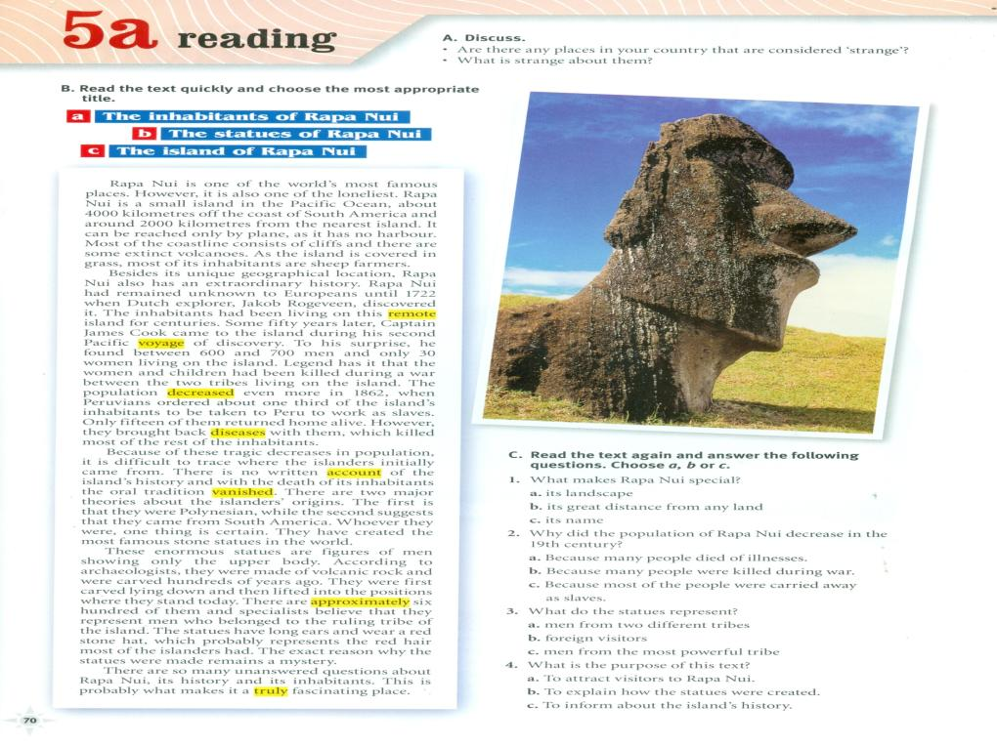

Slide 5
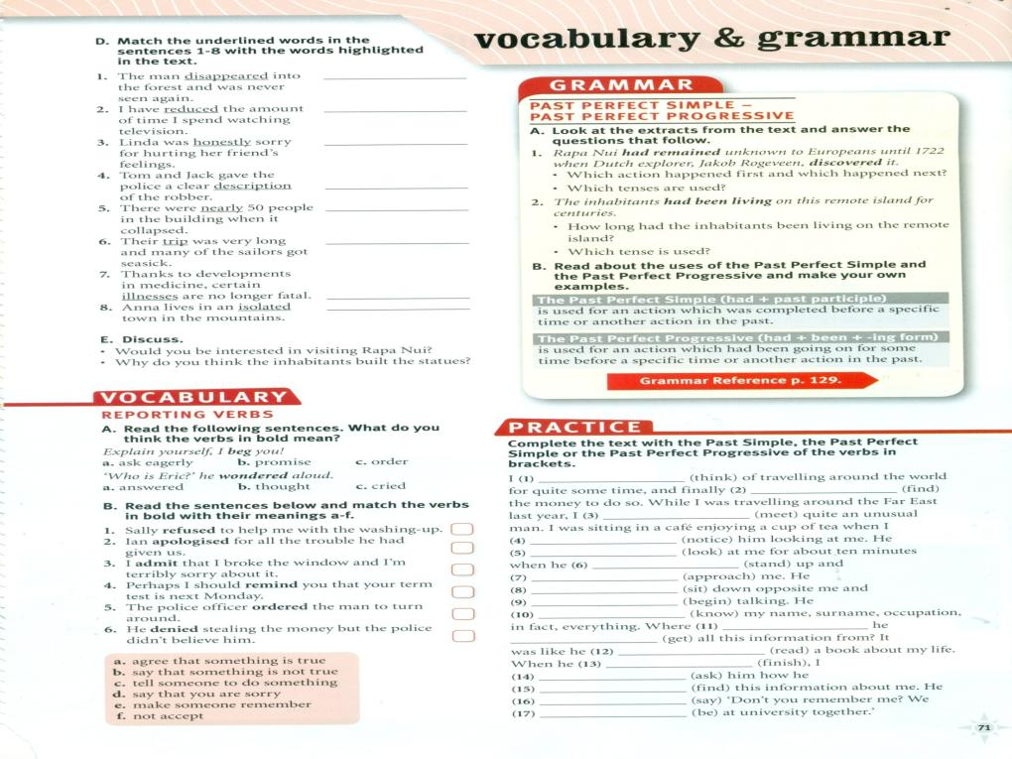
vanished
decreased
truly
account
approximately
voyage
disease
remote
Had been thinking
found
met
f
noticed
d
Had been looking
a
stood
sat
approached
e
began
c
knew
b
did get
had got
had red
asked
finished
Had found
said
were

Slide 7
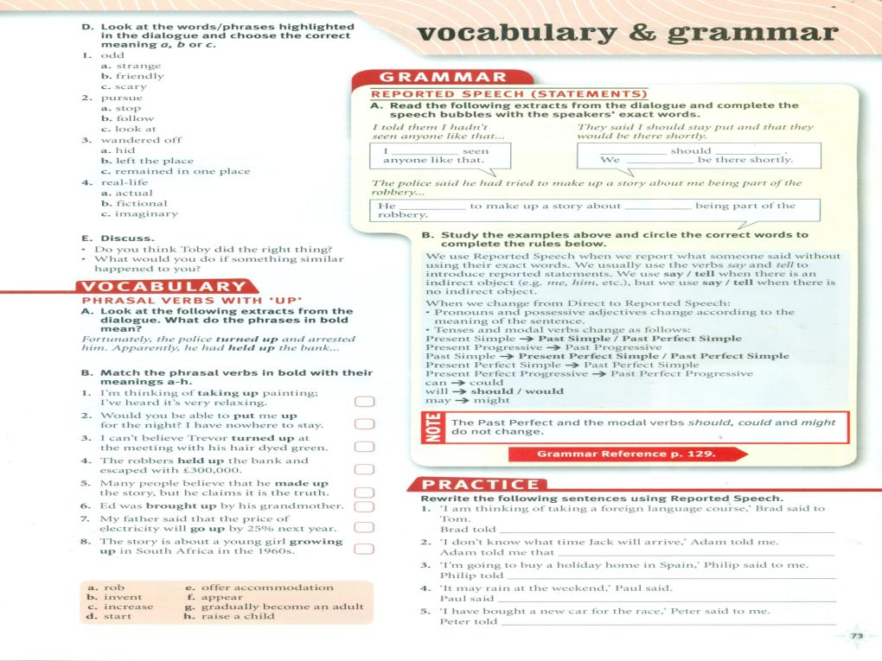
a
e
f
a
b
h
c
Brad told Tom that he was thinking of taking a foreign language course
g
Ahmed told me that he didn’t know what time Jack would arrive.
Philip told me that he was going to buy a holiday in Spain.
Paul said that it might rain at week the weekend.
Peter told me he had bought a new car for the race.

Slide 8
F
T
T
F
T
F

Slide 9
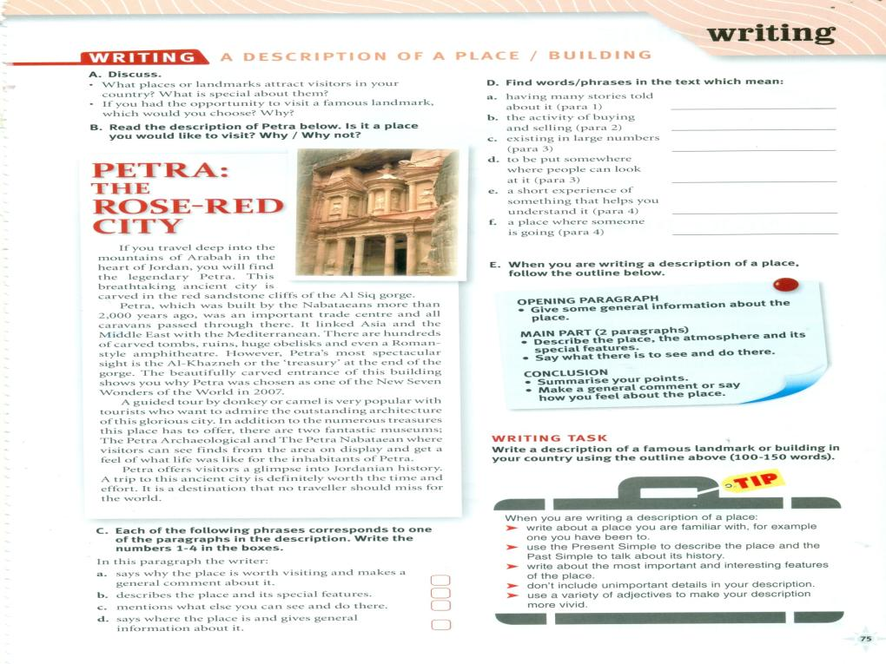
legendary
trade
numerous
On display
glimpse
destination

Slide 10
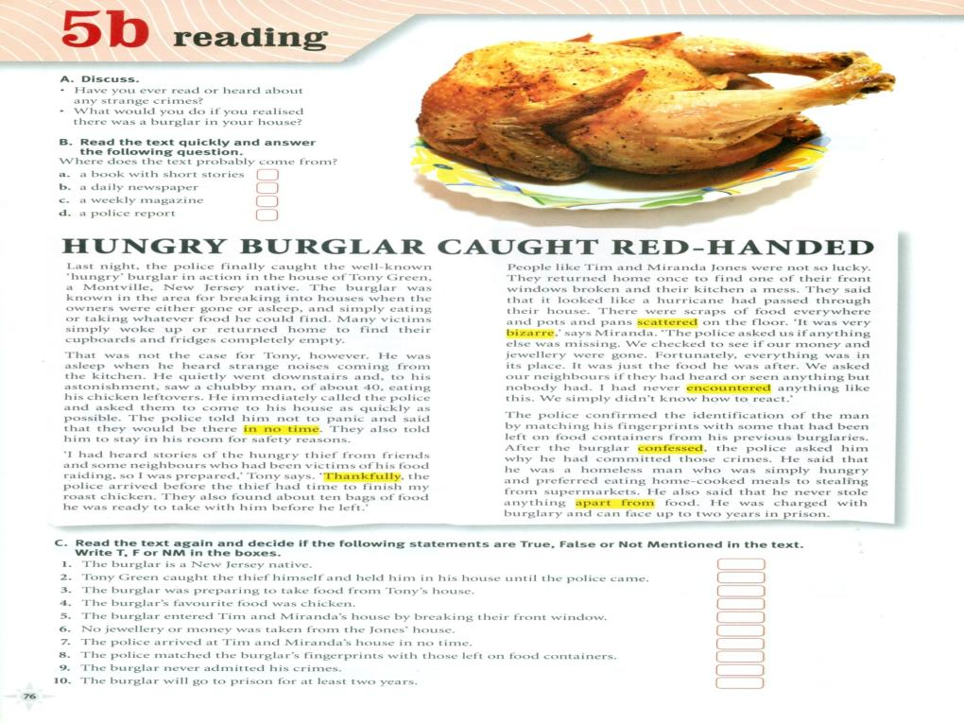

Slide 11
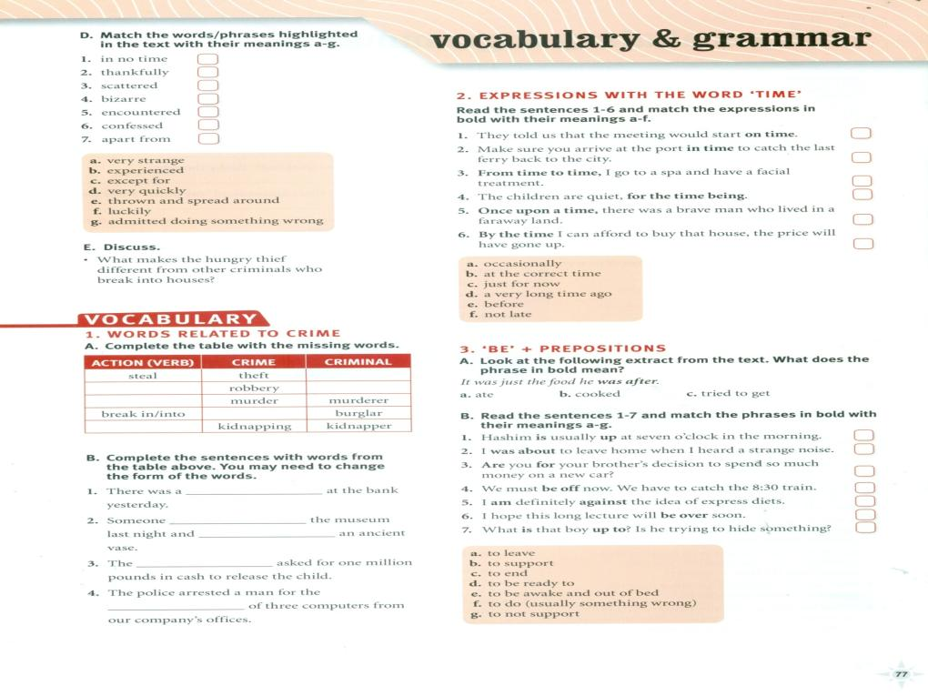
d
f
e
a
b
g
c
rob
thief
murder
robber
burglary
kidnap
robbery
Broke into
stole
kidnappers
theft

Slide 12
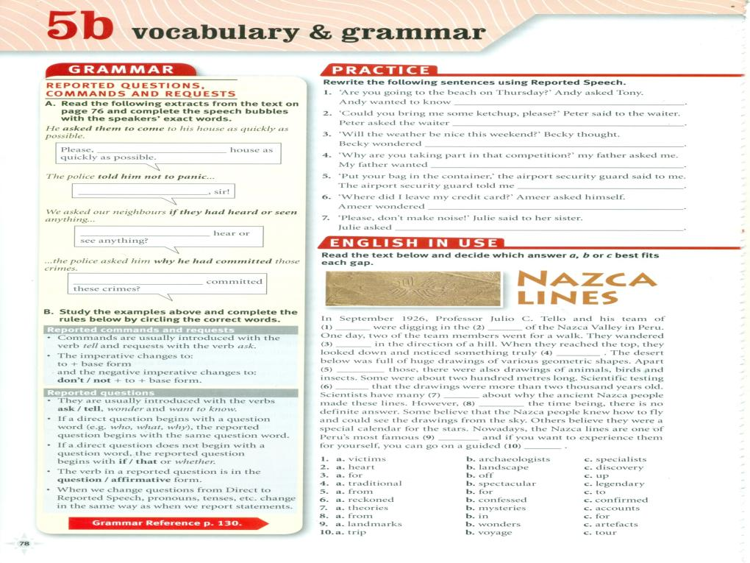

Slide 15
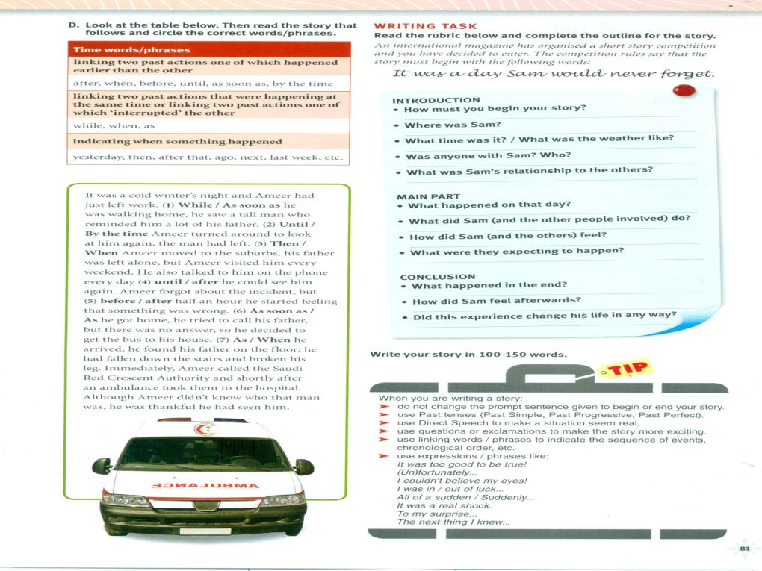

Slide 17
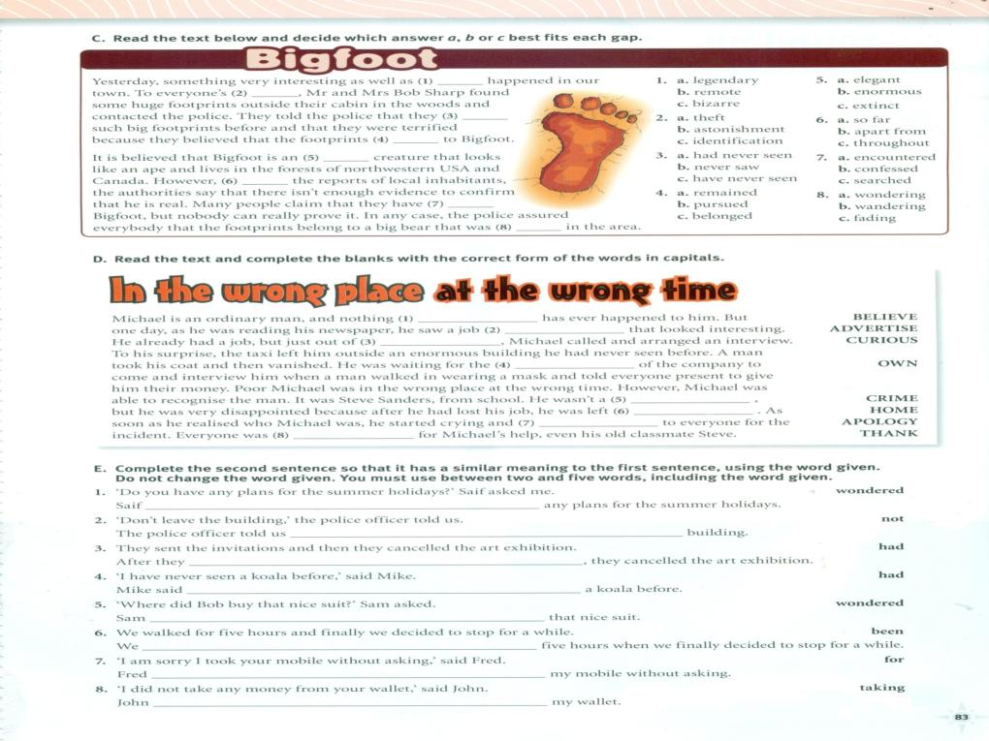
unbelievable
curiosity
advertisement
owner
criminal
apologised
homeless
thankful
wondered if
not to leave the
had sent an invitation
He had never seen
Wondered where Bob had bought
had been walking for
Apologised for taking
thankful

