Slide 1


exam
Teacher Hanaa Copyright © 2015

Slide 2
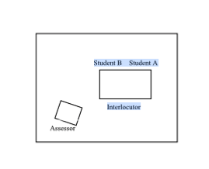
How you will be seated:
Student B
Student A
Teacher
Teacher

Slide 3
There will be two parts:
Part 1- Personal Questions: The teacher will ask you questions about yourself. (2 mins)
Part 2- Information Gap fill:
Student A (Shrouq) will receive a card with information.
Student B (Tahani) will receive a card with words to form questions.
Then, students change roles- Student A will become Student B etc and Student B will become Student A.
Student A (Tahani) Information card
Student B (Shrouq) Questions card

Slide 4
Part 1 – Personal Questions- The teacher will ask you some questions:
What’s your first name? My first name’s…….
What’s your surname/ family name? My surname’s……..
Could you spell that? It’s ….( A-L-H-A-R-B-I)
What’s you student identification number? My I.D number is ……( 43537688)
You will then be asked 5/6 questions:
I live in Riyadh.
Yes, it is.
It’s famous for it’s modern high buildings.
Yes, the Kingdom Tower and Faisaliah Tower.
Yes, I live in the centre of Riyadh. / No, I live in the suburbs.
**suburbs= just outside of Riyadh.
Rural life is quiet, peaceful and……
**rural= countryside
1) Where do you live?
2) Is this the capital city?
3) What is this city famous for?
4) Does this city have any famous buildings?
5) Do you live in the centre of the city? Or the suburbs?
6) What is rural life like in this country?

Slide 5
Part 1 – Personal Questions
Other possible questions:
Your Home
1. What type of home do you live in?
2. How many rooms does your home have?
3. Does your home have a garage?
4. Does your home have a swimming pool?
5. Are the homes in your neighbourhood similar to yours?
6. What makes your home different from those in your neighbourhood?
Answers:
I live in a….(house/ villa/ flat)
It has… rooms.
Yes, it does./ No, it doesn’t.
Yes, it does. It has a small/big swimming pool. / No, it doesn’t.
Yes, they’re the same. / No they’re different.
They’re different because…..

Slide 6
Part 1 – Personal Questions
Other possible questions:
1. What subjects do you study here at KSU?
2. How many people are there in your family?
3. What did you do last weekend?
4. Where do you usually have lunch? Why there?
5. Where do you usually go on holiday? / Where do you like to travel?
Answers:
I study….(English, statistics, math)
There are (6) people in my family. My parents, my two sisters, my brother and me.
Last weekend, I …(went shopping/ visited my grandparents)
I usually have lunch at…...
I usually go to……
  I like to travel to….

Slide 7
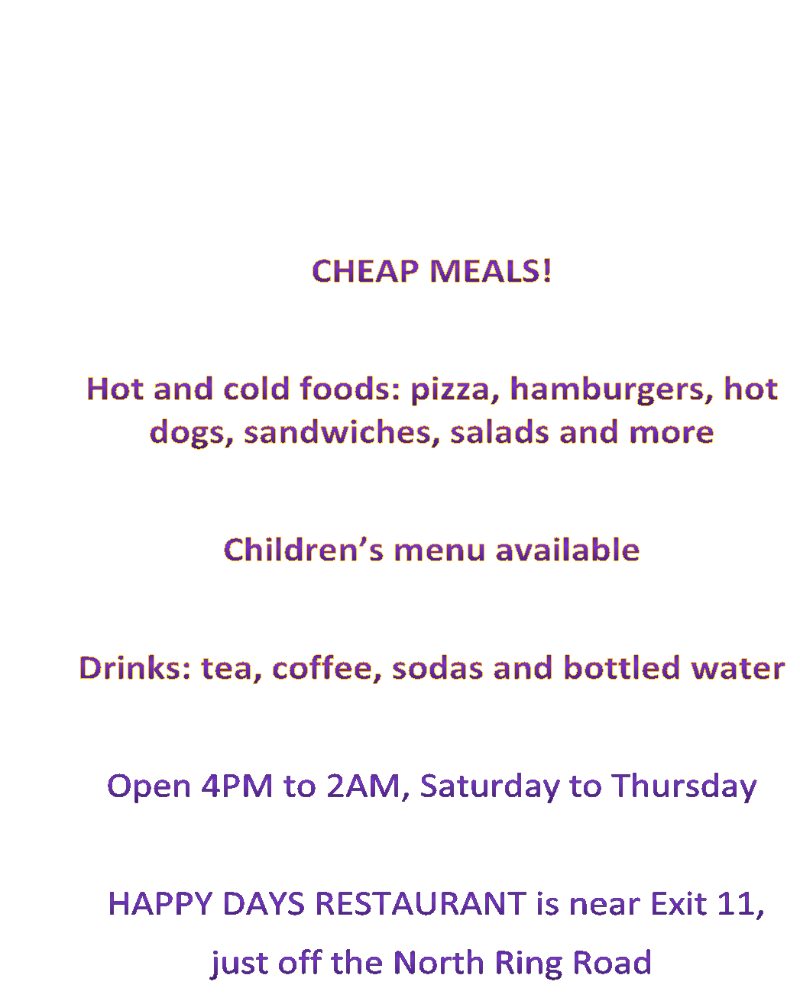
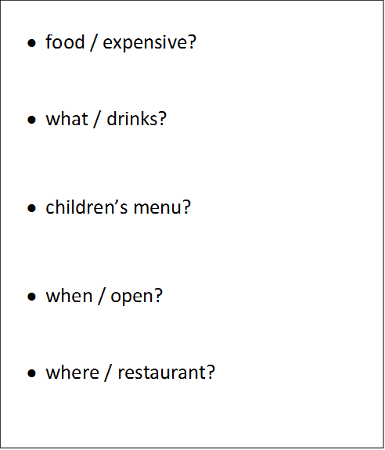
Part 2 – Ask and Answer with another student using information and question cards.
Student A:
You will have the information card first.
You will use the information to answer questions.
Student B:
You will make and ASK the questions to Student A.

Slide 8
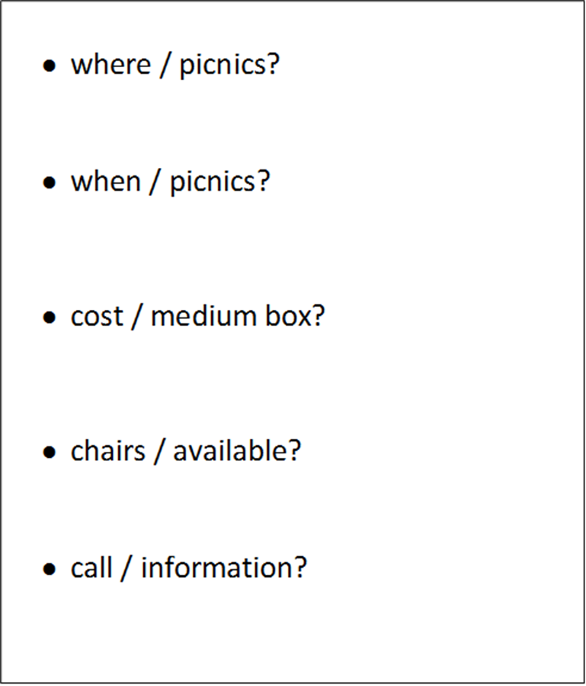
Part 2 – Then you will change. Student A becomes Student B. So whoever was answering the questions, will NOW, ASK the questions! (With different cards)
Student A:
You will have the information card first.
You will use the information to answer questions.
Student B:
You will make and ASK the questions to Student A, using the card below:

Slide 9
Part 2
Sample cards
These are only EXAMPLE cards. You may be given the same or different cards in your exam.

Slide 10
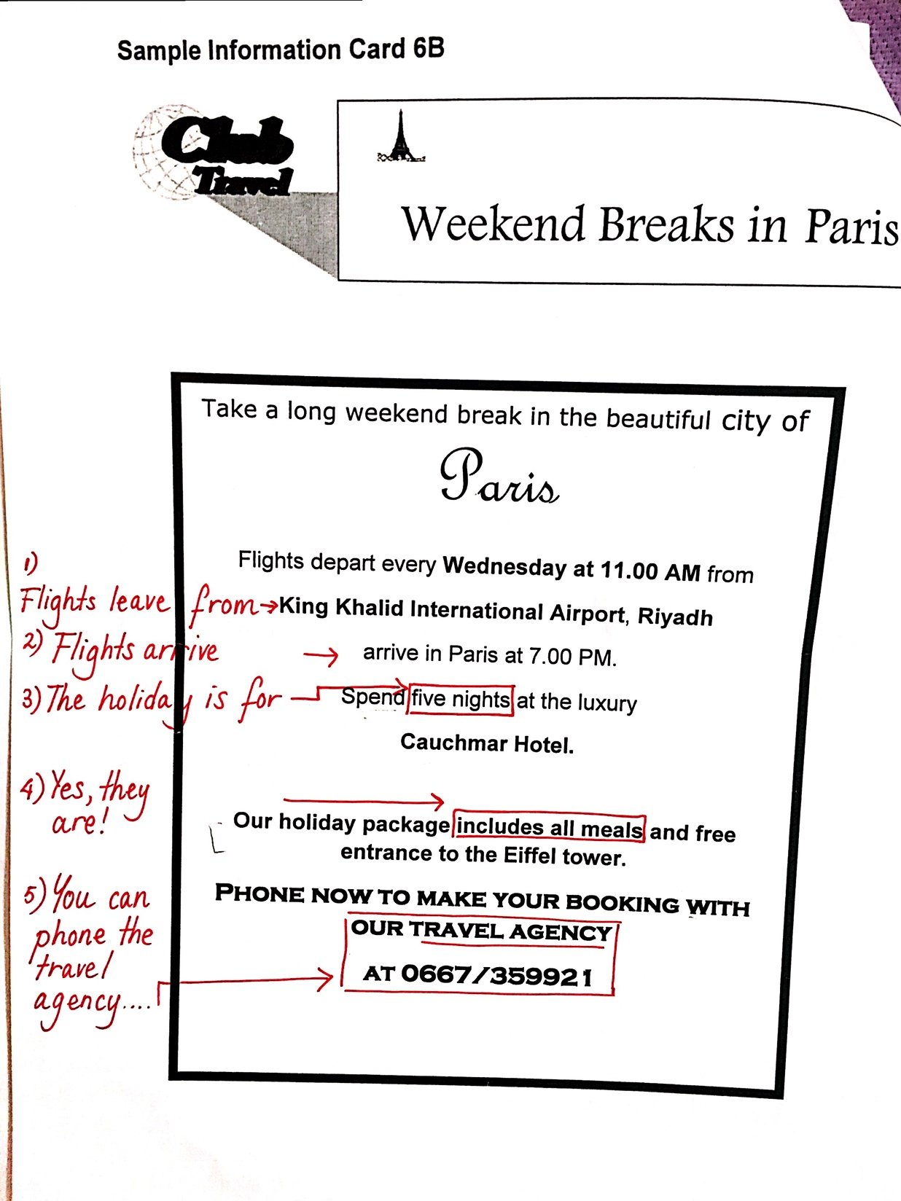
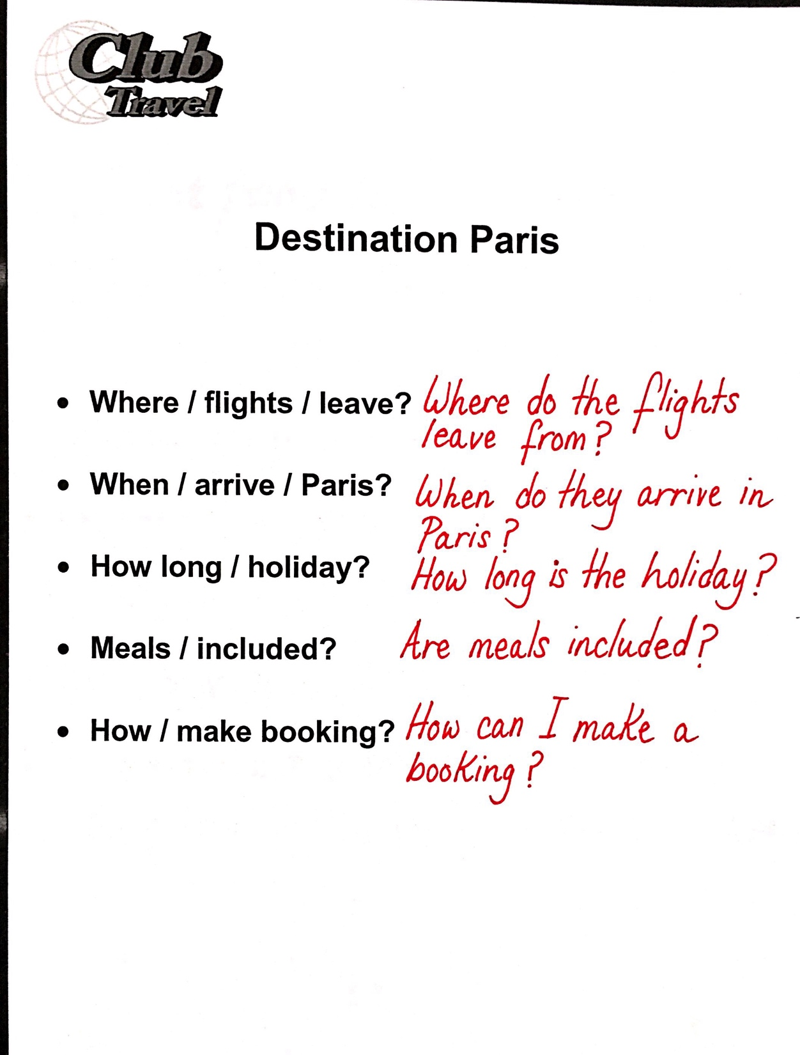

Slide 11
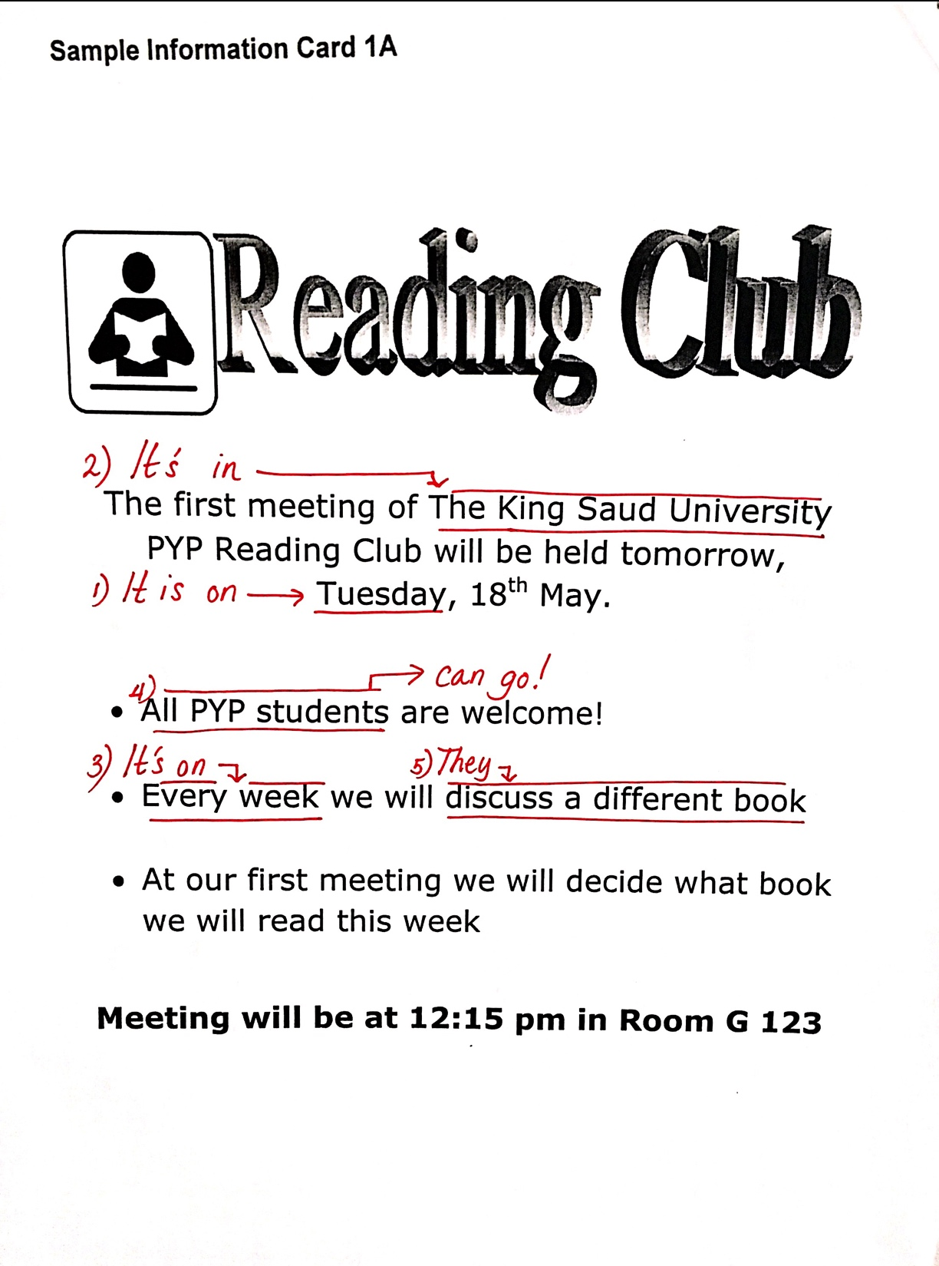
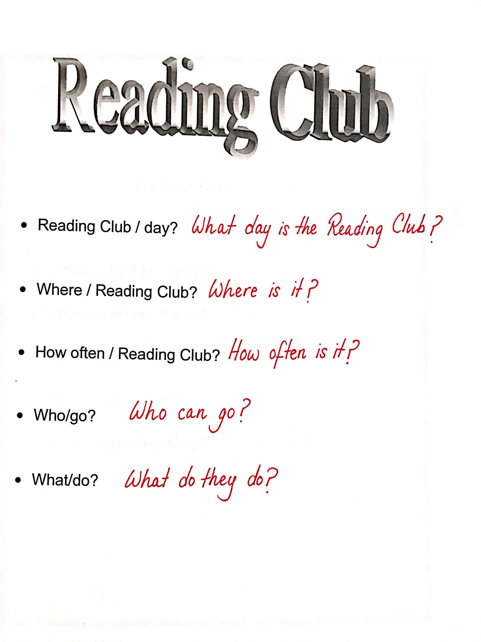

Slide 12
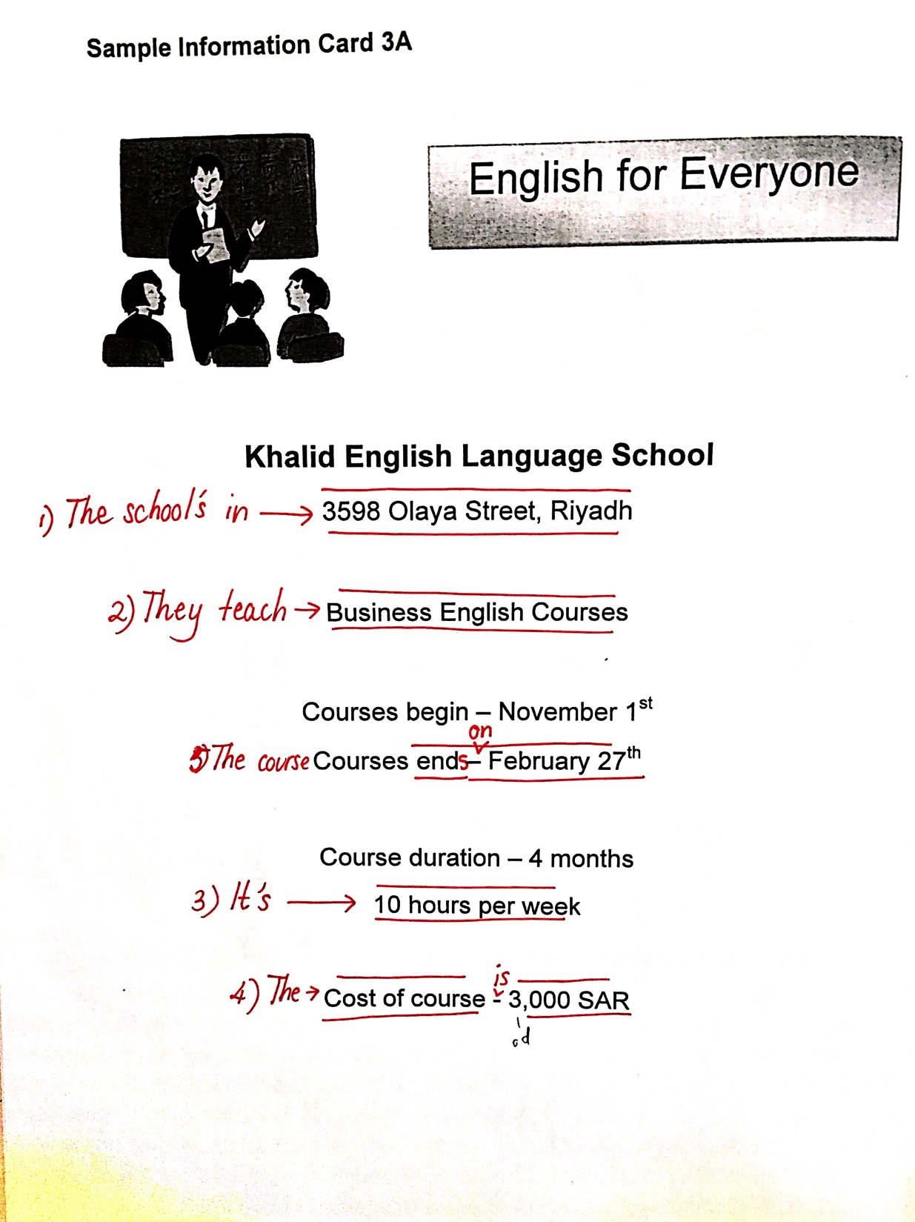
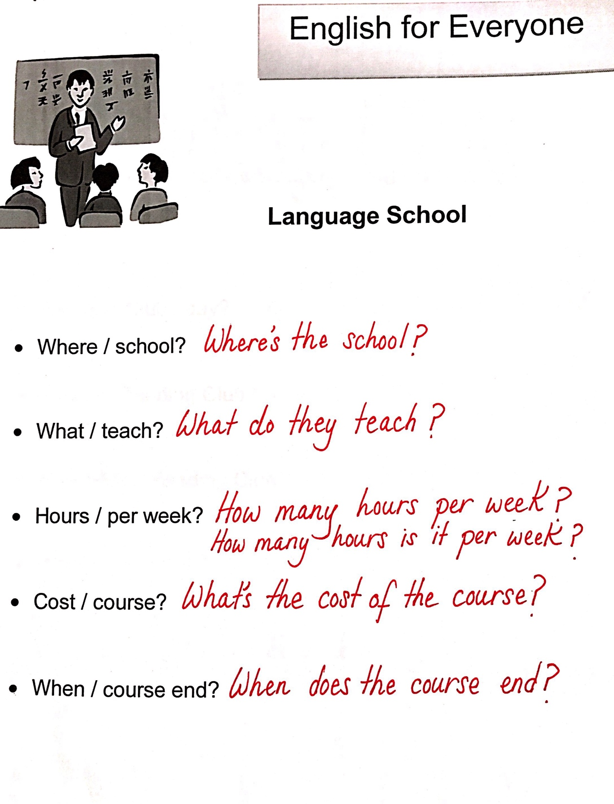

Slide 13
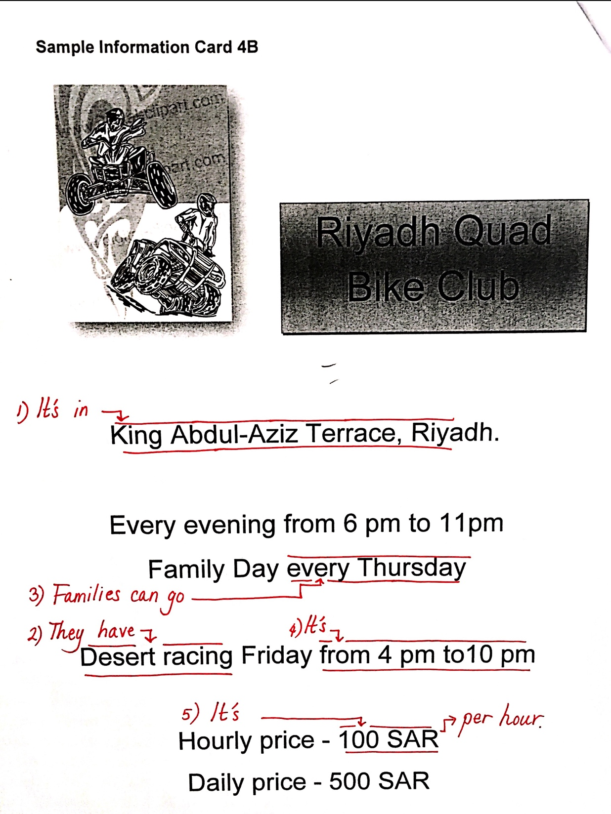
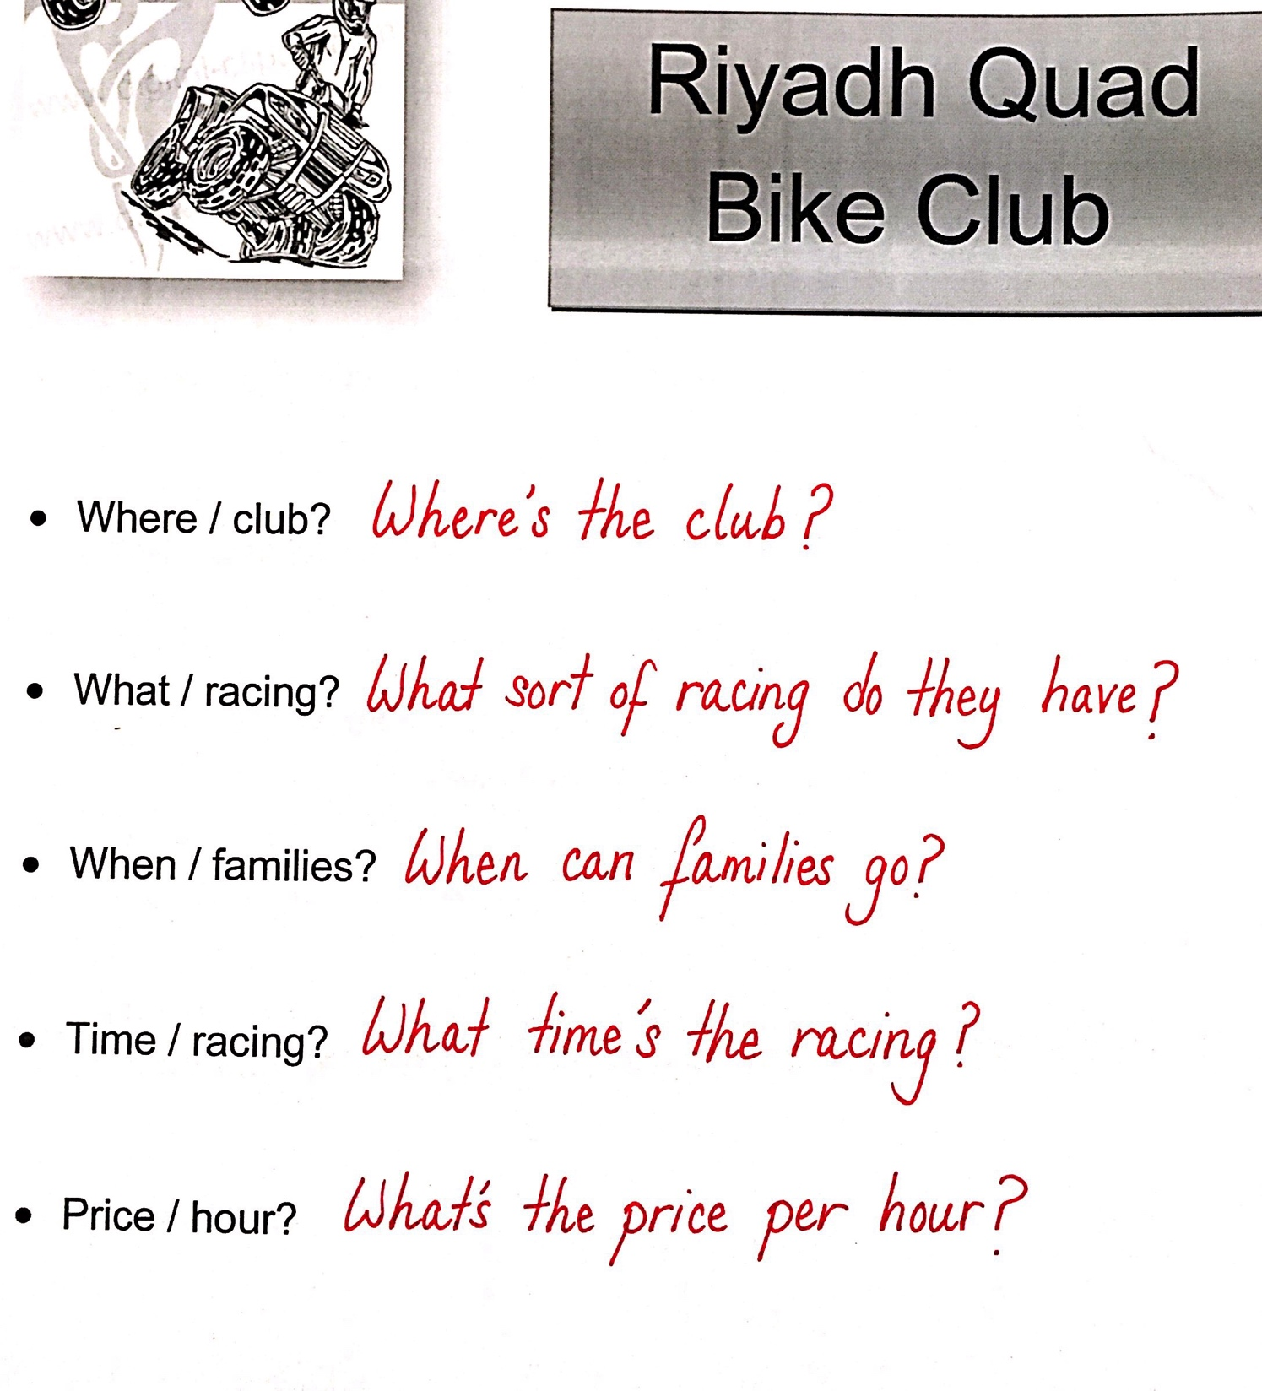

Slide 14
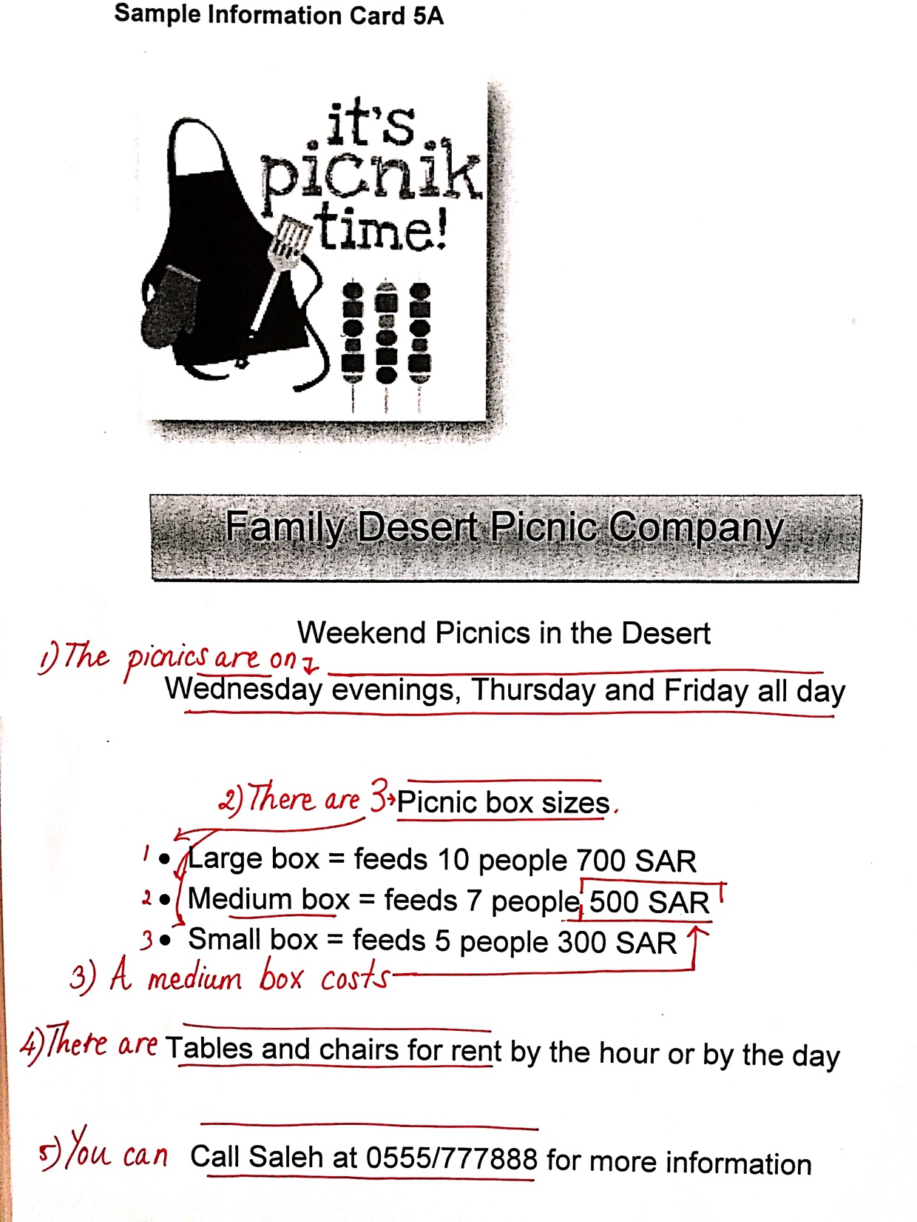
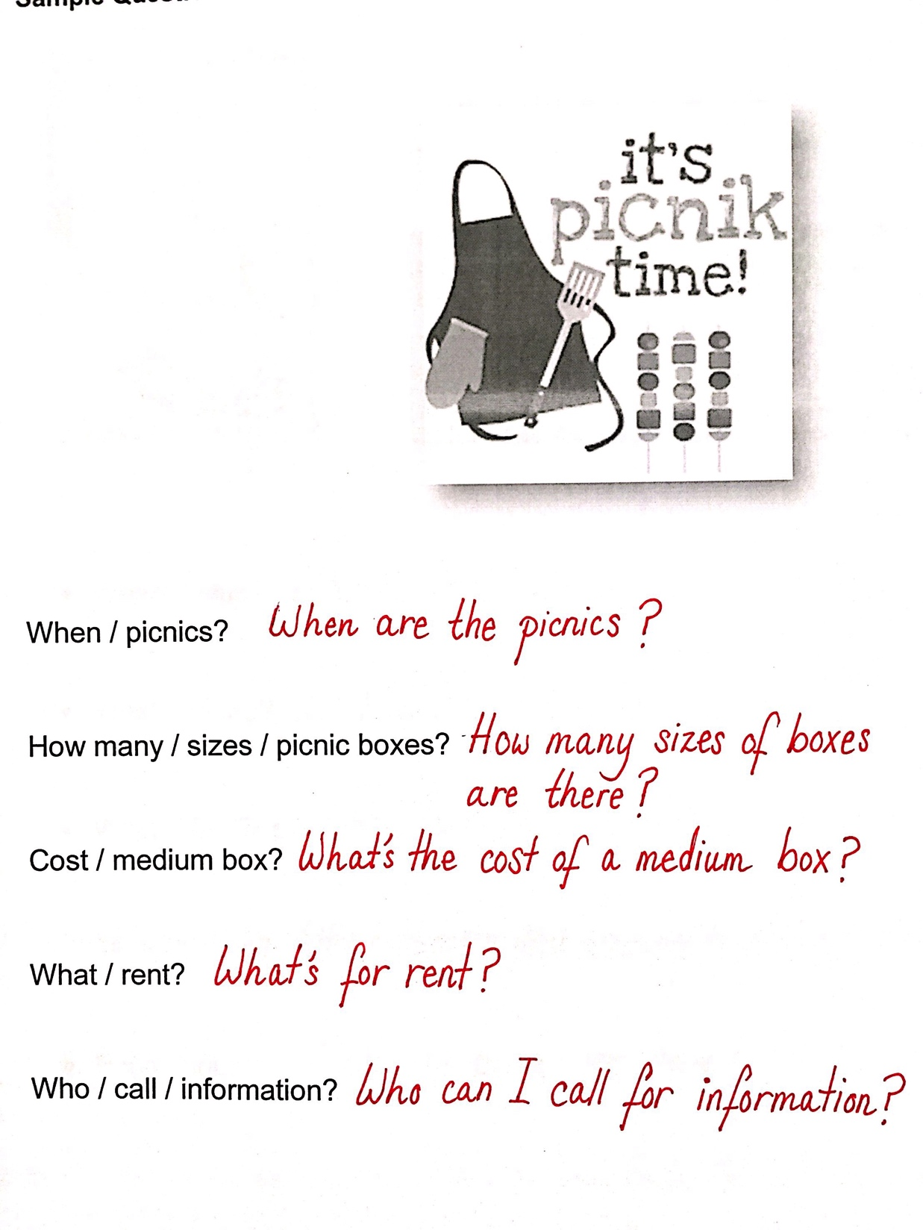

Slide 15
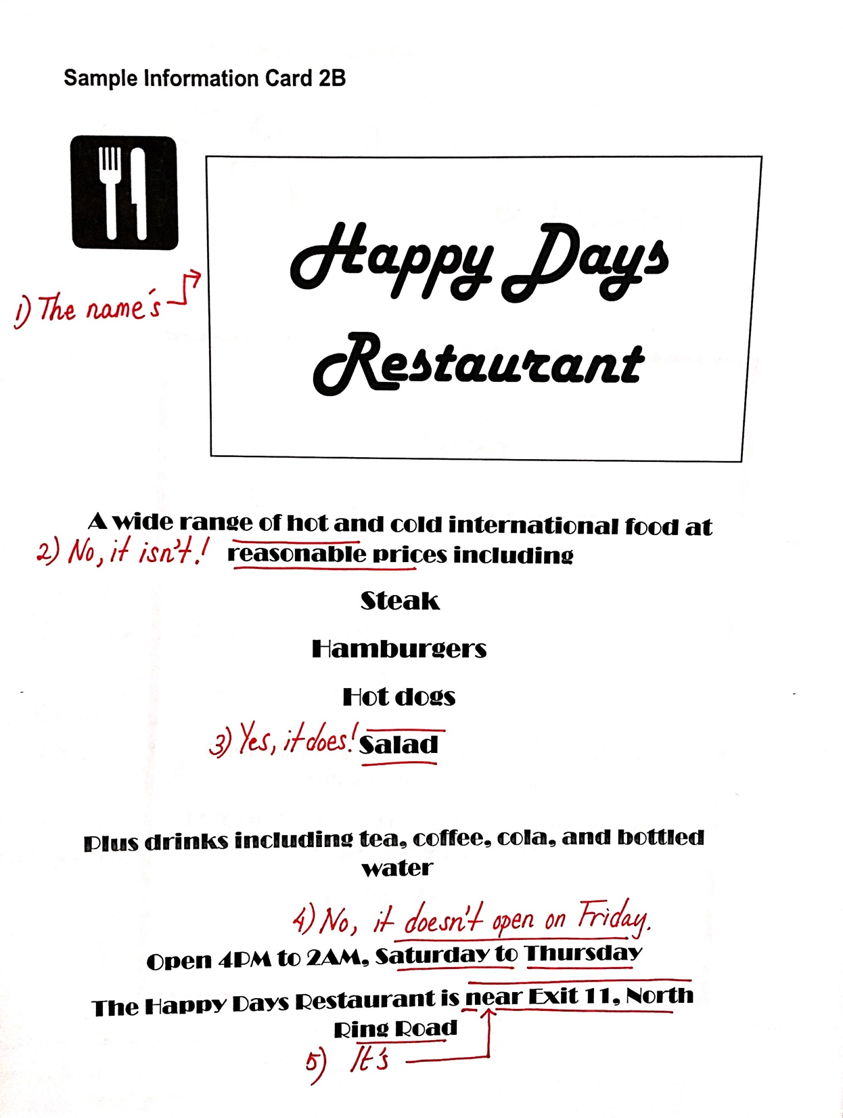
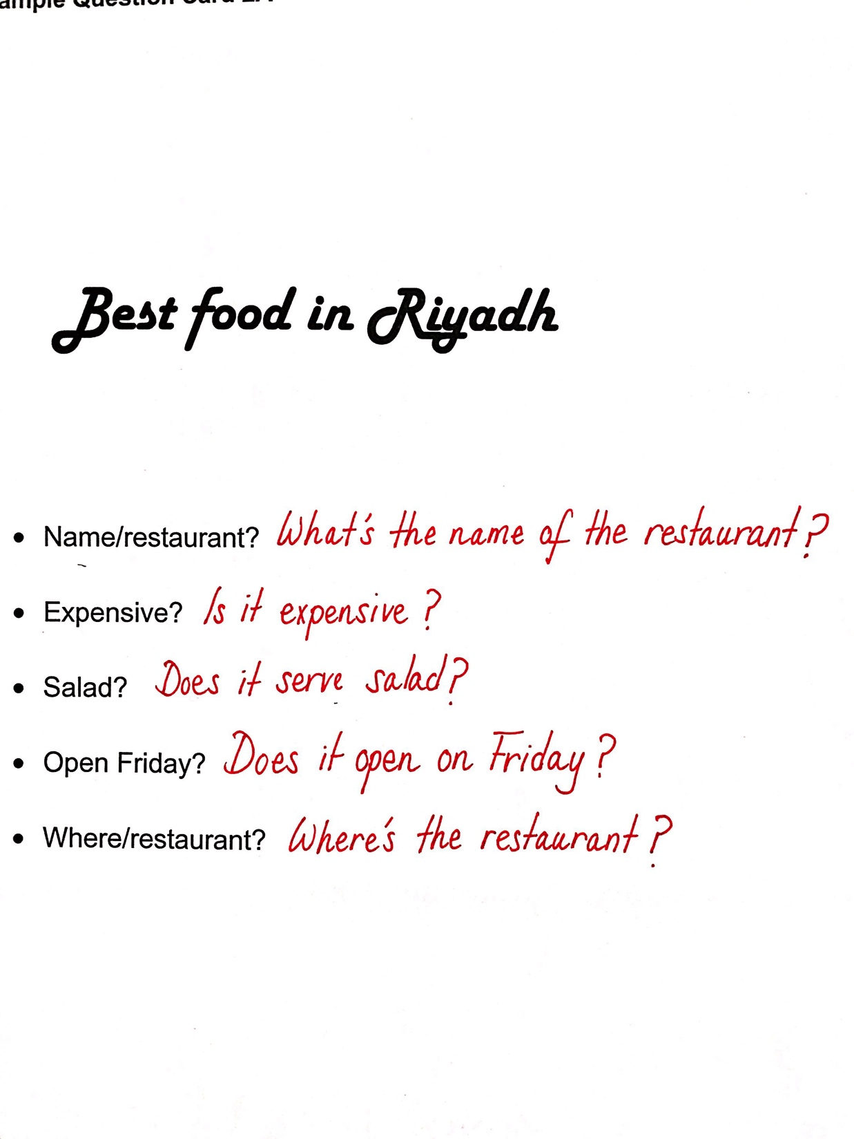

Slide 16
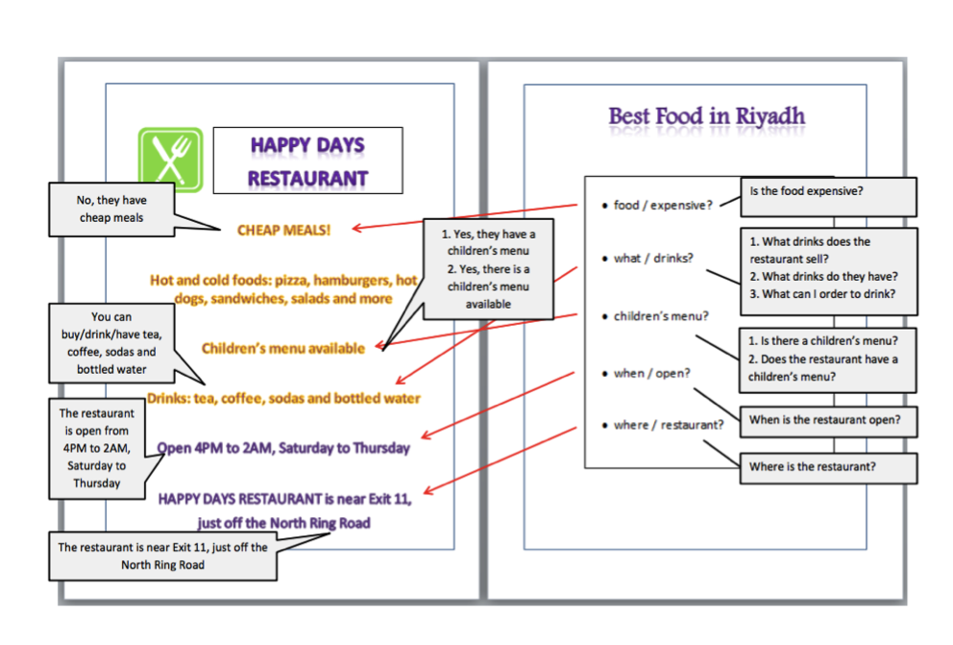

Slide 17
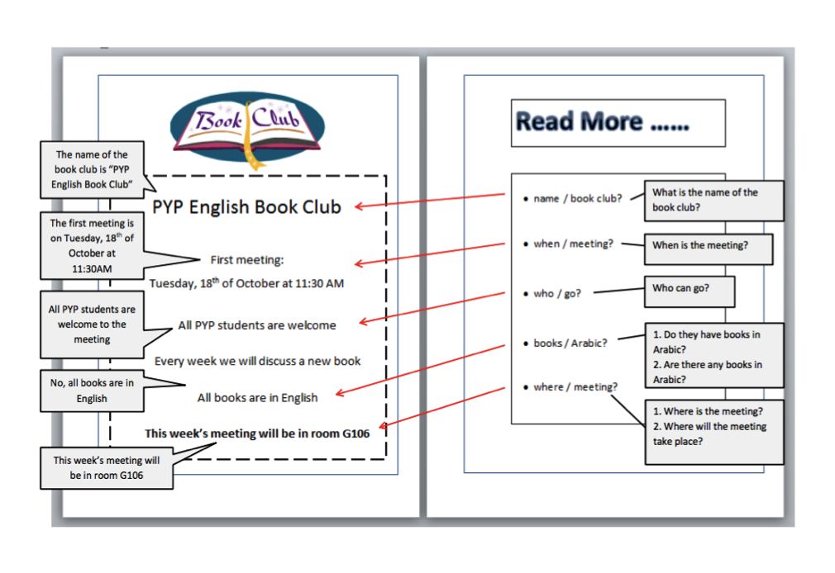

Slide 18
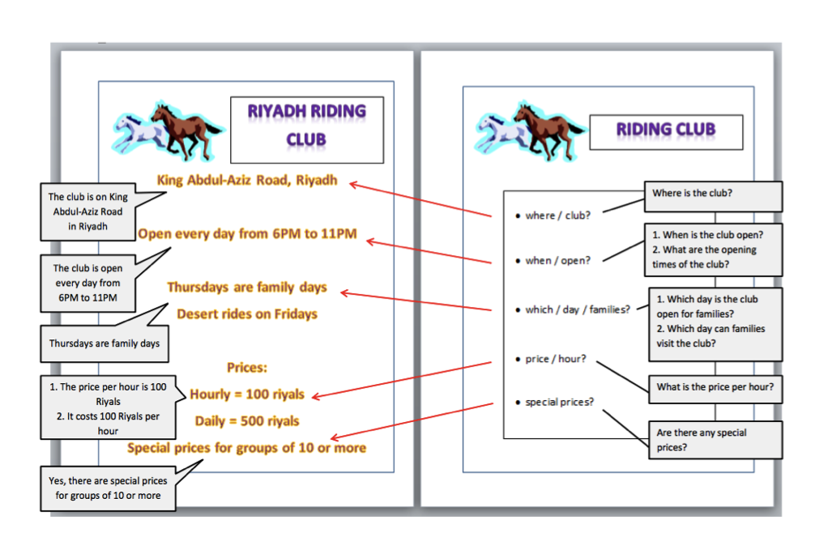

Slide 19
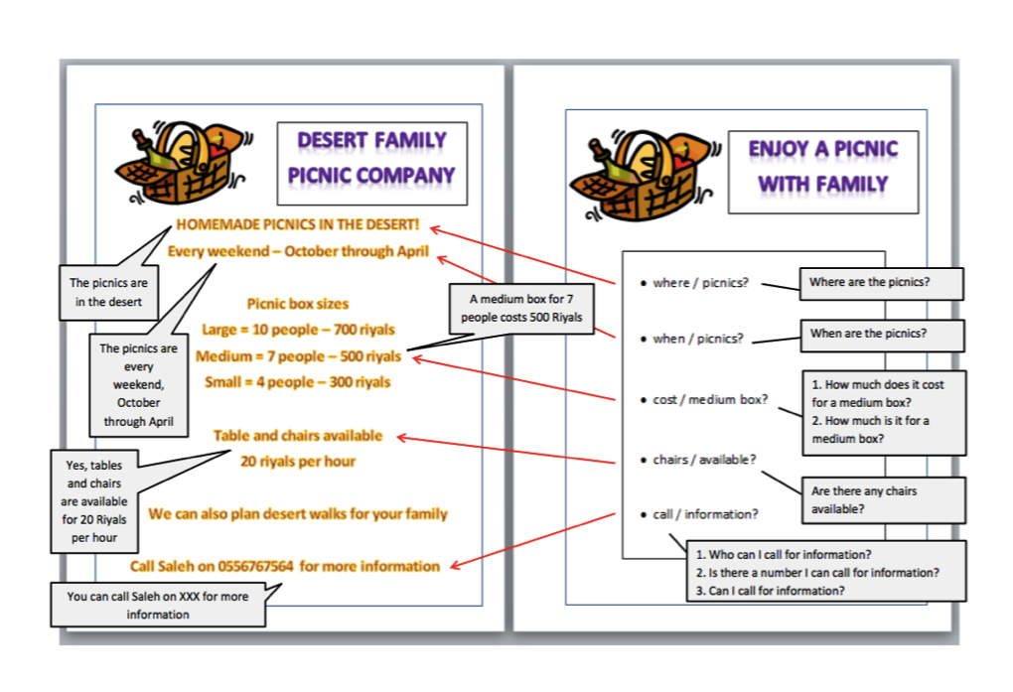

Slide 20
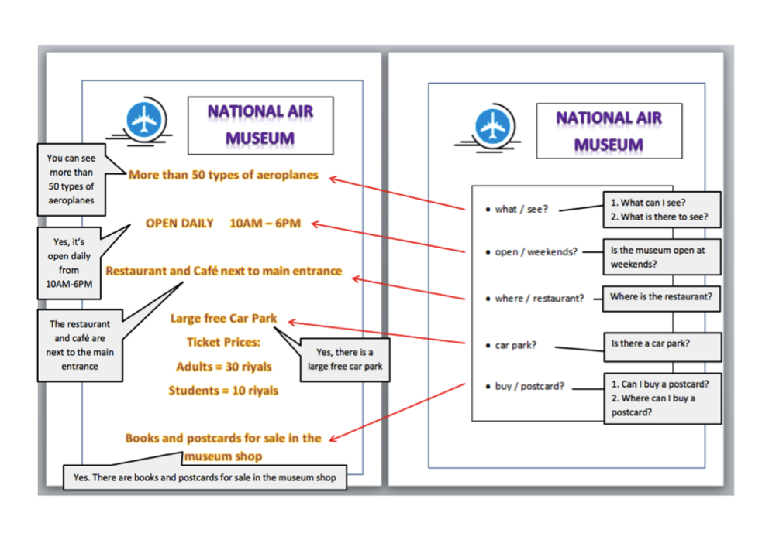

Slide 21
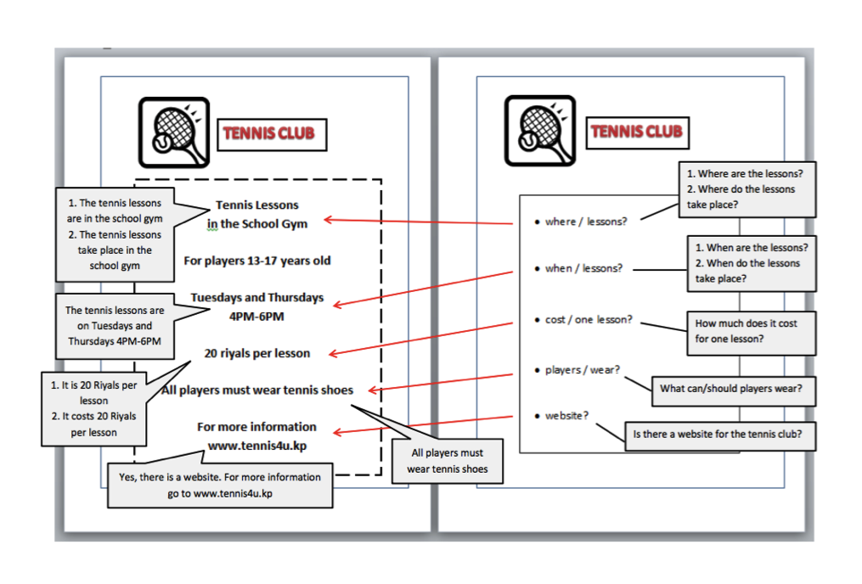

Slide 22
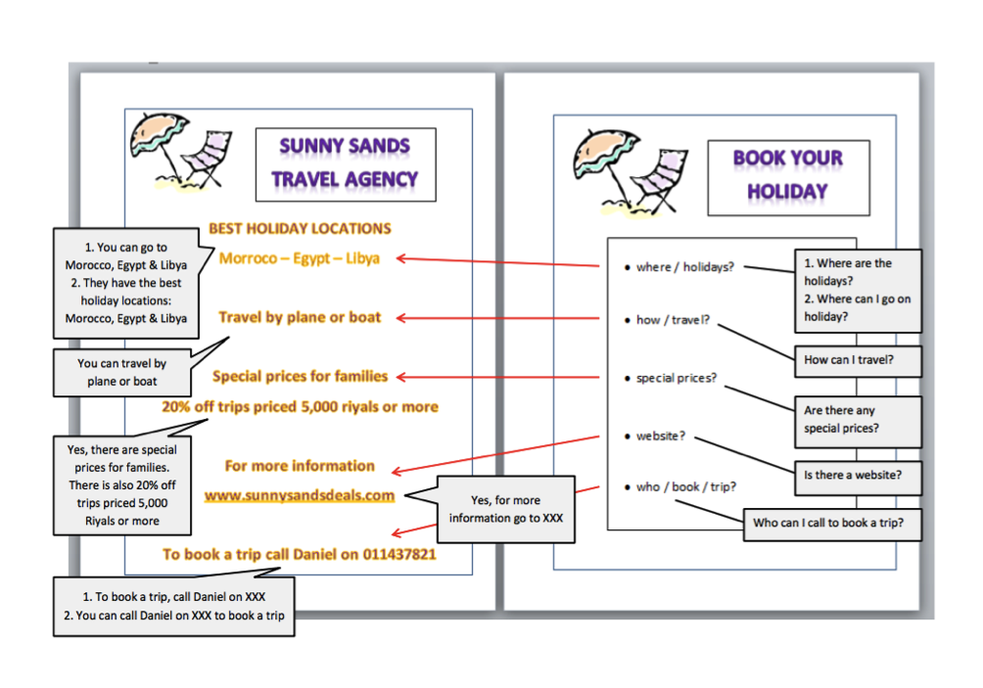

Slide 23
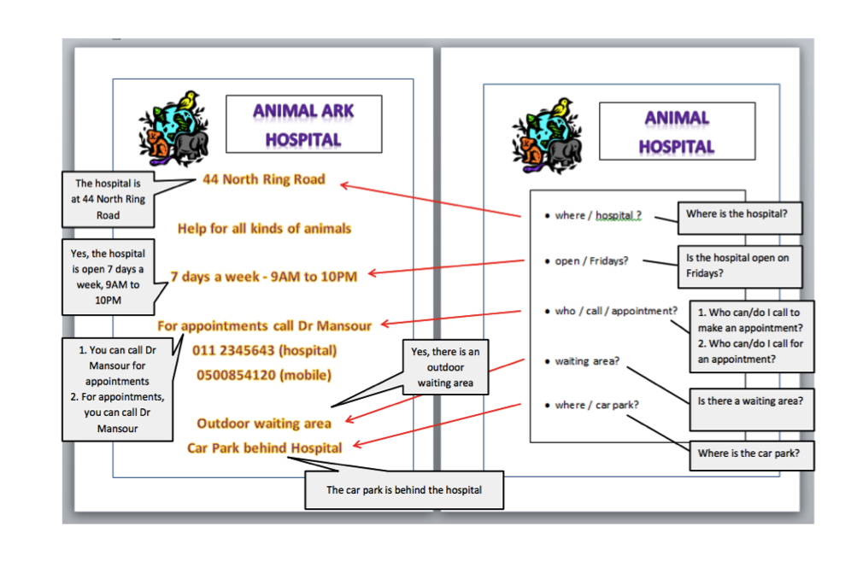

Slide 24
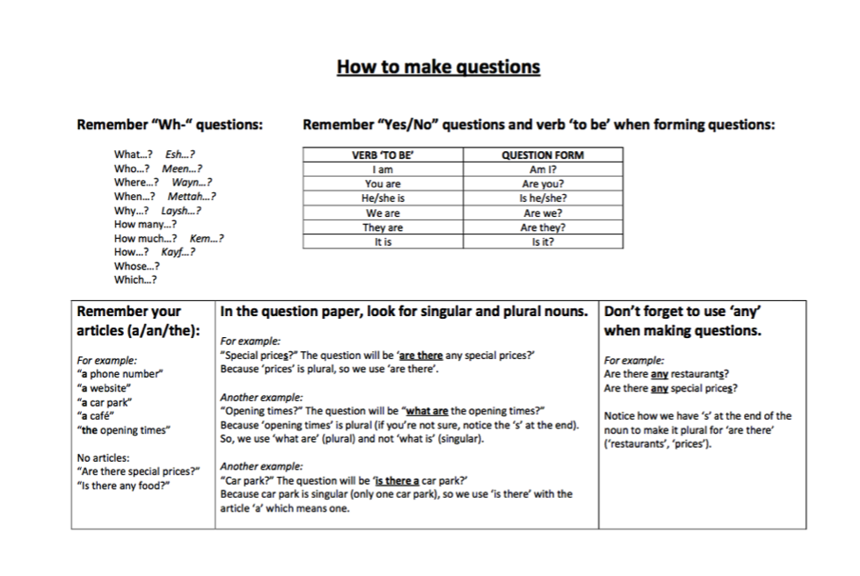

Slide 25
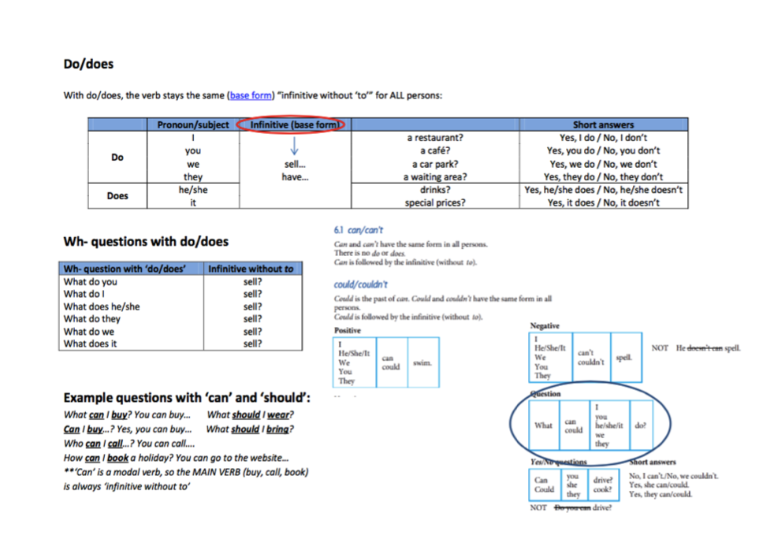

Slide 26
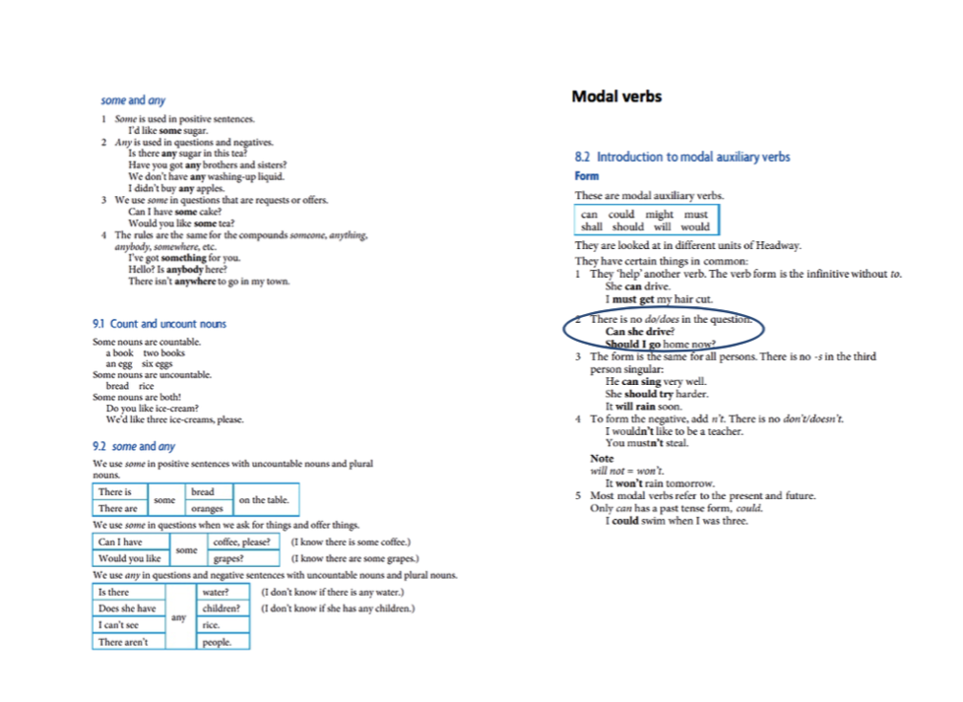

Slide 27
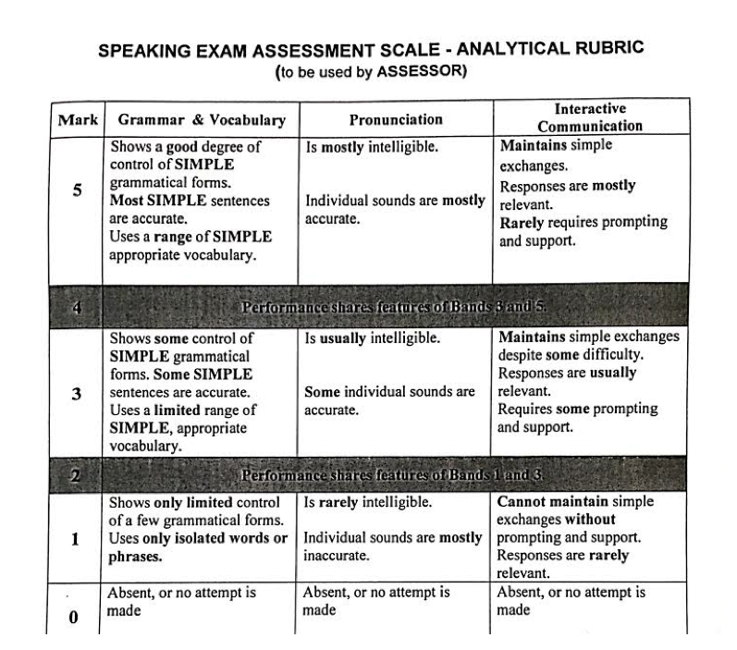

Slide 28


Tips
Don’t be nervous! Breathe and smile!
Speak clearly and with energy! Make sure the teacher can hear you!
If you don’t understand or you don’t hear the teacher, ask expressions like: Could you repeat that please?
Answer using full sentences!
Speak using short forms: Where’s the club? Not: Where is the club?
What’s the name of the club?.
My name is Rana Al Eyuni.

Slide 29

Hanaa Lanot Copyright © 2015

