Slide 1
ZOO 103 Lecture 9

Slide 2
Ascaris
External Features:
Kingdom: Animalia,
Phylum; Nematoda (Roundworms)
Class: Rhalditea
Order: Ascariida
Family: Ascariidae
Genus: Ascaris
Species: Ascaris lumbricoides
The body form, is cylindrical, long (length varies according to species).
Size in A. vitulorum (15-26 cm in the male and 22-30 cm in the female) and tapering at both ends.

Slide 3
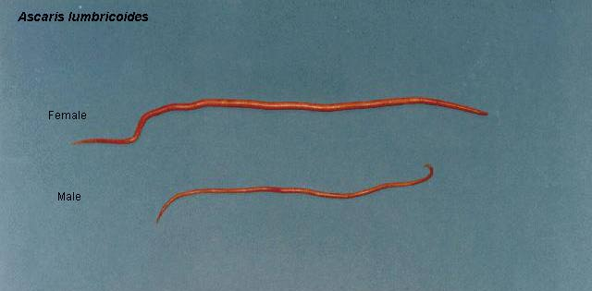
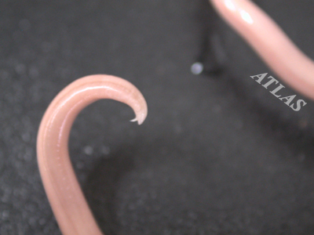
External Features:
The sexes are separate, the female is the larger and has a straight posterior end.
The male is more slender and has its posterior end sharply curled ventrally.

Slide 4
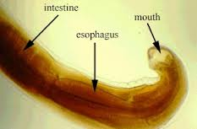
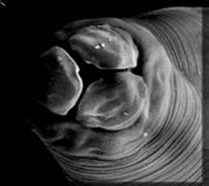
Four longitudinal streaks run the entire length of the body, 2 thin white dorsal and ventral lines, and 2 broader and darker lateral lines.
The mouth lies at the anterior end of the body and is guarded by three finely papillated lips, one dorsal and two ventro-lateral.

Slide 6
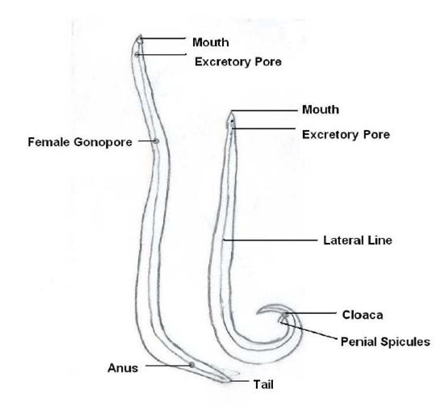
The minute excretory pore lies on the ventral side, 2 mm behind the mouth.
The genital aperture in the female is situated on the ventral side some distance from the anterior end (at about one third the length of the body in A. lumbricoides).

Slide 7
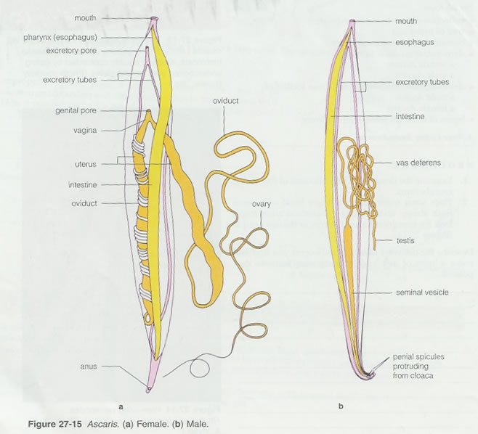
In the male, the genital duct joins the hind gut and both open by a common cloaca a short distance from the posterior end.
- A pair of minute copulatory spicules project from the latter aperture.
The female has a separate slit-like anus.

Slide 8
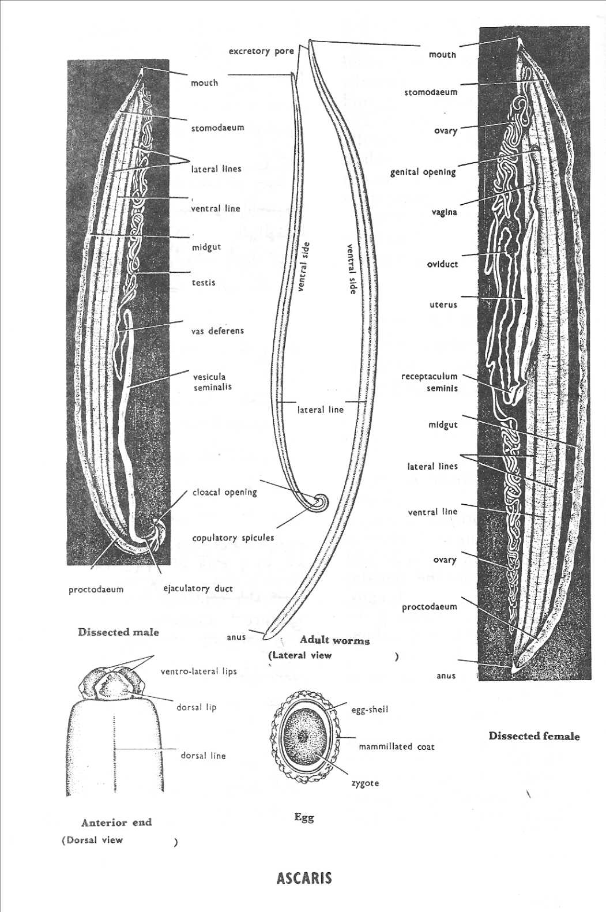

Slide 9
The Earthworm – Allolobophora:
External Features:
The body form is cylindrical pointed anteriorly and dorso-ventrally flattened posteriorly.
The dorsal surface is somewhat darker in colour.
The mouth and anus open terminally at the anterior and posterior ends respectively.
The body is divided into a great number of segments, separated by conspicuous intersegmental grooves.
The clitellum (secretes the cocoon) is the thickened skin of segments 26-34, and lies on the dorsal and lateral sides concealing the segments .
Kingdom: Animalia
Phylum: Annelida
Class: Oligochaeta
Genus: Allolobophora (Earthworm)
Species: caliginosa
Allolobophora caliginosa

Slide 10
The female openings are two small openings which lie ventrolaterally on segement 14.
The male openings are two slit-like apertures with thickened lips. They lie on the ventrolateral sides of segemnt 15.

Slide 11
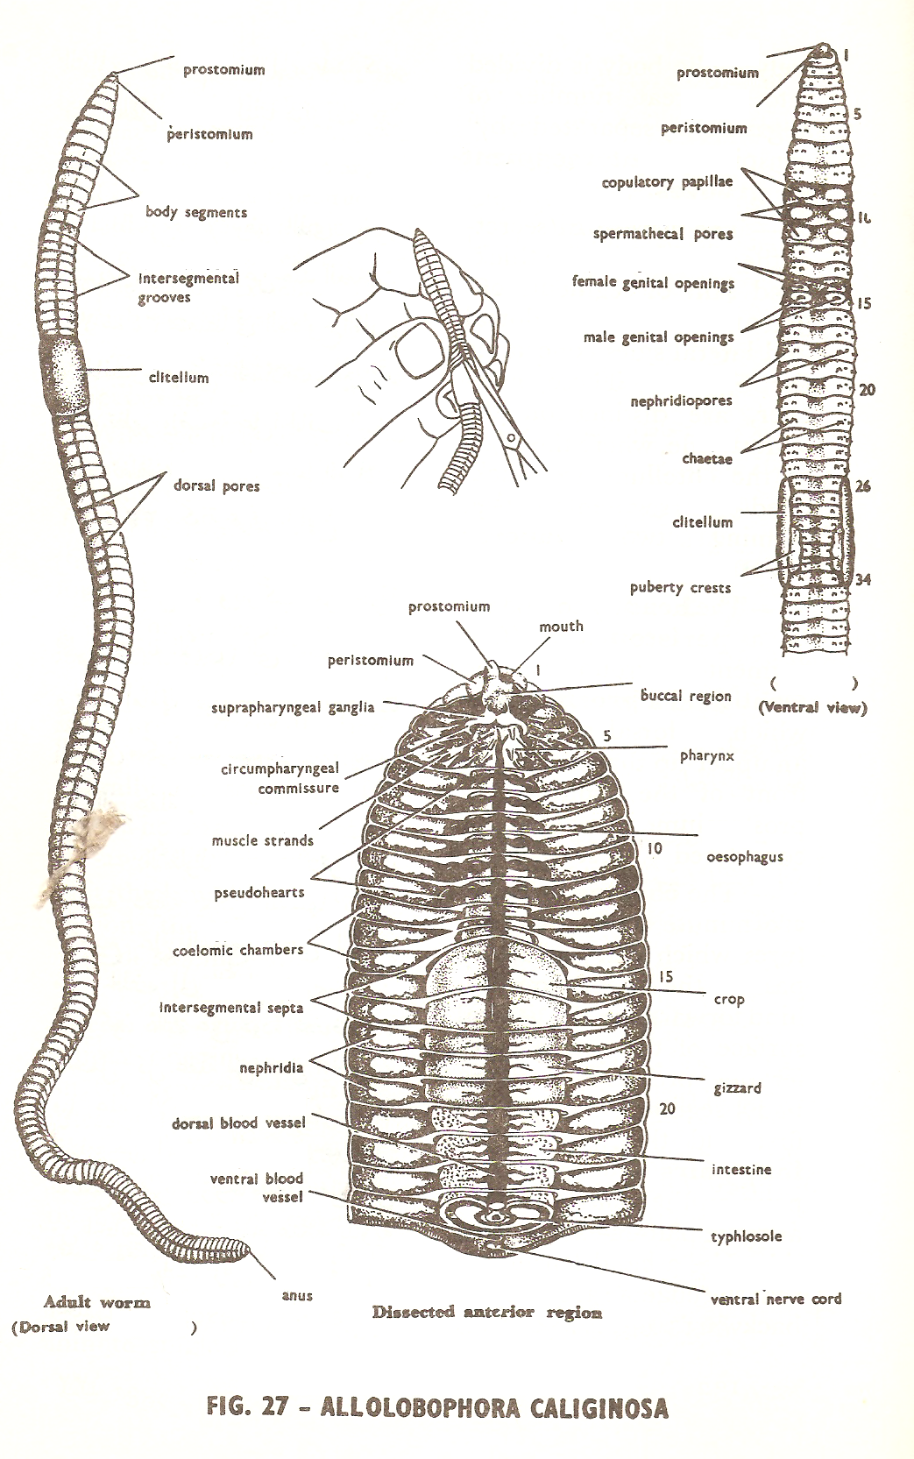

Slide 12
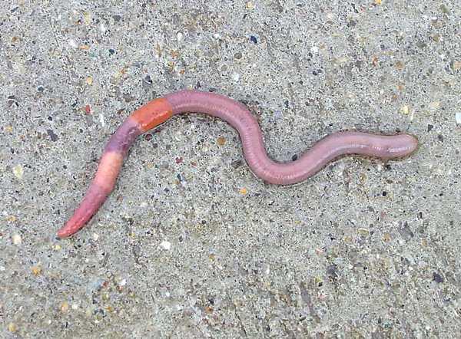

Slide 13
Hirudo
External Features:
Body form and colour, dorsoventrally flattened (not rounded) with a greenish-brown colour, paler below than above.
The dorsal surface is marked with yellowish longitudinal bands spotted with black pigment, while the ventral surface is irregularly mottled.
The suckers: a cup-shaped anterior sucker with the mouth opening in its middle, and a larger imperforated disc-like posterior sucker, both are ventrally directed.
The anus opens mid dorsally at the point of junction between segment 26 and the posterior sucker.
Kingdom: Animalia
Phylum: Annelida
Class: Hirudinea (leeches)
Genus: Hirudo
Species: medicinalis
Hirudo medicinalis.

Slide 14
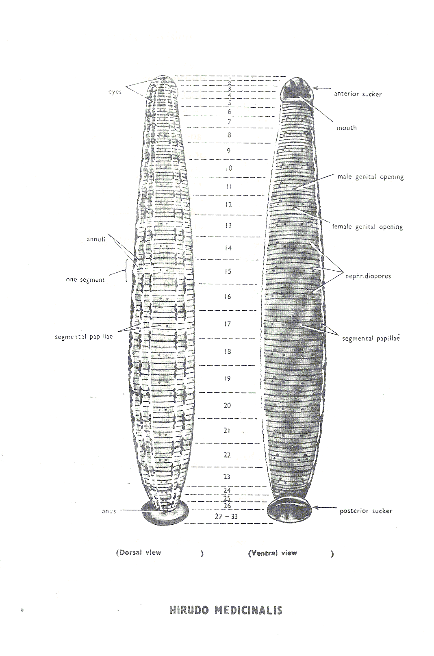

Slide 15
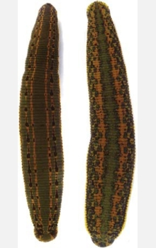

Slide 16
The cuttlefish – Sepia:
Kingdom: Animalia
Phylum: Mollusca
Class: Cephalopoda
Genus: Sepia
Species: savignyi
Sepia savignyi
External Features:
The body is mainly divided into a distinct head and a conical visceral humpحدبة حشوية , separated from one another by a short neck.
The head carries 2 large eyes, similar to those of vertebrates. It bears anteriorly the mouth opening surrounded by a prominent circular lip, and 2 large horny jaws project from it.

Slide 17
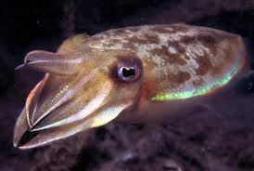
Eight pointed arms,each provided with 4 rows of suckers on its inner surface, and 2 much longer tentacles, carrying suckers only at their expanded tips, arise at the anterior end of the head, around the mouth opening (the tentacles are used in catching the prey and the arms for holding it while it is being devoured).
The arms and tentacles probably represent the highly modified anterior part of the foot, and hence the name Cephalopoda.

Slide 18
The posterior part of the foot is modified to form the large muscular funnel قمع which you see on the ventral side of the head (through which water is forced out of the mantle cavity, causing the animal to jerk quickly backwards

Slide 19
The Starfish
Kingdom: Animalia
Phylum: Echinodermata
Class: Asteroidea
Genus: Astropecten
Species: relitaris
Astropecten relitaris
(Sea star).
External Features:
The body is star-shaped consisting of a central disc prolonged radially into 5 felxible triangular arms with tapering tips.
The body is markedly flattened, with two distinct surfaces, a lower oral surface and an upper aboral surface.
On the oral surface, note the mouth opening in the centre, surrounded by-a soft membranous area, the peristome.
Five broadly open ambulacra grooves ميازيب حركية pass extend out from the mouth and each along the entire length of one of the arms.

Slide 20
Five broadly open ambulacra grooves ميازيب حركية pass extend out from the mouth and each along the entire length of one of the arms.
The terminal tube foot or tentacle, which stands at the tip of each arm, has a pigmented spot, the eye, at its base (light sensitive).

Slide 21
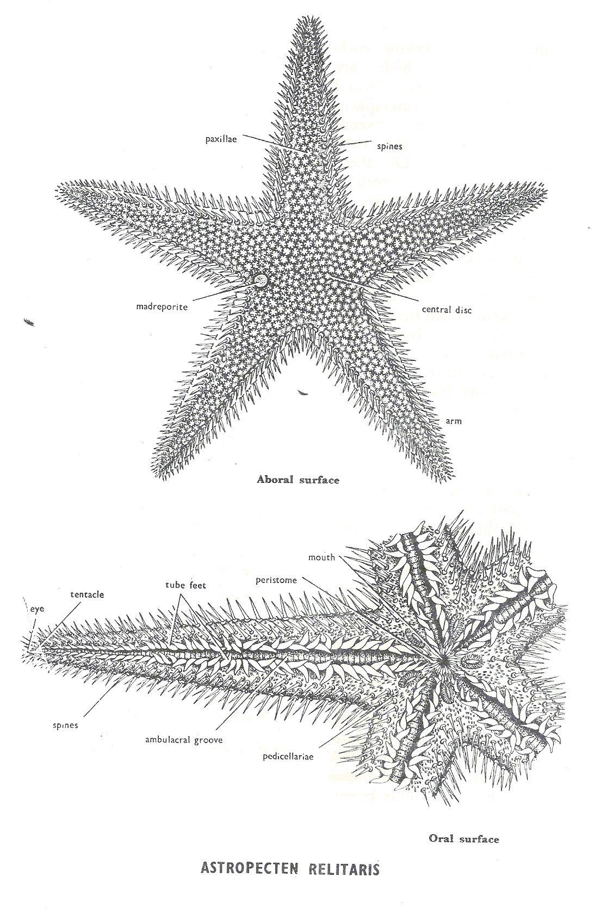
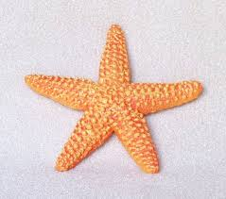

Slide 22
Thank you

