Slide 1
Lecture Slides
Elementary Statistics Eleventh Edition
and the Triola Statistics Series
by Mario F. Triola

Slide 2
Chapter 4 Probability
4-1 Review and Preview
4-2 Basic Concepts of Probability
4-3 Addition Rule
4-4 Multiplication Rule: Basics
4-5 Multiplication Rule: Complements and Conditional Probability
4-6 Probabilities Through Simulations
4-7 Counting

Slide 3
Section 4-1
Review and Preview

Slide 4
Review
Necessity of sound sampling methods.
Common measures of characteristics of data
Mean
Standard deviation

Slide 5
Preview
Rare Event Rule for Inferential Statistics:
If, under a given assumption, the probability of a particular observed event is extremely small, we conclude that the assumption is probably not correct.
Statisticians use the rare event rule for inferential statistics.

Slide 6
Section 4-2
Basic Concepts of Probability

Slide 7
Key Concept
This section presents three approaches to finding the probability of an event.
The most important objective of this section is to learn how to interpret probability values.

Slide 8
Part 1
Basics of Probability

Slide 9
Events and Sample Space
Event
any collection of results or outcomes of a procedure
Simple Event
an outcome or an event that cannot be further broken down into simpler components
Sample Space
for a procedure consists of all possible simple events; that is, the sample space consists of all outcomes that cannot be broken down any further

Slide 10
Notation for
Probabilities
P - denotes a probability.
A, B, and C - denote specific events.
P(A) - denotes the probability of event A occurring.

Slide 11
Basic Rules for
Computing Probability
Rule 1: Relative Frequency Approximation of Probability
Conduct (or observe) a procedure, and count the number of times event A actually occurs. Based on these actual results, P(A) is approximated as follows:
P(A) =
# of times A occurred
# of times procedure was repeated

Slide 12
Basic Rules for
Computing Probability - continued
Rule 2: Classical Approach to Probability (Requires Equally Likely Outcomes)
Assume that a given procedure has n different simple events and that each of those simple events has an equal chance of occurring. If event A can occur in s of these n ways, then
s
P(A) =
=
number of ways A can occur
n
number of different simple events

Slide 13
Basic Rules for
Computing Probability - continued
Rule 3: Subjective Probabilities
P(A), the probability of event A, is estimated by using knowledge of the relevant circumstances.

Slide 14
Law of
Large Numbers
As a procedure is repeated again and again, the relative frequency probability of an event tends to approach the actual probability.

Slide 15
Probability Limits
Always express a probability as a fraction or decimal number between 0 and 1.
The probability of an impossible event is 0.
The probability of an event that is certain to occur is 1.
For any event A, the probability of A is between 0 and 1 inclusive.
That is, 0 ≤ P(A) ≤ 1.

Slide 16
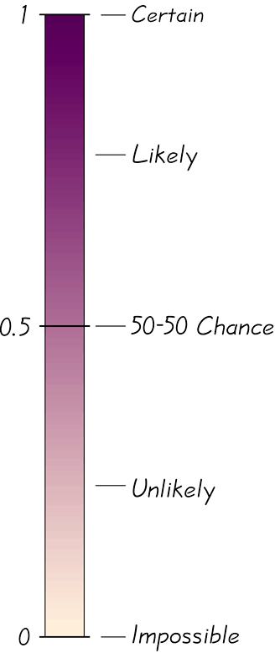
Possible Values for Probabilities

Slide 17
Complementary Events
The complement of event A, denoted by A, consists of all outcomes in which the event A does not occur.

Slide 18
Rounding Off Probabilities
When expressing the value of a probability, either give the exact fraction or decimal or round off final decimal results to three significant digits. (Suggestion: When a probability is not a simple fraction such as 2/3 or 5/9, express it as a decimal so that the number can be better understood.)

Slide 19
Part 2
Beyond the Basics of Probability: Odds

Slide 20
Odds
The actual odds against event A occurring are the ratio P(A)/P(A), usually expressed in the form of a:b (or “a to b”), where a and b are integers having no common factors.
The actual odds in favor of event A occurring are the ratio P(A)/P(A), which is the reciprocal of the actual odds against the event. If the odds against A are a:b, then the odds in favor of A are b:a.
The payoff odds against event A occurring are the ratio of the net profit (if you win) to the amount bet.
payoff odds against event A = (net profit) : (amount bet)

Slide 21
Recap
In this section we have discussed:
Rare event rule for inferential statistics.
Probability rules.
Law of large numbers.
Complementary events.
Rounding off probabilities.
Odds.

Slide 22
Section 4-3
Addition Rule

Slide 23
Key Concept
This section presents the addition rule as a device for finding probabilities that can be expressed as P(A or B), the probability that either event A occurs or event B occurs (or they both occur) as the single outcome of the procedure.
The key word in this section is “or.” It is the inclusive or, which means either one or the other or both.

Slide 24
Compound Event
Compound Event
any event combining 2 or more simple events
Notation
P(A or B) = P (in a single trial, event A occurs or event B occurs or they both occur)

Slide 25
General Rule for a
Compound Event
When finding the probability that event A occurs or event B occurs, find the total number of ways A can occur and the number of ways B can occur, but find that total in such a way that no outcome is counted more than once.

Slide 26
Compound Event
Formal Addition Rule
P(A or B) = P(A) + P(B) – P(A and B)
where P(A and B) denotes the probability that A and B both occur at the same time as an outcome in a trial of a procedure.

Slide 27
Compound Event
Intuitive Addition Rule
To find P(A or B), find the sum of the number of ways event A can occur and the number of ways event B can occur, adding in such a way that every outcome is counted only once. P(A or B) is equal to that sum, divided by the total number of outcomes in the sample space.

Slide 28
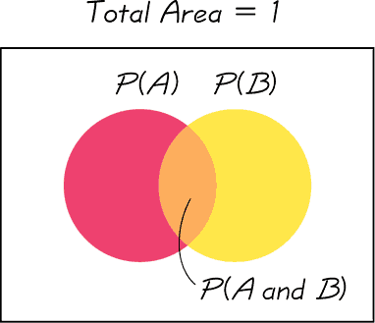
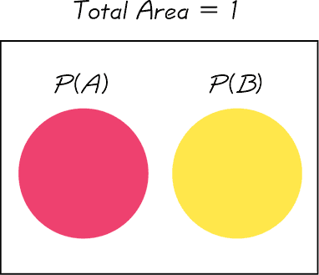
Disjoint or Mutually Exclusive
Events A and B are disjoint (or mutually exclusive) if they cannot occur at the same time. (That is, disjoint events do not overlap.)
Venn Diagram for Events That Are Not Disjoint
Venn Diagram for Disjoint Events

Slide 29
Complementary Events
P(A) and P(A)
are disjoint
It is impossible for an event and its complement to occur at the same time.

Slide 30
Rule of Complementary Events
P(A) + P(A) = 1
= 1 – P(A)
P(A) = 1 – P(A)
P(A)

Slide 31
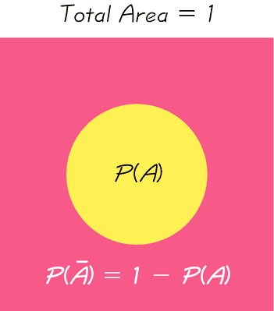
Venn Diagram for the Complement of Event A

Slide 32
Recap
In this section we have discussed:
Compound events.
Formal addition rule.
Intuitive addition rule.
Disjoint events.
Complementary events.

Slide 33
Section 4-4
Multiplication Rule: Basics

Slide 34
Key Concept
The basic multiplication rule is used for finding P(A and B), the probability that event A occurs in a first trial and event B occurs in a second trial.
If the outcome of the first event A somehow affects the probability of the second event B, it is important to adjust the probability of B to reflect the occurrence of event A.

Slide 35
Notation
P(A and B) =
P(event A occurs in a first trial and
event B occurs in a second trial)
Notes:
To differentiate between the addition rule and the multiplication rule, the addition rule will use the word ‘or’ - P(A or B) - , and the multiplication rule will use the word ‘and’ - P(A and B).
Page 159 of Elementary Statistics, 10th Edition

Slide 36
Tree Diagrams
A tree diagram is a picture of the possible outcomes of a procedure, shown as line segments emanating from one starting point. These diagrams are sometimes helpful in determining the number of possible outcomes in a sample space, if the number of possibilities is not too large.

Slide 37
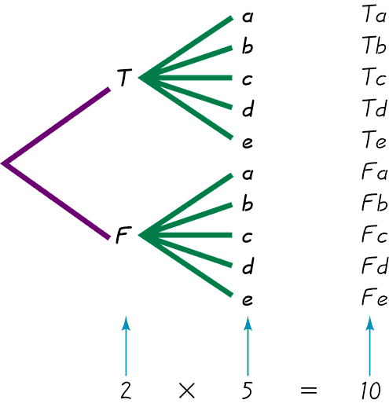
Tree Diagrams
This figure summarizes
the possible outcomes
for a true/false question followed
by a multiple choice question.
Note that there are 10 possible combinations.

Slide 38
Conditional Probability
Key Point
We must adjust the probability of the second event to reflect the outcome of the first event.

Slide 39
Conditional Probability
Important Principle
The probability for the second event B should take into account the fact that the first event A has already occurred.

Slide 40
Notation for Conditional Probability
P(B|A) represents the probability of event B occurring after it is assumed that event A has already occurred (read B|A as “B given A.”)

Slide 41
Dependent and Independent
Two events A and B are independent if the occurrence of one does not affect the probability of the occurrence of the other. (Several events are similarly independent if the occurrence of any does not affect the probabilities of the occurrence of the others.) If A and B are not independent, they are said to be dependent.
Notes:
Page 162 of Elementary Statistics, 10th Edition

Slide 42
Dependent Events
Two events are dependent if the occurrence of one of them affects the probability of the occurrence of the other, but this does not necessarily mean that one of the events is a cause of the other.
Notes:
Page 162 of Elementary Statistics, 10th Edition

Slide 43
Formal Multiplication Rule
P(A and B) = P(A) • P(B A)
Note that if A and B are independent events, P(B A) is really the same as P(B).

Slide 44
Intuitive Multiplication Rule
When finding the probability that event A occurs in one trial and event B occurs in the next trial, multiply the probability of event A by the probability of event B, but be sure that the probability of event B takes into account the previous occurrence of event A.
Notes:
Many students find that they understand the multiplication rule more intuitively than by using the formal rule and formula.
Example on page 162 of Elementary Statistics, 10th Edition

Slide 45
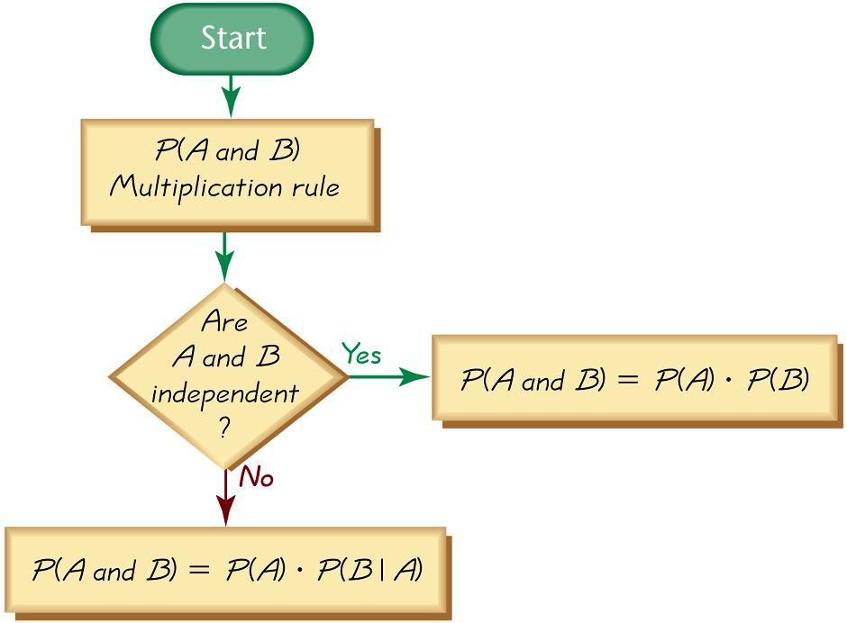
Applying the
Multiplication Rule

Slide 46
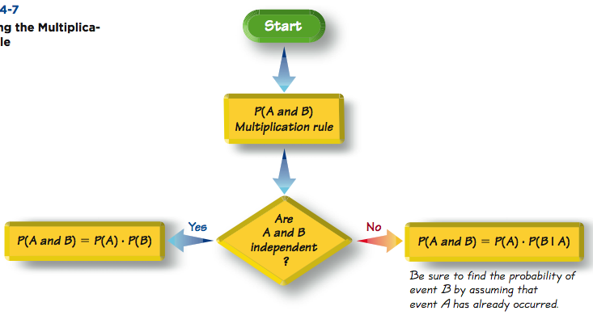
Applying the
Multiplication Rule

Slide 47
Caution
When applying the multiplication rule, always consider whether the events are independent or dependent, and adjust the calculations accordingly.

Slide 48
Multiplication Rule for Several Events
In general, the probability of any sequence of independent events is simply the product of their corresponding probabilities.

Slide 49
Treating Dependent Events as Independent
Some calculations are cumbersome, but they can be made manageable by using the common practice of treating events as independent when small samples are drawn from large populations. In such cases, it is rare to select the same item twice.
Notes:
Since independent events where the probability is the same for each event is much easier to compute (using exponential notation) than dependent events where each probability fraction will be different, the rule for small samples and large population is often used by pollsters.
Page 163 of Elementary Statistics, 10th Edition

Slide 50
The 5% Guideline for Cumbersome Calculations
If a sample size is no more than 5% of the size of the population, treat the selections as being independent (even if the selections are made without replacement, so they are technically dependent).
Notes:
Since independent events where the probability is the same for each event is much easier to compute (using exponential notation) than dependent events where each probability fraction will be different, the rule for small samples and large population is often used by pollsters.
Page 163 of Elementary Statistics, 10th Edition

Slide 51
Principle of Redundancy
One design feature contributing to reliability is the use of redundancy, whereby critical components are duplicated so that if one fails, the other will work. For example, single-engine aircraft now have two independent electrical systems so that if one electrical system fails, the other can continue to work so that the engine does not fail.
Notes:
Since independent events where the probability is the same for each event is much easier to compute (using exponential notation) than dependent events where each probability fraction will be different, the rule for small samples and large population is often used by pollsters.
Page 163 of Elementary Statistics, 10th Edition

Slide 52
Summary of Fundamentals
In the addition rule, the word “or” in P(A or B) suggests addition. Add P(A) and P(B), being careful to add in such a way that every outcome is counted only once.
In the multiplication rule, the word “and” in P(A and B) suggests multiplication. Multiply P(A) and P(B), but be sure that the probability of event B takes into account the previous occurrence of event A.

Slide 53
Recap
In this section we have discussed:
Notation for P(A and B).
Tree diagrams.
Notation for conditional probability.
Independent events.
Formal and intuitive multiplication rules.

Slide 54
Section 4-5
Multiplication Rule:
Complements and Conditional Probability

Slide 55
Key Concepts
Probability of “at least one”: Find the probability that among several trials, we get at least one of some specified event.
Conditional probability: Find the probability of an event when we have additional information that some other event has already occurred.

Slide 56
Complements: The Probability of “At Least One”
“At least one” is equivalent to “one or more.”
The complement of getting at least one item of a particular type is that you get no items of that type.

Slide 57
Finding the Probability of “At Least One”
To find the probability of at least one of something, calculate the probability of none, then subtract that result from 1. That is,
P(at least one) = 1 – P(none).

Slide 58
Conditional Probability
A conditional probability of an event is a probability obtained with the additional information that some other event has already occurred. P(B|A) denotes the conditional probability of event B occurring, given that event A has already occurred, and it can be found by dividing the probability of events A and B both occurring by the probability of event A:
P(A and B)
P(B A) =
P(A)

Slide 59
Intuitive Approach to Conditional Probability
The conditional probability of B given A can be found by assuming that event A has occurred, and then calculating the probability that event B will occur.

Slide 60
Confusion of the Inverse
To incorrectly believe that P(A|B) and P(B|A) are the same, or to incorrectly use one value for the other, is often called confusion of the inverse.

Slide 61
Recap
In this section we have discussed:
Concept of “at least one.”
Conditional probability.
Intuitive approach to conditional probability.

Slide 62
Section 4-6
Probabilities Through Simulations

Slide 63
Key Concept
In this section we use simulations as an alternative approach to finding probabilities. The advantage to using simulations is that we can overcome much of the difficulty encountered when using the formal rules discussed in the preceding sections.

Slide 64
Simulation
A simulation of a procedure is a process that behaves the same way as the procedure, so that similar results are produced.
Notes:
For students in a classroom with limited time, a simulation procedure is a convenient way to determine probabilities.
Page 174 of Elementary Statistics, 10th Edition

Slide 65
Simulation Example
Gender Selection In a test of the MicroSort method of gender selection developed by the Genetics & IVF Institute, 127 boys were born among 152 babies born to parents who used the YSORT method for trying to have a baby boy. In order to properly evaluate these results, we need to know the probability of getting at least 127 boys among 152 births, assuming that boys and girls are equally likely. Assuming that male and female births are equally likely, describe a simulation that results in the genders of 152 newborn babies.

Slide 66
Solution
One approach is simply to flip a fair coin 152 times, with heads representing females and tails representing males. Another approach is to use a calculator or computer to randomly generate 152 numbers that are 0s and 1s, with 0 representing a male and 1 representing a female. The numbers must be generated in such a way that they are equally likely. Here are typical results:

Slide 67
Simulation Examples
Solution 1:
Flipping a fair coin 100 times where heads = female and tails = male
H H T H T T H H H H
Generating 0’s and 1’s with a computer or calculator where 0 = male
1 = female
0 0 1 0 1 1 1 0 0 0
female female male female male male male female female female
Solution 2:
male male female male female female female male male male
Notes:
Page 174 of Elementary Statistics, 10th Edition

Slide 68
Random Numbers
In many experiments, random numbers are used in the simulation of naturally occurring events. Below are some ways to generate random numbers.
A table of random of digits
STATDISK
Minitab
Excel
TI-83/84 Plus calculator

Slide 69
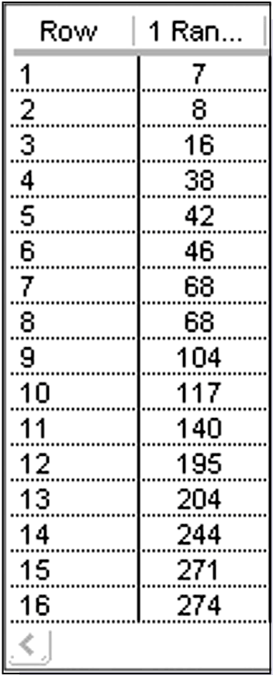
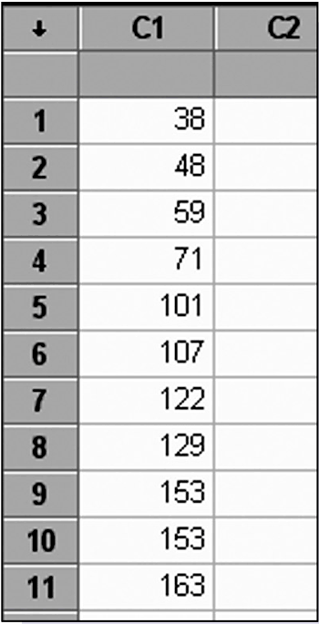
Random Numbers
STATDISK
Minitab

Slide 70
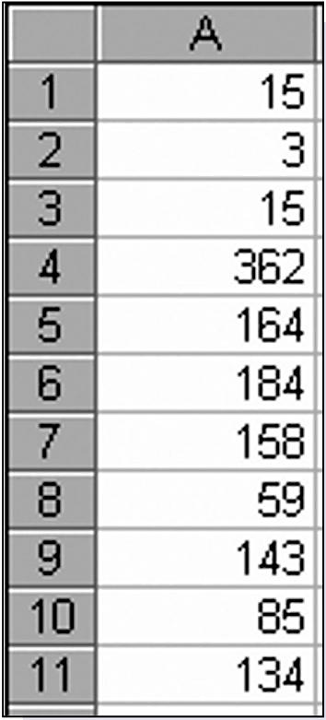
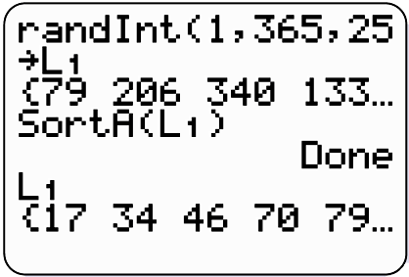
Random Numbers
Excel
TI-83/84 Plus calculator

Slide 71
Recap
In this section we have discussed:
The definition of a simulation.
How to create a simulation.
Ways to generate random numbers.

Slide 72
Section 4-7
Counting

Slide 73
Key Concept
In many probability problems, the big obstacle is finding the total number of outcomes, and this section presents several methods for finding such numbers without directly listing and counting the possibilities.

Slide 74
Fundamental Counting Rule
For a sequence of two events in which the first event can occur m ways and the second event can occur n ways, the events together can occur a total of m n ways.

Slide 75
Notation
The factorial symbol ! denotes the product of decreasing positive whole numbers.
For example,
By special definition, 0! = 1.

Slide 76
Factorial Rule
A collection of n different items can be arranged in order n! different ways. (This factorial rule reflects the fact that the first item may be selected in n different ways, the second item may be selected in n – 1 ways, and so on.)

Slide 77
Permutations Rule
(when items are all different)
Requirements:
There are n different items available. (This rule does not apply if some of the items are identical to others.)
We select r of the n items (without replacement).
We consider rearrangements of the same items to be different sequences. (The permutation of ABC is different from CBA and is counted separately.)
If the preceding requirements are satisfied, the number of permutations (or sequences) of r items selected from n available items (without replacement) is
P
n!
n r
=
(n - r)!

Slide 78
Permutations Rule
(when some items are identical to others)
Requirements:
There are n items available, and some items are identical to others.
We select all of the n items (without replacement).
We consider rearrangements of distinct items to be different sequences.
If the preceding requirements are satisfied, and if there are n₁ alike, n₂ alike, . . . n_{k} alike, the number of permutations (or sequences) of all items selected without replacement is
n!
n₁! . n₂! .. . . . . . . n_{k}!

Slide 79
Combinations Rule
Requirements:
There are n different items available.
We select r of the n items (without replacement).
We consider rearrangements of the same items to be the same. (The combination of ABC is the same as CBA.)
If the preceding requirements are satisfied, the number of combinations of r items selected from n different items is
n!
_{n}C_{r} =
(n - r )! r!

Slide 80
Permutations versus Combinations
When different orderings of the same items are to be counted separately, we have a permutation problem, but when different orderings are not to be counted separately, we have a combination problem.

Slide 81
Recap
In this section we have discussed:
The fundamental counting rule.
The factorial rule.
The permutations rule (when items are all different).
The permutations rule (when some items are identical to others).
The combinations rule.

