Slide 1
Chapter 8
0
Nutrition and Digestion
التغذية و الهضم

Slide 2
We need to eat
We need to eat healthy

Slide 4
Some 805 million people in the world do not have enough food to lead a healthy active life. That's about one in nine people on earth.
The vast majority of the world's hungry people live in developing countries, where 13.5 percent of the population is undernourished.
Asia is the continent with the most hungry people - two thirds of the total. The percentage in southern Asia has fallen in recent years but in western Asia it has increased slightly.
Poor nutrition causes nearly half (45%) of deaths in children under five - 3.1 million children each year.
66 million primary school-age children attend classes hungry across the developing world, with 23 million in Africa alone.

Slide 5
Objectives
By the end of this chapter students must be able to understand:
The different dietary categories in animals
The different feeding mechanisms used by animals
What are the essential nutrients for human and their deficiency
The role of vitamins and minerals in healthy diet
Food processing in animals – main stages
The complexity levels of digestion specialized compartment in different animals
The structure of the human digestive system

Slide 6
0
NUTRITION
التغذية
Copyright © 2009 Pearson Education, Inc.

Slide 7
Overview: A healthy diet satisfies three needs نظرة شاملة: التغذية الصحية تستوفي ثلاث احتياجات
0
Fuel to power the body
الوقود لمد الجسم بالقوة (الطاقة) اللازمة
Organic molecules to build molecules
الجزيئات العضوية لبناء الجزيئات
Essential nutrients—raw materials that animals cannot make for themselves
المواد الغذائية الاساسية – المواد الاولية التي لا تستطيع الحيوانات صنعها بنفسها
Copyright © 2009 Pearson Education, Inc.
Notes:
Student Misconceptions and Concerns
1. College students, given new choices and greater freedom than ever before in determining what they eat frequently experiment with their diets. The chapter details on nutritional requirements are worth additional emphasis in lecture.
2. Advertising frequently creates false expectations about simple shortcuts to dieting. Consider emphasizing the importance of a well-balanced diet and exercise.
3. Students may struggle with the concept that a pound of fat contains more than twice the calories of a pound of sugar. It might seem that a pound of food would simply add a pound of weight. (You might wish to remind them that fiber and water have no caloric value, but still add to the weight of food.) They may also have never understood the concept of dietary calories, but just tried to avoid fatty foods. Consider encouraging class discussions that explore student misconceptions about calories, body weight, and healthy diets.
Teaching Tips
1. Before discussing nutrition, challenge your students to explain why we need to eat. Module 21.14 identifies three resources obtained from diet.

Slide 8
Chemical energy powers the body تمد الطاقة الكيمائية الجسم بالقوة (الطاقة) اللازمة
0
Nutrients are oxidized inside cells to make ATP
تتأكسد المواد الغذائية داخل الخلايا لإنتاج ثلاثي فوسفات الادينوسين
Proteins, carbohydrates, and fats are the main sources of calories
تعتبر البروتينات , الكربوهيدرات و الدهون المصادر الاساسية للسعرات الحرارية
Basal metabolic rate (BMR): energy a resting animal requires each day
معدل الايض الاساسي هو نسبة ما يحتاجه الحيوان الساكن من الطاقة في اليوم
Metabolic rate: BMR + the energy needed for physical activity
معدل الايض هو معدل الايض الاساسي مضاف اليه الطاقة اللازمة للقيام بالأنشطة الحيوية
Excess energy is stored as glycogen or fat
تخزن الطاقة الفائضة على هيئة نشا حيواني او دهني
Copyright © 2009 Pearson Education, Inc.
Notes:
Student Misconceptions and Concerns
1. College students, given new choices and greater freedom than ever before in determining what they eat frequently experiment with their diets. The chapter details on nutritional requirements are worth additional emphasis in lecture.
2. Advertising frequently creates false expectations about simple shortcuts to dieting. Consider emphasizing the importance of a well-balanced diet and exercise.
3. Students may struggle with the concept that a pound of fat contains more than twice the calories of a pound of sugar. It might seem that a pound of food would simply add a pound of weight. (You might wish to remind them that fiber and water have no caloric value, but still add to the weight of food.) They may also have never understood the concept of dietary calories, but just tried to avoid fatty foods. Consider encouraging class discussions that explore student misconceptions about calories, body weight, and healthy diets.
Teaching Tips
1. Basal metabolic rates change throughout a lifetime. The high caloric needs of a growing child decrease in adulthood. College students might already be experiencing increased weight gain due in part to the reduced caloric needs of adulthood. Few students appreciate these fundamental changes in caloric demands.
2. Physical activity, which often remains high in active college students, also tends to decline throughout life. Few students appreciate the need to maintain physical activity throughout adulthood and/or reduce caloric intake.

Slide 9
An animal’s diet must supply essential nutrients ينبغي للنظام الغذائي في الحيوان ان يحتوي على المواد الغذائية الضرورية
0
Essential nutrients cannot be made from any raw material
المواد الغذائية الضرورية لا يمكن صنعها من أي مواد اولية (في الحيوان)
Undernourishment—not enough calories
قلة التغذية - سعرات حرارية غير كافية
Malnourishment—missing essential nutrients
سوء التغذية - فقدان المواد الغذائية الضرورية
Animals cannot produce eight of the 20 amino acids named essential amino acids.
لا يمكن للحيوانات انتاج ثمانية من الـ 20 حامض اميني تسمى احماض امينينة ضرورية
These eight amino acids must come from the diet.
ينبغي ان يحتوي النظام الغذائي على هذه الثمانية الاحماض الامينية
Copyright © 2009 Pearson Education, Inc.
Notes:
Student Misconceptions and Concerns
1. College students, given new choices and greater freedom than ever before in determining what they eat frequently experiment with their diets. The chapter details on nutritional requirements are worth additional emphasis in lecture.
2. Advertising frequently creates false expectations about simple shortcuts to dieting. Consider emphasizing the importance of a well-balanced diet and exercise.
3. Students may struggle with the concept that a pound of fat contains more than twice the calories of a pound of sugar. It might seem that a pound of food would simply add a pound of weight. (You might wish to remind them that fiber and water have no caloric value, but still add to the weight of food.) They may also have never understood the concept of dietary calories, but just tried to avoid fatty foods. Consider encouraging class discussions that explore student misconceptions about calories, body weight, and healthy diets.
Teaching Tips
1. A gram of fat stores more than twice the energy of a gram of polysaccharide such as starch. You might elaborate with a simple calculation to demonstrate how a person’s body weight would vary if the energy stored in body fat were stored instead in carbohydrates. If a 100-kg man carried 25% body fat, he would have 25 kg of fat in his body. Fat stores about 2.25 times more energy per gram than carbohydrate. What would be the man’s weight if he stored the energy in the fat in the form of carbohydrate? (2.25 × 25 = 56.25 kg of carbohydrate + 75 kg = 131.25 kg, an increase of 31.25%)
2. One of the challenges zookeepers face is to determine the essential nutrients required in the diets of exotic animals. Without an appreciation of the natural diet of a rare animal, certain dietary requirements may remain undetected, resulting in malnourishment.

Slide 10
A healthy diet includes 13 vitamins and many essential minerals يحتوي نظام الغذاء الصحي على 13 فيتامين و العديد من المعادن الضرورية
0
Essential vitamins and minerals الفيتامينات و المعادن الضرورية
Required in minute amounts الحاجة اليها بكميات ضئيلة -
Extreme excesses can be dangerous الزيادة المفرطة فيها قد تكون خطيرة -
Excess water-soluble vitamins can be eliminated in urine
الفائض من الفيتامينات التي تذوب في الماء يمكن التخلص منها عن طريق البول
Excess fat-soluble vitamins accumulate to dangerous levels in body fat
الفائض من الفيتامينات التي تذوب في الدهون تتراكم بمستويات خطيرة في الانسجة الدهنية للجسم
Minerals are simple inorganic nutrients usually required in small amounts
المعادن هي مواد غذائية غير عضوية بسيطة يحتاج الجسم اليها بكميات قليلة
Calcium and phosphorus are required in larger amounts
إلا ان الجسم يحتاج الى الكالسيوم والفسفور بكميات كبيرة
Copyright © 2009 Pearson Education, Inc.
Notes:
Student Misconceptions and Concerns
1. College students, given new choices and greater freedom than ever before in determining what they eat frequently experiment with their diets. The chapter details on nutritional requirements are worth additional emphasis in lecture.
2. Advertising frequently creates false expectations about simple shortcuts to dieting. Consider emphasizing the importance of a well-balanced diet and exercise.
3. Students may struggle with the concept that a pound of fat contains more than twice the calories of a pound of sugar. It might seem that a pound of food would simply add a pound of weight. (You might wish to remind them that fiber and water have no caloric value, but still add to the weight of food.) They may also have never understood the concept of dietary calories, but just tried to avoid fatty foods. Consider encouraging class discussions that explore student misconceptions about calories, body weight, and healthy diets.
Teaching Tips
1. The U.S. Department of Health and Human Services provides their Dietary Guidelines for All Americans at www.health.gov/dietaryguidelines.
2. Table 21.18A illustrates the details of vitamin requirements for humans. Students might benefit from a comparison of this table and the label from a bottle of daily vitamins.
3. Students are often surprised to learn that the mineral iron in our diets is the same iron we use as a building material. You might wish to point out that like the rust formed by the reaction of oxygen and iron, blood is also red, due to the bonding of oxygen to iron in our red blood cells. Furthermore, the familiar “metal” taste we experience when we have a cut in our mouth is due to the presence of iron in our blood.

Slide 11
CONNECTION: Diet can influence cardiovascular disease and cancer رابطة تطبيقية: يمكن لنظام الغذائي ان يؤثر في امراض الاوعية القلبية والسرطان
0
A healthy diet may reduce the risk of cardiovascular disease and cancer
ان النظام الغذائي الصحي قد يقلل من مخاطر الاصابة بامراض الاوعية القلبية والسرطان
Two main types of cholesterol يوجد نوعان من الكلسترول
LDL : contributes to blocked blood vessels and higher blood pressure
كلسترول منخفض الكثافة – يساهم في انسداد الاوعية الدموية وارتفاع الضغط
HDL : tends to reduce blocked blood vessels
الكلسترول عالي الكثافة – يؤدي الى خفض نسبة انسداد الاوعية الدموي
Exercise increases HDL levels
التمارين الرياضية تزيد من مستويات الكلسترول عالي الكثافة
Smoking decreases HDL levels
يخفض التدخين من مستويات الكلسترول عالي لكثافة
Copyright © 2009 Pearson Education, Inc.
Notes:
Student Misconceptions and Concerns
1. College students, given new choices and greater freedom than ever before in determining what they eat frequently experiment with their diets. The chapter details on nutritional requirements are worth additional emphasis in lecture.
2. Advertising frequently creates false expectations about simple shortcuts to dieting. Consider emphasizing the importance of a well-balanced diet and exercise.
3. Students may struggle with the concept that a pound of fat contains more than twice the calories of a pound of sugar. It might seem that a pound of food would simply add a pound of weight. (You might wish to remind them that fiber and water have no caloric value, but still add to the weight of food.) They may also have never understood the concept of dietary calories, but just tried to avoid fatty foods. Consider encouraging class discussions that explore student misconceptions about calories, body weight, and healthy diets.
Teaching Tips
1. Some research suggests that physical activity remains an important aspect of health, independent of body weight. Certain studies have concluded that sedentary people of normal body weight might be less healthy than very physically active people who are overweight.
2. Margarine commonly comes in liquid squeeze containers, in tubs, and in sticks. These forms reflect increasing amounts of hydrogenation, gradually increasing in firmness from a liquid, to a firmer spread, to a solid stick of margarine. As noted in the text, recent studies have suggested that unsaturated oils become increasingly unhealthy as they are hydrogenated. Public attention to hydrogenation and the health risks of the trans fats that result are causing many people to cut their consumption of trans fats.
3. The American Cancer Society’s website, www.cancer.org, has extensive information on the relationship between diet and cancer. Search within their website for “Common Questions About Diet and Cancer.”

Slide 12
0
OBTAINING AND PROCESSING FOOD
الحصول على الطعام وكيفية التعامل معه
Copyright © 2009 Pearson Education, Inc.

Slide 13
Animals ingest their food in a variety of ways تتناول الحيوانات طعامها بعدة طرق
0
Most animals have one of three kinds of diets
تتبع معظم الحيوانات احدى طرق الطعام الثلاث
Herbivores, plant-eaters—cattle, snails, sea urchins
اكلات الاعشاب , اكلات النباتات – مثل الابقار , الحلزونات , قنافذ البحر
Carnivores, meat-eaters—lions, hawks, spiders
اكلات اللحوم – الاسود , الصقور , العناكب
Omnivores, eating both plants and other animals—humans, roaches, raccoons, crows
مزدوجة التغذية , تأكل كلا من النبات و الحيوان – الانسان , الصراصير , الراكونات , الغربان
Copyright © 2009 Pearson Education, Inc.
Notes:
Student Misconceptions and Concerns
1. Students are likely familiar with the basics of the digestive system and the different types of animal diets. However, they are less likely to understand the distinctions between chemical and mechanical digestion and the specific roles of enzymes. It is worthwhile for an instructor to make an extra effort to differentiate between these important components of the digestive process.
Teaching Tips
1. If you have just completed Chapter 20, you may wish to point out the similarities between the ciliary mucus mechanism used to trap debris inhaled into our respiratory tract (Module 20.4) and the suspension feeding systems of clams.
2. Humans (as discussed in Module 19.10) are omnivores. Consider contrasting the teeth of a carnivore (perhaps a cat), an herbivore (perhaps a rodent or bovine), and a human to reveal the intermediate pattern of omnivore teeth. If appropriate skeletal materials are unavailable, good images can suffice.

Slide 14
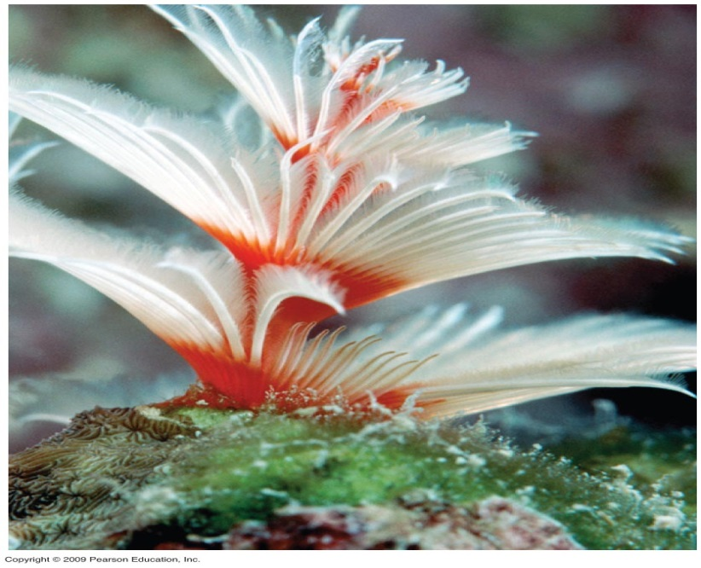
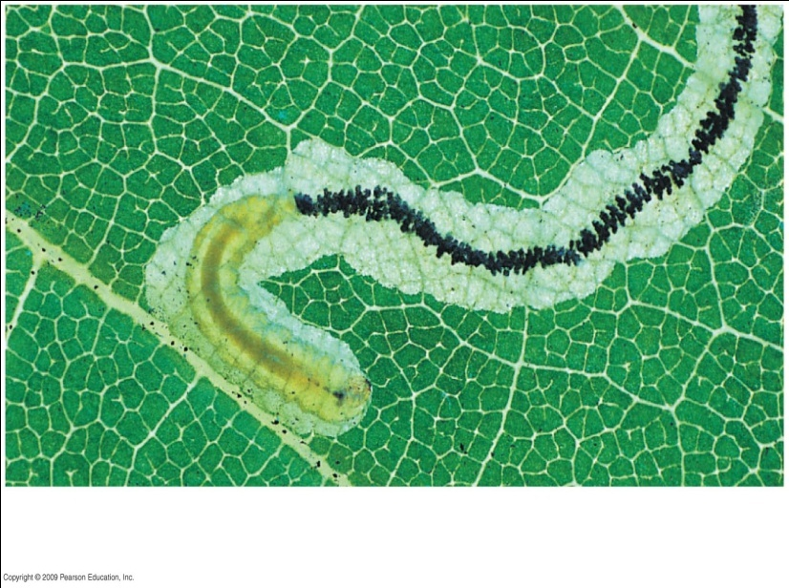
Animals ingest their food in a variety of ways تتناول الحيوانات طعامها بعدة طرق
0
Animals obtain and ingest their food in different ways
تتناول الحيوانات و تحصل على طعامها بعدة طرق
Suspension feeding التغذية بالعوالق
Substrate feeding التغذية مما يحيط به ويعيش عليه
Fluid feeding التغذية بالسوائل
Bulk feeding التغذية بكتل ضخمة
A substrate feeder: a caterpillar eating its way through the soft green tissues inside an oak leaf.
متغذي مما يحيط به ويعيش عليه: يرقة فراش تأكل الانسجة الخضراء الرقيقة داخل ورقة شجرة البلوط اثناء زحفها
Feces البراز
A suspension feeder: a tube worm filtering food from the surrounding water through its tentacles.
متغذي بالعوالق : الدودة الانبوبية ترشح طعامها من الماء المحيط بها بواسطة اللوامس
Caterpillar اليسروع: يرقة الفراش
Copyright © 2009 Pearson Education, Inc.
Notes:
Student Misconceptions and Concerns
1. Students are likely familiar with the basics of the digestive system and the different types of animal diets. However, they are less likely to understand the distinctions between chemical and mechanical digestion and the specific roles of enzymes. It is worthwhile for an instructor to make an extra effort to differentiate between these important components of the digestive process.
Teaching Tips
1. If you have just completed Chapter 20, you may wish to point out the similarities between the ciliary mucus mechanism used to trap debris inhaled into our respiratory tract (Module 20.4) and the suspension feeding systems of clams.
2. Humans (as discussed in Module 19.10) are omnivores. Consider contrasting the teeth of a carnivore (perhaps a cat), an herbivore (perhaps a rodent or bovine), and a human to reveal the intermediate pattern of omnivore teeth. If appropriate skeletal materials are unavailable, good images can suffice.

Slide 15
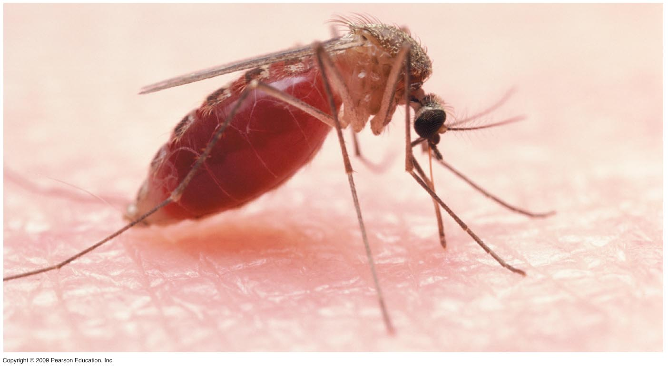
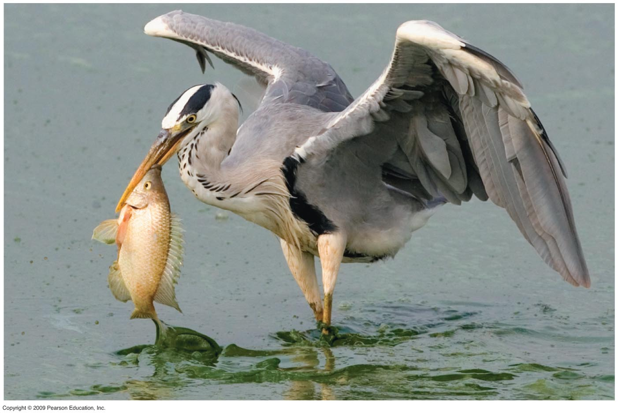
A fluid feeder: a mosquito sucking blood.
متغذي بالسوائل : بعوض اثناء امتصاصه للدم
A bulk feeder: a grey heron preparing to swallow a fish head first and the rest next.
متغذي بالكتل الضخمة : مالك الحزين الرمادي يستعد لابتلاع رأس السمكة اولا ومن ثم البقية
Notes:
Figure 21.1A A suspension feeder: a tube worm filtering food through its tentacles.

Slide 16
Digestion الهضم
Notes:
a-s.clayton.edu/helhag/BIOL1112/ BIOL1112Lectures/1112ch21.text.ppt

Slide 17
Overview: Food processing occurs in four stages نظرة شاملة: يتم التعامل مع الطعام ومعالجته في اربعة مراحل
0
Food is processed in four stages
يتم التعامل مع الطعام ومعالجته في اربعة مراحل
Ingestion التناول
Digestion الهضم
Absorption الامتصاص
Elimination الطرد خارج الجسم
Copyright © 2009 Pearson Education, Inc.
Notes:
Student Misconceptions and Concerns
1. Students are likely familiar with the basics of the digestive system and the different types of animal diets. However, they are less likely to understand the distinctions between chemical and mechanical digestion and the specific roles of enzymes. It is worthwhile for an instructor to make an extra effort to differentiate between these important components of the digestive process.
Teaching Tips
1. If your class size permits, consider demonstrating the process of chemical digestion in the human mouth by distributing crackers to students. Have students chew the crackers and hold them in their mouths without swallowing. The sweet taste they will notice is the sugars produced by the chemical breakdown of starch by amylase, a digestive enzyme found in human saliva.

Slide 18
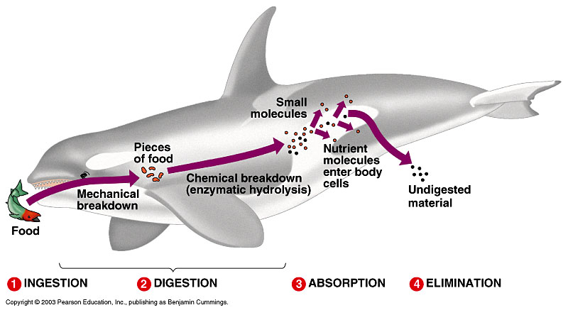
Food Processing تجهيز الغذاء
تناول الغذاء
هضم الغذاء
امتصاص الغذاء
اخراج فضلات الغذاء

Slide 19
0
HUMAN DIGESTIVE SYSTEM
الجهاز الهضمي في الانسان

Slide 20
How is food digested? كيف يتم هضم الطعام
Mechanical breaking down of food into smaller pieces
يجزئ الطعام الى قطع صغيرة بالمضغ والأسنان
Mixing of food with saliva (salivary enzyme + water)
يخلط مع اللعاب المحتوى أساسا على ماء وانزيمات لعابية
Movement through the digestive tract
يتحرك خلال القناة الهضمية من المرئ للمعدة ثم للأمعاء
Chemical breakdown of large food molecules to smaller ones (Stomach + Small intestine)
تتكسرجزيئات الغذاء الكبيرة كيميائيا الى جزيئات أصغرفى المعدة والأمعاء الدقيقة

Slide 21
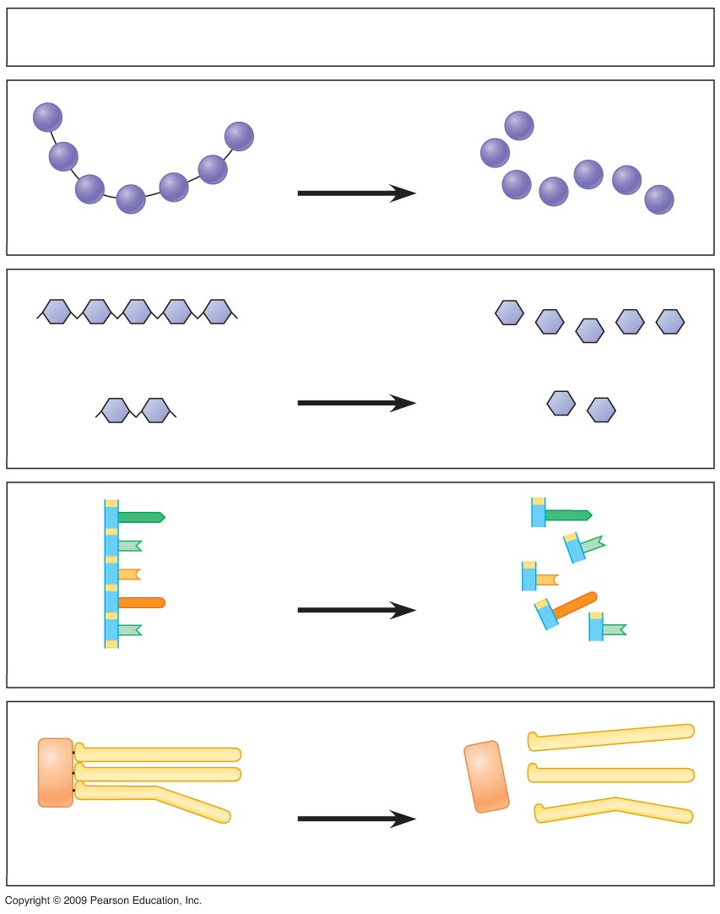
Mechanical digestion breaks food down into smaller pieces
الهضم الالي (بالأسنان مثلا) يجزئ الطعام الى قطع صغيرة
Chemical digestion breaks down large organic molecules into their components
يحلل الهضم الكيميائي الجزيئات العضوية الكبيرة الى مكوناتها
الجزيئ الكبير
المكونات
Macromolecule
Components
Protein-
digesting
enzymes
احماض امينية
Protein
البروتين
انزيمات هضم
البروتين
Amino acids
سكريات متعددة
Carbohydrate-
digesting
enzymes
Polysaccharide
سكاكر احادية
Disaccharide
انزيمات هضم
الكربوهيدرات
Monosaccharides
سكريات ثنائية
الحامض
النووي
نيوكليوتيدات
Nucleic acid-
digesting
enzymes
انزيمات هضم
الاحماض النووية
Nucleic acid
Nucleotides
Fat-digesting
enzymes
الدهن
Fat
انزيمات هضم
الدهون
Glycerol
Fatty acids
الجلسرول
احماض دهنية
Notes:
Figure 21.2B Chemical digestion: the breakdown of large organic molecules to their components.

Slide 22
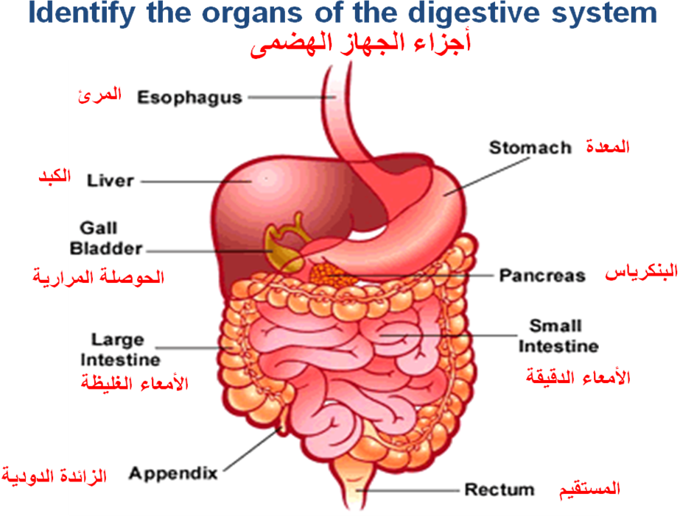

Slide 23
Digestion begins in the oral cavity يبدأ الهضم في التجويف الفمي
0
Teeth break up food, saliva moistens it
تجزئ الاسنان الطعام ويبلله اللعاب
Salivary enzymes begin the hydrolysis of starch
تبدأ انزيمات اللعاب بتحليل النشاء بالماء
Antibacterial agents kills some bacteria ingested with food
تقتل العوامل المضادة للبكتريا بعض البكتريا المتناولة مع الطعام
The tongue tastes, and moves it toward the pharynx
يتذوق اللسان الطعام، كما يشكل لقمة الطعام ويحركه باتجاه البلعوم
Copyright © 2009 Pearson Education, Inc.
Notes:
Teaching Tips
1. The role of saliva in causing food particles to adhere into a bolus and lubricating it for easy passage can be demonstrated by eating crackers or pretzels. You might wish to challenge your students to see how many pretzels/crackers they can chew and swallow in a short period of time, without the use of any beverages. The main factor limiting the speed of this consumption is the ability to produce sufficient saliva.
2. If you have not already discussed the functional significance of the structure of human teeth, consider the following exercise. Challenge your students to explain why the teeth in their mouths have different shapes. Help them to understand the form and function relationships of sharp incisors (best suited for cutting and biting) and the flatter, blunter surfaces of molars (more effective at smashing and grinding).

Slide 24
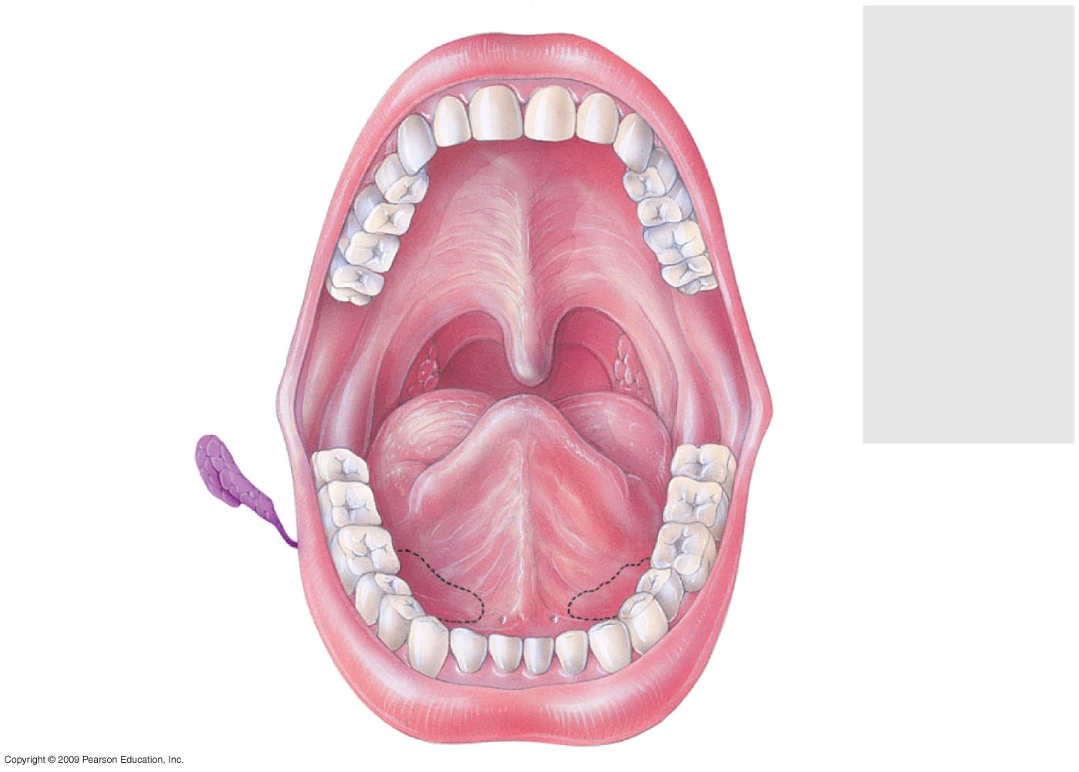
The human oral cavity
التجويف الفمي للإنسان
Teeth
السن
Incisors
القواطع
Canine
الناب
Premolars
الطواحن
Molars
الاضراس
“Wisdom”
Tooth
سن العقل
Tongue
اللسان
Salivary
glands
الغدد اللعابية
Notes:
Figure 21.5 The human oral cavity.

Slide 25
Esophagus المرئ
The esophagus is a muscular tube connects between pharynx and stomach.
It takes food from the throat and pushes it down into the stomach.
المرئ أنبوبة عضلية تصل بين البلعوم والمعدة وتأخذ الطعام من الحلق وتدفعة الى الأسفل باتجاة المعدة
It moves food by waves of muscle contraction and relaxations called peristalsis.
تتم هذة العملية عبرانقباضات وانبساطات لعضلات المرئ المسماة بالانقباض التموجى

Slide 26
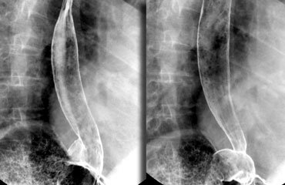
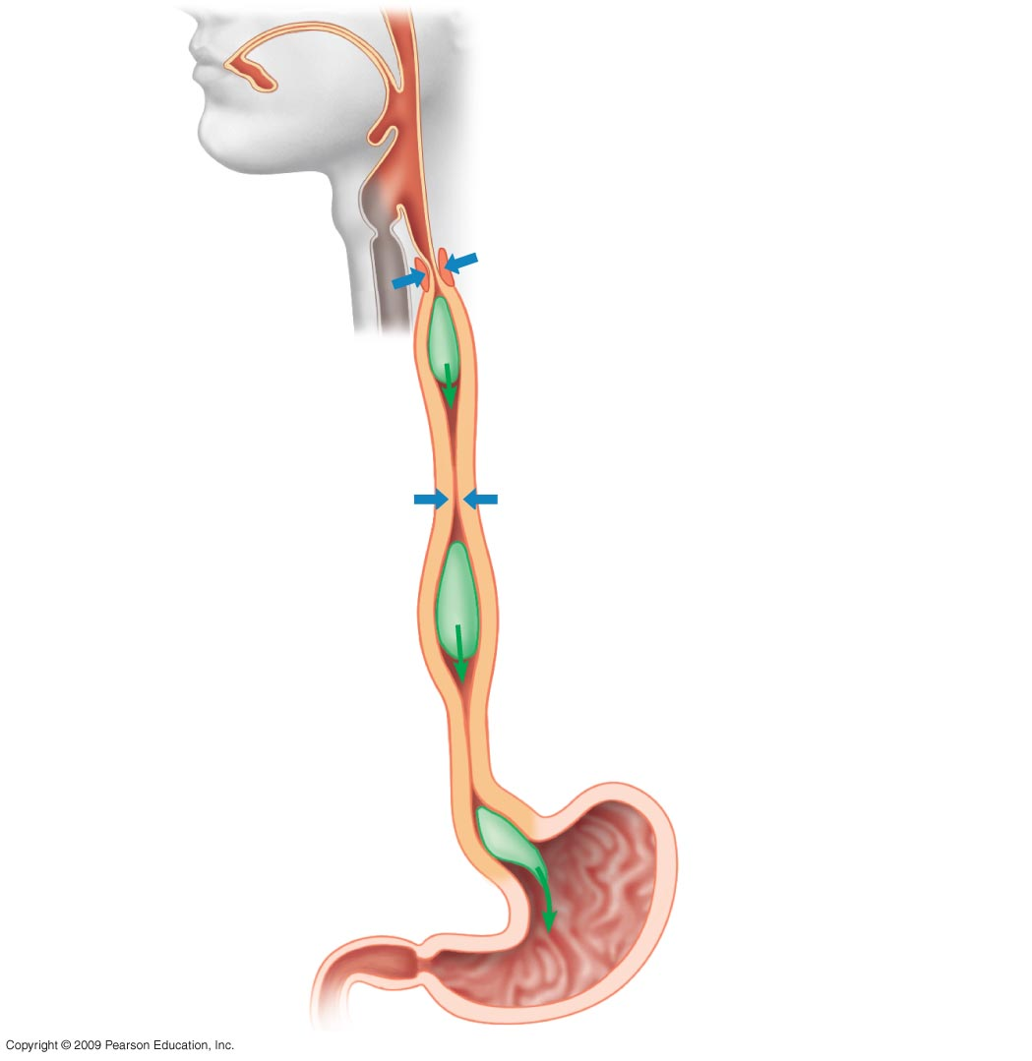
How esophagus conducts food from the pharynx to the stomach
كيف يقوم المرئ بتوصيل الطعام من البلعوم الى المعدة
0
Esophageal sphincter
(contracted)
العضلة العاصرة للمرئ (منقبضة )
Bolus of Food
لقمة الطعام
Muscles contract, constricting passageway and pushing bolus down
تنقبض العضلات، فيتقلص الممر دافعا اللقمة الى الاسفل
Bolus of Food
لقمة الطعام
Muscles relax allowing passageway
to open
ترتخي العضلات فتسمح بفتح الممر
Peristalsis moving a food bolus down the esophagus
يحرك الانقباض التموجي لقمة الطعام الى اسفل المرئ
Stomach
المعدة
Notes:
Teaching Tips
1. Demonstrate the process of peristalsis: move a tennis ball through a tube sock by squeezing behind the ball.
2. Students often invert the “y” and “n” of pharynx and larynx. Consider emphasizing the “inks” sound in these words. This mistake is nearly as common as pronouncing “nuclear” as “nucular”!
3. The esophagus is so efficient at peristalsis that it can propel liquid water along its length against the forces of gravity. If one of your students is willing to endure a little discomfort, have them fill their mouth with water and then bend over at the waist, so that their mouth is lower than their stomach. Ask them to swallow, then to remain bent over for a further 20–30 seconds. Then ask them a simple question. In answering, they will demonstrate that their mouth is now empty. (Some students might recognize this as a potential cure for hiccups.) It is possible that some water in the pharynx will leak back out the nasal passageway. Thus, this demonstration is best performed using water rather than carbonated beverages!

Slide 27
Stomach المعدة
Stomach is a muscular, hollow, dilated part of the digestive system located between the esophagus and the small intestine.
The stomach wall has thick muscles.
These contract to mash the food into a water soup called " chyme ".
جدار المعدة غليظ وانقباضة يهرس الغذاء بسائل يعرف باسم " الكيموس"
The stomach lining produces strong digestive juices.
تفرز بطانة المعدة عصير هاضم قوى
These create chemical reactions in the stomach, breaking down and dissolving nutrients.
هذا العصير يبدأ الهضم الكيميائى فى المعدة ويكسر الغذاء الى مواد بسيطة

Slide 28
Stomach Juice (gastric juice) العصير المعدى
0
Gastric acid is a digestive fluid, formed in the stomach. It has a pH of 1-2 and is composed of :
Acid الحامض
Stomach cell wall secrete hydrogen & chloride ions, which combine to make HCl.
The acid: plays a key role in digestion of proteins, breaks food , by activating digestive enzymes and kills bacteria
تفرز خلايا جدار المعدة ايونات الهيدروجين و الكلور التي تتحد مكونة حامض الهيدروكلوريكالذى يلعب دور هام فى هضم البروتين كما يجزئ الحامض الطعام كما يقتل البكتريا
Pepsin انزيم الببسين
Pepsin begins the chemical digestion of proteins
يبدأ الببسين الهضم الكيميائي للبروتينات
Large quantities of potassium chloride (KCl) and sodium chloride (NaCl).
Notes:
Teaching Tips
1. One of the important roles of stomach acids is to kill pathogens (mostly bacteria) that we ingest with our meals. Although it is best to wash our hands before we eat, saliva and stomach acids serve as a backup system.
2. The anticipation of a meal may result in an increase in the peristaltic activity of an empty stomach. The movement of gas pockets in the stomach and intestines lead to the sounds of a hungry stomach “growling.”

Slide 29
Question سؤال
0
What prevents the gastric juices from digesting the walls of the stomach?
لما لا تهضم العصارة المعدية جدار المعدة؟
Mucus helps protect against HCl and pepsin
يساعد المخاط على الوقاية من حامض الهيدروكلوريك وانزيم الببسين
New cells lining the stomach are produced about every 3 days
كما يتجدد انتاج الخلايا المبطنة للمعدة كل ثلاثة ايام تقريبا
Alkaline pancreatic juice neutralizes acid chyme
تقوم العصارة البنكرياسية القاعدية بمعادلة الكيموس الحامضي
Copyright © 2009 Pearson Education, Inc.
Notes:
Teaching Tips
1. One of the important roles of stomach acids is to kill pathogens (mostly bacteria) that we ingest with our meals. Although it is best to wash our hands before we eat, saliva and stomach acids serve as a backup system.
2. The anticipation of a meal may result in an increase in the peristaltic activity of an empty stomach. The movement of gas pockets in the stomach and intestines lead to the sounds of a hungry stomach “growling.”

Slide 30
The small intestine الامعاء الدقيقة العضو الرئيسي لعملية الهضم الكيميائي و امتصاص الغذاء
0
Small intestine is the part of the gastrointestinal tract following the stomach and followed by the large intestine, and is where much of the digestion and absorption of food takes place
Small intestine is named for its smaller diameter—it is about 6 meters long
سميت الامعاء الدقيقة بذلك الاسم لدقة قطر تجويفها – الا ان طولها يصل حوالي 6 امتار
Enzymes in the small intestine continue digestion process
تواصل انزيمات خلايا الامعاء عملية الهضم
Notes:
Teaching Tips
1. The same process of emulsification that helps break down fats in the small intestine also helps keep oil permanently mixed with vinegar in some commercial salad dressings.
2. A person who continues to vomit after emptying the stomach might eventually bring up a small amount of bitter-tasting green fluid. This is likely to be bile brought up from the small intestine.

Slide 31
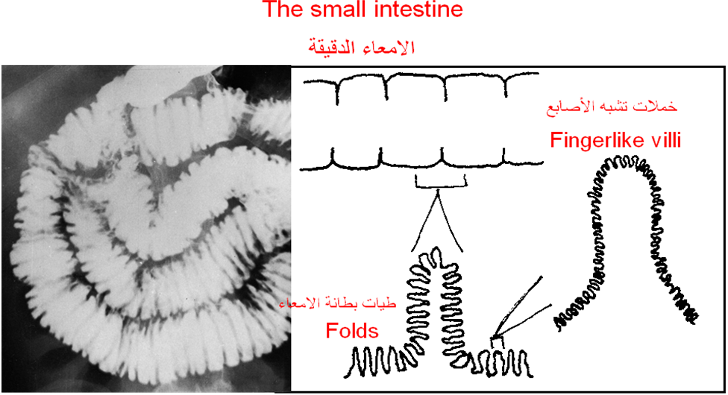
Surface area for absorption is increased by the length and two things:
تزداد مساحة سطح الامتصاص بطول الأمعاء وبشيئين:
folds of the intestine lining طيات بطانة الامعاء
Fingerlike villi الأصابع خملات تشبه
0
Notes:
Teaching Tips
1. The same process of emulsification that helps break down fats in the small intestine also helps keep oil permanently mixed with vinegar in some commercial salad dressings.
2. A person who continues to vomit after emptying the stomach might eventually bring up a small amount of bitter-tasting green fluid. This is likely to be bile brought up from the small intestine.

Slide 32
Liver’s many functions وظائف الكبد العديدة
0
Blood from the digestive tract drains to the liver
يصب الدم الاتي من القناة الهضمية في الكبد
The liver performs many functions يقوم الكبد بعدة وظائف
Stores glycogen (converted glucose in blood)
يتحول سكر الجلوكوزالموجود في الدم الى نشا حيواني يخزن في الكبد
Synthesizes many proteins like blood clotting proteins
يقوم ببناء البروتينات مثل بروتينات تجلط الدم
Changes toxins to less toxic forms
يحول الكبد السموم الى هيئات اقل سمية
Liver produces bile
ينتج الكبد العصارة الصفراوية
Notes:
Teaching Tips
1. The liver is often said to “filter” the blood. However, unlike a coffee or air filter, the liver does not trap particles. Instead, chemicals are broken down by the liver into less toxic forms.
2. Students might wonder why they might need to take another dose of aspirin or other drug every four hours. What happened to the first dose? The liver is often involved in the breakdown of these medicines, which are eliminated from the bloodstream over time.
3. If a person’s gallbladder is removed, they will continue to produce bile; however, they will no longer have the capacity to release large amounts of it.

Slide 33
- Bile (made in the liver and stored in the gall bladder) emulsifies fat before they get attacked by pancreatic enzymes (A process that forms a liquid, known as an emulsion)
- يتم تكوين العصارة الصفراوية في الكبد ومن ثم تخزن في الحوصلة الصفراوية , وهي تقوم باستحلاب الدهون قبل أن تهضم بالإنزيمات البنكرياسية
- Un-emulsified fat usually passes through the intestines and is eliminated in faeces
- الدهون التى لم تهضم بالإنزيمات البنكرياسية تخرج مع البراز

Slide 34
Large Intestine الأمعاء الغليظة
Substances (not absorbed in the small intestine) such as spare water & minerals, are absorbed through the large intestine.
المواد التى لم تمتص فى الأمعاء الدقيقة (مثل الماء والمعادن) يتم امتصاصها بواسطة جدر الأمعاء الغليظة
The remains are formed into brown, semi-solid feces, ready to be removed from the body
المتبقى يتحول الى براز بنى شبة صلDiarrhea occurs when too little water is reclaimed
ب وجاهز للاخراج من الجسم
يحدث الاسهال عندما لا تمتص الامعاء الغليظة الا قليل من الماء
Constipation occurs when too much water is reclaimed
ويحدث الامساك عندما لا تمتص الامعاء الغليظة الا كثير من الماء

Slide 35
Appendix الزائدة الدودية
Located near the junction of small intestine and colon
تقع بالقرب من التقاء الامعاء الدقيقة بالقولون
Makes a minor contribution to immunity
تساهم قليلا في مناعة الجسم
Gall Bladder الحوصلة المرارية
A small baglike part under the liver.
جسم صغير شكل الكيس يقع تحت الكبد مباشرة
It stores a fluid called bile, which is made in the liver
يتم تخزين العصارة الصفراوية المتكونة في الكبد داخل الحوصلة الصفراوية
It helps to digest fatty foods
0
Notes:
Teaching Tips
1. Bacteria in the large intestine ferment some of the indigestible carbohydrates, releasing methane, carbon dioxide, and other gases. Most adult humans produce about 500 milliliters of this gas (flatulus) each day. A diet particularly high in certain carbohydrate-rich foods (such as beans) can greatly increase the quantity of flatulus that is produced.
2. The UN has estimated that approximately 1.7 million deaths worldwide in 2002 were caused by unsafe water and inadequate sanitation and hygiene, and noted that most of these deaths could be attributed to various forms of infectious diarrhea.

Slide 36
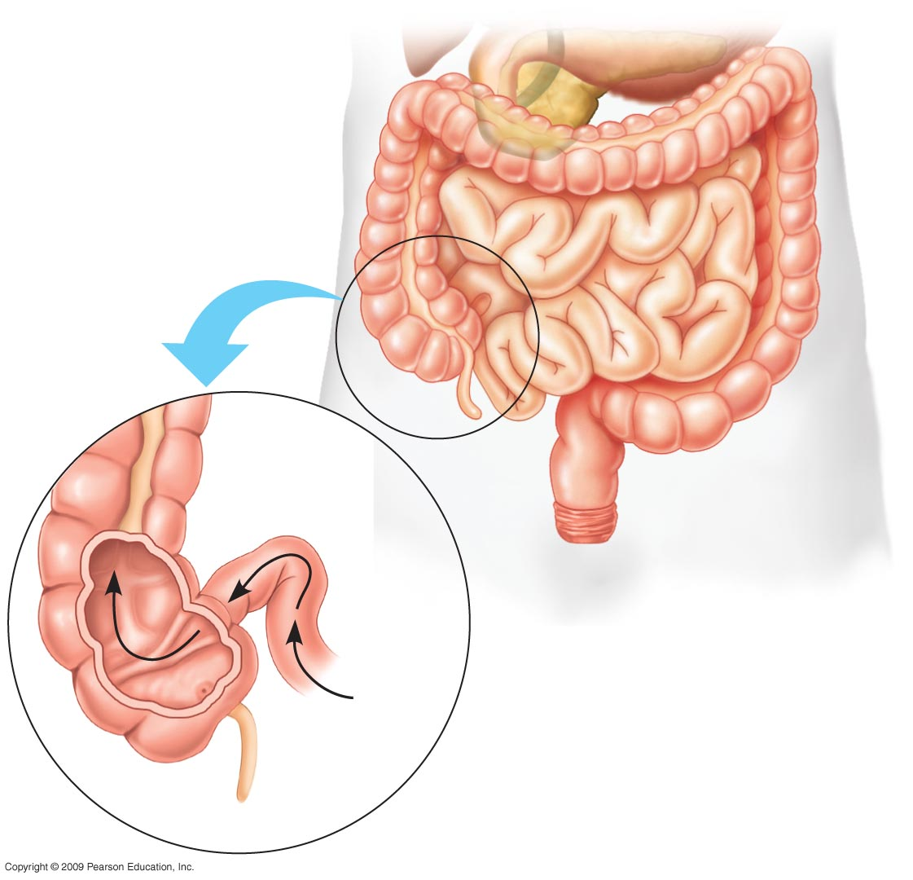
Large intestine
(colon)
الامعاء الغليظة
(القولون)
Small
intestine
الامعاء
الدقيقة
End
of small
Intestine
نهاية الأمعاء الدقيقة
Rectum
المستقيم
Anus
الشرج
المادة الغذائية
الغير ممتصة
Large
Intestine
الأمعاء الغليظة
Appendix
الزائدة الدودية
Notes:
Figure 21.12 The relationship of the small and large intestine.

Slide 37
conclusion
Animals obtain and ingest food in a variety of ways.
Food processing occurs in four stages : _______
Digestion occurs in specialized compartments.
A healthy diet satisfies three needs: chemical energy, raw materials for biosynthesis and essential nutrients.
A healthy diet includes 13 vitamins and many essential minerals.

Slide 38
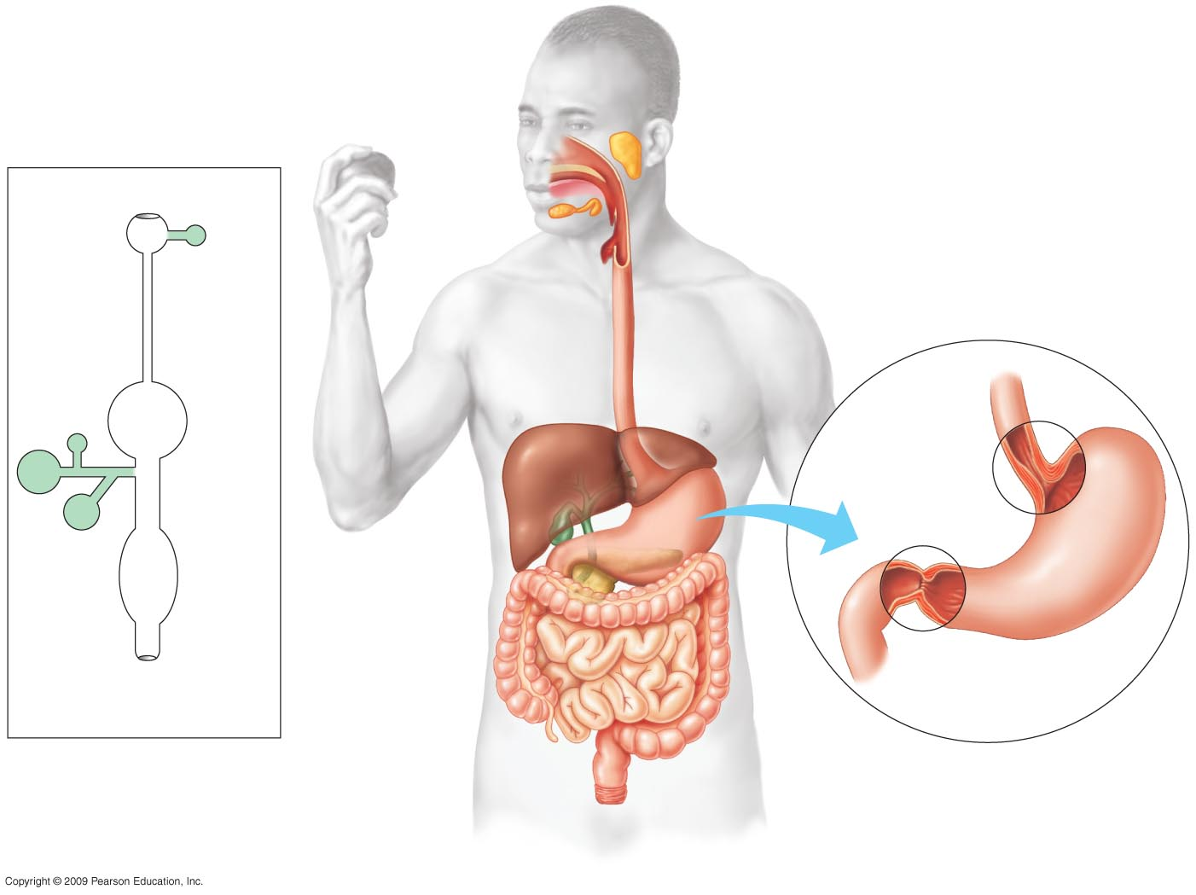
Oral cavity
تجويف الفم
Tongue اللسان
Salivary
glands
Mouth الفم
Pharynxالبلعوم
Mouth
Salivary glands
الغدد اللعابية
Esophagus المريء
Esophagus
Liver
Gall-
bladder
Esophagus
Stomach
Sphincter
Small
intestine
Stomach
Liver
Sphincter
Pancreas
Large
intestine
Gall bladder
الحوصلة الصفراوية
Pancreasالبنكرياس
Rectum
Small intestine
الأمعاء الدقيقة
Anus
Small
intestine
A schematic diagram of the
human digestive system
Large intestine
الأمعاء الغليظة
Rectum المستقيم
Anus الشرج
The human digestive system الجهاز الهضمي في الانسان
Notes:
Figure 21.4 The human digestive system The human digestive system.

Slide 39
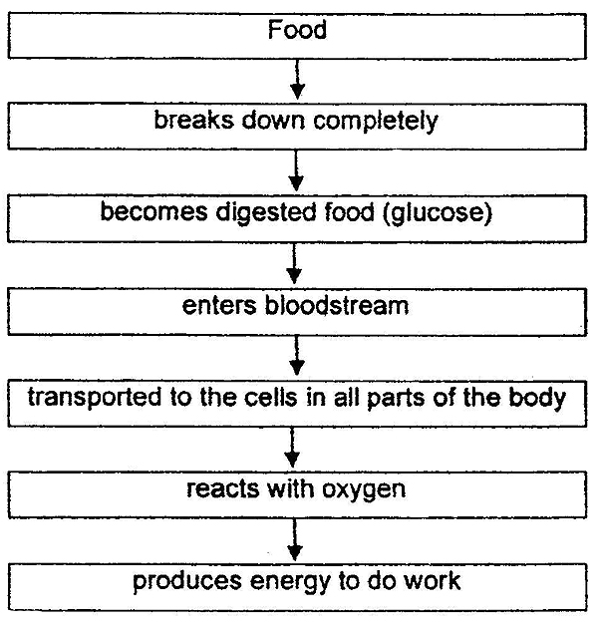
www.oldschool.com.sg

Slide 40
Nutrition and Digestion التغذية و الهضم
المصطلـــــــــــــــــــــــــــــــــح | تعريف المصطلــــــــــح
Obtaining And Processing Food | الحصول على الطعام وكيفية التعامل معه
Herbivores | اكلات الاعشاب
Carnivores | اكلات اللحوم
Omnivores | مزدوجة التغذية
Suspension Feeding | التغذية بالعوالق
Substrate Feeding | التغذية مما يحيط به ويعيش عليه
Fluid Feeding | التغذية بالسوائل
Bulk Feeding | التغذية بكتل ضخمة
Ingestion | التناول
Digestion | الهضم
Absorption | الامتصاص
Elimination | الطرد خارج الجسم
Mechanical Digestion | الهضم الالي
Chemical Digestion | الهضم الكيميائي
Cnidarians And Flatworms | الكنيداريات (الجوفمعويات قديم) و الديدان المفلطحة
Gastro Vascular Cavity | جوف معدي وعائي
Alimentary Canal | قناه هضمية
Human Digestive System | الجهاز الهضمي في الانسان

Slide 41
Nutrition and Digestion التغذية و الهضم
المصطلـــــــــــــــــــــــــــــــــح | تعريف المصطلــــــــــح
Alternating Waves | الموجات المتعاقبة
Contraction And Relaxation By Smooth Muscle | الانقباض والانبساط للعضلات الملساء
Peristalsis | الانقباضات التموجية
Sphincters | العضلات العاصرة
Digestive Chambers | القناة الهاضمة
Pyloric Sphincter | العضلة العاصرة البوابية
Salivary Enzymes | انزيمات اللعاب
Hydrolysis Of Starch | حلمأة
Buffers Neutralize Acids | تحييد ومعادلة الاحماض
Antibacterial Agents | المضادة للبكتريا
Shapes The Bolus Of Food | يشكل لقمة الطعام
Oral Cavity | الفمي للإنسان
Wisdom Tooth | سن العقل

Slide 42
Nutrition and Digestion التغذية و الهضم
المصطلـــــــــــــــــــــــــــــــــح | تعريف المصطلــــــــــح
Hcl | حامض الهيدروكلوريك
Positive Feedback | استرجاع ايجابي
Acidic Gastric Juices | العصارة المعدية الحامضية
Acid Chyme | الكيموس الحامضي
Alkaline Pancreatic Juice Neutralizes Acid Chyme | العصارة البنكرياسية القاعدية بمعادلة الكيموس الحامضي
Bile | العصارة الصفراوية
Gall Bladder | الحوصلة الصفراوية
Surface Area For Absorption | مساحة سطح الامتصاص
Folds Of The Intestinal Lining | طيات بطانة الامعاء
Fingerlike Villi | خملات تشبه الاصابع
Glucose In Blood Is Converted To Glycogen | يتحول سكر العنب (الجلوكوز) الموجود في الدم الى نشا حيواني
Stored In The Liver | ويخزن في الكبد
Liver Synthesizes Many Proteins | يقوم ببناء البروتينات
Blood Clotting Proteins | بروتينات تجلط الدم
Lipoproteins That Transport Fats And Cholesterol | البروتينات الليبدية التي تقوم بنقل الدهون و الكلسترول

Slide 43
Nutrition and Digestion التغذية و الهضم
المصطلـــــــــــــــــــــــــــــــــح | تعريف المصطلــــــــــح
Liver Changes Toxins To Less Toxic Forms | يحول الكبد السموم الى هيئات اقل سمية
Liver Produces Bile | ينتج الكبد العصارة الصفراوية
Diarrhea | الاسهال
Constipation | القبض
Feces Are Stored In The Rectum | يخزن البراز في المستقيم
Colon Bacteria Produce Vitamins—Biotin, Vitamin K, B Vitamins | بكتريا القولون تنتج الفيتامينات مثل البايوتين , فيتامين ك وفيتامينات ب
Appendix | الزائدة الدودية
Nutrition | التغذية
Nutrients Are Oxidized Inside Cells To Make ATP | تتأكسد المواد الغذائية داخل الخلايا لإنتاج ثلاثي فوسفات الادينوسين
Main Sources Of Calories | المصادر الاساسية للسعرات الحرارية
Basal Metabolic Rate (BMR) | معدل الايض الاساسي
Energy A Resting Animal Requires Each Day | نسبة ما يحتاجه الحيوان الساكن من الطاقة في اليوم
Metabolic Rate | معدل الايض
Physical Activity | بالأنشطة الحيوية

Slide 44
Nutrition and Digestion التغذية و الهضم
المصطلـــــــــــــــــــــــــــــــــح | تعريف المصطلــــــــــح
Excess Energy Is Stored As Glycogen Or Fat | خزن الطاقة الفائضة على هيئة نشا حيواني او دهني
Undernourishment | قلة التغذية
Malnourishment | سوء التغذية
Essential Amino Acids | احماض امينينة ضرورية
Diet | النظام الغذائي
Essential Vitamins And Minerals | الفيتامينات و المعادن الضرورية
Extreme Excesses | الزيادة المفرطة
Minerals | المعادن
Weight Loss Diets | الانظمة الغذائية لإنقاص الوزن
Most Effective Diets | نظام الحمية الاكثر تأثير
Increased Exercise | المزيد من التمارين الرياضية
Limited Balanced Diet | نظام حمية متوازن ومحدد
Cardiovascular Disease And Cancer | مخاطر الاصابة بامراض الاوعية القلبية والسرطان
Ldl | كلسترول منخفض الكثافة
Contributes To Blocked Blood Vessels | يساهم في انسداد الاوعية الدموية
Hdl | لكلسترول عالي الكثافة
Tends To Reduce Blocked Blood Vessels | يؤدي الى خفض نسبة انسداد الاوعية الدموي

