Slide 1
Lecture Slides
Elementary Statistics Eleventh Edition
and the Triola Statistics Series
by Mario F. Triola

Slide 2
Chapter 11 Goodness-of-Fit and Contingency Tables
11-1 Review and Preview
11-2 Goodness-of-fit
11-3 Contingency Tables
11-4 McNemar’s Test for Matched Pairs

Slide 3
Section 11-1
Review and Preview

Slide 4
Review
We began a study of inferential statistics in Chapter 7 when we presented methods for estimating a parameter for a single population and in Chapter 8 when we presented methods of testing claims about a single population. In Chapter 9 we extended those methods to situations involving two populations. In Chapter 10 we considered methods of correlation and regression using paired sample data.

Slide 5
Preview
We focus on analysis of categorical (qualitative or attribute) data that can be separated into different categories (often called cells).
Hypothesis test: Observed counts agree with some claimed distribution.
The contingency table or two-way frequency table (two or more rows and columns).
Two-way tables involving matched pairs.
Use the χ² (chi-square) distribution.

Slide 6
Section 11-2
Goodness of Fit
.

Slide 7
Key Concept
In this section we consider sample data consisting of observed frequency counts arranged in a single row or column (called a one-way frequency table). We will use a hypothesis test for the claim that the observed frequency counts agree with some claimed distribution, so that there is a good fit of the observed data with the claimed distribution.
.

Slide 8
Definition
A goodness-of-fit test is used to test the hypothesis that an observed frequency distribution fits (or conforms to) some claimed distribution.
.

Slide 9
Goodness-of-Fit Test
Notation
O represents the observed frequency of an outcome.
E represents the expected frequency of an outcome.
k represents the number of different categories or outcomes.
n represents the total number of trials.
.

Slide 10
Goodness-of-Fit Test
Requirements
The data have been randomly selected.
The sample data consist of frequency counts for each of the different categories.
For each category, the expected frequency is at least 5. (The expected frequency for a category is the frequency that would occur if the data actually have the distribution that is being claimed. There is no requirement that the observed frequency for each category must be at least 5.)
.

Slide 11
Goodness-of-Fit
Test Statistic
χ² = Σ
(O – E)²
E
.

Slide 12
Goodness-of-Fit
Critical Values
1. Found in Table A- 4 using k – 1 degrees of freedom, where k = number of categories.
2. Goodness-of-fit hypothesis tests are always right-tailed.
.

Slide 13
Goodness-of-Fit
P-Values
P-values are typically provided by computer software, or a range of P-values can be found from Table A-4.
.

Slide 14
Expected Frequencies
If all expected frequencies are equal:
the sum of all observed frequencies divided by the number of categories
n
E =
k
.

Slide 15
Expected Frequencies
If expected frequencies are not all equal:
Each expected frequency is found by multiplying the sum of all observed frequencies by the probability for the category.
E = np
.

Slide 16
Goodness-of-Fit Test
A close agreement between observed and expected values will lead to a small value of χ² and a large P-value.
A large disagreement between observed and expected values will lead to a large value of χ² and a small P-value.
A significantly large value of χ² will cause a rejection of the null hypothesis of no difference between the observed and the expected.
.

Slide 17
Goodness-of-Fit Test
“If the P is low, the null must go.”
(If the P-value is small, reject the null hypothesis that the distribution is as claimed.)
.

Slide 18
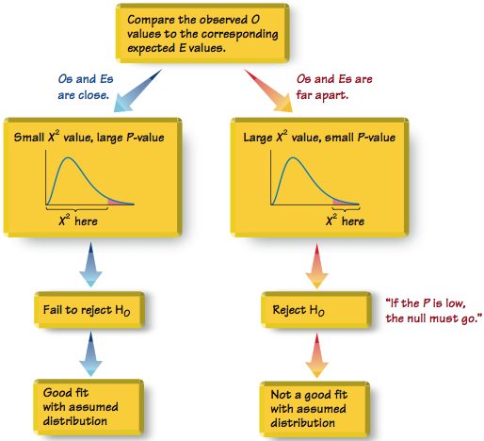
Relationships Among the χ² Test Statistic, P-Value, and Goodness-of-Fit
.
Figure 11-2

Slide 19
Example:
Data Set 1 in Appendix B includes weights from 40 randomly selected adult males and 40 randomly selected adult females. Those weights were obtained as part of the National Health Examination Survey. When obtaining weights of subjects, it is extremely important to actually weigh individuals instead of asking them to report their weights. By analyzing the last digits of weights, researchers can verify that weights were obtained through actual measurements instead of being reported.
.

Slide 20
Example:
When people report weights, they typically round to a whole number, so reported weights tend to have many last digits consisting of 0. In contrast, if people are actually weighed with a scale having precision to the nearest 0.1 pound, the weights tend to have last digits that are uniformly distributed, with 0, 1, 2, … , 9 all occurring with roughly the same frequencies. Table 11-2 shows the frequency distribution of the last digits from 80 weights listed in Data Set 1 in Appendix B.
.

Slide 21
Example:
(For example, the weight of 201.5 lb has a last digit of 5, and this is one of the data values included in Table 11-2.)
Test the claim that the sample is from a population of weights in which the last digits do not occur with the same frequency. Based on the results, what can we conclude about the procedure used to obtain the weights?
.

Slide 22
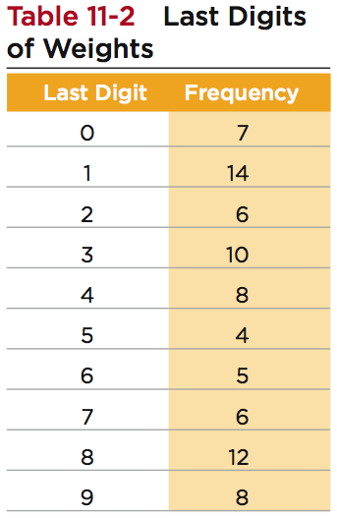
Example:
.

Slide 23
Example:
Requirements are satisfied: randomly selected subjects, frequency counts, expected frequency is 8 (> 5)
Step 1: at least one of the probabilities p₀, p₁,… p₉, is different from the others
Step 2: at least one of the probabilities are the same:
p₀ = p₁ = p₂ = p₃ = p₄ = p₅ = p₆ = p₇ = p₈ = p₉
Step 3: null hypothesis contains equality
H₀: p₀ = p₁ = p₂ = p₃ = p₄ = p₅ = p₆ = p₇ = p₈ = p₉
H₁: At least one probability is different
.

Slide 24
Example:
Step 4: no significance specified, use α = 0.05
Step 5: testing whether a uniform distribution so use goodness-of-fit test: χ²
Step 6: see the next slide for the computation of the χ² test statistic. The test statistic χ² = 11.250, using α = 0.05 and k – 1 = 9 degrees of freedom, the critical value is χ² = 16.919
.

Slide 25
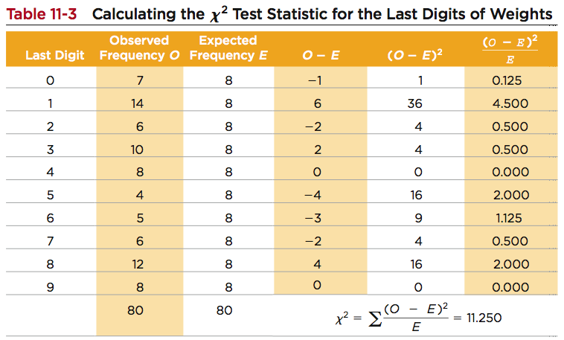
Example:
.

Slide 26
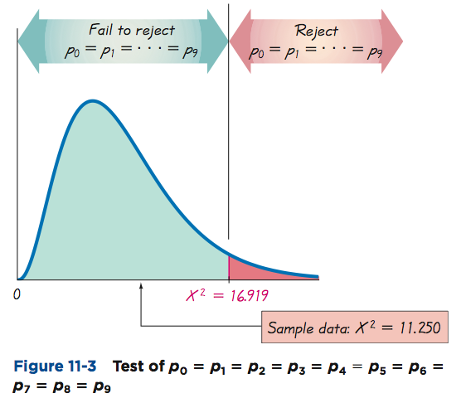
Example:
Step 7:
Because the test statistic does not fall in the critical region, there is not sufficient evidence to reject the null hypothesis.
.

Slide 27
Example:
Step 8: There is not sufficient evidence to support the claim that the last digits do not occur with the same relative frequency.
This goodness-of-fit test suggests that the last digits provide a reasonably good fit with the claimed distribution of equally likely frequencies. Instead of asking the subjects how much they weigh, it appears that their weights were actually measured as they should have been.
.

Slide 28
Recap
In this section we have discussed:
Goodness-of-Fit
Equal Expected Frequencies
Unequal Expected Frequencies
Test the hypothesis that an observed frequency distribution fits (or conforms to) some claimed distribution.
.

Slide 29
Section 11-3
Contingency Tables
.

Slide 30
Key Concept
In this section we consider contingency tables (or two-way frequency tables), which include frequency counts for categorical data arranged in a table with a least two rows and at least two columns.
We present a method for testing the claim that the row and column variables are independent of each other.
We will use the same method for a test of homogeneity, whereby we test the claim that different populations have the same proportion of some characteristics.
.

Slide 31
Part 1: Basic Concepts of Testing for Independence
.

Slide 32
Definition
A contingency table (or two-way frequency table) is a table in which frequencies correspond to two variables.
(One variable is used to categorize rows, and a second variable is used to categorize columns.)
Contingency tables have at least two rows and at least two columns.
.

Slide 33
Definition
Test of Independence
A test of independence tests the null hypothesis that in a contingency table, the row and column variables are independent.
.

Slide 34
Notation
O represents the observed frequency in a cell of a contingency table.
E represents the expected frequency in a cell, found by assuming that the row and column variables are independent
r represents the number of rows in a contingency table (not including labels).
c represents the number of columns in a contingency table (not including labels).
.

Slide 35
Requirements
The sample data are randomly selected.
The sample data are represented as frequency counts in a two-way table.
For every cell in the contingency table, the expected frequency E is at least 5. (There is no requirement that every observed frequency must be at least 5. Also, there is no requirement that the population must have a normal distribution or any other specific distribution.)
.

Slide 36
Null and Alternative Hypotheses
H₀: The row and column variables are independent.
H₁: The row and column variables are dependent.
.

Slide 37
Test of Independence
Test Statistic
χ² = Σ
(O – E)²
E
where O is the observed frequency in a cell and E is the expected frequency found by evaluating
E =
(row total) (column total)
(grand total)
.

Slide 38
Test of Independence
Critical Values
1. Found in Table A-4 using
degrees of freedom = (r – 1)(c – 1)
r is the number of rows and c is the number of columns
2. Tests of Independence are always right-tailed.
.

Slide 39
Test of Independence
P-Values
P-values are typically provided by computer software, or a range of P-values can be found from Table A-4.
.

Slide 40
Test of Independence
This procedure cannot be used to establish a direct cause-and-effect link between variables in question.
Dependence means only there is a relationship between the two variables.
.

Slide 41
Expected Frequency for Contingency Tables
row total column total
E = • •
grand total
grand total
grand total
n • p
(probability of a cell)
E =
(row total) (column total)
(grand total)
.

Slide 42
Example:
Refer to Table 11-6 and find the expected frequency for the first cell, where the observed frequency is 88.
The first cell lies in the first row (with a total frequency of 178) and the first column (with total frequency of 103). The “grand total” is the sum of all frequencies in the table, which is 207. The expected frequency of the first cell is
.

Slide 43
Example:
(row total) (column total)
(178)(103)
E =
(grand total)
=
= 88.570
207
We know that the first cell has an observed frequency of O = 88 and an expected frequency of E = 88.570. We can interpret the expected value by stating that if we assume that getting an infection is independent of the treatment, then we expect to find that 88.570 of the subjects would be given a placebo and would get an infection. There is a discrepancy between O = 88 and E = 88.570, and such discrepancies are key components of the test statistic.
.

Slide 44
Example:
Common colds are typically caused by a rhinovirus. In a test of the effectiveness of echinacea, some test subjects were treated with echinacea extracted with 20% ethanol, some were treated with echinacea extracted with 60% ethanol, and others were given a placebo. All of the test subjects were then exposed to rhinovirus. Results are summarized in Table 11-6 (next slide). Use a 0.05 significance level to test the claim that getting an infection (cold) is independent of the treatment group. What does the result indicated about the effectiveness of echinacea as a treatment for colds?
.

Slide 45
Example:
Requirements are satisfied: randomly assigned to treatment groups, frequency counts, expected frequencies are all at least 5
H₀: Getting an infection is independent of the treatment
H₁: Getting an infection and the treatment are dependent
.

Slide 46
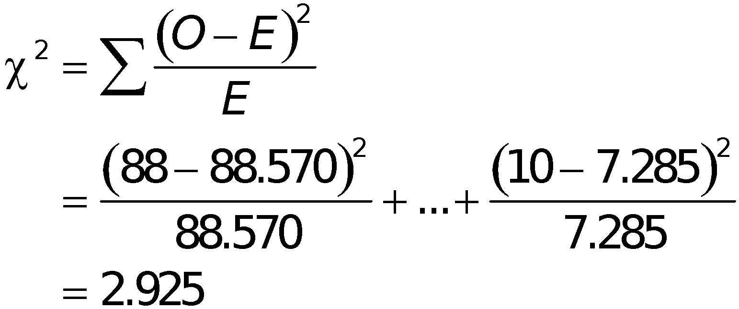
Example:
Significance level is α = 0.05.
Contingency table: use χ² distribution
The critical value of χ² = 5.991 is found from Table A-4 with α = 0.05 in the right tail and the number of degrees of freedom given by (r – 1)(c – 1) = (2 – 1)(3 – 1) = 2.
.

Slide 47
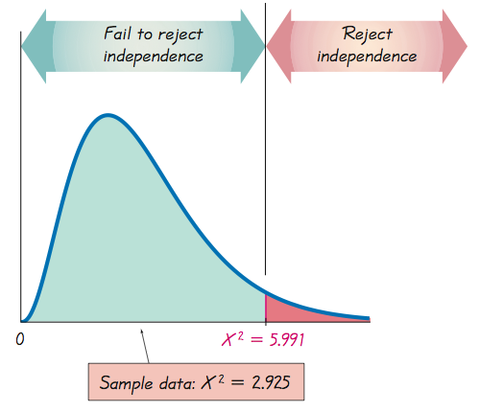
Example:
.

Slide 48
Example:
Because the test statistic does not fall within the critical region, we fail to reject the null hypothesis of independence between getting an infection and treatment.
It appears that getting an infection is independent of the treatment group. This suggests that echinacea is not an effective treatment for colds.
.

Slide 49
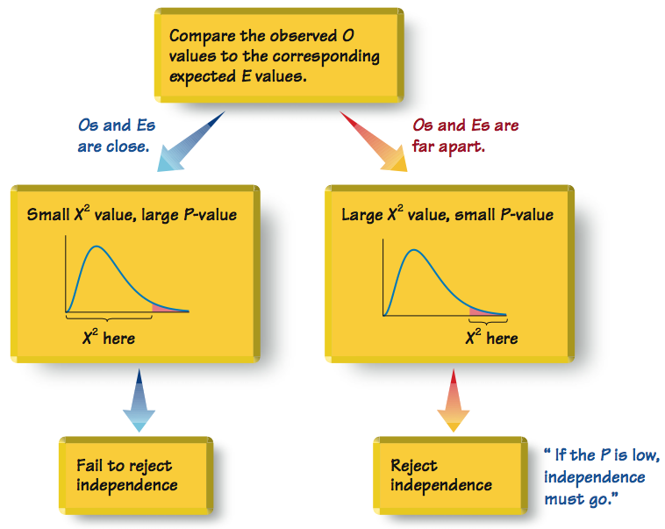
Relationships Among Key Components
in Test of Independence
Figure 11-6
.

Slide 50
Part 2: Test of Homogeneity and the Fisher Exact Test
.

Slide 51
Definition
Test of Homogeneity
In a test of homogeneity, we test the claim that different populations have the same proportions of some characteristics.
.

Slide 52
How to Distinguish Between a Test of Homogeneity and a Test for Independence:
Were predetermined sample sizes used for different populations (test of homogeneity), or was one big sample drawn so both row and column totals were determined randomly (test of independence)?
.
Notes:
The key to identifying it is a test of homogeneity is the predetermined sample sizes.

Slide 53
Example:
Does a pollster’s gender have an effect on poll responses by men? A U.S. News & World Report article about polls stated: “On sensitive issues, people tend to give ‘acceptable’ rather than honest responses; their answers may depend on the gender or race of the interviewer.” To support that claim, data were provided for an Eagleton Institute poll in which surveyed men were asked if they agreed with this statement: “Abortion is a private matter that should be left to the woman to decide without government intervention.”
.

Slide 54
Example:
We will analyze the effect of gender on male survey subjects only. Table 11-8 is based on the responses of surveyed men. Assume that the survey was designed so that male interviewers were instructed to obtain 800 responses from male subjects, and female interviewers were instructed to obtain 400 responses from male subjects. Using a 0.05 significance level, test the claim that the proportions of agree/disagree responses are the same for the subjects interviewed by men and the subjects interviewed by women.
.

Slide 55
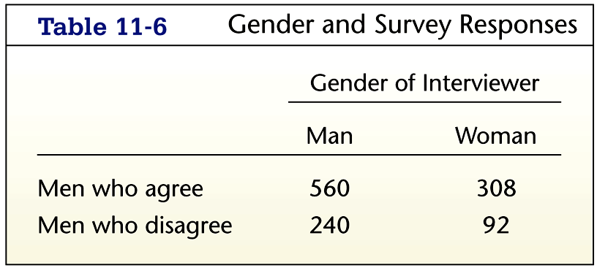
Example:
.

Slide 56
Example:
Requirements are satisfied: data are random, frequency counts in a two-way table, expected frequencies are all at least 5
Test for homogeneity.
H₀: The proportions of agree/disagree responses are the same for the subjects interviewed by men and the subjects interviewed by women.
H₁: The proportions are different.
.

Slide 57
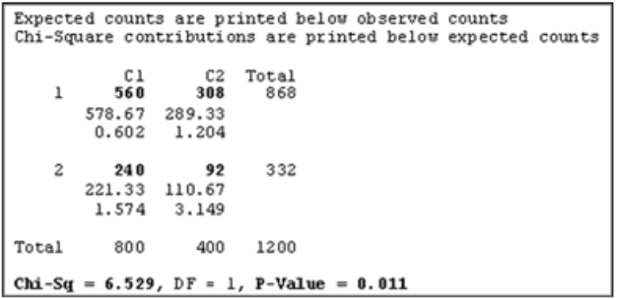
Example:
Significance level is a = 0.05.
This time we’ll use MINITAB.
.

Slide 58
Example:
The Minitab display shows the expected frequencies of 578.67, 289.33, 221.33, and 110.67. It also includes the test statistic of χ² = 6.529 and the P-value of 0.011.
Using the P-value approach to hypothesis testing, we reject the null hypothesis of equal (homogeneous) proportions (because the P-value of 0.011 is less than 0.05).
There is sufficient evidence to warrant rejection of the claim that the proportions are the same.
.

Slide 59
Example:
It appears that response and the gender of the interviewer are dependent. Although this statistical analysis cannot be used to justify any statement about causality, it does appear that men are influenced by the gender of the interviewer.
.

Slide 60
Fisher Exact Test
The procedures for testing hypotheses with contingency tables with two rows and two columns (2 × 2) have the requirement that every cell must have an expected frequency of at least 5. This requirement is necessary for the χ² distribution to be a suitable approximation to the exact distribution of the test statistic.
.

Slide 61
Fisher Exact Test
The Fisher exact test is often used for a 2 × 2 contingency table with one or more expected frequencies that are below 5. The Fisher exact test provides an exact P-value and does not require an approximation technique. Because the calculations are quite complex, it’s a good idea to use computer software when using the Fisher exact test. STATDISK and Minitab both have the ability to perform the Fisher exact test.
.

Slide 62
Recap
In this section we have discussed:
Contingency tables where categorical data is arranged in a table with a least two rows and at least two columns.
Test of Independence tests the claim that the row and column variables are independent of each other.
Test of Homogeneity tests the claim that different populations have the same proportion of some characteristics.
Fisher Exact Test
.

Slide 63
Section 11-4
McNemar’s Test for Matched Pairs
.
Notes:
This section is optional; it can easily be omitted.

Slide 64
Key Concept
The Contingency table procedures in Section 11-3 are based on independent data. For 2 x 2 tables consisting of frequency counts that result from matched pairs, we do not have independence, and for such cases, we can use McNemar’s test for matched pairs.
.

Slide 65
Key Concept
In this section we present the method of using McNemar’s test for testing the null hypothesis that the frequencies from the discordant (different) categories occur in the same proportion.
.

Slide 66
Table 11-9 is a general table summarizing the frequency counts that result from matched pairs.
.

Slide 67
Definition
McNemar’s Test uses frequency counts from matched pairs of nominal data from two categories to test the null hypothesis that for a 2 × 2 table such as Table 11-9, the frequencies b and c occur in the same proportion.
.

Slide 68
Notation
a, b, c, and d represent the frequency counts from a 2 × 2 table consisting of frequency counts from matched pairs.
(The total number of subjects is a + b + c + d.)
.

Slide 69
Requirements
The sample data have been randomly selected.
The sample data consist of matched pairs of frequency counts.
The data are at the nominal level of measurement, and each observation can be classified two ways: (1) According to the category distinguishing values with each matched pair, and (2) according to another category with two possible values.
For tables such as Table 11-9, the frequencies are such that b + c ≥ 10.
.

Slide 70
Null and Alternative Hypotheses
H₀: The proportions of the frequencies b and c (as in Table 11-9) are the same.
H₁: The proportions of the frequencies b and c (as in Table 11-9) are different.
.

Slide 71
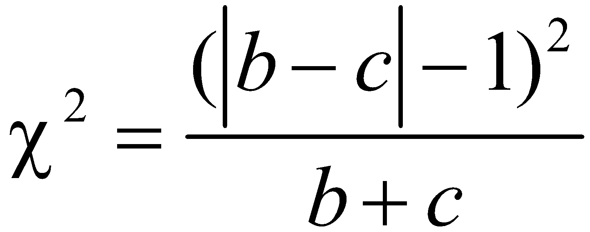
Test Statistic
Test Statistic (for testing the null hypothesis that for tables such as Table 11-9, the frequencies b and c occur in the same proportion):
where the frequencies of b and c are obtained from the 2 × 2 table with a format similar to Table 11-9.
.
Notes:
The test statistic chi-square values need to be compared with the chi-square critical value found in Table A-4.

Slide 72
Critical Values
The critical region is located in the right tail only.
2. The critical values are found in Table A-4 by using degrees of freedom = 1.
P-Values
P-values are typically provided by computer software, or a range of P-values can be found from Table A-4.
.
Notes:
The test statistic chi-square values need to be compared with the chi-square critical value found in Table A-4.

Slide 73
Example:
A randomized controlled trial was designed to test the effectiveness of hip protectors in preventing hip fractures in the elderly. Nursing home residents each wore protection on one hip, but not the other. Results are summarized in Table 11-10.
Using a 0.05 significance level, apply McNemar’s test to test the null hypothesis that the following two proportions are the same:
.
Notes:
The test statistic chi-square values need to be compared with the chi-square critical value found in Table A-4.

Slide 74
Example:
The proportion of subjects with no hip fracture on the protected hip and a hip fracture on the unprotected hip.
The proportion of subjects with a hip fracture on the protected hip and no hip fracture on the unprotected hip.
Based on the results, do the hip protectors appear to be effective in preventing hip fractures?
.
Notes:
The test statistic chi-square values need to be compared with the chi-square critical value found in Table A-4.

Slide 75
Example:
Requirements are satisfied: randomly selected subject; matched pairs of frequency counts; nominal level of measurement, categorized according to two variables, one is “hip protector worn” or “not”, the other is “hip fractured” or “not”; b + c = 10 + 15 = 25, which is at least 10
Data comes from matched pairs so use McNemar’s test: b = 10 and c = 15
.
Notes:
The test statistic chi-square values need to be compared with the chi-square critical value found in Table A-4.

Slide 76
Example:
Table A-4 with a 0.05 significance level and degrees of freedom = 1, right-tailed test: χ² = 3.841
The test statistic of χ² = 0.640 does not exceed the critical value of χ² = 3.841, so fail to reject the null hypothesis. Note the P-value is 0.424, which is greater than 0.05, so reject the null.
It appears that the proportion of hip fractures with the protectors worn is not significantly different from the proportion of hip fractures with- out the protectors worn. The hip protectors do not appear to be effective in preventing hip fractures.
.
Notes:
The test statistic chi-square values need to be compared with the chi-square critical value found in Table A-4.

Slide 77
Definition
Discordant pairs of results come from matched pairs of results in which two categories are different (as in the frequencies b and c in Table 11-9).
.
Notes:
The test statistic chi-square values need to be compared with the chi-square critical value found in Table A-4.

Slide 78
Caution
When applying McNemar’s test, be careful to use only the frequencies from the pairs of categories that are different. Do not blindly use the frequencies in the upper right and lower left corners, because they do not necessarily represent the discordant pairs. If Table 11-10 were reconfigured as shown on the next slide, it would be inconsistent in its format, but it would be technically correct in summarizing the same results as Table 11-10; however, blind use of the frequencies of 0 and 309 would result in the wrong test statistic.
.
Notes:
The test statistic chi-square values need to be compared with the chi-square critical value found in Table A-4.

Slide 79
Caution
The discordant pairs of frequencies are:
Hip fracture / No hip fracture: 15
No hip fracture / Hip fracture: 10
Still use 15 and 10 (not 0 and 309).
.
Notes:
The test statistic chi-square values need to be compared with the chi-square critical value found in Table A-4.

Slide 80
Caution
In addition to comparing treatments given to matched pairs McNemar’s test is often used to test a null hypothesis of no change in before/after types of experiments.
.
Notes:
The test statistic chi-square values need to be compared with the chi-square critical value found in Table A-4.

Slide 81
Recap
In this section we have discussed:
McNemar’s test for matched pairs.
Data are place in a 2 x 2 table where each
observation is classified in two ways.
The test only compares categories that
are different (discordant pairs).
.

