Slide 1
Chapter(10+13)
Correlation and
Regression

Slide 2
Outline
Introduction
10-1 Scatter plots .
10-2 Correlation .
10-3 Correlation Coefficient .
10-4 Regression .
Note: This PowerPoint is only a summary and your main source should be the book.

Slide 3
Correlation and Regression are inferential statistics involves determining whether a relationship between two or more numerical or quantitative variables exists.
Examples:
Is the number of hours a student studies is related to the student’s score on a particular exam?
Is caffeine related to heart damage?
Is there a relationship between a person’s age and his or her blood pressure?

Slide 4
Introduction
Correlation is a statistical method used to determine whether a linear relationship between variables exists.
Regression is a statistical method used to describe the nature of the relationship between variables—that is, positive or negative, linear or nonlinear.

Slide 5
There are two types of relationships
simple
multiple
In a simple relationship, there are two variables: an
independent variable (predictor variable)
dependent variable (response variable).
In a multiple relationship, there are two or more independent variables that are used to predict one dependent variable.
Note: This PowerPoint is only a summary and your main source should be the book.

Slide 6
Example:
1-Is there a relationship between a person’s age and his or her blood pressure?
The type of relationship:
The independent variable(s):
The dependent variable:
-------------------------------------------------------------
2-Is there a relationship between a students final score in math and factors such as the number of hours a student studies, the number of absences, and the IQ score.
The type of relationship:
The independent variable(s):
The dependent variable:

Slide 7
Simple relationship can also be positive or negative.
Positive relationship exists when both variables increase or decrease at the same time.
Example: a person’s height and perfect weight.
Negative relationship, as one variable increases, the other variable decreases and vice versa.
Example: the strength of people over 60 years of age.

Slide 8
Scatter Plots
A scatter plot is a graph of the ordered pairs (x, y) of numbers consisting of the independent variable x and the dependent variable y.
Notation:
  X: Explanatory (independent, predictor) variable
  Y: Response (dependent, outcome) variable

Slide 9
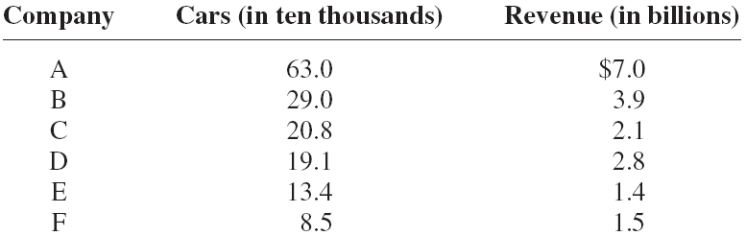
Example 10-1:
Construct a scatter plot for the data shown for car rental companies in the United States for a recent year.

Slide 10
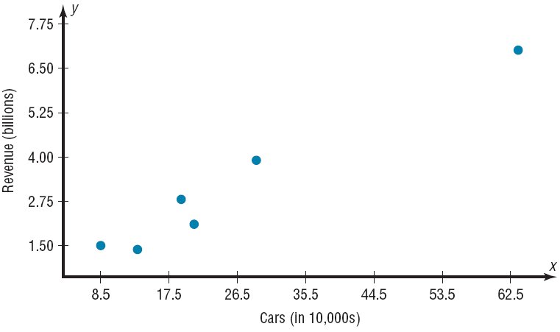
There is a positive relationship.
Dependent
Independent

Slide 11
Example 10-2:
Construct a scatter plot for the data obtained in a study on the number of absences and the final grades of seven randomly selected students from a statistics class.
Student | Number of absences x | Final grade y
A | 6 | 82
B | 2 | 86
C | 15 | 43
D | 9 | 74
E | 12 | 58
F | 5 | 90
G | 8 | 78

Slide 12
Solution :
Step 1: Draw and label the x and y axes.
Step 2: Plot each point on the graph.
There is a negative relationship

Slide 13
Example 10-3:
Construct a scatter plot for the data obtained in a study on the number of hours that nine people exercise each week and the amount of milk (in ounces) each person consumes per week.
Student | Hours x | Amount y
A | 3 | 48
B | 0 | 8
C | 2 | 32
D | 5 | 64
E | 8 | 10
F | 5 | 32
G | 10 | 56
H | 2 | 72
I | 1 | 48

Slide 14
There is no specific type of relationship.
Solution :
Step 1: Draw and label the x and y axes.
Step 2: Plot each point on the graph.

Slide 15
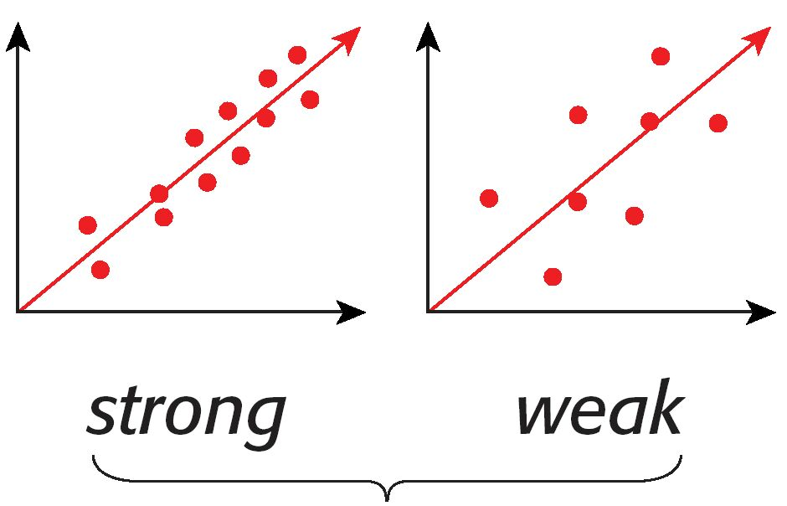
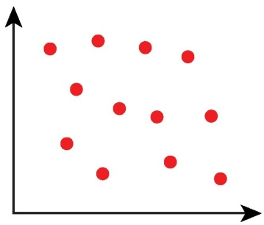
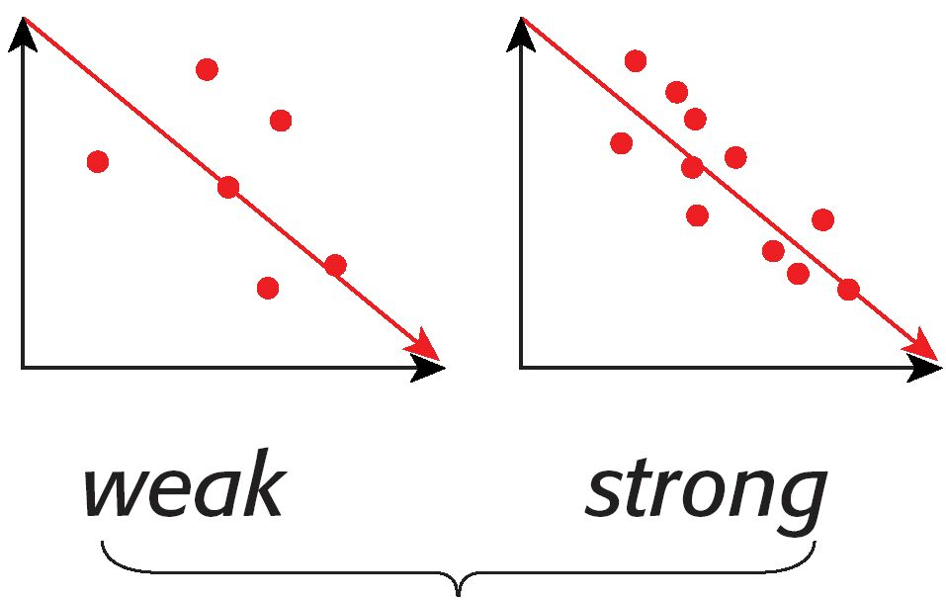
positive linear relationship
negative linear relationship

Slide 16
Do the data sets have a positive, a negative, or no relationship?
A. the relationship between exercise and weight
Negative relationship
C. The size of a person and the number of fingers he has
No relationship
D. When we study the relationship between the Number of hours
of studying and the final score
Positive relationship

Slide 17
Correlation

Slide 18
correlation coefficient, a numerical measure to determine whether two or more variables are related and to determine the strength of the relationship between or among the variables.
The correlation coefficient computed from the sample data measures the strength and direction of a linear relationship between two variables.
The symbol for the sample correlation coefficient is r.
The symbol for the population correlation coefficient is ρ.

Slide 19
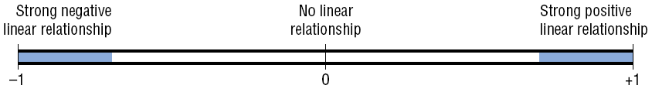
The range of the correlation coefficient is
from −1 to +1.
If there is a strong positive linear relationship between the variables, the value of r will be close to +1.
If there is a strong negative linear relationship between the variables, the value of r will be close to −1.
-1 ≤ r ≤ 1

Slide 20
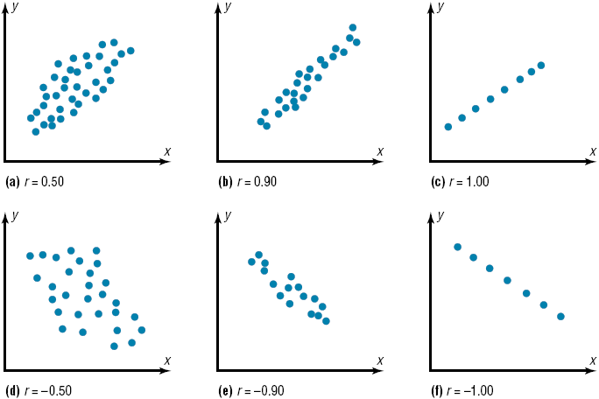

Slide 21
Correlation Coefficient
Pearson
Ch (10)
Spearman Rank
Ch (13)
-Denoted by ( r )
-Only Used when Two
variables are quantitative.
-Denoted by ( rs)
-Used when Two
variables are Quantitative
or Qualitative.

Slide 22
There are several types of correlation coefficients. The one explained in this section is called the Pearson product moment correlation coefficient (PPMC).

Slide 23
The formula for the correlation coefficient is
where n is the number of data pairs.
Rounding Rule: Round to three decimal places.

Slide 24
EX:
1- Compute the value of the Pearson product moment correlation coefficient for the data below:
2 | 1 | 4 | 2 | X
6 | 3 | 10 | 8 | Y

Slide 25
Example 10-4:
Compute the correlation coefficient for the data in Example 10–1.
company | Cars x | Income y | xy | x² | y²
A | 63.0 | 7.0 | 441 | 3969 | 49
B | 29.0 | 3.9 | 113.10 | 841 | 15.21
C | 20.8 | 2.1 | 43.68 | 432.64 | 4.41
D | 19.1 | 2.8 | 53.48 | 364.81 | 7.84
E | 13.4 | 1.4 | 18.76 | 179.56 | 1.96
F | 8.5 | 1.5 | 2.75 | 72.25 | 2.25
Σx = 153.8
Σy = 18.7
Σxy = 682.77
Σx² = 5859.26
Σy² = 80.67

Slide 26
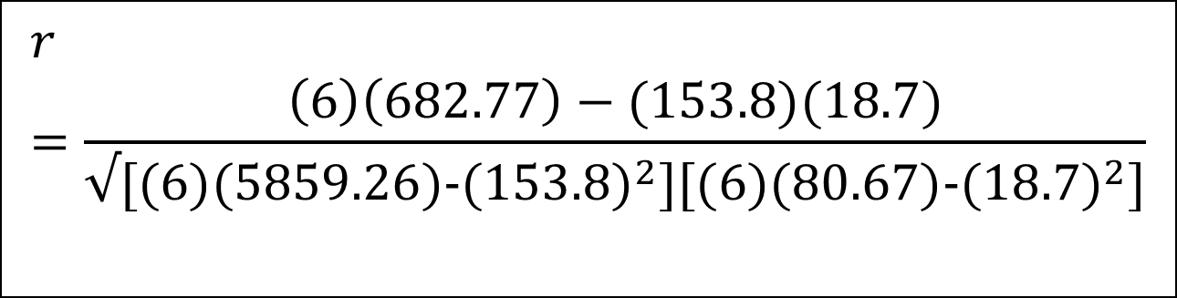
Solution :
$$r=\frac{\left(6\right)\left(682.77\right)−(153.8)(18.7)}{√[(6)(5859.26)-{(153.8)}^{2}][(6)(80.67)-{(18.7)}^{2}]}$$
r = 0.982 (Strong Positive Relationship)
Note: This PowerPoint is only a summary and your main source should be the book.

Slide 27
Example 10-5:
Compute the correlation coefficient for the data in Example 10–2.
Student | Number of absences | Final grade | xy | x² | y²
A | 6 | 82 | 492 | 36 | 6.724
B | 2 | 86 | 172 | 4 | 7.396
C | 15 | 43 | 645 | 225 | 1.849
D | 9 | 74 | 666 | 81 | 5.476
E | 12 | 58 | 696 | 144 | 3.364
F | 5 | 90 | 450 | 25 | 8.100
G | 8 | 78 | 624 | 64 | 6.084
Σx = 57
Σy = 511
Σxy = 3745
Σx² = 579
Σy² = 38.993

Slide 28

Solution :
r = -0.944 (strong negative relationship)
Note: This PowerPoint is only a summary and your main source should be the book.

Slide 29
Rank Correlation Coefficient

Slide 30
Other types of correlation coefficients. Is called the Spearman rank correlation coefficient, can be used when the data are ranked.
The formula for the correlation coefficient is
Where
d = difference in ranks.
n = number of data pairs.
If both sets of data have the same ranks ,r_{s} will be +1.
If the sets of data are ranked in exactly the opposite way , r_{s} will be
-1.
If there is no relationship between the ranking ,r_{s} will be near 0.

Slide 31
Example 13-7 P(698):
Two students were asked to rate eight different textbooks for a specific course on an ascending scale from 0 to 20 points. Compute the correlation coefficient for the data:
Textbook. | Student 1 | Student 2 | Rank(X1) | Rank(X2) | d=X1 – X2 | d²
A B C D E F G H | 4 10 18 20 12 2 5 9 | 4 6 20 14 16 8 11 7 |  |  | -1 -3 1 -2 1 3 2 -1 | 1 9 1 4 1 9 4 1
Total |  |  |  |  | 0 | 30
7
8
4
7
2
1
1
3
3
2
8
5
6
4
5
6

Slide 32
rs = 0.643 (strong positive relationship)

Slide 33
Regression
If the value of the correlation coefficient is significant, the next step is to determine the equation of the regression line which is the data’s line of best fit.

Slide 34
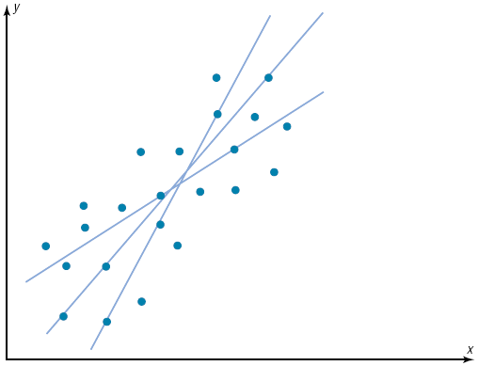
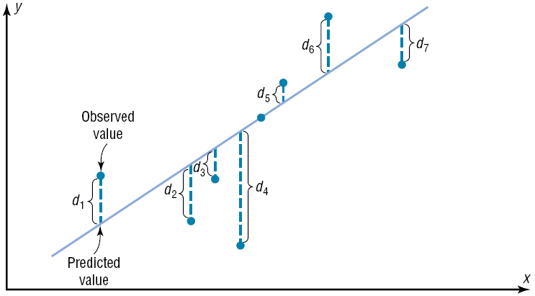
Best fit means that the sum of the squares of the vertical distance from each point to the line is at a minimum.

Slide 35
Regression Line

Slide 36
Example 10-9:
Find the equation of the regression line for the data in Example 10–4, and graph the line on the scatter plot.
Σx = 153.8, Σy = 18.7, Σxy = 682.77, Σx² = 5859.26,
Σy² = 80.67, n = 6

Slide 37
Find two points to sketch the graph of the regression line.
Use any x values between 10 and 60. For example, let x equal 15 and 40. Substitute in the equation and find the corresponding y value.
Plot (15,1.986) and (40,4.636), and sketch the resulting line.

Slide 38


Solution :
Example 10-10:
Find the equation of the regression line for the data in Example 10–5, and graph the line on the scatter plot.
Σx = 57, Σy = 511, Σxy = 3745, Σx² = 579, n = 7

Slide 39
*Remark:
The sign of the correlation coefficient and the sign of the slope of the regression line will always be the same.
r (positive) ↔ b (positive)
r (negative) ↔ b (negative)
Car Rental Companies: r=0.982, b=0.106
Absences and Final Grade: r= -0.944, b= -3.622
The regression line will always pass through the point
( ,ӯ).

Slide 40
*Remark:
The magnitude of the change in one variable when the other variable changes exactly 1 unit is called a marginal change. The value of slope b of the regression line equation represent the marginal change.
For Example:
Car Rental Companies: b= 0.106, which means for each increase of 10,000 cars, the value of y changes 0.106 unit (the annual income increase $106 million) on average.

Slide 41
For Example:
Absences and Final Grade :b= -3.622, which means for each increase of 1 absences, the value of y changes -3.62 unit (the final grade decrease 3.622 scores) on average.

Slide 42
Example 10-11:
Use the equation of the regression line to predict the income of a car rental agency that has 200,000 automobiles.
x = 20 corresponds to 200,000 automobiles.
Hence, when a rental agency has 200,000 automobiles, its revenue will be approximately $2.516 billion.

