Slide 1
Copyright © 2012 Pearson Prentice Hall. All rights reserved.

Slide 3
A P P L Y I N G T H E C O N C E P T S
1
Why does a new car lose about 20 percent of its value in the first week?
The Resale Value of a Week-Old Car
How can government solve the adverse-selection problem?
Regulation of the California Kiwifruit Market
Does the market for baseball pitchers suffer from the adverse-selection problem?
Baseball Pitchers Are Like Used Cars
How does car insurance affect driving behavior?
Car Insurance and Risky Driving
2
3
4

Slide 4
A P P L Y I N G T H E C O N C E P T S
5
How can we respond to the free-rider problem?
Free Riders and the Three-Clock Tower
What happens when external benefits spill across international borders?
Global Weather Observation
How do we determine the optimum level of pollution?
Reducing Methane Emissions
How do pollution taxes vary across space?
Pollution Taxes in Rural and Urban Areas
6
7
8

Slide 5
9.1
THE LEMONS PROBLEM
asymmetric information
A situation in which one side of the
market—either buyers or sellers—has
better information than the other.
mixed market
A market in which goods of different
qualities are sold for the same price.

Slide 6
9.1
THE LEMONS PROBLEM (cont’d)
Uninformed Buyers and Knowledgeable Sellers
How much is a consumer willing to pay for a used car that could be either a lemon or a plum? To determine a consumer’s willingness to pay in a mixed market with both lemons and plums, we must answer three questions:
1 How much is the consumer willing to pay for a plum?
2 How much is the consumer willing to pay for a lemon?
3 What is the chance that a used car purchased in the mixed market will be of low quality?
Consumer expectations play a key role in determining the market outcome when there is imperfect information.

Slide 7
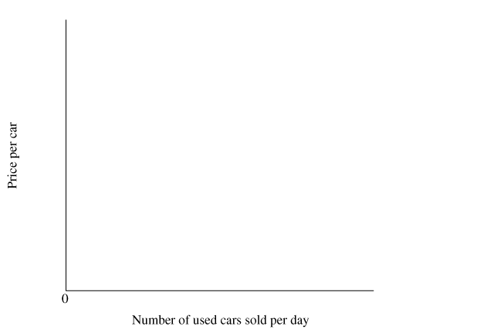
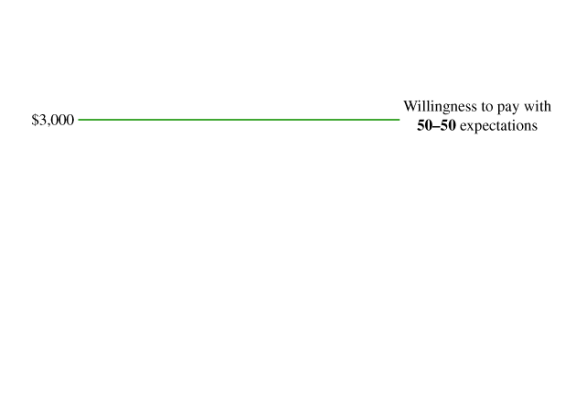
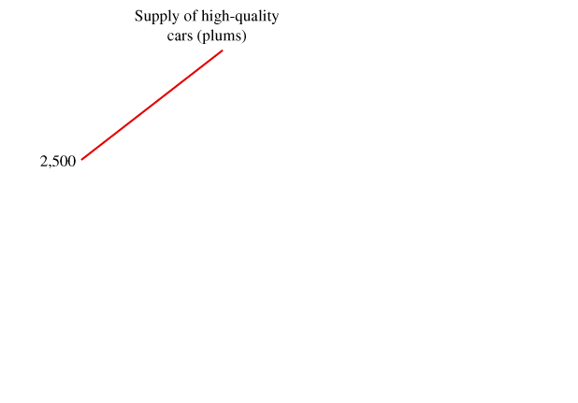
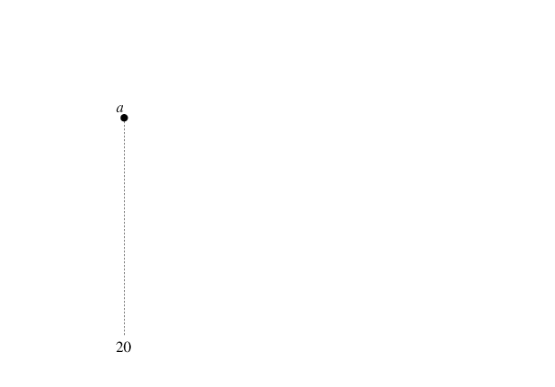
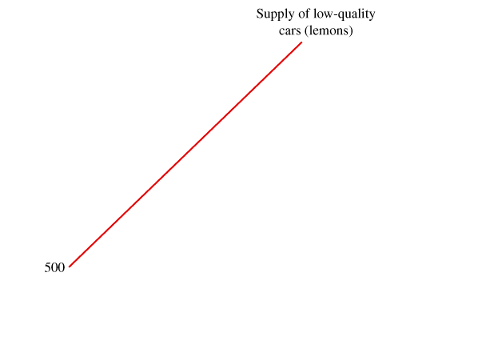
9.1
THE LEMONS PROBLEM (cont’d)
Uninformed Buyers and Knowledgeable Sellers
 FIGURE 9.1
All Used Cars on the Market Are Lemons
If buyers assume that there is a 50–50 chance of getting a lemon or a plum, they are willing to pay $3,000 for a used car.
At this price, 20 plums are supplied (point a) along with 80 lemons (point b). This is not an equilibrium because consumers’ expectations of a 50–50 split are not realized.
If consumers become pessimistic and assume that all cars on the market will be lemons, they are willing to pay $2,000 for a used car.
At this price, only lemons will be supplied (point c). Consumer expectations are realized, so the equilibrium is shown by point c, with an equilibrium price of $2,000.

Slide 8
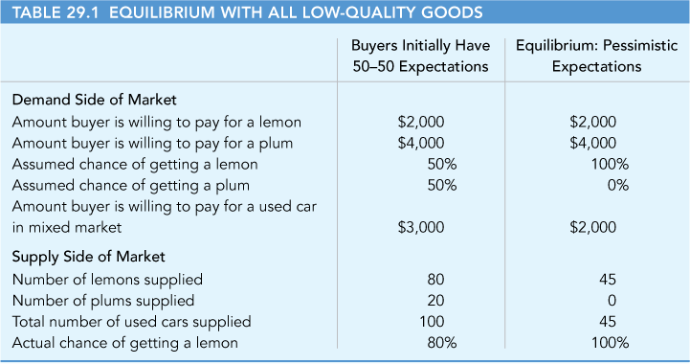
9.1
THE LEMONS PROBLEM (cont’d)
Equilibrium with All Low-Quality Goods

Slide 9
9.1
THE LEMONS PROBLEM (cont’d)
Equilibrium with All Low-Quality Goods
adverse-selection problem
A situation in which the uninformed side of the market must choose from an undesirable or adverse selection of goods.
The asymmetric information in the market generates a downward spiral of price and quality:
• The presence of low-quality goods on the market pulls down the price consumers are willing to pay.
• A decrease in price decreases the number of high-quality goods supplied, decreasing the average quality of goods on the market.
• The decrease in the average quality of goods on the market pulls down the price consumers are willing to pay again.

Slide 10
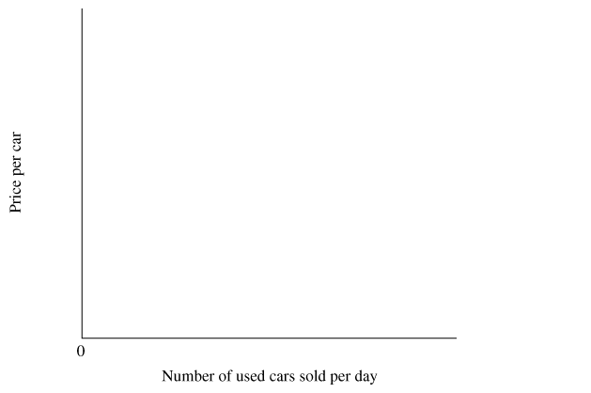
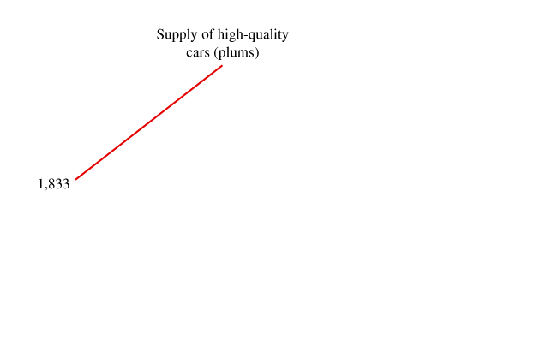
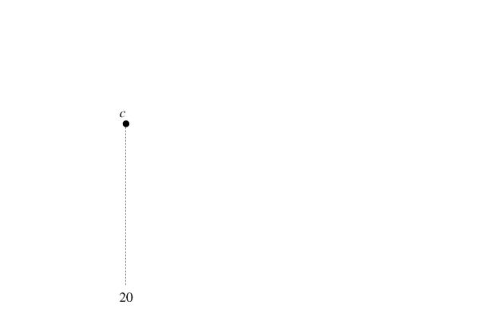
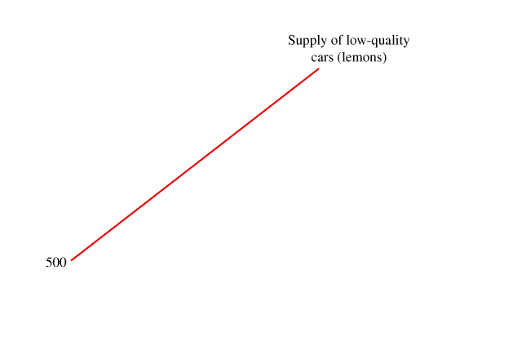
9.1
THE LEMONS PROBLEM (cont’d)
A Thin Market: Equilibrium with Some High-Quality Goods
 FIGURE 9.2
The Market for High-Quality Cars (Plums) Is Thin
If buyers are pessimistic and assume that only lemons will be sold, they are willing to pay $2,000 for a used car.
At this price, 5 plums are supplied (point a), along with 45 lemons (point b).
This is not an equilibrium because 10 percent of consumers get plums, contrary to expectations.
If consumers assume that there is a 25 percent chance of getting a plum, they are willing to pay $2,500 for a used car.
At this price, 20 plums are supplied (point c), along with 60 lemons (point d). This is an equilibrium because 25 percent of consumers get plums, consistent with their expectations.
Consumer expectations are realized, so the equilibrium is shown by points c and d.

Slide 11
9.1
THE LEMONS PROBLEM (cont’d)
A Thin Market: Equilibrium with Some High-Quality Goods
thin market
A market in which some high-quality goods are sold but fewer than would be sold in a market with perfect information.

Slide 12
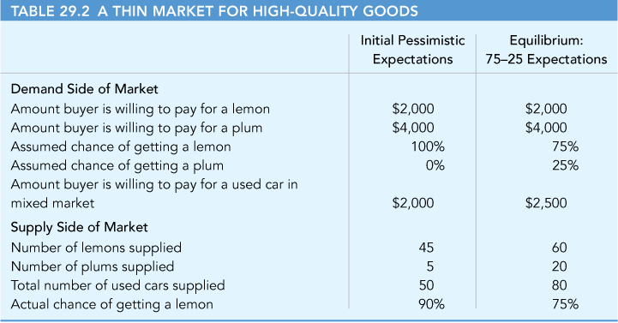
9.1
THE LEMONS PROBLEM (cont’d)
A Thin Market: Equilibrium with Some High-Quality Goods

Slide 13
9.1
THE LEMONS PROBLEM (cont’d)
Evidence of the Lemons Problem
The lemons model makes two predictions about markets with asymmetric information.
First, the presence of low-quality goods in a market will at least reduce the number of high-quality goods in the market and may even eliminate them.
Second, buyers and sellers will respond to the lemons problem by investing in information and other means of distinguishing between low-quality and high-quality goods.

Slide 14
9.2
RESPONDING TO THE LEMONS PROBLEM
Buyers Invest in Information
The more information a buyer has, the greater the chance of picking a plum from the cars in the mixed market.
Consumer Reports publishes information on repair histories of different models and computes a “Trouble” index, scoring each model on a scale of 1 to 5.
By consulting these information sources, a buyer improves the chances of getting a high-quality car.
Another information source is Carfax.com, which provides information on individual cars, including their accident histories.

Slide 15
9.2
RESPONDING TO THE LEMONS PROBLEM (cont’d)
Consumer Satisfaction Scores from ValueStar and eBay
How can a high-quality service provider distinguish itself from low-quality providers?
ValueStar is a consumer guide and business directory that uses customer satisfaction surveys to determine how well a firm does relative to its competitors in providing quality service.
Online consumers help each other by rating online sellers.

Slide 16
9.2
RESPONDING TO THE LEMONS PROBLEM (cont’d)
Guarantees and Lemons Laws
Sellers can identify a car as a plum in a sea of lemons by offering one of the following guarantees:
• Money-back guarantees.
Warranties and repair guarantees.

Slide 17
9.3
APPLICATIONS OF THE LEMONS PROBLEM
A P P L I C A T I O N
1
THE RESALE VALUE OF A WEEK-OLD CAR
APPLYING THE CONCEPTS #1: Why does a new car lose about 20 percent of its value in the first week?
If you buy a new car for $20,000 today and then try to sell it a week later, you probably won’t get more than $16,000 for it. The car will lose about 20 percent of its value in the first week. Why does the typical new car lose so much of its value in the first week?
A potential buyer of a week-old car might believe that a person who returns a car after only one week could have discovered it was a lemon and may be trying to get rid of it. Alternatively, the seller could have simply changed his or her mind about the car.
The problem is that buyers don’t know why the car is being sold. As long as there is a chance the car is a lemon, they won’t be willing to pay the full as-new price for it.
In general, buyers are willing to pay a lot less for a week-old car, and so the owners of high-quality, week-old cars are less likely to put them on the market.
This downward spiral ultimately reduces the price of week-old cars by about 20 percent.

Slide 18
A P P L I C A T I O N
2
REGULATION OF THE CALIFORNIA KIWIFRUIT MARKET
APPLYING THE CONCEPTS #2: How can government solve the adverse-selection problem?
Kiwifruit is subject to imperfect information because buyers cannot determine its sweetness—its quality level—by simple inspection.
There is asymmetric information because producers know the maturity of the fruit, but fruit wholesalers and grocery stores, who buy fruit at the time of harvest, cannot determine whether a piece of fruit will ultimately be sweet or sour.
Before 1987, kiwifruit from California suffered from the “lemons” problem. Maturity levels of the fruit varied across producers. On average, the sugar content at the time of harvest was below the industry standard, established by kiwifruit from New Zealand.
In 1987, California producers implemented a federal marketing order to address the lemon–kiwi problem. The federal order specified a minimum maturity standard, and as the average quality of California fruit increased, so did the price. Within a few years, the gap between California and New Zealand prices had decreased significantly.

Slide 19
A P P L I C A T I O N
3
BASEBALL PITCHERS ARE LIKE USED CARS
APPLYING THE CONCEPTS #3: Does the market for baseball pitchers suffer from the adverse-selection problem?
Professional baseball teams compete with each other for players. After six years of play in the major leagues, a player has the option of becoming a free agent. A player is likely to switch teams if the new team offers him a higher salary. One of the puzzling features of the free-agent market is that, on average, pitchers who switch teams spend 28 days per season on the disabled list, compared to only 5 days for pitchers who do not switch teams.
This puzzling feature of the free-agent market for baseball players is explained by asymmetric information and adverse selection.
Suppose the market price for pitchers is $1 million per year, and a pitcher who is currently with the Detroit Tigers is offered this salary by another team.
If the Tigers think the pitcher is likely to spend a lot of time next season recovering from injuries, they won’t try to outbid the other team for the pitcher.
If the Tigers think the pitcher will be injury-free and productive, he will be worth more than $1 million to the them, so they will outbid other teams.

Slide 20
INSURANCE AND MORAL HAZARD
9.4
moral hazard
A situation in which one side of
an economic relationship takes
undesirable or costly actions that the
other side of the relationship cannot
observe.
Insurance Companies and Moral Hazard
Insurance companies use various measures to decrease the moral-hazard problem. Many insurance policies have a deductible—a dollar amount that a policy holder must pay before getting compensation from the insurance company.
Deductibles reduce the moral-hazard problem because they shift to the policy holder part of the cost of a claim on the policy.

Slide 21
A P P L I C A T I O N
4
CAR INSURANCE AND RISKY DRIVING
APPLYING THE CONCEPTS #4: How does car insurance affect driving behavior?
The theory of moral hazard suggest that an insured driver would drive less carefully then an uninsured driver.
A recent study suggests the moral hazard cost of insurance is substantial.
When a state makes automobile compulsory, roads become more hazardous.
The number of collisions and traffic deaths increase.
Newly insured drivers drive less cautiously.
The study estimates that a one percent decrease in the number of uninsured drivers increases the number of traffic fatalities by two percent.

Slide 22
INSURANCE AND MORAL HAZARD (cont’d)
9.4
Deposit Insurance for Savings and Loans
When you deposit money in a Savings and Loan (S&L), the money doesn’t just sit in a vault. The S&L will invest the money, loaning it out and expecting to make a profit when loans are repaid with interest. Unfortunately, some loans are not repaid, and the S&L could lose money and be unable to return your money.
To protect people, the Federal Deposit Insurance Corporation (FDIC) insures the first $100,000 of your deposit, so if the S&L goes bankrupt, you’ll still get your money back.
The government enacted the federal deposit insurance law in 1933 in response to the bank failures of the Great Depression.

Slide 23
EXTERNAL BENEFITS AND PUBLIC GOODS
9.5
● external benefit A benefit from a good experienced by someone other than the person who buys the good.
Public Goods and the Free-Rider Problem
● public good A good that is available for everyone to consume, regardless of who pays and who doesn’t; a good that is nonrival in consumption and nonexcludable.
● private good A good that is consumed by a single person or household; a good that is rival in consumption and excludable.
● free rider A person who gets the benefit from a good but does not pay for it.

Slide 24
EXTERNAL BENEFITS AND PUBLIC GOODS (cont’d)
9.5
Overcoming the Free-Rider Problem
Successful organizations use a number of techniques to encourage people to contribute:
Giving contributors private goods such as coffee mugs, books, musical recordings, and magazine subscriptions.
Arranging matching contributions.
Appealing to a person’s sense of civic or moral responsibility.
Asteroid Diversion as a Public Good
The diversion of asteroids is a public good in the sense that it is available for everyone’s benefit, regardless of who pays and who doesn’t. As with any public good, the key to developing an asteroid-diversion program is to collect money to pay for the program.

Slide 25
A P P L I C A T I O N
5
FREE RIDERS AND THE THREE-CLOCK TOWER
APPLYING THE CONCEPTS #5: How can we respond to the free-rider problem?
Before inexpensive watches, many towns built clock towers, paid for by contributions.
One town built a four sided tower that only had three clocks, leaving blank the side facing a wealthy citizen who did not contribute.
This punished the non contributor that wanted a free ride, but also punished others who lived on that side of the clock.

Slide 26
A P P L I C A T I O N
6
GLOBAL WEATHER OBSERVATION
APPLYING THE CONCEPTS #6: What happens when external benefits spill across international borders?
As another example of a public good, consider global weather observation. In this case, information gathered by one country generates external benefits when it is shared with other countries.
Satellites, nomadic buoys, and weather stations monitor weather in different parts of the world, but no single organization gathers all the information to reveal the big weather picture.
Another problem is that the uninhabited parts of the world, in particular the vast oceans of the southern hemisphere, receive little monitoring.
In recent years, the United States has taken the lead in encouraging cooperation and the sharing of data collected by different organizations around the world.
According to the National Oceanic and Atmospheric Administration (NOAA), early warnings of a change in the current in 1997–98 reduced damage to the California economy by about $1.1 billion.

Slide 27
9.6
THE OPTIMAL LEVEL OF POLLUTION
Using the Marginal Principle
M A R G I N A L P R I N C I P L E
Increase the level of an activity as long as its marginal benefit exceeds its marginal cost. Choose the level at which the marginal benefit equals the marginal cost.
From society’s perspective, there are many benefits from pollution abatement:
Better health.
Increased enjoyment of the natural environment.
Lower production costs.

Slide 28
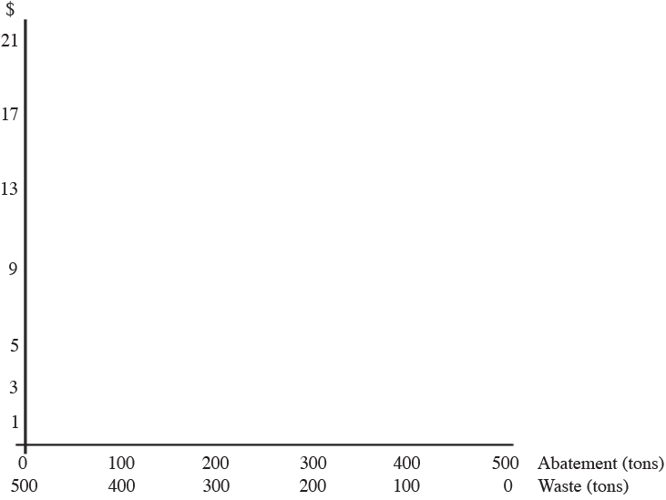
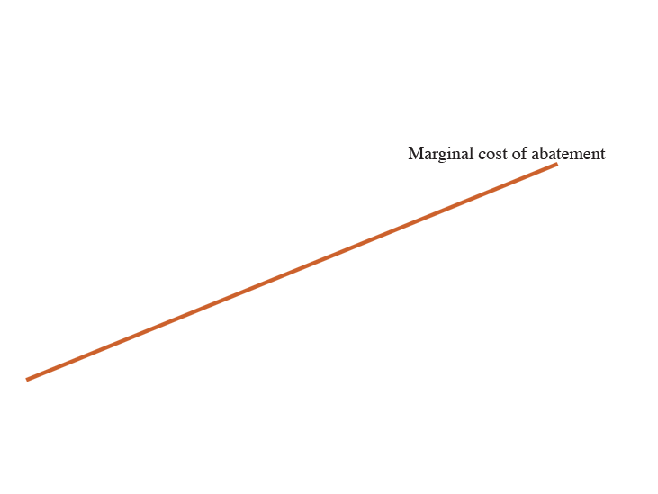
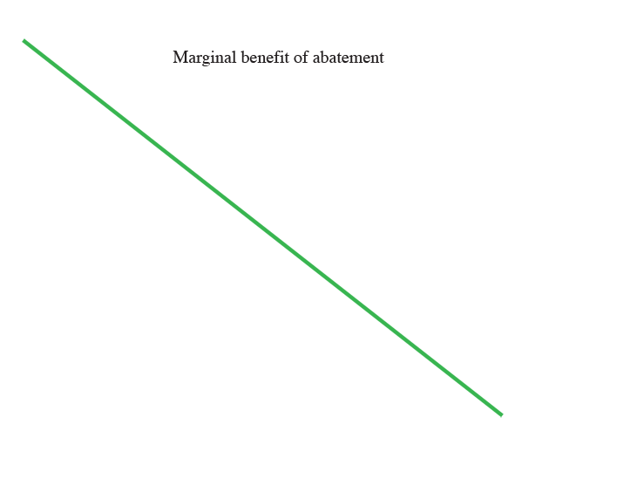
9.6
THE OPTIMAL LEVEL OF POLLUTION (cont’d)
Example: The Optimal Level of Water Pollution
 FIGURE 9.3 Efficient Abatement and Coase Bargaining
The efficient level of pollution abatement, where marginal benefit equals marginal cost, is 300 tons (200 tons of waste).
If the polluter has property rights we start with zero abatement and the other party pays for 300 tons of abatement.
If the other party has property rights, we start with zero abatement and the polluter pays to increase pollution to 200 tons of waste.

Slide 29
A P P L I C A T I O N
7
REDUCING METHANE EMISSIONS
APPLYING THE CONCEPTS #7: How do we determine the optimum level of pollution?
Methane contributes to global warming. It comes from landfills, natural gas systems, coal mining, and livestock.
The marginal cost of abatement is less than $10 per ton for the first 36 tons.
It increases to $150 per ton at 69 tons.
Recovery is relatively cheap at small amounts but becomes progressively more expensive
What is the optimum level of abatement?
It depends on the marginal benefit.

Slide 30
9.7
TAXING POLLUTION
● private cost of production The production cost borne by a producer, which typically includes the costs of labor, capital, and materials.
● external cost of production A cost incurred by someone other than the producer.
● social cost of production Private cost plus external cost.
● pollution tax A tax or charge equal to the external cost per unit of pollution.

Slide 31
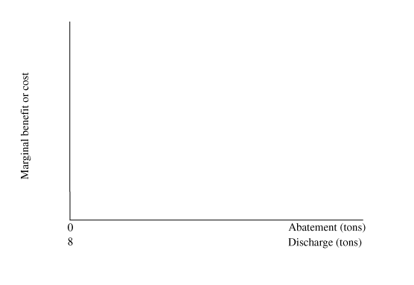
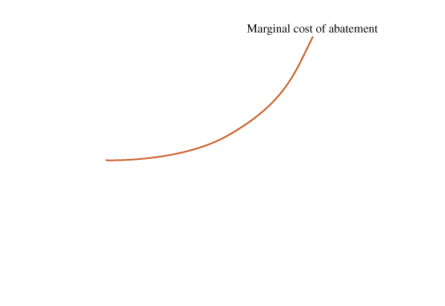
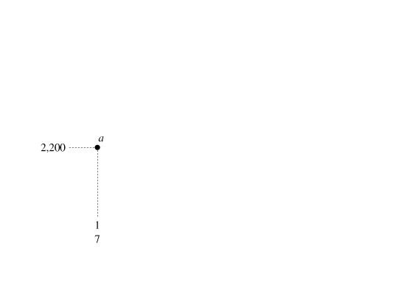
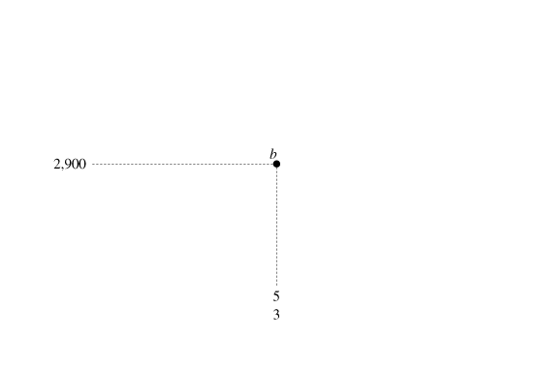
9.7
TAXING POLLUTION (cont’d)
A Firm’s Response to a Pollution Tax
FIGURE 9.4
The Firm’s Response to an SO₂ Tax
From the perspective of a firm subject to a pollution tax, the marginal benefit of abatement is the $3,500 pollution tax that can be avoided by cutting pollution by one ton.
The firm satisfies the marginal principle at point c, with six tons of abatement, leaving two tons of SO₂ discharged into the atmosphere.

Slide 32
9.7
TAXING POLLUTION (cont’d)
The Market Effects of a Pollution Tax
The production of electricity generates two major pollutants:
Sulfur dioxide.
Nitrogen oxides (NO_{x} ).

Slide 33
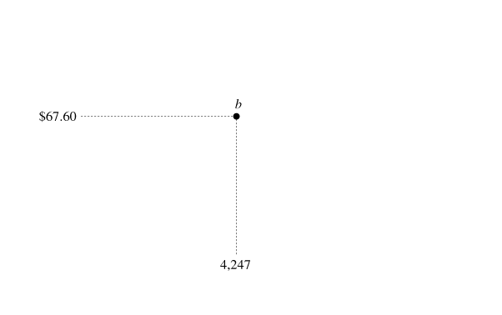
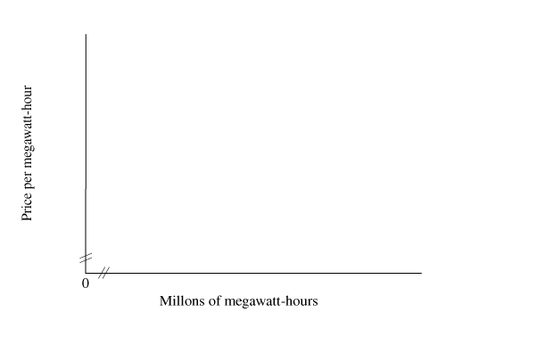
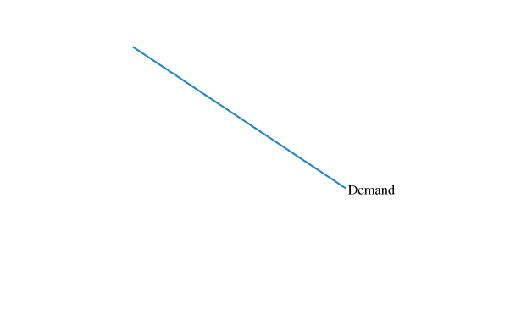
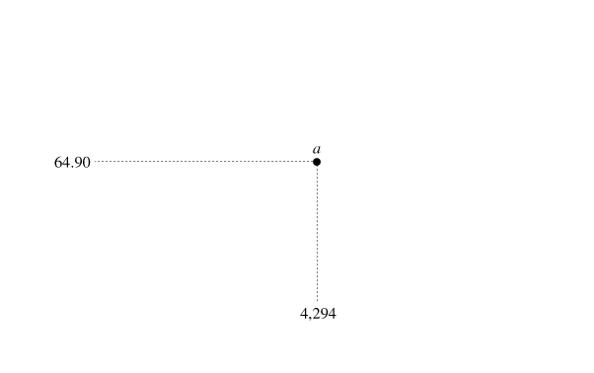
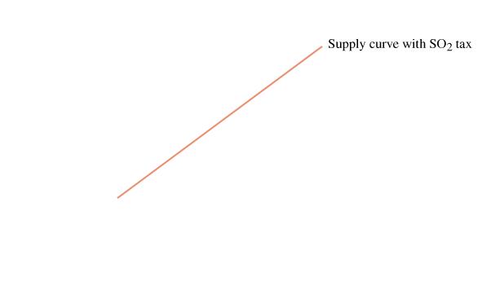
9.7
TAXING POLLUTION (cont’d)
►FIGURE 9.5 The Effects of SO₂ and NO_{x} Taxes on the Electricity Market
The pollution tax increases the cost of producing electricity, shifting the market supply curve up.
The equilibrium moves from point a to point b.
The tax increases the equilibrium price from $64.90 to $67.60 per megawatt-hour and decreases the equilibrium quantity.

Slide 34
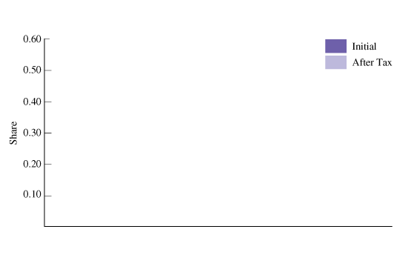
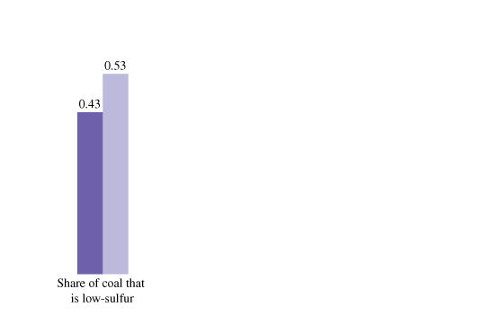
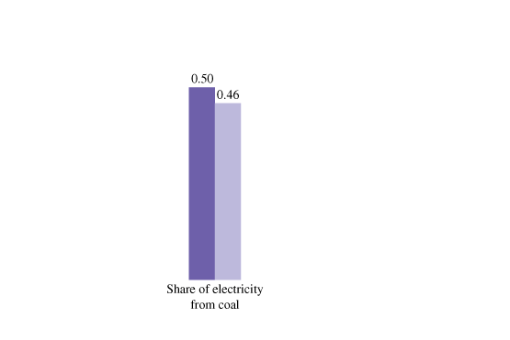
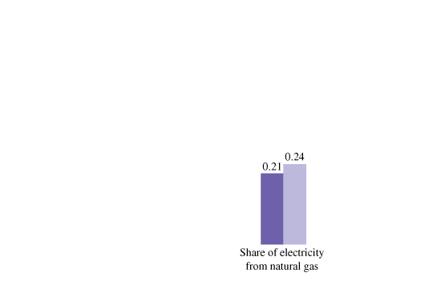
9.7
TAXING POLLUTION (cont’d)
►FIGURE 9.6 Responses to SO₂ and NOx Taxes on Electricity Generation
Taxes on SO₂ and NOx cause electricity generators to switch to low-sulfur coal and to alternative energy sources that generate less SO₂ and NOx.

Slide 35
A P P L I C A T I O N
8
POLLUTION TAXES IN RURAL AND URBAN AREAS
APPLYING THE CONCEPTS #8: How do pollution taxes vary across space?
A recent study estimated the marginal damages (external cost) for 10,000 sources of air pollution in the U.S.
• The study reveals substantial spatial variation because of differences in population density.
• Marginal damage is $220 per ton in rural Oregon.
• Marginal damage is $10,860 per ton near New York.
• The appropriate pollution tax is equal to the marginal damage, so the tax would be larger in an urban area than a rural one

Slide 36
9.8
TRADITIONAL REGULATION
Uniform Abatement with Permits
Consider an area with two electricity generators, firm L (for low cost) and firm H (for high cost). Suppose that in the absence of pollution-abatement efforts, each firm would discharge five tons of pollution per hour. The government sets a target abatement level of two tons of SO₂ per hour, divided equally between the two firms. Under this uniform abatement policy, the government will issue four pollution permits to each firm, forcing each firm to cut pollution from five tons to four tons.

Slide 37
9.8
TRADITIONAL REGULATION (cont’d)
Command and Control
The problem with this approach is that the mandated abatement technology—the control part of the policy—is unlikely to be the most efficient technology for two reasons:
The regulatory policy specifies a single abatement technology for all firms. Because the producers of a polluting good often use different materials and production techniques, an abatement technology that is efficient for one firm may be inefficient for others.
The regulatory policy decreases the incentives to develop more efficient abatement technologies. The command part of the policy specifies a maximum volume of waste for each firm, so there is no incentive to cut the volume of waste below the maximum allowed.

Slide 38
9.8
TRADITIONAL REGULATION (cont’d)
Market Effects of Pollution Regulations
How do the market effects of pollution regulation compare to a pollution tax?
The abatement policy achieves the same reduction in pollution at a higher cost because it doesn’t exploit differences in abatement costs across firms.
The control part of command and control may lead to costly abatement techniques because there’s no incentive to develop better ones.
This will cause the supply curve for the polluting good to shift upward by a larger amount than it would with a tax.
A larger supply shift causes a larger increase in the equilibrium price and a larger reduction in quantity. The inefficiency of regulations is passed on to consumers, who pay higher prices.

Slide 39
9.8
TRADITIONAL REGULATION (cont’d)
Lesson from Dear Abby: Options for Pollution Abatement
The readers of “Dear Abby” offered the following suggestions to Dreading Winter:
• Buy the neighbors a catalytic add-on for the wood stove or a wood-chip gasifier for an oil furnace. In either case, there would be much less air pollution from burning wood.
• Soak a towel in water, swish it around the room, and watch the smoke disappear.
• Leave a saucer of vinegar in each room to eliminate the smoke odor.
• Pay your neighbors to hire a chimney sweep to clean their flue.
• Seal and caulk your windows to keep the smoke outside at a cost of less than $500.
• Use the $500 to purchase an air purifier for your home.
There is usually more than one way to deal with a pollution problem.

Slide 40
9.9
MARKETABLE POLLUTION PERMITS
● marketable pollution permits
A system under which the government picks a target pollution level for a particular area, issues just enough pollution permits to meet the pollution target, and allows firms to buy and sell the permits; also known as a cap-and-trade system.

Slide 41
9.9
MARKETABLE POLLUTION PERMITS (cont’d)
Voluntary Exchange and Marketable Permits
Making pollution permits marketable is sensible because it allows mutually beneficial exchanges between firms with different abatement costs.
P R I N C I P L E O F V O L U N T A R Y E X C H A N G E
A voluntary exchange between two people makes both people better off.

Slide 42
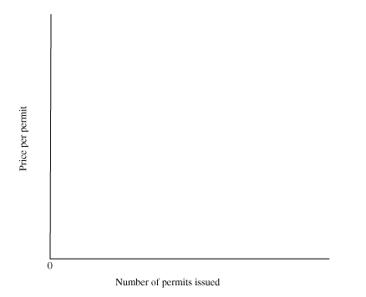
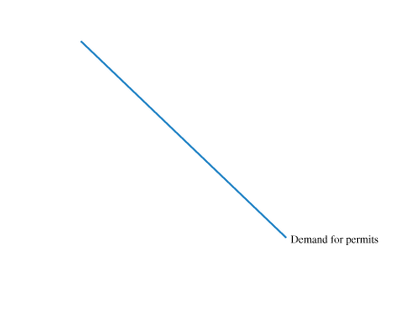
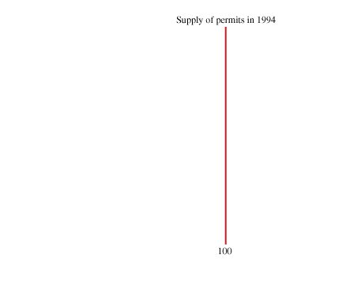
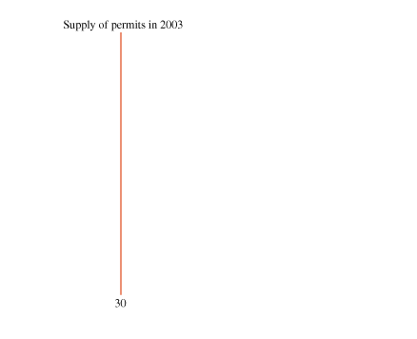
9.9
MARKETABLE POLLUTION PERMITS (cont’d)
Supply, Demand, and the Price of Marketable Permits
 FIGURE 9.7 The Market for Pollution Permits
The equilibrium price of permits is shown by the intersection of the demand curve and the vertical supply curve.
The supply curve is vertical because each year the government specifies a fixed number of permits.
A decrease in the number of permits shifts the supply curve to the left, increasing the equilibrium price.

Slide 43
KEY TERMS
adverse-selection problem
asymmetric information
experience rating
external cost of production
external benefit
marketable pollution permits
free rider
mixed market
marketable pollution permits
moral hazard
pollution tax
private cost of production
private good
public good
social cost of production
thin market

