Slide 1
Unit 5 In the street
Lesson 1

Slide 2
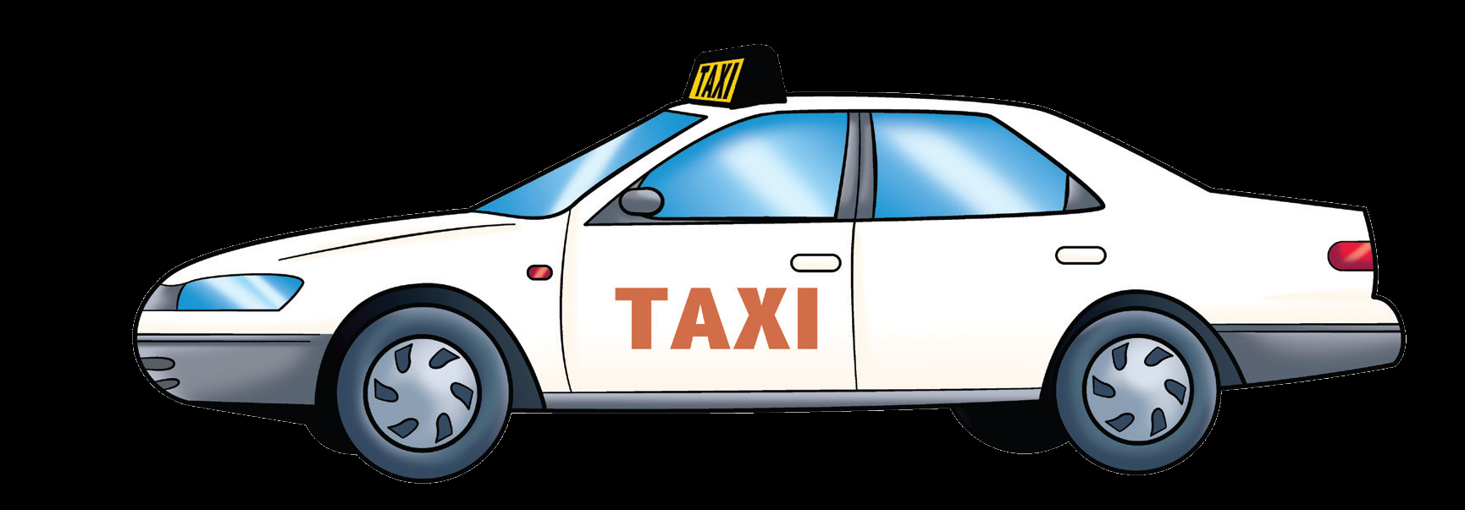
taxi

Slide 3
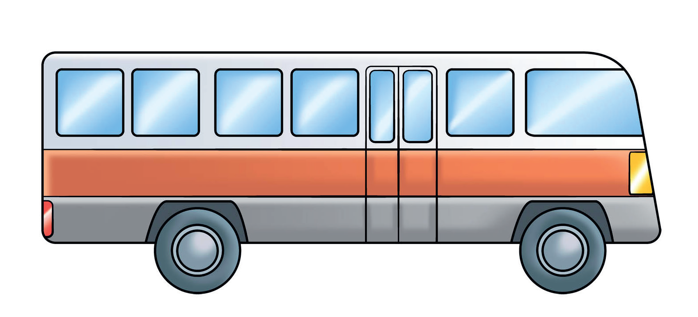
bus

Slide 4
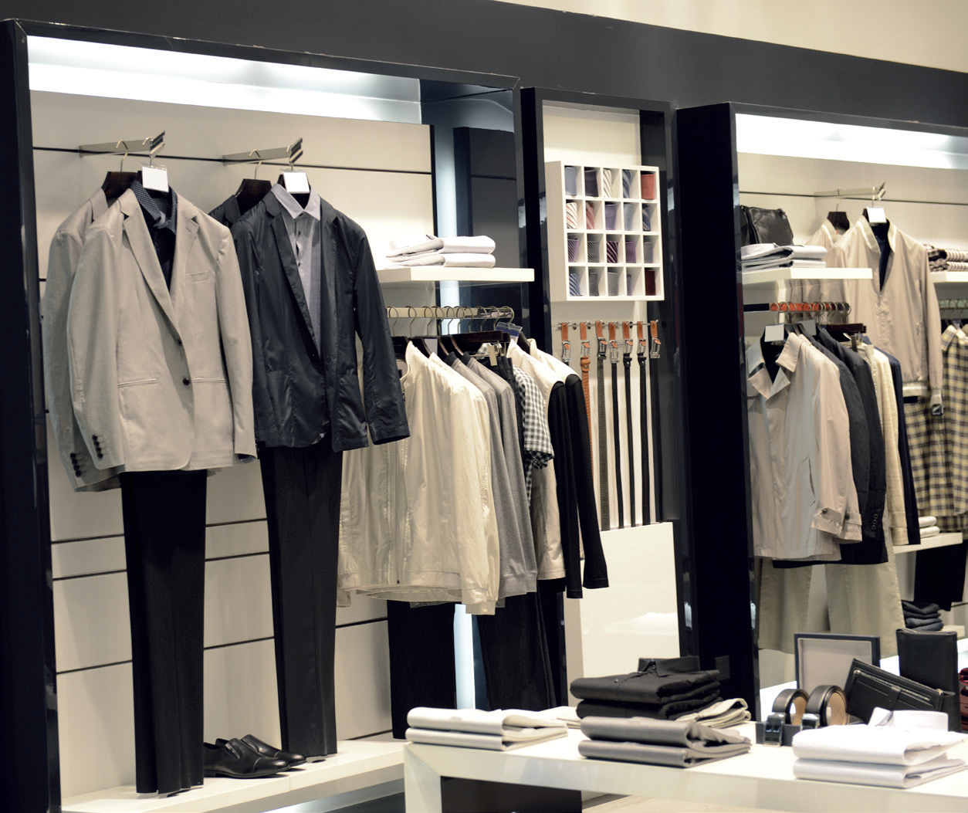
shop

Slide 5
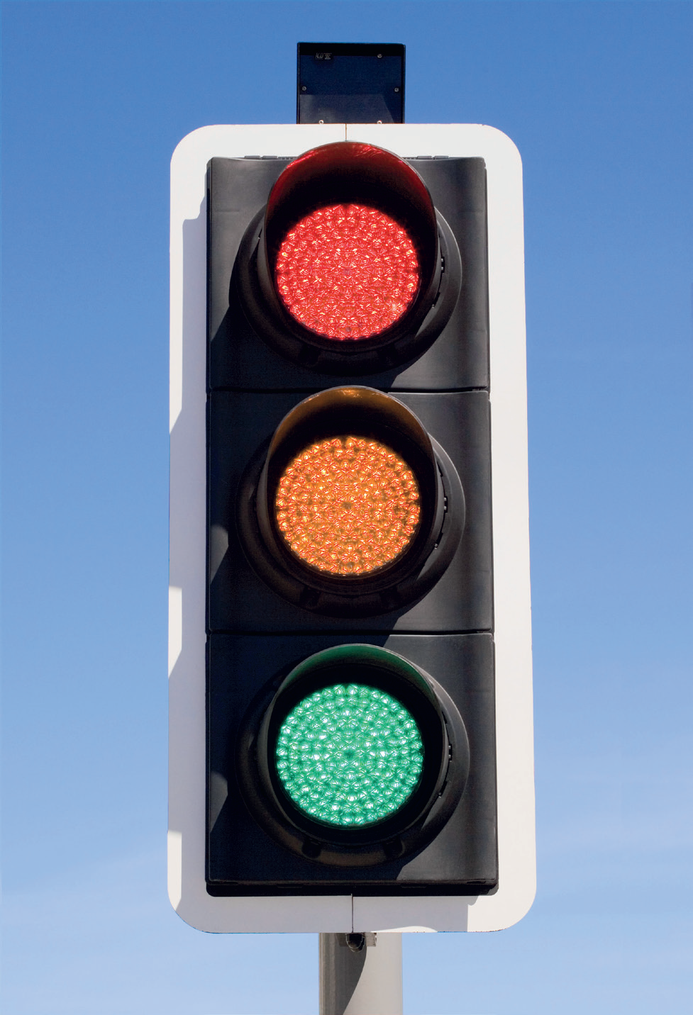
Traffic
light

Slide 6
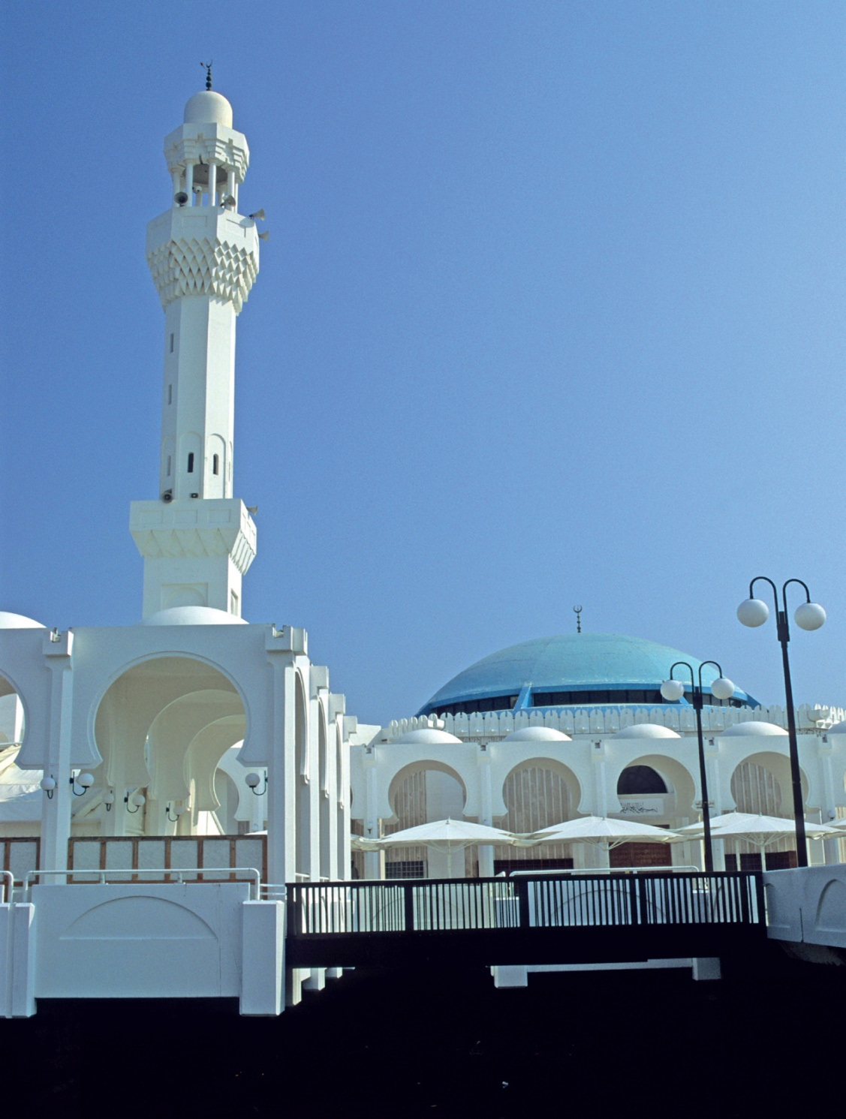
mosque

Slide 7
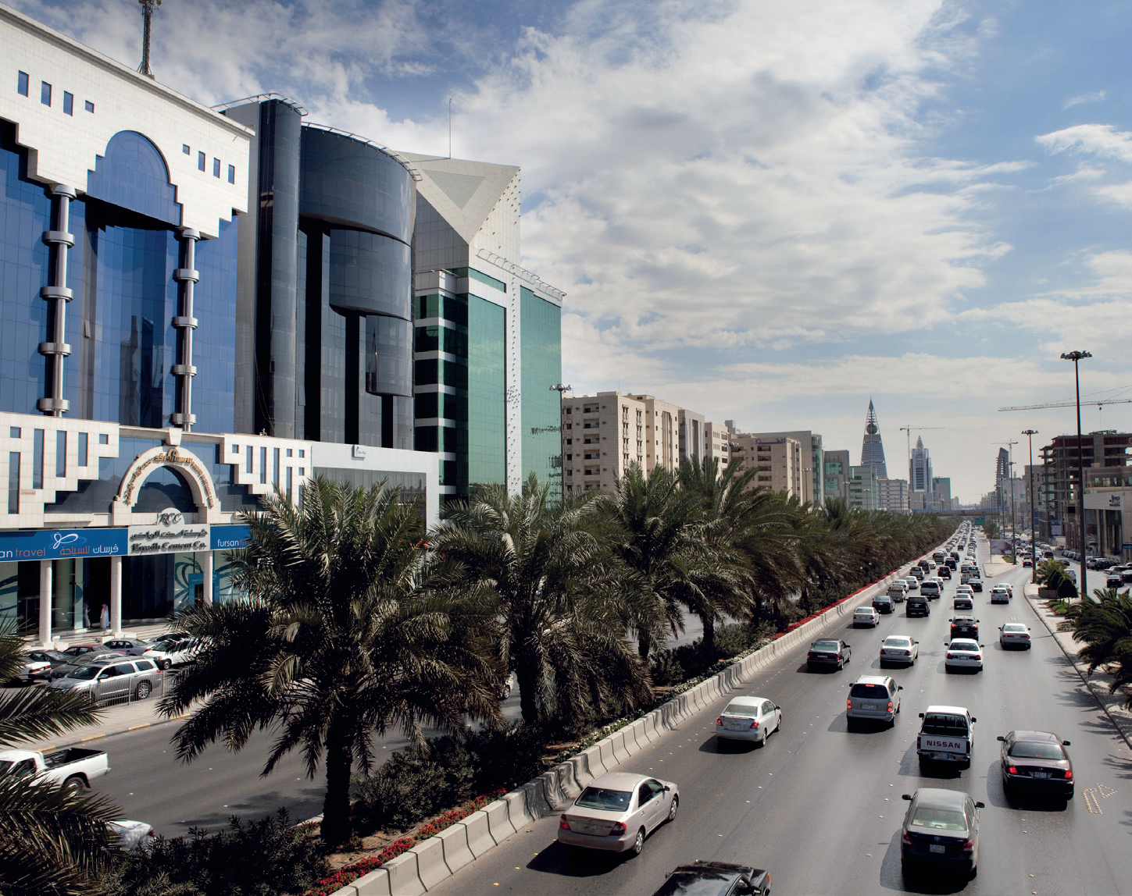
street

Slide 8
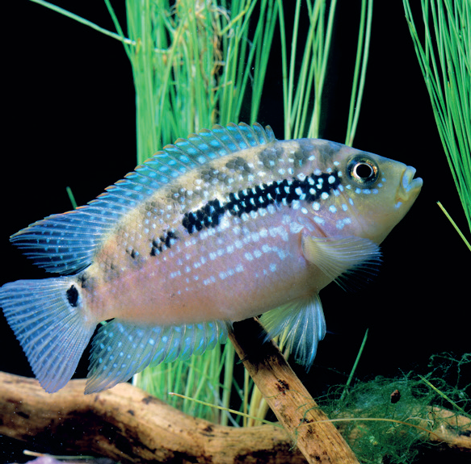
F f
fish

Slide 9
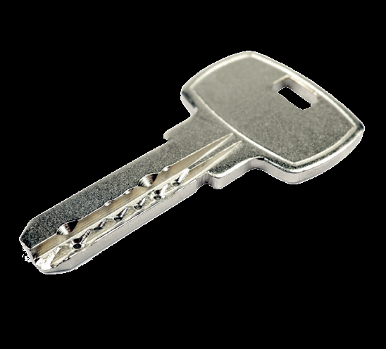
K k
key

Slide 10
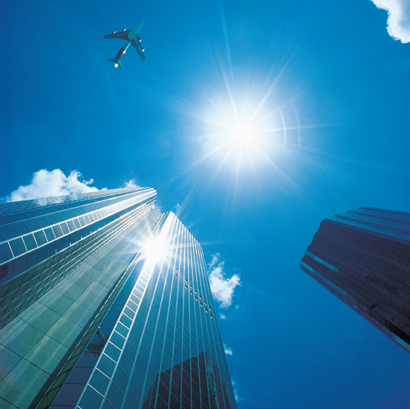
S s
sky

Slide 11
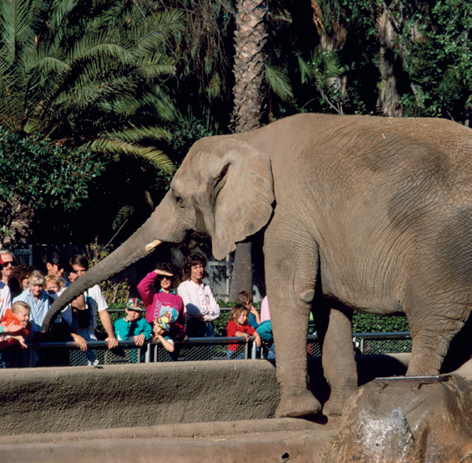
Z z
zoo

Slide 12
c
d
b
a

Slide 15
4
6
1
5
3
2

Slide 16
Work book P. 75

Slide 18
4
2
3
5

Slide 22
k
f
f
z
s
s
3
6
7
10
40
70
20
90
13
17
21
33
66
99

