Slide 1
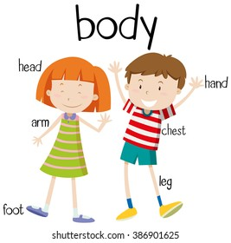
Day
Sunday
Date
3rd Oct 2021
Subject
We can 1
Unit
2 My Body
Lesson
3 Words
Page
16-17

Slide 2
objectives
*Pair work
*Role play
*Problem solving
strategies

Slide 3
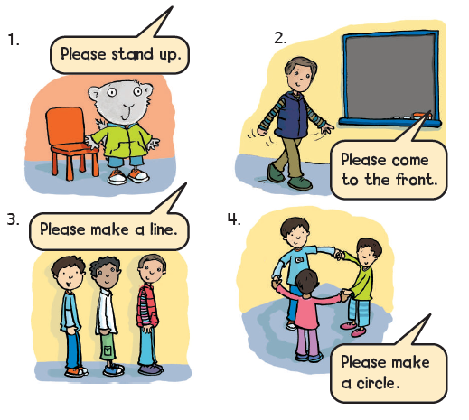
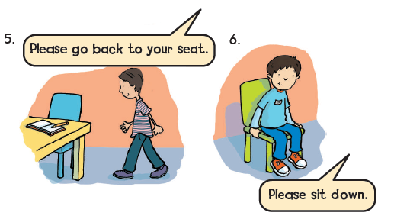
Listen and point.
1
2
Listen again , say and do

Slide 4
Choose the correct answer:
Please, stand up.
Please, sit down.
Please, make a line.
Please, make a circle.

Slide 5
Choose the correct answer:
Please, stand up.
Please, sit down.
Please, make a line.
Please, make a circle.

Slide 6
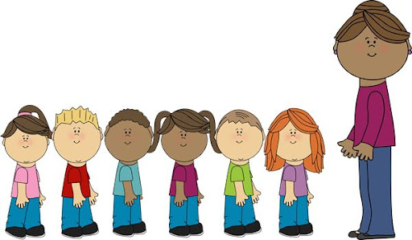
Choose the correct answer:
Please, stand up.
Please, sit down.
Please, make a line.
Please, make a circle.

Slide 7
Choose the correct answer:
Please, stand up.
Please, sit down.
Please, make a line.
Please, make a circle.

Slide 8
https://www.liveworksheets.com/c?a=s&t=db54lxqgcq&sr=n&ms=uz&l=sd&i=dcucnos&r=li&db=0&f=dzduzndo&cd=pnf89amtbktlpnnkxkljpao2ngnxglnjxg

Slide 9
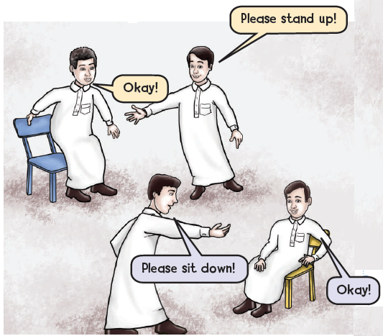
وقت المرح
3
Be the teacher
Give instructions to your partner .

Slide 11
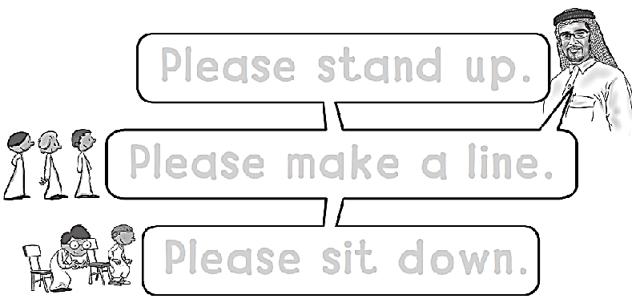
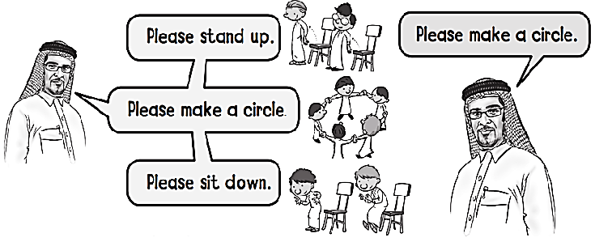
Please stand up .
Please make a line .
Please sit down .

Slide 12
M M M M M

Slide 14
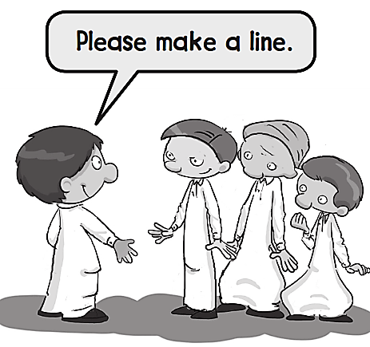
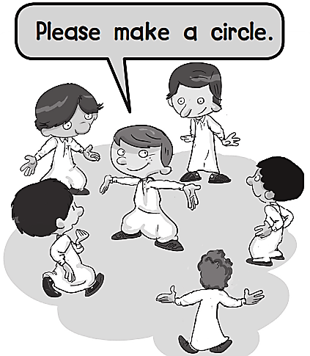
Please stand up .
Please come
to the front .

Slide 15
N N N N N N N

