Slide 1
Unit 2
Around The School

Slide 2
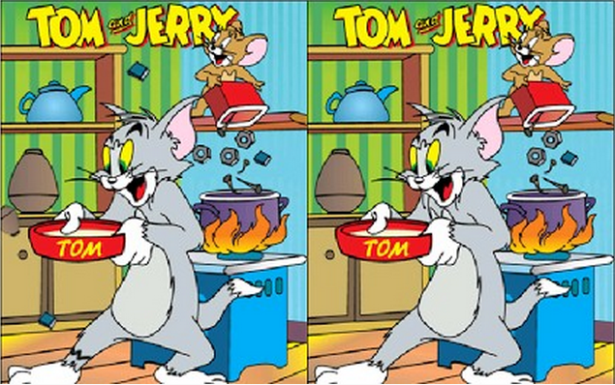

Slide 3
d
a
b
e
c

Slide 5
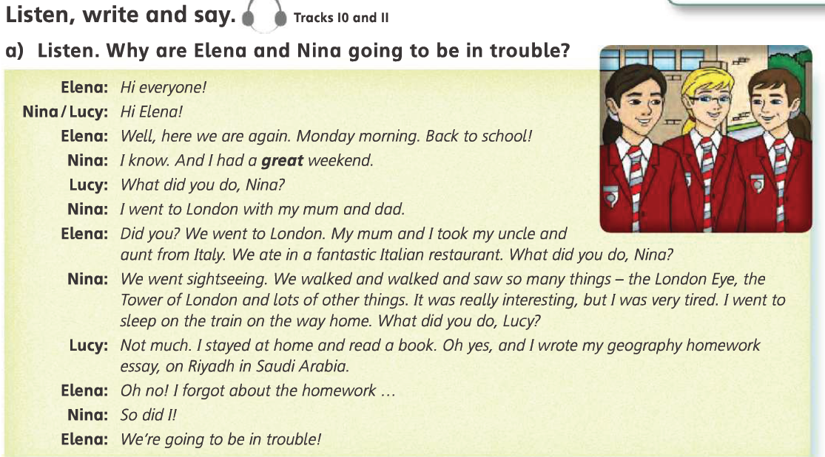

Slide 7
No, they didn’t.
Because they haven’t got there essay.
Yes, she does.

Slide 8
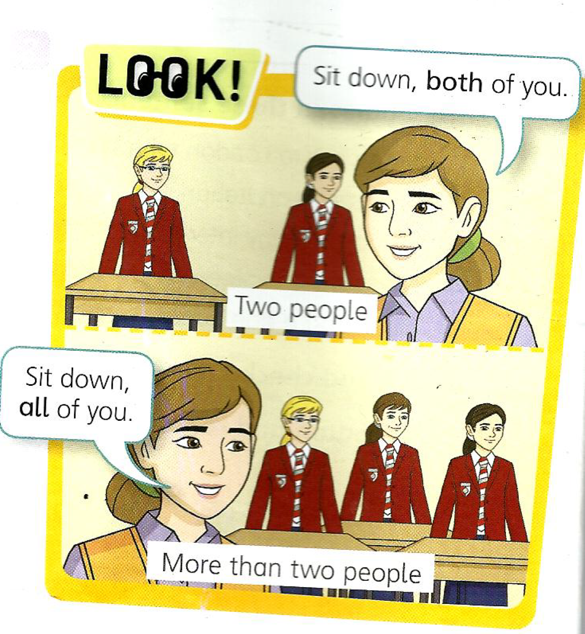

Slide 10
3
7
6
2
4
5

Slide 12
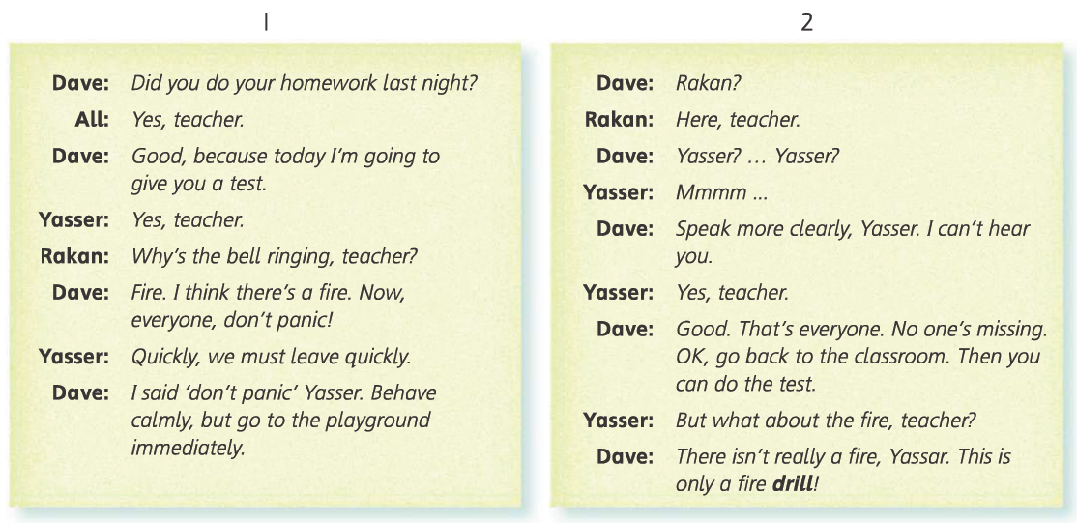
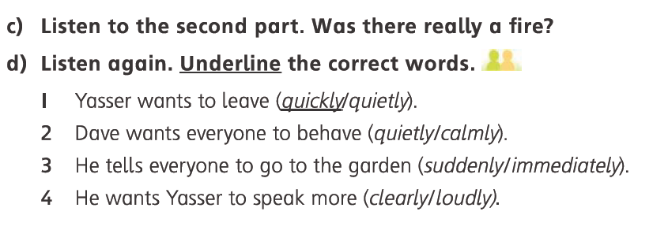

Slide 13
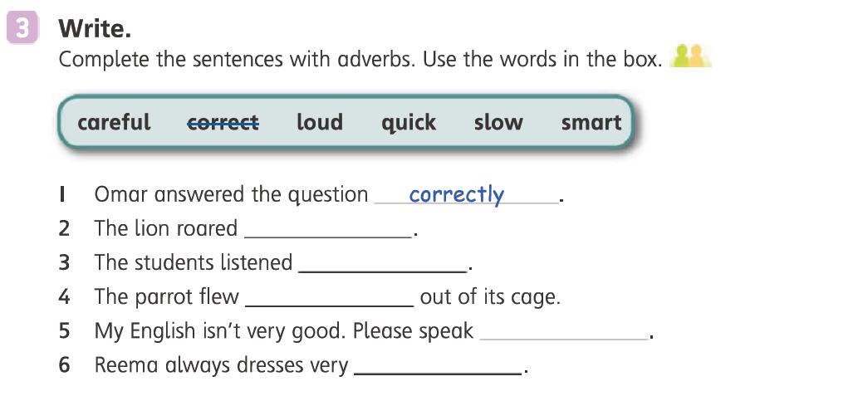

Slide 14
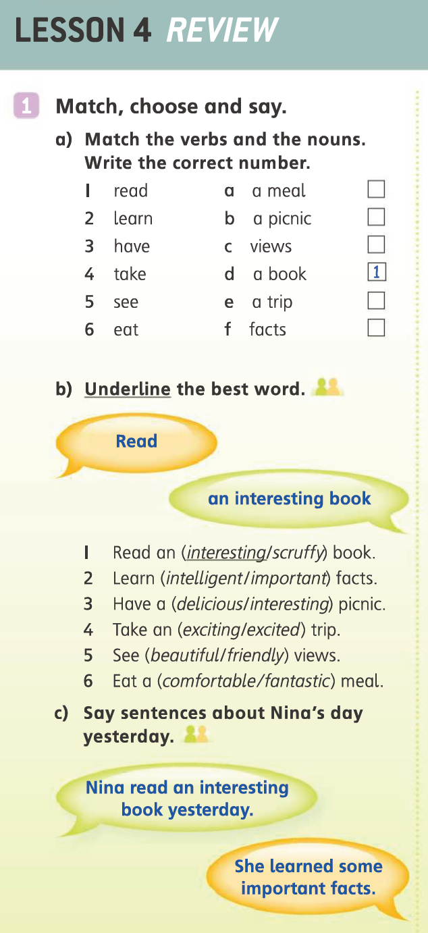
6
3
5
4
2

Slide 15
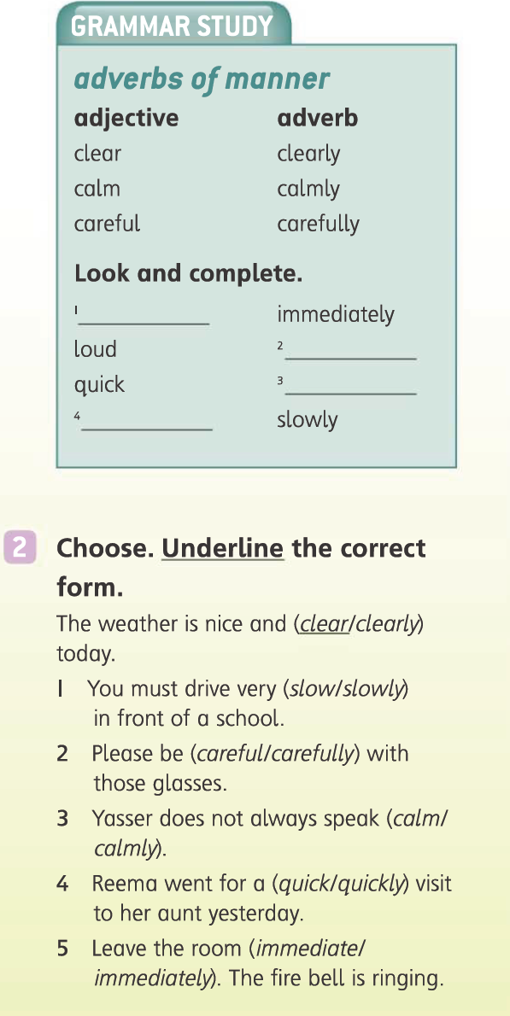
immediate
loudly
quickly
slow

Slide 17
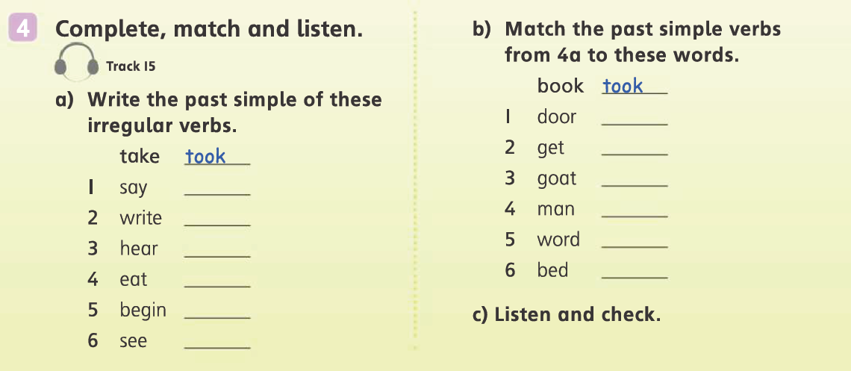
saw
ate
wrote
began
heard
said
saw

Slide 18
The End
والحمد الله والصلاة والسلام على رسول الله

