Slide 1
Chapter 11
Reproduction and Embryonic Development
1

Slide 2
ASEXUAL AND SEXUAL REPRODUCTION
2

Slide 3
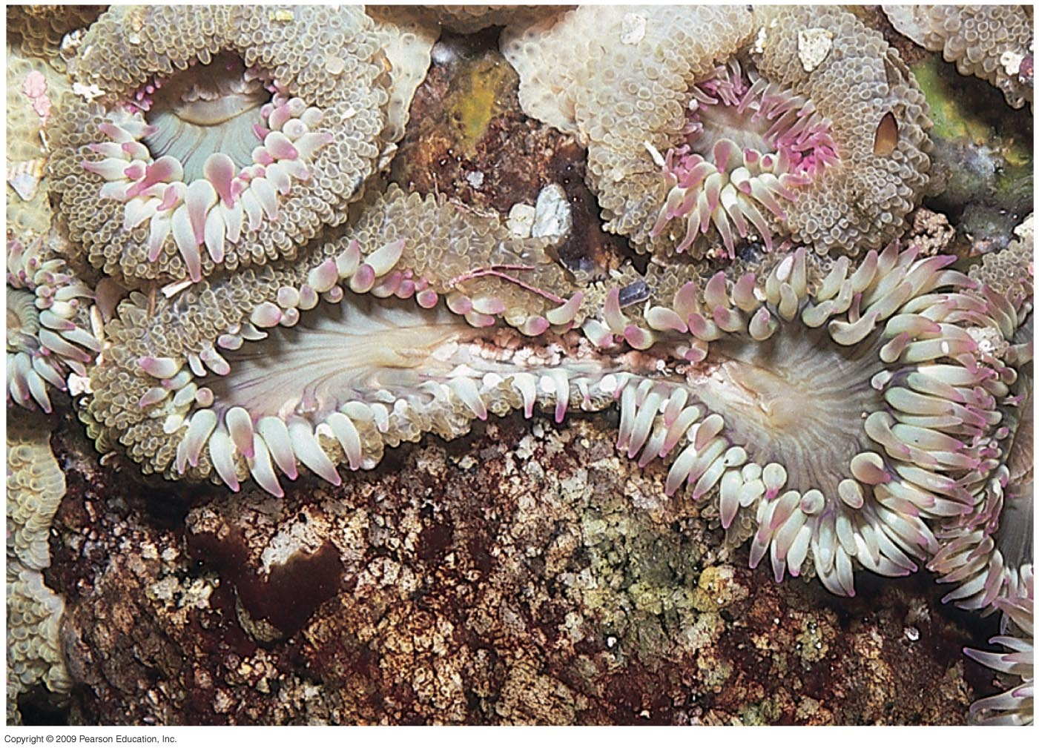
Asexual reproduction results in the generation of genetically identical offspring
0
Asexual reproduction
One parent produces genetically identical offspring
Very rapid reproduction
Can proceed via
Budding
Fission
Fragmentation/
regeneration
Asexual reproduction of an aggregating
Sea anemone (Anthopleura elegantissima)
by fission
3
Notes:
1. Students do not often understand the costs and benefits of asexual and sexual reproduction. Consider discussing the advantages and disadvantages of each of these forms of reproduction. Encourage students to focus on the compromises involved in any adaptation. There is simply no one “best” way for all animals to reproduce.
Teaching Tips
1. Aphid life cycles also alternate between asexual and sexual reproductive strategies. Consider challenging your class to explain why aphids (and other animals) do this. In general, sexual reproduction is most common in times of stress, and may be related to overpopulation or environmental change.

Slide 4
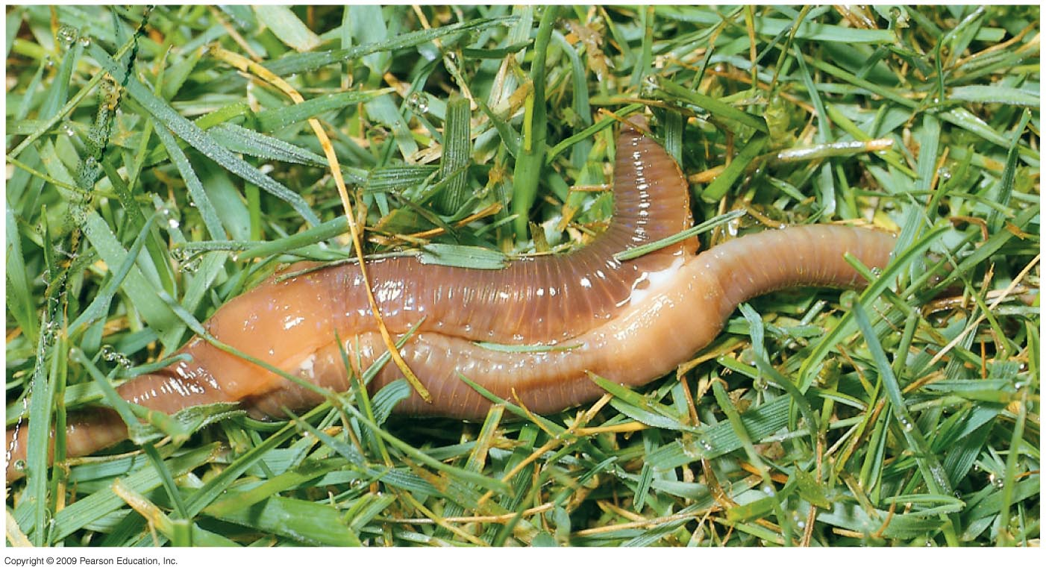
Sexual reproduction results in the generation of genetically unique offspring
0
Some animals exhibit hermaphroditism
One individual with male and female reproductive systems
Easier to find a mate for animals less mobile or solitary
Hermaphroditic earthworms mating
4

Slide 5
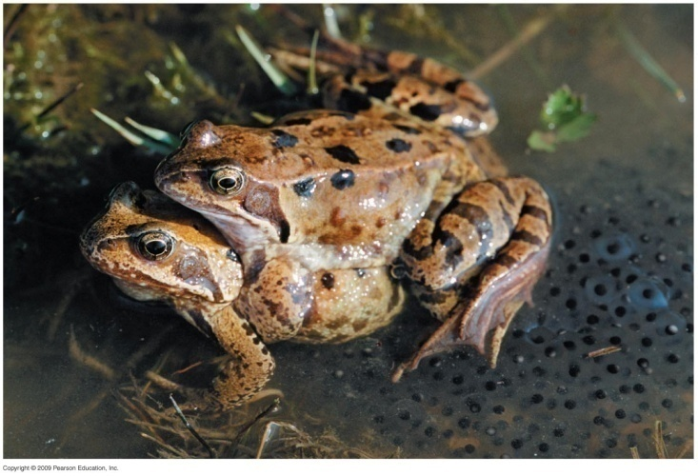
Sexual reproduction results in the generation of genetically unique offspring
0
Sperm may be transferred to the female by
External fertilization
Many fish and amphibian species
Eggs and sperm are discharged near each other
Internal fertilization
Some fish and amphibian species
Nearly all terrestrial animals
Sperm is deposited in or near the female reproductive tract
Frogs in an embrace that triggers the release of eggs and sperm
5

Slide 6
Human Reproduction
0
Both sexes in humans have
A set of gonads where gametes (sperms & ova) are produced
Ducts for gamete transport
Structures for copulation
6

Slide 7
Human Female Reproductive anatomy
0
Ovaries contain follicles that Nurture eggs and Produce sex hormones
Oviducts convey eggs to the uterus where embryos develop
The uterus opens into the vagina through the cervix
The vagina
Receives the penis during sexual intercourse
Forms the birth canal
7

Slide 8
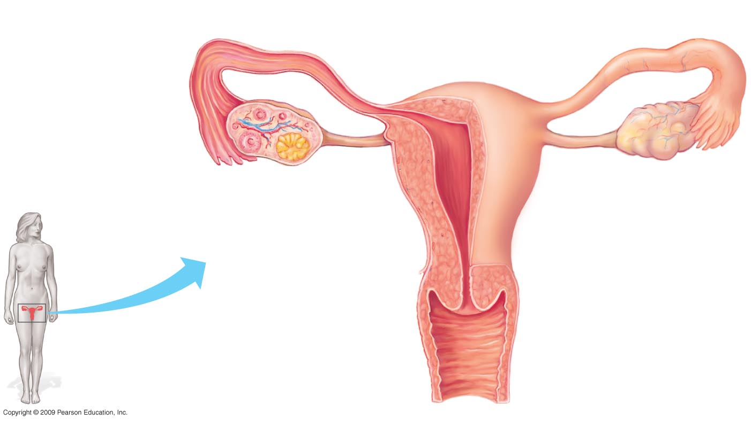
Oviduct
Ovaries
Follicles
Corpus luteum
Uterus
Wall of uterus
Endometrium
(lining of uterus)
Cervix
(“neck” of uterus)
Vagina
Front view of female reproductive anatomy
(upper portion)
8

Slide 9
Human Male Reproductive anatomy
0
Testes (singular testis) produce Sperm and male hormones
Epididymis stores sperm as they develop further
Several glands contribute to semen
Seminal vesicles
Prostate
Bulbourethral
Sperm production )Spermatogenesis(
Regulated by a negative feedback system of hormones
Involves the hypothalamus, pituitary, and testes
9

Slide 10
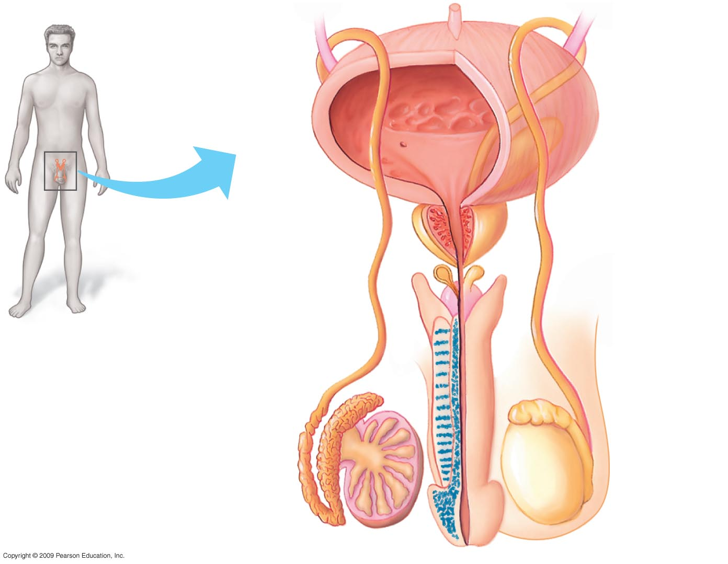
Urinary
Bladder
Seminal Vesicle
(behind bladder)
Prostate gland
Bulbourethral gland
Urethra
Erectile tissue of penis
Vas deferens
Scrotum
Epididymis
Testis
Glans of
Penis
Front view of male reproductive anatomy
10

Slide 11
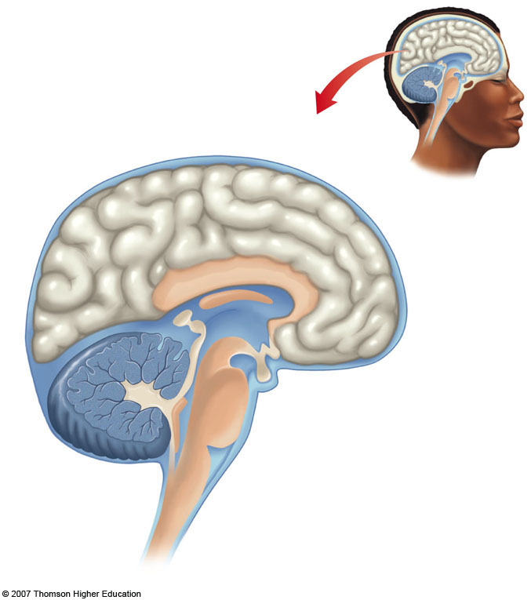
Midsagittal section through the human brain.
Cerebrum
Thalamus
Hypothalamus
Cerebellum
Pituitary gland
Medulla
Spinal cord
11
Notes:
Half of the brain has been cut away, exposing structures normally covered by the cerebrum. Compare the diagram (a) with the photograph of the human brain (b).

Slide 12
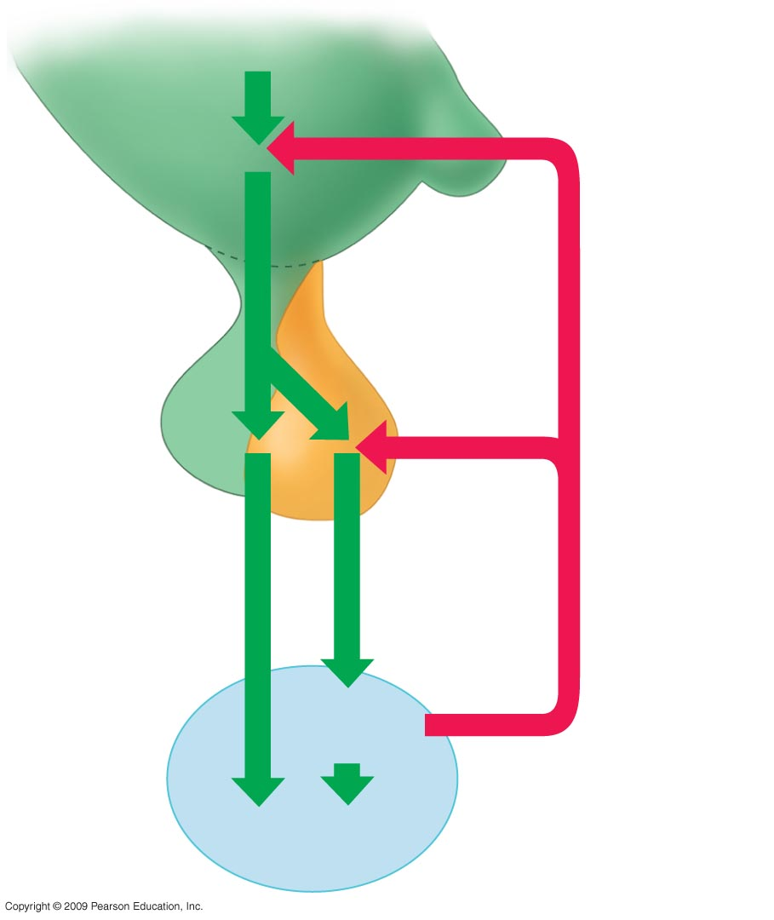
Stimuli from other
areas in the brain
Hypothalamus
Releasing
Hormone
Anterior
Pituitary
Negative feedback
Follicle stimulating hormone
(FSH)
Luteinizing hormone(LH)
Androgen
production
Testis
Sperm production
Hormonal control of the testis
12

Slide 13
Spermatogenesis (The formation of sperm)
0
Spermatogenesis
Occurs in seminiferous tubules
Primary spermatocytes
Formed by mitosis
Divide by meiosis I to produce secondary spermatocytes
Secondary spermatocytes divide by meiosis II to produce spermatids
Round spermatids differentiate into elongate sperm
Mature sperm released into seminiferous tubule and stored in the epididymis
13

Slide 14
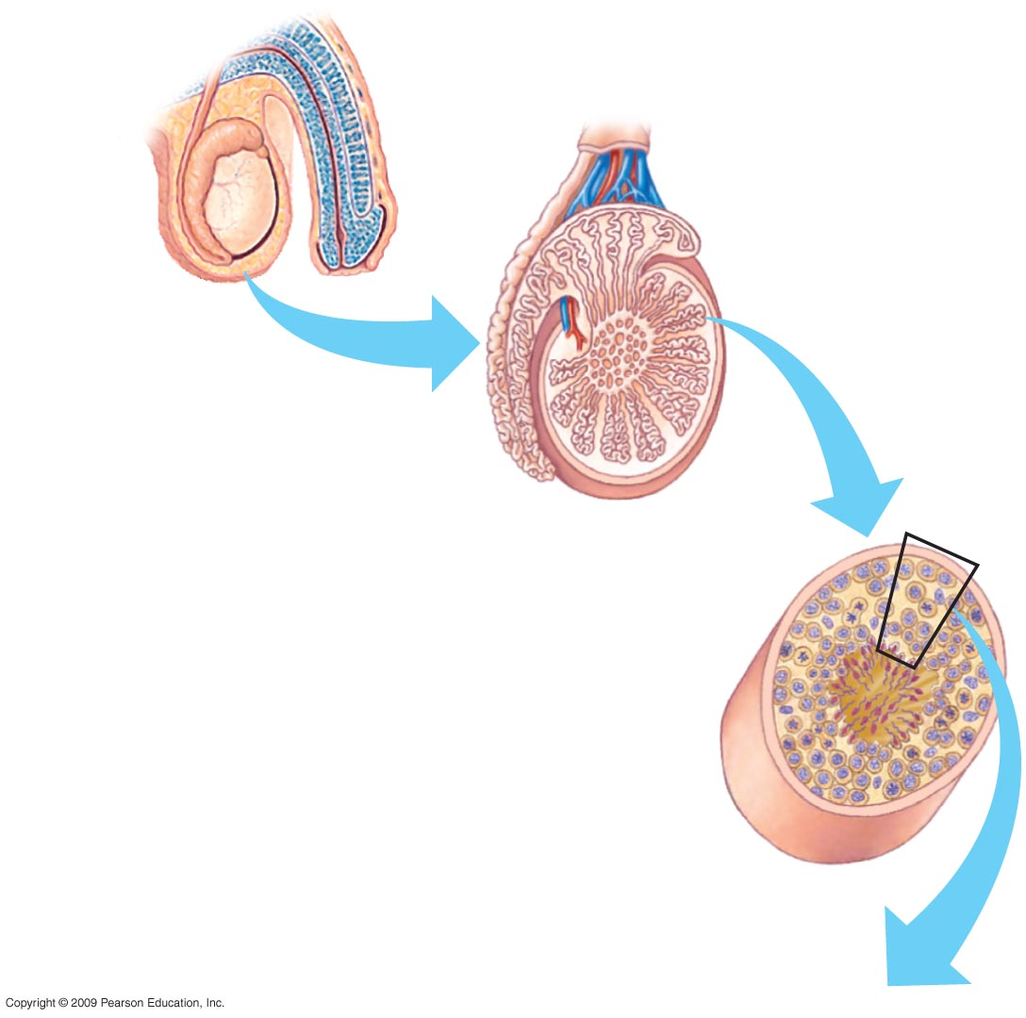
Epididymis
Testis
Penis
Scrotum
Testis
Seminiferous
Tubule
Cross section of
seminiferous tubule
14

Slide 15
Diploid cell
Primary spermatocyte
(in prophase of Meiosis I)
Secondary spermatocyte
(haploid; double chromatids)
spermatids
Sperm cells
(haploid)
Center of seminiferous tubule
15
Notes:
.

Slide 16
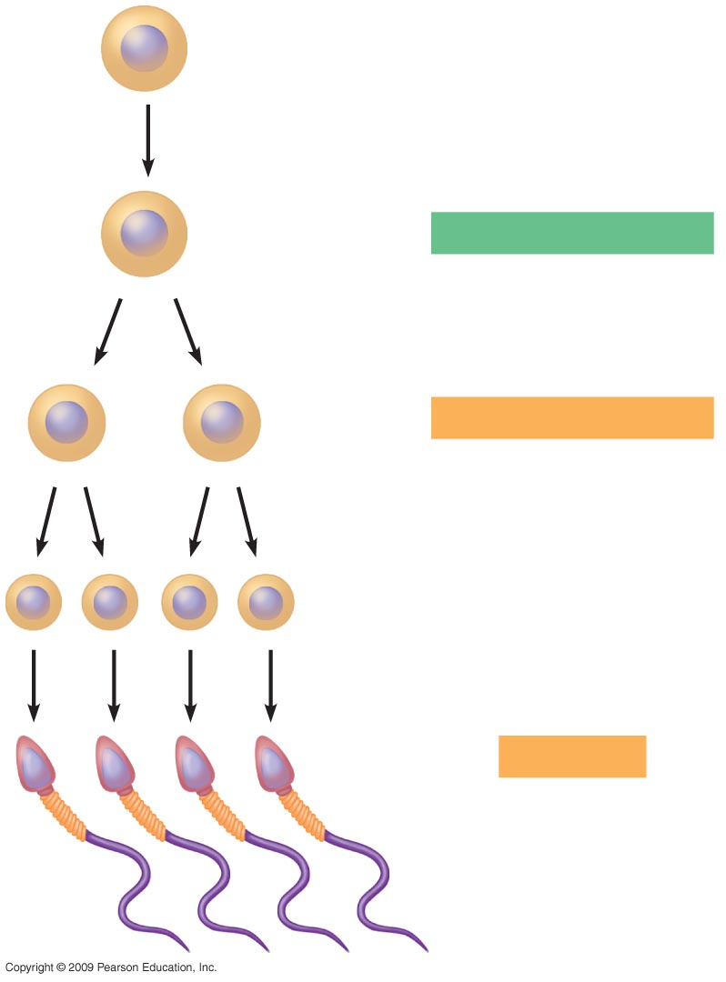
2n
Diploid cell
Differentiation and
onset of Meiosis I
2n
Primary spermatocyte
(in prophase of Meiosis I)
Meiosis I completed
n
n
Secondary spermatocyte
(haploid; double chromatids)
Meiosis II
n
n
n
n
Spermatids: Developing sperm cells
Differentiation
n
n
n
n
Sperm cells
(haploid)
16

Slide 17
Oogenesis (The formation of egg)
0
Oogenesis
Begins before birth: diploid cells start meiosis and stop
Each month about one primary oocyte resumes meiosis
A secondary oocyte arrested at metaphase of meiosis II is ovulated
Meiosis of the ovum is completed after fertilization
17

Slide 18
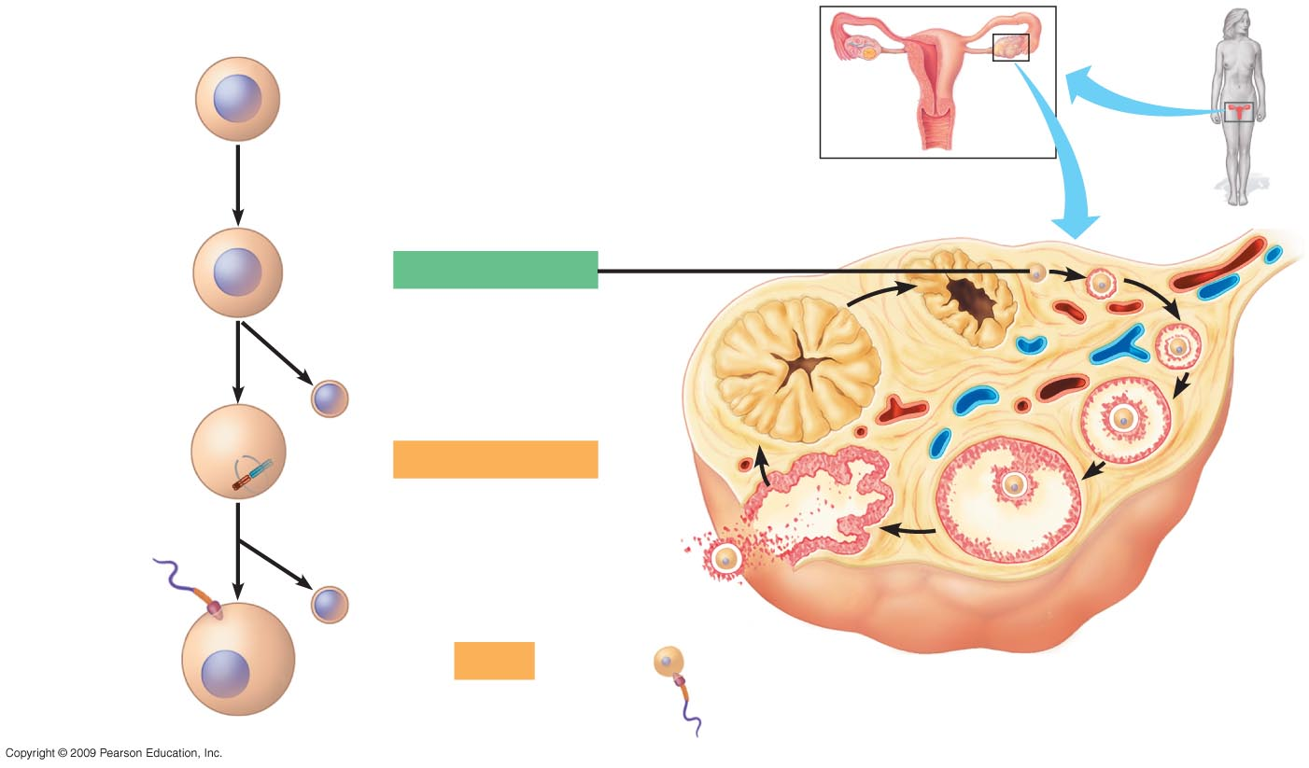
2n
Diploid cell in embryo
Differentiation
and onset of
Meiosis I
Ovary
2n
Primary oocyte
(arrested in prophase
of Meiosis I; present
at birth)
Completion
of Meiosis I
and onset of
Meiosis II
Corpus
luteum
n
First
polar body
n
Secondary oocyte
Entry of sperm
triggers completion
of Meiosis II
(arrested at meta-
phase of Meiosis II;
released from ovary)
Growing
Follicle
n
Second
polar body
Mature follicle
n
Ovum
(haploid)
Sperm
Ovulation
Ruptured follicle
Oogenesis and the development of an ovarian follicle
18

Slide 19
Hormones synchronize cyclic changes in the ovary and uterus
0
Ovarian and menstrual cycles
Occur about every 28 days
Hypothalamus signals the anterior pituitary to secrete follicle-stimulating hormone (FSH) and leuteinizing hormone (LH), which trigger
Growth of a follicle
Ovulation
19

Slide 20
Hormones synchronize cyclic changes in the ovary and uterus
0
After ovulation, empty ovarian follicle becomes corpus luteum
Corpus luteum secretes estrogen and progesterone hormones, which
Stimulate the endometrium to thicken
Prepare the uterus for implantation of the embryo
Inhibit hypothalamus, reducing FSH and LH secretion
20

Slide 21
Hormones synchronize cyclic changes in the ovary and uterus
0
If egg is fertilized
Embryo releases hormones that maintain the uterine lining
Menstruation does not occur
If egg is not fertilized
Drop in LH shuts down corpus luteum and its hormones
Menstruation is triggered
Hypothalamus and pituitary stimulate development of a new follicle
21

Slide 22
Embryonic Development
0
Embryonic development begins with fertilization
Fertilization is the union of sperm and egg to form a diploid zygote
Resulted zygote triggers embryonic development
22

Slide 23
Fertilization Sperm adaptation
0
Sperm are adapted to reach and fertilize an egg
Streamlined shape moves more easily through fluids
Many mitochondria provide ATP for tail movements
Head contains a haploid nucleus Tipped with an acrosome containing penetrating enzymes
23

Slide 24
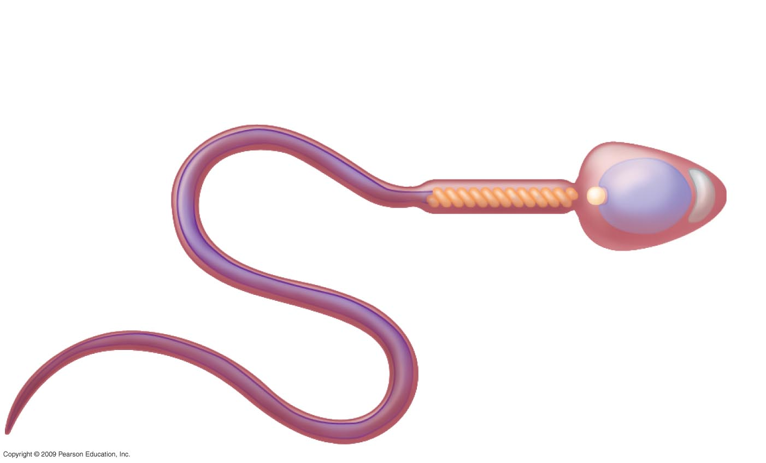
Neck
Plasma membrane
Middle piece
Head
Tail
Mitochondrion
(spiral shape)
Nucleus
Acrosome
The structure of a human sperm cell
24

Slide 25
Fertilization results in a zygote and triggers embryonic development
0
Fertilization events
Sperm squeeze past follicle cells
Acrosomal enzymes pierce egg’s coat
Sperm binds to vitelline layer
Sperm and egg plasma membranes fuse
Egg is stimulated to develop further
Egg and sperm nuclei fuse
25

Slide 26
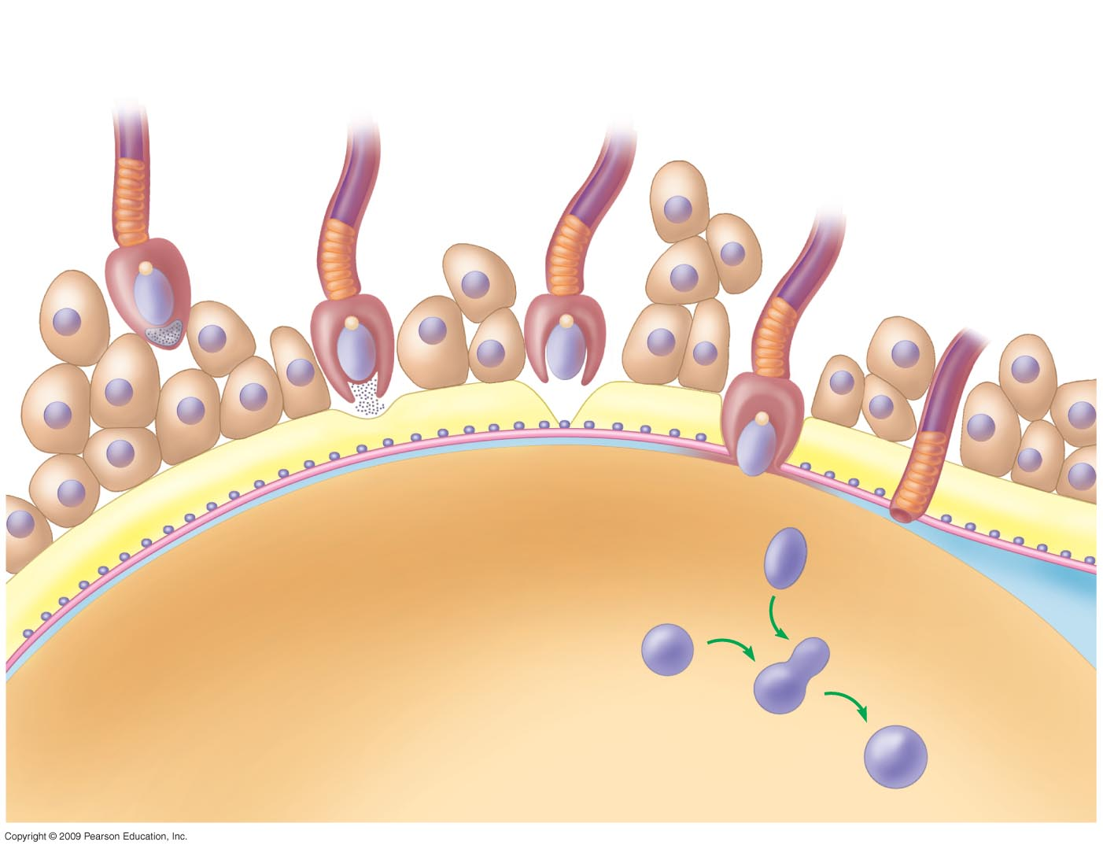
1
The sperm squeezes
through cells left
over from the follicle
2
The sperm’s
acrosomal
enzymes digest the
egg’s jelly coat
5
The sperm nucleus
enters the egg
cytoplasm
Acrosomal
enzymes
6
A fertilization
envelope
forms
Sperm
nucleus
Cytoplasm
The nuclei
of sperm and egg fuse
Egg
nucleus
7
Egg cell
Zygote nucleus
26

Slide 27
Embryonic development 1. Cleavage
0
Cleavage is a rapid series of cell divisions
Cleavage produces a ball of cells from the zygote
More cells
Embryo does not get larger
Thus new cells are smaller in size
A ball of cells called blastula is formed at the end of cleavege
27

Slide 28
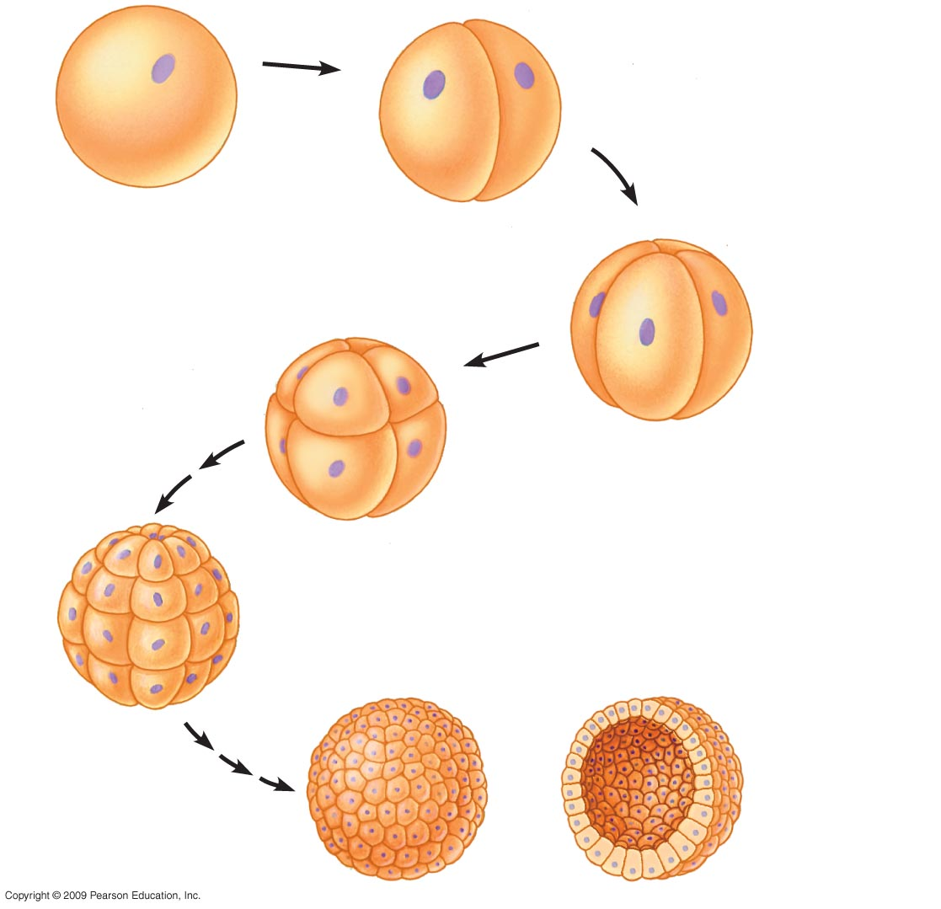
Cleavage
Zygote
2 cells
4 cells
8 cells
Blastula
(hollow ball)
Cross section
of blastula
Many cells
(solid ball)
Blastocoel
28

Slide 29
2. Gastrulation produces a three-layered embryo
0
Gastrulation
The blastula (ball of similar cells (resulted from cleavage go to gastrulation
Cells migrate
The basic body plan of three layers is established
Ectoderm outside - becomes skin and nervous systems
Endoderm inside - becomes digestive tract
Mesoderm in middle - becomes muscle and bone
29
Copyright © 2009 Pearson Education, Inc.
Notes:
Teaching Tips
1. You might wish to reflect on the somewhat-famous quote of Lewis Wolpert, who in 1986 said, “It is not birth, marriage, or death, but gastrulation, which is truly the most important time in your life.” The development and arrangement of the basic embryonic layers (ectoderm : skin and nervous system; mesoderm : muscle and bone; and endoderm : digestive tract) establishes the basic body plan.
2. Gastrulation establishes the basic body plan by positioning the future systems of the body in relationship to each other. This essential element of gastrulation is a crucial event that is a prerequisite for later developmental events (and thus is the basis of the quote directly above).
3. The colors used in the text to depict the three layers of embryonic tissue are standards used in embryology. Blue represents ectoderm and its derivatives, red represents mesoderm and its derivatives, and yellow represents endoderm and its derivatives.
4. Neural crest cells are often referred to as the fourth layer of embryonic tissue because these cells give rise to a variety of tissues in diverse locations in the body. Neural crest cells and their derivatives are not addressed in Chapter 27.

Slide 30
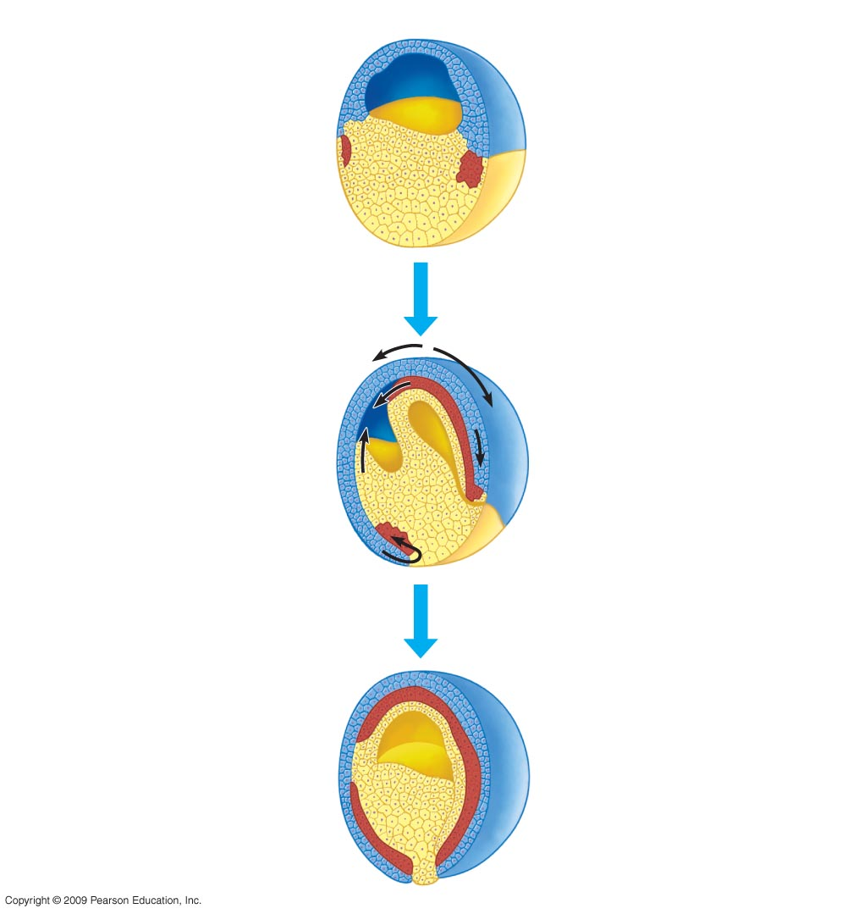
Blastula
(end of cleavage)
Development of the
frog gastrula
Gastrulation
(cell migration)
Gastrula
(end of gastrulation)
Ectoderm
Mesoderm
Simple
digestive
cavity
Endoderm
30

Slide 31
Reproduction
المصطلــــــــح | تعــريف المصطـــلح
Angiosperms | كاسيات البذور
Sporophyte: The Diploid Generation. | النابت البوغي: الجيل ثنائي العدد الكروموزومي.
Gametophyte: The Haploid Generation. | النابت الجاميطي: الجيل أحادي العدد الكروموزومي.
Pollen Grain: The Male Gametophyte. | حبه لقاح: النابت الجاميطي المذكر.
Embryo Sac: The Female Gametophyte. | الكيس الجنيني :النابت الجاميطي الأنثوي.
Endosperm: Central Cell Within The Embryo Sac Has Two Nuclei. | الإندوسبيرم: خلية واحدة مركزية داخل الكيس الجنيني لها نواتان.
Pollination: Transfer Of Pollen From Anther To Stigma. | عملية التلقيح: نقل حبوب اللقاح من المُتك إلى الميسم.
Double Fertilization: One Sperm Fertilizes The Egg To Produce A Zygote, The Other Fuses With The Central Cell Nuclei To Produce 3n Endosperm. | الاخصاب المزدوج: تقوم إحدى الخليتين المنويتين بتخصيب البيضة لإنتاج اللاقحة, و تقوم الأخرى بالاندماج مع النواة الخلية المركزية لتنتج نسيج الإندوسبيرم ثلاثي العدد الكروموزومي (3n).
Seed Dormancy: Embryo Growth And Development Are Suspended. | كمون البذرة: توقف نمو و تكوين الجنين.
Two Cotyledons = Eudicot Seeds | فلقتان
Single Cotyledon = Monocot Seeds | فلقة واحدة

Slide 32
Reproduction
المصطلــــــــح | تعــريف المصطـــلح
Fruit: Developed Ovary. | الثمرة: مبيض مكتمل النمو.
Germination | الإنبات
Asexual Reproduction: One Parent Produces Genetically Identical Offspring. | التكاثر اللاجنسي: ينتج أحد الوالدين ذرية متماثلة وراثياً .
Hermaphroditism: One Individual With Male And Female Reproductive Systems. | الخنوثة: فرد واحد بأجهزة تكاثر ذكرية وأنثوية .
External Fertilization: Eggs And Sperm Are Discharged Near Each Other. | الإخصاب الخارجي: يتم إطلاق البيض والحيوانات المنوية بالقرب من بعضها البعض.
Internal Fertilization: Sperm Is Deposited In Or Near The Female Reproductive Tract. | الإخصاب الداخلي: يتم إيداع الحيوانات المنوية في أو قريباً من القناة التناسلية للأنثي .
Gonads: Where Gametes Are Produced. | المناسل: حيث يتم انتاج الجاميطات.
Ovaries: Contain Follicles That Nurture Eggs And Produce Sex Hormones. | المبايض: تحتوي على حويصلات والتي تقوم بــ تغذية البيض وانتاج هرمونات الجنس.
Testes (Singular Testis): Produce Sperm And Male Hormones. | الخصي (مفردها خصية): تنتج الحيوانات المنوية هرمونات الذكورة .
Epididymis: Stores Sperm As They Develop Further | البربخ: يتم فيه تخزين الحيوانات المنوية وإنضاجها.

Slide 33
Reproduction
المصطلــــــــح | تعــريف المصطـــلح
Spermatogenesis: Formation Of Sperms. | عملية تكوين الحيوانات المنوية
Oogenesis: Formation Of Ovum. | عملية تكوين البيض
Menstrual Cycle | الدورة الشهرية
Menstruation | الحيض
Corpus Luteum | الجسم الأصفر
Endometrium | بطانة الرحم
Cleavage: Rapid Series Of Cell Divisions. | التفلج: هو سلسلة سريعة من الانقسامات الخلوية.
Gastrulation: Cells Migrate And Basic Body Plan Of Three Layers Is Established. | التبطن: هجرة الخلايا و يتم تأسيس الخطة الأساسية للجسم ذو الثلاث طبقات .

