Slide 1
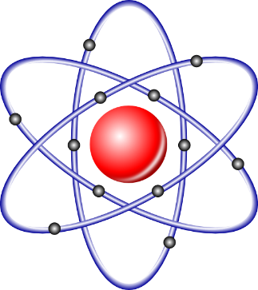
Chapter 2
Atoms, Molecules, Ions and Periodicity

Slide 2
Chapter 2
Atoms, Molecules, and Ions
Page:23-41
2.5. Subatomic particles: proton, neutrons and electrons in atom.
2.6. Finding patterns: The periodic law and periodic table.
2.7. Atomic Mass: Avogadro’s Mass of an element’s atoms.
2.8. Molar mass.
2.10. Electron Configuration.
2.11. Electron Configuration and valence electron
2.13. Periodic trends in the size of atoms.
2.14. Electron affinities and metallic character.

Slide 3
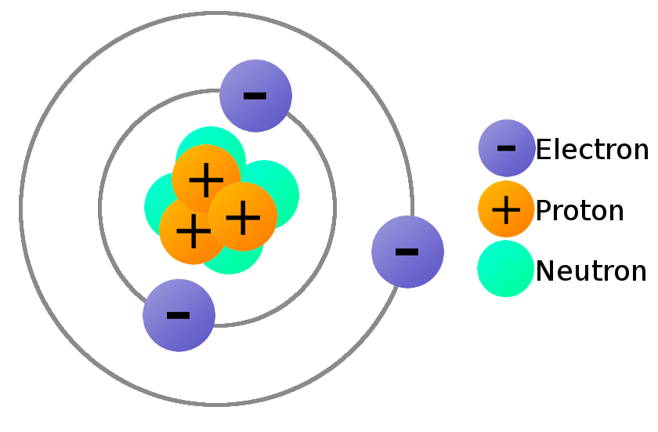
Chapter 2/Atoms, Molecules, and Ions
2.5. Subatomic particles
Elements: are composed of extremely small particles called atoms.
Atom: is the basic unit of an element that can enter into chemical combination.
Atom consist of:
Electron (e) (-ve charge)
Proton (p) (+ve charge)
Neutron (n) (neutral)
Notes:
{لاَ يَعْزُبُ عَنْهُ مِثْقَالُ ذَرَّةٍ فِي السَّمَاوَاتِ وَلاَ فِي الأَرْضِ وَلاَ أَصْغَرُ مِن ذَلِكَ وَلاَ أَكْبَرُ إِلاَّ فِي كِتَابٍ مُّبِينٍ} (سبأ: 3).

Slide 4
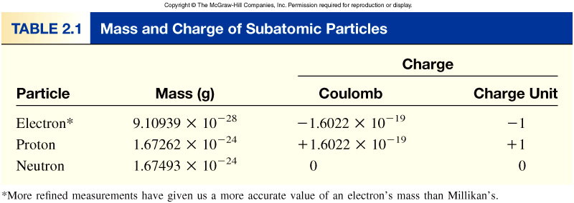
Chapter 2/Atoms, Molecules, and Ions
2.5. Subatomic particles
mass proton (p) = mass neutron (n) = 1840 x mass electron (e⁻)

Slide 5
Chapter 2/Atoms, Molecules, and Ions
2.5. Subatomic particles
Molecule: is a combined of two or more atoms in a definite arrangement held together by chemical forces.
a molecule may contain atoms of the same element or atoms of two or more elements.
H₂
H₂O
NH₃
CH₄

Slide 6
Chapter 2/Atoms, Molecules, and Ions
2.5. Subatomic particles
Ion: is an atom or a group of atoms that lose or gain electrons to form positive (+ve) or negative (-ve) Charge.
Ion
Cation: an ion with a +ve charge (lose electron/s)
Anion: an ion with a -ve charge ( Gain electron/s)
Na⁺, NH₄⁺, Mg²⁺
Cl⁻, OH⁻,S²⁻
Na→Na⁺ +1e⁻
Cl+1e⁻→ Cl⁻

Slide 7
Chapter 2/Atoms, Molecules, and Ions
2.5. Subatomic particles
Cation
₁₁Na
11 protons
11 electrons
11 protons
10 electrons
11Na⁺
Anion
₁₇Cl
17 protons
17 electrons
17Cl⁻
17 protons
18 electrons

Slide 8
Chapter 2/Atoms, Molecules, and Ions
2.5. Subatomic particles
27
3+
1-How many protons and electrons are in ?
Al
13
13 protons, 10 (13 – 3) electrons
78
2-
2-How many protons and electrons are in ?
Se
34
34 protons, 36 (34 + 2) electrons

Slide 9
Chapter 2/Atoms, Molecules, and Ions
2.5. Subatomic particles
1. Which of the following expressions represents two molecules of water?
H₂O
H₂O₂
2 H₂O
2 HO₂
2. The species S²⁻, F⁻, and Cl⁻ are all…
cations
anions
isotopes
Halogens
3. Atoms with the same number of electrons and number of protons are called…
ions
isotopes
neutral atoms
different atoms

Slide 10
Chapter 2/Atoms, Molecules, and Ions
2.5. Subatomic particles
Atomic number: is the number of protons in the nucleus of each atom of an element.
Mass number: is the total number of neutrons and protons present in the nucleus of an atom of an element
Atomic number (Z) = number of protons in nucleus.
For a neutral atom: Number of protons = number of electrons
Mass number (A) = atomic number (Z) + number of neutrons
Thus: the number of neutrons = A - Z

Slide 11
Chapter 2/Atoms, Molecules, and Ions
2.5. Subatomic particles
Examples
Mass Number
A
X
Atomic Number
Element Symbol
Z
1
2
3
H
H (D)
H (T)
1
1
1

Slide 12
Chapter 2/Atoms, Molecules, and Ions
2.5. Subatomic particles
Example 2.1
Give the number of protons, neutrons, and electrons in each of the following species:
Elements
Atomic Number (Z)
Mass Number (A)
No. of electrons (e)
No. of protons (p)
No. of neutrons (n)
20
22
17
14
200
Na
Na
O
C
Hg
11
11
8
6
80

Slide 13
Chapter 2/Atoms, Molecules, and Ions
2.5. Subatomic particles
Example 2.1
Give the number of protons, neutrons, and electrons in each of the following species:
Elements
Atomic Number (Z)
Mass Number (A)
No. of electrons (e)
No. of protons (p)
No. of neutrons (n)
20
22
17
14
200
Na
Na
O
C
Hg
11
11
8
6
80
11 | 11 | 8 | 6 | 80
20 | 22 | 17 | 14 | 200
11 | 11 | 8 | 6 | 80
11 | 11 | 8 | 6 | 80
9 | 11 | 9 | 8 | 120

Slide 14
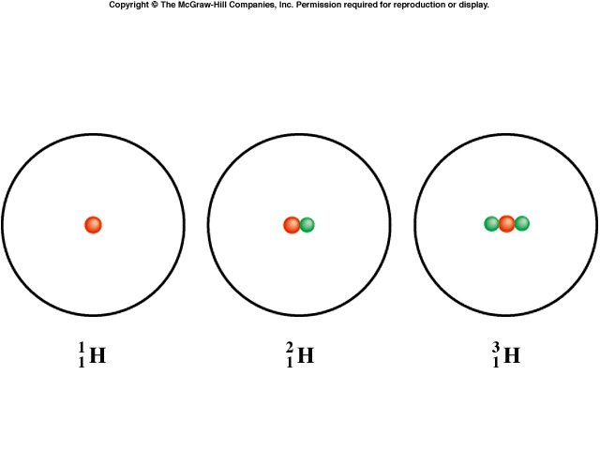
Chapter 2/Atoms, Molecules, and Ions
2.5. Subatomic particles
Isotopes: are atoms of the same element (X) with different numbers of neutrons in their nuclei.
Isotopes of Hydrogen:
1
H
2
H (D)
3
H (T)
1
1
1
1 P 1 P 1 P
0 n 1 n 2n
Protium Deuterium Tritium

Slide 15
Chapter 2/Atoms, Molecules, and Ions
2.5. Subatomic particles
Examples
14
?
1-How many protons, neutrons, and electrons are in
C
6
6 protons, 8 =(14 - 6) neutrons, 6 electrons
11
?
2-How many protons, neutrons, and electrons are in
C
6
6 protons, 5 =(11 - 6) neutrons, 6 electrons

Slide 16
Chapter 2/Atoms, Molecules, and Ions
2.5. Subatomic particles
Practice Exercise:
How many protons, neutrons, and electrons are in the following isotope of copper: ⁶³Cu?
P=29
n=34
e=29
How can I get the atomic number: look to
at the periodic table
then find the number of p, n & e.

Slide 17
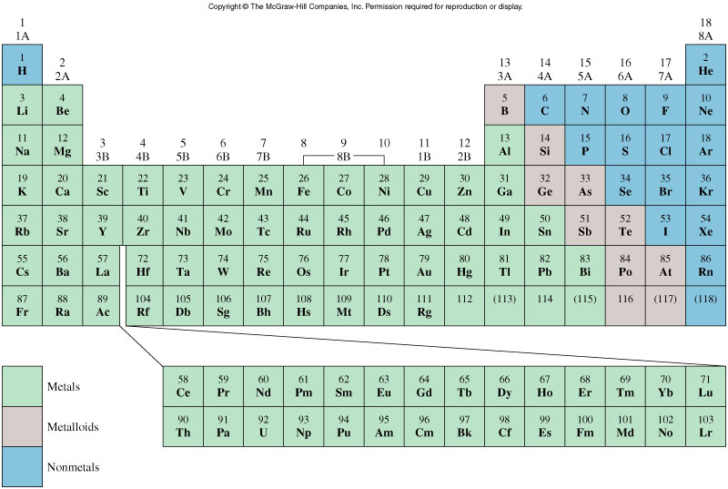
Chapter 2/Atoms, Molecules, and Ions
2.6. The Periodic Table
The periodic Table: is a chart in which elements having similar chemical and physical properties are grouped together.
The elements in the modern periodic table are arranged by atomic number

Slide 18
Chapter 2/Atoms, Molecules, and Ions
2.6. The Periodic Table
Transition Metals
Alkali Metal
Noble Gases
Alkaline Earth Metal
Group
Halogen
Period

Slide 19
Chapter 2/Atoms, Molecules, and Ions
2.6. The Periodic Table
Elements are arranged by atomic number (Z)
Periods: are the horizontal rows . There are 7 Periods.
Groups: are the vertical rows , elements in the same group have similar chemical and physical properties
There are 8 groups, assigned as 1A-to-8A
Also 8 groups are assigned as 1B-to-8B.
Some groups are given special names:
Groups 1B-to-8B are called the Transition Metals
Group 1A elements (Li, Na, K, Rb, Cs and Fr) are called Alkali Metals
Group 2A elements (Be, Mg, Ca, Sr, Ba and Ra) are called Alkaline Earth Metals
Group 7A elements (F, Cl, Br, I and At) are as Halogens
Group 8A elements (He, Ne, Ar, Kr, Xe and Rn) are called Noble Gases or Rare gasses

Slide 20
Chapter 2/Atoms, Molecules, and Ions
2.6. The Periodic Table
Elements in the periodic table are divided into three categories:
Metal: (in green colour, Most elements) is a good conductor of heat and electricity.
Nonmetal: (in blue colour, 17 elements) is a poor conductor of heat and electricity.
Metalloid: (in brown colour, 8 elements) has properties that are intermediate between those of metals and nonmetals.

Slide 21
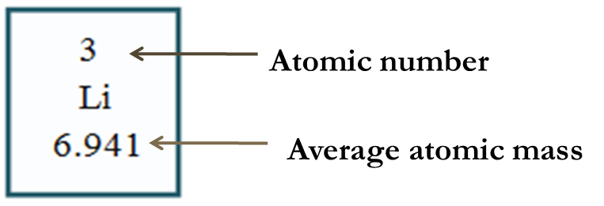
Chapter 2/Atoms, Molecules, and Ions
2.7. Atomic Mass:
Atomic mass (or atomic weight): is the mass of the atom in atomic mass unit (amu).
Atomic mass unit: is the mass that exactly equal to one-twelfth the mass of one carbon-12 (¹²C) atom.
The atomic mass of ¹²C = 12.00 amu
atomic mass: is the average weight of an element
mass number: is the total number of nucleons and proton in the atom's nucleus
Isotope 1
Isotope 2
(Atomic mass × abundance percent) + (Atomic mass × abundance percent)
Average atomic mass=
100
Notes:
the weighted average mass of an atom of an element based on the relative natural abundance of that element's isotopes.

Slide 22
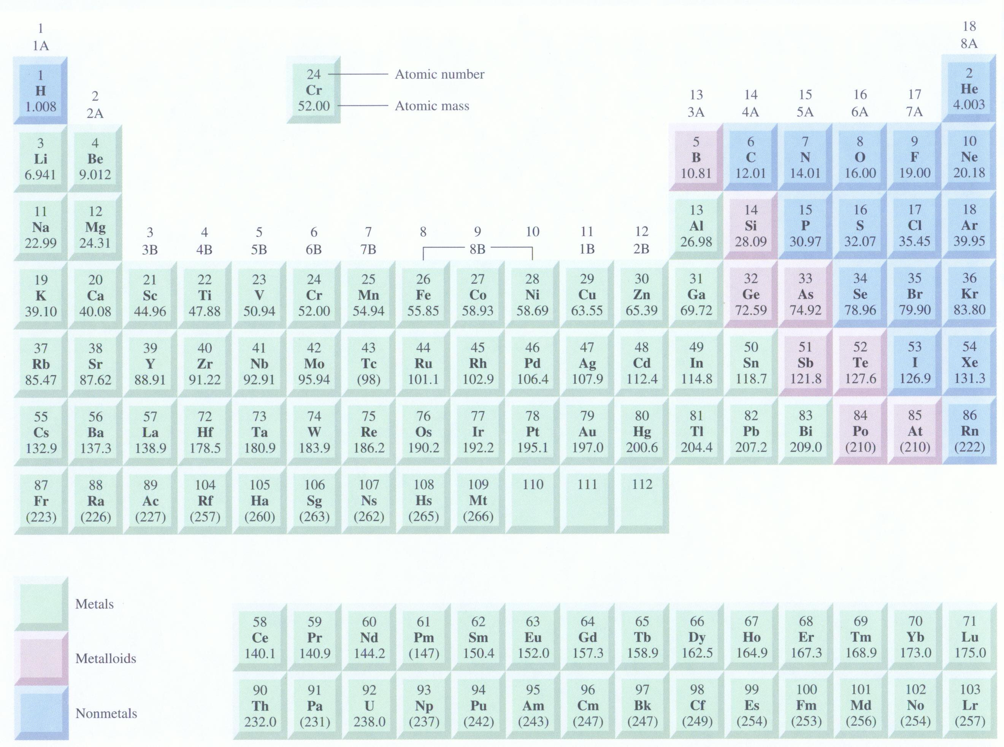
Average atomic mass (6.941)

Slide 23
Chapter 2/Atoms, Molecules, and Ions
2.7. Atomic Mass:
The atomic masses of (75.53 %) and (24.47 %) are 34.968 amu and 36.956 amu, respectively. Calculate the average atomic mass of chlorine?
Isotope I
Atomic mass = 34.698 amu
Abundance percent = 75.53 %
Isotope II
Atomic mass = 36.956 amu
Abundance percent = 24.47 %
Isotope 1
Isotope 2
(Atomic mass × abundance percent) + (Atomic mass × abundance percent)
Average atomic mass=
100
Isotope 1
Isotope 2
(34.698 × 75.53)+ (36.956 × 24.47)
Average atomic mass=
=
35.45 amu
100

Slide 24
Chapter 2/Atoms, Molecules, and Ions
2.7. Atomic Mass:
 | What information would you need to calculate the average atomic mass of an element?
 | A. | The number of neutrons in the element.
 | B. | The atomic number of the element.
 | C. | The mass and abundance of each isotope of the element.
 | D. | The position in the periodic table of the element.
H.W: Solve the Example 2.1 p26

Slide 25
Chapter 2/Atoms, Molecules, and Ions
2.8. Molar mass:
Mole (mol) is the SI unit of the amount of substance.
Avogadro’s Number (N_{A}): one mole of each substance contains 6.022 x 10²³ particles (atoms or molecules or ions etc.).
Thus 6.022 x 10²³ is the Avogadro's Number (N_{A})
1 mol = N_{A} = 6.0221367 x 10²³
=Dozen = 12
1 dozen = 12 Anything
1 mol = 6.022 x10²³ particles

Slide 26
Chapter 2/Atoms, Molecules, and Ions
2.8. Molar mass:
Molar mass (M): the mass (in g or kg) of one mole of a substance;
M = mass/mol = g/mol
For 1 MOLE: 1 amu = 1 g
e.g. The atomic mass of ¹²C is 12.00 amu = 12.00 g
1 mole of ¹²C = 12.00 amu = 12.00 g = has 6.022 x 10²³ (N_{A} )atoms
Thus:
The Molar Mass (M) of ¹²C = 12.00 g/mol
Molar Mass (g/mol)= Atomic Mass (amu)
Examples:
1. The atomic mass of Na = 22.99 amu
The molar mass of Na = 22.99 g/mol

Slide 27
Chapter 2/Atoms, Molecules, and Ions
2.8. Molar mass:
Example:
How many the amount (in moles) of He atoms are in 6.46 g of He?
Solution:
Number of moles = n
The atomic mass of He = The Molar mass of He
From the periodic Table:
The atomic mass of He = The molar mass of He = 4.003 g/mol
Thus: 4.003 g → 1 mole of He
6.46 g → ? moles of He
Thus: there is 1.61 moles of He atoms in 6.46 g of He

Slide 28
Chapter 2/Atoms, Molecules, and Ions
2.8. Molar mass:
n = number of moles
m = mass (atom or molecule)
M = molar mass (atomic mass or molecular mass)
What is the relation between them?
n = number of moles
N = number of atoms or molecules
N_{A} = Avogadro's number (atoms (or molecules)/mol)
What is the relation between them?

Slide 29
Chapter 2/Atoms, Molecules, and Ions
2.8. Molar mass:
How many the amount (in moles) of He atoms are in 6.46 g of He?
H.W: Solve the Example 2.3 p28

Slide 30
Chapter 2/Atoms, Molecules, and Ions
2.8. Molar mass:
Example: How many S atoms are in 16.3 g of S?
H.W: Solve the Example 2.4 p29

Slide 31
h.w
12, 14, 16, 17, 19
p45

