Slide 1
University of Hail
Preparatory Year College
Medical Physics
PHYS121
Introduction to
Biological Physics
For The Health Life Science
Kirsten Franklin and others

Slide 2
Part 2 Mechanics
Wave- sound and hearing

Slide 3
Objectives
To understand the concepts of wave, and its properties.
To understand the production and transmission of sound wave.
To understand how the frequency and amplitude of sound wave influence the pitch and loudness experienced by a listener.
To understand the function of the human vocal organs and ear
To see how the motion of a sound source or observer changes the observed frequency.

Slide 4
Topics to be covered
Introduction,
Wave -Frequency, wavelength and Speed,
Types of Wave,
Standing Waves,
Sound Waves in Media,
Ultrasound Sonography
Pitch and Loudness,
Resonance and Sound Generation,
The human voice
The Doppler Effect

Slide 5
1- Introduction
In this chapter we will investigate the nature of wave. Normally, but not always, waves travel as a disturbance in some medium. We will show that wave motion is deeply connected to oscillations in the medium which the wave propagates.
Also, we will investigate the properties of sound wave, how the human ear detects sounds, and give an overview of the function of the human vocal organs. Lastly, a brief overview of the Doppler effect is given and the uses of sound in diagnostic medicine.

Slide 6
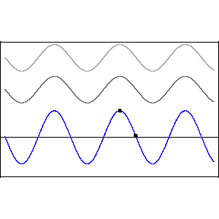
2- Waves Frequency, wavelength and Speed
A wave is a repeating disturbance or movement that transfers energy through matter or space

Slide 7
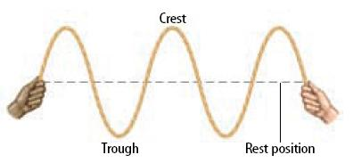
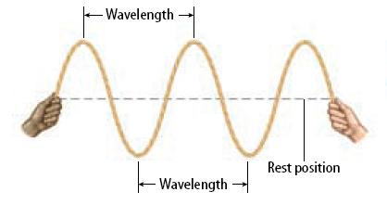
What is the wavelength?
The wavelength is the distance from one point on the wave to the next corresponding adjacent point (between two crests or two troughs).

Slide 8
Quick quiz???
In the figure given below the complete wave represent by letter?
From A to E
From B to D
From A to C
From C to E
From B to F
From E to G
From C to G
1, 5, and 7 are correct

Slide 9
Quick quiz???
In the figure given below the wave length of wave represent by letter
A
B
C
D

Slide 10
What is wave frequency?
Frequency is the number of waves that pass through a point in one second. The unit for frequency is waves per second or Hertz (Hz).
Wavelength and frequency are inversely related.
For smaller wavelength, we have higher frequency.
For larger the wavelength, we have smaller frequency.

Slide 11
Time Period of a wave
It is time taken by one wave to pass through a point. It is represented by T . It has value T = 1/ f. that is reciprocal of the frequency of the wave. As the frequency of a wave increases, the time period of the wave decreases.

Slide 12
A wave moving through a medium travels at a certain speed. This is Wave Speed.
Wave speed (c) is calculated as the product of a waves frequency (f) and wavelength (λ).
Wave Speed = Wavelength • Frequency
c = f λ or f = c / λ

Slide 13
3-Types of waves
1- Mechanical waves are waves which require a medium (such as water, air, glass, etc.) to travel the wave.
Mechanical waves are two distinct kinds of wave: Transverse Waves and Longitudinal Waves
2- Electromagnetic waves such as light, x-rays, and other forms of radiation do not require a medium.

Slide 14
3-Types of waves
1- Mechanical waves are waves (Sound, Heat) which require a medium (such as water, air, glass, etc.) to travel the wave.
2- Electromagnetic waves such as light, x-rays, and other forms of radiation do not require a medium.
Mechanical waves are two distinct kinds:
Transverse Waves
and Longitudinal Waves

Slide 15
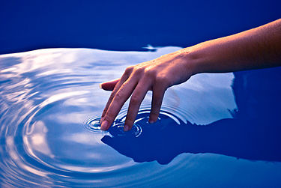
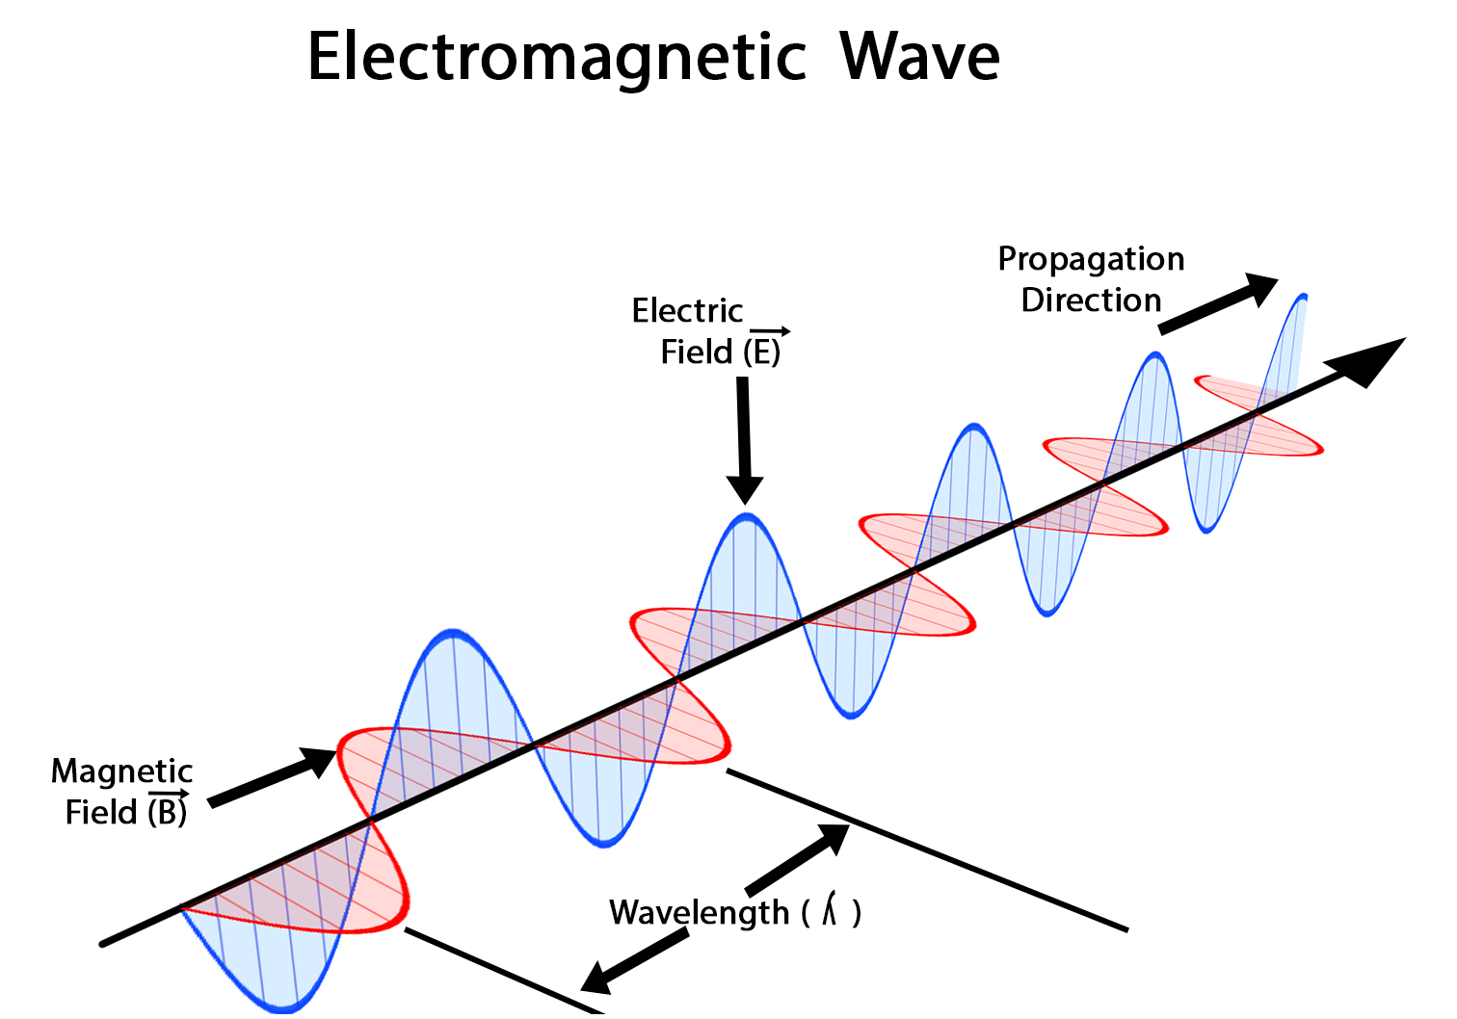
Mechanical wave

Slide 16
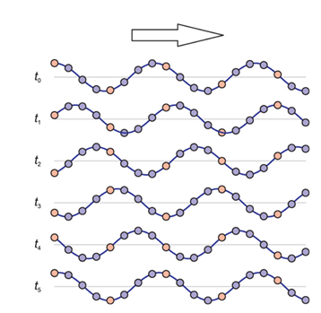
1-Transverse Waves
In a transverse wave, the molecules of the matter in the wave moves up and down at a right angle to the direction of the wave.

Slide 17
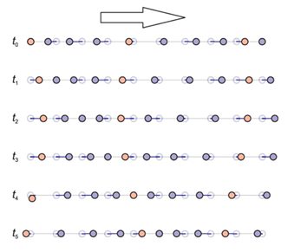
2-Longitudinal Waves (Compression Waves)
In a longitudinal wave, the molecules of the matter in the wave moves back and forth parallel to the direction of the wave.

Slide 18
Quick quiz???
A transverse wave is transporting energy from east to west. The particles of the medium will move_____.
east to west only
both eastward and westward
north to south only
both northward and southward

Slide 19
Quick quiz???
A wave is transporting energy from left to right. The particles of the medium are moving back and forth in a leftward and rightward direction. This type of wave is known as a ____.
mechanical
Electromagnetic
transverse
longitudinal

Slide 20
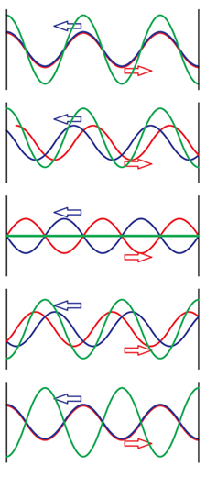
4. Standing waves
When a wave is incident inside a tube at one end it reflected at the boundary. The incident and reflected waves combine to form a standing wave.
The standing wave is two waves have the same wavelength and speed (so the same frequency), but are travelling in opposite direction through the same medium.

Slide 21
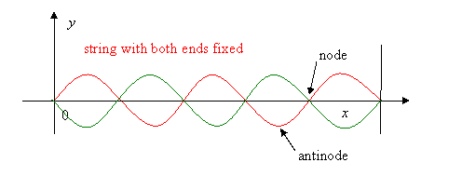

Slide 22
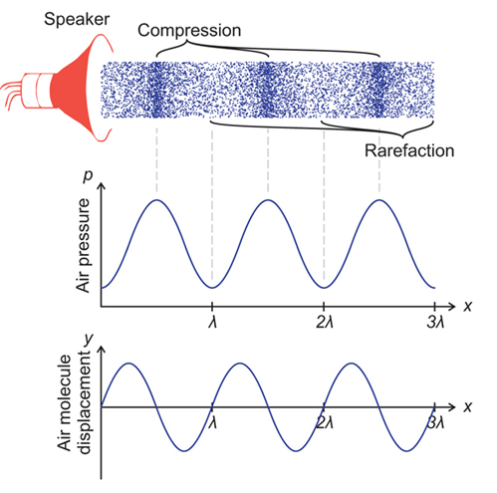
5- Sound Waves and Media
Sound wave is a longitudinal wave which travels through the air through a series of compressions and rarefactions.

Slide 23
Production of sound by a tuning fork
high density and pressure
low density and pressure

Slide 24
Speed of Sound wave
The speed of sound is not fixed and depends on the medium (gases, liquids and solid).
The more elastic the medium the faster sound will travel through it.
Speed in metals > speed in water > speed in air
When the temperature is higher, so is the speed of sound.

Slide 25
If a sound wave passes from one medium of density ρ₁ and sound velocity c₁ to a second medium of density ρ₂ and sound velocity c₂, then the ratio of the reflected to incident intensities is given as:
Boundary
1st medium
2nd medium
ρ₁, c₁
ρ₂, c₂
I_{i}
Incident Wave
I_{r}
Reflected Wave
Notice: The wave travels perpendicular to the boundary.

Slide 26
The reflectance (R) is the ratio of intensity of the reflected wave (I_{r}) to the intensity of the incident wave (I₀):
Where z is the acoustic impedance and defined as: Z = ρ c
When the absorbed part is neglected, the transmittance (T) can be calculated from:
Problem: calculate the proportion of a sound wave’s energy transmitted at air/water boundary. Where Z₁ =413 kg m⁻² s⁻¹ , Z₂= 1.44×106kg m⁻² s⁻¹ .

Slide 27
6. Ultrasound and Sonography
Ultrasound is a type of imaging. It uses high-frequency sound waves to look at organs and structures inside the body.
Health care professionals use it to view the heart, blood vessels, kidneys, liver, and other organs.
During pregnancy, doctors use ultrasound to view the fetus.

Slide 28
Ultrasound is safe and painless, and produces pictures of the inside of the body using sound waves. Ultrasound imaging, also called ultrasound scanning or sonography, involves the use of a small transducer (probe) and ultrasound gel placed directly on the skin. High-frequency sound waves are transmitted from the probe through the gel into the body. The transducer collects the sounds that bounce back and a computer then uses those sound waves to create an image. Ultrasound examinations do not use ionizing radiation (as used in x-rays), thus there is no radiation exposure to the patient. Because ultrasound images are captured in real-time, they can show the structure and movement of the body's internal organs, as well as blood flowing through blood vessels.

Slide 29
Sonography is a medical diagnostic imaging technique using ultrasound (high frequency acoustic vibrations is about 20 KHz), above the limit of human hearing.( 20Hz-20Kz is Human hearing).
The theory of this technique is depended on the acoustic impedance (Z = ρc) reflected from the boundaries between materials of different densities, i.e. the reflectance (R) which is given by

Slide 30
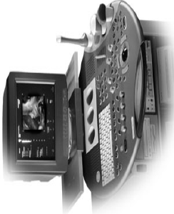

Slide 31
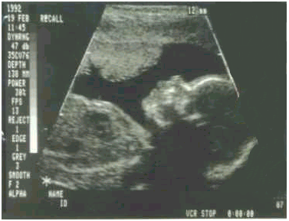
scan for a fetus

Slide 32
7. Loudness and Pitch
Frequency and Pitch
The Pitch, how high or low it sounds, is closely related to the frequency.
A high pitched sound, when the vibrations are fast you hear a high sound.
A low pitched sound, when the vibrations are slow, you hear a low sound.
The human ear ranges is 20 Hz to 20KHz. The upper end of the range typically decreases with age; for children 40 KHz. The ear is most sensitive to frequencies between 100 Hz and 4000Hz.

Slide 33
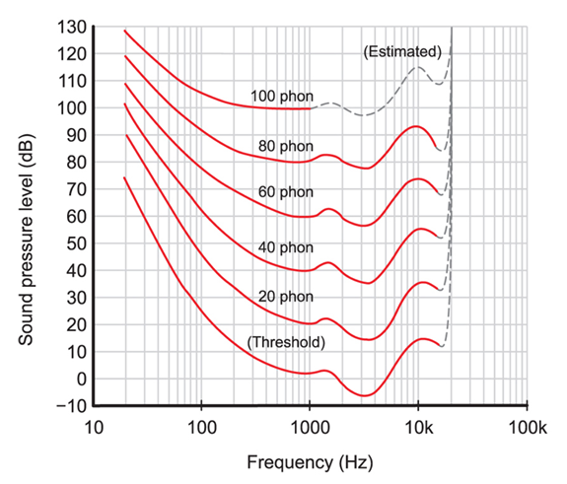
Intensity, Loudness and Decibel Scale
The human ear can respond to intensities from as low as 10⁻¹² Wm⁻² up to 1(=10⁰)Wm⁻², 12 orders of magnitude.
Logarithmic units or decibels (dB) is used to measure sound intensities. The sound intensity level is related to the intensity by:
$$L=10 log\frac{I}{Io}$$
Here I₀ is specify a reference level intensity equal (10⁻¹² Wm⁻² ).
Decibel Scale
The threshold of hearing is the minimum intensity that is just audible at a given frequency (lower curve in fig.)

Slide 34
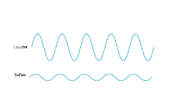
Loudness depends primarily on intensity (amplitude).
Δp
Pressure
Time
Louder
Softer
The higher pressure (amplitude), the louder sound.
The lower pressure (amplitude) the softer the sound.
Where (Δp) is the maximum pressure (amplitude) and (ρ) is the density of the medium and (v) is the velocity of sound.

Slide 35
8. Resonance and Sound Generation
To generate sound, the only requirement is that something moves to create an air pressure wave of enough intensity.
If you drop a rock on a hard surface, you will hear a sharp noise made up many different frequencies.
If instead you strike a metal rod, or a hollow plastic tube, the sound will tend to have distinct frequencies.
The rod or a hollow plastic tube producing standing waves, so it called Resonant structure .

Slide 36
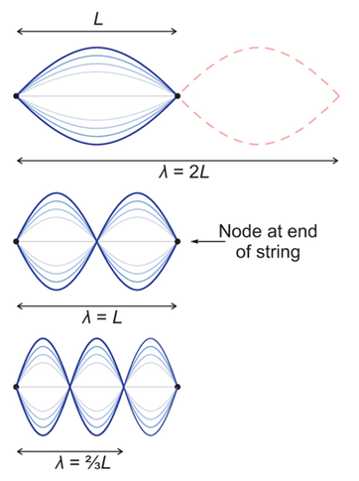
Modes of Vibration of a String
A wave which is repeatedly reflected between two parallel reflecting boundaries will form a standing wave.
The longest wavelength pattern has a wavelength twice the length of the string. This is called the fundamental mode of vibration and the frequency is known as the fundamental frequency, or first harmonic.

Slide 37
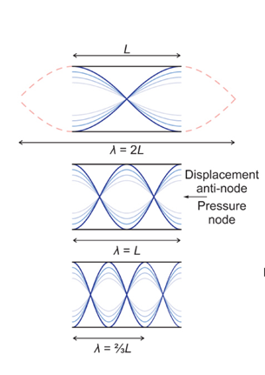
Modes of Vibration of an open Pipe
In this situation, the sound wave in the pipe reflect off the open ends and form a standing wave pattern like that shown in figure.
So, tubes with two open ends have a fundamental frequency that is determined by the length, which is half the fundamental wavelength.

Slide 38
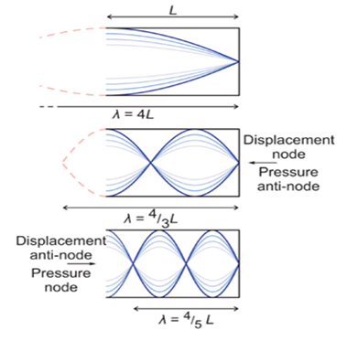
Modes of Vibration of a Half-open Pipe
In this case of a pipe with one end open and one closed, the open end is a pressure node and the closed end is a displacement node.
The standing wave pattern with the longest wavelength is has equal to four times the pipe length.
When n=1
1st of fundamental harmony

Slide 39
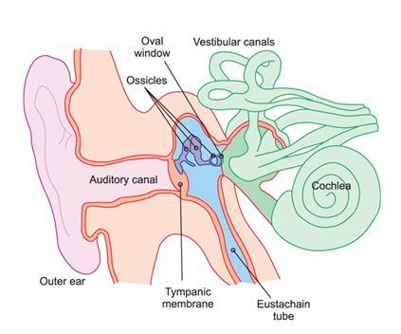
Problem: The ear canal extending from the open outer ear to the closed surface of the eardrum is 26 mm in length for particular person. What are the frequencies of the first three resonant modes
Solution: The ear canal is open at one end and closed at the eardrum, so make as a half-open pipe
$fn=c \frac{(2n−1)}{4L}$ ; n=1,2,3,…..
$f1=3300 Hz , f2$= 9900 Hz , $f3$= 16500 Hz
Notice that: all of these frequencies are in the normal range of human hearing (20 Hz- 20 KHz)

Slide 40
Quick quiz???
The figure represents the 1st harmonic for an open pipe. If the length of the pipe is 40 cm, the frequency of the sound wave resonating inside the pipe is. Value of c= 344 m/s.

Slide 41
Quick quiz???
1- A vibrating tuning fork is held above a closed-end air column, forcing the air into resonance. If the length of the column is 20 cm, the frequency of the second harmonic resonance inside the pipe is
2- Second harmonic of a close end pipe is 344 hz. Find the length of the pipe.

Slide 42
9. The human voice
In human speech:
The vocal cords initiate vibrations of the air.
The throat and the nasal and oral cavities serve as resonant structures.
The remarkable ability of human to produce so many different sounds stem from two facts:
- The vocal cord tension can be varied; hence the frequencies produced can be changed.
- The oral cavity, can be changed in shape and dimensions to modify the frequency content of the amplified sounds.

Slide 43
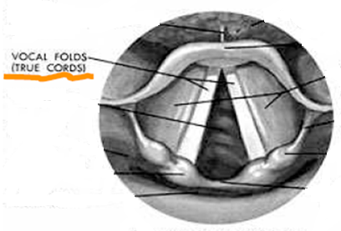
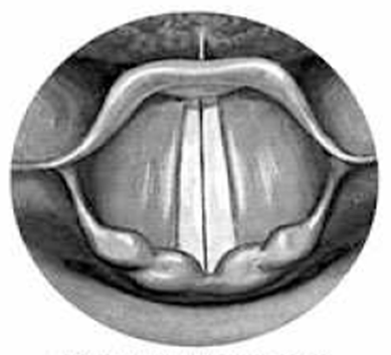
The vocal cords are relaxed and present no obstruction to air through the larynx during normal breathing.
During preparation for speech the tension in the vocal cords increases and the larynx is closed.
The air pressure below the vocal cords increases until the cords are open. The air then rushes (يتدفق) through the opening, causing the vocal cords to vibrate.

Slide 44
As air rushes through the opening, its velocity is large, and hence the pressure is lowered, allowing the vocal cords to start to close.
Once the opening becomes sufficiently small, the pressure below the vocal cords increases and forces the cords to spread apart again.
This process is continues as long as exhalation persists and the fundamental as well as the many harmonics of the vocal cords are excited.

Slide 45
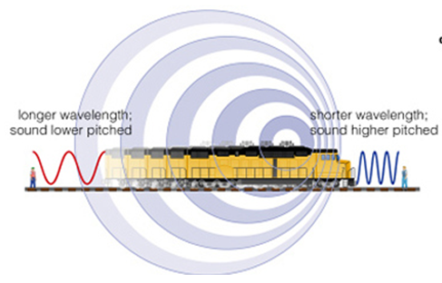
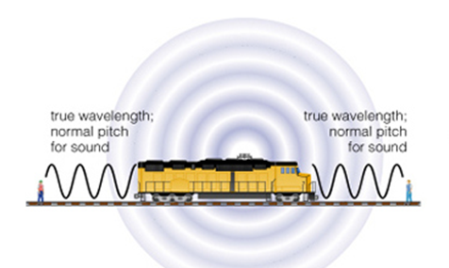
10. Doppler Effect
The Doppler effect is a well known and frequently observed phenomenon in which the apparent pitch of a sound is changed by the relative motion between the sound source and the observer..
https://www.youtube.com/watch?v=a3RfULw7aAY
https://www.youtube.com/watch?v=p-hBCcmCUPg

Slide 46
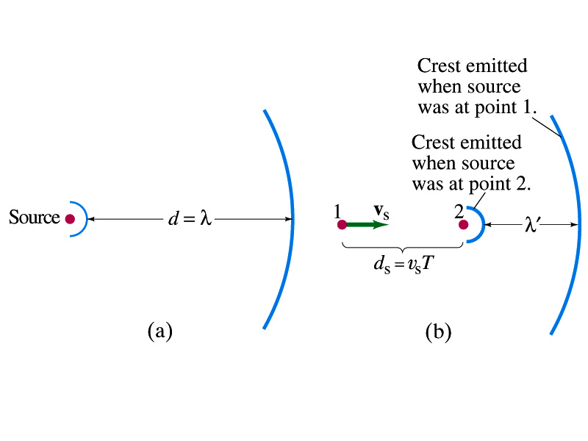
A- Moving Source towards the observer, and the observer is fixed
There are two situation
1- Moving Source, fixed Observer
$f$` $=\frac{c}{λ`}$
$$=\frac{c}{λ−vsT}$$
$$=\frac{c}{ \frac{c}{f}−\frac{vs}{f}}$$
$f$` $=f\frac{c}{c−vs}$

Slide 47
B- Moving Source away from the observer, and the observer is fixed.
The situation is similar but the wavelength is increased, so the minus sign become a plus sign.
$f$`$=f\frac{c}{c+vs}$
To summarize
$f$`$=f\frac{c}{c±vs}$
Where the minus sign for an approaching sound source and plus sign for retreating source.

Slide 48
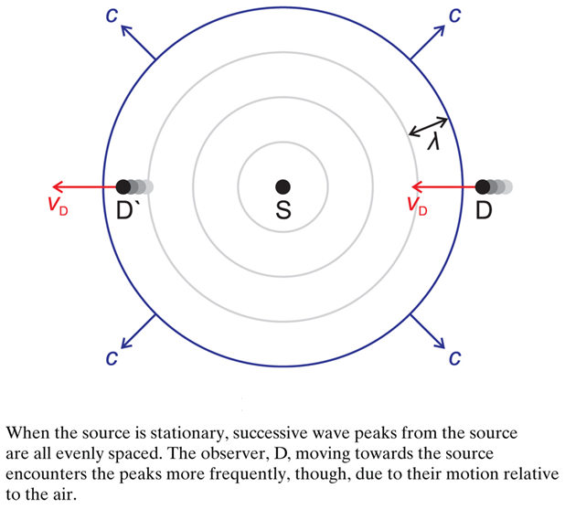
2- Fixed Source, Moving Observer

Slide 49
A- For a moving observer, the time between successive peaks in the sound waves will be decreased when moving towards the source at speed v_{D}. The new period, T ` , will be shortened
$$T=\frac{λ}{c}$$
$$T`=\frac{λ}{c+vD}$$
$$f`=\frac{1}{T`}=\frac{c+vD}{λ}$$
$$f`=f\frac{c+vD}{c}$$

Slide 50
B- Once again, if the observer is moving in the other direction (away from the source) the sign is reversed,
$$f`=f\frac{c−vD}{c}$$
To summarize
$$f`=f\frac{c±vD}{c}$$

Slide 51
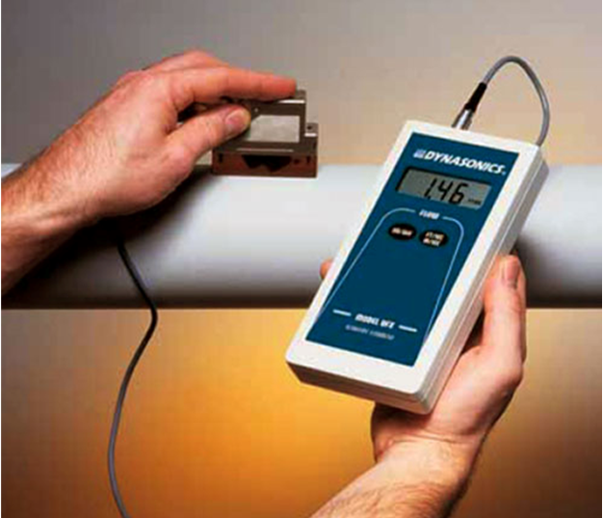
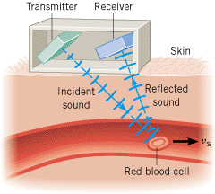
The Doppler flow meter
Is a device used for measuring blood flow rate i.e. Q value.

Slide 52
The frequency at the cells is given by:
where
f’ = frequency at the cells
v_{RBC} = speed of red blood cells
f = frequency from source
v = speed of sound in blood
The cells acting as a moving source, hence the frequency at the receiver is given by:

Slide 53
The End of the Chapter
Any Questions?
Thank You

