Slide 1
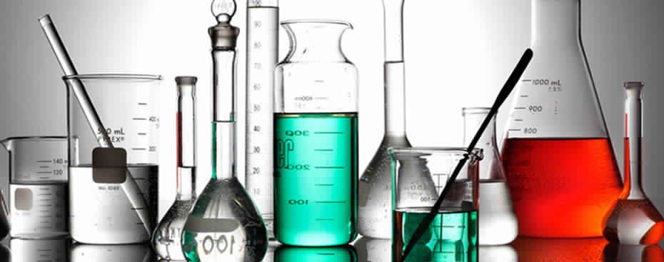
General Chemistry I
Chem. 110

Slide 2
Ohoud S. Al-Qurashi Lecturer of Physical Chemistry
Where you can find me?
Building 5 –Second floor – Room 309B
Office HOURS:…
E-mail: oaqurshi@uj.edu.sa
Web site: (http://www.uj.edu.sa/DRS-1001177.aspx )

Slide 3
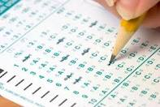
General Information
Grade:
30% First midterm exam
30% Second midterm exam
40% Final exam
Grade system
A⁺ = 100 – 95, A = 94 – 90
B⁺ = 89 – 85, B = 84 – 80
C⁺ = 79 – 75, C =74 – 70
D⁺ = 69 – 65, D = 64 – 60
F = <60 FAIL

Slide 4
السياسة الواجب على الطالبة الالتزام بها
حضور المحاضرة في وقتها المحدد، عدم تكرار التأخر عن المحاضرة، حضور الامتحانات في موعدها المحدد، أداء الواجبات المطلوبة.
الطالبة التي تزيد نسبة غيابها عن 25% من مجموع المحاضرات (أي بما يعادل 8 محاضرات)، دون عذر، تحرم من دخول الامتحان النهائي.
الطالبة التي تتخلف عن الاختبار لن يعاد لها الاختبار (إلا في حالة الظروف القاهرة).
عدم ارتداء العباءة في قاعة الامتحان.
يجب على الطالبة إحضار الأدوات التي تحتاجها في الامتحان والآلة الحاسبة الخاصة بها.
عدم استخدام الجوال كآلة حاسبة في الامتحان.
في حالة الغش تسحب ورقة الطالبة فوراً وتحرم من استكمال الاختبار وتقدم للجنة تأديبية.

Slide 5
References
General chemistry for preparatory year students
Required chapters:
1 – 2 – 3 – 4 – 5 – 7
Other useful references:
Chemistry by Steven S. Zumdahl, Sixth Edition.
Chemistry by Mortimer, Sixth Edition.
General Chemistry System by Marwani and Albar.
Any General Chemistry text book.

Slide 6
Curriculum
Chapter one: Matter and Measurements: Atom and molecules. Classifications of Matter. Physical And Chemical Changes. Energy: fundamental part of physical and chemical change. Unite of Measurement. Chapter two: Atoms, Molecules, Ions and Periodicity: Subatomic particles: proton, neutrons and electrons in atom. Finding patterns: The periodic law and periodic table. Atomic Mass: Avogadro’s Mass of an element’s atoms. Molar mass. Electron Configuration. Periodic trends in the size of atoms. Electron affinities and metallic character. | Chapter Three: Stoichiometry: calculations with chemical formulas and equations : Representing compounds. An atomic level view of elements and compounds. Ionic compounds. Molecular compounds. Writing and balancing chemical equation. Chapter Four: Chemical Bonds and chemical reaction: Concentration of Solutions: The Molarity and Dilution. Limiting Reagents, theoretical yield and percent Yield. Solutions Concentration. Types of Chemical Bonds. Representing valence electron with Dot. Ionic bonding. Covalent bonding. Electronegativity and bond polarity.

Slide 7
Curriculum
Chapter Five: Aqueous Solutions and acids-base equilibria: The Concept of dynamic Equilibrium The Equilibrium Constant Expressions Equilibrium Constant. Heterogeneous Equilibrium. Calculating Equilibrium constant. Le Chatelier’s principle. The natural of Acid and Base. The pH scale. Chapter Seven: Organic and biological Chemistry Introduction to Hydrocarbons Alkane, Alkene and Alkynes Organic Functional Groups. Introduction to biochemistry. Proteins. Nucleic Acids.

Slide 8
Chapter 1
Matter and Measurements

Slide 9
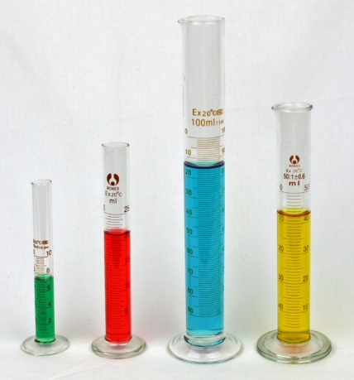
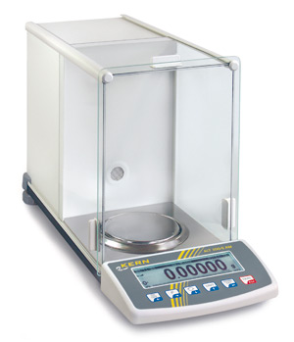
Chapter 1
Matter and Measurements
Page:3-10
1.1. Atom and molecules.
1.2 Classifications of Matter.
1.3 Physical And Chemical Changes.
1.4 Energy: fundamental part of physical and chemical change.
1.5 Unite of Measurement.

Slide 10
Chapter 1/ Matter and Measurements
Chemistry the science that seeks to understand the behavior of the matter by studying the behavior of atoms and molecules.
Matter is anything that occupies space and has mass.
1-Mixture is a combination of two or more substances in which the substances retain their distinct identities.
1- Homogenous mixture:
composition of the mixture is the same throughout.
Example: sugar in water
2- Heterogeneous mixture
composition is not uniform throughout.
Example: fruit salad

Slide 11
Chapter 1/ Matter and Measurements
2-Pure substance: is substance composed of only a single type of atom or molecule of substances.
Example: water , sugar and gold.
2- Compound is a substance composed of atoms of two or more elements chemically united in fixed proportions
and can only be separated into their pure components (elements) by chemical means.
Example: water (H₂O).
1-Element: is a substance that can not be separated into simpler substances by chemical means
Example: Gold (Ag), Oxygen (O).

Slide 12
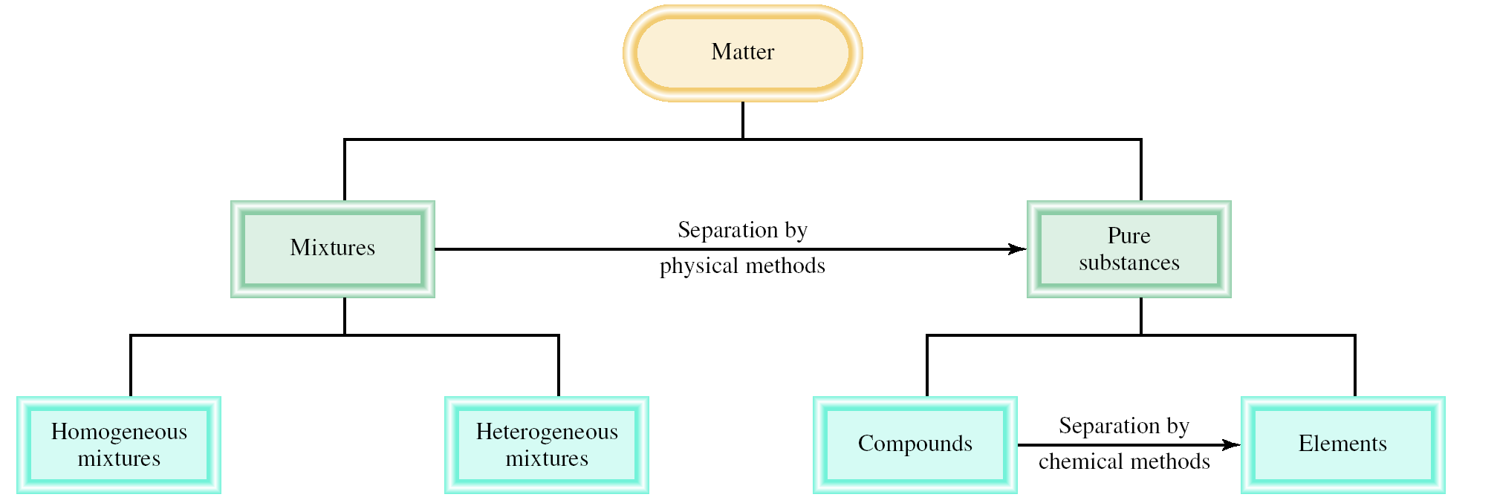
Chapter 1/ Matter and Measurements
1.2 Classifications of Matter

Slide 13
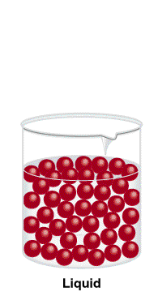
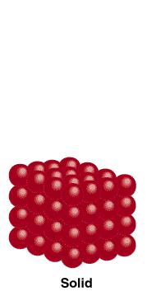
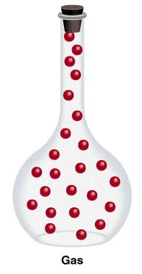
Chapter 1/ Matter and Measurements
States of Matter
Gas
Liquid
Solid
Molecules are separated by distance.
Have no definite shape.
Have no definite volume.
Molecules are close together but not held so rigidly in position and can move past on another.
Have no definite shape.
Have a definite volume .
Molecules are held close together in orderly fashion with little freedom of motion.
Have a definite shape.
Have a definite volume.

Slide 14
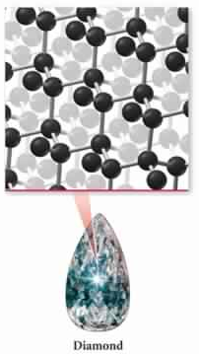
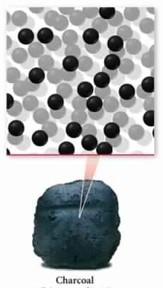
Chapter 1/ Matter and Measurements
Solid
Amorphous
crystalline
some solids have their particles arranged in an orderly geometric pattern.
e.g. salt and diamonds
some solids have their particles randomly distributed without any long-range pattern.
e.g. plastic – glass – charcoal

Slide 15
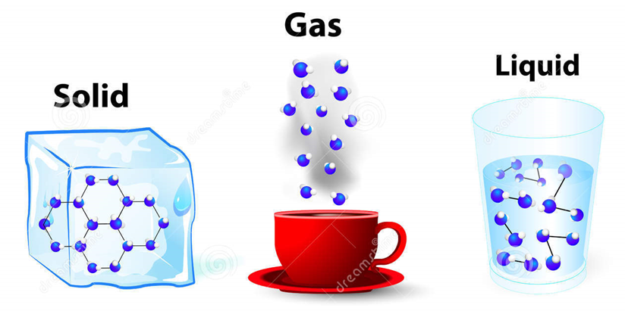
Chapter 1/ Matter and Measurements
1.3 Physical And Chemical Changes
A physical change
A chemical change
changes the composition or identity of the substance/s involved.
e.g. rusting of iron.
does not change the composition or identity of a substance.
e.g. ice melting or salt dissolving in water.

Slide 16
Chapter 1/ Matter and Measurements
1.4 Energy: fundamental part of physical
and chemical change
The FIRST PRINCIPLE to note about the way energy changes as the weight falls to the ground is that energy is neither created nor destroyed.
(The law of conservation of energy )
The SECOND PRINCIPLE to note is the tendency of systems with HIGH potential energy to change in a way that LOWERS their potential energy.

Slide 17
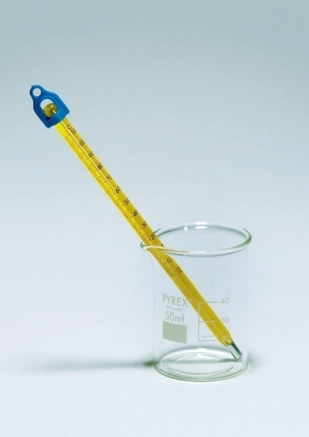
Chapter 1/ Matter and Measurements
1.5 Unite of Measurement
Some properties in chemistry can be measured.
Different instrument enable us to measure a substance’s properties:
Volume
Mass
Temperature
Graduated cylinder
Balance
Thermometer

Slide 18
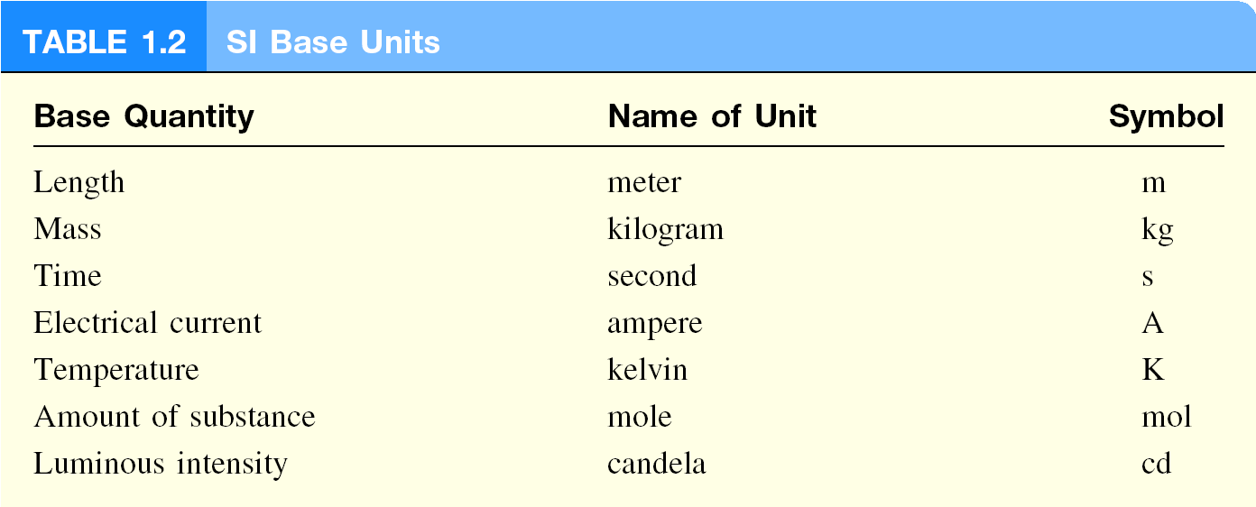
Chapter 1/ Matter and Measurements
1.5 Unite of Measurement
1- English system. e.g yard, inches and pounds.
2- metric system e.g. cm and km. →The international system of units (SI)
(SI) is used world wide to reports result.
There are seven SI base units as following:

Slide 19
Chapter 1/ Matter and Measurements
Prefixes used with SI Unit
SI units are modified in decimal fashion by a series of prefixes.
A prefix may be added to a unit to produce a multiple of the original unit.
استخدام البادئات (مضاعفات أو أجزاء) هو من أجل التبسيط والاختصار للكميات المقاسة
Examples
The base unit is meter (m)
The base unit is gram (g)
The base unit is liter (L)

Slide 20
Chapter 1/ Matter and Measurements
Prefixes used with SI Unit
Bigger unit
Smaller unit

Slide 21
Chapter 1/ Matter and Measurements
Prefixes used with SI Unit
Examples
The SI prefixes giga- and micro represent, respectively:
(a) 10⁻⁹ and 10⁻⁶
(b) 10⁶ and 10⁻³
(c) 10³ and 10⁻³
(d) 10⁹ and 10⁻⁶

Slide 22
Chapter 1/ Matter and Measurements
Prefixes used with SI Unit
Unit conversion:
Prefix (جزء أو مضاعف) → Base Unit (وحدة أساسية)
put the power sign from the table of prefixes
Example
convert 8.53 pm to meters?
Replace p with x 10⁻¹², therefore the answer is 8.53 x 10⁻¹² m
Base Unit (وحدة أساسية)→ Prefix(جزء أو مضاعف)
reverse the power sign from the table of prefixes
Example
convert 0.000462 g to milligrams ?
0.000462 x 10³ mg = 0.462 mg

Slide 23
Chapter 1/ Matter and Measurements
Prefixes used with SI Unit
Examples
. | What is 22.6 m when converted to decimeters?
 | A) | 0.226 dm
 | B) | 2.26 dm
 | C) | 226 dm
 | D) | 2.26 x 10^{–3} dm
* في حالة التحويل من وحدة كبيرة إلى وحدة صغيرة نجمع الأسس ونضرب في معامل بأس موجب.
* أما في حالة التحويل من وحدة صغيرة إلى وحدة كبيرة نجمع الأسس ونضرب في معامل بأس سالب.
The diameter of an atom is approximately 1 × 10⁻⁷ mm. What is this diameter when expressed in nanometers?
(a) 1 × 10⁻¹⁸ nm
(b) 1 × 10⁻¹⁵ nm
(c) 1 × 10⁻⁹ nm
(d) 1 × 10⁻¹ nm

Slide 24
Chapter 1/ Matter and Measurements
Prefixes used with SI Unit
Examples
Which of the following is the smallest distance?
(a) 21 m
(b) 2.1 x 10² cm
(c) 21 mm
(d) 2.1 x 10⁴ pm
→ 21m
→ 2.1m
Put all of them
in the same unit
→ 0.021 m
→ 2.1 x 10⁻⁸ m

Slide 25
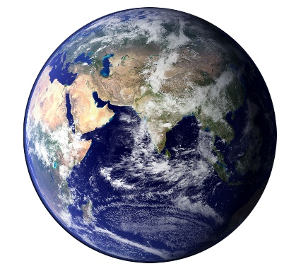
Chapter 1/ Matter and Measurements
1.5 Unite of Measurement
1- Mass: is a measure of the quantity of matter in an object.
SI unit of mass is the kilogram (kg)
1 kg = 1000 g = 1 x 10³ g
2- Weight: is force that gravity exerts on an object.
Mass of an object does not change when an object's location changes.
Weight, on the other hand does change with location.
weight = c x mass
on earth, c = 1.0
on moon, c ~ 0.1

Slide 26
Chapter 1/ Matter and Measurements
1.5 Unite of Measurement
3-Volume : SI derived unit for volume is cubic meter (m³)
Volume = width × length × height
= m × m × m = m³
Common unit of volume is liter (L) and milliliter (mL)
1 L = 1000 mL = 1000 cm³ = 1 dm³
The relationship between (L), (mL) and SI:
1 mL = 1 cm³
1 L = 1 dm³

Slide 27
Chapter 1/ Matter and Measurements
Measurement in chemistry
4-Density: SI derived unit for density is kg/m³
1 g/cm³ = 1 g/mL = 1000 kg/m³
1 g/mL = 1×10⁻³ g/L
Mass (g)
Mass (m)
density =
Density (g/ml)
Volume (ml)
Volume (V)
Examples
A piece of platinum metal with a density of 21.5 g/cm³ has a volume of 4.49 cm³. What is its mass?
m
d =
V
=> m = d x V= 21.5 g/cm³ x 4.49 cm³ = 96.5 g

Slide 28
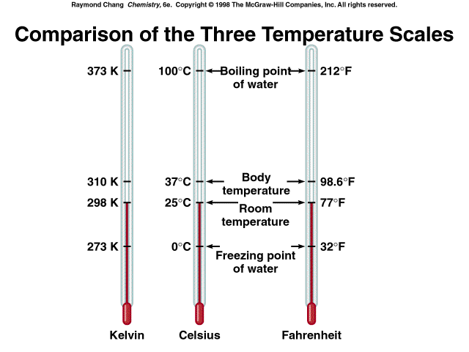
Chapter 1/ Matter and Measurements
Measurement in chemistry
5-Temperature Scales
There are three temperature scales, their units are:
1. Degrees Celsius ⁰C
2. Degrees Fahrenheit ⁰F
3. Kelvin K
Kelvin is the SI Base Unit of Temperature

Slide 29
Chapter 1/ Matter and Measurements
Measurement in chemistry
Temperature Units Conversion
K → °C or °C → K
K = °C + 273.15
°C = K - 273.15
°F → °C or °C → °F
°F = [ (9/5) × °C] + 32
°C = (5/9) x (°F - 32)
No relatationship between
K → °F or °F → K
Thus: K → ⁰C → ⁰F or
⁰F → ⁰C → K

Slide 30
Chapter 1/ Matter and Measurements
Measurement in chemistry
Examples 1.3
Solder is an alloy made of tin and lead that is used in electronic circuits. A certain solder has a melting point of 224°C. What is its melting point in degrees Fahrenheit?
°F = [(9 /5 ) × °C ] + 32
[°F = (9 /5 ) × 224 °C] + 32 = 435 ⁰F
(b) Helium has the lowest boiling point of all the elements at 2452°F. Convert this temperature to degrees Celsius.
°C = (5 /9 ) (°F - 32 )
°C = (5 /9 ) (-452 - 32 ) = -269 ⁰C
(c) Mercury, the only metal that exists as a liquid at room temperature, melts at 238.9°C. Convert its melting point to kelvins.
°K = °C + 273.15
°K = 238.9 °C + 273.15 = 234.3 K

Slide 31
H.W:
7 and 9
page 11-12

