Slide 1
Macmillan Education English Language Teacher Training Secondary: Flying High for Saudi Arabia + Flying High for Saudi Arabia Plus

Slide 2
Grade 10
Semester 1
Grade 11
Grade 12

Slide 3
An overview of:
Flying High for Saudi Arabia + FHSA Plus
Components
Approach

Slide 4
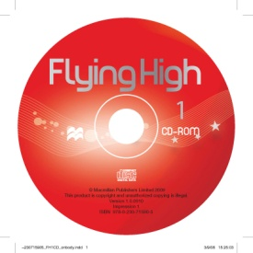
Course components of
Flying High for Saudi Arabia 1-4
Flying High for Saudi Arabia Plus 5-6
Teacher’s Book
Student’s Book
Workbook
CD-ROM
Website: www.macmillanenglish.com/fhsa
Notes:
4

Slide 5
Flying High for Saudi Arabia
Notes:
Macmillan website screenshot for FHSA

Slide 6
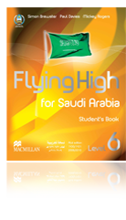
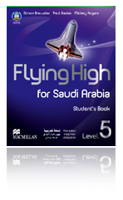
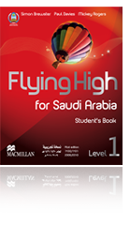
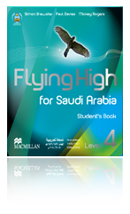
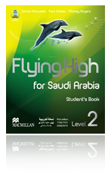
6 levels
Intermediate [B1] to Advanced
[B2+]
Notes:
Common European Framework for Reference B1/B2

Slide 7
Grade 10: Levels 1 and 2
Grade 11: Levels 3 and 4
Grade 12: FHSA Plus
Levels 5 and 6

Slide 8
Flying High for Saudi Arabia
8 units
Student’s Book
Four lessons
Workbook
Three lessons

Slide 9
Flying High for Saudi Arabia Plus
6 units
Student’s Book
10 pages/unit
Workbook
7 pages / unit

Slide 10
Useful websites
http://www.macmillanenglish.com/fhsa/
PASSWORD: ELDP [Please don’t give to students!]
http://app.macmillanksa.com/

Slide 11
Flying High 2013: Approach
Aimed at young adults
Raised level of linguistic complexity
New FHSA 1 + 2 = level B1 (CEFR)
New FHSA 5 + 6 get students exam-ready = level B2+ (CEFR)

Slide 12
Flying High 2013: Approach
Integrated skills
Lessons tend to start with speaking
Topic-based
No continuing characters
Grammar and vocabulary strands
More advanced pronunciation work
'look‘ and ‘feel’ for older students

Slide 13
Starts with speaking focus

Slide 14
Pronunciation
focus

Slide 15
Other skills integrated
Vocabulary building skills
Pair and group work

Slide 16
Grammar support

Slide 17
Focus on Saudi Arabia
NEW lesson 4: “Saudi Arabia and the World”
Enrich course with Saudi culture
More flexible lessons
Help mixed ability classes
- Extra support for weaker students
- Stretch more able students
- Group and individual work

Slide 18
Focus on Saudi Arabia in every unit

Slide 19
Progress Tests
After every 4 units
Grammar focus
Vocabulary focus
3 skills (Reading, Listening, Writing)

Slide 20
Grammar focus

Slide 21
Vocabulary focus
Skills assessment

Slide 22
Skills assessment

Slide 23
Learner Training activities

Slide 24
Help with Spelling

Slide 25
Workbook

Slide 26
Word lists – frequency system
Notes:
In the workbook wordlists have star system to indicate frequency of words

Slide 27
1,000,000+
45,000
2,500 80%
7,500 90%
Notes:
27
Ask participants to guess what these numbers might refer to when talking about vocabulary
Answers:
1 million+ Number of words in English language
45,000 Number of words recognised by an educated native speaker
2,500 most frequent words account for 80% of most texts
7,500 most frequent words account for 90% of most texts

Slide 28
Which words do you think are NOT high frequency in the following passage?
A survey has found some shocking lapses of etiquette in the messages passed around by people under the age of 20. It found that many youngsters prefer to send e-mail rather than write a letter, and reveals that most have no conception of what counts as proper manners when penning a digital missive.

Slide 29
A survey has found some shocking lapses of etiquette in the messages passed around by people under the age of 20. It found that many youngsters prefer to send e-mail rather than write a letter, and reveals that most have no conception of what counts as proper manners when penning a digital missive.
Notes:
Answer: lapses; etiquette; penning; missive

Slide 30
Stars
*** 1-2500 most frequent
** 2501-5000
* 5001-7500

Slide 31
Star Ratings *** ** *
*** 1-2500 most frequent ** 2501-5000 *5001-7500
Write 1, 2 or 3 stars next to the word to show the frequency.
morning together officially
tomorrow charity person
religion airline wet
arrest (n) what fierce

Slide 32
morning*** together*** officially**
tomorrow*** charity*** person***
religion*** airline** wet***
arrest (n)* what*** fierce**
Notes:
Answers

Slide 33
Understanding the teaching approach
Differentiation in materials:
To help teachers deal with less and more able learners within their classes
- C = core materials, these need to be taught in order to cover all the syllabus
D = desirable materials, these could be taught in order to consolidate learning
E = extension materials, these may be used for fast finishers or if the teachers finds they have a free lesson

Slide 34
Teacher’s Book

Slide 35
Notes:
Mapping to Saudi curriculum

Slide 36
Flying High for Saudi Arabia PLUS
Third Secondary Grade (Grade 12)
Semesters 1 and 2
Extensive exam preparation
Academic skills focus
Language learning strategies and techniques
Focus on necessary sub-skills
Motivating contexts
Independent learning and self-assessment

Slide 37
Flying towards Academia…
Designed to lead students to success in school exams/ university entrance exams, university level work and the world of work
Academically challenging content speaks to this age group without being patronising
Many authentic texts – that are longer and more weighty than in many young adult courses

Slide 38
Academic enrichment
Notes:
Activities that challenge student intellectually while developing learning skills, speak to this age group in a non-patronising way.

Slide 39
Substantial and authentic texts
Notes:
FHSA Plus contains ‘meaty’ authentic texts that are longer and more weighty than in most upper secondary and young adult courses. This provides students with food for thought and opportunities to expand their horizons while giving and addressing the interests, needs and concerns of this age group.

Slide 40
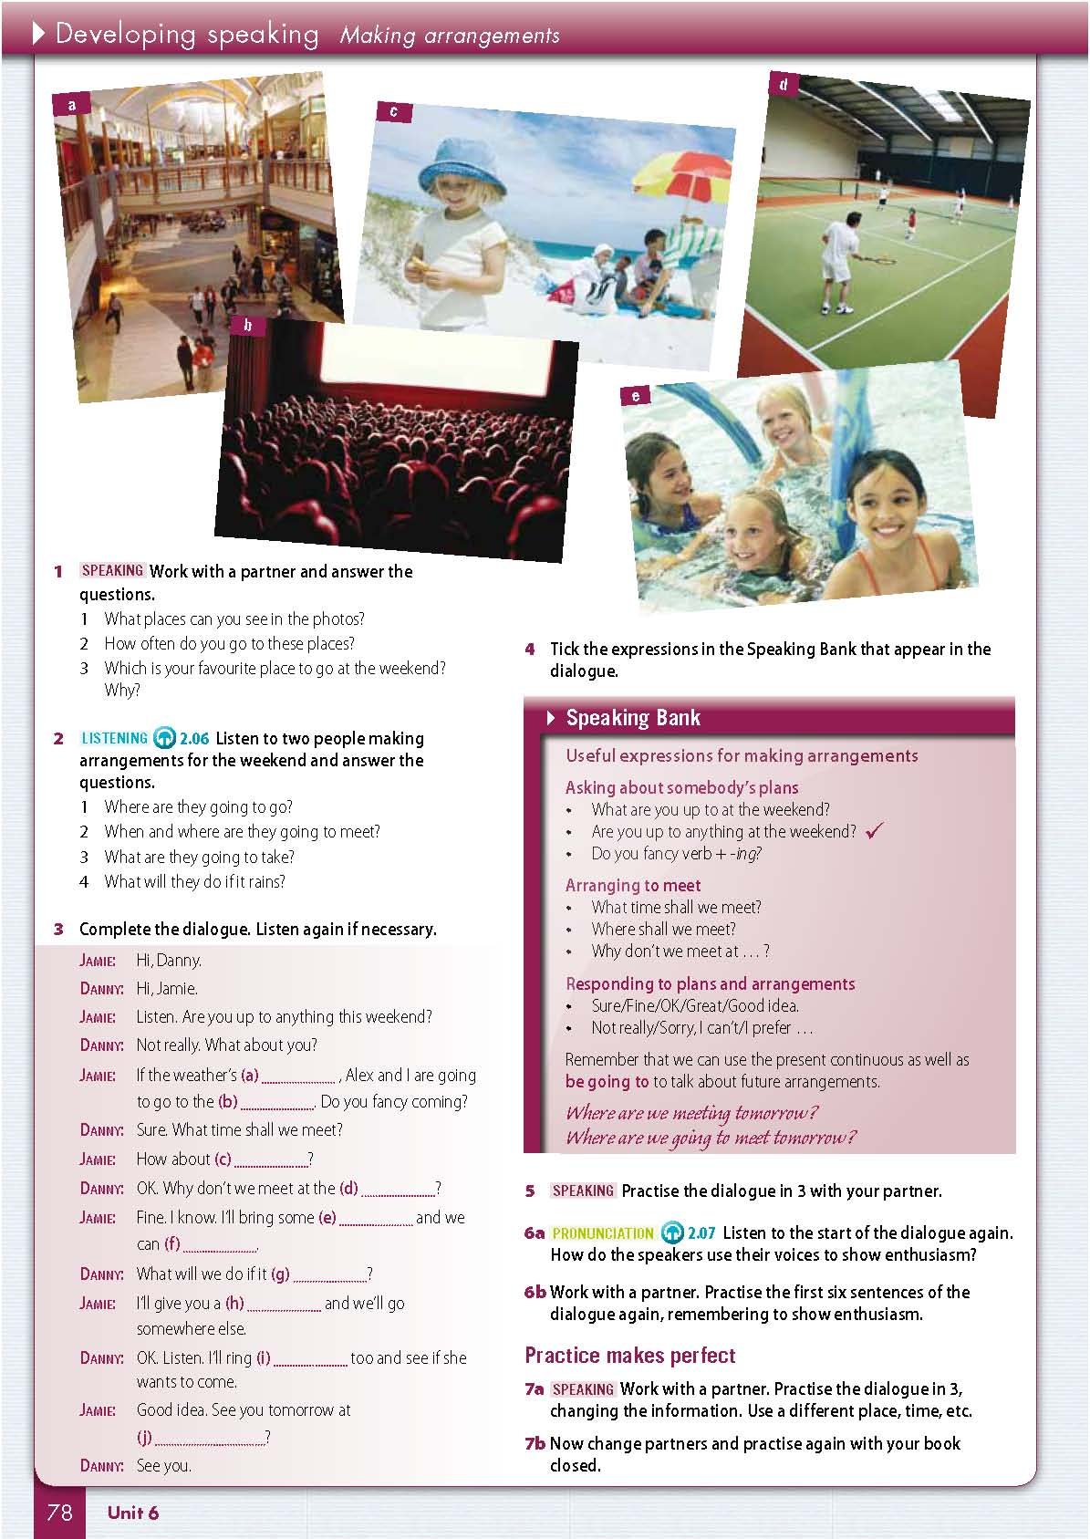
Developing Academic skills
Reference banks
- Integrated throughout the unit
- Further detail in the detailed reference bank sections at the back of the Student’s Book
Notes:
The emphasis in FHSA Plus is very much on developing and refining skills, not just testing them. Students often need more help to develop productive skills than receptive skills. These sections build students’ confidence and knowledge through step-by-step preparation for the final, exam-style task. At the back of every Student’s Book are the Speaking and Writing Banks. In these reference sections, Students can find further detailed help for Speaking and Writing that relate to the work in the relevant units.

Slide 41
Writing bank
Writing models
Notes:
Staged speaking and writing activities and models guide students through the process of developing speaking and writing and demonstrate how to prepare and present key concepts effectively in an academic context.

Slide 42
Flying into the Real World…
Grabs students’ attention and helps them to develop other areas of knowledge, alongside language skills
Blends content-based, cross-curricular or literary texts together while integrating skills practice
Introduces meaningful contexts

Slide 43
C.L.I.C.K.
Notes:
Cross-curricular, Literature and International Cultural Knowledge
Blending content-based, cross-curricular or literary texts together while integrating skills practice, means that the CLICK approach to learning is fully integrated throughout the book and clearly in line with the language objectives for the level. The topics explored in depth in these pages, will appeal to the student’s natural curiosity to explore the world outside of the classroom, and reflect material that they would naturally read for pleasure in their native language

Slide 44
Grammar in context
Grammar Guide
Grammar in context
Notes:
The target grammar in each unit is given meaningful context through the reading and listening texts. Using a guided discovery approach, students follow the questions to work out the use and form of the grammar in question with contextual hints to help them along.
Students are directed to the Language Reference Section at the end of every unit to check their findings and grammatical hypotheses. These reference pages bring together all the grammar and vocabulary taught in the unit, making it much easier for student to revise and prepare for exams.

Slide 45
Flying towards Exam Success…
Exam preparation
Practice of specific exam tasks

Slide 46
Exam success
Notes:
There are two Exam Success boxes in each unit. They ask student to reflect on the best way to do a specific exam task. Student can discuss their answers to the question in pairs and are then directed to a special section at the end of the book where typical strategies and tips are explained.
Exam-style tasks
There are a wide variety of typical exam-style tasks throughout FHSA Plus. All of which appear in typical exams, such as these examples for Listening: completing notes, matching the speakers with statements, true/false/not mentioned, correcting incorrect information in a text etc…Typical reading tasks also include exam-style exercises such as true/false statements, multiple-choice, comprehension questions, matching and inserting sentences.

Slide 47
Progress Tests
Notes:
FHSA Plus has been designed to lead teenage students to success in school leaving/university entrance examinations and to prepare them for further study and the world of work.
After every two units is a Progress Test which revises the exam techniques that students have learnt in the unit and gives them more practice in doing typical exam-style tasks. There is also a CEFR ‘can do’ progress check in every Progress Test to help encourage learners to take responsibility for their own learning.
Students are also directed to the back of the Student’s Book for further step-by-step guidance on similar exam style tasks.

Slide 48
Flying towards Independence…
Life-long learning skills
Revision, extension and practice
Self-access to lexical sets

Slide 49
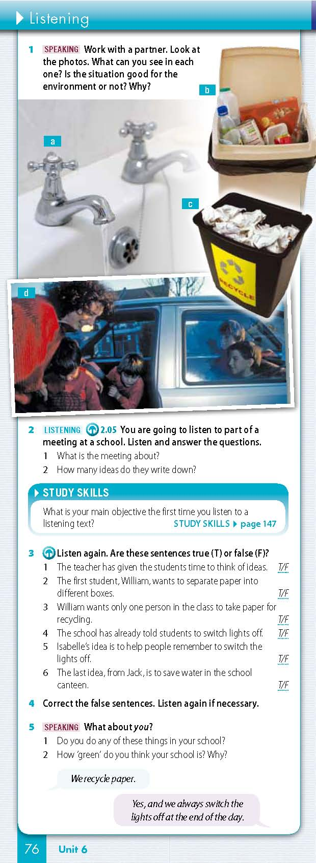
Life-long learning
Study Skills boxes
Notes:
Study skills and Exam success sections equip students with life-long learning skills. These tip boxes appear regularly asking students to reflect on why they should work in a particular way, which sub-skills they should use, or how they should go about a particular activity. Students are then guided to further in depth skills development at the back of the Student’s Book.

Slide 50
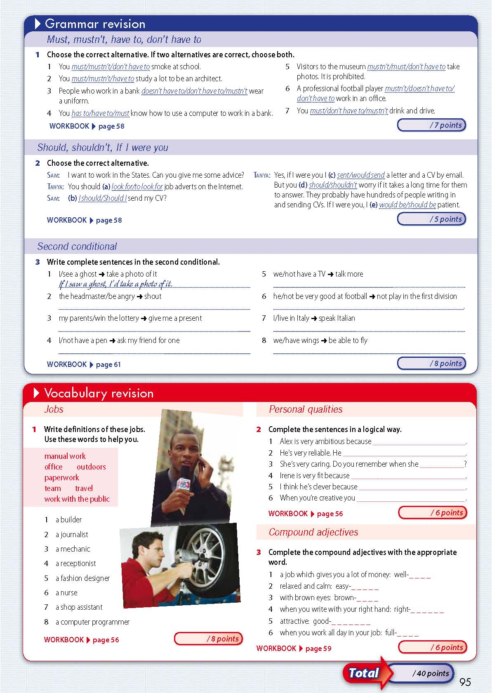
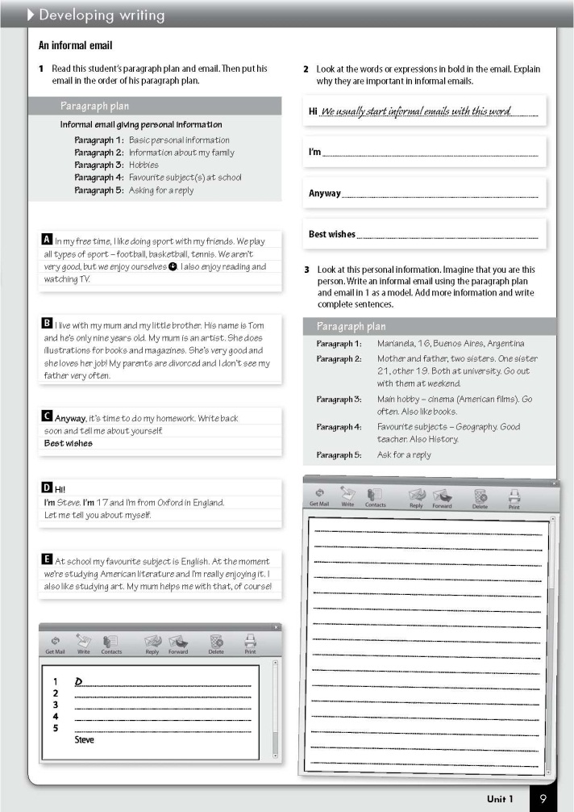
Reference and revision
Notes:
FHSA Plus revises, extends and practises the most important lexical sets in typical school leaving exams so that students can write and talk about these with ease. The reference and revision sections give students the opportunity to work through carefully graded exercises which make the detailed reference points interactive and ideal for self-study or for homework practice. Students are then directed to further practice in the Workbook.

Slide 51
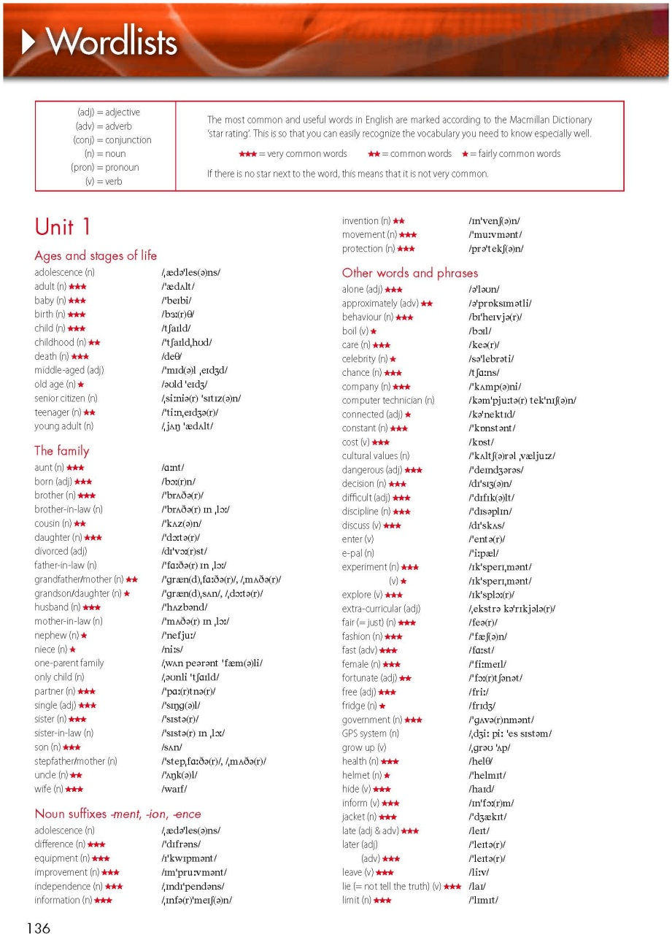
Self-study
Notes:
Each WorkBook contains wordlists for the relevant units, listed by lexical set. These can be found at the back of the book and are marked with the Macmillan Dictionary star rating. The most common and useful words in English have the highest star rating, making it easy for students to practise and revise the most important and most frequently used words.

Slide 52
The Teacher’s Book is YOUR lesson plan
It contains:
aims language materials
answers warmers homework
Teacher development notes
core materials
desirable materials
extension materials
Notes:
Summary of TB

Slide 53
Thank you for listening!
Questions and Answers

