Slide 1
برنامج التسريع الاكاديمي

Slide 4
What is Biology?

Slide 5
What is Biology?
Biology is the scientific study of life. But
what is a scientific study?
what does it mean to be alive?
To answer these questions, you need to know:
What is science?
ًWhat is the nature and properties of life?
What are the Major themes of life?

Slide 6
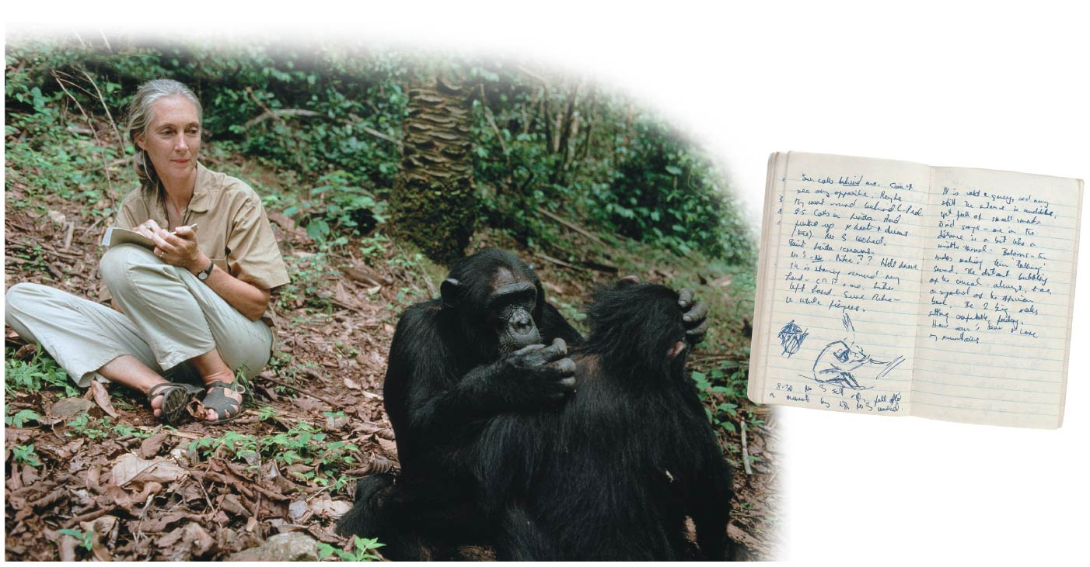
What is science?
Science is an approach to understanding the natural world that is based on inquiry (a search for information, explanations, and answers to specific questions).

Slide 7
The Process of Science
This basic human drive to understand our natural world is manifest in two main scientific approaches:
Most scientists practice a combination of these two forms of inquiry.
Scientific approaches
Discovery Science: which is mostly about describing nature
Hypothesis-driven science: which is mostly about explaining nature.
هذه الشرائح مخصصة للشرح و ليست للمذاكرة

Slide 8
Discovery Science
Discovery Science: the study of structures and processes that depends on:
1. Verifiable observations
2. measurements: directly or indirectly with the help of tools and technology, such as microscopes.
Recorded observations are called data, which are the items of information on which scientific inquiry is based.
هذه الشرائح مخصصة للشرح و ليست للمذاكرة
Notes:
8
Student Misconceptions and Concerns
1. Contrasting the concept of faith with the tentative nature of science can help to define and distinguish science from other ways of knowing. Students sometimes enter science classes expecting absolutes of facts and rigid dogma. Instead, scientific knowledge is tentative, reflecting degrees of confidence closely correlated to the strength of the evidence.
2. The authors’ distinction between natural and supernatural explanations is essential to understanding the power and limits of scientific explanations.
3. Some students think that variables are somehow restricted in a controlled experiment. That is, everything about the experiment is “controlled.” But controlled experiments limit the differences between experimental and control groups, with only one difference in most situations. That way, when a difference between the groups is identified, it can be explained by the single difference between the groups.
4. The common use of the terms law and theory by the public often blurs the stricter definitions of these terms in science. In general, laws describe and theories explain. Both are typically well-established concepts in science. A free online publication by the National Academy of Sciences helps to define these and related terms more carefully. See Chapter 1 of Teaching about Evolution and the Nature of Science at www.nap.edu/openbook.php?record_id=5787.
Teaching Tips
1. Consider using a laboratory exercise to have your students plan and perhaps conduct investigations using discovery science and a hypothesis-driven approach. Emphasize the processes and not the significance of the questions. Students can conduct descriptive surveys of student behavior (e.g., use of pens, pencils, or electronic devices for taking notes) or test hypotheses using controlled trials. Students may need considerable supervision and advice while planning and conducting their experiments.
Active Lecture Tips
1. Consider presenting your class with several descriptions of scientific investigations. Then ask students to categorize each type of experiment as discovery science or hypothesis-driven science. If students can work in small groups, encourage quick discussions to clarify these two types of scientific investigations.
2. You might also present to your class descriptions of several scientific investigations that you have written. Include in your descriptions numerous examples of improper methodology (small sample size, several variables existing between the control and experimental groups, failure to specifically test the hypothesis, and the like). Let small groups or individuals analyze the experiments in class to identify the flaws. This critical analysis allows students the opportunity to suggest the characteristics of good investigations in class.
3. Have your students turn to a few other students seated nearby to explain why a coordinated conspiracy promoting a specific idea in science is unlikely to succeed. Have your students describe aspects of science that would check fraudulent or erroneous claims and/or political efforts.
4. See the Activity Practicing the Scientific Method: Are Girls Better Than Boys at Some Tasks? on the Instructor Exchange. Visit the Instructor Exchange in the MasteringBiology instructor resource area for a description of this activity.

Slide 9
Hypothesis-Driven Science
Most modern scientific investigations can be described as hypothesis-driven science.
A hypothesis is:
a tentative answer to a question or
a proposed explanation for a set of observations.
A good hypothesis ➟ predictions ➟ experiments.
A good hypothesis immediately leads to predictions that can be tested by experiments.
هذه الشرائح مخصصة للشرح و ليست للمذاكرة
Notes:
9
Student Misconceptions and Concerns
1. Contrasting the concept of faith with the tentative nature of science can help to define and distinguish science from other ways of knowing. Students sometimes enter science classes expecting absolutes of facts and rigid dogma. Instead, scientific knowledge is tentative, reflecting degrees of confidence closely correlated to the strength of the evidence.
2. The authors’ distinction between natural and supernatural explanations is essential to understanding the power and limits of scientific explanations.
3. Some students think that variables are somehow restricted in a controlled experiment. That is, everything about the experiment is “controlled.” But controlled experiments limit the differences between experimental and control groups, with only one difference in most situations. That way, when a difference between the groups is identified, it can be explained by the single difference between the groups.
4. The common use of the terms law and theory by the public often blurs the stricter definitions of these terms in science. In general, laws describe and theories explain. Both are typically well-established concepts in science. A free online publication by the National Academy of Sciences helps to define these and related terms more carefully. See Chapter 1 of Teaching about Evolution and the Nature of Science at www.nap.edu/openbook.php?record_id=5787.
Teaching Tips
1. Consider using a laboratory exercise to have your students plan and perhaps conduct investigations using discovery science and a hypothesis-driven approach. Emphasize the processes and not the significance of the questions. Students can conduct descriptive surveys of student behavior (e.g., use of pens, pencils, or electronic devices for taking notes) or test hypotheses using controlled trials. Students may need considerable supervision and advice while planning and conducting their experiments.
Active Lecture Tips
1. Consider presenting your class with several descriptions of scientific investigations. Then ask students to categorize each type of experiment as discovery science or hypothesis-driven science. If students can work in small groups, encourage quick discussions to clarify these two types of scientific investigations.
2. You might also present to your class descriptions of several scientific investigations that you have written. Include in your descriptions numerous examples of improper methodology (small sample size, several variables existing between the control and experimental groups, failure to specifically test the hypothesis, and the like). Let small groups or individuals analyze the experiments in class to identify the flaws. This critical analysis allows students the opportunity to suggest the characteristics of good investigations in class.
3. Have your students turn to a few other students seated nearby to explain why a coordinated conspiracy promoting a specific idea in science is unlikely to succeed. Have your students describe aspects of science that would check fraudulent or erroneous claims and/or political efforts.
4. See the Activity Practicing the Scientific Method: Are Girls Better Than Boys at Some Tasks? on the Instructor Exchange. Visit the Instructor Exchange in the MasteringBiology instructor resource area for a description of this activity.

Slide 10
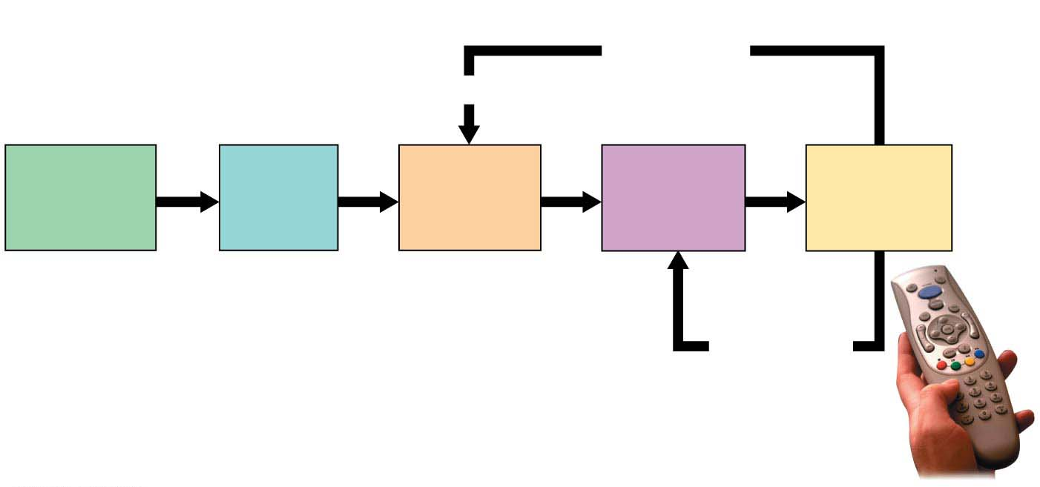
Figure 1.3: Applying the scientific method to a common problem
Experiment
does not
support
hypothesis.
Revise.
Observation
The remote
doesn’t
work.
Question
What’s
wrong?
Hypothesis
The
batteries
are dead.
Prediction
With new
batteries, it
will work.
Experiment
Replace
batteries.
Experiment
supports
hypothesis;
make more
predictions
and test.
Notes:
Figure 1.3-s5 Applying the scientific method to a common problem (step 5)

Slide 11
Theories in Science
Accumulating facts is not the primary goal of science.
Facts in the form of verifiable observations and repeatable experimental results are essential to science.
But what really advances science are new theories that tie together a number of observations that previously seemed unrelated.
The cornerstones of science are the explanations that apply to the greatest variety of phenomena.
هذه الشرائح مخصصة للشرح و ليست للمذاكرة
Notes:
11
Student Misconceptions and Concerns
1. Contrasting the concept of faith with the tentative nature of science can help to define and distinguish science from other ways of knowing. Students sometimes enter science classes expecting absolutes of facts and rigid dogma. Instead, scientific knowledge is tentative, reflecting degrees of confidence closely correlated to the strength of the evidence.
2. The authors’ distinction between natural and supernatural explanations is essential to understanding the power and limits of scientific explanations.
3. Some students think that variables are somehow restricted in a controlled experiment. That is, everything about the experiment is “controlled.” But controlled experiments limit the differences between experimental and control groups, with only one difference in most situations. That way, when a difference between the groups is identified, it can be explained by the single difference between the groups.
4. The common use of the terms law and theory by the public often blurs the stricter definitions of these terms in science. In general, laws describe and theories explain. Both are typically well-established concepts in science. A free online publication by the National Academy of Sciences helps to define these and related terms more carefully. See Chapter 1 of Teaching about Evolution and the Nature of Science at www.nap.edu/openbook.php?record_id=5787.
Teaching Tips
1. Consider using a laboratory exercise to have your students plan and perhaps conduct investigations using discovery science and a hypothesis-driven approach. Emphasize the processes and not the significance of the questions. Students can conduct descriptive surveys of student behavior (e.g., use of pens, pencils, or electronic devices for taking notes) or test hypotheses using controlled trials. Students may need considerable supervision and advice while planning and conducting their experiments.
Active Lecture Tips
1. Consider presenting your class with several descriptions of scientific investigations. Then ask students to categorize each type of experiment as discovery science or hypothesis-driven science. If students can work in small groups, encourage quick discussions to clarify these two types of scientific investigations.
2. You might also present to your class descriptions of several scientific investigations that you have written. Include in your descriptions numerous examples of improper methodology (small sample size, several variables existing between the control and experimental groups, failure to specifically test the hypothesis, and the like). Let small groups or individuals analyze the experiments in class to identify the flaws. This critical analysis allows students the opportunity to suggest the characteristics of good investigations in class.
3. Have your students turn to a few other students seated nearby to explain why a coordinated conspiracy promoting a specific idea in science is unlikely to succeed. Have your students describe aspects of science that would check fraudulent or erroneous claims and/or political efforts.
4. See the Activity Practicing the Scientific Method: Are Girls Better Than Boys at Some Tasks? on the Instructor Exchange. Visit the Instructor Exchange in the MasteringBiology instructor resource area for a description of this activity.

Slide 12
Theories in Science
People like Isaac Newton, Charles Darwin, and Albert Einstein stand out in the history of science not because they discovered a great many facts but because their theories had such broad explanatory power.
What is a scientific theory, and how is it different from a hypothesis?
A scientific theory is much broader in scope than a hypothesis.
هذه الشرائح مخصصة للشرح و ليست للمذاكرة
Notes:
12
Student Misconceptions and Concerns
1. Contrasting the concept of faith with the tentative nature of science can help to define and distinguish science from other ways of knowing. Students sometimes enter science classes expecting absolutes of facts and rigid dogma. Instead, scientific knowledge is tentative, reflecting degrees of confidence closely correlated to the strength of the evidence.
2. The authors’ distinction between natural and supernatural explanations is essential to understanding the power and limits of scientific explanations.
3. Some students think that variables are somehow restricted in a controlled experiment. That is, everything about the experiment is “controlled.” But controlled experiments limit the differences between experimental and control groups, with only one difference in most situations. That way, when a difference between the groups is identified, it can be explained by the single difference between the groups.
4. The common use of the terms law and theory by the public often blurs the stricter definitions of these terms in science. In general, laws describe and theories explain. Both are typically well-established concepts in science. A free online publication by the National Academy of Sciences helps to define these and related terms more carefully. See Chapter 1 of Teaching about Evolution and the Nature of Science at www.nap.edu/openbook.php?record_id=5787.
Teaching Tips
1. Consider using a laboratory exercise to have your students plan and perhaps conduct investigations using discovery science and a hypothesis-driven approach. Emphasize the processes and not the significance of the questions. Students can conduct descriptive surveys of student behavior (e.g., use of pens, pencils, or electronic devices for taking notes) or test hypotheses using controlled trials. Students may need considerable supervision and advice while planning and conducting their experiments.
Active Lecture Tips
1. Consider presenting your class with several descriptions of scientific investigations. Then ask students to categorize each type of experiment as discovery science or hypothesis-driven science. If students can work in small groups, encourage quick discussions to clarify these two types of scientific investigations.
2. You might also present to your class descriptions of several scientific investigations that you have written. Include in your descriptions numerous examples of improper methodology (small sample size, several variables existing between the control and experimental groups, failure to specifically test the hypothesis, and the like). Let small groups or individuals analyze the experiments in class to identify the flaws. This critical analysis allows students the opportunity to suggest the characteristics of good investigations in class.
3. Have your students turn to a few other students seated nearby to explain why a coordinated conspiracy promoting a specific idea in science is unlikely to succeed. Have your students describe aspects of science that would check fraudulent or erroneous claims and/or political efforts.
4. See the Activity Practicing the Scientific Method: Are Girls Better Than Boys at Some Tasks? on the Instructor Exchange. Visit the Instructor Exchange in the MasteringBiology instructor resource area for a description of this activity.

Slide 13
Theories in Science
A theory:
1. is a comprehensive explanation supported by abundant evidence, and
2. is general enough to spin off many new testable hypotheses.
Theories only become widely accepted by scientists if they
are supported by an accumulation of extensive and varied evidence and
have not been contradicted by any scientific data.
هذه الشرائح مخصصة للشرح و ليست للمذاكرة
Notes:
13
Student Misconceptions and Concerns
1. Contrasting the concept of faith with the tentative nature of science can help to define and distinguish science from other ways of knowing. Students sometimes enter science classes expecting absolutes of facts and rigid dogma. Instead, scientific knowledge is tentative, reflecting degrees of confidence closely correlated to the strength of the evidence.
2. The authors’ distinction between natural and supernatural explanations is essential to understanding the power and limits of scientific explanations.
3. Some students think that variables are somehow restricted in a controlled experiment. That is, everything about the experiment is “controlled.” But controlled experiments limit the differences between experimental and control groups, with only one difference in most situations. That way, when a difference between the groups is identified, it can be explained by the single difference between the groups.
4. The common use of the terms law and theory by the public often blurs the stricter definitions of these terms in science. In general, laws describe and theories explain. Both are typically well-established concepts in science. A free online publication by the National Academy of Sciences helps to define these and related terms more carefully. See Chapter 1 of Teaching about Evolution and the Nature of Science at www.nap.edu/openbook.php?record_id=5787.
Teaching Tips
1. Consider using a laboratory exercise to have your students plan and perhaps conduct investigations using discovery science and a hypothesis-driven approach. Emphasize the processes and not the significance of the questions. Students can conduct descriptive surveys of student behavior (e.g., use of pens, pencils, or electronic devices for taking notes) or test hypotheses using controlled trials. Students may need considerable supervision and advice while planning and conducting their experiments.
Active Lecture Tips
1. Consider presenting your class with several descriptions of scientific investigations. Then ask students to categorize each type of experiment as discovery science or hypothesis-driven science. If students can work in small groups, encourage quick discussions to clarify these two types of scientific investigations.
2. You might also present to your class descriptions of several scientific investigations that you have written. Include in your descriptions numerous examples of improper methodology (small sample size, several variables existing between the control and experimental groups, failure to specifically test the hypothesis, and the like). Let small groups or individuals analyze the experiments in class to identify the flaws. This critical analysis allows students the opportunity to suggest the characteristics of good investigations in class.
3. Have your students turn to a few other students seated nearby to explain why a coordinated conspiracy promoting a specific idea in science is unlikely to succeed. Have your students describe aspects of science that would check fraudulent or erroneous claims and/or political efforts.
4. See the Activity Practicing the Scientific Method: Are Girls Better Than Boys at Some Tasks? on the Instructor Exchange. Visit the Instructor Exchange in the MasteringBiology instructor resource area for a description of this activity.

Slide 14
The Nature of Life
What is life?
What distinguishes livings from nonliving things?
Biology is the scientific study of life.
We recognize life mainly by what living things do.
هذه الشرائح مخصصة للشرح و ليست للمذاكرة
Notes:
14
Student Misconceptions and Concerns
1. We live in a world that is largely understood by what we can distinguish and identify with our naked senses. However, the diversity of life and the levels of biological organization extend well beyond the physical scale of our daily lives. For many students, appreciating the diversity of the microscopic world is abstract, nearly on par with an understanding of the workings of atoms and molecules. A laboratory opportunity to examine the microscopic details of objects from our daily lives (the surface of potato chips, the structure of table salt and sugar, the details of a blade of grass) can be an important sensory extension that prepares the mind for greater comprehension of these minute biological details.
Teaching Tips
1. Consider asking students to bring to class a page or two of an article about biology that appeared in the media in the last month. Alternatively, you could have each student email a Web address of a recent biology-related news event to you. You might even have them e-mail relevant articles to you for each of the main topics you address throughout the semester.
2. Here is a simple way to contrast the relative size of prokaryotic and eukaryotic cells. Mitochondria and chloroplasts are thought to have evolved by endosymbiosis. Thus, mitochondria and chloroplasts are about the size of bacteria, contained within a plant cell. A figure of a plant cell therefore provides an immediate comparison of these sizes, not side-by-side, but one inside the other!
3. The scientific organization Sigma Xi offers a free summary of the major science news articles each weekday. The first few paragraphs of each article are included with a hyperlink to the source of the entire article. The topics are diverse and can be an excellent way to be aware of daily scientific announcements and reports. Typically, about ten articles are cited each weekday. Science in the News is part of the website www.americanscientist.org/, where you can sign up for a free newsletter each weekday.
4. An excellent introduction to the domains and kingdoms of life is presented at www.ucmp.berkeley.edu/exhibits/historyoflife.php.
Active Lecture Tips
1. Ask your students, at the start of the semester, to write down the first type of animal that comes to mind. The most frequent response is a mammal. (In my courses, over a 25-year period, more than 98% of the examples have been mammals.) As the diversity of life is explored, the common heritage of biological organization can be less, and not more, apparent. The diverse forms, habits, and ecological interactions overwhelm our senses with differences. Emphasizing the diversity and unifying aspects of life is necessary for a greater understanding of the evolutionary history of life on Earth.
2. Consider asking students to pair up with someone sitting near them to identify examples of the seven properties of life in some organism from your region (or perhaps a school mascot, if appropriate).

Slide 15
Properties of life
Order: all living things exhibit complex but ordered organization
Regulation: organisms can adjust its internal environment, keeping it within appropriate limits

Slide 16
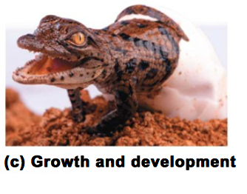
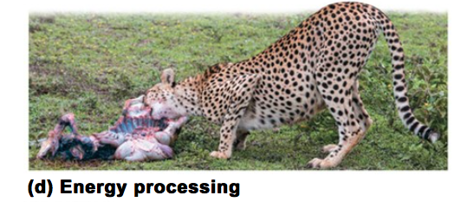
Properties of life
Growth and development: Information carried by DNA controls the pattern of growth and development in all organisms.
Energy processing: organisms take in energy and use it to perform all of life’s activities.

Slide 17
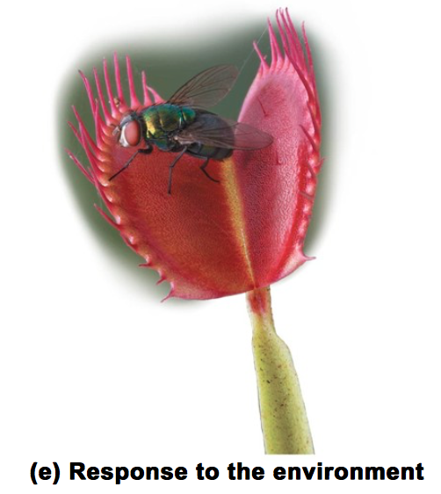
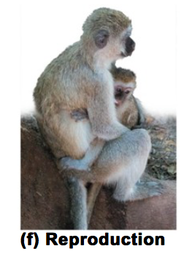
Properties of life
Response to the environment:
all organisms respond to the external stimuli.
Reproduction:
organisms reproduce their own kind.

Slide 18
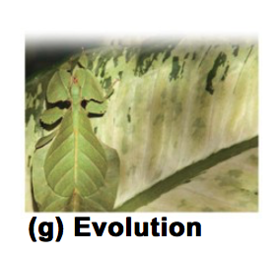
Properties of life
Evolution:
reproduction underlies the capacity of population to change (evolve) over time.

Slide 19
Grouping Species: The Basic Concept
A species is generally defined as a group of organisms that
live in the same place and time and
have the potential to interbreed with one another in nature to produce healthy offspring.
Taxonomy, the branch of biology that names and classifies species and arrange them into a hierarchy of broader and broader groups.

Slide 20
The Three Domains of Life
Domains
Bacteria
Eukarya
Plantae
Archaea
Fungi
Animalia
Protists
Prokaryotic or eukaryotic cells
Kingdoms
Most of the first three are multicellular
Single or multicellular
Notes:
20
Student Misconceptions and Concerns
1. We live in a world that is largely understood by what we can distinguish and identify with our naked senses. However, the diversity of life and the levels of biological organization extend well beyond the physical scale of our daily lives. For many students, appreciating the diversity of the microscopic world is abstract, nearly on par with an understanding of the workings of atoms and molecules. A laboratory opportunity to examine the microscopic details of objects from our daily lives (the surface of potato chips, the structure of table salt and sugar, the details of a blade of grass) can be an important sensory extension that prepares the mind for greater comprehension of these minute biological details.
Teaching Tips
1. Consider asking students to bring to class a page or two of an article about biology that appeared in the media in the last month. Alternatively, you could have each student email a Web address of a recent biology-related news event to you. You might even have them e-mail relevant articles to you for each of the main topics you address throughout the semester.
2. Here is a simple way to contrast the relative size of prokaryotic and eukaryotic cells. Mitochondria and chloroplasts are thought to have evolved by endosymbiosis. Thus, mitochondria and chloroplasts are about the size of bacteria, contained within a plant cell. A figure of a plant cell therefore provides an immediate comparison of these sizes, not side-by-side, but one inside the other!
3. The scientific organization Sigma Xi offers a free summary of the major science news articles each weekday. The first few paragraphs of each article are included with a hyperlink to the source of the entire article. The topics are diverse and can be an excellent way to be aware of daily scientific announcements and reports. Typically, about ten articles are cited each weekday. Science in the News is part of the website www.americanscientist.org/, where you can sign up for a free newsletter each weekday.
4. An excellent introduction to the domains and kingdoms of life is presented at www.ucmp.berkeley.edu/exhibits/historyoflife.php.
Active Lecture Tips
1. Ask your students, at the start of the semester, to write down the first type of animal that comes to mind. The most frequent response is a mammal. (In my courses, over a 25-year period, more than 98% of the examples have been mammals.) As the diversity of life is explored, the common heritage of biological organization can be less, and not more, apparent. The diverse forms, habits, and ecological interactions overwhelm our senses with differences. Emphasizing the diversity and unifying aspects of life is necessary for a greater understanding of the evolutionary history of life on Earth.
2. Consider asking students to pair up with someone sitting near them to identify examples of the seven properties of life in some organism from your region (or perhaps a school mascot, if appropriate).

Slide 21
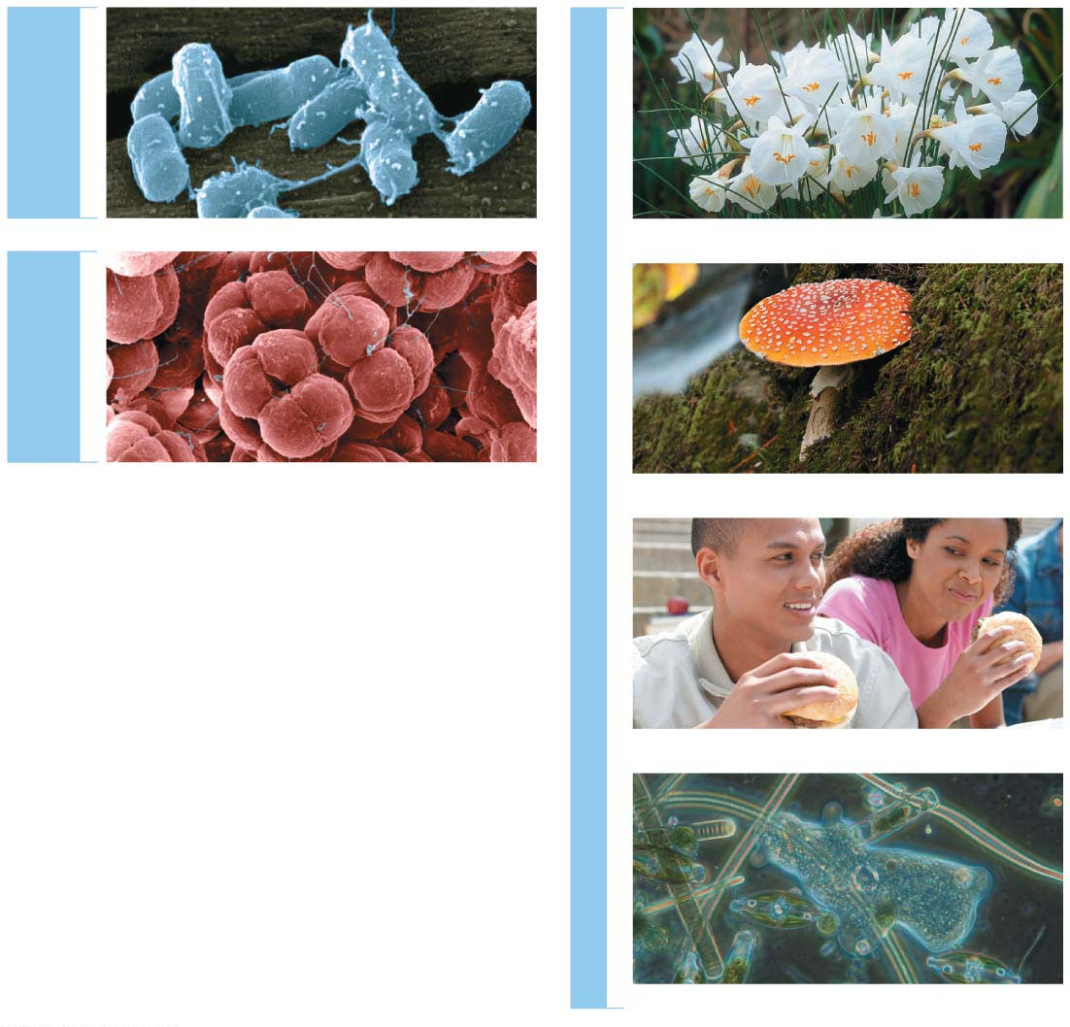
DOMAIN
BACTERIA
Kingdom Plantae
DOMAIN
ARCHAEA
DOMAIN EUKARYA
Kingdom Fungi
Figure 1.7: The three domains of life
Kingdom Animalia
Protists (multiple kingdoms)
Notes:
Figure 1.7 The three domains of life

Slide 22
Major Themes in Biology
Five unifying themes will serve as touchstones throughout our investigation of biology.
MAJOR THEMES IN BIOLOGY
Structure/
Function
Information
Flow
Energy
Transformations
Interconnections
within Systems
Evolution
Notes:
22
Student Misconceptions and Concerns
1. Students often believe that Charles Darwin was the first to suggest that life evolves; the early contributions by Greek philosophers and the work of Jean-Baptiste Lamarck may be unappreciated. Consider emphasizing this earlier work in your introduction to Darwin’s contributions.
2. Students often misunderstand the basic process of evolution and instead reflect a Lamarckian point of view. Organisms do not evolve structures deliberately or out of want or need. Individuals do not evolve. Evolution is a passive process in which the environment favors one or more existing variations of a trait already present in a population.
Teaching Tips
1. Many resources related to Charles Darwin are available on the Internet:
a. General evolution resources:
evolution.berkeley.edu
nationalacademies.org/evolution
ncse.com
b. The complete works of Charles Darwin can be found at darwin-online.org.uk/
c. Details of Charles Darwin’s home are located at http://williamcalvin.com/bookshelf/down_hse.htm
2. There are many variations of games that model aspects of natural selection. Here is one that is appropriate for a laboratory exercise. Purchase several bags of dried grocery store beans of diverse sizes and colors. Large lima beans, small white beans, red beans, and black beans are all good options. Consider the beans “food” for the “predatory” students. To begin, randomly distribute (throw) 100 beans of each of four colors onto a green lawn. Allow individual students to collect beans over a set period, perhaps 3 minutes. Then count the total number of each color of bean collected. Assume that the beans remaining undetected (still in the lawn) reproduce by doubling in number. Calculate the number of beans of each color remaining in the field. For the next round, count out the number of each color to add to the lawn so that the new totals on the lawn will double the number of beans that students did not find in the first “generation.” Before each predatory episode, record the total number of each color of beans that have “survived” in the field. Then let your student “predators” out for another round of collection (generation). Repeat the process for at least three or four “generations.” Note what colors of beans are favored by the environment. Ask students to speculate which colors might have been favored during another season or on a parking lot.
3. Many websites devoted to domesticated species can be used to illustrate the variety of forms produced by artificial selection. Those devoted to pigeons, chickens, and dogs have proven to be especially useful.
4. The authors make an analogy between the four bases used to form genes and the 26 letters of the English alphabet used to create words and sentences. One could also make an analogy between the four bases and trains composed of four different types of railroad cars (perhaps an engine, boxcar, tanker, and flatcar). Imagine how many different types of trains one could make using just 100 rail cars of four different types. (The answer is 4¹⁰⁰.)
5. For a chance to add a little math to the biological levels of organization, consider calculating the general scale differences between each level of biological organization. For example, are cells generally 5, 10, 50, or 100 times more massive than organelles? Are organelles generally 5, 10, 50, or 100 times more massive than macromolecules? For some levels of organization, such as ecosystems, communities, and populations, size or scale differences are perhaps less relevant and more problematic to consider. However, at the smaller levels, the sense of scale might enhance an appreciation for levels of biological organization.
6. The U.S. Census Bureau maintains updated population clocks that estimate the U.S. and world populations (www.census.gov/popclock/). If students have a general idea of the human population of the United States, statistics about the number of people affected with a disease or disaster become more significant. For example, the current population of the United States is about 320,000,000 (in 2014). It is currently estimated that at least 1 million people in the United States are infected with HIV. The number of people infected with HIV is impressive and concerning, but not perhaps as meaningful as the realization that this represents about one of every 320 people in the United States. Although the infected people are not evenly distributed among geographic and ethnic groups, if you apply this generality to the enrollments in your classes, the students might better understand the tremendous impact of HIV infection.
Active Lecture Tips
1. Help the class think through the diverse interactions between an organism and its environment. In class, select an organism and have students work in small groups to develop a list of environmental components that interact with the organism. This list should include living and nonliving categories.

Slide 23
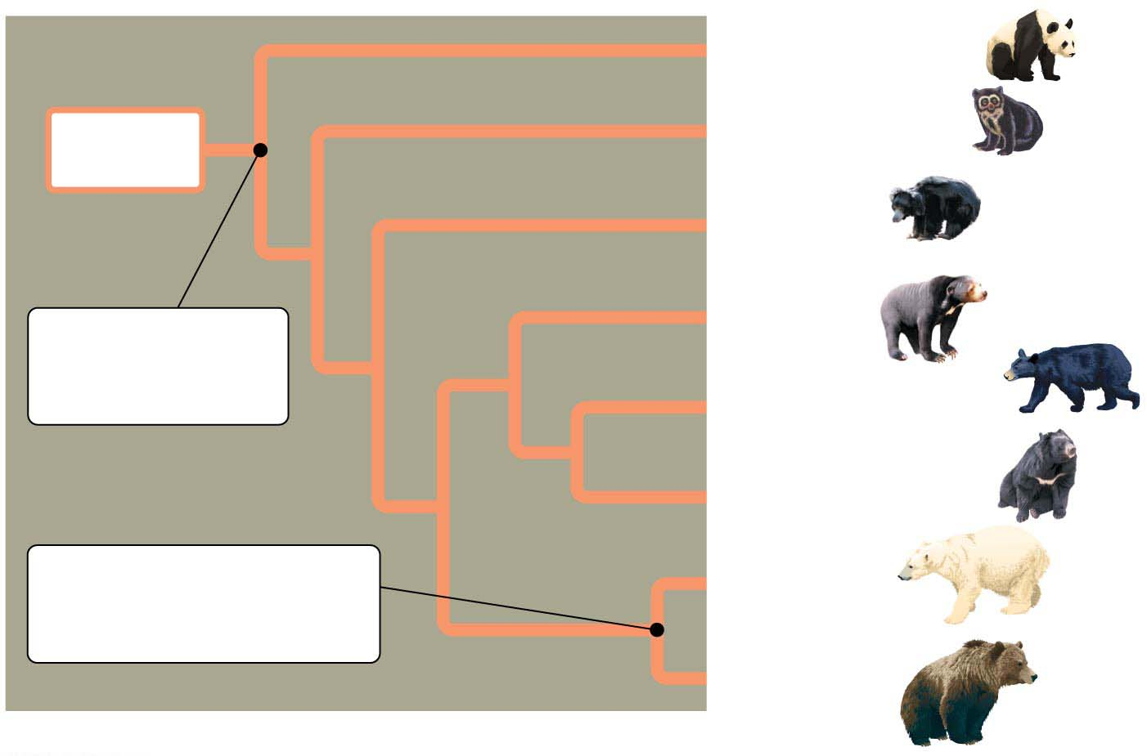
Figure 1.9: An evolutionary tree of bears.
Giant panda bear
Ancestral
bear
Spectacled bear
Sloth bear
Sun bear
Common
ancestor of all
modern bears
American black bear
Asiatic black bear
Common
ancestor of polar bear
and brown bear
Polar bear
Brown bear
Figure 1.9: An evolutionary tree of bears
Notes:
Figure 1.9 An evolutionary tree of bears

Slide 24
1. Evolution
Evolution:
the fundamental principle of life and
the core theme that unifies all of biology.
Natural selection:
Environment “select” only certain heritable traits from those already existing
Artificial selection:
is the purposeful breeding of domesticated plants and animals by humans.

Slide 25
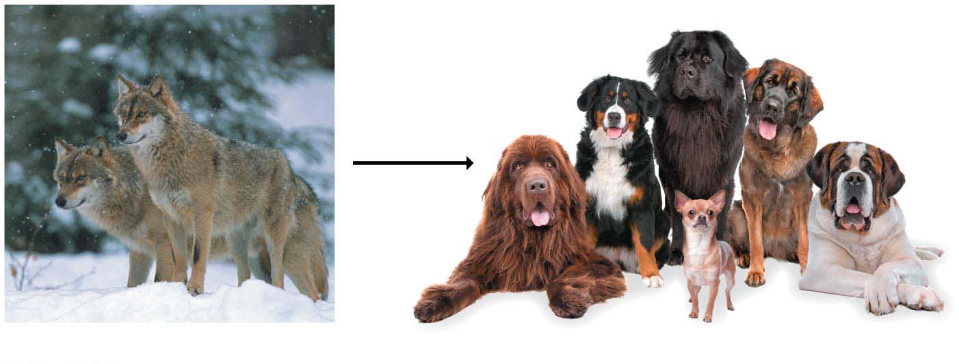
People in different cultures have customized hundreds of dog breeds as different as basset hounds and Saint Bernards, all descended from wolves.
Artificial
selection
Gray wolves
Domesticated dogs
Figure 1.14: The artificial selection of pets
Notes:
Figure 1.14 The artificial selection of pets

Slide 26
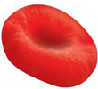
2. Structure/Function: The Relationship of Structure to Function
The correlation of structure and function can be seen at every level of biological organization.
Example: at organ level,
lungs, (function) to exchange gases with the environment: oxygen (O₂) in, carbon dioxide (CO₂) out.
The (structure) of lungs correlates with this function.
Increasingly smaller branches end in millions of tiny sacs in which the gases cross from the air to your blood and vice versa.
This structure provides a tremendous surface area over which a very high volume of air may pass.
Notes:
26
Student Misconceptions and Concerns
1. Students often believe that Charles Darwin was the first to suggest that life evolves; the early contributions by Greek philosophers and the work of Jean-Baptiste Lamarck may be unappreciated. Consider emphasizing this earlier work in your introduction to Darwin’s contributions.
2. Students often misunderstand the basic process of evolution and instead reflect a Lamarckian point of view. Organisms do not evolve structures deliberately or out of want or need. Individuals do not evolve. Evolution is a passive process in which the environment favors one or more existing variations of a trait already present in a population.
Teaching Tips
1. Many resources related to Charles Darwin are available on the Internet:
a. General evolution resources:
evolution.berkeley.edu
nationalacademies.org/evolution
ncse.com
b. The complete works of Charles Darwin can be found at darwin-online.org.uk/
c. Details of Charles Darwin’s home are located at http://williamcalvin.com/bookshelf/down_hse.htm
2. There are many variations of games that model aspects of natural selection. Here is one that is appropriate for a laboratory exercise. Purchase several bags of dried grocery store beans of diverse sizes and colors. Large lima beans, small white beans, red beans, and black beans are all good options. Consider the beans “food” for the “predatory” students. To begin, randomly distribute (throw) 100 beans of each of four colors onto a green lawn. Allow individual students to collect beans over a set period, perhaps 3 minutes. Then count the total number of each color of bean collected. Assume that the beans remaining undetected (still in the lawn) reproduce by doubling in number. Calculate the number of beans of each color remaining in the field. For the next round, count out the number of each color to add to the lawn so that the new totals on the lawn will double the number of beans that students did not find in the first “generation.” Before each predatory episode, record the total number of each color of beans that have “survived” in the field. Then let your student “predators” out for another round of collection (generation). Repeat the process for at least three or four “generations.” Note what colors of beans are favored by the environment. Ask students to speculate which colors might have been favored during another season or on a parking lot.
3. Many websites devoted to domesticated species can be used to illustrate the variety of forms produced by artificial selection. Those devoted to pigeons, chickens, and dogs have proven to be especially useful.
4. The authors make an analogy between the four bases used to form genes and the 26 letters of the English alphabet used to create words and sentences. One could also make an analogy between the four bases and trains composed of four different types of railroad cars (perhaps an engine, boxcar, tanker, and flatcar). Imagine how many different types of trains one could make using just 100 rail cars of four different types. (The answer is 4¹⁰⁰.)
5. For a chance to add a little math to the biological levels of organization, consider calculating the general scale differences between each level of biological organization. For example, are cells generally 5, 10, 50, or 100 times more massive than organelles? Are organelles generally 5, 10, 50, or 100 times more massive than macromolecules? For some levels of organization, such as ecosystems, communities, and populations, size or scale differences are perhaps less relevant and more problematic to consider. However, at the smaller levels, the sense of scale might enhance an appreciation for levels of biological organization.
6. The U.S. Census Bureau maintains updated population clocks that estimate the U.S. and world populations (www.census.gov/popclock/). If students have a general idea of the human population of the United States, statistics about the number of people affected with a disease or disaster become more significant. For example, the current population of the United States is about 320,000,000 (in 2014). It is currently estimated that at least 1 million people in the United States are infected with HIV. The number of people infected with HIV is impressive and concerning, but not perhaps as meaningful as the realization that this represents about one of every 320 people in the United States. Although the infected people are not evenly distributed among geographic and ethnic groups, if you apply this generality to the enrollments in your classes, the students might better understand the tremendous impact of HIV infection.
Active Lecture Tips
1. Help the class think through the diverse interactions between an organism and its environment. In class, select an organism and have students work in small groups to develop a list of environmental components that interact with the organism. This list should include living and nonliving categories.

Slide 27
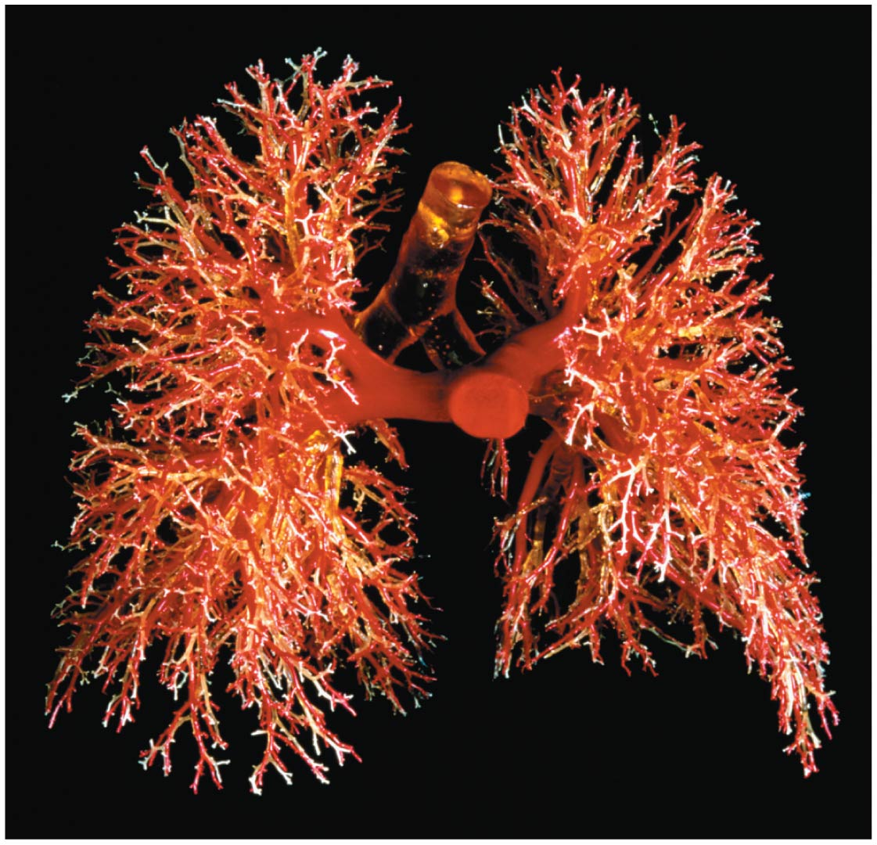
1.15: The structure of human lungs
Notes:
Figure 1.15 Structure/function: human lungs

Slide 28
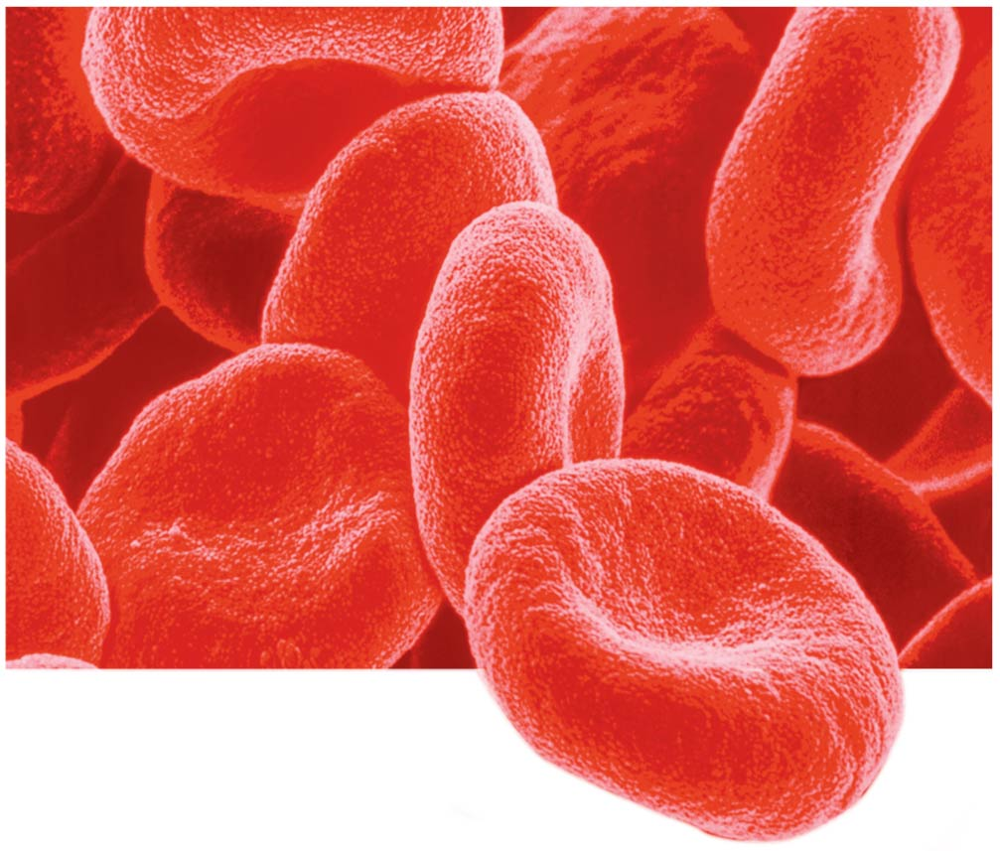
2. Structure/Function: The Relationship of Structure to Function
At cellular level, cells display a correlation of structure and function.
As oxygen enters the blood in the lungs, it diffuses into red blood cells.
The shape of red blood cells provides a large surface area over which oxygen can diffuse.
Notes:
28
Student Misconceptions and Concerns
1. Students often believe that Charles Darwin was the first to suggest that life evolves; the early contributions by Greek philosophers and the work of Jean-Baptiste Lamarck may be unappreciated. Consider emphasizing this earlier work in your introduction to Darwin’s contributions.
2. Students often misunderstand the basic process of evolution and instead reflect a Lamarckian point of view. Organisms do not evolve structures deliberately or out of want or need. Individuals do not evolve. Evolution is a passive process in which the environment favors one or more existing variations of a trait already present in a population.
Teaching Tips
1. Many resources related to Charles Darwin are available on the Internet:
a. General evolution resources:
evolution.berkeley.edu
nationalacademies.org/evolution
ncse.com
b. The complete works of Charles Darwin can be found at darwin-online.org.uk/
c. Details of Charles Darwin’s home are located at http://williamcalvin.com/bookshelf/down_hse.htm
2. There are many variations of games that model aspects of natural selection. Here is one that is appropriate for a laboratory exercise. Purchase several bags of dried grocery store beans of diverse sizes and colors. Large lima beans, small white beans, red beans, and black beans are all good options. Consider the beans “food” for the “predatory” students. To begin, randomly distribute (throw) 100 beans of each of four colors onto a green lawn. Allow individual students to collect beans over a set period, perhaps 3 minutes. Then count the total number of each color of bean collected. Assume that the beans remaining undetected (still in the lawn) reproduce by doubling in number. Calculate the number of beans of each color remaining in the field. For the next round, count out the number of each color to add to the lawn so that the new totals on the lawn will double the number of beans that students did not find in the first “generation.” Before each predatory episode, record the total number of each color of beans that have “survived” in the field. Then let your student “predators” out for another round of collection (generation). Repeat the process for at least three or four “generations.” Note what colors of beans are favored by the environment. Ask students to speculate which colors might have been favored during another season or on a parking lot.
3. Many websites devoted to domesticated species can be used to illustrate the variety of forms produced by artificial selection. Those devoted to pigeons, chickens, and dogs have proven to be especially useful.
4. The authors make an analogy between the four bases used to form genes and the 26 letters of the English alphabet used to create words and sentences. One could also make an analogy between the four bases and trains composed of four different types of railroad cars (perhaps an engine, boxcar, tanker, and flatcar). Imagine how many different types of trains one could make using just 100 rail cars of four different types. (The answer is 4¹⁰⁰.)
5. For a chance to add a little math to the biological levels of organization, consider calculating the general scale differences between each level of biological organization. For example, are cells generally 5, 10, 50, or 100 times more massive than organelles? Are organelles generally 5, 10, 50, or 100 times more massive than macromolecules? For some levels of organization, such as ecosystems, communities, and populations, size or scale differences are perhaps less relevant and more problematic to consider. However, at the smaller levels, the sense of scale might enhance an appreciation for levels of biological organization.
6. The U.S. Census Bureau maintains updated population clocks that estimate the U.S. and world populations (www.census.gov/popclock/). If students have a general idea of the human population of the United States, statistics about the number of people affected with a disease or disaster become more significant. For example, the current population of the United States is about 320,000,000 (in 2014). It is currently estimated that at least 1 million people in the United States are infected with HIV. The number of people infected with HIV is impressive and concerning, but not perhaps as meaningful as the realization that this represents about one of every 320 people in the United States. Although the infected people are not evenly distributed among geographic and ethnic groups, if you apply this generality to the enrollments in your classes, the students might better understand the tremendous impact of HIV infection.
Active Lecture Tips
1. Help the class think through the diverse interactions between an organism and its environment. In class, select an organism and have students work in small groups to develop a list of environmental components that interact with the organism. This list should include living and nonliving categories.

Slide 29
3. Information Flow
In every cell, information (in the form of DNA) are transmitted from previous cell to it.
The zygote (fertilized egg) contains information passed on from the previous generation.
Through living system, information is stored, transmitted and used.
Notes:
29
Student Misconceptions and Concerns
1. Students often believe that Charles Darwin was the first to suggest that life evolves; the early contributions by Greek philosophers and the work of Jean-Baptiste Lamarck may be unappreciated. Consider emphasizing this earlier work in your introduction to Darwin’s contributions.
2. Students often misunderstand the basic process of evolution and instead reflect a Lamarckian point of view. Organisms do not evolve structures deliberately or out of want or need. Individuals do not evolve. Evolution is a passive process in which the environment favors one or more existing variations of a trait already present in a population.
Teaching Tips
1. Many resources related to Charles Darwin are available on the Internet:
a. General evolution resources:
evolution.berkeley.edu
nationalacademies.org/evolution
ncse.com
b. The complete works of Charles Darwin can be found at darwin-online.org.uk/
c. Details of Charles Darwin’s home are located at http://williamcalvin.com/bookshelf/down_hse.htm
2. There are many variations of games that model aspects of natural selection. Here is one that is appropriate for a laboratory exercise. Purchase several bags of dried grocery store beans of diverse sizes and colors. Large lima beans, small white beans, red beans, and black beans are all good options. Consider the beans “food” for the “predatory” students. To begin, randomly distribute (throw) 100 beans of each of four colors onto a green lawn. Allow individual students to collect beans over a set period, perhaps 3 minutes. Then count the total number of each color of bean collected. Assume that the beans remaining undetected (still in the lawn) reproduce by doubling in number. Calculate the number of beans of each color remaining in the field. For the next round, count out the number of each color to add to the lawn so that the new totals on the lawn will double the number of beans that students did not find in the first “generation.” Before each predatory episode, record the total number of each color of beans that have “survived” in the field. Then let your student “predators” out for another round of collection (generation). Repeat the process for at least three or four “generations.” Note what colors of beans are favored by the environment. Ask students to speculate which colors might have been favored during another season or on a parking lot.
3. Many websites devoted to domesticated species can be used to illustrate the variety of forms produced by artificial selection. Those devoted to pigeons, chickens, and dogs have proven to be especially useful.
4. The authors make an analogy between the four bases used to form genes and the 26 letters of the English alphabet used to create words and sentences. One could also make an analogy between the four bases and trains composed of four different types of railroad cars (perhaps an engine, boxcar, tanker, and flatcar). Imagine how many different types of trains one could make using just 100 rail cars of four different types. (The answer is 4¹⁰⁰.)
5. For a chance to add a little math to the biological levels of organization, consider calculating the general scale differences between each level of biological organization. For example, are cells generally 5, 10, 50, or 100 times more massive than organelles? Are organelles generally 5, 10, 50, or 100 times more massive than macromolecules? For some levels of organization, such as ecosystems, communities, and populations, size or scale differences are perhaps less relevant and more problematic to consider. However, at the smaller levels, the sense of scale might enhance an appreciation for levels of biological organization.
6. The U.S. Census Bureau maintains updated population clocks that estimate the U.S. and world populations (www.census.gov/popclock/). If students have a general idea of the human population of the United States, statistics about the number of people affected with a disease or disaster become more significant. For example, the current population of the United States is about 320,000,000 (in 2014). It is currently estimated that at least 1 million people in the United States are infected with HIV. The number of people infected with HIV is impressive and concerning, but not perhaps as meaningful as the realization that this represents about one of every 320 people in the United States. Although the infected people are not evenly distributed among geographic and ethnic groups, if you apply this generality to the enrollments in your classes, the students might better understand the tremendous impact of HIV infection.
Active Lecture Tips
1. Help the class think through the diverse interactions between an organism and its environment. In class, select an organism and have students work in small groups to develop a list of environmental components that interact with the organism. This list should include living and nonliving categories.

Slide 30
3. Information Flow
In all organisms, information is encoded in an identical chemical names of DNA’s four molecular building blocks are abbreviated as A, G, C, and T.
Genes are heredity units of information consisting of specific sequences of DNA passed from the previous generation.
Within your body, genes provide instructions for building proteins, which perform many of life’s tasks.
هذه الشرائح مخصصة للشرح و ليست للمذاكرة
Notes:
30
Student Misconceptions and Concerns
1. Students often believe that Charles Darwin was the first to suggest that life evolves; the early contributions by Greek philosophers and the work of Jean-Baptiste Lamarck may be unappreciated. Consider emphasizing this earlier work in your introduction to Darwin’s contributions.
2. Students often misunderstand the basic process of evolution and instead reflect a Lamarckian point of view. Organisms do not evolve structures deliberately or out of want or need. Individuals do not evolve. Evolution is a passive process in which the environment favors one or more existing variations of a trait already present in a population.
Teaching Tips
1. Many resources related to Charles Darwin are available on the Internet:
a. General evolution resources:
evolution.berkeley.edu
nationalacademies.org/evolution
ncse.com
b. The complete works of Charles Darwin can be found at darwin-online.org.uk/
c. Details of Charles Darwin’s home are located at http://williamcalvin.com/bookshelf/down_hse.htm
2. There are many variations of games that model aspects of natural selection. Here is one that is appropriate for a laboratory exercise. Purchase several bags of dried grocery store beans of diverse sizes and colors. Large lima beans, small white beans, red beans, and black beans are all good options. Consider the beans “food” for the “predatory” students. To begin, randomly distribute (throw) 100 beans of each of four colors onto a green lawn. Allow individual students to collect beans over a set period, perhaps 3 minutes. Then count the total number of each color of bean collected. Assume that the beans remaining undetected (still in the lawn) reproduce by doubling in number. Calculate the number of beans of each color remaining in the field. For the next round, count out the number of each color to add to the lawn so that the new totals on the lawn will double the number of beans that students did not find in the first “generation.” Before each predatory episode, record the total number of each color of beans that have “survived” in the field. Then let your student “predators” out for another round of collection (generation). Repeat the process for at least three or four “generations.” Note what colors of beans are favored by the environment. Ask students to speculate which colors might have been favored during another season or on a parking lot.
3. Many websites devoted to domesticated species can be used to illustrate the variety of forms produced by artificial selection. Those devoted to pigeons, chickens, and dogs have proven to be especially useful.
4. The authors make an analogy between the four bases used to form genes and the 26 letters of the English alphabet used to create words and sentences. One could also make an analogy between the four bases and trains composed of four different types of railroad cars (perhaps an engine, boxcar, tanker, and flatcar). Imagine how many different types of trains one could make using just 100 rail cars of four different types. (The answer is 4¹⁰⁰.)
5. For a chance to add a little math to the biological levels of organization, consider calculating the general scale differences between each level of biological organization. For example, are cells generally 5, 10, 50, or 100 times more massive than organelles? Are organelles generally 5, 10, 50, or 100 times more massive than macromolecules? For some levels of organization, such as ecosystems, communities, and populations, size or scale differences are perhaps less relevant and more problematic to consider. However, at the smaller levels, the sense of scale might enhance an appreciation for levels of biological organization.
6. The U.S. Census Bureau maintains updated population clocks that estimate the U.S. and world populations (www.census.gov/popclock/). If students have a general idea of the human population of the United States, statistics about the number of people affected with a disease or disaster become more significant. For example, the current population of the United States is about 320,000,000 (in 2014). It is currently estimated that at least 1 million people in the United States are infected with HIV. The number of people infected with HIV is impressive and concerning, but not perhaps as meaningful as the realization that this represents about one of every 320 people in the United States. Although the infected people are not evenly distributed among geographic and ethnic groups, if you apply this generality to the enrollments in your classes, the students might better understand the tremendous impact of HIV infection.
Active Lecture Tips
1. Help the class think through the diverse interactions between an organism and its environment. In class, select an organism and have students work in small groups to develop a list of environmental components that interact with the organism. This list should include living and nonliving categories.

Slide 31
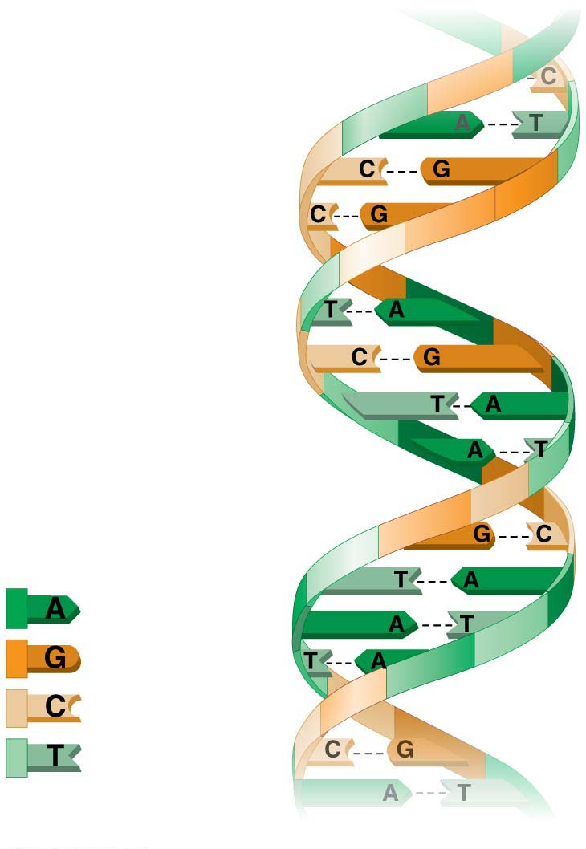
Figure 1.17: the language of DNA
The four
chemical
building
blocks of
DNA
A DNA molecule
Notes:
Figure 1.17 The language of DNA

Slide 32
3. Information Flow
Genome is the entire set of genetic information that an organism inherits.
The nucleus of each human cell contains a genome that is about 3 billion chemical letters long.
At any given moment, your genes are producing thousands of different proteins that control your body’s processes.
هذه الشرائح مخصصة للشرح و ليست للمذاكرة
Notes:
32
Student Misconceptions and Concerns
1. Students often believe that Charles Darwin was the first to suggest that life evolves; the early contributions by Greek philosophers and the work of Jean-Baptiste Lamarck may be unappreciated. Consider emphasizing this earlier work in your introduction to Darwin’s contributions.
2. Students often misunderstand the basic process of evolution and instead reflect a Lamarckian point of view. Organisms do not evolve structures deliberately or out of want or need. Individuals do not evolve. Evolution is a passive process in which the environment favors one or more existing variations of a trait already present in a population.
Teaching Tips
1. Many resources related to Charles Darwin are available on the Internet:
a. General evolution resources:
evolution.berkeley.edu
nationalacademies.org/evolution
ncse.com
b. The complete works of Charles Darwin can be found at darwin-online.org.uk/
c. Details of Charles Darwin’s home are located at http://williamcalvin.com/bookshelf/down_hse.htm
2. There are many variations of games that model aspects of natural selection. Here is one that is appropriate for a laboratory exercise. Purchase several bags of dried grocery store beans of diverse sizes and colors. Large lima beans, small white beans, red beans, and black beans are all good options. Consider the beans “food” for the “predatory” students. To begin, randomly distribute (throw) 100 beans of each of four colors onto a green lawn. Allow individual students to collect beans over a set period, perhaps 3 minutes. Then count the total number of each color of bean collected. Assume that the beans remaining undetected (still in the lawn) reproduce by doubling in number. Calculate the number of beans of each color remaining in the field. For the next round, count out the number of each color to add to the lawn so that the new totals on the lawn will double the number of beans that students did not find in the first “generation.” Before each predatory episode, record the total number of each color of beans that have “survived” in the field. Then let your student “predators” out for another round of collection (generation). Repeat the process for at least three or four “generations.” Note what colors of beans are favored by the environment. Ask students to speculate which colors might have been favored during another season or on a parking lot.
3. Many websites devoted to domesticated species can be used to illustrate the variety of forms produced by artificial selection. Those devoted to pigeons, chickens, and dogs have proven to be especially useful.
4. The authors make an analogy between the four bases used to form genes and the 26 letters of the English alphabet used to create words and sentences. One could also make an analogy between the four bases and trains composed of four different types of railroad cars (perhaps an engine, boxcar, tanker, and flatcar). Imagine how many different types of trains one could make using just 100 rail cars of four different types. (The answer is 4¹⁰⁰.)
5. For a chance to add a little math to the biological levels of organization, consider calculating the general scale differences between each level of biological organization. For example, are cells generally 5, 10, 50, or 100 times more massive than organelles? Are organelles generally 5, 10, 50, or 100 times more massive than macromolecules? For some levels of organization, such as ecosystems, communities, and populations, size or scale differences are perhaps less relevant and more problematic to consider. However, at the smaller levels, the sense of scale might enhance an appreciation for levels of biological organization.
6. The U.S. Census Bureau maintains updated population clocks that estimate the U.S. and world populations (www.census.gov/popclock/). If students have a general idea of the human population of the United States, statistics about the number of people affected with a disease or disaster become more significant. For example, the current population of the United States is about 320,000,000 (in 2014). It is currently estimated that at least 1 million people in the United States are infected with HIV. The number of people infected with HIV is impressive and concerning, but not perhaps as meaningful as the realization that this represents about one of every 320 people in the United States. Although the infected people are not evenly distributed among geographic and ethnic groups, if you apply this generality to the enrollments in your classes, the students might better understand the tremendous impact of HIV infection.
Active Lecture Tips
1. Help the class think through the diverse interactions between an organism and its environment. In class, select an organism and have students work in small groups to develop a list of environmental components that interact with the organism. This list should include living and nonliving categories.

Slide 33
4. Energy Transformations: Pathways That Transform Energy and Matter
The input of energy is primarily from the sun (solar power) and the transformation of energy from one form to another.
Producers: (ex. Plants and other photosynthetic organisms) capture the energy from sunlight and convert it, storing it as chemical bonds within sugars and other complex molecules.
Consumers: break the bonds, releasing the stored energy and putting it to use.
هذه الشرائح مخصصة للشرح و ليست للمذاكرة
Notes:
33
Student Misconceptions and Concerns
1. Students often believe that Charles Darwin was the first to suggest that life evolves; the early contributions by Greek philosophers and the work of Jean-Baptiste Lamarck may be unappreciated. Consider emphasizing this earlier work in your introduction to Darwin’s contributions.
2. Students often misunderstand the basic process of evolution and instead reflect a Lamarckian point of view. Organisms do not evolve structures deliberately or out of want or need. Individuals do not evolve. Evolution is a passive process in which the environment favors one or more existing variations of a trait already present in a population.
Teaching Tips
1. Many resources related to Charles Darwin are available on the Internet:
a. General evolution resources:
evolution.berkeley.edu
nationalacademies.org/evolution
ncse.com
b. The complete works of Charles Darwin can be found at darwin-online.org.uk/
c. Details of Charles Darwin’s home are located at http://williamcalvin.com/bookshelf/down_hse.htm
2. There are many variations of games that model aspects of natural selection. Here is one that is appropriate for a laboratory exercise. Purchase several bags of dried grocery store beans of diverse sizes and colors. Large lima beans, small white beans, red beans, and black beans are all good options. Consider the beans “food” for the “predatory” students. To begin, randomly distribute (throw) 100 beans of each of four colors onto a green lawn. Allow individual students to collect beans over a set period, perhaps 3 minutes. Then count the total number of each color of bean collected. Assume that the beans remaining undetected (still in the lawn) reproduce by doubling in number. Calculate the number of beans of each color remaining in the field. For the next round, count out the number of each color to add to the lawn so that the new totals on the lawn will double the number of beans that students did not find in the first “generation.” Before each predatory episode, record the total number of each color of beans that have “survived” in the field. Then let your student “predators” out for another round of collection (generation). Repeat the process for at least three or four “generations.” Note what colors of beans are favored by the environment. Ask students to speculate which colors might have been favored during another season or on a parking lot.
3. Many websites devoted to domesticated species can be used to illustrate the variety of forms produced by artificial selection. Those devoted to pigeons, chickens, and dogs have proven to be especially useful.
4. The authors make an analogy between the four bases used to form genes and the 26 letters of the English alphabet used to create words and sentences. One could also make an analogy between the four bases and trains composed of four different types of railroad cars (perhaps an engine, boxcar, tanker, and flatcar). Imagine how many different types of trains one could make using just 100 rail cars of four different types. (The answer is 4¹⁰⁰.)
5. For a chance to add a little math to the biological levels of organization, consider calculating the general scale differences between each level of biological organization. For example, are cells generally 5, 10, 50, or 100 times more massive than organelles? Are organelles generally 5, 10, 50, or 100 times more massive than macromolecules? For some levels of organization, such as ecosystems, communities, and populations, size or scale differences are perhaps less relevant and more problematic to consider. However, at the smaller levels, the sense of scale might enhance an appreciation for levels of biological organization.
6. The U.S. Census Bureau maintains updated population clocks that estimate the U.S. and world populations (www.census.gov/popclock/). If students have a general idea of the human population of the United States, statistics about the number of people affected with a disease or disaster become more significant. For example, the current population of the United States is about 320,000,000 (in 2014). It is currently estimated that at least 1 million people in the United States are infected with HIV. The number of people infected with HIV is impressive and concerning, but not perhaps as meaningful as the realization that this represents about one of every 320 people in the United States. Although the infected people are not evenly distributed among geographic and ethnic groups, if you apply this generality to the enrollments in your classes, the students might better understand the tremendous impact of HIV infection.
Active Lecture Tips
1. Help the class think through the diverse interactions between an organism and its environment. In class, select an organism and have students work in small groups to develop a list of environmental components that interact with the organism. This list should include living and nonliving categories.

Slide 34
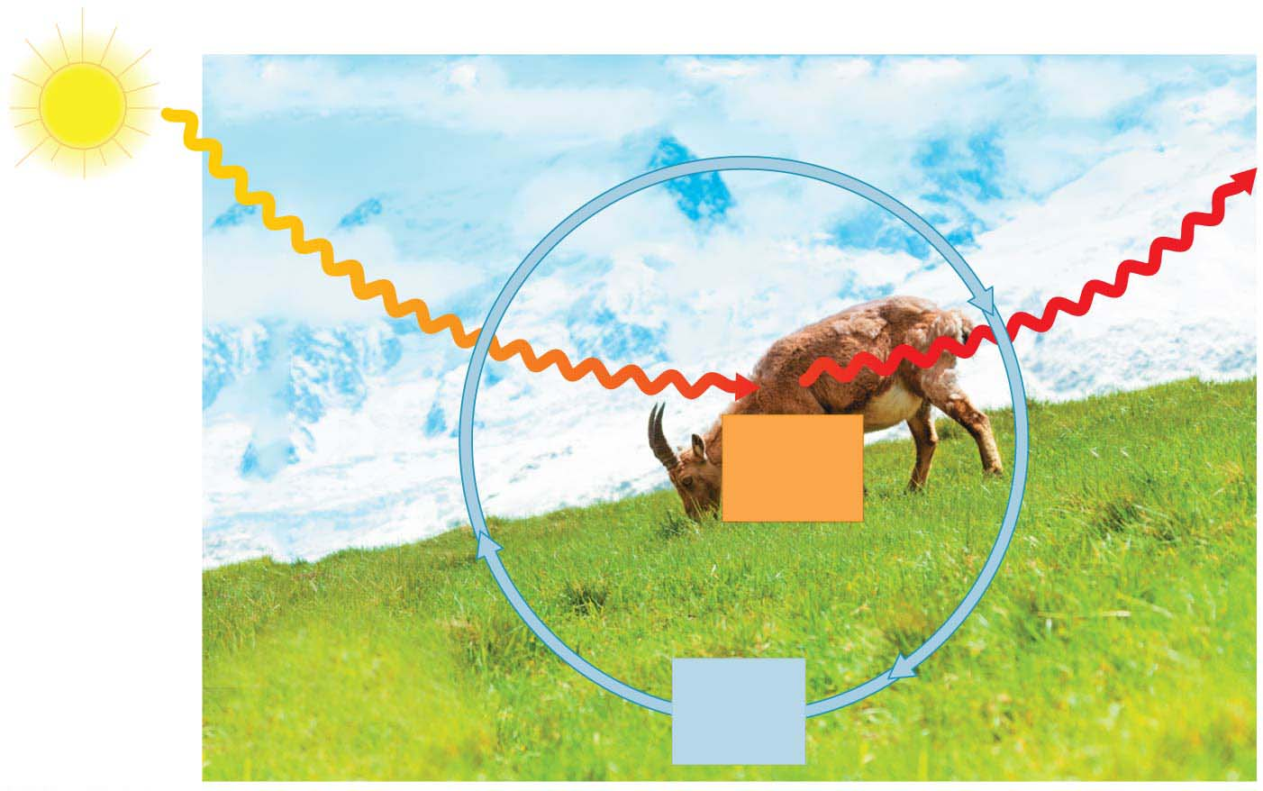
Figure 1.9: Nutrient and energy flow in an ecosystem
Inflow
of light
energy
ECOSYSTEM
Outflow
of heat
energy
Consumers
(animals)
Chemical
energy
(food)
Producers
(plants and other
photosynthetic
organisms)
Decomposers
(in soil)
Cycling
of
nutrients
Notes:
Figure 1.19 Nutrient and energy flow in an ecosystem

Slide 35
4. Energy Transformations: Pathways That Transform Energy and Matter
In the process of these energy conversions between and within organisms, some energy is converted to heat, which is then lost from the system.
Thus, energy flows through an ecosystem,
entering as light and
exiting as heat.
هذه الشرائح مخصصة للشرح و ليست للمذاكرة
Notes:
35
Student Misconceptions and Concerns
1. Students often believe that Charles Darwin was the first to suggest that life evolves; the early contributions by Greek philosophers and the work of Jean-Baptiste Lamarck may be unappreciated. Consider emphasizing this earlier work in your introduction to Darwin’s contributions.
2. Students often misunderstand the basic process of evolution and instead reflect a Lamarckian point of view. Organisms do not evolve structures deliberately or out of want or need. Individuals do not evolve. Evolution is a passive process in which the environment favors one or more existing variations of a trait already present in a population.
Teaching Tips
1. Many resources related to Charles Darwin are available on the Internet:
a. General evolution resources:
evolution.berkeley.edu
nationalacademies.org/evolution
ncse.com
b. The complete works of Charles Darwin can be found at darwin-online.org.uk/
c. Details of Charles Darwin’s home are located at http://williamcalvin.com/bookshelf/down_hse.htm
2. There are many variations of games that model aspects of natural selection. Here is one that is appropriate for a laboratory exercise. Purchase several bags of dried grocery store beans of diverse sizes and colors. Large lima beans, small white beans, red beans, and black beans are all good options. Consider the beans “food” for the “predatory” students. To begin, randomly distribute (throw) 100 beans of each of four colors onto a green lawn. Allow individual students to collect beans over a set period, perhaps 3 minutes. Then count the total number of each color of bean collected. Assume that the beans remaining undetected (still in the lawn) reproduce by doubling in number. Calculate the number of beans of each color remaining in the field. For the next round, count out the number of each color to add to the lawn so that the new totals on the lawn will double the number of beans that students did not find in the first “generation.” Before each predatory episode, record the total number of each color of beans that have “survived” in the field. Then let your student “predators” out for another round of collection (generation). Repeat the process for at least three or four “generations.” Note what colors of beans are favored by the environment. Ask students to speculate which colors might have been favored during another season or on a parking lot.
3. Many websites devoted to domesticated species can be used to illustrate the variety of forms produced by artificial selection. Those devoted to pigeons, chickens, and dogs have proven to be especially useful.
4. The authors make an analogy between the four bases used to form genes and the 26 letters of the English alphabet used to create words and sentences. One could also make an analogy between the four bases and trains composed of four different types of railroad cars (perhaps an engine, boxcar, tanker, and flatcar). Imagine how many different types of trains one could make using just 100 rail cars of four different types. (The answer is 4¹⁰⁰.)
5. For a chance to add a little math to the biological levels of organization, consider calculating the general scale differences between each level of biological organization. For example, are cells generally 5, 10, 50, or 100 times more massive than organelles? Are organelles generally 5, 10, 50, or 100 times more massive than macromolecules? For some levels of organization, such as ecosystems, communities, and populations, size or scale differences are perhaps less relevant and more problematic to consider. However, at the smaller levels, the sense of scale might enhance an appreciation for levels of biological organization.
6. The U.S. Census Bureau maintains updated population clocks that estimate the U.S. and world populations (www.census.gov/popclock/). If students have a general idea of the human population of the United States, statistics about the number of people affected with a disease or disaster become more significant. For example, the current population of the United States is about 320,000,000 (in 2014). It is currently estimated that at least 1 million people in the United States are infected with HIV. The number of people infected with HIV is impressive and concerning, but not perhaps as meaningful as the realization that this represents about one of every 320 people in the United States. Although the infected people are not evenly distributed among geographic and ethnic groups, if you apply this generality to the enrollments in your classes, the students might better understand the tremendous impact of HIV infection.
Active Lecture Tips
1. Help the class think through the diverse interactions between an organism and its environment. In class, select an organism and have students work in small groups to develop a list of environmental components that interact with the organism. This list should include living and nonliving categories.

Slide 36
4. Energy Transformations: Pathways That Transform Energy and Matter
II. Every object in the universe, both living and nonliving, is composed of matter.
In contrast to energy flowing through an ecosystem, matter is recycled within an ecosystem.
Within ecosystem, nutrients are recycled, but energy flows through.
هذه الشرائح مخصصة للشرح و ليست للمذاكرة
Notes:
36
Student Misconceptions and Concerns
1. Students often believe that Charles Darwin was the first to suggest that life evolves; the early contributions by Greek philosophers and the work of Jean-Baptiste Lamarck may be unappreciated. Consider emphasizing this earlier work in your introduction to Darwin’s contributions.
2. Students often misunderstand the basic process of evolution and instead reflect a Lamarckian point of view. Organisms do not evolve structures deliberately or out of want or need. Individuals do not evolve. Evolution is a passive process in which the environment favors one or more existing variations of a trait already present in a population.
Teaching Tips
1. Many resources related to Charles Darwin are available on the Internet:
a. General evolution resources:
evolution.berkeley.edu
nationalacademies.org/evolution
ncse.com
b. The complete works of Charles Darwin can be found at darwin-online.org.uk/
c. Details of Charles Darwin’s home are located at http://williamcalvin.com/bookshelf/down_hse.htm
2. There are many variations of games that model aspects of natural selection. Here is one that is appropriate for a laboratory exercise. Purchase several bags of dried grocery store beans of diverse sizes and colors. Large lima beans, small white beans, red beans, and black beans are all good options. Consider the beans “food” for the “predatory” students. To begin, randomly distribute (throw) 100 beans of each of four colors onto a green lawn. Allow individual students to collect beans over a set period, perhaps 3 minutes. Then count the total number of each color of bean collected. Assume that the beans remaining undetected (still in the lawn) reproduce by doubling in number. Calculate the number of beans of each color remaining in the field. For the next round, count out the number of each color to add to the lawn so that the new totals on the lawn will double the number of beans that students did not find in the first “generation.” Before each predatory episode, record the total number of each color of beans that have “survived” in the field. Then let your student “predators” out for another round of collection (generation). Repeat the process for at least three or four “generations.” Note what colors of beans are favored by the environment. Ask students to speculate which colors might have been favored during another season or on a parking lot.
3. Many websites devoted to domesticated species can be used to illustrate the variety of forms produced by artificial selection. Those devoted to pigeons, chickens, and dogs have proven to be especially useful.
4. The authors make an analogy between the four bases used to form genes and the 26 letters of the English alphabet used to create words and sentences. One could also make an analogy between the four bases and trains composed of four different types of railroad cars (perhaps an engine, boxcar, tanker, and flatcar). Imagine how many different types of trains one could make using just 100 rail cars of four different types. (The answer is 4¹⁰⁰.)
5. For a chance to add a little math to the biological levels of organization, consider calculating the general scale differences between each level of biological organization. For example, are cells generally 5, 10, 50, or 100 times more massive than organelles? Are organelles generally 5, 10, 50, or 100 times more massive than macromolecules? For some levels of organization, such as ecosystems, communities, and populations, size or scale differences are perhaps less relevant and more problematic to consider. However, at the smaller levels, the sense of scale might enhance an appreciation for levels of biological organization.
6. The U.S. Census Bureau maintains updated population clocks that estimate the U.S. and world populations (www.census.gov/popclock/). If students have a general idea of the human population of the United States, statistics about the number of people affected with a disease or disaster become more significant. For example, the current population of the United States is about 320,000,000 (in 2014). It is currently estimated that at least 1 million people in the United States are infected with HIV. The number of people infected with HIV is impressive and concerning, but not perhaps as meaningful as the realization that this represents about one of every 320 people in the United States. Although the infected people are not evenly distributed among geographic and ethnic groups, if you apply this generality to the enrollments in your classes, the students might better understand the tremendous impact of HIV infection.
Active Lecture Tips
1. Help the class think through the diverse interactions between an organism and its environment. In class, select an organism and have students work in small groups to develop a list of environmental components that interact with the organism. This list should include living and nonliving categories.

Slide 37
5. Interconnections within Biological Systems
Life can be studied on many scales from the microscopic scale of the molecules and cells that make up organisms to the global scale of the entire living planet.
As complexity increases, novel properties emerge. For example, the cell is the smallest unit that can possibly display all of the characteristics of life.
هذه الشرائح مخصصة للشرح و ليست للمذاكرة
Notes:
37
Student Misconceptions and Concerns
1. Students often believe that Charles Darwin was the first to suggest that life evolves; the early contributions by Greek philosophers and the work of Jean-Baptiste Lamarck may be unappreciated. Consider emphasizing this earlier work in your introduction to Darwin’s contributions.
2. Students often misunderstand the basic process of evolution and instead reflect a Lamarckian point of view. Organisms do not evolve structures deliberately or out of want or need. Individuals do not evolve. Evolution is a passive process in which the environment favors one or more existing variations of a trait already present in a population.
Teaching Tips
1. Many resources related to Charles Darwin are available on the Internet:
a. General evolution resources:
evolution.berkeley.edu
nationalacademies.org/evolution
ncse.com
b. The complete works of Charles Darwin can be found at darwin-online.org.uk/
c. Details of Charles Darwin’s home are located at http://williamcalvin.com/bookshelf/down_hse.htm
2. There are many variations of games that model aspects of natural selection. Here is one that is appropriate for a laboratory exercise. Purchase several bags of dried grocery store beans of diverse sizes and colors. Large lima beans, small white beans, red beans, and black beans are all good options. Consider the beans “food” for the “predatory” students. To begin, randomly distribute (throw) 100 beans of each of four colors onto a green lawn. Allow individual students to collect beans over a set period, perhaps 3 minutes. Then count the total number of each color of bean collected. Assume that the beans remaining undetected (still in the lawn) reproduce by doubling in number. Calculate the number of beans of each color remaining in the field. For the next round, count out the number of each color to add to the lawn so that the new totals on the lawn will double the number of beans that students did not find in the first “generation.” Before each predatory episode, record the total number of each color of beans that have “survived” in the field. Then let your student “predators” out for another round of collection (generation). Repeat the process for at least three or four “generations.” Note what colors of beans are favored by the environment. Ask students to speculate which colors might have been favored during another season or on a parking lot.
3. Many websites devoted to domesticated species can be used to illustrate the variety of forms produced by artificial selection. Those devoted to pigeons, chickens, and dogs have proven to be especially useful.
4. The authors make an analogy between the four bases used to form genes and the 26 letters of the English alphabet used to create words and sentences. One could also make an analogy between the four bases and trains composed of four different types of railroad cars (perhaps an engine, boxcar, tanker, and flatcar). Imagine how many different types of trains one could make using just 100 rail cars of four different types. (The answer is 4¹⁰⁰.)
5. For a chance to add a little math to the biological levels of organization, consider calculating the general scale differences between each level of biological organization. For example, are cells generally 5, 10, 50, or 100 times more massive than organelles? Are organelles generally 5, 10, 50, or 100 times more massive than macromolecules? For some levels of organization, such as ecosystems, communities, and populations, size or scale differences are perhaps less relevant and more problematic to consider. However, at the smaller levels, the sense of scale might enhance an appreciation for levels of biological organization.
6. The U.S. Census Bureau maintains updated population clocks that estimate the U.S. and world populations (www.census.gov/popclock/). If students have a general idea of the human population of the United States, statistics about the number of people affected with a disease or disaster become more significant. For example, the current population of the United States is about 320,000,000 (in 2014). It is currently estimated that at least 1 million people in the United States are infected with HIV. The number of people infected with HIV is impressive and concerning, but not perhaps as meaningful as the realization that this represents about one of every 320 people in the United States. Although the infected people are not evenly distributed among geographic and ethnic groups, if you apply this generality to the enrollments in your classes, the students might better understand the tremendous impact of HIV infection.
Active Lecture Tips
1. Help the class think through the diverse interactions between an organism and its environment. In class, select an organism and have students work in small groups to develop a list of environmental components that interact with the organism. This list should include living and nonliving categories.

Slide 38
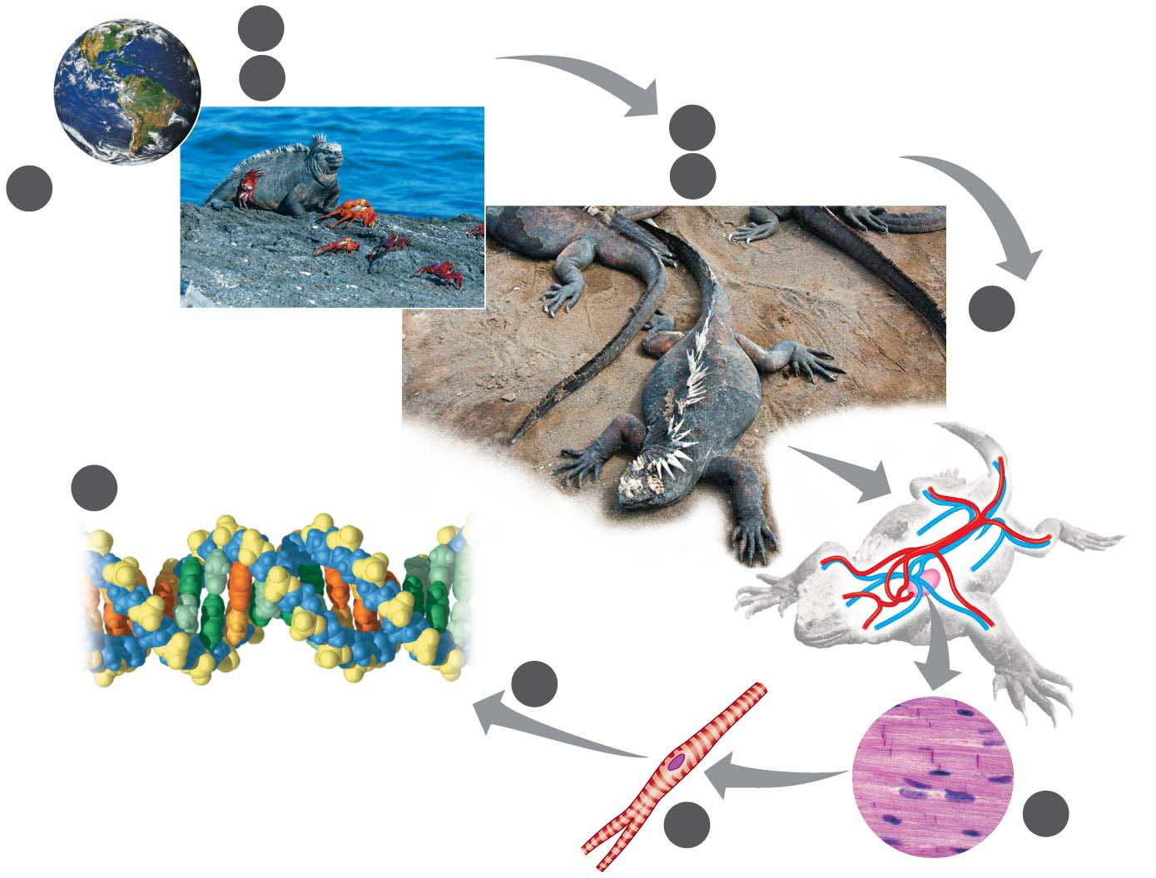
Figure 1.20: zooming in on life
2
Ecosystems
3
Communities
4
Populations
1
5
Organisms
Biosphere
6
Organ
Systems
and
Organs
10
Molecules and Atoms
9
Organelles
Atom
Nucleus
8
Cells
7
Tissues
Notes:
Figure 1.20-s3 Zooming in on life (step 3)

Slide 39
Essential chemistry and the molecules of life
Chapter 2 & 3

Slide 40
Overview
In this chapter you will learn the following:
Some basic chemistry ( matter, element, compound)
Biological compound (organic, inorganic)
Water and life
Organic compound (chemistry)
The four large biological macromolecules:
Carbohydrate
Protein
Lipid
Nucleic acid

Slide 41
Matter: Elements and Compounds
Matter is anything that occupies space and has mass.
Matter is found on Earth in three physical states:
solid,
liquid, and
gas.
An element is a substance that cannot be broken down into other substances by chemical reactions.
All matter is composed of chemical elements.
Copper
Lead
هذه الشرائح مخصصة للشرح و ليست للمذاكرة
Notes:
41
Student Misconceptions and Concerns
1. The dangers posed by certain chemicals in our food and broader environment often mislead people to associate “chemicals” with harm. People might not want “chemicals” added to their food or present in their environment. Students often fail to appreciate the chemical nature of our bodies and our world and the potential harm or benefits of naturally occurring chemistry. They often fail to understand why “natural” does not necessarily mean “good.” (Consider presenting a long list of naturally occurring toxins to make this point.) Your class may benefit from a class discussion of these misconceptions about our attitudes toward “chemicals.”
2. Students with limited backgrounds in chemistry and physics might struggle with basic concepts of mass, weight, compounds, elements, and isotopes. It may also be early in the semester, when mature study habits have not yet developed. Consider passing along basic studying advice and tips to help students master these early chemistry concepts. In-class quizzes (graded or not) or a few homework problems will also provide reinforcing practice.
3. The half-lives of many radioactive substances, especially those used for dating fossils, might lead some students to expect very long periods of decay for any radioactive substance. This might even be alarming if students are someday asked to consume a radioactive substance for a medical test. However, some medically significant isotopes have relatively short half-lives. Radioactive iodine-131 is often used to diagnose or treat certain thyroid problems. Its half-life of 8 days means that it will decay quickly.
Teaching Tips
1. Students might be interested in the following aside: One of the challenges of raising captive, exotic animals is meeting the unique dietary requirements of the species. A zoo might have trouble keeping a particular animal because science has not fully determined what trace elements the animal requires.
2. Many breakfast cereals are fortified with iron. A person can crush the cereal and extract distinct iron particles with a magnet. An overhead projector or video imagining device should clearly reveal the iron particles stuck to the magnet. This short practical demonstration can help connect an abstract concept to a concrete example.
3. Students with limited backgrounds in chemistry will benefit from a discussion of Figure 2.7 and the differences and limitations of diagrams of atomic structures. The contrasts in Figure 2.7 are a good beginning of such a discussion.
4. Here is a comparison that helps make the point about the differences in mass of protons and electrons. If a proton is as massive as a bowling ball, an electron will be the mass of a Life Saver candy. (This is calculated by considering a 15-pound bowling ball, a Life Saver with a mass of 0.12 ounces, and the textbook’s formula that an electron is 1/2,000 the mass of a proton.)
5. Here is an analogy regarding the size of a helium atom. If a helium atom were the size of a major league baseball stadium, the nucleus would be about the size of a pea near the pitcher’s mound, and the two electrons would be like tiny gnats buzzing around the stadium. This analogy helps to relate the great distances between parts of an atom. Consider modifying the analogy to any local stadium in your region.
6. After sharing teaching tips 4 and 5 above, consider asking your students to compare the mass of the pea near the pitcher’s mound to the mass of one of the gnats orbiting the stadium. If a proton or neutron is about 2,000 times more massive than an electron, how does the mass of a helium nucleus compare to the mass of one of its electrons?
7. Have your students try to calculate the number of covalent bonds possible for a variety of atoms. Then provide the students with a list of elements and the number of outer electrons for each and have them make predictions about the chemical formula for many types of molecules.
8. Consider challenging your students to suggest relationships in human lives that are analogous to each of the three main types of chemical bonds (covalent, ionic, and hydrogen). Evaluating the accuracy of potential analogies requires careful analysis of the chemical bonding relationships and critical thinking skills. Small groups might provide immediate critiques before passing along analogies for the entire class to consider. The following is one example. Ionic and covalent bonds are different types of relationships. Consider this analogy. A woman taking out a loan has a specific relationship to her bank. She owes the bank money, something she got from the bank. A man shares an office with another man. Both look out the same window and answer the same phone. Ionic bonds are like a bank loan, in which something is borrowed. Covalent bonds are like sharing an office, with items (electrons) shared by both members of the relationship. After presenting this analogy, ask your students to modify the office analogy to represent a polar covalent bond. (Perhaps one man in the office sits closer to the window and the phone.)
9. As noted in the text, chemical reactions do not create or destroy matter. Instead, they rearrange the structure and form new relationships. This is much like shuffling and dealing cards. When playing poker, cards are not created nor destroyed. Instead, new combinations are formed as the cards are dealt to the players.
Active Lecture Tips
1. See the Essay Electrons and Ceiling Fans on the Instructor Exchange. Visit the Instructor Exchange in the MasteringBiology instructor resource area for a description of this activity.
2. See the Essay Relating Chemical Bonds to Everyday Ideas on the Instructor Exchange. Visit the Instructor Exchange in the MasteringBiology instructor resource area for a description of this activity.

Slide 42
Matter: Elements and Compounds
Of the naturally occurring elements, 25 are essential to people (essential elements)
Four of these elements make up about 96% of the weight of the body.
These four elements are
oxygen (O),
carbon (C),
hydrogen (H), and
nitrogen (N).
هذه الشرائح مخصصة للشرح و ليست للمذاكرة
Notes:
42
Student Misconceptions and Concerns
1. The dangers posed by certain chemicals in our food and broader environment often mislead people to associate “chemicals” with harm. People might not want “chemicals” added to their food or present in their environment. Students often fail to appreciate the chemical nature of our bodies and our world and the potential harm or benefits of naturally occurring chemistry. They often fail to understand why “natural” does not necessarily mean “good.” (Consider presenting a long list of naturally occurring toxins to make this point.) Your class may benefit from a class discussion of these misconceptions about our attitudes toward “chemicals.”
2. Students with limited backgrounds in chemistry and physics might struggle with basic concepts of mass, weight, compounds, elements, and isotopes. It may also be early in the semester, when mature study habits have not yet developed. Consider passing along basic studying advice and tips to help students master these early chemistry concepts. In-class quizzes (graded or not) or a few homework problems will also provide reinforcing practice.
3. The half-lives of many radioactive substances, especially those used for dating fossils, might lead some students to expect very long periods of decay for any radioactive substance. This might even be alarming if students are someday asked to consume a radioactive substance for a medical test. However, some medically significant isotopes have relatively short half-lives. Radioactive iodine-131 is often used to diagnose or treat certain thyroid problems. Its half-life of 8 days means that it will decay quickly.
Teaching Tips
1. Students might be interested in the following aside: One of the challenges of raising captive, exotic animals is meeting the unique dietary requirements of the species. A zoo might have trouble keeping a particular animal because science has not fully determined what trace elements the animal requires.
2. Many breakfast cereals are fortified with iron. A person can crush the cereal and extract distinct iron particles with a magnet. An overhead projector or video imagining device should clearly reveal the iron particles stuck to the magnet. This short practical demonstration can help connect an abstract concept to a concrete example.
3. Students with limited backgrounds in chemistry will benefit from a discussion of Figure 2.7 and the differences and limitations of diagrams of atomic structures. The contrasts in Figure 2.7 are a good beginning of such a discussion.
4. Here is a comparison that helps make the point about the differences in mass of protons and electrons. If a proton is as massive as a bowling ball, an electron will be the mass of a Life Saver candy. (This is calculated by considering a 15-pound bowling ball, a Life Saver with a mass of 0.12 ounces, and the textbook’s formula that an electron is 1/2,000 the mass of a proton.)
5. Here is an analogy regarding the size of a helium atom. If a helium atom were the size of a major league baseball stadium, the nucleus would be about the size of a pea near the pitcher’s mound, and the two electrons would be like tiny gnats buzzing around the stadium. This analogy helps to relate the great distances between parts of an atom. Consider modifying the analogy to any local stadium in your region.
6. After sharing teaching tips 4 and 5 above, consider asking your students to compare the mass of the pea near the pitcher’s mound to the mass of one of the gnats orbiting the stadium. If a proton or neutron is about 2,000 times more massive than an electron, how does the mass of a helium nucleus compare to the mass of one of its electrons?
7. Have your students try to calculate the number of covalent bonds possible for a variety of atoms. Then provide the students with a list of elements and the number of outer electrons for each and have them make predictions about the chemical formula for many types of molecules.
8. Consider challenging your students to suggest relationships in human lives that are analogous to each of the three main types of chemical bonds (covalent, ionic, and hydrogen). Evaluating the accuracy of potential analogies requires careful analysis of the chemical bonding relationships and critical thinking skills. Small groups might provide immediate critiques before passing along analogies for the entire class to consider. The following is one example. Ionic and covalent bonds are different types of relationships. Consider this analogy. A woman taking out a loan has a specific relationship to her bank. She owes the bank money, something she got from the bank. A man shares an office with another man. Both look out the same window and answer the same phone. Ionic bonds are like a bank loan, in which something is borrowed. Covalent bonds are like sharing an office, with items (electrons) shared by both members of the relationship. After presenting this analogy, ask your students to modify the office analogy to represent a polar covalent bond. (Perhaps one man in the office sits closer to the window and the phone.)
9. As noted in the text, chemical reactions do not create or destroy matter. Instead, they rearrange the structure and form new relationships. This is much like shuffling and dealing cards. When playing poker, cards are not created nor destroyed. Instead, new combinations are formed as the cards are dealt to the players.
Active Lecture Tips
1. See the Essay Electrons and Ceiling Fans on the Instructor Exchange. Visit the Instructor Exchange in the MasteringBiology instructor resource area for a description of this activity.
2. See the Essay Relating Chemical Bonds to Everyday Ideas on the Instructor Exchange. Visit the Instructor Exchange in the MasteringBiology instructor resource area for a description of this activity.

Slide 43
Matter: Elements and Compounds
Much of the remaining 4% is accounted for by 7 elements, most of which are probably familiar to you such as:
Calcium, important for building strong bones and teeth, is found abundantly in dairy products, sardines, and green leafy vegetables.
Phosphorus, a component of DNA, can be obtained by eating eggs, beans, and nuts.
هذه الشرائح مخصصة للشرح و ليست للمذاكرة
Notes:
43
Student Misconceptions and Concerns
1. The dangers posed by certain chemicals in our food and broader environment often mislead people to associate “chemicals” with harm. People might not want “chemicals” added to their food or present in their environment. Students often fail to appreciate the chemical nature of our bodies and our world and the potential harm or benefits of naturally occurring chemistry. They often fail to understand why “natural” does not necessarily mean “good.” (Consider presenting a long list of naturally occurring toxins to make this point.) Your class may benefit from a class discussion of these misconceptions about our attitudes toward “chemicals.”
2. Students with limited backgrounds in chemistry and physics might struggle with basic concepts of mass, weight, compounds, elements, and isotopes. It may also be early in the semester, when mature study habits have not yet developed. Consider passing along basic studying advice and tips to help students master these early chemistry concepts. In-class quizzes (graded or not) or a few homework problems will also provide reinforcing practice.
3. The half-lives of many radioactive substances, especially those used for dating fossils, might lead some students to expect very long periods of decay for any radioactive substance. This might even be alarming if students are someday asked to consume a radioactive substance for a medical test. However, some medically significant isotopes have relatively short half-lives. Radioactive iodine-131 is often used to diagnose or treat certain thyroid problems. Its half-life of 8 days means that it will decay quickly.
Teaching Tips
1. Students might be interested in the following aside: One of the challenges of raising captive, exotic animals is meeting the unique dietary requirements of the species. A zoo might have trouble keeping a particular animal because science has not fully determined what trace elements the animal requires.
2. Many breakfast cereals are fortified with iron. A person can crush the cereal and extract distinct iron particles with a magnet. An overhead projector or video imagining device should clearly reveal the iron particles stuck to the magnet. This short practical demonstration can help connect an abstract concept to a concrete example.
3. Students with limited backgrounds in chemistry will benefit from a discussion of Figure 2.7 and the differences and limitations of diagrams of atomic structures. The contrasts in Figure 2.7 are a good beginning of such a discussion.
4. Here is a comparison that helps make the point about the differences in mass of protons and electrons. If a proton is as massive as a bowling ball, an electron will be the mass of a Life Saver candy. (This is calculated by considering a 15-pound bowling ball, a Life Saver with a mass of 0.12 ounces, and the textbook’s formula that an electron is 1/2,000 the mass of a proton.)
5. Here is an analogy regarding the size of a helium atom. If a helium atom were the size of a major league baseball stadium, the nucleus would be about the size of a pea near the pitcher’s mound, and the two electrons would be like tiny gnats buzzing around the stadium. This analogy helps to relate the great distances between parts of an atom. Consider modifying the analogy to any local stadium in your region.
6. After sharing teaching tips 4 and 5 above, consider asking your students to compare the mass of the pea near the pitcher’s mound to the mass of one of the gnats orbiting the stadium. If a proton or neutron is about 2,000 times more massive than an electron, how does the mass of a helium nucleus compare to the mass of one of its electrons?
7. Have your students try to calculate the number of covalent bonds possible for a variety of atoms. Then provide the students with a list of elements and the number of outer electrons for each and have them make predictions about the chemical formula for many types of molecules.
8. Consider challenging your students to suggest relationships in human lives that are analogous to each of the three main types of chemical bonds (covalent, ionic, and hydrogen). Evaluating the accuracy of potential analogies requires careful analysis of the chemical bonding relationships and critical thinking skills. Small groups might provide immediate critiques before passing along analogies for the entire class to consider. The following is one example. Ionic and covalent bonds are different types of relationships. Consider this analogy. A woman taking out a loan has a specific relationship to her bank. She owes the bank money, something she got from the bank. A man shares an office with another man. Both look out the same window and answer the same phone. Ionic bonds are like a bank loan, in which something is borrowed. Covalent bonds are like sharing an office, with items (electrons) shared by both members of the relationship. After presenting this analogy, ask your students to modify the office analogy to represent a polar covalent bond. (Perhaps one man in the office sits closer to the window and the phone.)
9. As noted in the text, chemical reactions do not create or destroy matter. Instead, they rearrange the structure and form new relationships. This is much like shuffling and dealing cards. When playing poker, cards are not created nor destroyed. Instead, new combinations are formed as the cards are dealt to the players.
Active Lecture Tips
1. See the Essay Electrons and Ceiling Fans on the Instructor Exchange. Visit the Instructor Exchange in the MasteringBiology instructor resource area for a description of this activity.
2. See the Essay Relating Chemical Bonds to Everyday Ideas on the Instructor Exchange. Visit the Instructor Exchange in the MasteringBiology instructor resource area for a description of this activity.

Slide 44
The chemical composition of the human body
Carbon (C): 18.5%
Oxygen (O):
65.0%
(4%)
Calcium (Ca): 1.5%
Phosphorus (P): 1.0%
Potassium (K): 0.4%
Sulfur (S): 0.3%
Sodium (Na): 0.2%
Chlorine (Cl): 0.2%
Hydrogen (H):
Magnesium (Mg): 0.1%
9.5%
Trace elements: less than 0.01%
Boron (B)
Manganese (Mn)
Nitrogen (N):
Chromium (Cr)
Molybdenum (Mo)
3.3%
Cobalt (Co)
Selenium (Se)
Copper (Cu)
Silicon (Si)
Fluorine (F)
Tin (Sn)
Iodine (I)
Vanadium (V)
Iron (Fe)
Zinc (Zn)
Notes:
Figure 2.2 Chemical composition of the human body

Slide 45
Matter: Elements and Compounds
Trace elements (0.01%) are
required in only very small amounts and
essential for life.
Iodine:
An iodine deficiency causes the thyroid gland to enlarge, a condition called goiter.
Fluorine:
It is added to dental products (in the form of fluoride) and drinking water and helps to maintain healthy bones and teeth.
هذه الشرائح مخصصة للشرح و ليست للمذاكرة
Notes:
45
Student Misconceptions and Concerns
1. The dangers posed by certain chemicals in our food and broader environment often mislead people to associate “chemicals” with harm. People might not want “chemicals” added to their food or present in their environment. Students often fail to appreciate the chemical nature of our bodies and our world and the potential harm or benefits of naturally occurring chemistry. They often fail to understand why “natural” does not necessarily mean “good.” (Consider presenting a long list of naturally occurring toxins to make this point.) Your class may benefit from a class discussion of these misconceptions about our attitudes toward “chemicals.”
2. Students with limited backgrounds in chemistry and physics might struggle with basic concepts of mass, weight, compounds, elements, and isotopes. It may also be early in the semester, when mature study habits have not yet developed. Consider passing along basic studying advice and tips to help students master these early chemistry concepts. In-class quizzes (graded or not) or a few homework problems will also provide reinforcing practice.
3. The half-lives of many radioactive substances, especially those used for dating fossils, might lead some students to expect very long periods of decay for any radioactive substance. This might even be alarming if students are someday asked to consume a radioactive substance for a medical test. However, some medically significant isotopes have relatively short half-lives. Radioactive iodine-131 is often used to diagnose or treat certain thyroid problems. Its half-life of 8 days means that it will decay quickly.
Teaching Tips
1. Students might be interested in the following aside: One of the challenges of raising captive, exotic animals is meeting the unique dietary requirements of the species. A zoo might have trouble keeping a particular animal because science has not fully determined what trace elements the animal requires.
2. Many breakfast cereals are fortified with iron. A person can crush the cereal and extract distinct iron particles with a magnet. An overhead projector or video imagining device should clearly reveal the iron particles stuck to the magnet. This short practical demonstration can help connect an abstract concept to a concrete example.
3. Students with limited backgrounds in chemistry will benefit from a discussion of Figure 2.7 and the differences and limitations of diagrams of atomic structures. The contrasts in Figure 2.7 are a good beginning of such a discussion.
4. Here is a comparison that helps make the point about the differences in mass of protons and electrons. If a proton is as massive as a bowling ball, an electron will be the mass of a Life Saver candy. (This is calculated by considering a 15-pound bowling ball, a Life Saver with a mass of 0.12 ounces, and the textbook’s formula that an electron is 1/2,000 the mass of a proton.)
5. Here is an analogy regarding the size of a helium atom. If a helium atom were the size of a major league baseball stadium, the nucleus would be about the size of a pea near the pitcher’s mound, and the two electrons would be like tiny gnats buzzing around the stadium. This analogy helps to relate the great distances between parts of an atom. Consider modifying the analogy to any local stadium in your region.
6. After sharing teaching tips 4 and 5 above, consider asking your students to compare the mass of the pea near the pitcher’s mound to the mass of one of the gnats orbiting the stadium. If a proton or neutron is about 2,000 times more massive than an electron, how does the mass of a helium nucleus compare to the mass of one of its electrons?
7. Have your students try to calculate the number of covalent bonds possible for a variety of atoms. Then provide the students with a list of elements and the number of outer electrons for each and have them make predictions about the chemical formula for many types of molecules.
8. Consider challenging your students to suggest relationships in human lives that are analogous to each of the three main types of chemical bonds (covalent, ionic, and hydrogen). Evaluating the accuracy of potential analogies requires careful analysis of the chemical bonding relationships and critical thinking skills. Small groups might provide immediate critiques before passing along analogies for the entire class to consider. The following is one example. Ionic and covalent bonds are different types of relationships. Consider this analogy. A woman taking out a loan has a specific relationship to her bank. She owes the bank money, something she got from the bank. A man shares an office with another man. Both look out the same window and answer the same phone. Ionic bonds are like a bank loan, in which something is borrowed. Covalent bonds are like sharing an office, with items (electrons) shared by both members of the relationship. After presenting this analogy, ask your students to modify the office analogy to represent a polar covalent bond. (Perhaps one man in the office sits closer to the window and the phone.)
9. As noted in the text, chemical reactions do not create or destroy matter. Instead, they rearrange the structure and form new relationships. This is much like shuffling and dealing cards. When playing poker, cards are not created nor destroyed. Instead, new combinations are formed as the cards are dealt to the players.
Active Lecture Tips
1. See the Essay Electrons and Ceiling Fans on the Instructor Exchange. Visit the Instructor Exchange in the MasteringBiology instructor resource area for a description of this activity.
2. See the Essay Relating Chemical Bonds to Everyday Ideas on the Instructor Exchange. Visit the Instructor Exchange in the MasteringBiology instructor resource area for a description of this activity.

Slide 46
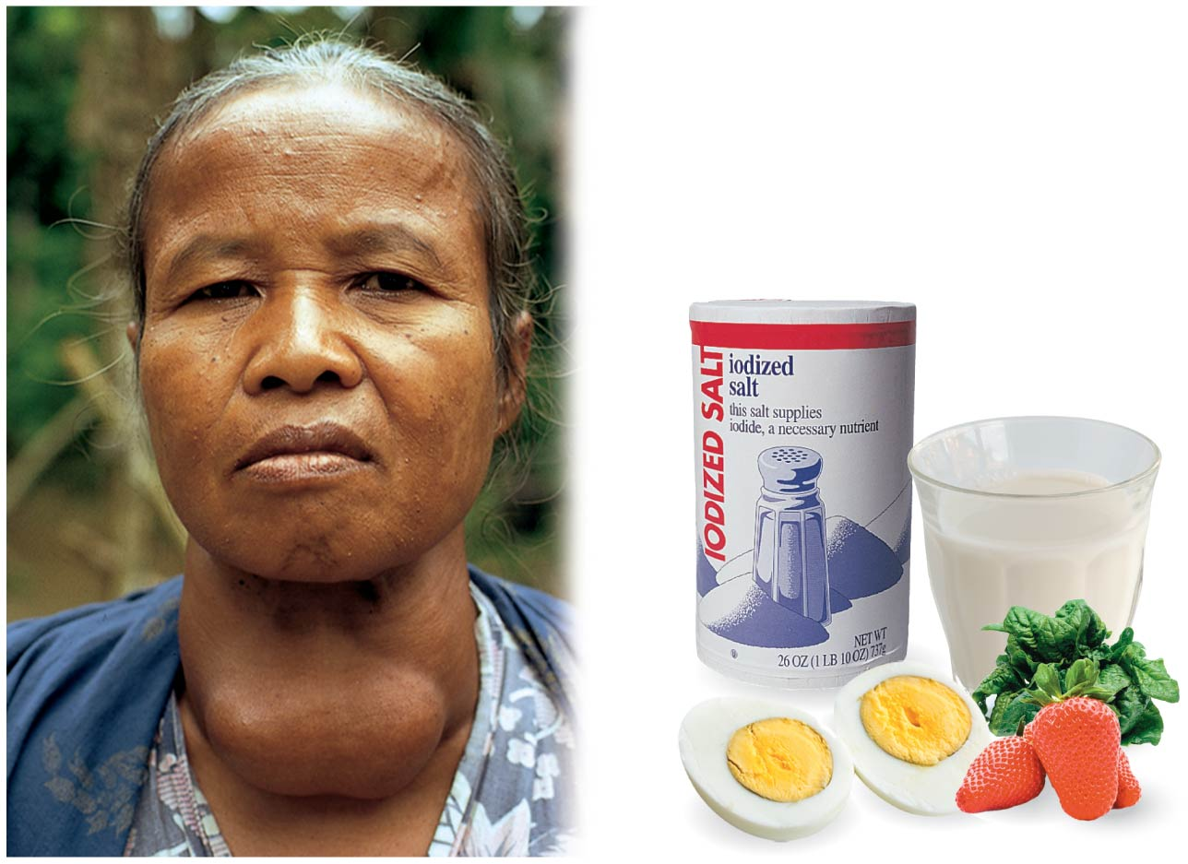
Diet and goiter
Eating iodine-rich foods can prevent goiter
Goiter, an enlargement of the thyroid gland, shown here in a Malaysian woman
Notes:
Figure 2.3 Diet and goiter

Slide 47
Matter: Elements and Compounds
Elements can combine to form compounds, substances that contain two or more elements in a fixed ratio.
Common compounds include:
NaCl (table salt) and
H₂O (water).
هذه الشرائح مخصصة للشرح و ليست للمذاكرة
Notes:
47
Student Misconceptions and Concerns
1. The dangers posed by certain chemicals in our food and broader environment often mislead people to associate “chemicals” with harm. People might not want “chemicals” added to their food or present in their environment. Students often fail to appreciate the chemical nature of our bodies and our world and the potential harm or benefits of naturally occurring chemistry. They often fail to understand why “natural” does not necessarily mean “good.” (Consider presenting a long list of naturally occurring toxins to make this point.) Your class may benefit from a class discussion of these misconceptions about our attitudes toward “chemicals.”
2. Students with limited backgrounds in chemistry and physics might struggle with basic concepts of mass, weight, compounds, elements, and isotopes. It may also be early in the semester, when mature study habits have not yet developed. Consider passing along basic studying advice and tips to help students master these early chemistry concepts. In-class quizzes (graded or not) or a few homework problems will also provide reinforcing practice.
3. The half-lives of many radioactive substances, especially those used for dating fossils, might lead some students to expect very long periods of decay for any radioactive substance. This might even be alarming if students are someday asked to consume a radioactive substance for a medical test. However, some medically significant isotopes have relatively short half-lives. Radioactive iodine-131 is often used to diagnose or treat certain thyroid problems. Its half-life of 8 days means that it will decay quickly.
Teaching Tips
1. Students might be interested in the following aside: One of the challenges of raising captive, exotic animals is meeting the unique dietary requirements of the species. A zoo might have trouble keeping a particular animal because science has not fully determined what trace elements the animal requires.
2. Many breakfast cereals are fortified with iron. A person can crush the cereal and extract distinct iron particles with a magnet. An overhead projector or video imagining device should clearly reveal the iron particles stuck to the magnet. This short practical demonstration can help connect an abstract concept to a concrete example.
3. Students with limited backgrounds in chemistry will benefit from a discussion of Figure 2.7 and the differences and limitations of diagrams of atomic structures. The contrasts in Figure 2.7 are a good beginning of such a discussion.
4. Here is a comparison that helps make the point about the differences in mass of protons and electrons. If a proton is as massive as a bowling ball, an electron will be the mass of a Life Saver candy. (This is calculated by considering a 15-pound bowling ball, a Life Saver with a mass of 0.12 ounces, and the textbook’s formula that an electron is 1/2,000 the mass of a proton.)
5. Here is an analogy regarding the size of a helium atom. If a helium atom were the size of a major league baseball stadium, the nucleus would be about the size of a pea near the pitcher’s mound, and the two electrons would be like tiny gnats buzzing around the stadium. This analogy helps to relate the great distances between parts of an atom. Consider modifying the analogy to any local stadium in your region.
6. After sharing teaching tips 4 and 5 above, consider asking your students to compare the mass of the pea near the pitcher’s mound to the mass of one of the gnats orbiting the stadium. If a proton or neutron is about 2,000 times more massive than an electron, how does the mass of a helium nucleus compare to the mass of one of its electrons?
7. Have your students try to calculate the number of covalent bonds possible for a variety of atoms. Then provide the students with a list of elements and the number of outer electrons for each and have them make predictions about the chemical formula for many types of molecules.
8. Consider challenging your students to suggest relationships in human lives that are analogous to each of the three main types of chemical bonds (covalent, ionic, and hydrogen). Evaluating the accuracy of potential analogies requires careful analysis of the chemical bonding relationships and critical thinking skills. Small groups might provide immediate critiques before passing along analogies for the entire class to consider. The following is one example. Ionic and covalent bonds are different types of relationships. Consider this analogy. A woman taking out a loan has a specific relationship to her bank. She owes the bank money, something she got from the bank. A man shares an office with another man. Both look out the same window and answer the same phone. Ionic bonds are like a bank loan, in which something is borrowed. Covalent bonds are like sharing an office, with items (electrons) shared by both members of the relationship. After presenting this analogy, ask your students to modify the office analogy to represent a polar covalent bond. (Perhaps one man in the office sits closer to the window and the phone.)
9. As noted in the text, chemical reactions do not create or destroy matter. Instead, they rearrange the structure and form new relationships. This is much like shuffling and dealing cards. When playing poker, cards are not created nor destroyed. Instead, new combinations are formed as the cards are dealt to the players.
Active Lecture Tips
1. See the Essay Electrons and Ceiling Fans on the Instructor Exchange. Visit the Instructor Exchange in the MasteringBiology instructor resource area for a description of this activity.
2. See the Essay Relating Chemical Bonds to Everyday Ideas on the Instructor Exchange. Visit the Instructor Exchange in the MasteringBiology instructor resource area for a description of this activity.

Slide 48
Atoms
An atom is the smallest unit of matter that still retains the properties of a element
Structure of Atoms:
Atoms are made of over a hundred subatomic particles, but only three are important for biological compounds
Proton—has a single positive electrical charge
Electron—has a single negative electrical charge
Neutron—is electrically neutral (has no charge)
هذه الشرائح مخصصة للشرح و ليست للمذاكرة
Notes:
Student Misconceptions
1. The dangers posed by certain chemicals in our food and broader environment often misled people to associate chemicals with harm. People might not want chemicals added to their food or in their environment. Students often fail to appreciate the chemical nature of our bodies and our world and the potential harm or benefits of naturally occurring chemistry. They often fail to understand why natural does not necessarily mean good. (Consider presenting a long list of naturally occurring toxins to make this point.) Your class may benefit from a class discussion of these misconceptions about our attitudes toward chemicals.
2. Students with limited backgrounds in chemistry and physics might struggle with basic concepts of mass, weight, compounds, elements, and isotopes. It may also be early in the semester when mature study habits have not yet developed. Consider passing along basic studying advice and tips to help students master these early chemistry concepts. In-class quizzes (graded or not) or a few homework problems will also provide reinforcing practice.
3. The half-lives of many radioactive substances, especially those used for dating fossils, might lead some students to expect very long periods of decay for any radioactive substance. This might even be alarming if students are someday asked to consume a radioactive substance for a medical test. However, some medically significant isotopes have relatively short half-lives. Radioactive iodine-131 is often used to diagnose or treat certain thyroid problems. Its half-life of eight days means that it will decay quickly.
Teaching Tips
1. Here is a comparison that helps make the point about the differences in mass of protons and electrons. If a proton were as massive as a bowling ball, an electron would be the mass of a Lifesaver. (This is calculated by considering a 15-pound bowling ball, a Lifesaver with a mass of 0.12 ounces, and the mention in Module 2.4 that an electron is about 1/2,000 the mass of a proton.)
2. The text in Module 2.4 makes an analogy regarding the size of a helium atom. The text notes that if a helium atom were the size of Yankee Stadium, the nucleus would be about the size of a fly in center field, and the two electrons would be like tiny gnats buzzing around the stadium. This analogy helps to relate the great distances between parts of an atom. Consider modifying the analogy to any local stadium in your region. Such concrete examples help to relate abstract concepts.
3. After sharing teaching tips 1 and 2 above, consider asking your students to compare the mass of the gnat orbiting Yankee Stadium to the mass of the fly in center field. If a proton or neutron is about 2,000 times more massive than an electron, how does the mass of a helium nucleus compare to the mass of one of its electrons?
4. The text notes the use of radioactive isotopes in dating fossils but references Module 15.5 for further discussion. If your course does not include Chapter 15, consider explaining this process at this point in your course.

Slide 49
Atoms
Atomic number: is the number of protons.
Mass number: is the sum of the number of protons and neutrons
هذه الشرائح مخصصة للشرح و ليست للمذاكرة

Slide 50
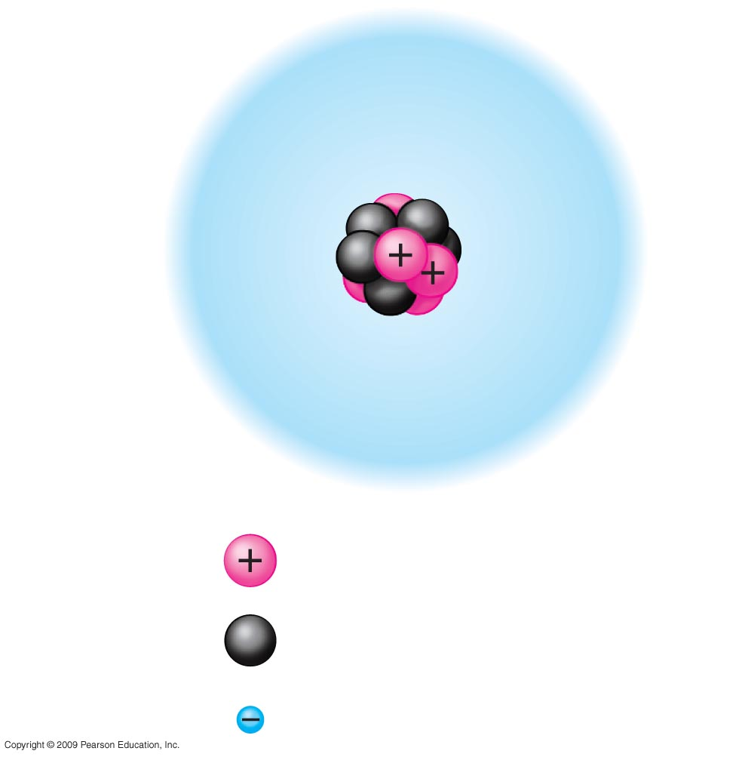
Model of a carbon atom
Electron
cloud
6e–
Nucleus
Protons
6
Mass number = 12
6
Neutrons
6
Electrons
Notes:
Figure 2.4B Model of a carbon atom.

Slide 51
Atoms
Although all atoms of an element have the same atomic number, some differ in mass number
Isotopes are atoms have the same numbers of protons and electrons but different numbers of neutrons (differ in mass)
One isotope of carbon has 8 neutrons instead of 6 (written ¹⁴C)
Unlike ¹²C, ¹⁴C is an unstable (radioactive) isotope that gives off energy
هذه الشرائح مخصصة للشرح و ليست للمذاكرة
Notes:
The isotope ¹²C is stable—its nucleus does not have a tendency to lose particles. The isotope ¹⁴C is radioactive—its nucleus decays spontaneously giving off particles and energy.
Student Misconceptions
1. The dangers posed by certain chemicals in our food and broader environment often misled people to associate chemicals with harm. People might not want chemicals added to their food or in their environment. Students often fail to appreciate the chemical nature of our bodies and our world and the potential harm or benefits of naturally occurring chemistry. They often fail to understand why natural does not necessarily mean good. (Consider presenting a long list of naturally occurring toxins to make this point.) Your class may benefit from a class discussion of these misconceptions about our attitudes toward chemicals.
2. Students with limited backgrounds in chemistry and physics might struggle with basic concepts of mass, weight, compounds, elements, and isotopes. It may also be early in the semester when mature study habits have not yet developed. Consider passing along basic studying advice and tips to help students master these early chemistry concepts. In-class quizzes (graded or not) or a few homework problems will also provide reinforcing practice.
3. The half-lives of many radioactive substances, especially those used for dating fossils, might lead some students to expect very long periods of decay for any radioactive substance. This might even be alarming if students are someday asked to consume a radioactive substance for a medical test. However, some medically significant isotopes have relatively short half-lives. Radioactive iodine-131 is often used to diagnose or treat certain thyroid problems. Its half-life of eight days means that it will decay quickly.
Teaching Tips
1. Here is a comparison that helps make the point about the differences in mass of protons and electrons. If a proton were as massive as a bowling ball, an electron would be the mass of a Lifesaver. (This is calculated by considering a 15-pound bowling ball, a Lifesaver with a mass of 0.12 ounces, and the mention in Module 2.4 that an electron is about 1/2,000 the mass of a proton.)
2. The text in Module 2.4 makes an analogy regarding the size of a helium atom. The text notes that if a helium atom were the size of Yankee Stadium, the nucleus would be about the size of a fly in center field, and the two electrons would be like tiny gnats buzzing around the stadium. This analogy helps to relate the great distances between parts of an atom. Consider modifying the analogy to any local stadium in your region. Such concrete examples help to relate abstract concepts.
3. After sharing teaching tips 1 and 2 above, consider asking your students to compare the mass of the gnat orbiting Yankee Stadium to the mass of the fly in center field. If a proton or neutron is about 2,000 times more massive than an electron, how does the mass of a helium nucleus compare to the mass of one of its electrons?
4. The text notes the use of radioactive isotopes in dating fossils but references Module 15.5 for further discussion. If your course does not include Chapter 15, consider explaining this process at this point in your course.

Slide 52
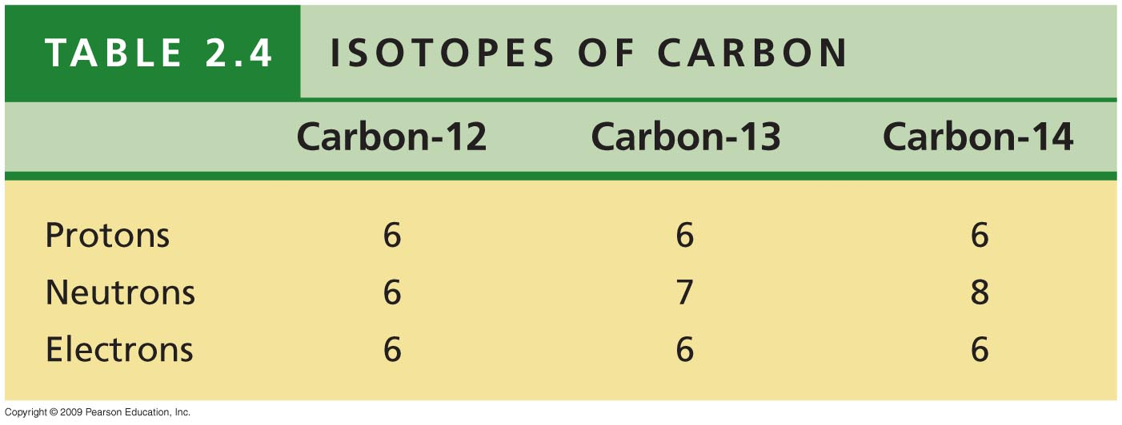
Notes:
Table 2.4 Isotopes of Carbon.

Slide 53
CONNECTION: Radioactive isotopes can help or harm us
Living cells cannot distinguish between isotopes of the same element.
Therefore, when radioactive compounds are used in metabolic processes, they act as tracers.
Radioactivity can be detected by instruments.
With instruments, the fate of radioactive tracers can be monitored in living organisms.
Radioactive tracers are frequently used in medical diagnosis.
Sophisticated imaging instruments are used to detect them.
هذه الشرائح مخصصة للشرح و ليست للمذاكرة
Notes:
Student Misconceptions
1. The dangers posed by certain chemicals in our food and broader environment often misled people to associate chemicals with harm. People might not want chemicals added to their food or in their environment. Students often fail to appreciate the chemical nature of our bodies and our world and the potential harm or benefits of naturally occurring chemistry. They often fail to understand why natural does not necessarily mean good. (Consider presenting a long list of naturally occurring toxins to make this point.) Your class may benefit from a class discussion of these misconceptions about our attitudes toward chemicals.

Slide 54
CONNECTION: Radioactive isotopes can help or harm us
In addition to benefits, there are also dangers associated with using radioactive substances
Uncontrolled exposure can cause damage to some molecules in a living cell, especially DNA
Chemical bonds are broken by the emitted energy,
هذه الشرائح مخصصة للشرح و ليست للمذاكرة
Notes:
One of the most serious environmental threats of radioactivity is radioactive fallout from nuclear accidents. A 1979 accident in the United States at the Three Mile Island nuclear power plant led to strict regulations about safety. In the Soviet Union on Saturday, April 26, 1986, the Number 4 reactor at the Chernobyl nuclear power plant blew apart and blasted through the surrounding concrete containment structure. Two workers died immediately in the blast, but over the following months 30 others died, most of them firefighters who battled to prevent the fire from spreading to the reactor in the next building. All died from radiation burns and radiation sickness following exposure to strong gamma and beta radiation.
Student Misconceptions
1. The dangers posed by certain chemicals in our food and broader environment often misled people to associate chemicals with harm. People might not want chemicals added to their food or in their environment. Students often fail to appreciate the chemical nature of our bodies and our world and the potential harm or benefits of naturally occurring chemistry. They often fail to understand why natural does not necessarily mean good. (Consider presenting a long list of naturally occurring toxins to make this point.) Your class may benefit from a class discussion of these misconceptions about our attitudes toward chemicals.

Slide 55
Biological molecules
Inorganic
Water
Salts
Organic
Carbohydrates
Acids
Bases
Proteins
Lipids
Nucleic acid

Slide 56
Water and Life
Life on Earth began in water and evolved there for 3 billion years before spreading onto land.
Modern life is still tied to water.
Your cells are composed of 70–95% water.
The abundance of water is a major reason that Earth is habitable.
هذه الشرائح مخصصة للشرح و ليست للمذاكرة
Notes:
56
Student Misconceptions and Concerns
1. Students are unlikely to have carefully considered the four special properties of water that are apparent in our lives. However, these properties are of great biological significance and are often familiar. The connections between these properties and personal experiences can invest great meaning into a discussion of water’s properties. See Active Lecture Tips 1 and 2 below.
2. Students at all levels struggle with the distinction between heat and temperature. Students might also expect that all ice is about the same temperature, 0°C. Redefining and correcting misunderstandings often takes more class time and energy than introducing previously unknown concepts.
Teaching Tips
1. Here is a way to have your students think about the “sticky” nature of water in their lives. Ask them to consider the need for a towel after a shower or a bath. Once we get out of the shower or bath, we have left the source of water. So why do we need the towel? The reason we need a towel to dry off is that water is still clinging to our bodies because water molecules are polar. The molecules on cell surfaces are also polar, so our skin and the water both “stick” to each other.
2. Some students may be intrigued if you tell them that you too can stand on the surface of water—when it is frozen. Thus, it is necessary to note a liquid water surface when talking about surface tension.
3. Have students compare the seasonal ranges of temperatures of Anchorage and Fairbanks, Alaska. (Many websites provide weather information about various cities.) These two northern cities have large differences in their annual temperature ranges. Make the point that the coastal location of Anchorage moderates the temperature.
4. Several versions of the following analogy are easy to relate to students. (a) Ask students how the average on an exam would be affected if the brightest students did not take the test. (b) The authors note that the performance of a track team would drop if the fastest runners did not compete. In both analogies, removing the top performers lowers the average just as the evaporation of the most active water molecules cools the evaporative surface.
5. “It is not the heat, it is the humidity.” The efficiency of evaporative cooling is affected by humidity. As humidity rises, the rate of evaporation decreases, making it more difficult to cool our heat-generating bodies on a warm and humid summer day.
6. Ask your students if the ocean levels would change if ice did not float or if all the floating ice in the oceans were to melt. They can try this experiment to find out. Place several large chunks of ice in a glass and fill the glass up completely with water to the top rim. Thus, the ice cubes should be sticking up above the top of the filled glass. Will the glass overflow when the ice melts? (No.) This phenomenon is important when we consider the potential consequences of global warming. If floating glaciers melt, ocean levels will not be affected. However, if the ice over land melts, we can expect increased ocean levels.
7. A simple demonstration of a solute dissolving in a solvent can focus students’ attention on the process when discussing solutions. Using colored water and white sugar or salt may make it easier to see and reference while you are discussing the process. Such simple visual aids add life to a lecture. (You might also add corn oil to the top of the solution to demonstrate the properties of hydrophobic substances, and challenge your class to explain why oil and water do not mix.)
8. Discussions of pH are enhanced by lab activities that permit students to test the pH of everyday items (foods and household solutions). If students do not have opportunities to conduct such tests in lab, consider testing a few items during your class (pH paper or a basic pH meter will, of course, be necessary).
9. The Environmental Protection Agency website www.epa.gov/acidrain/ includes good information about acid precipitation and teaching ideas.
10. The SETI (Search for Extraterrestrial Intelligence) Institute’s mission is “to explore, understand and explain the origin, nature, and prevalence of life in the universe” (www.seti.org). Your students might enjoy exploring this respected scientific organization.
Active Lecture Tips
1. Prepare a list of examples of the four properties of water. Then present each example and ask students to work in pairs at their seats to identify the property of water associated with each example. Students will engage in higher-level analysis as they apply the properties. Students are likely to want to know the answer in what may be a surprisingly engaging class exercise!
2. The Chapter 2 text notes the insulating effect of ice forming at the surface of a lake. This phenomenon would not occur if ice were denser than water. Ask students to turn to someone near them to think of other consequences of the expansion of water when it forms ice. After perhaps two minutes, have students share their examples. (These include the ability to widen cracks in rocks, roads, and sidewalks!)
3. See the Essay The Earthquake Richter Scale and the pH Scale on the Instructor Exchange. Visit the Instructor Exchange in the MasteringBiology instructor resource area for a description of this activity.

Slide 57
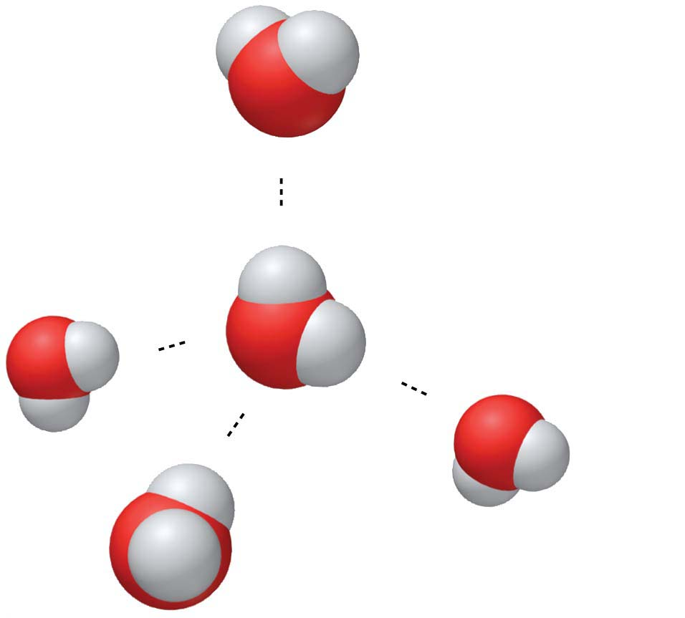
Structure/Function: Water
A water molecule has 2 hydrogen atoms joined to one oxygen atom by single covalent bond.
Water molecule is polar, the oxygen end of the molecule has a slight (-) charge, and the region around hydrogen atoms is slightly(+).
Water molecules form hydrogen bonds between neighboring molecules.
(−)
Hydrogen bond
(+)
Slightly positive
charge
H
(−)
O
H
(+)
Slightly negative
charge
(+)
(−)
(−)
(+)
هذه الشرائح مخصصة للشرح و ليست للمذاكرة
Notes:
57
Student Misconceptions and Concerns
1. Students are unlikely to have carefully considered the four special properties of water that are apparent in our lives. However, these properties are of great biological significance and are often familiar. The connections between these properties and personal experiences can invest great meaning into a discussion of water’s properties. See Active Lecture Tips 1 and 2 below.
2. Students at all levels struggle with the distinction between heat and temperature. Students might also expect that all ice is about the same temperature, 0°C. Redefining and correcting misunderstandings often takes more class time and energy than introducing previously unknown concepts.
Teaching Tips
1. Here is a way to have your students think about the “sticky” nature of water in their lives. Ask them to consider the need for a towel after a shower or a bath. Once we get out of the shower or bath, we have left the source of water. So why do we need the towel? The reason we need a towel to dry off is that water is still clinging to our bodies because water molecules are polar. The molecules on cell surfaces are also polar, so our skin and the water both “stick” to each other.
2. Some students may be intrigued if you tell them that you too can stand on the surface of water—when it is frozen. Thus, it is necessary to note a liquid water surface when talking about surface tension.
3. Have students compare the seasonal ranges of temperatures of Anchorage and Fairbanks, Alaska. (Many websites provide weather information about various cities.) These two northern cities have large differences in their annual temperature ranges. Make the point that the coastal location of Anchorage moderates the temperature.
4. Several versions of the following analogy are easy to relate to students. (a) Ask students how the average on an exam would be affected if the brightest students did not take the test. (b) The authors note that the performance of a track team would drop if the fastest runners did not compete. In both analogies, removing the top performers lowers the average just as the evaporation of the most active water molecules cools the evaporative surface.
5. “It is not the heat, it is the humidity.” The efficiency of evaporative cooling is affected by humidity. As humidity rises, the rate of evaporation decreases, making it more difficult to cool our heat-generating bodies on a warm and humid summer day.
6. Ask your students if the ocean levels would change if ice did not float or if all the floating ice in the oceans were to melt. They can try this experiment to find out. Place several large chunks of ice in a glass and fill the glass up completely with water to the top rim. Thus, the ice cubes should be sticking up above the top of the filled glass. Will the glass overflow when the ice melts? (No.) This phenomenon is important when we consider the potential consequences of global warming. If floating glaciers melt, ocean levels will not be affected. However, if the ice over land melts, we can expect increased ocean levels.
7. A simple demonstration of a solute dissolving in a solvent can focus students’ attention on the process when discussing solutions. Using colored water and white sugar or salt may make it easier to see and reference while you are discussing the process. Such simple visual aids add life to a lecture. (You might also add corn oil to the top of the solution to demonstrate the properties of hydrophobic substances, and challenge your class to explain why oil and water do not mix.)
8. Discussions of pH are enhanced by lab activities that permit students to test the pH of everyday items (foods and household solutions). If students do not have opportunities to conduct such tests in lab, consider testing a few items during your class (pH paper or a basic pH meter will, of course, be necessary).
9. The Environmental Protection Agency website www.epa.gov/acidrain/ includes good information about acid precipitation and teaching ideas.
10. The SETI (Search for Extraterrestrial Intelligence) Institute’s mission is “to explore, understand and explain the origin, nature, and prevalence of life in the universe” (www.seti.org). Your students might enjoy exploring this respected scientific organization.
Active Lecture Tips
1. Prepare a list of examples of the four properties of water. Then present each example and ask students to work in pairs at their seats to identify the property of water associated with each example. Students will engage in higher-level analysis as they apply the properties. Students are likely to want to know the answer in what may be a surprisingly engaging class exercise!
2. The Chapter 2 text notes the insulating effect of ice forming at the surface of a lake. This phenomenon would not occur if ice were denser than water. Ask students to turn to someone near them to think of other consequences of the expansion of water when it forms ice. After perhaps two minutes, have students share their examples. (These include the ability to widen cracks in rocks, roads, and sidewalks!)
3. See the Essay The Earthquake Richter Scale and the pH Scale on the Instructor Exchange. Visit the Instructor Exchange in the MasteringBiology instructor resource area for a description of this activity.

Slide 58
Structure/Function: Water
The polarity of water molecules and the hydrogen bonding that results explain most of water’s life-supporting properties.
We will explore three of those properties:
the cohesive nature of water,
the biological significance of ice floating, and
the versatility of water as a solvent.
هذه الشرائح مخصصة للشرح و ليست للمذاكرة

Slide 59
1. The Cohesion of Water
Water molecules stick together as a result of hydrogen bonding.
Cohesion is the tendency of molecules of the same kind to stick together and is much stronger for water than for most other liquids.
Trees depend on cohesion to help transport water from their roots to their leaves.
هذه الشرائح مخصصة للشرح و ليست للمذاكرة
Notes:
59
Student Misconceptions and Concerns
1. Students are unlikely to have carefully considered the four special properties of water that are apparent in our lives. However, these properties are of great biological significance and are often familiar. The connections between these properties and personal experiences can invest great meaning into a discussion of water’s properties. See Active Lecture Tips 1 and 2 below.
2. Students at all levels struggle with the distinction between heat and temperature. Students might also expect that all ice is about the same temperature, 0°C. Redefining and correcting misunderstandings often takes more class time and energy than introducing previously unknown concepts.
Teaching Tips
1. Here is a way to have your students think about the “sticky” nature of water in their lives. Ask them to consider the need for a towel after a shower or a bath. Once we get out of the shower or bath, we have left the source of water. So why do we need the towel? The reason we need a towel to dry off is that water is still clinging to our bodies because water molecules are polar. The molecules on cell surfaces are also polar, so our skin and the water both “stick” to each other.
2. Some students may be intrigued if you tell them that you too can stand on the surface of water—when it is frozen. Thus, it is necessary to note a liquid water surface when talking about surface tension.
3. Have students compare the seasonal ranges of temperatures of Anchorage and Fairbanks, Alaska. (Many websites provide weather information about various cities.) These two northern cities have large differences in their annual temperature ranges. Make the point that the coastal location of Anchorage moderates the temperature.
4. Several versions of the following analogy are easy to relate to students. (a) Ask students how the average on an exam would be affected if the brightest students did not take the test. (b) The authors note that the performance of a track team would drop if the fastest runners did not compete. In both analogies, removing the top performers lowers the average just as the evaporation of the most active water molecules cools the evaporative surface.
5. “It is not the heat, it is the humidity.” The efficiency of evaporative cooling is affected by humidity. As humidity rises, the rate of evaporation decreases, making it more difficult to cool our heat-generating bodies on a warm and humid summer day.
6. Ask your students if the ocean levels would change if ice did not float or if all the floating ice in the oceans were to melt. They can try this experiment to find out. Place several large chunks of ice in a glass and fill the glass up completely with water to the top rim. Thus, the ice cubes should be sticking up above the top of the filled glass. Will the glass overflow when the ice melts? (No.) This phenomenon is important when we consider the potential consequences of global warming. If floating glaciers melt, ocean levels will not be affected. However, if the ice over land melts, we can expect increased ocean levels.
7. A simple demonstration of a solute dissolving in a solvent can focus students’ attention on the process when discussing solutions. Using colored water and white sugar or salt may make it easier to see and reference while you are discussing the process. Such simple visual aids add life to a lecture. (You might also add corn oil to the top of the solution to demonstrate the properties of hydrophobic substances, and challenge your class to explain why oil and water do not mix.)
8. Discussions of pH are enhanced by lab activities that permit students to test the pH of everyday items (foods and household solutions). If students do not have opportunities to conduct such tests in lab, consider testing a few items during your class (pH paper or a basic pH meter will, of course, be necessary).
9. The Environmental Protection Agency website www.epa.gov/acidrain/ includes good information about acid precipitation and teaching ideas.
10. The SETI (Search for Extraterrestrial Intelligence) Institute’s mission is “to explore, understand and explain the origin, nature, and prevalence of life in the universe” (www.seti.org). Your students might enjoy exploring this respected scientific organization.
Active Lecture Tips
1. Prepare a list of examples of the four properties of water. Then present each example and ask students to work in pairs at their seats to identify the property of water associated with each example. Students will engage in higher-level analysis as they apply the properties. Students are likely to want to know the answer in what may be a surprisingly engaging class exercise!
2. The Chapter 2 text notes the insulating effect of ice forming at the surface of a lake. This phenomenon would not occur if ice were denser than water. Ask students to turn to someone near them to think of other consequences of the expansion of water when it forms ice. After perhaps two minutes, have students share their examples. (These include the ability to widen cracks in rocks, roads, and sidewalks!)
3. See the Essay The Earthquake Richter Scale and the pH Scale on the Instructor Exchange. Visit the Instructor Exchange in the MasteringBiology instructor resource area for a description of this activity.

Slide 60
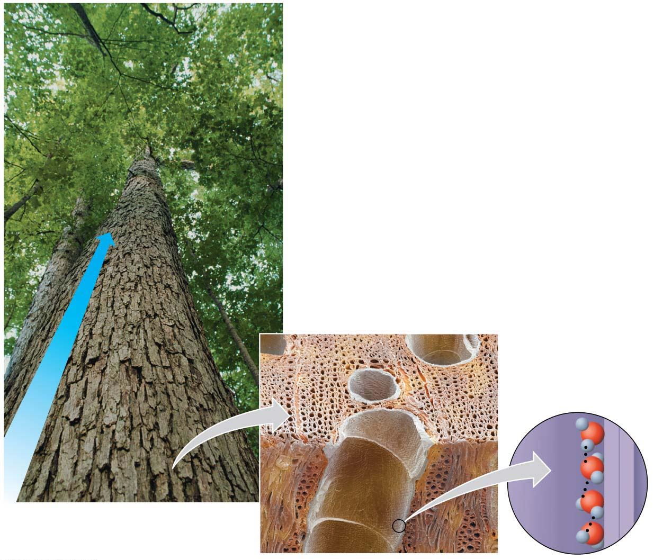
Cohesion and water transport in plant
Evaporation from the leaves
Microscopic water-
conducting tubes
Flow of water
Cohesion due to
hydrogen bonds
between water
molecules
Colorized
SEM
Notes:
Figure 2.10 Cohesion and water transport in plants

Slide 61
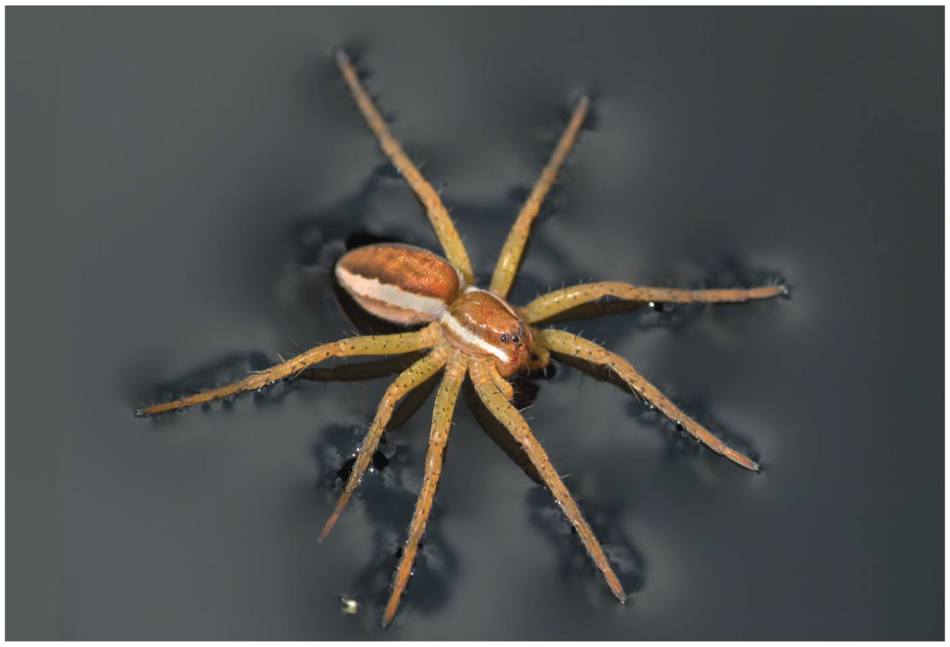
1. The Cohesion of Water
Surface tension is a measure of how difficult it is to stretch or break the surface of a liquid.
Hydrogen bonds give water unusually high surface tension and make water behave as though it were coated with an invisible film.
Figure 2.11: a raft spider walking on water
هذه الشرائح مخصصة للشرح و ليست للمذاكرة
Notes:
61
Student Misconceptions and Concerns
1. Students are unlikely to have carefully considered the four special properties of water that are apparent in our lives. However, these properties are of great biological significance and are often familiar. The connections between these properties and personal experiences can invest great meaning into a discussion of water’s properties. See Active Lecture Tips 1 and 2 below.
2. Students at all levels struggle with the distinction between heat and temperature. Students might also expect that all ice is about the same temperature, 0°C. Redefining and correcting misunderstandings often takes more class time and energy than introducing previously unknown concepts.
Teaching Tips
1. Here is a way to have your students think about the “sticky” nature of water in their lives. Ask them to consider the need for a towel after a shower or a bath. Once we get out of the shower or bath, we have left the source of water. So why do we need the towel? The reason we need a towel to dry off is that water is still clinging to our bodies because water molecules are polar. The molecules on cell surfaces are also polar, so our skin and the water both “stick” to each other.
2. Some students may be intrigued if you tell them that you too can stand on the surface of water—when it is frozen. Thus, it is necessary to note a liquid water surface when talking about surface tension.
3. Have students compare the seasonal ranges of temperatures of Anchorage and Fairbanks, Alaska. (Many websites provide weather information about various cities.) These two northern cities have large differences in their annual temperature ranges. Make the point that the coastal location of Anchorage moderates the temperature.
4. Several versions of the following analogy are easy to relate to students. (a) Ask students how the average on an exam would be affected if the brightest students did not take the test. (b) The authors note that the performance of a track team would drop if the fastest runners did not compete. In both analogies, removing the top performers lowers the average just as the evaporation of the most active water molecules cools the evaporative surface.
5. “It is not the heat, it is the humidity.” The efficiency of evaporative cooling is affected by humidity. As humidity rises, the rate of evaporation decreases, making it more difficult to cool our heat-generating bodies on a warm and humid summer day.
6. Ask your students if the ocean levels would change if ice did not float or if all the floating ice in the oceans were to melt. They can try this experiment to find out. Place several large chunks of ice in a glass and fill the glass up completely with water to the top rim. Thus, the ice cubes should be sticking up above the top of the filled glass. Will the glass overflow when the ice melts? (No.) This phenomenon is important when we consider the potential consequences of global warming. If floating glaciers melt, ocean levels will not be affected. However, if the ice over land melts, we can expect increased ocean levels.
7. A simple demonstration of a solute dissolving in a solvent can focus students’ attention on the process when discussing solutions. Using colored water and white sugar or salt may make it easier to see and reference while you are discussing the process. Such simple visual aids add life to a lecture. (You might also add corn oil to the top of the solution to demonstrate the properties of hydrophobic substances, and challenge your class to explain why oil and water do not mix.)
8. Discussions of pH are enhanced by lab activities that permit students to test the pH of everyday items (foods and household solutions). If students do not have opportunities to conduct such tests in lab, consider testing a few items during your class (pH paper or a basic pH meter will, of course, be necessary).
9. The Environmental Protection Agency website www.epa.gov/acidrain/ includes good information about acid precipitation and teaching ideas.
10. The SETI (Search for Extraterrestrial Intelligence) Institute’s mission is “to explore, understand and explain the origin, nature, and prevalence of life in the universe” (www.seti.org). Your students might enjoy exploring this respected scientific organization.
Active Lecture Tips
1. Prepare a list of examples of the four properties of water. Then present each example and ask students to work in pairs at their seats to identify the property of water associated with each example. Students will engage in higher-level analysis as they apply the properties. Students are likely to want to know the answer in what may be a surprisingly engaging class exercise!
2. The Chapter 2 text notes the insulating effect of ice forming at the surface of a lake. This phenomenon would not occur if ice were denser than water. Ask students to turn to someone near them to think of other consequences of the expansion of water when it forms ice. After perhaps two minutes, have students share their examples. (These include the ability to widen cracks in rocks, roads, and sidewalks!)
3. See the Essay The Earthquake Richter Scale and the pH Scale on the Instructor Exchange. Visit the Instructor Exchange in the MasteringBiology instructor resource area for a description of this activity.

Slide 62
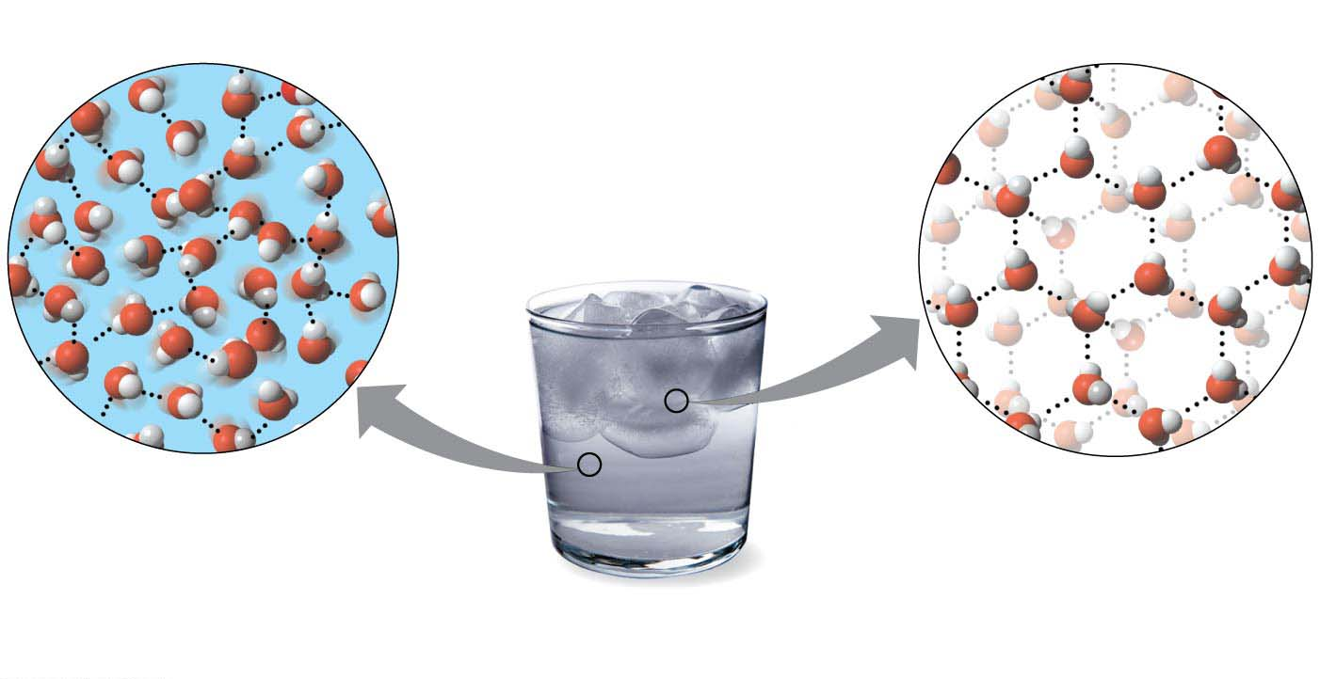
2. The Biological Significance of Ice Floating
When water molecules get cold enough, they move apart, forming ice.
A chunk of ice floats because it is less dense than the liquid water in which it is floating.
Hydrogen bond
Ice
Liquid water
Hydrogen bonds constantly
break and re-form.
Stable hydrogen bonds
hold molecules apart,
making ice less dense
than water.
Notes:
62
Student Misconceptions and Concerns
1. Students are unlikely to have carefully considered the four special properties of water that are apparent in our lives. However, these properties are of great biological significance and are often familiar. The connections between these properties and personal experiences can invest great meaning into a discussion of water’s properties. See Active Lecture Tips 1 and 2 below.
2. Students at all levels struggle with the distinction between heat and temperature. Students might also expect that all ice is about the same temperature, 0°C. Redefining and correcting misunderstandings often takes more class time and energy than introducing previously unknown concepts.
Teaching Tips
1. Here is a way to have your students think about the “sticky” nature of water in their lives. Ask them to consider the need for a towel after a shower or a bath. Once we get out of the shower or bath, we have left the source of water. So why do we need the towel? The reason we need a towel to dry off is that water is still clinging to our bodies because water molecules are polar. The molecules on cell surfaces are also polar, so our skin and the water both “stick” to each other.
2. Some students may be intrigued if you tell them that you too can stand on the surface of water—when it is frozen. Thus, it is necessary to note a liquid water surface when talking about surface tension.
3. Have students compare the seasonal ranges of temperatures of Anchorage and Fairbanks, Alaska. (Many websites provide weather information about various cities.) These two northern cities have large differences in their annual temperature ranges. Make the point that the coastal location of Anchorage moderates the temperature.
4. Several versions of the following analogy are easy to relate to students. (a) Ask students how the average on an exam would be affected if the brightest students did not take the test. (b) The authors note that the performance of a track team would drop if the fastest runners did not compete. In both analogies, removing the top performers lowers the average just as the evaporation of the most active water molecules cools the evaporative surface.
5. “It is not the heat, it is the humidity.” The efficiency of evaporative cooling is affected by humidity. As humidity rises, the rate of evaporation decreases, making it more difficult to cool our heat-generating bodies on a warm and humid summer day.
6. Ask your students if the ocean levels would change if ice did not float or if all the floating ice in the oceans were to melt. They can try this experiment to find out. Place several large chunks of ice in a glass and fill the glass up completely with water to the top rim. Thus, the ice cubes should be sticking up above the top of the filled glass. Will the glass overflow when the ice melts? (No.) This phenomenon is important when we consider the potential consequences of global warming. If floating glaciers melt, ocean levels will not be affected. However, if the ice over land melts, we can expect increased ocean levels.
7. A simple demonstration of a solute dissolving in a solvent can focus students’ attention on the process when discussing solutions. Using colored water and white sugar or salt may make it easier to see and reference while you are discussing the process. Such simple visual aids add life to a lecture. (You might also add corn oil to the top of the solution to demonstrate the properties of hydrophobic substances, and challenge your class to explain why oil and water do not mix.)
8. Discussions of pH are enhanced by lab activities that permit students to test the pH of everyday items (foods and household solutions). If students do not have opportunities to conduct such tests in lab, consider testing a few items during your class (pH paper or a basic pH meter will, of course, be necessary).
9. The Environmental Protection Agency website www.epa.gov/acidrain/ includes good information about acid precipitation and teaching ideas.
10. The SETI (Search for Extraterrestrial Intelligence) Institute’s mission is “to explore, understand and explain the origin, nature, and prevalence of life in the universe” (www.seti.org). Your students might enjoy exploring this respected scientific organization.
Active Lecture Tips
1. Prepare a list of examples of the four properties of water. Then present each example and ask students to work in pairs at their seats to identify the property of water associated with each example. Students will engage in higher-level analysis as they apply the properties. Students are likely to want to know the answer in what may be a surprisingly engaging class exercise!
2. The Chapter 2 text notes the insulating effect of ice forming at the surface of a lake. This phenomenon would not occur if ice were denser than water. Ask students to turn to someone near them to think of other consequences of the expansion of water when it forms ice. After perhaps two minutes, have students share their examples. (These include the ability to widen cracks in rocks, roads, and sidewalks!)
3. See the Essay The Earthquake Richter Scale and the pH Scale on the Instructor Exchange. Visit the Instructor Exchange in the MasteringBiology instructor resource area for a description of this activity.

Slide 63
2. The Biological Significance of Ice Floating
Floating ice is a result of hydrogen bonding.
How does floating ice help support life on earth?
When a deep body of water cools and a layer of ice forms on top, the floating ice acts as an insulating “blanket” over the liquid water, allowing life to persist under the frozen surface.
If ice did not float, ponds, lakes, and even the oceans would freeze solid.
هذه الشرائح مخصصة للشرح و ليست للمذاكرة
Notes:
63
Student Misconceptions and Concerns
1. Students are unlikely to have carefully considered the four special properties of water that are apparent in our lives. However, these properties are of great biological significance and are often familiar. The connections between these properties and personal experiences can invest great meaning into a discussion of water’s properties. See Active Lecture Tips 1 and 2 below.
2. Students at all levels struggle with the distinction between heat and temperature. Students might also expect that all ice is about the same temperature, 0°C. Redefining and correcting misunderstandings often takes more class time and energy than introducing previously unknown concepts.
Teaching Tips
1. Here is a way to have your students think about the “sticky” nature of water in their lives. Ask them to consider the need for a towel after a shower or a bath. Once we get out of the shower or bath, we have left the source of water. So why do we need the towel? The reason we need a towel to dry off is that water is still clinging to our bodies because water molecules are polar. The molecules on cell surfaces are also polar, so our skin and the water both “stick” to each other.
2. Some students may be intrigued if you tell them that you too can stand on the surface of water—when it is frozen. Thus, it is necessary to note a liquid water surface when talking about surface tension.
3. Have students compare the seasonal ranges of temperatures of Anchorage and Fairbanks, Alaska. (Many websites provide weather information about various cities.) These two northern cities have large differences in their annual temperature ranges. Make the point that the coastal location of Anchorage moderates the temperature.
4. Several versions of the following analogy are easy to relate to students. (a) Ask students how the average on an exam would be affected if the brightest students did not take the test. (b) The authors note that the performance of a track team would drop if the fastest runners did not compete. In both analogies, removing the top performers lowers the average just as the evaporation of the most active water molecules cools the evaporative surface.
5. “It is not the heat, it is the humidity.” The efficiency of evaporative cooling is affected by humidity. As humidity rises, the rate of evaporation decreases, making it more difficult to cool our heat-generating bodies on a warm and humid summer day.
6. Ask your students if the ocean levels would change if ice did not float or if all the floating ice in the oceans were to melt. They can try this experiment to find out. Place several large chunks of ice in a glass and fill the glass up completely with water to the top rim. Thus, the ice cubes should be sticking up above the top of the filled glass. Will the glass overflow when the ice melts? (No.) This phenomenon is important when we consider the potential consequences of global warming. If floating glaciers melt, ocean levels will not be affected. However, if the ice over land melts, we can expect increased ocean levels.
7. A simple demonstration of a solute dissolving in a solvent can focus students’ attention on the process when discussing solutions. Using colored water and white sugar or salt may make it easier to see and reference while you are discussing the process. Such simple visual aids add life to a lecture. (You might also add corn oil to the top of the solution to demonstrate the properties of hydrophobic substances, and challenge your class to explain why oil and water do not mix.)
8. Discussions of pH are enhanced by lab activities that permit students to test the pH of everyday items (foods and household solutions). If students do not have opportunities to conduct such tests in lab, consider testing a few items during your class (pH paper or a basic pH meter will, of course, be necessary).
9. The Environmental Protection Agency website www.epa.gov/acidrain/ includes good information about acid precipitation and teaching ideas.
10. The SETI (Search for Extraterrestrial Intelligence) Institute’s mission is “to explore, understand and explain the origin, nature, and prevalence of life in the universe” (www.seti.org). Your students might enjoy exploring this respected scientific organization.
Active Lecture Tips
1. Prepare a list of examples of the four properties of water. Then present each example and ask students to work in pairs at their seats to identify the property of water associated with each example. Students will engage in higher-level analysis as they apply the properties. Students are likely to want to know the answer in what may be a surprisingly engaging class exercise!
2. The Chapter 2 text notes the insulating effect of ice forming at the surface of a lake. This phenomenon would not occur if ice were denser than water. Ask students to turn to someone near them to think of other consequences of the expansion of water when it forms ice. After perhaps two minutes, have students share their examples. (These include the ability to widen cracks in rocks, roads, and sidewalks!)
3. See the Essay The Earthquake Richter Scale and the pH Scale on the Instructor Exchange. Visit the Instructor Exchange in the MasteringBiology instructor resource area for a description of this activity.

Slide 64
3. Water as the Solvent of Life
A solution is a liquid consisting of a homogeneous mixture of two or more substances.
The dissolving agent is the solvent.
The dissolved substance is the solute.
When water is the solvent, the result is an aqueous solution.
Water can dissolve an enormous variety of solutes necessary for life, providing a medium for chemical reactions.
When water dissolves salt ions, each ion becomes surrounded by oppositely charged regions of water molecules.
هذه الشرائح مخصصة للشرح و ليست للمذاكرة
Notes:
64
Student Misconceptions and Concerns
1. Students are unlikely to have carefully considered the four special properties of water that are apparent in our lives. However, these properties are of great biological significance and are often familiar. The connections between these properties and personal experiences can invest great meaning into a discussion of water’s properties. See Active Lecture Tips 1 and 2 below.
2. Students at all levels struggle with the distinction between heat and temperature. Students might also expect that all ice is about the same temperature, 0°C. Redefining and correcting misunderstandings often takes more class time and energy than introducing previously unknown concepts.
Teaching Tips
1. Here is a way to have your students think about the “sticky” nature of water in their lives. Ask them to consider the need for a towel after a shower or a bath. Once we get out of the shower or bath, we have left the source of water. So why do we need the towel? The reason we need a towel to dry off is that water is still clinging to our bodies because water molecules are polar. The molecules on cell surfaces are also polar, so our skin and the water both “stick” to each other.
2. Some students may be intrigued if you tell them that you too can stand on the surface of water—when it is frozen. Thus, it is necessary to note a liquid water surface when talking about surface tension.
3. Have students compare the seasonal ranges of temperatures of Anchorage and Fairbanks, Alaska. (Many websites provide weather information about various cities.) These two northern cities have large differences in their annual temperature ranges. Make the point that the coastal location of Anchorage moderates the temperature.
4. Several versions of the following analogy are easy to relate to students. (a) Ask students how the average on an exam would be affected if the brightest students did not take the test. (b) The authors note that the performance of a track team would drop if the fastest runners did not compete. In both analogies, removing the top performers lowers the average just as the evaporation of the most active water molecules cools the evaporative surface.
5. “It is not the heat, it is the humidity.” The efficiency of evaporative cooling is affected by humidity. As humidity rises, the rate of evaporation decreases, making it more difficult to cool our heat-generating bodies on a warm and humid summer day.
6. Ask your students if the ocean levels would change if ice did not float or if all the floating ice in the oceans were to melt. They can try this experiment to find out. Place several large chunks of ice in a glass and fill the glass up completely with water to the top rim. Thus, the ice cubes should be sticking up above the top of the filled glass. Will the glass overflow when the ice melts? (No.) This phenomenon is important when we consider the potential consequences of global warming. If floating glaciers melt, ocean levels will not be affected. However, if the ice over land melts, we can expect increased ocean levels.
7. A simple demonstration of a solute dissolving in a solvent can focus students’ attention on the process when discussing solutions. Using colored water and white sugar or salt may make it easier to see and reference while you are discussing the process. Such simple visual aids add life to a lecture. (You might also add corn oil to the top of the solution to demonstrate the properties of hydrophobic substances, and challenge your class to explain why oil and water do not mix.)
8. Discussions of pH are enhanced by lab activities that permit students to test the pH of everyday items (foods and household solutions). If students do not have opportunities to conduct such tests in lab, consider testing a few items during your class (pH paper or a basic pH meter will, of course, be necessary).
9. The Environmental Protection Agency website www.epa.gov/acidrain/ includes good information about acid precipitation and teaching ideas.
10. The SETI (Search for Extraterrestrial Intelligence) Institute’s mission is “to explore, understand and explain the origin, nature, and prevalence of life in the universe” (www.seti.org). Your students might enjoy exploring this respected scientific organization.
Active Lecture Tips
1. Prepare a list of examples of the four properties of water. Then present each example and ask students to work in pairs at their seats to identify the property of water associated with each example. Students will engage in higher-level analysis as they apply the properties. Students are likely to want to know the answer in what may be a surprisingly engaging class exercise!
2. The Chapter 2 text notes the insulating effect of ice forming at the surface of a lake. This phenomenon would not occur if ice were denser than water. Ask students to turn to someone near them to think of other consequences of the expansion of water when it forms ice. After perhaps two minutes, have students share their examples. (These include the ability to widen cracks in rocks, roads, and sidewalks!)
3. See the Essay The Earthquake Richter Scale and the pH Scale on the Instructor Exchange. Visit the Instructor Exchange in the MasteringBiology instructor resource area for a description of this activity.

Slide 65
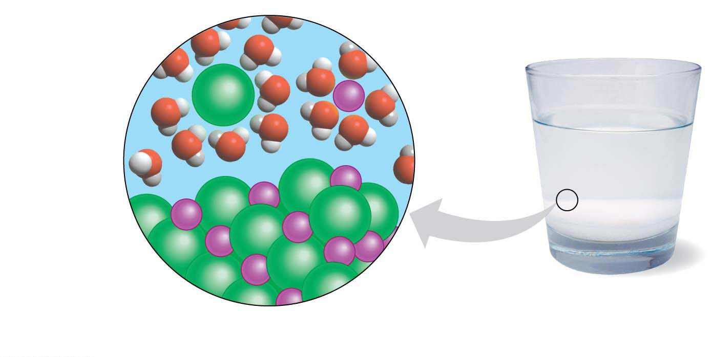
A crystal of table salt (NaCl) dissolving in water
Sodium ion
in solution
Chloride ion
in solution
Cl⁻
Na⁺
Cl⁻
Na⁺
Salt crystal
A crystal of table salt (NaCl) dissolving in water
Notes:
Figure 2.14 A crystal of table salt (NaCl) dissolving in water

Slide 66
Acids, Bases, and pH
Acid: is a chemical compound that releases H⁺ to a solution. (ex. HCl)
Base: is a compound that accepts H⁺ and removes them from solution. (ex. NaOH)
pH scale is used to describe the acidity of a solution.
It is a measure of the hydrogen ion (H⁺) concentration in a solution.
The scale ranges from 0 (most acidic) to 14 (most basic)
هذه الشرائح مخصصة للشرح و ليست للمذاكرة
Notes:
66
Student Misconceptions and Concerns
1. Students are unlikely to have carefully considered the four special properties of water that are apparent in our lives. However, these properties are of great biological significance and are often familiar. The connections between these properties and personal experiences can invest great meaning into a discussion of water’s properties. See Active Lecture Tips 1 and 2 below.
2. Students at all levels struggle with the distinction between heat and temperature. Students might also expect that all ice is about the same temperature, 0°C. Redefining and correcting misunderstandings often takes more class time and energy than introducing previously unknown concepts.
Teaching Tips
1. Here is a way to have your students think about the “sticky” nature of water in their lives. Ask them to consider the need for a towel after a shower or a bath. Once we get out of the shower or bath, we have left the source of water. So why do we need the towel? The reason we need a towel to dry off is that water is still clinging to our bodies because water molecules are polar. The molecules on cell surfaces are also polar, so our skin and the water both “stick” to each other.
2. Some students may be intrigued if you tell them that you too can stand on the surface of water—when it is frozen. Thus, it is necessary to note a liquid water surface when talking about surface tension.
3. Have students compare the seasonal ranges of temperatures of Anchorage and Fairbanks, Alaska. (Many websites provide weather information about various cities.) These two northern cities have large differences in their annual temperature ranges. Make the point that the coastal location of Anchorage moderates the temperature.
4. Several versions of the following analogy are easy to relate to students. (a) Ask students how the average on an exam would be affected if the brightest students did not take the test. (b) The authors note that the performance of a track team would drop if the fastest runners did not compete. In both analogies, removing the top performers lowers the average just as the evaporation of the most active water molecules cools the evaporative surface.
5. “It is not the heat, it is the humidity.” The efficiency of evaporative cooling is affected by humidity. As humidity rises, the rate of evaporation decreases, making it more difficult to cool our heat-generating bodies on a warm and humid summer day.
6. Ask your students if the ocean levels would change if ice did not float or if all the floating ice in the oceans were to melt. They can try this experiment to find out. Place several large chunks of ice in a glass and fill the glass up completely with water to the top rim. Thus, the ice cubes should be sticking up above the top of the filled glass. Will the glass overflow when the ice melts? (No.) This phenomenon is important when we consider the potential consequences of global warming. If floating glaciers melt, ocean levels will not be affected. However, if the ice over land melts, we can expect increased ocean levels.
7. A simple demonstration of a solute dissolving in a solvent can focus students’ attention on the process when discussing solutions. Using colored water and white sugar or salt may make it easier to see and reference while you are discussing the process. Such simple visual aids add life to a lecture. (You might also add corn oil to the top of the solution to demonstrate the properties of hydrophobic substances, and challenge your class to explain why oil and water do not mix.)
8. Discussions of pH are enhanced by lab activities that permit students to test the pH of everyday items (foods and household solutions). If students do not have opportunities to conduct such tests in lab, consider testing a few items during your class (pH paper or a basic pH meter will, of course, be necessary).
9. The Environmental Protection Agency website www.epa.gov/acidrain/ includes good information about acid precipitation and teaching ideas.
10. The SETI (Search for Extraterrestrial Intelligence) Institute’s mission is “to explore, understand and explain the origin, nature, and prevalence of life in the universe” (www.seti.org). Your students might enjoy exploring this respected scientific organization.
Active Lecture Tips
1. Prepare a list of examples of the four properties of water. Then present each example and ask students to work in pairs at their seats to identify the property of water associated with each example. Students will engage in higher-level analysis as they apply the properties. Students are likely to want to know the answer in what may be a surprisingly engaging class exercise!
2. The Chapter 2 text notes the insulating effect of ice forming at the surface of a lake. This phenomenon would not occur if ice were denser than water. Ask students to turn to someone near them to think of other consequences of the expansion of water when it forms ice. After perhaps two minutes, have students share their examples. (These include the ability to widen cracks in rocks, roads, and sidewalks!)
3. See the Essay The Earthquake Richter Scale and the pH Scale on the Instructor Exchange. Visit the Instructor Exchange in the MasteringBiology instructor resource area for a description of this activity.

Slide 67
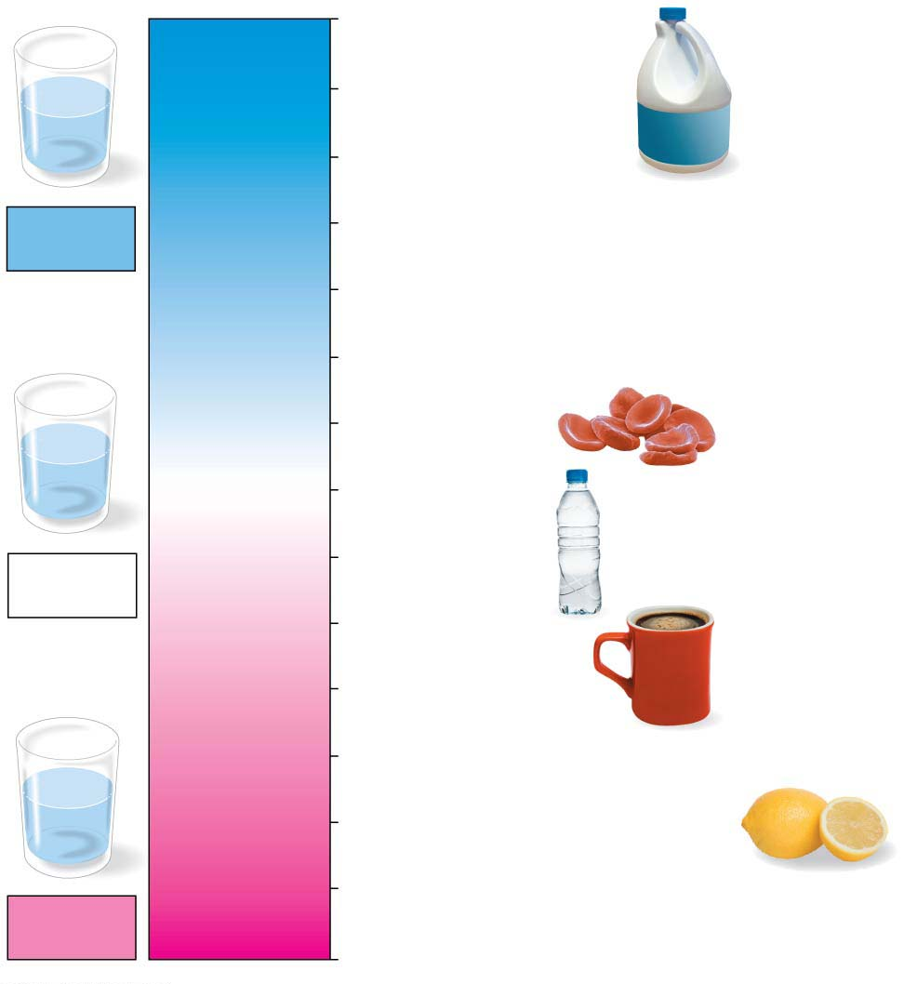
The PH scale
14
Oven cleaner
OH⁻
Lower H⁺ concentration
13
Household bleach
OH⁻
OH⁻
OH⁻
H⁺
OH⁻
OH⁻
H⁺
12
Household ammonia
Basic
solution
11
Milk of magnesia
10
9
Seawater
8
pH scale
OH⁻
H⁺
Human blood
OH⁻
OH⁻
H⁺
[H⁺] = [OH⁻]
7
Pure water
H⁺
OH⁻
H⁺
Neutral
solution
6
Urine
Greater H⁺ concentration
5
Black coffee
4
Tomato juice
3
Grapefruit juice, soft drink
H⁺
H⁺
2
Lemon juice, stomach acid
OH⁻
H⁺
H⁺
H⁺
H⁺
OH⁻
1
Battery acid
Acidic
solution
0
Notes:
Figure 2.15 The pH scale

Slide 68
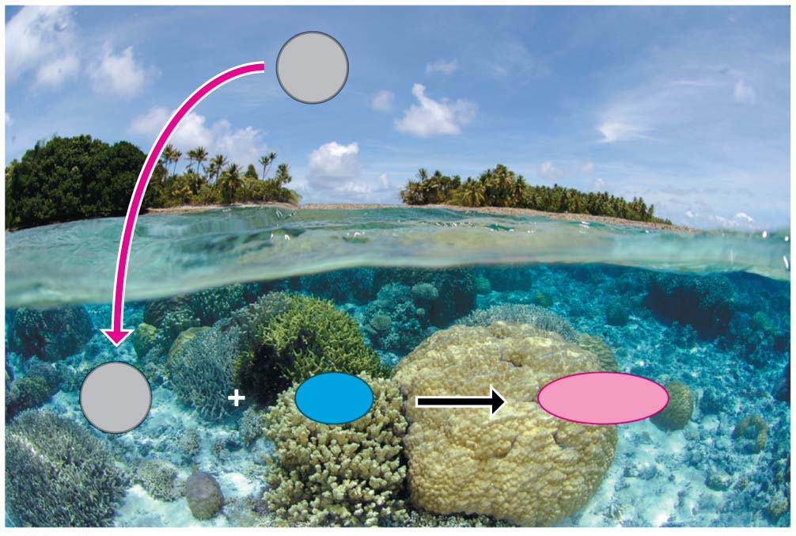
Acids, Bases, and pH
Buffers are substances that minimize changes in pH.
Buffers
accept H⁺ when they are in excess
donate H⁺ when they are depleted.
When CO₂ dissolves in seawater, it reacts with water to form an acid, which
lowers ocean pH and
can greatly change marine
environments.
CO₂
Carbon dioxide
CO₂
H₂O
H₂CO₂
Carbon
dioxide
Water
Carbonic acid
هذه الشرائح مخصصة للشرح و ليست للمذاكرة
Notes:
68
Student Misconceptions and Concerns
1. Students are unlikely to have carefully considered the four special properties of water that are apparent in our lives. However, these properties are of great biological significance and are often familiar. The connections between these properties and personal experiences can invest great meaning into a discussion of water’s properties. See Active Lecture Tips 1 and 2 below.
2. Students at all levels struggle with the distinction between heat and temperature. Students might also expect that all ice is about the same temperature, 0°C. Redefining and correcting misunderstandings often takes more class time and energy than introducing previously unknown concepts.
Teaching Tips
1. Here is a way to have your students think about the “sticky” nature of water in their lives. Ask them to consider the need for a towel after a shower or a bath. Once we get out of the shower or bath, we have left the source of water. So why do we need the towel? The reason we need a towel to dry off is that water is still clinging to our bodies because water molecules are polar. The molecules on cell surfaces are also polar, so our skin and the water both “stick” to each other.
2. Some students may be intrigued if you tell them that you too can stand on the surface of water—when it is frozen. Thus, it is necessary to note a liquid water surface when talking about surface tension.
3. Have students compare the seasonal ranges of temperatures of Anchorage and Fairbanks, Alaska. (Many websites provide weather information about various cities.) These two northern cities have large differences in their annual temperature ranges. Make the point that the coastal location of Anchorage moderates the temperature.
4. Several versions of the following analogy are easy to relate to students. (a) Ask students how the average on an exam would be affected if the brightest students did not take the test. (b) The authors note that the performance of a track team would drop if the fastest runners did not compete. In both analogies, removing the top performers lowers the average just as the evaporation of the most active water molecules cools the evaporative surface.
5. “It is not the heat, it is the humidity.” The efficiency of evaporative cooling is affected by humidity. As humidity rises, the rate of evaporation decreases, making it more difficult to cool our heat-generating bodies on a warm and humid summer day.
6. Ask your students if the ocean levels would change if ice did not float or if all the floating ice in the oceans were to melt. They can try this experiment to find out. Place several large chunks of ice in a glass and fill the glass up completely with water to the top rim. Thus, the ice cubes should be sticking up above the top of the filled glass. Will the glass overflow when the ice melts? (No.) This phenomenon is important when we consider the potential consequences of global warming. If floating glaciers melt, ocean levels will not be affected. However, if the ice over land melts, we can expect increased ocean levels.
7. A simple demonstration of a solute dissolving in a solvent can focus students’ attention on the process when discussing solutions. Using colored water and white sugar or salt may make it easier to see and reference while you are discussing the process. Such simple visual aids add life to a lecture. (You might also add corn oil to the top of the solution to demonstrate the properties of hydrophobic substances, and challenge your class to explain why oil and water do not mix.)
8. Discussions of pH are enhanced by lab activities that permit students to test the pH of everyday items (foods and household solutions). If students do not have opportunities to conduct such tests in lab, consider testing a few items during your class (pH paper or a basic pH meter will, of course, be necessary).
9. The Environmental Protection Agency website www.epa.gov/acidrain/ includes good information about acid precipitation and teaching ideas.
10. The SETI (Search for Extraterrestrial Intelligence) Institute’s mission is “to explore, understand and explain the origin, nature, and prevalence of life in the universe” (www.seti.org). Your students might enjoy exploring this respected scientific organization.
Active Lecture Tips
1. Prepare a list of examples of the four properties of water. Then present each example and ask students to work in pairs at their seats to identify the property of water associated with each example. Students will engage in higher-level analysis as they apply the properties. Students are likely to want to know the answer in what may be a surprisingly engaging class exercise!
2. The Chapter 2 text notes the insulating effect of ice forming at the surface of a lake. This phenomenon would not occur if ice were denser than water. Ask students to turn to someone near them to think of other consequences of the expansion of water when it forms ice. After perhaps two minutes, have students share their examples. (These include the ability to widen cracks in rocks, roads, and sidewalks!)
3. See the Essay The Earthquake Richter Scale and the pH Scale on the Instructor Exchange. Visit the Instructor Exchange in the MasteringBiology instructor resource area for a description of this activity.

Slide 69
Organic Compounds

Slide 70
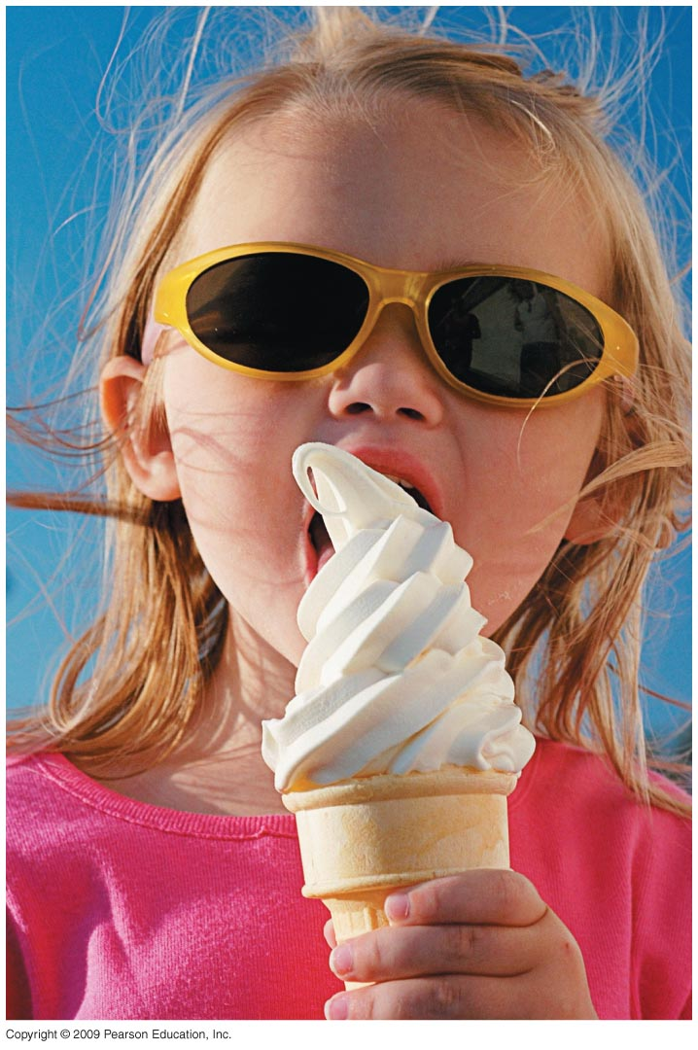
Biology and Society: Got Lactose?
Lactose is the main sugar found in milk.
Lactose intolerance is the inability to properly digest lactose.
Instead of lactose being broken down and absorbed in the small intestine, lactose is broken down by bacteria in the large intestine, producing gas and discomfort.
Lactose intolerance can be addressed by:
avoiding lactose-containing foods or
consuming lactase pills along with food.
هذه الشرائح مخصصة للشرح و ليست للمذاكرة
Notes:
70

Slide 71
Organic Compounds
A cell is mostly water.
The rest of the cell consists mainly of carbon-based molecules.
Carbon forms large, complex, and diverse molecules necessary for life’s functions.
Organic compounds are carbon-based molecules.
هذه الشرائح مخصصة للشرح و ليست للمذاكرة
Notes:
71
Student Misconceptions and Concerns
1. General biology students might not have previously taken a chemistry course. The concept of molecular building blocks that cannot be seen can be abstract and difficult to comprehend for such students. Concrete examples from our diets and good images will increase comprehension.
2. Students might need to be reminded about the levels of biological organization. The relationship between atoms, monomers, and polymers can be confusing. Consider noting these relationships somewhere in the classroom (such as on the board) where students can quickly glance for reassurance.
Teaching Tips
1. One of the great advantages of carbon is its ability to form up to four bonds, permitting the assembly of diverse components and branching configurations. Challenge your students to find another element that might also permit this sort of adaptability. (Like carbon, silicon has four electrons in its outer shell.)
2. Toothpicks and gumdrops (or any other pliable small candy) permit the quick construction of chemical models. Different candy colors can represent certain atoms. The model of the methane molecule in Figure 3.2 can thus easily be demonstrated (and consumed!).
3. A drill with interchangeable drill bits is a nice analogy to carbon skeletons with different functional groups. The analogy supports the role of different functions with different structures.
4. The author notes that a polymer is a like a pearl necklace made of many pearl “monomers.”
5. Train cars linking together to form a train is another nice analogy to monomers linking to form polymers. Consider adding that as the train cars are joined, a puff of steam appears—thus, the reference to water production and a dehydration reaction when linking molecular monomers.
Active Lecture Tips
1. See the Activity Reviewing Macromolecules on the Instructor Exchange. Visit the Instructor Exchange in the MasteringBiology instructor resource area for a description of this activity.

Slide 72
Carbon Chemistry
Carbon is a versatile molecule.
Carbon can share electrons with other atoms in four covalent bonds.
Because carbon can use one or more of its bonds to attach to other carbon atoms, it is possible to construct an endless diversity of carbon skeletons varying in
size and
branching pattern.
هذه الشرائح مخصصة للشرح و ليست للمذاكرة
Notes:
72
Student Misconceptions and Concerns
1. General biology students might not have previously taken a chemistry course. The concept of molecular building blocks that cannot be seen can be abstract and difficult to comprehend for such students. Concrete examples from our diets and good images will increase comprehension.
2. Students might need to be reminded about the levels of biological organization. The relationship between atoms, monomers, and polymers can be confusing. Consider noting these relationships somewhere in the classroom (such as on the board) where students can quickly glance for reassurance.
Teaching Tips
1. One of the great advantages of carbon is its ability to form up to four bonds, permitting the assembly of diverse components and branching configurations. Challenge your students to find another element that might also permit this sort of adaptability. (Like carbon, silicon has four electrons in its outer shell.)
2. Toothpicks and gumdrops (or any other pliable small candy) permit the quick construction of chemical models. Different candy colors can represent certain atoms. The model of the methane molecule in Figure 3.2 can thus easily be demonstrated (and consumed!).
3. A drill with interchangeable drill bits is a nice analogy to carbon skeletons with different functional groups. The analogy supports the role of different functions with different structures.
4. The author notes that a polymer is a like a pearl necklace made of many pearl “monomers.”
5. Train cars linking together to form a train is another nice analogy to monomers linking to form polymers. Consider adding that as the train cars are joined, a puff of steam appears—thus, the reference to water production and a dehydration reaction when linking molecular monomers.
Active Lecture Tips
1. See the Activity Reviewing Macromolecules on the Instructor Exchange. Visit the Instructor Exchange in the MasteringBiology instructor resource area for a description of this activity.

Slide 73
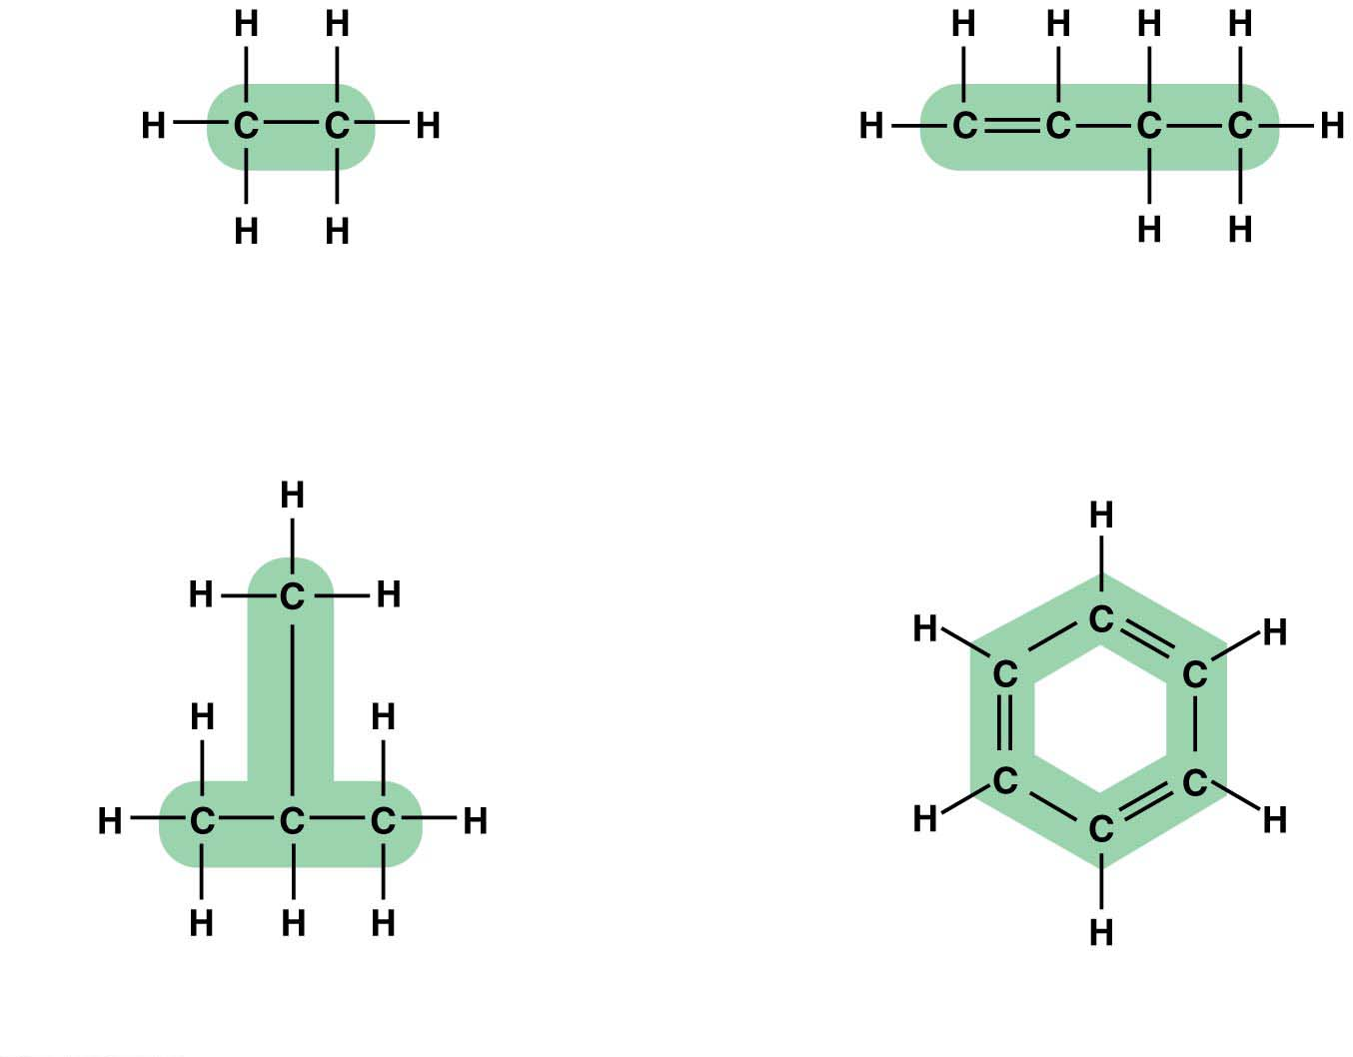
Variation in carbon skeleton
Double bond
Carbon skeletons vary in length
Carbon skeletons may
have double bonds,
which can vary in location
Carbon skeletons may be
unbranched or branched
Carbon skeletons may
be arranged in rings
Notes:
Figure 3.1 Variations in carbon skeletons

Slide 74
Carbon Chemistry
The carbon atoms of organic compounds can also bond with other elements, most commonly
hydrogen,
oxygen, and
nitrogen.
One of the simplest organic compounds is methane, CH₄, with a single carbon atom bonded to four hydrogen atoms.
Methane is abundant in natural gas and is produced
by prokaryotes that live in swamps (i.e., swamp gas) and
in the digestive tracts of grazing animals, such as cows.
هذه الشرائح مخصصة للشرح و ليست للمذاكرة
Notes:
74
Student Misconceptions and Concerns
1. General biology students might not have previously taken a chemistry course. The concept of molecular building blocks that cannot be seen can be abstract and difficult to comprehend for such students. Concrete examples from our diets and good images will increase comprehension.
2. Students might need to be reminded about the levels of biological organization. The relationship between atoms, monomers, and polymers can be confusing. Consider noting these relationships somewhere in the classroom (such as on the board) where students can quickly glance for reassurance.
Teaching Tips
1. One of the great advantages of carbon is its ability to form up to four bonds, permitting the assembly of diverse components and branching configurations. Challenge your students to find another element that might also permit this sort of adaptability. (Like carbon, silicon has four electrons in its outer shell.)
2. Toothpicks and gumdrops (or any other pliable small candy) permit the quick construction of chemical models. Different candy colors can represent certain atoms. The model of the methane molecule in Figure 3.2 can thus easily be demonstrated (and consumed!).
3. A drill with interchangeable drill bits is a nice analogy to carbon skeletons with different functional groups. The analogy supports the role of different functions with different structures.
4. The author notes that a polymer is a like a pearl necklace made of many pearl “monomers.”
5. Train cars linking together to form a train is another nice analogy to monomers linking to form polymers. Consider adding that as the train cars are joined, a puff of steam appears—thus, the reference to water production and a dehydration reaction when linking molecular monomers.
Active Lecture Tips
1. See the Activity Reviewing Macromolecules on the Instructor Exchange. Visit the Instructor Exchange in the MasteringBiology instructor resource area for a description of this activity.

Slide 75
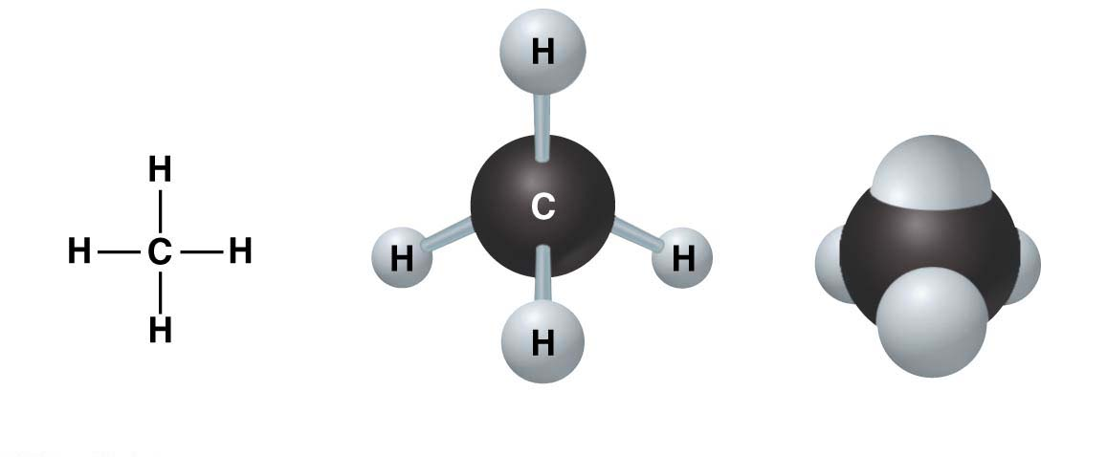
methane, a simple organic compound
Structural formula
Ball-and-stick model
Space-filling model
Notes:
Figure 3.2 Methane, a simple organic compound

Slide 76
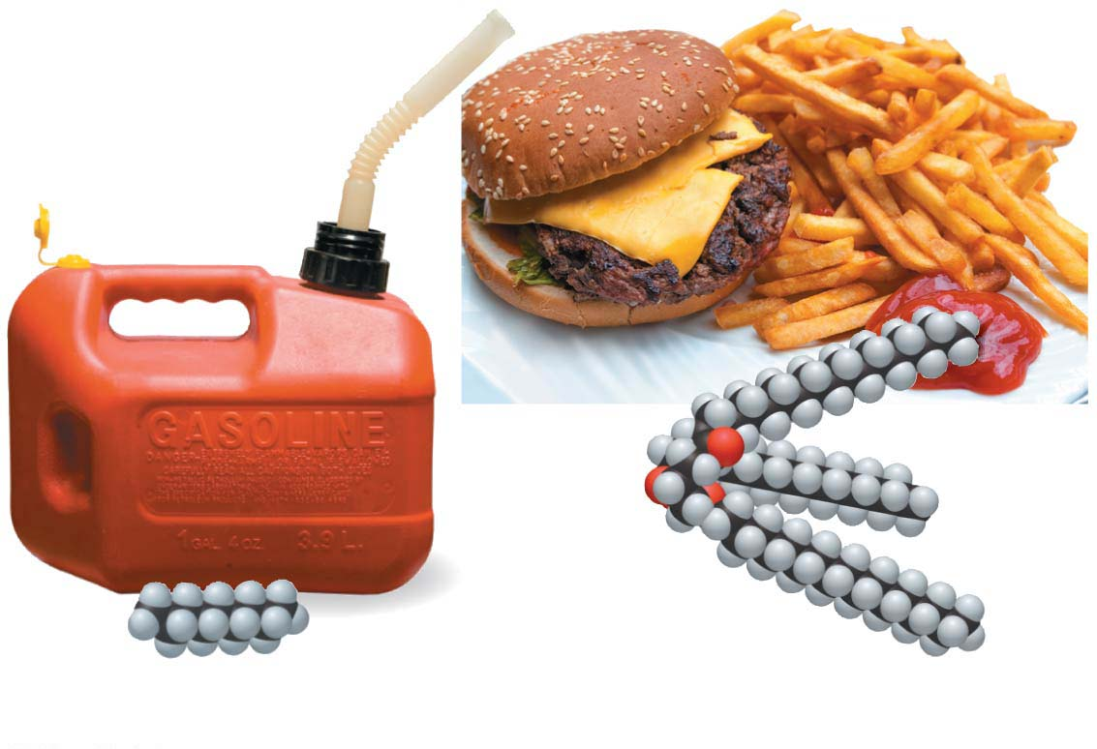
Carbon Chemistry
Larger organic compounds
are the main molecules in the gasoline we burn in cars and other machines and
are important fuels in your body.
The energy-rich parts of fat molecules have a structure similar to gasoline.
Dietary fat
Octane
هذه الشرائح مخصصة للشرح و ليست للمذاكرة
Notes:
76
Student Misconceptions and Concerns
1. General biology students might not have previously taken a chemistry course. The concept of molecular building blocks that cannot be seen can be abstract and difficult to comprehend for such students. Concrete examples from our diets and good images will increase comprehension.
2. Students might need to be reminded about the levels of biological organization. The relationship between atoms, monomers, and polymers can be confusing. Consider noting these relationships somewhere in the classroom (such as on the board) where students can quickly glance for reassurance.
Teaching Tips
1. One of the great advantages of carbon is its ability to form up to four bonds, permitting the assembly of diverse components and branching configurations. Challenge your students to find another element that might also permit this sort of adaptability. (Like carbon, silicon has four electrons in its outer shell.)
2. Toothpicks and gumdrops (or any other pliable small candy) permit the quick construction of chemical models. Different candy colors can represent certain atoms. The model of the methane molecule in Figure 3.2 can thus easily be demonstrated (and consumed!).
3. A drill with interchangeable drill bits is a nice analogy to carbon skeletons with different functional groups. The analogy supports the role of different functions with different structures.
4. The author notes that a polymer is a like a pearl necklace made of many pearl “monomers.”
5. Train cars linking together to form a train is another nice analogy to monomers linking to form polymers. Consider adding that as the train cars are joined, a puff of steam appears—thus, the reference to water production and a dehydration reaction when linking molecular monomers.
Active Lecture Tips
1. See the Activity Reviewing Macromolecules on the Instructor Exchange. Visit the Instructor Exchange in the MasteringBiology instructor resource area for a description of this activity.

Slide 77
Carbon Chemistry
The unique properties of an organic compound depend on
its carbon skeleton and
the atoms attached to the skeleton.
In an organic compound, Functional groups are the groups of atoms directly involved in chemical reactions.
Each functional group plays a particular role during chemical reactions.
Example: hydroxyl group (-OH) and carboxyl group (-COOH)
Many biological molecules have two or more functional groups.
هذه الشرائح مخصصة للشرح و ليست للمذاكرة
Notes:
77
Student Misconceptions and Concerns
1. General biology students might not have previously taken a chemistry course. The concept of molecular building blocks that cannot be seen can be abstract and difficult to comprehend for such students. Concrete examples from our diets and good images will increase comprehension.
2. Students might need to be reminded about the levels of biological organization. The relationship between atoms, monomers, and polymers can be confusing. Consider noting these relationships somewhere in the classroom (such as on the board) where students can quickly glance for reassurance.
Teaching Tips
1. One of the great advantages of carbon is its ability to form up to four bonds, permitting the assembly of diverse components and branching configurations. Challenge your students to find another element that might also permit this sort of adaptability. (Like carbon, silicon has four electrons in its outer shell.)
2. Toothpicks and gumdrops (or any other pliable small candy) permit the quick construction of chemical models. Different candy colors can represent certain atoms. The model of the methane molecule in Figure 3.2 can thus easily be demonstrated (and consumed!).
3. A drill with interchangeable drill bits is a nice analogy to carbon skeletons with different functional groups. The analogy supports the role of different functions with different structures.
4. The author notes that a polymer is a like a pearl necklace made of many pearl “monomers.”
5. Train cars linking together to form a train is another nice analogy to monomers linking to form polymers. Consider adding that as the train cars are joined, a puff of steam appears—thus, the reference to water production and a dehydration reaction when linking molecular monomers.
Active Lecture Tips
1. See the Activity Reviewing Macromolecules on the Instructor Exchange. Visit the Instructor Exchange in the MasteringBiology instructor resource area for a description of this activity.

Slide 78
Giant Molecules from Smaller Building Blocks
On a molecular scale, many of life’s molecules are giant, earning the name macromolecules.
The four categories of macromolecules are:
Carbohydrate
Protein
Nucleic acid
Lipid
Macromolecules are polymers.
Polymers are made by stringing together many smaller molecules called monomers.
هذه الشرائح مخصصة للشرح و ليست للمذاكرة
Notes:
78
Student Misconceptions and Concerns
1. General biology students might not have previously taken a chemistry course. The concept of molecular building blocks that cannot be seen can be abstract and difficult to comprehend for such students. Concrete examples from our diets and good images will increase comprehension.
2. Students might need to be reminded about the levels of biological organization. The relationship between atoms, monomers, and polymers can be confusing. Consider noting these relationships somewhere in the classroom (such as on the board) where students can quickly glance for reassurance.
Teaching Tips
1. One of the great advantages of carbon is its ability to form up to four bonds, permitting the assembly of diverse components and branching configurations. Challenge your students to find another element that might also permit this sort of adaptability. (Like carbon, silicon has four electrons in its outer shell.)
2. Toothpicks and gumdrops (or any other pliable small candy) permit the quick construction of chemical models. Different candy colors can represent certain atoms. The model of the methane molecule in Figure 3.2 can thus easily be demonstrated (and consumed!).
3. A drill with interchangeable drill bits is a nice analogy to carbon skeletons with different functional groups. The analogy supports the role of different functions with different structures.
4. The author notes that a polymer is a like a pearl necklace made of many pearl “monomers.”
5. Train cars linking together to form a train is another nice analogy to monomers linking to form polymers. Consider adding that as the train cars are joined, a puff of steam appears—thus, the reference to water production and a dehydration reaction when linking molecular monomers.
Active Lecture Tips
1. See the Activity Reviewing Macromolecules on the Instructor Exchange. Visit the Instructor Exchange in the MasteringBiology instructor resource area for a description of this activity.

Slide 79
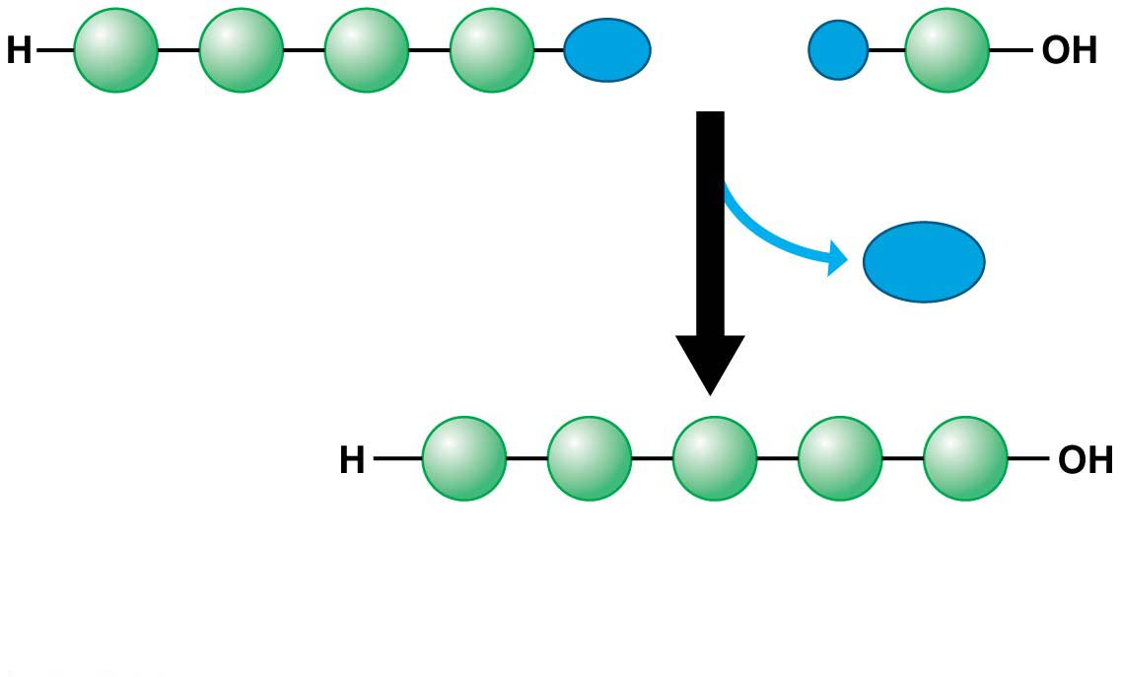
Giant Molecules from Smaller Building Blocks
A dehydration reaction
links two monomers together and
removes a molecule of water.
OH
H
Short polymer
Monomer
Dehydration
reaction
H₂O
Longer polymer
(a) Building a polymer chain
هذه الشرائح مخصصة للشرح و ليست للمذاكرة
Notes:
Figure 3.4-1 Synthesis and breakdown of polymers (part 1: synthesis)

Slide 80
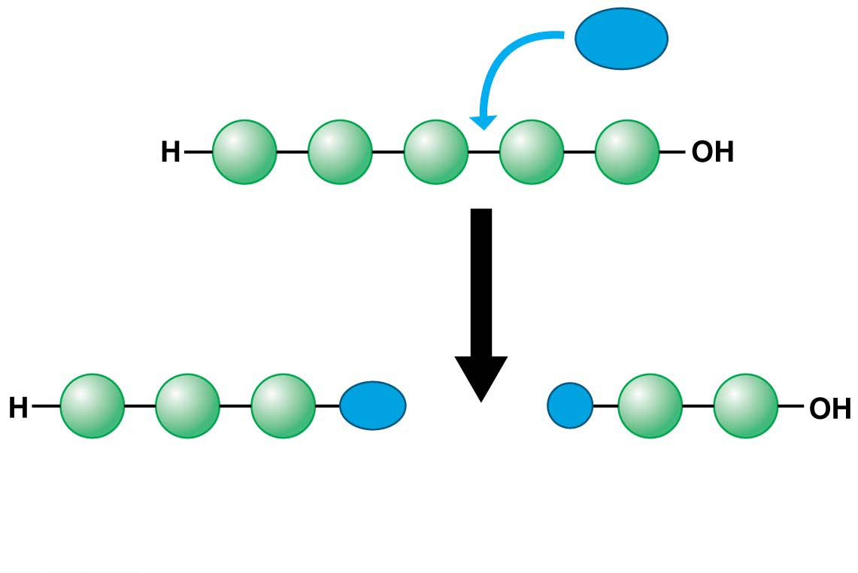
Giant Molecules from Smaller Building Blocks
Organisms also have to break down macromolecules to make monomers available to cells as in digestion. .
Hydrolysis
breaks bonds between monomers, adds a molecule of water, and reverses the dehydration reaction.
H₂O
Hydrolysis
OH
H
(b) Breaking a polymer chain
هذه الشرائح مخصصة للشرح و ليست للمذاكرة
Notes:
80
Student Misconceptions and Concerns
1. General biology students might not have previously taken a chemistry course. The concept of molecular building blocks that cannot be seen can be abstract and difficult to comprehend for such students. Concrete examples from our diets and good images will increase comprehension.
2. Students might need to be reminded about the levels of biological organization. The relationship between atoms, monomers, and polymers can be confusing. Consider noting these relationships somewhere in the classroom (such as on the board) where students can quickly glance for reassurance.
Teaching Tips
1. One of the great advantages of carbon is its ability to form up to four bonds, permitting the assembly of diverse components and branching configurations. Challenge your students to find another element that might also permit this sort of adaptability. (Like carbon, silicon has four electrons in its outer shell.)
2. Toothpicks and gumdrops (or any other pliable small candy) permit the quick construction of chemical models. Different candy colors can represent certain atoms. The model of the methane molecule in Figure 3.2 can thus easily be demonstrated (and consumed!).
3. A drill with interchangeable drill bits is a nice analogy to carbon skeletons with different functional groups. The analogy supports the role of different functions with different structures.
4. The author notes that a polymer is a like a pearl necklace made of many pearl “monomers.”
5. Train cars linking together to form a train is another nice analogy to monomers linking to form polymers. Consider adding that as the train cars are joined, a puff of steam appears—thus, the reference to water production and a dehydration reaction when linking molecular monomers.
Active Lecture Tips
1. See the Activity Reviewing Macromolecules on the Instructor Exchange. Visit the Instructor Exchange in the MasteringBiology instructor resource area for a description of this activity.

Slide 81
Large Biological Molecules
Carbohydrates
Proteins
Lipids
The Four Categories of large biological molecules
Found in all living creatures
Nucleic acids
هذه الشرائح مخصصة للشرح و ليست للمذاكرة
Notes:
81
Student Misconceptions and Concerns
1. The abstract nature of chemistry can be discouraging to many students. Consider starting out this section of the lecture by examining the chemical groups on a food nutrition label. Candy bars with peanuts are particularly useful as they contain significant amounts of all three sources of calories (carbohydrates, proteins, and lipids).
2. Students might struggle to extrapolate the properties of lipids to their roles in an organism. Ducks float because their feathers repel water instead of attracting it. Hair on your head remains flexible because of oils produced in your scalp. Examples such as these help connect the abstract properties of lipids to concrete examples in our world.
3. The functional significance of protein shape is an abstract molecular example of form and function relationships, which might be new to some students. The binding of an enzyme to its substrate is a type of molecular handshake, which permits specific interactions. To help students think about form and function relationships, share some concrete analogies in their lives—perhaps flathead and Phillips screwdrivers that match the proper type of screws or the fit of a hand into a glove.
4. The evolution of lactose tolerance within human groups in East Africa does not represent a deliberate decision, yet this evolutionary change appears logical. Many students perceive adaptations as deliberate events with purpose. As students develop a better understanding of the mechanisms of evolution, it will be important to point out that mutations arise by chance, with the culling hand of natural selection favoring traits that convey an advantage. Organisms cannot plan evolutionary change.
Teaching Tips
1. Consider reinforcing the three main sources of calories with food items that clearly represent each group. Bring clear examples to class as visual references, for example, a can of Coke or a bag of sugar for carbohydrates, a tub of margarine for lipids, and some beef jerky for protein (although some fat and carbohydrates might also be included).
2. If your lectures will eventually include details of glycolysis and aerobic respiration, this is a good point to introduce the basic concepts of glucose as fuel. Just introducing this conceptual formula might help: eating glucose + breathing in oxygen (yields) water + usable energy (used to build ATP) + heat + exhaled CO₂.
3. The section about our use of sugars may be of considerable interest to your students, who might not be expecting much interest in a lecture about organic chemistry. Consider an assignment for each student to bring to class a product label indicating high-fructose corn syrup (HFCS) as an ingredient.
4. Learning the definitions of word roots is invaluable when learning science. Learning the meaning of the prefix word roots “mono” (one), “di” (two), and “poly” (many) helps to distinguish the structures of various carbohydrates.
5. Consider an assignment for students to find reliable sources that discuss high sugar consumption in the modern diet. The key, of course, is in the quality of the resource. Consider narrowing down the categories to certain nonprofit health organizations (American Cancer Society, American Heart Association, and the like) and peer-reviewed journals.
6. A simple exercise demonstrates the enzymatic breakdown of starches into sugars. If students place an unsalted cracker in their mouths, holding it in their mouths while it mixes well with saliva, they might soon notice that a sweeter taste begins to emerge. The salivary enzyme amylase begins the digestion of starches into disaccharides, which may be degraded further by other enzymes. These disaccharides are the source of the sweet taste.
7. An adult human may store about a half of a kilogram of glycogen in the liver and muscles of the body, depending on recent dietary habits. A person who begins dieting might soon notice an immediate weight loss of 2–4 pounds (1–2 kilograms) over several days, reflecting reductions in stored glycogen, water, and intestinal contents (among other factors).
8. Another simple demonstration can illustrate hydrophobic and hydrophilic substances. In front of the class, mix colored water and a yellow oil (corn or canola oil work well). Shake up the mixture and then watch as the two separate. (You may have a mixture already made that remains separated; however, the dyes may bleed between the oil and the water.)
9. Margarine in stores commonly comes in liquid squeeze containers, in tubs, and in sticks. These forms reflect increasing amounts of hydrogenation, gradually increasing the stiffness from a liquid, to a firmer spread, to a firm stick of margarine. As noted in the text, recent studies have suggested that unsaturated oils become increasingly unhealthy as they are hydrogenated. Perhaps your students can find references to this correlation on the Internet.
10. Many analogies can help students understand the diversity of proteins that can be made from just 20 amino acids. The authors note that our language uses combinations of 26 letters to form words. Proteins are much longer “words,” creating even more diversity. Another analogy is to trains. This builds on the earlier analogy when polymers were introduced. Imagine making different trains about 100 cars long, using any combination of 20 types of railroad cars. Mathematically, the number of possible trains is 20¹⁰⁰, a number beyond imagination.
11. The authors note that the difference between a polypeptide and a protein is analogous to the relationship between a long strand of yarn and a sweater knitted from yarn. Proteins are clearly more complex!
12. Most cooking results in changes in the texture and color of a food. The brown color of a steak is the product of the denaturation of proteins. Fixatives such as formalin also denature proteins and cause color changes. Students who have dissected vertebrates will realize that the brown color of the muscles makes it look as if the animal has been cooked.
13. The “NA” in DNA and RNA stands for “nucleic acid.” Students often do not make this association without assistance.
Active Lecture Tips
1. The cellophane wrap often used to package foods is a biodegradable material derived from cellulose. Challenge students to work in pairs to create a list of other cellulose-derived products (such as paper).
2. Consider this assignment to finish a discussion of the diverse organic molecules in our diets. Have students work in pairs or small groups to analyze a food label listing the components of a McDonald’s Big Mac. Note the most abundant organic molecule class (perhaps by weight) found in each component.
3. See the Activity What Ingredients Make Up Your Snack Food on the Instructor Exchange. Visit the Instructor Exchange in the MasteringBiology instructor resource area for a description of this activity.
4. See the Activity Drawing Hydrophobic and Hydrophilic Interactions on the Instructor Exchange. Visit the Instructor Exchange in the MasteringBiology instructor resource area for a description of this activity.

Slide 82
CARBOHYDRATE

Slide 83
Carbohydrates
Carbohydrates include sugars and polymers of sugar. Examples are
small sugar molecules in soft drinks and
long starch molecules in spaghetti and bread.
In animals, carbohydrates are
a primary source of dietary energy and
raw material for manufacturing other kinds of organic compounds.
In plants, carbohydrates serve as a building material for much of the plant body.
هذه الشرائح مخصصة للشرح و ليست للمذاكرة
Notes:
83
Student Misconceptions and Concerns
1. The abstract nature of chemistry can be discouraging to many students. Consider starting out this section of the lecture by examining the chemical groups on a food nutrition label. Candy bars with peanuts are particularly useful as they contain significant amounts of all three sources of calories (carbohydrates, proteins, and lipids).
2. Students might struggle to extrapolate the properties of lipids to their roles in an organism. Ducks float because their feathers repel water instead of attracting it. Hair on your head remains flexible because of oils produced in your scalp. Examples such as these help connect the abstract properties of lipids to concrete examples in our world.
3. The functional significance of protein shape is an abstract molecular example of form and function relationships, which might be new to some students. The binding of an enzyme to its substrate is a type of molecular handshake, which permits specific interactions. To help students think about form and function relationships, share some concrete analogies in their lives—perhaps flathead and Phillips screwdrivers that match the proper type of screws or the fit of a hand into a glove.
4. The evolution of lactose tolerance within human groups in East Africa does not represent a deliberate decision, yet this evolutionary change appears logical. Many students perceive adaptations as deliberate events with purpose. As students develop a better understanding of the mechanisms of evolution, it will be important to point out that mutations arise by chance, with the culling hand of natural selection favoring traits that convey an advantage. Organisms cannot plan evolutionary change.
Teaching Tips
1. Consider reinforcing the three main sources of calories with food items that clearly represent each group. Bring clear examples to class as visual references, for example, a can of Coke or a bag of sugar for carbohydrates, a tub of margarine for lipids, and some beef jerky for protein (although some fat and carbohydrates might also be included).
2. If your lectures will eventually include details of glycolysis and aerobic respiration, this is a good point to introduce the basic concepts of glucose as fuel. Just introducing this conceptual formula might help: eating glucose + breathing in oxygen (yields) water + usable energy (used to build ATP) + heat + exhaled CO₂.
3. The section about our use of sugars may be of considerable interest to your students, who might not be expecting much interest in a lecture about organic chemistry. Consider an assignment for each student to bring to class a product label indicating high-fructose corn syrup (HFCS) as an ingredient.
4. Learning the definitions of word roots is invaluable when learning science. Learning the meaning of the prefix word roots “mono” (one), “di” (two), and “poly” (many) helps to distinguish the structures of various carbohydrates.
5. Consider an assignment for students to find reliable sources that discuss high sugar consumption in the modern diet. The key, of course, is in the quality of the resource. Consider narrowing down the categories to certain nonprofit health organizations (American Cancer Society, American Heart Association, and the like) and peer-reviewed journals.
6. A simple exercise demonstrates the enzymatic breakdown of starches into sugars. If students place an unsalted cracker in their mouths, holding it in their mouths while it mixes well with saliva, they might soon notice that a sweeter taste begins to emerge. The salivary enzyme amylase begins the digestion of starches into disaccharides, which may be degraded further by other enzymes. These disaccharides are the source of the sweet taste.
7. An adult human may store about a half of a kilogram of glycogen in the liver and muscles of the body, depending on recent dietary habits. A person who begins dieting might soon notice an immediate weight loss of 2–4 pounds (1–2 kilograms) over several days, reflecting reductions in stored glycogen, water, and intestinal contents (among other factors).
8. Another simple demonstration can illustrate hydrophobic and hydrophilic substances. In front of the class, mix colored water and a yellow oil (corn or canola oil work well). Shake up the mixture and then watch as the two separate. (You may have a mixture already made that remains separated; however, the dyes may bleed between the oil and the water.)
9. Margarine in stores commonly comes in liquid squeeze containers, in tubs, and in sticks. These forms reflect increasing amounts of hydrogenation, gradually increasing the stiffness from a liquid, to a firmer spread, to a firm stick of margarine. As noted in the text, recent studies have suggested that unsaturated oils become increasingly unhealthy as they are hydrogenated. Perhaps your students can find references to this correlation on the Internet.
10. Many analogies can help students understand the diversity of proteins that can be made from just 20 amino acids. The authors note that our language uses combinations of 26 letters to form words. Proteins are much longer “words,” creating even more diversity. Another analogy is to trains. This builds on the earlier analogy when polymers were introduced. Imagine making different trains about 100 cars long, using any combination of 20 types of railroad cars. Mathematically, the number of possible trains is 20¹⁰⁰, a number beyond imagination.
11. The authors note that the difference between a polypeptide and a protein is analogous to the relationship between a long strand of yarn and a sweater knitted from yarn. Proteins are clearly more complex!
12. Most cooking results in changes in the texture and color of a food. The brown color of a steak is the product of the denaturation of proteins. Fixatives such as formalin also denature proteins and cause color changes. Students who have dissected vertebrates will realize that the brown color of the muscles makes it look as if the animal has been cooked.
13. The “NA” in DNA and RNA stands for “nucleic acid.” Students often do not make this association without assistance.
Active Lecture Tips
1. The cellophane wrap often used to package foods is a biodegradable material derived from cellulose. Challenge students to work in pairs to create a list of other cellulose-derived products (such as paper).
2. Consider this assignment to finish a discussion of the diverse organic molecules in our diets. Have students work in pairs or small groups to analyze a food label listing the components of a McDonald’s Big Mac. Note the most abundant organic molecule class (perhaps by weight) found in each component.
3. See the Activity What Ingredients Make Up Your Snack Food on the Instructor Exchange. Visit the Instructor Exchange in the MasteringBiology instructor resource area for a description of this activity.
4. See the Activity Drawing Hydrophobic and Hydrophilic Interactions on the Instructor Exchange. Visit the Instructor Exchange in the MasteringBiology instructor resource area for a description of this activity.

Slide 84
Monosaccharides
Monosaccharides
are the monomers of carbohydrates and
cannot be broken down into smaller sugars.
Common examples are glucose in sports drinks and fructose found in fruit.
Both of these simple sugars are also in honey.
Isomers: are molecules that have the same molecular formula but different structures.
Glucose and fructose are isomers.
هذه الشرائح مخصصة للشرح و ليست للمذاكرة
Notes:
84
Student Misconceptions and Concerns
1. The abstract nature of chemistry can be discouraging to many students. Consider starting out this section of the lecture by examining the chemical groups on a food nutrition label. Candy bars with peanuts are particularly useful as they contain significant amounts of all three sources of calories (carbohydrates, proteins, and lipids).
2. Students might struggle to extrapolate the properties of lipids to their roles in an organism. Ducks float because their feathers repel water instead of attracting it. Hair on your head remains flexible because of oils produced in your scalp. Examples such as these help connect the abstract properties of lipids to concrete examples in our world.
3. The functional significance of protein shape is an abstract molecular example of form and function relationships, which might be new to some students. The binding of an enzyme to its substrate is a type of molecular handshake, which permits specific interactions. To help students think about form and function relationships, share some concrete analogies in their lives—perhaps flathead and Phillips screwdrivers that match the proper type of screws or the fit of a hand into a glove.
4. The evolution of lactose tolerance within human groups in East Africa does not represent a deliberate decision, yet this evolutionary change appears logical. Many students perceive adaptations as deliberate events with purpose. As students develop a better understanding of the mechanisms of evolution, it will be important to point out that mutations arise by chance, with the culling hand of natural selection favoring traits that convey an advantage. Organisms cannot plan evolutionary change.
Teaching Tips
1. Consider reinforcing the three main sources of calories with food items that clearly represent each group. Bring clear examples to class as visual references, for example, a can of Coke or a bag of sugar for carbohydrates, a tub of margarine for lipids, and some beef jerky for protein (although some fat and carbohydrates might also be included).
2. If your lectures will eventually include details of glycolysis and aerobic respiration, this is a good point to introduce the basic concepts of glucose as fuel. Just introducing this conceptual formula might help: eating glucose + breathing in oxygen (yields) water + usable energy (used to build ATP) + heat + exhaled CO₂.
3. The section about our use of sugars may be of considerable interest to your students, who might not be expecting much interest in a lecture about organic chemistry. Consider an assignment for each student to bring to class a product label indicating high-fructose corn syrup (HFCS) as an ingredient.
4. Learning the definitions of word roots is invaluable when learning science. Learning the meaning of the prefix word roots “mono” (one), “di” (two), and “poly” (many) helps to distinguish the structures of various carbohydrates.
5. Consider an assignment for students to find reliable sources that discuss high sugar consumption in the modern diet. The key, of course, is in the quality of the resource. Consider narrowing down the categories to certain nonprofit health organizations (American Cancer Society, American Heart Association, and the like) and peer-reviewed journals.
6. A simple exercise demonstrates the enzymatic breakdown of starches into sugars. If students place an unsalted cracker in their mouths, holding it in their mouths while it mixes well with saliva, they might soon notice that a sweeter taste begins to emerge. The salivary enzyme amylase begins the digestion of starches into disaccharides, which may be degraded further by other enzymes. These disaccharides are the source of the sweet taste.
7. An adult human may store about a half of a kilogram of glycogen in the liver and muscles of the body, depending on recent dietary habits. A person who begins dieting might soon notice an immediate weight loss of 2–4 pounds (1–2 kilograms) over several days, reflecting reductions in stored glycogen, water, and intestinal contents (among other factors).
8. Another simple demonstration can illustrate hydrophobic and hydrophilic substances. In front of the class, mix colored water and a yellow oil (corn or canola oil work well). Shake up the mixture and then watch as the two separate. (You may have a mixture already made that remains separated; however, the dyes may bleed between the oil and the water.)
9. Margarine in stores commonly comes in liquid squeeze containers, in tubs, and in sticks. These forms reflect increasing amounts of hydrogenation, gradually increasing the stiffness from a liquid, to a firmer spread, to a firm stick of margarine. As noted in the text, recent studies have suggested that unsaturated oils become increasingly unhealthy as they are hydrogenated. Perhaps your students can find references to this correlation on the Internet.
10. Many analogies can help students understand the diversity of proteins that can be made from just 20 amino acids. The authors note that our language uses combinations of 26 letters to form words. Proteins are much longer “words,” creating even more diversity. Another analogy is to trains. This builds on the earlier analogy when polymers were introduced. Imagine making different trains about 100 cars long, using any combination of 20 types of railroad cars. Mathematically, the number of possible trains is 20¹⁰⁰, a number beyond imagination.
11. The authors note that the difference between a polypeptide and a protein is analogous to the relationship between a long strand of yarn and a sweater knitted from yarn. Proteins are clearly more complex!
12. Most cooking results in changes in the texture and color of a food. The brown color of a steak is the product of the denaturation of proteins. Fixatives such as formalin also denature proteins and cause color changes. Students who have dissected vertebrates will realize that the brown color of the muscles makes it look as if the animal has been cooked.
13. The “NA” in DNA and RNA stands for “nucleic acid.” Students often do not make this association without assistance.
Active Lecture Tips
1. The cellophane wrap often used to package foods is a biodegradable material derived from cellulose. Challenge students to work in pairs to create a list of other cellulose-derived products (such as paper).
2. Consider this assignment to finish a discussion of the diverse organic molecules in our diets. Have students work in pairs or small groups to analyze a food label listing the components of a McDonald’s Big Mac. Note the most abundant organic molecule class (perhaps by weight) found in each component.
3. See the Activity What Ingredients Make Up Your Snack Food on the Instructor Exchange. Visit the Instructor Exchange in the MasteringBiology instructor resource area for a description of this activity.
4. See the Activity Drawing Hydrophobic and Hydrophilic Interactions on the Instructor Exchange. Visit the Instructor Exchange in the MasteringBiology instructor resource area for a description of this activity.

Slide 85
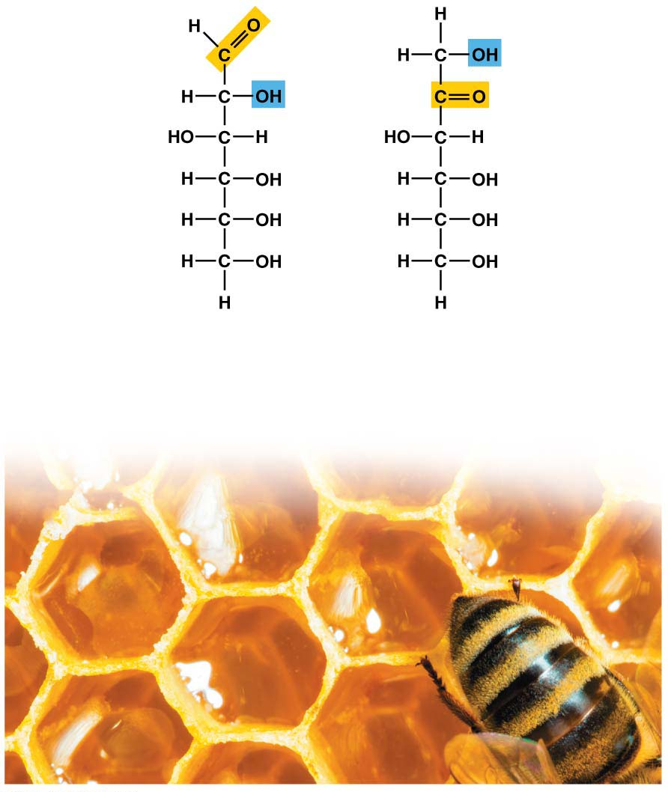
Glucose
Fructose
C₆H₁₂O₆
C₆H₁₂O₆
Isomers
(same formula, different arrangements)
Notes:
Figure 3.5 Monosaccharides (simple sugars)

Slide 86
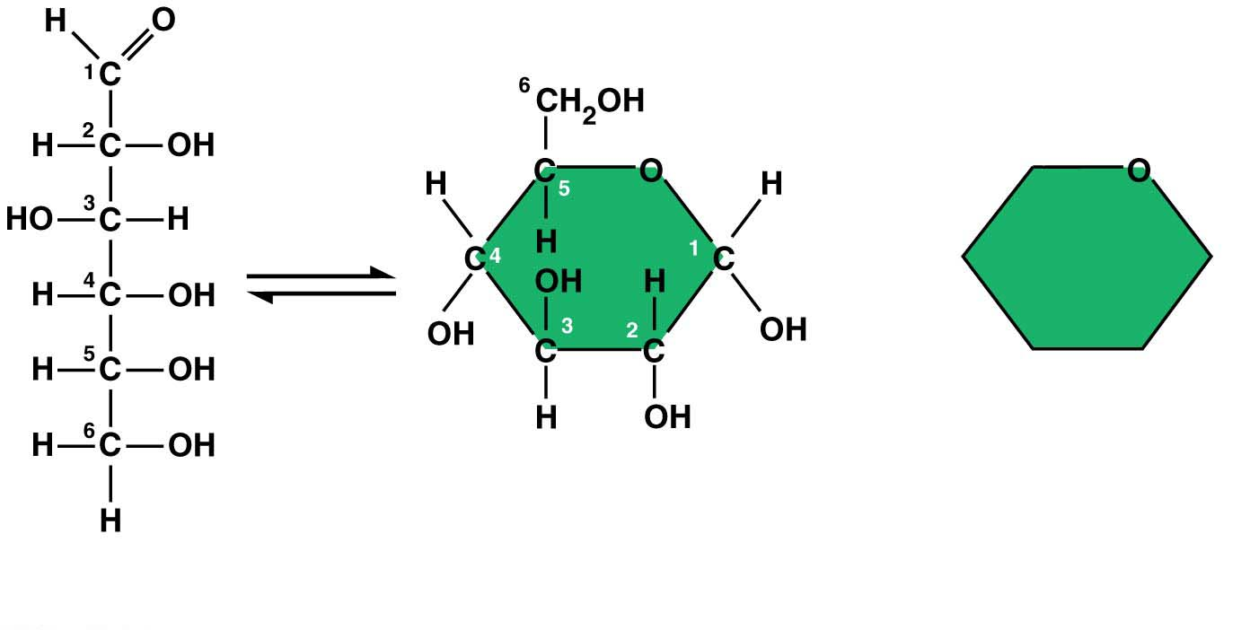
Monosaccharides
Monosaccharides, particularly glucose, are the main fuels for cellular work.
In water, many monosaccharides form rings.
(b) Abbreviated ring
structure
(a) Linear and ring structures
هذه الشرائح مخصصة للشرح و ليست للمذاكرة
Notes:
86
Student Misconceptions and Concerns
1. The abstract nature of chemistry can be discouraging to many students. Consider starting out this section of the lecture by examining the chemical groups on a food nutrition label. Candy bars with peanuts are particularly useful as they contain significant amounts of all three sources of calories (carbohydrates, proteins, and lipids).
2. Students might struggle to extrapolate the properties of lipids to their roles in an organism. Ducks float because their feathers repel water instead of attracting it. Hair on your head remains flexible because of oils produced in your scalp. Examples such as these help connect the abstract properties of lipids to concrete examples in our world.
3. The functional significance of protein shape is an abstract molecular example of form and function relationships, which might be new to some students. The binding of an enzyme to its substrate is a type of molecular handshake, which permits specific interactions. To help students think about form and function relationships, share some concrete analogies in their lives—perhaps flathead and Phillips screwdrivers that match the proper type of screws or the fit of a hand into a glove.
4. The evolution of lactose tolerance within human groups in East Africa does not represent a deliberate decision, yet this evolutionary change appears logical. Many students perceive adaptations as deliberate events with purpose. As students develop a better understanding of the mechanisms of evolution, it will be important to point out that mutations arise by chance, with the culling hand of natural selection favoring traits that convey an advantage. Organisms cannot plan evolutionary change.
Teaching Tips
1. Consider reinforcing the three main sources of calories with food items that clearly represent each group. Bring clear examples to class as visual references, for example, a can of Coke or a bag of sugar for carbohydrates, a tub of margarine for lipids, and some beef jerky for protein (although some fat and carbohydrates might also be included).
2. If your lectures will eventually include details of glycolysis and aerobic respiration, this is a good point to introduce the basic concepts of glucose as fuel. Just introducing this conceptual formula might help: eating glucose + breathing in oxygen (yields) water + usable energy (used to build ATP) + heat + exhaled CO₂.
3. The section about our use of sugars may be of considerable interest to your students, who might not be expecting much interest in a lecture about organic chemistry. Consider an assignment for each student to bring to class a product label indicating high-fructose corn syrup (HFCS) as an ingredient.
4. Learning the definitions of word roots is invaluable when learning science. Learning the meaning of the prefix word roots “mono” (one), “di” (two), and “poly” (many) helps to distinguish the structures of various carbohydrates.
5. Consider an assignment for students to find reliable sources that discuss high sugar consumption in the modern diet. The key, of course, is in the quality of the resource. Consider narrowing down the categories to certain nonprofit health organizations (American Cancer Society, American Heart Association, and the like) and peer-reviewed journals.
6. A simple exercise demonstrates the enzymatic breakdown of starches into sugars. If students place an unsalted cracker in their mouths, holding it in their mouths while it mixes well with saliva, they might soon notice that a sweeter taste begins to emerge. The salivary enzyme amylase begins the digestion of starches into disaccharides, which may be degraded further by other enzymes. These disaccharides are the source of the sweet taste.
7. An adult human may store about a half of a kilogram of glycogen in the liver and muscles of the body, depending on recent dietary habits. A person who begins dieting might soon notice an immediate weight loss of 2–4 pounds (1–2 kilograms) over several days, reflecting reductions in stored glycogen, water, and intestinal contents (among other factors).
8. Another simple demonstration can illustrate hydrophobic and hydrophilic substances. In front of the class, mix colored water and a yellow oil (corn or canola oil work well). Shake up the mixture and then watch as the two separate. (You may have a mixture already made that remains separated; however, the dyes may bleed between the oil and the water.)
9. Margarine in stores commonly comes in liquid squeeze containers, in tubs, and in sticks. These forms reflect increasing amounts of hydrogenation, gradually increasing the stiffness from a liquid, to a firmer spread, to a firm stick of margarine. As noted in the text, recent studies have suggested that unsaturated oils become increasingly unhealthy as they are hydrogenated. Perhaps your students can find references to this correlation on the Internet.
10. Many analogies can help students understand the diversity of proteins that can be made from just 20 amino acids. The authors note that our language uses combinations of 26 letters to form words. Proteins are much longer “words,” creating even more diversity. Another analogy is to trains. This builds on the earlier analogy when polymers were introduced. Imagine making different trains about 100 cars long, using any combination of 20 types of railroad cars. Mathematically, the number of possible trains is 20¹⁰⁰, a number beyond imagination.
11. The authors note that the difference between a polypeptide and a protein is analogous to the relationship between a long strand of yarn and a sweater knitted from yarn. Proteins are clearly more complex!
12. Most cooking results in changes in the texture and color of a food. The brown color of a steak is the product of the denaturation of proteins. Fixatives such as formalin also denature proteins and cause color changes. Students who have dissected vertebrates will realize that the brown color of the muscles makes it look as if the animal has been cooked.
13. The “NA” in DNA and RNA stands for “nucleic acid.” Students often do not make this association without assistance.
Active Lecture Tips
1. The cellophane wrap often used to package foods is a biodegradable material derived from cellulose. Challenge students to work in pairs to create a list of other cellulose-derived products (such as paper).
2. Consider this assignment to finish a discussion of the diverse organic molecules in our diets. Have students work in pairs or small groups to analyze a food label listing the components of a McDonald’s Big Mac. Note the most abundant organic molecule class (perhaps by weight) found in each component.
3. See the Activity What Ingredients Make Up Your Snack Food on the Instructor Exchange. Visit the Instructor Exchange in the MasteringBiology instructor resource area for a description of this activity.
4. See the Activity Drawing Hydrophobic and Hydrophilic Interactions on the Instructor Exchange. Visit the Instructor Exchange in the MasteringBiology instructor resource area for a description of this activity.

Slide 87
Disaccharides
A disaccharide is a double sugar constructed from two monosaccharides by a dehydration reaction.
Disaccharides include
lactose in milk, made from the monosaccharides glucose and galactose,
maltose in beer, malted milk shakes, consists of two glucose monomers joined together.
sucrose in table sugar (glucose + fructose).
Sucrose is the main carbohydrate in plant sap.
هذه الشرائح مخصصة للشرح و ليست للمذاكرة
Notes:
87
Student Misconceptions and Concerns
1. The abstract nature of chemistry can be discouraging to many students. Consider starting out this section of the lecture by examining the chemical groups on a food nutrition label. Candy bars with peanuts are particularly useful as they contain significant amounts of all three sources of calories (carbohydrates, proteins, and lipids).
2. Students might struggle to extrapolate the properties of lipids to their roles in an organism. Ducks float because their feathers repel water instead of attracting it. Hair on your head remains flexible because of oils produced in your scalp. Examples such as these help connect the abstract properties of lipids to concrete examples in our world.
3. The functional significance of protein shape is an abstract molecular example of form and function relationships, which might be new to some students. The binding of an enzyme to its substrate is a type of molecular handshake, which permits specific interactions. To help students think about form and function relationships, share some concrete analogies in their lives—perhaps flathead and Phillips screwdrivers that match the proper type of screws or the fit of a hand into a glove.
4. The evolution of lactose tolerance within human groups in East Africa does not represent a deliberate decision, yet this evolutionary change appears logical. Many students perceive adaptations as deliberate events with purpose. As students develop a better understanding of the mechanisms of evolution, it will be important to point out that mutations arise by chance, with the culling hand of natural selection favoring traits that convey an advantage. Organisms cannot plan evolutionary change.
Teaching Tips
1. Consider reinforcing the three main sources of calories with food items that clearly represent each group. Bring clear examples to class as visual references, for example, a can of Coke or a bag of sugar for carbohydrates, a tub of margarine for lipids, and some beef jerky for protein (although some fat and carbohydrates might also be included).
2. If your lectures will eventually include details of glycolysis and aerobic respiration, this is a good point to introduce the basic concepts of glucose as fuel. Just introducing this conceptual formula might help: eating glucose + breathing in oxygen (yields) water + usable energy (used to build ATP) + heat + exhaled CO₂.
3. The section about our use of sugars may be of considerable interest to your students, who might not be expecting much interest in a lecture about organic chemistry. Consider an assignment for each student to bring to class a product label indicating high-fructose corn syrup (HFCS) as an ingredient.
4. Learning the definitions of word roots is invaluable when learning science. Learning the meaning of the prefix word roots “mono” (one), “di” (two), and “poly” (many) helps to distinguish the structures of various carbohydrates.
5. Consider an assignment for students to find reliable sources that discuss high sugar consumption in the modern diet. The key, of course, is in the quality of the resource. Consider narrowing down the categories to certain nonprofit health organizations (American Cancer Society, American Heart Association, and the like) and peer-reviewed journals.
6. A simple exercise demonstrates the enzymatic breakdown of starches into sugars. If students place an unsalted cracker in their mouths, holding it in their mouths while it mixes well with saliva, they might soon notice that a sweeter taste begins to emerge. The salivary enzyme amylase begins the digestion of starches into disaccharides, which may be degraded further by other enzymes. These disaccharides are the source of the sweet taste.
7. An adult human may store about a half of a kilogram of glycogen in the liver and muscles of the body, depending on recent dietary habits. A person who begins dieting might soon notice an immediate weight loss of 2–4 pounds (1–2 kilograms) over several days, reflecting reductions in stored glycogen, water, and intestinal contents (among other factors).
8. Another simple demonstration can illustrate hydrophobic and hydrophilic substances. In front of the class, mix colored water and a yellow oil (corn or canola oil work well). Shake up the mixture and then watch as the two separate. (You may have a mixture already made that remains separated; however, the dyes may bleed between the oil and the water.)
9. Margarine in stores commonly comes in liquid squeeze containers, in tubs, and in sticks. These forms reflect increasing amounts of hydrogenation, gradually increasing the stiffness from a liquid, to a firmer spread, to a firm stick of margarine. As noted in the text, recent studies have suggested that unsaturated oils become increasingly unhealthy as they are hydrogenated. Perhaps your students can find references to this correlation on the Internet.
10. Many analogies can help students understand the diversity of proteins that can be made from just 20 amino acids. The authors note that our language uses combinations of 26 letters to form words. Proteins are much longer “words,” creating even more diversity. Another analogy is to trains. This builds on the earlier analogy when polymers were introduced. Imagine making different trains about 100 cars long, using any combination of 20 types of railroad cars. Mathematically, the number of possible trains is 20¹⁰⁰, a number beyond imagination.
11. The authors note that the difference between a polypeptide and a protein is analogous to the relationship between a long strand of yarn and a sweater knitted from yarn. Proteins are clearly more complex!
12. Most cooking results in changes in the texture and color of a food. The brown color of a steak is the product of the denaturation of proteins. Fixatives such as formalin also denature proteins and cause color changes. Students who have dissected vertebrates will realize that the brown color of the muscles makes it look as if the animal has been cooked.
13. The “NA” in DNA and RNA stands for “nucleic acid.” Students often do not make this association without assistance.
Active Lecture Tips
1. The cellophane wrap often used to package foods is a biodegradable material derived from cellulose. Challenge students to work in pairs to create a list of other cellulose-derived products (such as paper).
2. Consider this assignment to finish a discussion of the diverse organic molecules in our diets. Have students work in pairs or small groups to analyze a food label listing the components of a McDonald’s Big Mac. Note the most abundant organic molecule class (perhaps by weight) found in each component.
3. See the Activity What Ingredients Make Up Your Snack Food on the Instructor Exchange. Visit the Instructor Exchange in the MasteringBiology instructor resource area for a description of this activity.
4. See the Activity Drawing Hydrophobic and Hydrophilic Interactions on the Instructor Exchange. Visit the Instructor Exchange in the MasteringBiology instructor resource area for a description of this activity.

Slide 88
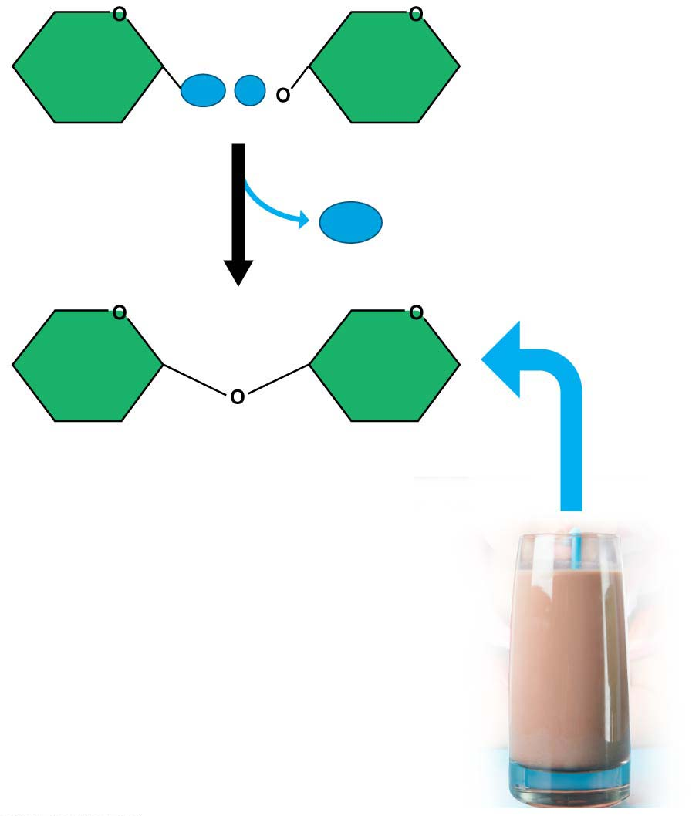
OH
H
Glucose
Galactose
H₂O
Lactose
Disaccharide (double sugar) formation
Notes:
Figure 3.7 Disaccharide (double sugar) formation

Slide 89
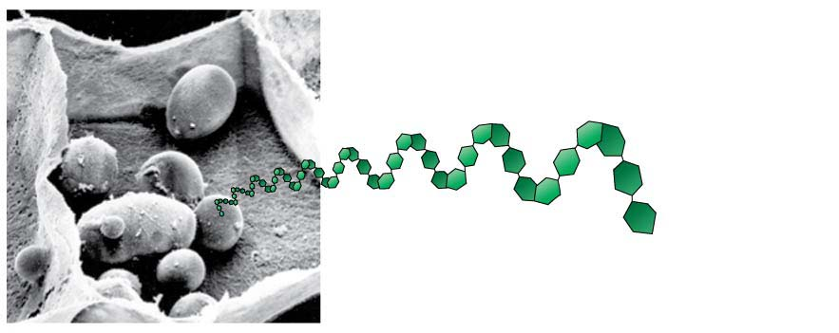
Polysaccharides
Polysaccharides
are complex carbohydrates and
are made of long chains of sugars-polymers of monosaccharides.
Starch
is a familiar example of a polysaccharide,
consists of long strings of glucose monomers, and
is used by plant cells to store energy.
Potatoes and grains are major sources of starch in our diet.
Starch granules
in potato tuber cells
هذه الشرائح مخصصة للشرح و ليست للمذاكرة
Notes:
89
Student Misconceptions and Concerns
1. The abstract nature of chemistry can be discouraging to many students. Consider starting out this section of the lecture by examining the chemical groups on a food nutrition label. Candy bars with peanuts are particularly useful as they contain significant amounts of all three sources of calories (carbohydrates, proteins, and lipids).
2. Students might struggle to extrapolate the properties of lipids to their roles in an organism. Ducks float because their feathers repel water instead of attracting it. Hair on your head remains flexible because of oils produced in your scalp. Examples such as these help connect the abstract properties of lipids to concrete examples in our world.
3. The functional significance of protein shape is an abstract molecular example of form and function relationships, which might be new to some students. The binding of an enzyme to its substrate is a type of molecular handshake, which permits specific interactions. To help students think about form and function relationships, share some concrete analogies in their lives—perhaps flathead and Phillips screwdrivers that match the proper type of screws or the fit of a hand into a glove.
4. The evolution of lactose tolerance within human groups in East Africa does not represent a deliberate decision, yet this evolutionary change appears logical. Many students perceive adaptations as deliberate events with purpose. As students develop a better understanding of the mechanisms of evolution, it will be important to point out that mutations arise by chance, with the culling hand of natural selection favoring traits that convey an advantage. Organisms cannot plan evolutionary change.
Teaching Tips
1. Consider reinforcing the three main sources of calories with food items that clearly represent each group. Bring clear examples to class as visual references, for example, a can of Coke or a bag of sugar for carbohydrates, a tub of margarine for lipids, and some beef jerky for protein (although some fat and carbohydrates might also be included).
2. If your lectures will eventually include details of glycolysis and aerobic respiration, this is a good point to introduce the basic concepts of glucose as fuel. Just introducing this conceptual formula might help: eating glucose + breathing in oxygen (yields) water + usable energy (used to build ATP) + heat + exhaled CO₂.
3. The section about our use of sugars may be of considerable interest to your students, who might not be expecting much interest in a lecture about organic chemistry. Consider an assignment for each student to bring to class a product label indicating high-fructose corn syrup (HFCS) as an ingredient.
4. Learning the definitions of word roots is invaluable when learning science. Learning the meaning of the prefix word roots “mono” (one), “di” (two), and “poly” (many) helps to distinguish the structures of various carbohydrates.
5. Consider an assignment for students to find reliable sources that discuss high sugar consumption in the modern diet. The key, of course, is in the quality of the resource. Consider narrowing down the categories to certain nonprofit health organizations (American Cancer Society, American Heart Association, and the like) and peer-reviewed journals.
6. A simple exercise demonstrates the enzymatic breakdown of starches into sugars. If students place an unsalted cracker in their mouths, holding it in their mouths while it mixes well with saliva, they might soon notice that a sweeter taste begins to emerge. The salivary enzyme amylase begins the digestion of starches into disaccharides, which may be degraded further by other enzymes. These disaccharides are the source of the sweet taste.
7. An adult human may store about a half of a kilogram of glycogen in the liver and muscles of the body, depending on recent dietary habits. A person who begins dieting might soon notice an immediate weight loss of 2–4 pounds (1–2 kilograms) over several days, reflecting reductions in stored glycogen, water, and intestinal contents (among other factors).
8. Another simple demonstration can illustrate hydrophobic and hydrophilic substances. In front of the class, mix colored water and a yellow oil (corn or canola oil work well). Shake up the mixture and then watch as the two separate. (You may have a mixture already made that remains separated; however, the dyes may bleed between the oil and the water.)
9. Margarine in stores commonly comes in liquid squeeze containers, in tubs, and in sticks. These forms reflect increasing amounts of hydrogenation, gradually increasing the stiffness from a liquid, to a firmer spread, to a firm stick of margarine. As noted in the text, recent studies have suggested that unsaturated oils become increasingly unhealthy as they are hydrogenated. Perhaps your students can find references to this correlation on the Internet.
10. Many analogies can help students understand the diversity of proteins that can be made from just 20 amino acids. The authors note that our language uses combinations of 26 letters to form words. Proteins are much longer “words,” creating even more diversity. Another analogy is to trains. This builds on the earlier analogy when polymers were introduced. Imagine making different trains about 100 cars long, using any combination of 20 types of railroad cars. Mathematically, the number of possible trains is 20¹⁰⁰, a number beyond imagination.
11. The authors note that the difference between a polypeptide and a protein is analogous to the relationship between a long strand of yarn and a sweater knitted from yarn. Proteins are clearly more complex!
12. Most cooking results in changes in the texture and color of a food. The brown color of a steak is the product of the denaturation of proteins. Fixatives such as formalin also denature proteins and cause color changes. Students who have dissected vertebrates will realize that the brown color of the muscles makes it look as if the animal has been cooked.
13. The “NA” in DNA and RNA stands for “nucleic acid.” Students often do not make this association without assistance.
Active Lecture Tips
1. The cellophane wrap often used to package foods is a biodegradable material derived from cellulose. Challenge students to work in pairs to create a list of other cellulose-derived products (such as paper).
2. Consider this assignment to finish a discussion of the diverse organic molecules in our diets. Have students work in pairs or small groups to analyze a food label listing the components of a McDonald’s Big Mac. Note the most abundant organic molecule class (perhaps by weight) found in each component.
3. See the Activity What Ingredients Make Up Your Snack Food on the Instructor Exchange. Visit the Instructor Exchange in the MasteringBiology instructor resource area for a description of this activity.
4. See the Activity Drawing Hydrophobic and Hydrophilic Interactions on the Instructor Exchange. Visit the Instructor Exchange in the MasteringBiology instructor resource area for a description of this activity.

Slide 90
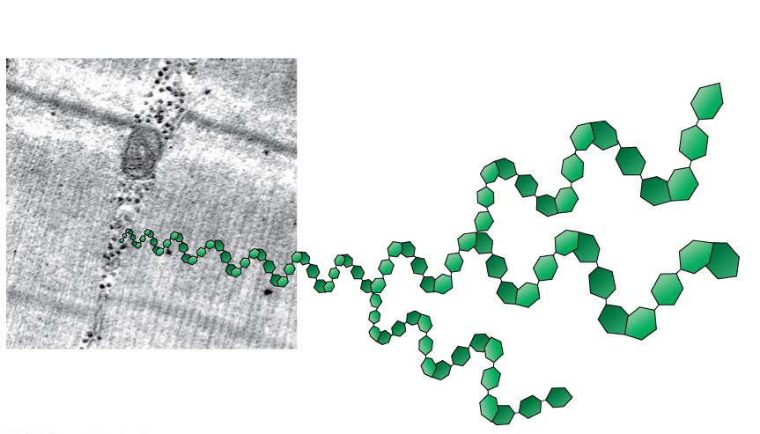
Polysaccharides
Glycogen
is used by animal cells to store energy and
is broken down to release glucose when you need energy.
Glycogen granules
in muscle tissue
هذه الشرائح مخصصة للشرح و ليست للمذاكرة
Notes:
90
Student Misconceptions and Concerns
1. The abstract nature of chemistry can be discouraging to many students. Consider starting out this section of the lecture by examining the chemical groups on a food nutrition label. Candy bars with peanuts are particularly useful as they contain significant amounts of all three sources of calories (carbohydrates, proteins, and lipids).
2. Students might struggle to extrapolate the properties of lipids to their roles in an organism. Ducks float because their feathers repel water instead of attracting it. Hair on your head remains flexible because of oils produced in your scalp. Examples such as these help connect the abstract properties of lipids to concrete examples in our world.
3. The functional significance of protein shape is an abstract molecular example of form and function relationships, which might be new to some students. The binding of an enzyme to its substrate is a type of molecular handshake, which permits specific interactions. To help students think about form and function relationships, share some concrete analogies in their lives—perhaps flathead and Phillips screwdrivers that match the proper type of screws or the fit of a hand into a glove.
4. The evolution of lactose tolerance within human groups in East Africa does not represent a deliberate decision, yet this evolutionary change appears logical. Many students perceive adaptations as deliberate events with purpose. As students develop a better understanding of the mechanisms of evolution, it will be important to point out that mutations arise by chance, with the culling hand of natural selection favoring traits that convey an advantage. Organisms cannot plan evolutionary change.
Teaching Tips
1. Consider reinforcing the three main sources of calories with food items that clearly represent each group. Bring clear examples to class as visual references, for example, a can of Coke or a bag of sugar for carbohydrates, a tub of margarine for lipids, and some beef jerky for protein (although some fat and carbohydrates might also be included).
2. If your lectures will eventually include details of glycolysis and aerobic respiration, this is a good point to introduce the basic concepts of glucose as fuel. Just introducing this conceptual formula might help: eating glucose + breathing in oxygen (yields) water + usable energy (used to build ATP) + heat + exhaled CO₂.
3. The section about our use of sugars may be of considerable interest to your students, who might not be expecting much interest in a lecture about organic chemistry. Consider an assignment for each student to bring to class a product label indicating high-fructose corn syrup (HFCS) as an ingredient.
4. Learning the definitions of word roots is invaluable when learning science. Learning the meaning of the prefix word roots “mono” (one), “di” (two), and “poly” (many) helps to distinguish the structures of various carbohydrates.
5. Consider an assignment for students to find reliable sources that discuss high sugar consumption in the modern diet. The key, of course, is in the quality of the resource. Consider narrowing down the categories to certain nonprofit health organizations (American Cancer Society, American Heart Association, and the like) and peer-reviewed journals.
6. A simple exercise demonstrates the enzymatic breakdown of starches into sugars. If students place an unsalted cracker in their mouths, holding it in their mouths while it mixes well with saliva, they might soon notice that a sweeter taste begins to emerge. The salivary enzyme amylase begins the digestion of starches into disaccharides, which may be degraded further by other enzymes. These disaccharides are the source of the sweet taste.
7. An adult human may store about a half of a kilogram of glycogen in the liver and muscles of the body, depending on recent dietary habits. A person who begins dieting might soon notice an immediate weight loss of 2–4 pounds (1–2 kilograms) over several days, reflecting reductions in stored glycogen, water, and intestinal contents (among other factors).
8. Another simple demonstration can illustrate hydrophobic and hydrophilic substances. In front of the class, mix colored water and a yellow oil (corn or canola oil work well). Shake up the mixture and then watch as the two separate. (You may have a mixture already made that remains separated; however, the dyes may bleed between the oil and the water.)
9. Margarine in stores commonly comes in liquid squeeze containers, in tubs, and in sticks. These forms reflect increasing amounts of hydrogenation, gradually increasing the stiffness from a liquid, to a firmer spread, to a firm stick of margarine. As noted in the text, recent studies have suggested that unsaturated oils become increasingly unhealthy as they are hydrogenated. Perhaps your students can find references to this correlation on the Internet.
10. Many analogies can help students understand the diversity of proteins that can be made from just 20 amino acids. The authors note that our language uses combinations of 26 letters to form words. Proteins are much longer “words,” creating even more diversity. Another analogy is to trains. This builds on the earlier analogy when polymers were introduced. Imagine making different trains about 100 cars long, using any combination of 20 types of railroad cars. Mathematically, the number of possible trains is 20¹⁰⁰, a number beyond imagination.
11. The authors note that the difference between a polypeptide and a protein is analogous to the relationship between a long strand of yarn and a sweater knitted from yarn. Proteins are clearly more complex!
12. Most cooking results in changes in the texture and color of a food. The brown color of a steak is the product of the denaturation of proteins. Fixatives such as formalin also denature proteins and cause color changes. Students who have dissected vertebrates will realize that the brown color of the muscles makes it look as if the animal has been cooked.
13. The “NA” in DNA and RNA stands for “nucleic acid.” Students often do not make this association without assistance.
Active Lecture Tips
1. The cellophane wrap often used to package foods is a biodegradable material derived from cellulose. Challenge students to work in pairs to create a list of other cellulose-derived products (such as paper).
2. Consider this assignment to finish a discussion of the diverse organic molecules in our diets. Have students work in pairs or small groups to analyze a food label listing the components of a McDonald’s Big Mac. Note the most abundant organic molecule class (perhaps by weight) found in each component.
3. See the Activity What Ingredients Make Up Your Snack Food on the Instructor Exchange. Visit the Instructor Exchange in the MasteringBiology instructor resource area for a description of this activity.
4. See the Activity Drawing Hydrophobic and Hydrophilic Interactions on the Instructor Exchange. Visit the Instructor Exchange in the MasteringBiology instructor resource area for a description of this activity.

Slide 91
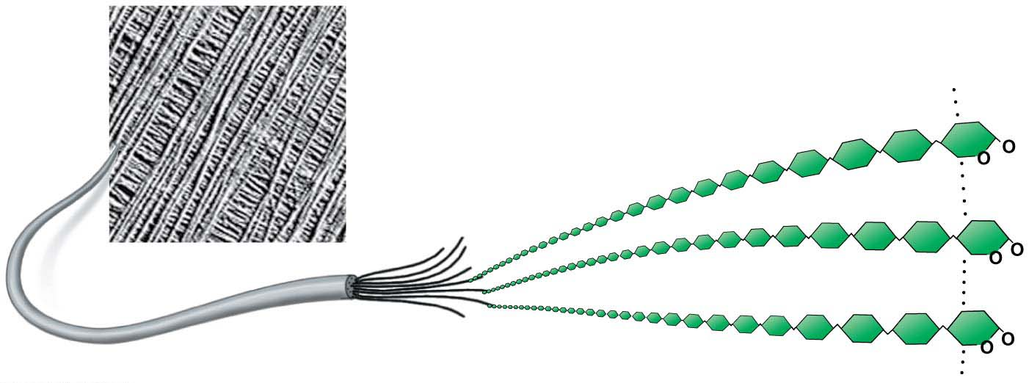
Polysaccharides
Cellulose
is the most abundant organic compound on Earth,
forms cable-like fibrils in the walls that enclose plant cells, and
cannot be broken by any enzyme produced by animals.
Cellulose microfibrils
in a plant cell wall
Cellulose
molecules
هذه الشرائح مخصصة للشرح و ليست للمذاكرة
Notes:
91
Student Misconceptions and Concerns
1. The abstract nature of chemistry can be discouraging to many students. Consider starting out this section of the lecture by examining the chemical groups on a food nutrition label. Candy bars with peanuts are particularly useful as they contain significant amounts of all three sources of calories (carbohydrates, proteins, and lipids).
2. Students might struggle to extrapolate the properties of lipids to their roles in an organism. Ducks float because their feathers repel water instead of attracting it. Hair on your head remains flexible because of oils produced in your scalp. Examples such as these help connect the abstract properties of lipids to concrete examples in our world.
3. The functional significance of protein shape is an abstract molecular example of form and function relationships, which might be new to some students. The binding of an enzyme to its substrate is a type of molecular handshake, which permits specific interactions. To help students think about form and function relationships, share some concrete analogies in their lives—perhaps flathead and Phillips screwdrivers that match the proper type of screws or the fit of a hand into a glove.
4. The evolution of lactose tolerance within human groups in East Africa does not represent a deliberate decision, yet this evolutionary change appears logical. Many students perceive adaptations as deliberate events with purpose. As students develop a better understanding of the mechanisms of evolution, it will be important to point out that mutations arise by chance, with the culling hand of natural selection favoring traits that convey an advantage. Organisms cannot plan evolutionary change.
Teaching Tips
1. Consider reinforcing the three main sources of calories with food items that clearly represent each group. Bring clear examples to class as visual references, for example, a can of Coke or a bag of sugar for carbohydrates, a tub of margarine for lipids, and some beef jerky for protein (although some fat and carbohydrates might also be included).
2. If your lectures will eventually include details of glycolysis and aerobic respiration, this is a good point to introduce the basic concepts of glucose as fuel. Just introducing this conceptual formula might help: eating glucose + breathing in oxygen (yields) water + usable energy (used to build ATP) + heat + exhaled CO₂.
3. The section about our use of sugars may be of considerable interest to your students, who might not be expecting much interest in a lecture about organic chemistry. Consider an assignment for each student to bring to class a product label indicating high-fructose corn syrup (HFCS) as an ingredient.
4. Learning the definitions of word roots is invaluable when learning science. Learning the meaning of the prefix word roots “mono” (one), “di” (two), and “poly” (many) helps to distinguish the structures of various carbohydrates.
5. Consider an assignment for students to find reliable sources that discuss high sugar consumption in the modern diet. The key, of course, is in the quality of the resource. Consider narrowing down the categories to certain nonprofit health organizations (American Cancer Society, American Heart Association, and the like) and peer-reviewed journals.
6. A simple exercise demonstrates the enzymatic breakdown of starches into sugars. If students place an unsalted cracker in their mouths, holding it in their mouths while it mixes well with saliva, they might soon notice that a sweeter taste begins to emerge. The salivary enzyme amylase begins the digestion of starches into disaccharides, which may be degraded further by other enzymes. These disaccharides are the source of the sweet taste.
7. An adult human may store about a half of a kilogram of glycogen in the liver and muscles of the body, depending on recent dietary habits. A person who begins dieting might soon notice an immediate weight loss of 2–4 pounds (1–2 kilograms) over several days, reflecting reductions in stored glycogen, water, and intestinal contents (among other factors).
8. Another simple demonstration can illustrate hydrophobic and hydrophilic substances. In front of the class, mix colored water and a yellow oil (corn or canola oil work well). Shake up the mixture and then watch as the two separate. (You may have a mixture already made that remains separated; however, the dyes may bleed between the oil and the water.)
9. Margarine in stores commonly comes in liquid squeeze containers, in tubs, and in sticks. These forms reflect increasing amounts of hydrogenation, gradually increasing the stiffness from a liquid, to a firmer spread, to a firm stick of margarine. As noted in the text, recent studies have suggested that unsaturated oils become increasingly unhealthy as they are hydrogenated. Perhaps your students can find references to this correlation on the Internet.
10. Many analogies can help students understand the diversity of proteins that can be made from just 20 amino acids. The authors note that our language uses combinations of 26 letters to form words. Proteins are much longer “words,” creating even more diversity. Another analogy is to trains. This builds on the earlier analogy when polymers were introduced. Imagine making different trains about 100 cars long, using any combination of 20 types of railroad cars. Mathematically, the number of possible trains is 20¹⁰⁰, a number beyond imagination.
11. The authors note that the difference between a polypeptide and a protein is analogous to the relationship between a long strand of yarn and a sweater knitted from yarn. Proteins are clearly more complex!
12. Most cooking results in changes in the texture and color of a food. The brown color of a steak is the product of the denaturation of proteins. Fixatives such as formalin also denature proteins and cause color changes. Students who have dissected vertebrates will realize that the brown color of the muscles makes it look as if the animal has been cooked.
13. The “NA” in DNA and RNA stands for “nucleic acid.” Students often do not make this association without assistance.
Active Lecture Tips
1. The cellophane wrap often used to package foods is a biodegradable material derived from cellulose. Challenge students to work in pairs to create a list of other cellulose-derived products (such as paper).
2. Consider this assignment to finish a discussion of the diverse organic molecules in our diets. Have students work in pairs or small groups to analyze a food label listing the components of a McDonald’s Big Mac. Note the most abundant organic molecule class (perhaps by weight) found in each component.
3. See the Activity What Ingredients Make Up Your Snack Food on the Instructor Exchange. Visit the Instructor Exchange in the MasteringBiology instructor resource area for a description of this activity.
4. See the Activity Drawing Hydrophobic and Hydrophilic Interactions on the Instructor Exchange. Visit the Instructor Exchange in the MasteringBiology instructor resource area for a description of this activity.

Slide 92
LIPIDS

Slide 93
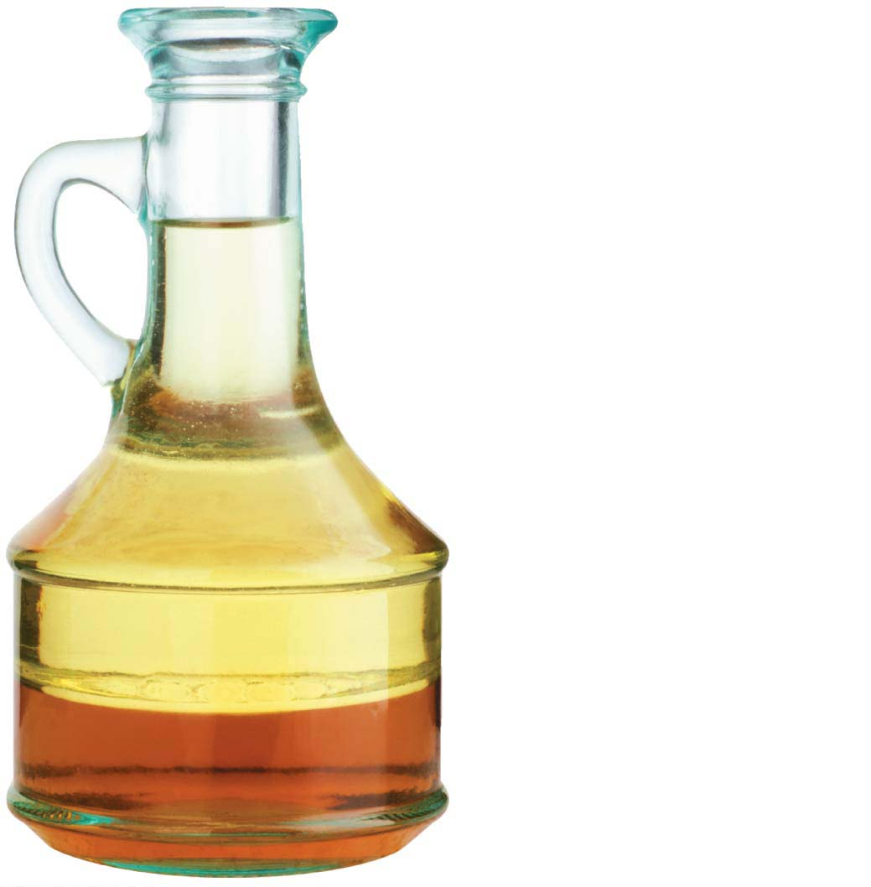
Lipids
Almost all carbohydrates are hydrophilic (“water-loving”) molecules that dissolve readily in water.
Lipids are hydrophobic, unable to mix with water.
When you combine oil and vinegar, the oil, which is a type of lipid, separates from the vinegar, which is mostly water.
Oil (hydrophobic)
Vinegar (hydrophilic)
هذه الشرائح مخصصة للشرح و ليست للمذاكرة
Notes:
93
Student Misconceptions and Concerns
1. The abstract nature of chemistry can be discouraging to many students. Consider starting out this section of the lecture by examining the chemical groups on a food nutrition label. Candy bars with peanuts are particularly useful as they contain significant amounts of all three sources of calories (carbohydrates, proteins, and lipids).
2. Students might struggle to extrapolate the properties of lipids to their roles in an organism. Ducks float because their feathers repel water instead of attracting it. Hair on your head remains flexible because of oils produced in your scalp. Examples such as these help connect the abstract properties of lipids to concrete examples in our world.
3. The functional significance of protein shape is an abstract molecular example of form and function relationships, which might be new to some students. The binding of an enzyme to its substrate is a type of molecular handshake, which permits specific interactions. To help students think about form and function relationships, share some concrete analogies in their lives—perhaps flathead and Phillips screwdrivers that match the proper type of screws or the fit of a hand into a glove.
4. The evolution of lactose tolerance within human groups in East Africa does not represent a deliberate decision, yet this evolutionary change appears logical. Many students perceive adaptations as deliberate events with purpose. As students develop a better understanding of the mechanisms of evolution, it will be important to point out that mutations arise by chance, with the culling hand of natural selection favoring traits that convey an advantage. Organisms cannot plan evolutionary change.
Teaching Tips
1. Consider reinforcing the three main sources of calories with food items that clearly represent each group. Bring clear examples to class as visual references, for example, a can of Coke or a bag of sugar for carbohydrates, a tub of margarine for lipids, and some beef jerky for protein (although some fat and carbohydrates might also be included).
2. If your lectures will eventually include details of glycolysis and aerobic respiration, this is a good point to introduce the basic concepts of glucose as fuel. Just introducing this conceptual formula might help: eating glucose + breathing in oxygen (yields) water + usable energy (used to build ATP) + heat + exhaled CO₂.
3. The section about our use of sugars may be of considerable interest to your students, who might not be expecting much interest in a lecture about organic chemistry. Consider an assignment for each student to bring to class a product label indicating high-fructose corn syrup (HFCS) as an ingredient.
4. Learning the definitions of word roots is invaluable when learning science. Learning the meaning of the prefix word roots “mono” (one), “di” (two), and “poly” (many) helps to distinguish the structures of various carbohydrates.
5. Consider an assignment for students to find reliable sources that discuss high sugar consumption in the modern diet. The key, of course, is in the quality of the resource. Consider narrowing down the categories to certain nonprofit health organizations (American Cancer Society, American Heart Association, and the like) and peer-reviewed journals.
6. A simple exercise demonstrates the enzymatic breakdown of starches into sugars. If students place an unsalted cracker in their mouths, holding it in their mouths while it mixes well with saliva, they might soon notice that a sweeter taste begins to emerge. The salivary enzyme amylase begins the digestion of starches into disaccharides, which may be degraded further by other enzymes. These disaccharides are the source of the sweet taste.
7. An adult human may store about a half of a kilogram of glycogen in the liver and muscles of the body, depending on recent dietary habits. A person who begins dieting might soon notice an immediate weight loss of 2–4 pounds (1–2 kilograms) over several days, reflecting reductions in stored glycogen, water, and intestinal contents (among other factors).
8. Another simple demonstration can illustrate hydrophobic and hydrophilic substances. In front of the class, mix colored water and a yellow oil (corn or canola oil work well). Shake up the mixture and then watch as the two separate. (You may have a mixture already made that remains separated; however, the dyes may bleed between the oil and the water.)
9. Margarine in stores commonly comes in liquid squeeze containers, in tubs, and in sticks. These forms reflect increasing amounts of hydrogenation, gradually increasing the stiffness from a liquid, to a firmer spread, to a firm stick of margarine. As noted in the text, recent studies have suggested that unsaturated oils become increasingly unhealthy as they are hydrogenated. Perhaps your students can find references to this correlation on the Internet.
10. Many analogies can help students understand the diversity of proteins that can be made from just 20 amino acids. The authors note that our language uses combinations of 26 letters to form words. Proteins are much longer “words,” creating even more diversity. Another analogy is to trains. This builds on the earlier analogy when polymers were introduced. Imagine making different trains about 100 cars long, using any combination of 20 types of railroad cars. Mathematically, the number of possible trains is 20¹⁰⁰, a number beyond imagination.
11. The authors note that the difference between a polypeptide and a protein is analogous to the relationship between a long strand of yarn and a sweater knitted from yarn. Proteins are clearly more complex!
12. Most cooking results in changes in the texture and color of a food. The brown color of a steak is the product of the denaturation of proteins. Fixatives such as formalin also denature proteins and cause color changes. Students who have dissected vertebrates will realize that the brown color of the muscles makes it look as if the animal has been cooked.
13. The “NA” in DNA and RNA stands for “nucleic acid.” Students often do not make this association without assistance.
Active Lecture Tips
1. The cellophane wrap often used to package foods is a biodegradable material derived from cellulose. Challenge students to work in pairs to create a list of other cellulose-derived products (such as paper).
2. Consider this assignment to finish a discussion of the diverse organic molecules in our diets. Have students work in pairs or small groups to analyze a food label listing the components of a McDonald’s Big Mac. Note the most abundant organic molecule class (perhaps by weight) found in each component.
3. See the Activity What Ingredients Make Up Your Snack Food on the Instructor Exchange. Visit the Instructor Exchange in the MasteringBiology instructor resource area for a description of this activity.
4. See the Activity Drawing Hydrophobic and Hydrophilic Interactions on the Instructor Exchange. Visit the Instructor Exchange in the MasteringBiology instructor resource area for a description of this activity.

Slide 94
Lipids
Lipids also differ from carbohydrates, proteins, and nucleic acids in that:
They are neither huge macromolecules nor are they necessarily polymers built from repeating monomers.
Lipids are a diverse group of molecules made from different molecular building blocks.
Lipids include:
Fat
Steroid
هذه الشرائح مخصصة للشرح و ليست للمذاكرة
Notes:
94
Student Misconceptions and Concerns
1. The abstract nature of chemistry can be discouraging to many students. Consider starting out this section of the lecture by examining the chemical groups on a food nutrition label. Candy bars with peanuts are particularly useful as they contain significant amounts of all three sources of calories (carbohydrates, proteins, and lipids).
2. Students might struggle to extrapolate the properties of lipids to their roles in an organism. Ducks float because their feathers repel water instead of attracting it. Hair on your head remains flexible because of oils produced in your scalp. Examples such as these help connect the abstract properties of lipids to concrete examples in our world.
3. The functional significance of protein shape is an abstract molecular example of form and function relationships, which might be new to some students. The binding of an enzyme to its substrate is a type of molecular handshake, which permits specific interactions. To help students think about form and function relationships, share some concrete analogies in their lives—perhaps flathead and Phillips screwdrivers that match the proper type of screws or the fit of a hand into a glove.
4. The evolution of lactose tolerance within human groups in East Africa does not represent a deliberate decision, yet this evolutionary change appears logical. Many students perceive adaptations as deliberate events with purpose. As students develop a better understanding of the mechanisms of evolution, it will be important to point out that mutations arise by chance, with the culling hand of natural selection favoring traits that convey an advantage. Organisms cannot plan evolutionary change.
Teaching Tips
1. Consider reinforcing the three main sources of calories with food items that clearly represent each group. Bring clear examples to class as visual references, for example, a can of Coke or a bag of sugar for carbohydrates, a tub of margarine for lipids, and some beef jerky for protein (although some fat and carbohydrates might also be included).
2. If your lectures will eventually include details of glycolysis and aerobic respiration, this is a good point to introduce the basic concepts of glucose as fuel. Just introducing this conceptual formula might help: eating glucose + breathing in oxygen (yields) water + usable energy (used to build ATP) + heat + exhaled CO₂.
3. The section about our use of sugars may be of considerable interest to your students, who might not be expecting much interest in a lecture about organic chemistry. Consider an assignment for each student to bring to class a product label indicating high-fructose corn syrup (HFCS) as an ingredient.
4. Learning the definitions of word roots is invaluable when learning science. Learning the meaning of the prefix word roots “mono” (one), “di” (two), and “poly” (many) helps to distinguish the structures of various carbohydrates.
5. Consider an assignment for students to find reliable sources that discuss high sugar consumption in the modern diet. The key, of course, is in the quality of the resource. Consider narrowing down the categories to certain nonprofit health organizations (American Cancer Society, American Heart Association, and the like) and peer-reviewed journals.
6. A simple exercise demonstrates the enzymatic breakdown of starches into sugars. If students place an unsalted cracker in their mouths, holding it in their mouths while it mixes well with saliva, they might soon notice that a sweeter taste begins to emerge. The salivary enzyme amylase begins the digestion of starches into disaccharides, which may be degraded further by other enzymes. These disaccharides are the source of the sweet taste.
7. An adult human may store about a half of a kilogram of glycogen in the liver and muscles of the body, depending on recent dietary habits. A person who begins dieting might soon notice an immediate weight loss of 2–4 pounds (1–2 kilograms) over several days, reflecting reductions in stored glycogen, water, and intestinal contents (among other factors).
8. Another simple demonstration can illustrate hydrophobic and hydrophilic substances. In front of the class, mix colored water and a yellow oil (corn or canola oil work well). Shake up the mixture and then watch as the two separate. (You may have a mixture already made that remains separated; however, the dyes may bleed between the oil and the water.)
9. Margarine in stores commonly comes in liquid squeeze containers, in tubs, and in sticks. These forms reflect increasing amounts of hydrogenation, gradually increasing the stiffness from a liquid, to a firmer spread, to a firm stick of margarine. As noted in the text, recent studies have suggested that unsaturated oils become increasingly unhealthy as they are hydrogenated. Perhaps your students can find references to this correlation on the Internet.
10. Many analogies can help students understand the diversity of proteins that can be made from just 20 amino acids. The authors note that our language uses combinations of 26 letters to form words. Proteins are much longer “words,” creating even more diversity. Another analogy is to trains. This builds on the earlier analogy when polymers were introduced. Imagine making different trains about 100 cars long, using any combination of 20 types of railroad cars. Mathematically, the number of possible trains is 20¹⁰⁰, a number beyond imagination.
11. The authors note that the difference between a polypeptide and a protein is analogous to the relationship between a long strand of yarn and a sweater knitted from yarn. Proteins are clearly more complex!
12. Most cooking results in changes in the texture and color of a food. The brown color of a steak is the product of the denaturation of proteins. Fixatives such as formalin also denature proteins and cause color changes. Students who have dissected vertebrates will realize that the brown color of the muscles makes it look as if the animal has been cooked.
13. The “NA” in DNA and RNA stands for “nucleic acid.” Students often do not make this association without assistance.
Active Lecture Tips
1. The cellophane wrap often used to package foods is a biodegradable material derived from cellulose. Challenge students to work in pairs to create a list of other cellulose-derived products (such as paper).
2. Consider this assignment to finish a discussion of the diverse organic molecules in our diets. Have students work in pairs or small groups to analyze a food label listing the components of a McDonald’s Big Mac. Note the most abundant organic molecule class (perhaps by weight) found in each component.
3. See the Activity What Ingredients Make Up Your Snack Food on the Instructor Exchange. Visit the Instructor Exchange in the MasteringBiology instructor resource area for a description of this activity.
4. See the Activity Drawing Hydrophobic and Hydrophilic Interactions on the Instructor Exchange. Visit the Instructor Exchange in the MasteringBiology instructor resource area for a description of this activity.

Slide 95
Fats
A typical fat, or triglyceride, consists of a glycerol molecule joined with three fatty acid molecules via a dehydration reaction.
Fats perform essential functions in the human body including
energy storage,
cushioning, and
insulation.
هذه الشرائح مخصصة للشرح و ليست للمذاكرة
Notes:
95
Student Misconceptions and Concerns
1. The abstract nature of chemistry can be discouraging to many students. Consider starting out this section of the lecture by examining the chemical groups on a food nutrition label. Candy bars with peanuts are particularly useful as they contain significant amounts of all three sources of calories (carbohydrates, proteins, and lipids).
2. Students might struggle to extrapolate the properties of lipids to their roles in an organism. Ducks float because their feathers repel water instead of attracting it. Hair on your head remains flexible because of oils produced in your scalp. Examples such as these help connect the abstract properties of lipids to concrete examples in our world.
3. The functional significance of protein shape is an abstract molecular example of form and function relationships, which might be new to some students. The binding of an enzyme to its substrate is a type of molecular handshake, which permits specific interactions. To help students think about form and function relationships, share some concrete analogies in their lives—perhaps flathead and Phillips screwdrivers that match the proper type of screws or the fit of a hand into a glove.
4. The evolution of lactose tolerance within human groups in East Africa does not represent a deliberate decision, yet this evolutionary change appears logical. Many students perceive adaptations as deliberate events with purpose. As students develop a better understanding of the mechanisms of evolution, it will be important to point out that mutations arise by chance, with the culling hand of natural selection favoring traits that convey an advantage. Organisms cannot plan evolutionary change.
Teaching Tips
1. Consider reinforcing the three main sources of calories with food items that clearly represent each group. Bring clear examples to class as visual references, for example, a can of Coke or a bag of sugar for carbohydrates, a tub of margarine for lipids, and some beef jerky for protein (although some fat and carbohydrates might also be included).
2. If your lectures will eventually include details of glycolysis and aerobic respiration, this is a good point to introduce the basic concepts of glucose as fuel. Just introducing this conceptual formula might help: eating glucose + breathing in oxygen (yields) water + usable energy (used to build ATP) + heat + exhaled CO₂.
3. The section about our use of sugars may be of considerable interest to your students, who might not be expecting much interest in a lecture about organic chemistry. Consider an assignment for each student to bring to class a product label indicating high-fructose corn syrup (HFCS) as an ingredient.
4. Learning the definitions of word roots is invaluable when learning science. Learning the meaning of the prefix word roots “mono” (one), “di” (two), and “poly” (many) helps to distinguish the structures of various carbohydrates.
5. Consider an assignment for students to find reliable sources that discuss high sugar consumption in the modern diet. The key, of course, is in the quality of the resource. Consider narrowing down the categories to certain nonprofit health organizations (American Cancer Society, American Heart Association, and the like) and peer-reviewed journals.
6. A simple exercise demonstrates the enzymatic breakdown of starches into sugars. If students place an unsalted cracker in their mouths, holding it in their mouths while it mixes well with saliva, they might soon notice that a sweeter taste begins to emerge. The salivary enzyme amylase begins the digestion of starches into disaccharides, which may be degraded further by other enzymes. These disaccharides are the source of the sweet taste.
7. An adult human may store about a half of a kilogram of glycogen in the liver and muscles of the body, depending on recent dietary habits. A person who begins dieting might soon notice an immediate weight loss of 2–4 pounds (1–2 kilograms) over several days, reflecting reductions in stored glycogen, water, and intestinal contents (among other factors).
8. Another simple demonstration can illustrate hydrophobic and hydrophilic substances. In front of the class, mix colored water and a yellow oil (corn or canola oil work well). Shake up the mixture and then watch as the two separate. (You may have a mixture already made that remains separated; however, the dyes may bleed between the oil and the water.)
9. Margarine in stores commonly comes in liquid squeeze containers, in tubs, and in sticks. These forms reflect increasing amounts of hydrogenation, gradually increasing the stiffness from a liquid, to a firmer spread, to a firm stick of margarine. As noted in the text, recent studies have suggested that unsaturated oils become increasingly unhealthy as they are hydrogenated. Perhaps your students can find references to this correlation on the Internet.
10. Many analogies can help students understand the diversity of proteins that can be made from just 20 amino acids. The authors note that our language uses combinations of 26 letters to form words. Proteins are much longer “words,” creating even more diversity. Another analogy is to trains. This builds on the earlier analogy when polymers were introduced. Imagine making different trains about 100 cars long, using any combination of 20 types of railroad cars. Mathematically, the number of possible trains is 20¹⁰⁰, a number beyond imagination.
11. The authors note that the difference between a polypeptide and a protein is analogous to the relationship between a long strand of yarn and a sweater knitted from yarn. Proteins are clearly more complex!
12. Most cooking results in changes in the texture and color of a food. The brown color of a steak is the product of the denaturation of proteins. Fixatives such as formalin also denature proteins and cause color changes. Students who have dissected vertebrates will realize that the brown color of the muscles makes it look as if the animal has been cooked.
13. The “NA” in DNA and RNA stands for “nucleic acid.” Students often do not make this association without assistance.
Active Lecture Tips
1. The cellophane wrap often used to package foods is a biodegradable material derived from cellulose. Challenge students to work in pairs to create a list of other cellulose-derived products (such as paper).
2. Consider this assignment to finish a discussion of the diverse organic molecules in our diets. Have students work in pairs or small groups to analyze a food label listing the components of a McDonald’s Big Mac. Note the most abundant organic molecule class (perhaps by weight) found in each component.
3. See the Activity What Ingredients Make Up Your Snack Food on the Instructor Exchange. Visit the Instructor Exchange in the MasteringBiology instructor resource area for a description of this activity.
4. See the Activity Drawing Hydrophobic and Hydrophilic Interactions on the Instructor Exchange. Visit the Instructor Exchange in the MasteringBiology instructor resource area for a description of this activity.

Slide 96
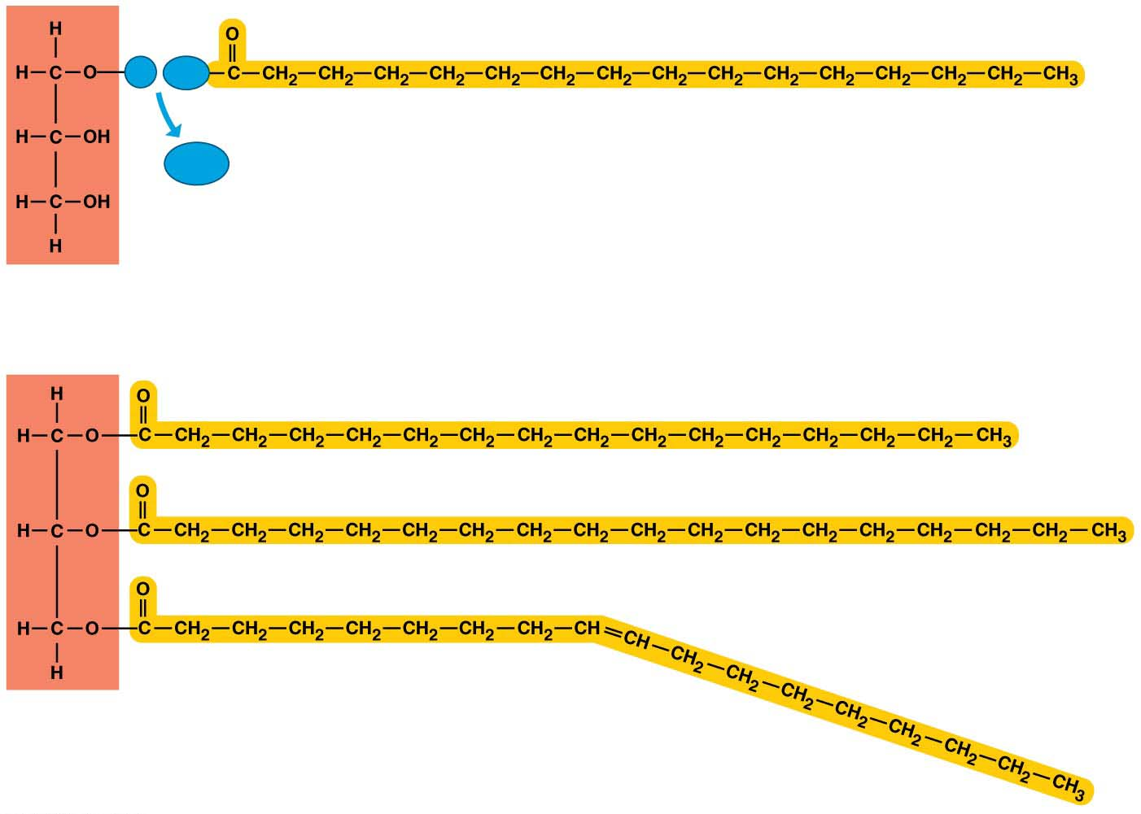
The synthesis and structure of a triglyceride molecule
H
HO
Fatty acid
H₂O
Glycerol
(a) A dehydration reaction linking a fatty acid to glycerol
(b) A fat molecule with a glycerol “head” and three
energy-rich hydrocarbon fatty acid “tails”
Notes:
Figure 3.11 The synthesis and structure of a triglyceride molecule

Slide 97
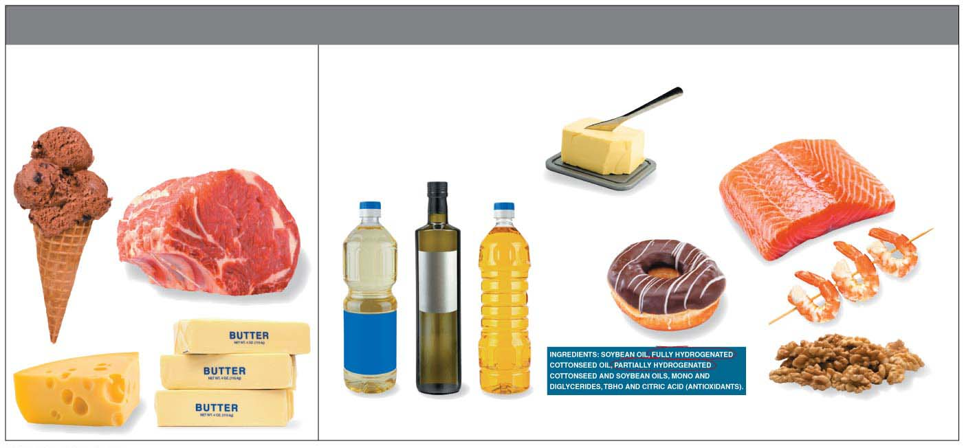
Fats
Fatty acids can be either:
Saturated:
It has the maximum number of hydrogens.
It has all three of its fatty acids saturated and solid at room temperature.
2. Unsaturated:
The carbon skeleton of a fatty acid has fewer than the maximum number of hydrogens at the double bond.
Rarely form solid and mostly liquid at room temperature.
Saturated Fats
Unsaturated Fats
Margarine
Plant oils
Trans fats
Omega-3 fats
Notes:
97
Student Misconceptions and Concerns
1. The abstract nature of chemistry can be discouraging to many students. Consider starting out this section of the lecture by examining the chemical groups on a food nutrition label. Candy bars with peanuts are particularly useful as they contain significant amounts of all three sources of calories (carbohydrates, proteins, and lipids).
2. Students might struggle to extrapolate the properties of lipids to their roles in an organism. Ducks float because their feathers repel water instead of attracting it. Hair on your head remains flexible because of oils produced in your scalp. Examples such as these help connect the abstract properties of lipids to concrete examples in our world.
3. The functional significance of protein shape is an abstract molecular example of form and function relationships, which might be new to some students. The binding of an enzyme to its substrate is a type of molecular handshake, which permits specific interactions. To help students think about form and function relationships, share some concrete analogies in their lives—perhaps flathead and Phillips screwdrivers that match the proper type of screws or the fit of a hand into a glove.
4. The evolution of lactose tolerance within human groups in East Africa does not represent a deliberate decision, yet this evolutionary change appears logical. Many students perceive adaptations as deliberate events with purpose. As students develop a better understanding of the mechanisms of evolution, it will be important to point out that mutations arise by chance, with the culling hand of natural selection favoring traits that convey an advantage. Organisms cannot plan evolutionary change.
Teaching Tips
1. Consider reinforcing the three main sources of calories with food items that clearly represent each group. Bring clear examples to class as visual references, for example, a can of Coke or a bag of sugar for carbohydrates, a tub of margarine for lipids, and some beef jerky for protein (although some fat and carbohydrates might also be included).
2. If your lectures will eventually include details of glycolysis and aerobic respiration, this is a good point to introduce the basic concepts of glucose as fuel. Just introducing this conceptual formula might help: eating glucose + breathing in oxygen (yields) water + usable energy (used to build ATP) + heat + exhaled CO₂.
3. The section about our use of sugars may be of considerable interest to your students, who might not be expecting much interest in a lecture about organic chemistry. Consider an assignment for each student to bring to class a product label indicating high-fructose corn syrup (HFCS) as an ingredient.
4. Learning the definitions of word roots is invaluable when learning science. Learning the meaning of the prefix word roots “mono” (one), “di” (two), and “poly” (many) helps to distinguish the structures of various carbohydrates.
5. Consider an assignment for students to find reliable sources that discuss high sugar consumption in the modern diet. The key, of course, is in the quality of the resource. Consider narrowing down the categories to certain nonprofit health organizations (American Cancer Society, American Heart Association, and the like) and peer-reviewed journals.
6. A simple exercise demonstrates the enzymatic breakdown of starches into sugars. If students place an unsalted cracker in their mouths, holding it in their mouths while it mixes well with saliva, they might soon notice that a sweeter taste begins to emerge. The salivary enzyme amylase begins the digestion of starches into disaccharides, which may be degraded further by other enzymes. These disaccharides are the source of the sweet taste.
7. An adult human may store about a half of a kilogram of glycogen in the liver and muscles of the body, depending on recent dietary habits. A person who begins dieting might soon notice an immediate weight loss of 2–4 pounds (1–2 kilograms) over several days, reflecting reductions in stored glycogen, water, and intestinal contents (among other factors).
8. Another simple demonstration can illustrate hydrophobic and hydrophilic substances. In front of the class, mix colored water and a yellow oil (corn or canola oil work well). Shake up the mixture and then watch as the two separate. (You may have a mixture already made that remains separated; however, the dyes may bleed between the oil and the water.)
9. Margarine in stores commonly comes in liquid squeeze containers, in tubs, and in sticks. These forms reflect increasing amounts of hydrogenation, gradually increasing the stiffness from a liquid, to a firmer spread, to a firm stick of margarine. As noted in the text, recent studies have suggested that unsaturated oils become increasingly unhealthy as they are hydrogenated. Perhaps your students can find references to this correlation on the Internet.
10. Many analogies can help students understand the diversity of proteins that can be made from just 20 amino acids. The authors note that our language uses combinations of 26 letters to form words. Proteins are much longer “words,” creating even more diversity. Another analogy is to trains. This builds on the earlier analogy when polymers were introduced. Imagine making different trains about 100 cars long, using any combination of 20 types of railroad cars. Mathematically, the number of possible trains is 20¹⁰⁰, a number beyond imagination.
11. The authors note that the difference between a polypeptide and a protein is analogous to the relationship between a long strand of yarn and a sweater knitted from yarn. Proteins are clearly more complex!
12. Most cooking results in changes in the texture and color of a food. The brown color of a steak is the product of the denaturation of proteins. Fixatives such as formalin also denature proteins and cause color changes. Students who have dissected vertebrates will realize that the brown color of the muscles makes it look as if the animal has been cooked.
13. The “NA” in DNA and RNA stands for “nucleic acid.” Students often do not make this association without assistance.
Active Lecture Tips
1. The cellophane wrap often used to package foods is a biodegradable material derived from cellulose. Challenge students to work in pairs to create a list of other cellulose-derived products (such as paper).
2. Consider this assignment to finish a discussion of the diverse organic molecules in our diets. Have students work in pairs or small groups to analyze a food label listing the components of a McDonald’s Big Mac. Note the most abundant organic molecule class (perhaps by weight) found in each component.
3. See the Activity What Ingredients Make Up Your Snack Food on the Instructor Exchange. Visit the Instructor Exchange in the MasteringBiology instructor resource area for a description of this activity.
4. See the Activity Drawing Hydrophobic and Hydrophilic Interactions on the Instructor Exchange. Visit the Instructor Exchange in the MasteringBiology instructor resource area for a description of this activity.

Slide 98
Fats
Most plant and fish fats tend to be
high in unsaturated fatty acids and
liquid at room temperature.
Hydrogenation
adds hydrogen,
converts unsaturated fats to saturated fats,
makes liquid fats solid at room temperature, and
creates trans fats, a type of unsaturated fat that is particularly bad for your health.
هذه الشرائح مخصصة للشرح و ليست للمذاكرة
Notes:
98
Student Misconceptions and Concerns
1. The abstract nature of chemistry can be discouraging to many students. Consider starting out this section of the lecture by examining the chemical groups on a food nutrition label. Candy bars with peanuts are particularly useful as they contain significant amounts of all three sources of calories (carbohydrates, proteins, and lipids).
2. Students might struggle to extrapolate the properties of lipids to their roles in an organism. Ducks float because their feathers repel water instead of attracting it. Hair on your head remains flexible because of oils produced in your scalp. Examples such as these help connect the abstract properties of lipids to concrete examples in our world.
3. The functional significance of protein shape is an abstract molecular example of form and function relationships, which might be new to some students. The binding of an enzyme to its substrate is a type of molecular handshake, which permits specific interactions. To help students think about form and function relationships, share some concrete analogies in their lives—perhaps flathead and Phillips screwdrivers that match the proper type of screws or the fit of a hand into a glove.
4. The evolution of lactose tolerance within human groups in East Africa does not represent a deliberate decision, yet this evolutionary change appears logical. Many students perceive adaptations as deliberate events with purpose. As students develop a better understanding of the mechanisms of evolution, it will be important to point out that mutations arise by chance, with the culling hand of natural selection favoring traits that convey an advantage. Organisms cannot plan evolutionary change.
Teaching Tips
1. Consider reinforcing the three main sources of calories with food items that clearly represent each group. Bring clear examples to class as visual references, for example, a can of Coke or a bag of sugar for carbohydrates, a tub of margarine for lipids, and some beef jerky for protein (although some fat and carbohydrates might also be included).
2. If your lectures will eventually include details of glycolysis and aerobic respiration, this is a good point to introduce the basic concepts of glucose as fuel. Just introducing this conceptual formula might help: eating glucose + breathing in oxygen (yields) water + usable energy (used to build ATP) + heat + exhaled CO₂.
3. The section about our use of sugars may be of considerable interest to your students, who might not be expecting much interest in a lecture about organic chemistry. Consider an assignment for each student to bring to class a product label indicating high-fructose corn syrup (HFCS) as an ingredient.
4. Learning the definitions of word roots is invaluable when learning science. Learning the meaning of the prefix word roots “mono” (one), “di” (two), and “poly” (many) helps to distinguish the structures of various carbohydrates.
5. Consider an assignment for students to find reliable sources that discuss high sugar consumption in the modern diet. The key, of course, is in the quality of the resource. Consider narrowing down the categories to certain nonprofit health organizations (American Cancer Society, American Heart Association, and the like) and peer-reviewed journals.
6. A simple exercise demonstrates the enzymatic breakdown of starches into sugars. If students place an unsalted cracker in their mouths, holding it in their mouths while it mixes well with saliva, they might soon notice that a sweeter taste begins to emerge. The salivary enzyme amylase begins the digestion of starches into disaccharides, which may be degraded further by other enzymes. These disaccharides are the source of the sweet taste.
7. An adult human may store about a half of a kilogram of glycogen in the liver and muscles of the body, depending on recent dietary habits. A person who begins dieting might soon notice an immediate weight loss of 2–4 pounds (1–2 kilograms) over several days, reflecting reductions in stored glycogen, water, and intestinal contents (among other factors).
8. Another simple demonstration can illustrate hydrophobic and hydrophilic substances. In front of the class, mix colored water and a yellow oil (corn or canola oil work well). Shake up the mixture and then watch as the two separate. (You may have a mixture already made that remains separated; however, the dyes may bleed between the oil and the water.)
9. Margarine in stores commonly comes in liquid squeeze containers, in tubs, and in sticks. These forms reflect increasing amounts of hydrogenation, gradually increasing the stiffness from a liquid, to a firmer spread, to a firm stick of margarine. As noted in the text, recent studies have suggested that unsaturated oils become increasingly unhealthy as they are hydrogenated. Perhaps your students can find references to this correlation on the Internet.
10. Many analogies can help students understand the diversity of proteins that can be made from just 20 amino acids. The authors note that our language uses combinations of 26 letters to form words. Proteins are much longer “words,” creating even more diversity. Another analogy is to trains. This builds on the earlier analogy when polymers were introduced. Imagine making different trains about 100 cars long, using any combination of 20 types of railroad cars. Mathematically, the number of possible trains is 20¹⁰⁰, a number beyond imagination.
11. The authors note that the difference between a polypeptide and a protein is analogous to the relationship between a long strand of yarn and a sweater knitted from yarn. Proteins are clearly more complex!
12. Most cooking results in changes in the texture and color of a food. The brown color of a steak is the product of the denaturation of proteins. Fixatives such as formalin also denature proteins and cause color changes. Students who have dissected vertebrates will realize that the brown color of the muscles makes it look as if the animal has been cooked.
13. The “NA” in DNA and RNA stands for “nucleic acid.” Students often do not make this association without assistance.
Active Lecture Tips
1. The cellophane wrap often used to package foods is a biodegradable material derived from cellulose. Challenge students to work in pairs to create a list of other cellulose-derived products (such as paper).
2. Consider this assignment to finish a discussion of the diverse organic molecules in our diets. Have students work in pairs or small groups to analyze a food label listing the components of a McDonald’s Big Mac. Note the most abundant organic molecule class (perhaps by weight) found in each component.
3. See the Activity What Ingredients Make Up Your Snack Food on the Instructor Exchange. Visit the Instructor Exchange in the MasteringBiology instructor resource area for a description of this activity.
4. See the Activity Drawing Hydrophobic and Hydrophilic Interactions on the Instructor Exchange. Visit the Instructor Exchange in the MasteringBiology instructor resource area for a description of this activity.

Slide 99
Steroids
Steroids are very different from fats in structure and function.
The carbon skeleton has four fused rings.
Steroids vary in the functional groups attached to this set of rings, and these chemical variations affect their function.
1.Cholesterol:
a key component of cell membranes and
the “base steroid” from which your body produces other steroids, such as estrogen and testosterone.
هذه الشرائح مخصصة للشرح و ليست للمذاكرة
Notes:
99
Student Misconceptions and Concerns
1. The abstract nature of chemistry can be discouraging to many students. Consider starting out this section of the lecture by examining the chemical groups on a food nutrition label. Candy bars with peanuts are particularly useful as they contain significant amounts of all three sources of calories (carbohydrates, proteins, and lipids).
2. Students might struggle to extrapolate the properties of lipids to their roles in an organism. Ducks float because their feathers repel water instead of attracting it. Hair on your head remains flexible because of oils produced in your scalp. Examples such as these help connect the abstract properties of lipids to concrete examples in our world.
3. The functional significance of protein shape is an abstract molecular example of form and function relationships, which might be new to some students. The binding of an enzyme to its substrate is a type of molecular handshake, which permits specific interactions. To help students think about form and function relationships, share some concrete analogies in their lives—perhaps flathead and Phillips screwdrivers that match the proper type of screws or the fit of a hand into a glove.
4. The evolution of lactose tolerance within human groups in East Africa does not represent a deliberate decision, yet this evolutionary change appears logical. Many students perceive adaptations as deliberate events with purpose. As students develop a better understanding of the mechanisms of evolution, it will be important to point out that mutations arise by chance, with the culling hand of natural selection favoring traits that convey an advantage. Organisms cannot plan evolutionary change.
Teaching Tips
1. Consider reinforcing the three main sources of calories with food items that clearly represent each group. Bring clear examples to class as visual references, for example, a can of Coke or a bag of sugar for carbohydrates, a tub of margarine for lipids, and some beef jerky for protein (although some fat and carbohydrates might also be included).
2. If your lectures will eventually include details of glycolysis and aerobic respiration, this is a good point to introduce the basic concepts of glucose as fuel. Just introducing this conceptual formula might help: eating glucose + breathing in oxygen (yields) water + usable energy (used to build ATP) + heat + exhaled CO₂.
3. The section about our use of sugars may be of considerable interest to your students, who might not be expecting much interest in a lecture about organic chemistry. Consider an assignment for each student to bring to class a product label indicating high-fructose corn syrup (HFCS) as an ingredient.
4. Learning the definitions of word roots is invaluable when learning science. Learning the meaning of the prefix word roots “mono” (one), “di” (two), and “poly” (many) helps to distinguish the structures of various carbohydrates.
5. Consider an assignment for students to find reliable sources that discuss high sugar consumption in the modern diet. The key, of course, is in the quality of the resource. Consider narrowing down the categories to certain nonprofit health organizations (American Cancer Society, American Heart Association, and the like) and peer-reviewed journals.
6. A simple exercise demonstrates the enzymatic breakdown of starches into sugars. If students place an unsalted cracker in their mouths, holding it in their mouths while it mixes well with saliva, they might soon notice that a sweeter taste begins to emerge. The salivary enzyme amylase begins the digestion of starches into disaccharides, which may be degraded further by other enzymes. These disaccharides are the source of the sweet taste.
7. An adult human may store about a half of a kilogram of glycogen in the liver and muscles of the body, depending on recent dietary habits. A person who begins dieting might soon notice an immediate weight loss of 2–4 pounds (1–2 kilograms) over several days, reflecting reductions in stored glycogen, water, and intestinal contents (among other factors).
8. Another simple demonstration can illustrate hydrophobic and hydrophilic substances. In front of the class, mix colored water and a yellow oil (corn or canola oil work well). Shake up the mixture and then watch as the two separate. (You may have a mixture already made that remains separated; however, the dyes may bleed between the oil and the water.)
9. Margarine in stores commonly comes in liquid squeeze containers, in tubs, and in sticks. These forms reflect increasing amounts of hydrogenation, gradually increasing the stiffness from a liquid, to a firmer spread, to a firm stick of margarine. As noted in the text, recent studies have suggested that unsaturated oils become increasingly unhealthy as they are hydrogenated. Perhaps your students can find references to this correlation on the Internet.
10. Many analogies can help students understand the diversity of proteins that can be made from just 20 amino acids. The authors note that our language uses combinations of 26 letters to form words. Proteins are much longer “words,” creating even more diversity. Another analogy is to trains. This builds on the earlier analogy when polymers were introduced. Imagine making different trains about 100 cars long, using any combination of 20 types of railroad cars. Mathematically, the number of possible trains is 20¹⁰⁰, a number beyond imagination.
11. The authors note that the difference between a polypeptide and a protein is analogous to the relationship between a long strand of yarn and a sweater knitted from yarn. Proteins are clearly more complex!
12. Most cooking results in changes in the texture and color of a food. The brown color of a steak is the product of the denaturation of proteins. Fixatives such as formalin also denature proteins and cause color changes. Students who have dissected vertebrates will realize that the brown color of the muscles makes it look as if the animal has been cooked.
13. The “NA” in DNA and RNA stands for “nucleic acid.” Students often do not make this association without assistance.
Active Lecture Tips
1. The cellophane wrap often used to package foods is a biodegradable material derived from cellulose. Challenge students to work in pairs to create a list of other cellulose-derived products (such as paper).
2. Consider this assignment to finish a discussion of the diverse organic molecules in our diets. Have students work in pairs or small groups to analyze a food label listing the components of a McDonald’s Big Mac. Note the most abundant organic molecule class (perhaps by weight) found in each component.
3. See the Activity What Ingredients Make Up Your Snack Food on the Instructor Exchange. Visit the Instructor Exchange in the MasteringBiology instructor resource area for a description of this activity.
4. See the Activity Drawing Hydrophobic and Hydrophilic Interactions on the Instructor Exchange. Visit the Instructor Exchange in the MasteringBiology instructor resource area for a description of this activity.

Slide 100
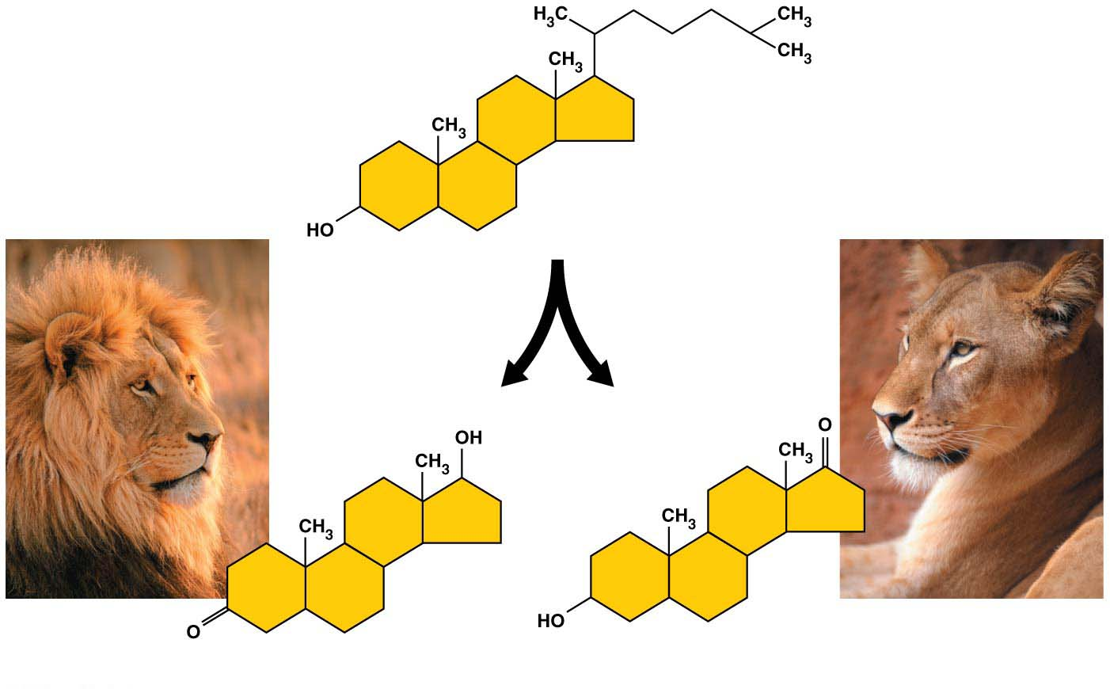
Example of steroids
Cholesterol
can be converted
by the body to
Testosterone
A type of estrogen
Notes:
Figure 3.13 Examples of steroids

Slide 101
Steroids
2. Synthetic anabolic steroids:
are variants of testosterone,
mimic some of its effects,
may be prescribed to treat diseases such as cancer and AIDS,
are abused by athletes to build up their muscles quickly, and
can cause serious physical and mental problems.
Most athletic organizations ban the use of anabolic steroids because of their many potential health hazards coupled with the unfairness of an artificial advantage.
هذه الشرائح مخصصة للشرح و ليست للمذاكرة
Notes:
101
Student Misconceptions and Concerns
1. The abstract nature of chemistry can be discouraging to many students. Consider starting out this section of the lecture by examining the chemical groups on a food nutrition label. Candy bars with peanuts are particularly useful as they contain significant amounts of all three sources of calories (carbohydrates, proteins, and lipids).
2. Students might struggle to extrapolate the properties of lipids to their roles in an organism. Ducks float because their feathers repel water instead of attracting it. Hair on your head remains flexible because of oils produced in your scalp. Examples such as these help connect the abstract properties of lipids to concrete examples in our world.
3. The functional significance of protein shape is an abstract molecular example of form and function relationships, which might be new to some students. The binding of an enzyme to its substrate is a type of molecular handshake, which permits specific interactions. To help students think about form and function relationships, share some concrete analogies in their lives—perhaps flathead and Phillips screwdrivers that match the proper type of screws or the fit of a hand into a glove.
4. The evolution of lactose tolerance within human groups in East Africa does not represent a deliberate decision, yet this evolutionary change appears logical. Many students perceive adaptations as deliberate events with purpose. As students develop a better understanding of the mechanisms of evolution, it will be important to point out that mutations arise by chance, with the culling hand of natural selection favoring traits that convey an advantage. Organisms cannot plan evolutionary change.
Teaching Tips
1. Consider reinforcing the three main sources of calories with food items that clearly represent each group. Bring clear examples to class as visual references, for example, a can of Coke or a bag of sugar for carbohydrates, a tub of margarine for lipids, and some beef jerky for protein (although some fat and carbohydrates might also be included).
2. If your lectures will eventually include details of glycolysis and aerobic respiration, this is a good point to introduce the basic concepts of glucose as fuel. Just introducing this conceptual formula might help: eating glucose + breathing in oxygen (yields) water + usable energy (used to build ATP) + heat + exhaled CO₂.
3. The section about our use of sugars may be of considerable interest to your students, who might not be expecting much interest in a lecture about organic chemistry. Consider an assignment for each student to bring to class a product label indicating high-fructose corn syrup (HFCS) as an ingredient.
4. Learning the definitions of word roots is invaluable when learning science. Learning the meaning of the prefix word roots “mono” (one), “di” (two), and “poly” (many) helps to distinguish the structures of various carbohydrates.
5. Consider an assignment for students to find reliable sources that discuss high sugar consumption in the modern diet. The key, of course, is in the quality of the resource. Consider narrowing down the categories to certain nonprofit health organizations (American Cancer Society, American Heart Association, and the like) and peer-reviewed journals.
6. A simple exercise demonstrates the enzymatic breakdown of starches into sugars. If students place an unsalted cracker in their mouths, holding it in their mouths while it mixes well with saliva, they might soon notice that a sweeter taste begins to emerge. The salivary enzyme amylase begins the digestion of starches into disaccharides, which may be degraded further by other enzymes. These disaccharides are the source of the sweet taste.
7. An adult human may store about a half of a kilogram of glycogen in the liver and muscles of the body, depending on recent dietary habits. A person who begins dieting might soon notice an immediate weight loss of 2–4 pounds (1–2 kilograms) over several days, reflecting reductions in stored glycogen, water, and intestinal contents (among other factors).
8. Another simple demonstration can illustrate hydrophobic and hydrophilic substances. In front of the class, mix colored water and a yellow oil (corn or canola oil work well). Shake up the mixture and then watch as the two separate. (You may have a mixture already made that remains separated; however, the dyes may bleed between the oil and the water.)
9. Margarine in stores commonly comes in liquid squeeze containers, in tubs, and in sticks. These forms reflect increasing amounts of hydrogenation, gradually increasing the stiffness from a liquid, to a firmer spread, to a firm stick of margarine. As noted in the text, recent studies have suggested that unsaturated oils become increasingly unhealthy as they are hydrogenated. Perhaps your students can find references to this correlation on the Internet.
10. Many analogies can help students understand the diversity of proteins that can be made from just 20 amino acids. The authors note that our language uses combinations of 26 letters to form words. Proteins are much longer “words,” creating even more diversity. Another analogy is to trains. This builds on the earlier analogy when polymers were introduced. Imagine making different trains about 100 cars long, using any combination of 20 types of railroad cars. Mathematically, the number of possible trains is 20¹⁰⁰, a number beyond imagination.
11. The authors note that the difference between a polypeptide and a protein is analogous to the relationship between a long strand of yarn and a sweater knitted from yarn. Proteins are clearly more complex!
12. Most cooking results in changes in the texture and color of a food. The brown color of a steak is the product of the denaturation of proteins. Fixatives such as formalin also denature proteins and cause color changes. Students who have dissected vertebrates will realize that the brown color of the muscles makes it look as if the animal has been cooked.
13. The “NA” in DNA and RNA stands for “nucleic acid.” Students often do not make this association without assistance.
Active Lecture Tips
1. The cellophane wrap often used to package foods is a biodegradable material derived from cellulose. Challenge students to work in pairs to create a list of other cellulose-derived products (such as paper).
2. Consider this assignment to finish a discussion of the diverse organic molecules in our diets. Have students work in pairs or small groups to analyze a food label listing the components of a McDonald’s Big Mac. Note the most abundant organic molecule class (perhaps by weight) found in each component.
3. See the Activity What Ingredients Make Up Your Snack Food on the Instructor Exchange. Visit the Instructor Exchange in the MasteringBiology instructor resource area for a description of this activity.
4. See the Activity Drawing Hydrophobic and Hydrophilic Interactions on the Instructor Exchange. Visit the Instructor Exchange in the MasteringBiology instructor resource area for a description of this activity.

Slide 102
PROTEIN

Slide 103
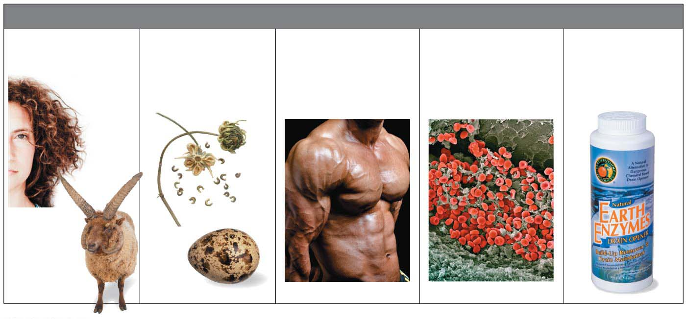
Proteins
Proteins are polymers of amino acid monomers,
account for more than 50% of the dry weight of most cells, and
are instrumental in almost everything cells do.
MAJOR TYPES OF PROTEINS
Structural Proteins
(provide support)
Storage Proteins
(provide amino
acids for growth)
Contractile
Proteins
(help movement)
Transport Proteins
(help transport
substances)
Enzymes
(help chemical
reactions)
Some of the varied roles played by proteins
هذه الشرائح مخصصة للشرح و ليست للمذاكرة
Notes:
103
Student Misconceptions and Concerns
1. The abstract nature of chemistry can be discouraging to many students. Consider starting out this section of the lecture by examining the chemical groups on a food nutrition label. Candy bars with peanuts are particularly useful as they contain significant amounts of all three sources of calories (carbohydrates, proteins, and lipids).
2. Students might struggle to extrapolate the properties of lipids to their roles in an organism. Ducks float because their feathers repel water instead of attracting it. Hair on your head remains flexible because of oils produced in your scalp. Examples such as these help connect the abstract properties of lipids to concrete examples in our world.
3. The functional significance of protein shape is an abstract molecular example of form and function relationships, which might be new to some students. The binding of an enzyme to its substrate is a type of molecular handshake, which permits specific interactions. To help students think about form and function relationships, share some concrete analogies in their lives—perhaps flathead and Phillips screwdrivers that match the proper type of screws or the fit of a hand into a glove.
4. The evolution of lactose tolerance within human groups in East Africa does not represent a deliberate decision, yet this evolutionary change appears logical. Many students perceive adaptations as deliberate events with purpose. As students develop a better understanding of the mechanisms of evolution, it will be important to point out that mutations arise by chance, with the culling hand of natural selection favoring traits that convey an advantage. Organisms cannot plan evolutionary change.
Teaching Tips
1. Consider reinforcing the three main sources of calories with food items that clearly represent each group. Bring clear examples to class as visual references, for example, a can of Coke or a bag of sugar for carbohydrates, a tub of margarine for lipids, and some beef jerky for protein (although some fat and carbohydrates might also be included).
2. If your lectures will eventually include details of glycolysis and aerobic respiration, this is a good point to introduce the basic concepts of glucose as fuel. Just introducing this conceptual formula might help: eating glucose + breathing in oxygen (yields) water + usable energy (used to build ATP) + heat + exhaled CO₂.
3. The section about our use of sugars may be of considerable interest to your students, who might not be expecting much interest in a lecture about organic chemistry. Consider an assignment for each student to bring to class a product label indicating high-fructose corn syrup (HFCS) as an ingredient.
4. Learning the definitions of word roots is invaluable when learning science. Learning the meaning of the prefix word roots “mono” (one), “di” (two), and “poly” (many) helps to distinguish the structures of various carbohydrates.
5. Consider an assignment for students to find reliable sources that discuss high sugar consumption in the modern diet. The key, of course, is in the quality of the resource. Consider narrowing down the categories to certain nonprofit health organizations (American Cancer Society, American Heart Association, and the like) and peer-reviewed journals.
6. A simple exercise demonstrates the enzymatic breakdown of starches into sugars. If students place an unsalted cracker in their mouths, holding it in their mouths while it mixes well with saliva, they might soon notice that a sweeter taste begins to emerge. The salivary enzyme amylase begins the digestion of starches into disaccharides, which may be degraded further by other enzymes. These disaccharides are the source of the sweet taste.
7. An adult human may store about a half of a kilogram of glycogen in the liver and muscles of the body, depending on recent dietary habits. A person who begins dieting might soon notice an immediate weight loss of 2–4 pounds (1–2 kilograms) over several days, reflecting reductions in stored glycogen, water, and intestinal contents (among other factors).
8. Another simple demonstration can illustrate hydrophobic and hydrophilic substances. In front of the class, mix colored water and a yellow oil (corn or canola oil work well). Shake up the mixture and then watch as the two separate. (You may have a mixture already made that remains separated; however, the dyes may bleed between the oil and the water.)
9. Margarine in stores commonly comes in liquid squeeze containers, in tubs, and in sticks. These forms reflect increasing amounts of hydrogenation, gradually increasing the stiffness from a liquid, to a firmer spread, to a firm stick of margarine. As noted in the text, recent studies have suggested that unsaturated oils become increasingly unhealthy as they are hydrogenated. Perhaps your students can find references to this correlation on the Internet.
10. Many analogies can help students understand the diversity of proteins that can be made from just 20 amino acids. The authors note that our language uses combinations of 26 letters to form words. Proteins are much longer “words,” creating even more diversity. Another analogy is to trains. This builds on the earlier analogy when polymers were introduced. Imagine making different trains about 100 cars long, using any combination of 20 types of railroad cars. Mathematically, the number of possible trains is 20¹⁰⁰, a number beyond imagination.
11. The authors note that the difference between a polypeptide and a protein is analogous to the relationship between a long strand of yarn and a sweater knitted from yarn. Proteins are clearly more complex!
12. Most cooking results in changes in the texture and color of a food. The brown color of a steak is the product of the denaturation of proteins. Fixatives such as formalin also denature proteins and cause color changes. Students who have dissected vertebrates will realize that the brown color of the muscles makes it look as if the animal has been cooked.
13. The “NA” in DNA and RNA stands for “nucleic acid.” Students often do not make this association without assistance.
Active Lecture Tips
1. The cellophane wrap often used to package foods is a biodegradable material derived from cellulose. Challenge students to work in pairs to create a list of other cellulose-derived products (such as paper).
2. Consider this assignment to finish a discussion of the diverse organic molecules in our diets. Have students work in pairs or small groups to analyze a food label listing the components of a McDonald’s Big Mac. Note the most abundant organic molecule class (perhaps by weight) found in each component.
3. See the Activity What Ingredients Make Up Your Snack Food on the Instructor Exchange. Visit the Instructor Exchange in the MasteringBiology instructor resource area for a description of this activity.
4. See the Activity Drawing Hydrophobic and Hydrophilic Interactions on the Instructor Exchange. Visit the Instructor Exchange in the MasteringBiology instructor resource area for a description of this activity.

Slide 104
The Monomers of Proteins: Amino Acids
All proteins are made by stringing together a common set of 20 kinds of amino acids.
Every amino acid consists of a central carbon atom bonded to four covalent partners.
هذه الشرائح مخصصة للشرح و ليست للمذاكرة
Notes:
104
Student Misconceptions and Concerns
1. The abstract nature of chemistry can be discouraging to many students. Consider starting out this section of the lecture by examining the chemical groups on a food nutrition label. Candy bars with peanuts are particularly useful as they contain significant amounts of all three sources of calories (carbohydrates, proteins, and lipids).
2. Students might struggle to extrapolate the properties of lipids to their roles in an organism. Ducks float because their feathers repel water instead of attracting it. Hair on your head remains flexible because of oils produced in your scalp. Examples such as these help connect the abstract properties of lipids to concrete examples in our world.
3. The functional significance of protein shape is an abstract molecular example of form and function relationships, which might be new to some students. The binding of an enzyme to its substrate is a type of molecular handshake, which permits specific interactions. To help students think about form and function relationships, share some concrete analogies in their lives—perhaps flathead and Phillips screwdrivers that match the proper type of screws or the fit of a hand into a glove.
4. The evolution of lactose tolerance within human groups in East Africa does not represent a deliberate decision, yet this evolutionary change appears logical. Many students perceive adaptations as deliberate events with purpose. As students develop a better understanding of the mechanisms of evolution, it will be important to point out that mutations arise by chance, with the culling hand of natural selection favoring traits that convey an advantage. Organisms cannot plan evolutionary change.
Teaching Tips
1. Consider reinforcing the three main sources of calories with food items that clearly represent each group. Bring clear examples to class as visual references, for example, a can of Coke or a bag of sugar for carbohydrates, a tub of margarine for lipids, and some beef jerky for protein (although some fat and carbohydrates might also be included).
2. If your lectures will eventually include details of glycolysis and aerobic respiration, this is a good point to introduce the basic concepts of glucose as fuel. Just introducing this conceptual formula might help: eating glucose + breathing in oxygen (yields) water + usable energy (used to build ATP) + heat + exhaled CO₂.
3. The section about our use of sugars may be of considerable interest to your students, who might not be expecting much interest in a lecture about organic chemistry. Consider an assignment for each student to bring to class a product label indicating high-fructose corn syrup (HFCS) as an ingredient.
4. Learning the definitions of word roots is invaluable when learning science. Learning the meaning of the prefix word roots “mono” (one), “di” (two), and “poly” (many) helps to distinguish the structures of various carbohydrates.
5. Consider an assignment for students to find reliable sources that discuss high sugar consumption in the modern diet. The key, of course, is in the quality of the resource. Consider narrowing down the categories to certain nonprofit health organizations (American Cancer Society, American Heart Association, and the like) and peer-reviewed journals.
6. A simple exercise demonstrates the enzymatic breakdown of starches into sugars. If students place an unsalted cracker in their mouths, holding it in their mouths while it mixes well with saliva, they might soon notice that a sweeter taste begins to emerge. The salivary enzyme amylase begins the digestion of starches into disaccharides, which may be degraded further by other enzymes. These disaccharides are the source of the sweet taste.
7. An adult human may store about a half of a kilogram of glycogen in the liver and muscles of the body, depending on recent dietary habits. A person who begins dieting might soon notice an immediate weight loss of 2–4 pounds (1–2 kilograms) over several days, reflecting reductions in stored glycogen, water, and intestinal contents (among other factors).
8. Another simple demonstration can illustrate hydrophobic and hydrophilic substances. In front of the class, mix colored water and a yellow oil (corn or canola oil work well). Shake up the mixture and then watch as the two separate. (You may have a mixture already made that remains separated; however, the dyes may bleed between the oil and the water.)
9. Margarine in stores commonly comes in liquid squeeze containers, in tubs, and in sticks. These forms reflect increasing amounts of hydrogenation, gradually increasing the stiffness from a liquid, to a firmer spread, to a firm stick of margarine. As noted in the text, recent studies have suggested that unsaturated oils become increasingly unhealthy as they are hydrogenated. Perhaps your students can find references to this correlation on the Internet.
10. Many analogies can help students understand the diversity of proteins that can be made from just 20 amino acids. The authors note that our language uses combinations of 26 letters to form words. Proteins are much longer “words,” creating even more diversity. Another analogy is to trains. This builds on the earlier analogy when polymers were introduced. Imagine making different trains about 100 cars long, using any combination of 20 types of railroad cars. Mathematically, the number of possible trains is 20¹⁰⁰, a number beyond imagination.
11. The authors note that the difference between a polypeptide and a protein is analogous to the relationship between a long strand of yarn and a sweater knitted from yarn. Proteins are clearly more complex!
12. Most cooking results in changes in the texture and color of a food. The brown color of a steak is the product of the denaturation of proteins. Fixatives such as formalin also denature proteins and cause color changes. Students who have dissected vertebrates will realize that the brown color of the muscles makes it look as if the animal has been cooked.
13. The “NA” in DNA and RNA stands for “nucleic acid.” Students often do not make this association without assistance.
Active Lecture Tips
1. The cellophane wrap often used to package foods is a biodegradable material derived from cellulose. Challenge students to work in pairs to create a list of other cellulose-derived products (such as paper).
2. Consider this assignment to finish a discussion of the diverse organic molecules in our diets. Have students work in pairs or small groups to analyze a food label listing the components of a McDonald’s Big Mac. Note the most abundant organic molecule class (perhaps by weight) found in each component.
3. See the Activity What Ingredients Make Up Your Snack Food on the Instructor Exchange. Visit the Instructor Exchange in the MasteringBiology instructor resource area for a description of this activity.
4. See the Activity Drawing Hydrophobic and Hydrophilic Interactions on the Instructor Exchange. Visit the Instructor Exchange in the MasteringBiology instructor resource area for a description of this activity.

Slide 105
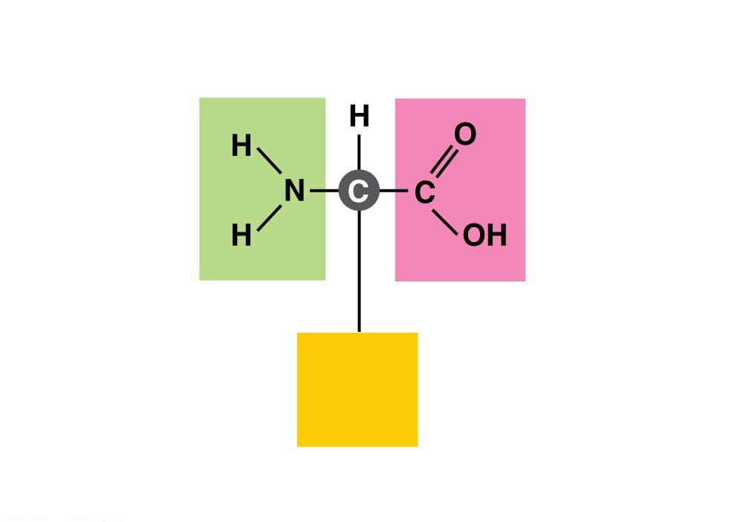
The Monomers of Proteins: Amino Acids
Three of those attachment groups are common to all amino acids:
a carboxyl group (−COOH),
an amino group (−NH₂), and
a hydrogen atom.
The variable component of amino acids is called the side chain and is attached to the fourth bond of the central carbon.
Amino
group
Carboxyl
group
Side
chain
هذه الشرائح مخصصة للشرح و ليست للمذاكرة
(a) The general structure of an amino acid
Notes:
105
Student Misconceptions and Concerns
1. The abstract nature of chemistry can be discouraging to many students. Consider starting out this section of the lecture by examining the chemical groups on a food nutrition label. Candy bars with peanuts are particularly useful as they contain significant amounts of all three sources of calories (carbohydrates, proteins, and lipids).
2. Students might struggle to extrapolate the properties of lipids to their roles in an organism. Ducks float because their feathers repel water instead of attracting it. Hair on your head remains flexible because of oils produced in your scalp. Examples such as these help connect the abstract properties of lipids to concrete examples in our world.
3. The functional significance of protein shape is an abstract molecular example of form and function relationships, which might be new to some students. The binding of an enzyme to its substrate is a type of molecular handshake, which permits specific interactions. To help students think about form and function relationships, share some concrete analogies in their lives—perhaps flathead and Phillips screwdrivers that match the proper type of screws or the fit of a hand into a glove.
4. The evolution of lactose tolerance within human groups in East Africa does not represent a deliberate decision, yet this evolutionary change appears logical. Many students perceive adaptations as deliberate events with purpose. As students develop a better understanding of the mechanisms of evolution, it will be important to point out that mutations arise by chance, with the culling hand of natural selection favoring traits that convey an advantage. Organisms cannot plan evolutionary change.
Teaching Tips
1. Consider reinforcing the three main sources of calories with food items that clearly represent each group. Bring clear examples to class as visual references, for example, a can of Coke or a bag of sugar for carbohydrates, a tub of margarine for lipids, and some beef jerky for protein (although some fat and carbohydrates might also be included).
2. If your lectures will eventually include details of glycolysis and aerobic respiration, this is a good point to introduce the basic concepts of glucose as fuel. Just introducing this conceptual formula might help: eating glucose + breathing in oxygen (yields) water + usable energy (used to build ATP) + heat + exhaled CO₂.
3. The section about our use of sugars may be of considerable interest to your students, who might not be expecting much interest in a lecture about organic chemistry. Consider an assignment for each student to bring to class a product label indicating high-fructose corn syrup (HFCS) as an ingredient.
4. Learning the definitions of word roots is invaluable when learning science. Learning the meaning of the prefix word roots “mono” (one), “di” (two), and “poly” (many) helps to distinguish the structures of various carbohydrates.
5. Consider an assignment for students to find reliable sources that discuss high sugar consumption in the modern diet. The key, of course, is in the quality of the resource. Consider narrowing down the categories to certain nonprofit health organizations (American Cancer Society, American Heart Association, and the like) and peer-reviewed journals.
6. A simple exercise demonstrates the enzymatic breakdown of starches into sugars. If students place an unsalted cracker in their mouths, holding it in their mouths while it mixes well with saliva, they might soon notice that a sweeter taste begins to emerge. The salivary enzyme amylase begins the digestion of starches into disaccharides, which may be degraded further by other enzymes. These disaccharides are the source of the sweet taste.
7. An adult human may store about a half of a kilogram of glycogen in the liver and muscles of the body, depending on recent dietary habits. A person who begins dieting might soon notice an immediate weight loss of 2–4 pounds (1–2 kilograms) over several days, reflecting reductions in stored glycogen, water, and intestinal contents (among other factors).
8. Another simple demonstration can illustrate hydrophobic and hydrophilic substances. In front of the class, mix colored water and a yellow oil (corn or canola oil work well). Shake up the mixture and then watch as the two separate. (You may have a mixture already made that remains separated; however, the dyes may bleed between the oil and the water.)
9. Margarine in stores commonly comes in liquid squeeze containers, in tubs, and in sticks. These forms reflect increasing amounts of hydrogenation, gradually increasing the stiffness from a liquid, to a firmer spread, to a firm stick of margarine. As noted in the text, recent studies have suggested that unsaturated oils become increasingly unhealthy as they are hydrogenated. Perhaps your students can find references to this correlation on the Internet.
10. Many analogies can help students understand the diversity of proteins that can be made from just 20 amino acids. The authors note that our language uses combinations of 26 letters to form words. Proteins are much longer “words,” creating even more diversity. Another analogy is to trains. This builds on the earlier analogy when polymers were introduced. Imagine making different trains about 100 cars long, using any combination of 20 types of railroad cars. Mathematically, the number of possible trains is 20¹⁰⁰, a number beyond imagination.
11. The authors note that the difference between a polypeptide and a protein is analogous to the relationship between a long strand of yarn and a sweater knitted from yarn. Proteins are clearly more complex!
12. Most cooking results in changes in the texture and color of a food. The brown color of a steak is the product of the denaturation of proteins. Fixatives such as formalin also denature proteins and cause color changes. Students who have dissected vertebrates will realize that the brown color of the muscles makes it look as if the animal has been cooked.
13. The “NA” in DNA and RNA stands for “nucleic acid.” Students often do not make this association without assistance.
Active Lecture Tips
1. The cellophane wrap often used to package foods is a biodegradable material derived from cellulose. Challenge students to work in pairs to create a list of other cellulose-derived products (such as paper).
2. Consider this assignment to finish a discussion of the diverse organic molecules in our diets. Have students work in pairs or small groups to analyze a food label listing the components of a McDonald’s Big Mac. Note the most abundant organic molecule class (perhaps by weight) found in each component.
3. See the Activity What Ingredients Make Up Your Snack Food on the Instructor Exchange. Visit the Instructor Exchange in the MasteringBiology instructor resource area for a description of this activity.
4. See the Activity Drawing Hydrophobic and Hydrophilic Interactions on the Instructor Exchange. Visit the Instructor Exchange in the MasteringBiology instructor resource area for a description of this activity.

Slide 106
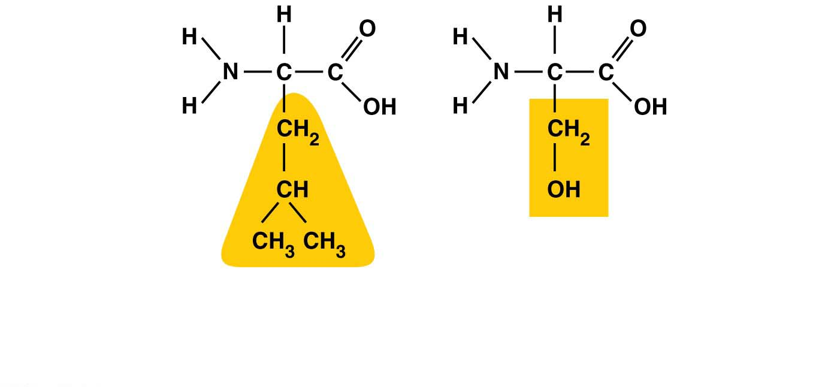
The Monomers of Proteins: Amino Acids
Each type of amino acid has a unique side chain, which gives that amino acid its special chemical properties.
Hydrophobic
side chain
Hydrophilic
side chain
Leucine
Serine
(b) Examples of amino acids with hydrophobic and hydrophilic side chains
هذه الشرائح مخصصة للشرح و ليست للمذاكرة
Notes:
Figure 3.16-2 Amino acids (part 2: side chain examples)

Slide 107
Structure/Function: Protein Shape
Cells link amino acids together by dehydration reactions,
forming peptide bonds, and creating long chains of amino acids called polypeptides.
How is it possible to make the huge variety of proteins found in your body from just 20 kinds of amino acids?
Like the English alphabet used to make different words by varying the sequent of just 26 letters, proteins use 20 different “letters” (amino acids) to create polypeptides hundreds or thousands of amino acids in length.
هذه الشرائح مخصصة للشرح و ليست للمذاكرة
Notes:
107
Student Misconceptions and Concerns
1. The abstract nature of chemistry can be discouraging to many students. Consider starting out this section of the lecture by examining the chemical groups on a food nutrition label. Candy bars with peanuts are particularly useful as they contain significant amounts of all three sources of calories (carbohydrates, proteins, and lipids).
2. Students might struggle to extrapolate the properties of lipids to their roles in an organism. Ducks float because their feathers repel water instead of attracting it. Hair on your head remains flexible because of oils produced in your scalp. Examples such as these help connect the abstract properties of lipids to concrete examples in our world.
3. The functional significance of protein shape is an abstract molecular example of form and function relationships, which might be new to some students. The binding of an enzyme to its substrate is a type of molecular handshake, which permits specific interactions. To help students think about form and function relationships, share some concrete analogies in their lives—perhaps flathead and Phillips screwdrivers that match the proper type of screws or the fit of a hand into a glove.
4. The evolution of lactose tolerance within human groups in East Africa does not represent a deliberate decision, yet this evolutionary change appears logical. Many students perceive adaptations as deliberate events with purpose. As students develop a better understanding of the mechanisms of evolution, it will be important to point out that mutations arise by chance, with the culling hand of natural selection favoring traits that convey an advantage. Organisms cannot plan evolutionary change.
Teaching Tips
1. Consider reinforcing the three main sources of calories with food items that clearly represent each group. Bring clear examples to class as visual references, for example, a can of Coke or a bag of sugar for carbohydrates, a tub of margarine for lipids, and some beef jerky for protein (although some fat and carbohydrates might also be included).
2. If your lectures will eventually include details of glycolysis and aerobic respiration, this is a good point to introduce the basic concepts of glucose as fuel. Just introducing this conceptual formula might help: eating glucose + breathing in oxygen (yields) water + usable energy (used to build ATP) + heat + exhaled CO₂.
3. The section about our use of sugars may be of considerable interest to your students, who might not be expecting much interest in a lecture about organic chemistry. Consider an assignment for each student to bring to class a product label indicating high-fructose corn syrup (HFCS) as an ingredient.
4. Learning the definitions of word roots is invaluable when learning science. Learning the meaning of the prefix word roots “mono” (one), “di” (two), and “poly” (many) helps to distinguish the structures of various carbohydrates.
5. Consider an assignment for students to find reliable sources that discuss high sugar consumption in the modern diet. The key, of course, is in the quality of the resource. Consider narrowing down the categories to certain nonprofit health organizations (American Cancer Society, American Heart Association, and the like) and peer-reviewed journals.
6. A simple exercise demonstrates the enzymatic breakdown of starches into sugars. If students place an unsalted cracker in their mouths, holding it in their mouths while it mixes well with saliva, they might soon notice that a sweeter taste begins to emerge. The salivary enzyme amylase begins the digestion of starches into disaccharides, which may be degraded further by other enzymes. These disaccharides are the source of the sweet taste.
7. An adult human may store about a half of a kilogram of glycogen in the liver and muscles of the body, depending on recent dietary habits. A person who begins dieting might soon notice an immediate weight loss of 2–4 pounds (1–2 kilograms) over several days, reflecting reductions in stored glycogen, water, and intestinal contents (among other factors).
8. Another simple demonstration can illustrate hydrophobic and hydrophilic substances. In front of the class, mix colored water and a yellow oil (corn or canola oil work well). Shake up the mixture and then watch as the two separate. (You may have a mixture already made that remains separated; however, the dyes may bleed between the oil and the water.)
9. Margarine in stores commonly comes in liquid squeeze containers, in tubs, and in sticks. These forms reflect increasing amounts of hydrogenation, gradually increasing the stiffness from a liquid, to a firmer spread, to a firm stick of margarine. As noted in the text, recent studies have suggested that unsaturated oils become increasingly unhealthy as they are hydrogenated. Perhaps your students can find references to this correlation on the Internet.
10. Many analogies can help students understand the diversity of proteins that can be made from just 20 amino acids. The authors note that our language uses combinations of 26 letters to form words. Proteins are much longer “words,” creating even more diversity. Another analogy is to trains. This builds on the earlier analogy when polymers were introduced. Imagine making different trains about 100 cars long, using any combination of 20 types of railroad cars. Mathematically, the number of possible trains is 20¹⁰⁰, a number beyond imagination.
11. The authors note that the difference between a polypeptide and a protein is analogous to the relationship between a long strand of yarn and a sweater knitted from yarn. Proteins are clearly more complex!
12. Most cooking results in changes in the texture and color of a food. The brown color of a steak is the product of the denaturation of proteins. Fixatives such as formalin also denature proteins and cause color changes. Students who have dissected vertebrates will realize that the brown color of the muscles makes it look as if the animal has been cooked.
13. The “NA” in DNA and RNA stands for “nucleic acid.” Students often do not make this association without assistance.
Active Lecture Tips
1. The cellophane wrap often used to package foods is a biodegradable material derived from cellulose. Challenge students to work in pairs to create a list of other cellulose-derived products (such as paper).
2. Consider this assignment to finish a discussion of the diverse organic molecules in our diets. Have students work in pairs or small groups to analyze a food label listing the components of a McDonald’s Big Mac. Note the most abundant organic molecule class (perhaps by weight) found in each component.
3. See the Activity What Ingredients Make Up Your Snack Food on the Instructor Exchange. Visit the Instructor Exchange in the MasteringBiology instructor resource area for a description of this activity.
4. See the Activity Drawing Hydrophobic and Hydrophilic Interactions on the Instructor Exchange. Visit the Instructor Exchange in the MasteringBiology instructor resource area for a description of this activity.

Slide 108
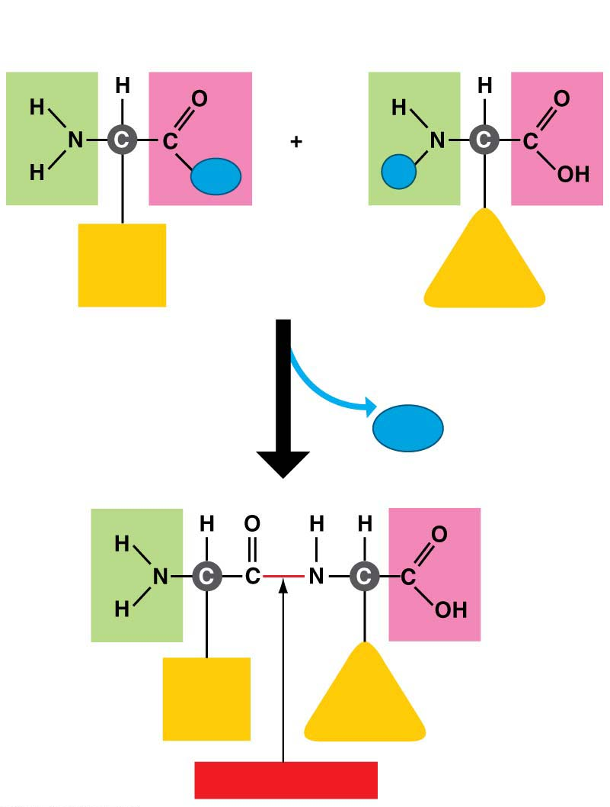
Joining amino acids
Carboxyl
group
Amino
group
OH
H
Side
chain
Side
chain
Amino acid
Amino acid
Dehydration reaction
H₂O
Side
chain
Side
chain
Peptide bond
Notes:
Figure 3.17-s2 Joining amino acids (step 2)

Slide 109
Structure/Function: Protein Shape
A functional protein is one or more polypeptide chains precisely twisted, folded, and coiled into a molecule of unique shape.
The amino acid sequence of each polypeptide determines the three-dimensional structure of the protein, which enable the molecule to carry out its specific function.
Nearly all proteins work by recognizing and binding to some other molecule.
هذه الشرائح مخصصة للشرح و ليست للمذاكرة
Notes:
109
Student Misconceptions and Concerns
1. The abstract nature of chemistry can be discouraging to many students. Consider starting out this section of the lecture by examining the chemical groups on a food nutrition label. Candy bars with peanuts are particularly useful as they contain significant amounts of all three sources of calories (carbohydrates, proteins, and lipids).
2. Students might struggle to extrapolate the properties of lipids to their roles in an organism. Ducks float because their feathers repel water instead of attracting it. Hair on your head remains flexible because of oils produced in your scalp. Examples such as these help connect the abstract properties of lipids to concrete examples in our world.
3. The functional significance of protein shape is an abstract molecular example of form and function relationships, which might be new to some students. The binding of an enzyme to its substrate is a type of molecular handshake, which permits specific interactions. To help students think about form and function relationships, share some concrete analogies in their lives—perhaps flathead and Phillips screwdrivers that match the proper type of screws or the fit of a hand into a glove.
4. The evolution of lactose tolerance within human groups in East Africa does not represent a deliberate decision, yet this evolutionary change appears logical. Many students perceive adaptations as deliberate events with purpose. As students develop a better understanding of the mechanisms of evolution, it will be important to point out that mutations arise by chance, with the culling hand of natural selection favoring traits that convey an advantage. Organisms cannot plan evolutionary change.
Teaching Tips
1. Consider reinforcing the three main sources of calories with food items that clearly represent each group. Bring clear examples to class as visual references, for example, a can of Coke or a bag of sugar for carbohydrates, a tub of margarine for lipids, and some beef jerky for protein (although some fat and carbohydrates might also be included).
2. If your lectures will eventually include details of glycolysis and aerobic respiration, this is a good point to introduce the basic concepts of glucose as fuel. Just introducing this conceptual formula might help: eating glucose + breathing in oxygen (yields) water + usable energy (used to build ATP) + heat + exhaled CO₂.
3. The section about our use of sugars may be of considerable interest to your students, who might not be expecting much interest in a lecture about organic chemistry. Consider an assignment for each student to bring to class a product label indicating high-fructose corn syrup (HFCS) as an ingredient.
4. Learning the definitions of word roots is invaluable when learning science. Learning the meaning of the prefix word roots “mono” (one), “di” (two), and “poly” (many) helps to distinguish the structures of various carbohydrates.
5. Consider an assignment for students to find reliable sources that discuss high sugar consumption in the modern diet. The key, of course, is in the quality of the resource. Consider narrowing down the categories to certain nonprofit health organizations (American Cancer Society, American Heart Association, and the like) and peer-reviewed journals.
6. A simple exercise demonstrates the enzymatic breakdown of starches into sugars. If students place an unsalted cracker in their mouths, holding it in their mouths while it mixes well with saliva, they might soon notice that a sweeter taste begins to emerge. The salivary enzyme amylase begins the digestion of starches into disaccharides, which may be degraded further by other enzymes. These disaccharides are the source of the sweet taste.
7. An adult human may store about a half of a kilogram of glycogen in the liver and muscles of the body, depending on recent dietary habits. A person who begins dieting might soon notice an immediate weight loss of 2–4 pounds (1–2 kilograms) over several days, reflecting reductions in stored glycogen, water, and intestinal contents (among other factors).
8. Another simple demonstration can illustrate hydrophobic and hydrophilic substances. In front of the class, mix colored water and a yellow oil (corn or canola oil work well). Shake up the mixture and then watch as the two separate. (You may have a mixture already made that remains separated; however, the dyes may bleed between the oil and the water.)
9. Margarine in stores commonly comes in liquid squeeze containers, in tubs, and in sticks. These forms reflect increasing amounts of hydrogenation, gradually increasing the stiffness from a liquid, to a firmer spread, to a firm stick of margarine. As noted in the text, recent studies have suggested that unsaturated oils become increasingly unhealthy as they are hydrogenated. Perhaps your students can find references to this correlation on the Internet.
10. Many analogies can help students understand the diversity of proteins that can be made from just 20 amino acids. The authors note that our language uses combinations of 26 letters to form words. Proteins are much longer “words,” creating even more diversity. Another analogy is to trains. This builds on the earlier analogy when polymers were introduced. Imagine making different trains about 100 cars long, using any combination of 20 types of railroad cars. Mathematically, the number of possible trains is 20¹⁰⁰, a number beyond imagination.
11. The authors note that the difference between a polypeptide and a protein is analogous to the relationship between a long strand of yarn and a sweater knitted from yarn. Proteins are clearly more complex!
12. Most cooking results in changes in the texture and color of a food. The brown color of a steak is the product of the denaturation of proteins. Fixatives such as formalin also denature proteins and cause color changes. Students who have dissected vertebrates will realize that the brown color of the muscles makes it look as if the animal has been cooked.
13. The “NA” in DNA and RNA stands for “nucleic acid.” Students often do not make this association without assistance.
Active Lecture Tips
1. The cellophane wrap often used to package foods is a biodegradable material derived from cellulose. Challenge students to work in pairs to create a list of other cellulose-derived products (such as paper).
2. Consider this assignment to finish a discussion of the diverse organic molecules in our diets. Have students work in pairs or small groups to analyze a food label listing the components of a McDonald’s Big Mac. Note the most abundant organic molecule class (perhaps by weight) found in each component.
3. See the Activity What Ingredients Make Up Your Snack Food on the Instructor Exchange. Visit the Instructor Exchange in the MasteringBiology instructor resource area for a description of this activity.
4. See the Activity Drawing Hydrophobic and Hydrophilic Interactions on the Instructor Exchange. Visit the Instructor Exchange in the MasteringBiology instructor resource area for a description of this activity.

Slide 110
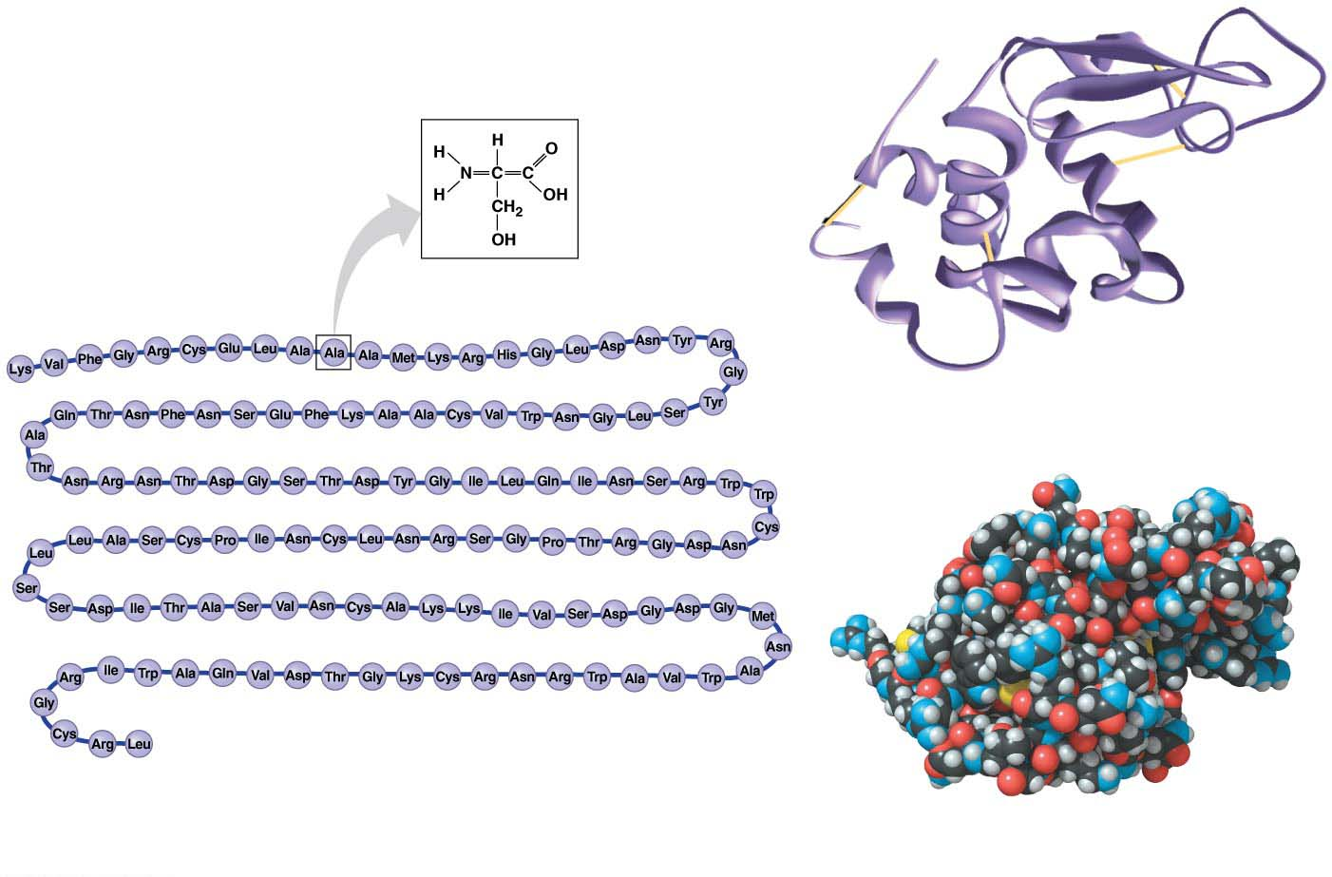
The structure of a protein
One amino acid
(alanine)
1
Here you can see how the polypeptide
folds into a compact shape.
129
The amino acid sequence of lysozyme
This model allows you to see the details
of the protein’s structure.
Notes:
Figure 3.18 The structure of a protein

Slide 111
Structure/Function: Protein Shape
A slight change in the amino acid sequence can affect a protein’s ability to function.
The substitution of one amino acid for another at a particular position in hemoglobin, the blood protein that carries oxygen, causes sickle-cell disease, an inherited blood disorder.
هذه الشرائح مخصصة للشرح و ليست للمذاكرة
Notes:
111
Student Misconceptions and Concerns
1. The abstract nature of chemistry can be discouraging to many students. Consider starting out this section of the lecture by examining the chemical groups on a food nutrition label. Candy bars with peanuts are particularly useful as they contain significant amounts of all three sources of calories (carbohydrates, proteins, and lipids).
2. Students might struggle to extrapolate the properties of lipids to their roles in an organism. Ducks float because their feathers repel water instead of attracting it. Hair on your head remains flexible because of oils produced in your scalp. Examples such as these help connect the abstract properties of lipids to concrete examples in our world.
3. The functional significance of protein shape is an abstract molecular example of form and function relationships, which might be new to some students. The binding of an enzyme to its substrate is a type of molecular handshake, which permits specific interactions. To help students think about form and function relationships, share some concrete analogies in their lives—perhaps flathead and Phillips screwdrivers that match the proper type of screws or the fit of a hand into a glove.
4. The evolution of lactose tolerance within human groups in East Africa does not represent a deliberate decision, yet this evolutionary change appears logical. Many students perceive adaptations as deliberate events with purpose. As students develop a better understanding of the mechanisms of evolution, it will be important to point out that mutations arise by chance, with the culling hand of natural selection favoring traits that convey an advantage. Organisms cannot plan evolutionary change.
Teaching Tips
1. Consider reinforcing the three main sources of calories with food items that clearly represent each group. Bring clear examples to class as visual references, for example, a can of Coke or a bag of sugar for carbohydrates, a tub of margarine for lipids, and some beef jerky for protein (although some fat and carbohydrates might also be included).
2. If your lectures will eventually include details of glycolysis and aerobic respiration, this is a good point to introduce the basic concepts of glucose as fuel. Just introducing this conceptual formula might help: eating glucose + breathing in oxygen (yields) water + usable energy (used to build ATP) + heat + exhaled CO₂.
3. The section about our use of sugars may be of considerable interest to your students, who might not be expecting much interest in a lecture about organic chemistry. Consider an assignment for each student to bring to class a product label indicating high-fructose corn syrup (HFCS) as an ingredient.
4. Learning the definitions of word roots is invaluable when learning science. Learning the meaning of the prefix word roots “mono” (one), “di” (two), and “poly” (many) helps to distinguish the structures of various carbohydrates.
5. Consider an assignment for students to find reliable sources that discuss high sugar consumption in the modern diet. The key, of course, is in the quality of the resource. Consider narrowing down the categories to certain nonprofit health organizations (American Cancer Society, American Heart Association, and the like) and peer-reviewed journals.
6. A simple exercise demonstrates the enzymatic breakdown of starches into sugars. If students place an unsalted cracker in their mouths, holding it in their mouths while it mixes well with saliva, they might soon notice that a sweeter taste begins to emerge. The salivary enzyme amylase begins the digestion of starches into disaccharides, which may be degraded further by other enzymes. These disaccharides are the source of the sweet taste.
7. An adult human may store about a half of a kilogram of glycogen in the liver and muscles of the body, depending on recent dietary habits. A person who begins dieting might soon notice an immediate weight loss of 2–4 pounds (1–2 kilograms) over several days, reflecting reductions in stored glycogen, water, and intestinal contents (among other factors).
8. Another simple demonstration can illustrate hydrophobic and hydrophilic substances. In front of the class, mix colored water and a yellow oil (corn or canola oil work well). Shake up the mixture and then watch as the two separate. (You may have a mixture already made that remains separated; however, the dyes may bleed between the oil and the water.)
9. Margarine in stores commonly comes in liquid squeeze containers, in tubs, and in sticks. These forms reflect increasing amounts of hydrogenation, gradually increasing the stiffness from a liquid, to a firmer spread, to a firm stick of margarine. As noted in the text, recent studies have suggested that unsaturated oils become increasingly unhealthy as they are hydrogenated. Perhaps your students can find references to this correlation on the Internet.
10. Many analogies can help students understand the diversity of proteins that can be made from just 20 amino acids. The authors note that our language uses combinations of 26 letters to form words. Proteins are much longer “words,” creating even more diversity. Another analogy is to trains. This builds on the earlier analogy when polymers were introduced. Imagine making different trains about 100 cars long, using any combination of 20 types of railroad cars. Mathematically, the number of possible trains is 20¹⁰⁰, a number beyond imagination.
11. The authors note that the difference between a polypeptide and a protein is analogous to the relationship between a long strand of yarn and a sweater knitted from yarn. Proteins are clearly more complex!
12. Most cooking results in changes in the texture and color of a food. The brown color of a steak is the product of the denaturation of proteins. Fixatives such as formalin also denature proteins and cause color changes. Students who have dissected vertebrates will realize that the brown color of the muscles makes it look as if the animal has been cooked.
13. The “NA” in DNA and RNA stands for “nucleic acid.” Students often do not make this association without assistance.
Active Lecture Tips
1. The cellophane wrap often used to package foods is a biodegradable material derived from cellulose. Challenge students to work in pairs to create a list of other cellulose-derived products (such as paper).
2. Consider this assignment to finish a discussion of the diverse organic molecules in our diets. Have students work in pairs or small groups to analyze a food label listing the components of a McDonald’s Big Mac. Note the most abundant organic molecule class (perhaps by weight) found in each component.
3. See the Activity What Ingredients Make Up Your Snack Food on the Instructor Exchange. Visit the Instructor Exchange in the MasteringBiology instructor resource area for a description of this activity.
4. See the Activity Drawing Hydrophobic and Hydrophilic Interactions on the Instructor Exchange. Visit the Instructor Exchange in the MasteringBiology instructor resource area for a description of this activity.

Slide 112
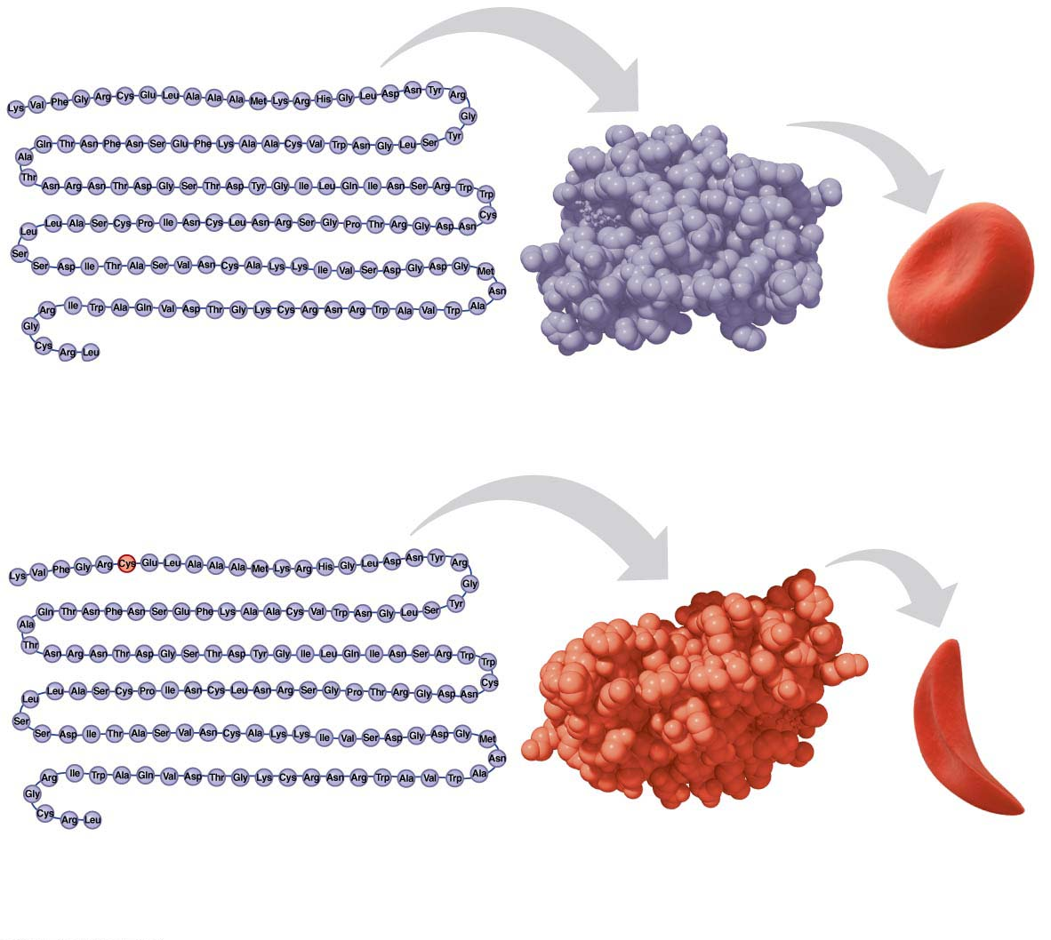
A single amino acid substitution in a protein causes sickle-cell disease
SEM
Amino acid sequence
Normal red
blood cell
Normal peptide
(a) Normal hemoglobin
SEM
Amino acid sequence
Sickle-cell
Sickled red
blood cell
polypeptide
(b) Sickle-cell hemoglobin
Notes:
Figure 3.19 A single amino acid substitution in a protein causes sickle-cell disease

Slide 113
Structure/Function: Protein Shape
One difference in structure is enough to cause the protein to fold into a different shape, which alters its function, which in turn causes disease.
Misfolded proteins are associated with many diseases.
A protein’s shape can change for many reasons:
change in temperature
Change in pH
or some other factor can cause a protein to unravel.
هذه الشرائح مخصصة للشرح و ليست للمذاكرة
Notes:
113
Student Misconceptions and Concerns
1. The abstract nature of chemistry can be discouraging to many students. Consider starting out this section of the lecture by examining the chemical groups on a food nutrition label. Candy bars with peanuts are particularly useful as they contain significant amounts of all three sources of calories (carbohydrates, proteins, and lipids).
2. Students might struggle to extrapolate the properties of lipids to their roles in an organism. Ducks float because their feathers repel water instead of attracting it. Hair on your head remains flexible because of oils produced in your scalp. Examples such as these help connect the abstract properties of lipids to concrete examples in our world.
3. The functional significance of protein shape is an abstract molecular example of form and function relationships, which might be new to some students. The binding of an enzyme to its substrate is a type of molecular handshake, which permits specific interactions. To help students think about form and function relationships, share some concrete analogies in their lives—perhaps flathead and Phillips screwdrivers that match the proper type of screws or the fit of a hand into a glove.
4. The evolution of lactose tolerance within human groups in East Africa does not represent a deliberate decision, yet this evolutionary change appears logical. Many students perceive adaptations as deliberate events with purpose. As students develop a better understanding of the mechanisms of evolution, it will be important to point out that mutations arise by chance, with the culling hand of natural selection favoring traits that convey an advantage. Organisms cannot plan evolutionary change.
Teaching Tips
1. Consider reinforcing the three main sources of calories with food items that clearly represent each group. Bring clear examples to class as visual references, for example, a can of Coke or a bag of sugar for carbohydrates, a tub of margarine for lipids, and some beef jerky for protein (although some fat and carbohydrates might also be included).
2. If your lectures will eventually include details of glycolysis and aerobic respiration, this is a good point to introduce the basic concepts of glucose as fuel. Just introducing this conceptual formula might help: eating glucose + breathing in oxygen (yields) water + usable energy (used to build ATP) + heat + exhaled CO₂.
3. The section about our use of sugars may be of considerable interest to your students, who might not be expecting much interest in a lecture about organic chemistry. Consider an assignment for each student to bring to class a product label indicating high-fructose corn syrup (HFCS) as an ingredient.
4. Learning the definitions of word roots is invaluable when learning science. Learning the meaning of the prefix word roots “mono” (one), “di” (two), and “poly” (many) helps to distinguish the structures of various carbohydrates.
5. Consider an assignment for students to find reliable sources that discuss high sugar consumption in the modern diet. The key, of course, is in the quality of the resource. Consider narrowing down the categories to certain nonprofit health organizations (American Cancer Society, American Heart Association, and the like) and peer-reviewed journals.
6. A simple exercise demonstrates the enzymatic breakdown of starches into sugars. If students place an unsalted cracker in their mouths, holding it in their mouths while it mixes well with saliva, they might soon notice that a sweeter taste begins to emerge. The salivary enzyme amylase begins the digestion of starches into disaccharides, which may be degraded further by other enzymes. These disaccharides are the source of the sweet taste.
7. An adult human may store about a half of a kilogram of glycogen in the liver and muscles of the body, depending on recent dietary habits. A person who begins dieting might soon notice an immediate weight loss of 2–4 pounds (1–2 kilograms) over several days, reflecting reductions in stored glycogen, water, and intestinal contents (among other factors).
8. Another simple demonstration can illustrate hydrophobic and hydrophilic substances. In front of the class, mix colored water and a yellow oil (corn or canola oil work well). Shake up the mixture and then watch as the two separate. (You may have a mixture already made that remains separated; however, the dyes may bleed between the oil and the water.)
9. Margarine in stores commonly comes in liquid squeeze containers, in tubs, and in sticks. These forms reflect increasing amounts of hydrogenation, gradually increasing the stiffness from a liquid, to a firmer spread, to a firm stick of margarine. As noted in the text, recent studies have suggested that unsaturated oils become increasingly unhealthy as they are hydrogenated. Perhaps your students can find references to this correlation on the Internet.
10. Many analogies can help students understand the diversity of proteins that can be made from just 20 amino acids. The authors note that our language uses combinations of 26 letters to form words. Proteins are much longer “words,” creating even more diversity. Another analogy is to trains. This builds on the earlier analogy when polymers were introduced. Imagine making different trains about 100 cars long, using any combination of 20 types of railroad cars. Mathematically, the number of possible trains is 20¹⁰⁰, a number beyond imagination.
11. The authors note that the difference between a polypeptide and a protein is analogous to the relationship between a long strand of yarn and a sweater knitted from yarn. Proteins are clearly more complex!
12. Most cooking results in changes in the texture and color of a food. The brown color of a steak is the product of the denaturation of proteins. Fixatives such as formalin also denature proteins and cause color changes. Students who have dissected vertebrates will realize that the brown color of the muscles makes it look as if the animal has been cooked.
13. The “NA” in DNA and RNA stands for “nucleic acid.” Students often do not make this association without assistance.
Active Lecture Tips
1. The cellophane wrap often used to package foods is a biodegradable material derived from cellulose. Challenge students to work in pairs to create a list of other cellulose-derived products (such as paper).
2. Consider this assignment to finish a discussion of the diverse organic molecules in our diets. Have students work in pairs or small groups to analyze a food label listing the components of a McDonald’s Big Mac. Note the most abundant organic molecule class (perhaps by weight) found in each component.
3. See the Activity What Ingredients Make Up Your Snack Food on the Instructor Exchange. Visit the Instructor Exchange in the MasteringBiology instructor resource area for a description of this activity.
4. See the Activity Drawing Hydrophobic and Hydrophilic Interactions on the Instructor Exchange. Visit the Instructor Exchange in the MasteringBiology instructor resource area for a description of this activity.

Slide 114
NUCLEIC ACID

Slide 115
Nucleic Acids
Nucleic acids are macromolecules that
store information and
provide the instructions for building proteins.
They consist of two types:
DNA (deoxyribonucleic acid) and
RNA (ribonucleic acid).
The genetic material that humans and all other organisms inherit from their parents consists of giant molecules of DNA.
The DNA resides in the cell as one or more very long fibers called chromosomes.
هذه الشرائح مخصصة للشرح و ليست للمذاكرة
Notes:
115
Student Misconceptions and Concerns
1. The abstract nature of chemistry can be discouraging to many students. Consider starting out this section of the lecture by examining the chemical groups on a food nutrition label. Candy bars with peanuts are particularly useful as they contain significant amounts of all three sources of calories (carbohydrates, proteins, and lipids).
2. Students might struggle to extrapolate the properties of lipids to their roles in an organism. Ducks float because their feathers repel water instead of attracting it. Hair on your head remains flexible because of oils produced in your scalp. Examples such as these help connect the abstract properties of lipids to concrete examples in our world.
3. The functional significance of protein shape is an abstract molecular example of form and function relationships, which might be new to some students. The binding of an enzyme to its substrate is a type of molecular handshake, which permits specific interactions. To help students think about form and function relationships, share some concrete analogies in their lives—perhaps flathead and Phillips screwdrivers that match the proper type of screws or the fit of a hand into a glove.
4. The evolution of lactose tolerance within human groups in East Africa does not represent a deliberate decision, yet this evolutionary change appears logical. Many students perceive adaptations as deliberate events with purpose. As students develop a better understanding of the mechanisms of evolution, it will be important to point out that mutations arise by chance, with the culling hand of natural selection favoring traits that convey an advantage. Organisms cannot plan evolutionary change.
Teaching Tips
1. Consider reinforcing the three main sources of calories with food items that clearly represent each group. Bring clear examples to class as visual references, for example, a can of Coke or a bag of sugar for carbohydrates, a tub of margarine for lipids, and some beef jerky for protein (although some fat and carbohydrates might also be included).
2. If your lectures will eventually include details of glycolysis and aerobic respiration, this is a good point to introduce the basic concepts of glucose as fuel. Just introducing this conceptual formula might help: eating glucose + breathing in oxygen (yields) water + usable energy (used to build ATP) + heat + exhaled CO₂.
3. The section about our use of sugars may be of considerable interest to your students, who might not be expecting much interest in a lecture about organic chemistry. Consider an assignment for each student to bring to class a product label indicating high-fructose corn syrup (HFCS) as an ingredient.
4. Learning the definitions of word roots is invaluable when learning science. Learning the meaning of the prefix word roots “mono” (one), “di” (two), and “poly” (many) helps to distinguish the structures of various carbohydrates.
5. Consider an assignment for students to find reliable sources that discuss high sugar consumption in the modern diet. The key, of course, is in the quality of the resource. Consider narrowing down the categories to certain nonprofit health organizations (American Cancer Society, American Heart Association, and the like) and peer-reviewed journals.
6. A simple exercise demonstrates the enzymatic breakdown of starches into sugars. If students place an unsalted cracker in their mouths, holding it in their mouths while it mixes well with saliva, they might soon notice that a sweeter taste begins to emerge. The salivary enzyme amylase begins the digestion of starches into disaccharides, which may be degraded further by other enzymes. These disaccharides are the source of the sweet taste.
7. An adult human may store about a half of a kilogram of glycogen in the liver and muscles of the body, depending on recent dietary habits. A person who begins dieting might soon notice an immediate weight loss of 2–4 pounds (1–2 kilograms) over several days, reflecting reductions in stored glycogen, water, and intestinal contents (among other factors).
8. Another simple demonstration can illustrate hydrophobic and hydrophilic substances. In front of the class, mix colored water and a yellow oil (corn or canola oil work well). Shake up the mixture and then watch as the two separate. (You may have a mixture already made that remains separated; however, the dyes may bleed between the oil and the water.)
9. Margarine in stores commonly comes in liquid squeeze containers, in tubs, and in sticks. These forms reflect increasing amounts of hydrogenation, gradually increasing the stiffness from a liquid, to a firmer spread, to a firm stick of margarine. As noted in the text, recent studies have suggested that unsaturated oils become increasingly unhealthy as they are hydrogenated. Perhaps your students can find references to this correlation on the Internet.
10. Many analogies can help students understand the diversity of proteins that can be made from just 20 amino acids. The authors note that our language uses combinations of 26 letters to form words. Proteins are much longer “words,” creating even more diversity. Another analogy is to trains. This builds on the earlier analogy when polymers were introduced. Imagine making different trains about 100 cars long, using any combination of 20 types of railroad cars. Mathematically, the number of possible trains is 20¹⁰⁰, a number beyond imagination.
11. The authors note that the difference between a polypeptide and a protein is analogous to the relationship between a long strand of yarn and a sweater knitted from yarn. Proteins are clearly more complex!
12. Most cooking results in changes in the texture and color of a food. The brown color of a steak is the product of the denaturation of proteins. Fixatives such as formalin also denature proteins and cause color changes. Students who have dissected vertebrates will realize that the brown color of the muscles makes it look as if the animal has been cooked.
13. The “NA” in DNA and RNA stands for “nucleic acid.” Students often do not make this association without assistance.
Active Lecture Tips
1. The cellophane wrap often used to package foods is a biodegradable material derived from cellulose. Challenge students to work in pairs to create a list of other cellulose-derived products (such as paper).
2. Consider this assignment to finish a discussion of the diverse organic molecules in our diets. Have students work in pairs or small groups to analyze a food label listing the components of a McDonald’s Big Mac. Note the most abundant organic molecule class (perhaps by weight) found in each component.
3. See the Activity What Ingredients Make Up Your Snack Food on the Instructor Exchange. Visit the Instructor Exchange in the MasteringBiology instructor resource area for a description of this activity.
4. See the Activity Drawing Hydrophobic and Hydrophilic Interactions on the Instructor Exchange. Visit the Instructor Exchange in the MasteringBiology instructor resource area for a description of this activity.

Slide 116
Nucleic Acids
What is a gene?
It is a unit of inheritance encoded in a specific stretch of DNA that programs the amino acid sequence of a polypeptide.
Those programmed instructions are written in a chemical code that must be translated
from “nucleic acid language” to “protein language.”
Nucleic acids are polymers made from monomers called nucleotides.
هذه الشرائح مخصصة للشرح و ليست للمذاكرة
Notes:
116
Student Misconceptions and Concerns
1. The abstract nature of chemistry can be discouraging to many students. Consider starting out this section of the lecture by examining the chemical groups on a food nutrition label. Candy bars with peanuts are particularly useful as they contain significant amounts of all three sources of calories (carbohydrates, proteins, and lipids).
2. Students might struggle to extrapolate the properties of lipids to their roles in an organism. Ducks float because their feathers repel water instead of attracting it. Hair on your head remains flexible because of oils produced in your scalp. Examples such as these help connect the abstract properties of lipids to concrete examples in our world.
3. The functional significance of protein shape is an abstract molecular example of form and function relationships, which might be new to some students. The binding of an enzyme to its substrate is a type of molecular handshake, which permits specific interactions. To help students think about form and function relationships, share some concrete analogies in their lives—perhaps flathead and Phillips screwdrivers that match the proper type of screws or the fit of a hand into a glove.
4. The evolution of lactose tolerance within human groups in East Africa does not represent a deliberate decision, yet this evolutionary change appears logical. Many students perceive adaptations as deliberate events with purpose. As students develop a better understanding of the mechanisms of evolution, it will be important to point out that mutations arise by chance, with the culling hand of natural selection favoring traits that convey an advantage. Organisms cannot plan evolutionary change.
Teaching Tips
1. Consider reinforcing the three main sources of calories with food items that clearly represent each group. Bring clear examples to class as visual references, for example, a can of Coke or a bag of sugar for carbohydrates, a tub of margarine for lipids, and some beef jerky for protein (although some fat and carbohydrates might also be included).
2. If your lectures will eventually include details of glycolysis and aerobic respiration, this is a good point to introduce the basic concepts of glucose as fuel. Just introducing this conceptual formula might help: eating glucose + breathing in oxygen (yields) water + usable energy (used to build ATP) + heat + exhaled CO₂.
3. The section about our use of sugars may be of considerable interest to your students, who might not be expecting much interest in a lecture about organic chemistry. Consider an assignment for each student to bring to class a product label indicating high-fructose corn syrup (HFCS) as an ingredient.
4. Learning the definitions of word roots is invaluable when learning science. Learning the meaning of the prefix word roots “mono” (one), “di” (two), and “poly” (many) helps to distinguish the structures of various carbohydrates.
5. Consider an assignment for students to find reliable sources that discuss high sugar consumption in the modern diet. The key, of course, is in the quality of the resource. Consider narrowing down the categories to certain nonprofit health organizations (American Cancer Society, American Heart Association, and the like) and peer-reviewed journals.
6. A simple exercise demonstrates the enzymatic breakdown of starches into sugars. If students place an unsalted cracker in their mouths, holding it in their mouths while it mixes well with saliva, they might soon notice that a sweeter taste begins to emerge. The salivary enzyme amylase begins the digestion of starches into disaccharides, which may be degraded further by other enzymes. These disaccharides are the source of the sweet taste.
7. An adult human may store about a half of a kilogram of glycogen in the liver and muscles of the body, depending on recent dietary habits. A person who begins dieting might soon notice an immediate weight loss of 2–4 pounds (1–2 kilograms) over several days, reflecting reductions in stored glycogen, water, and intestinal contents (among other factors).
8. Another simple demonstration can illustrate hydrophobic and hydrophilic substances. In front of the class, mix colored water and a yellow oil (corn or canola oil work well). Shake up the mixture and then watch as the two separate. (You may have a mixture already made that remains separated; however, the dyes may bleed between the oil and the water.)
9. Margarine in stores commonly comes in liquid squeeze containers, in tubs, and in sticks. These forms reflect increasing amounts of hydrogenation, gradually increasing the stiffness from a liquid, to a firmer spread, to a firm stick of margarine. As noted in the text, recent studies have suggested that unsaturated oils become increasingly unhealthy as they are hydrogenated. Perhaps your students can find references to this correlation on the Internet.
10. Many analogies can help students understand the diversity of proteins that can be made from just 20 amino acids. The authors note that our language uses combinations of 26 letters to form words. Proteins are much longer “words,” creating even more diversity. Another analogy is to trains. This builds on the earlier analogy when polymers were introduced. Imagine making different trains about 100 cars long, using any combination of 20 types of railroad cars. Mathematically, the number of possible trains is 20¹⁰⁰, a number beyond imagination.
11. The authors note that the difference between a polypeptide and a protein is analogous to the relationship between a long strand of yarn and a sweater knitted from yarn. Proteins are clearly more complex!
12. Most cooking results in changes in the texture and color of a food. The brown color of a steak is the product of the denaturation of proteins. Fixatives such as formalin also denature proteins and cause color changes. Students who have dissected vertebrates will realize that the brown color of the muscles makes it look as if the animal has been cooked.
13. The “NA” in DNA and RNA stands for “nucleic acid.” Students often do not make this association without assistance.
Active Lecture Tips
1. The cellophane wrap often used to package foods is a biodegradable material derived from cellulose. Challenge students to work in pairs to create a list of other cellulose-derived products (such as paper).
2. Consider this assignment to finish a discussion of the diverse organic molecules in our diets. Have students work in pairs or small groups to analyze a food label listing the components of a McDonald’s Big Mac. Note the most abundant organic molecule class (perhaps by weight) found in each component.
3. See the Activity What Ingredients Make Up Your Snack Food on the Instructor Exchange. Visit the Instructor Exchange in the MasteringBiology instructor resource area for a description of this activity.
4. See the Activity Drawing Hydrophobic and Hydrophilic Interactions on the Instructor Exchange. Visit the Instructor Exchange in the MasteringBiology instructor resource area for a description of this activity.

Slide 117
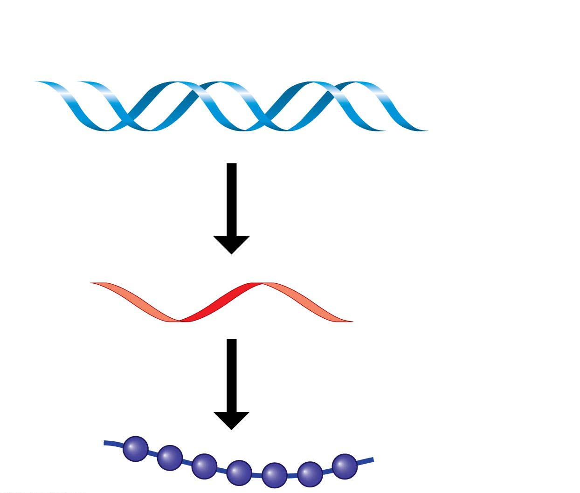
Gene
DNA
Nucleic
acids
Building a protein
RNA
Amino acid
Protein
Notes:
Figure 3.21 Building a protein

Slide 118
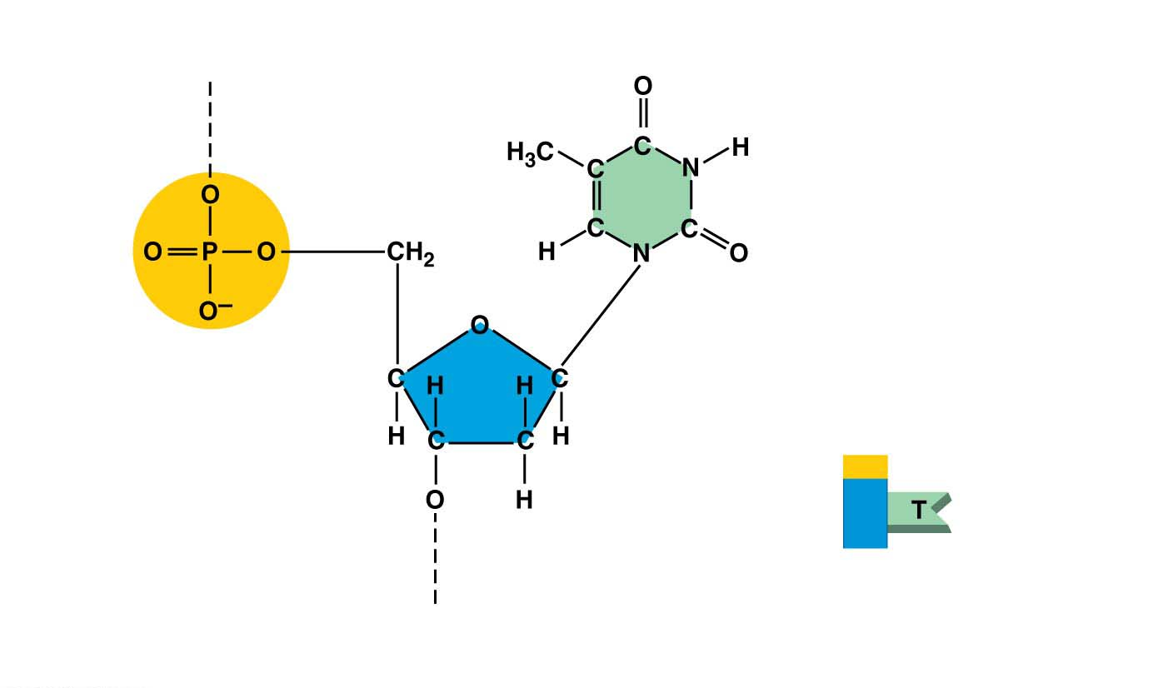
Each nucleotide has three parts:
a five-carbon sugar,
a phosphate group, and
a nitrogen-containing base.
Nitrogenous base
(can be A, G, C, or T)
Connection
to the next
nucleotide
in the chain
Thymine (T)
Phosphate
group
Phosphate
Base
Sugar
(deoxyribose)
Connection to the
next nucleotide in
the chain
Sugar
(a) Atomic structure
A DNA nucleotide
(b) Symbol used in this book
Notes:
Figure 3.22 A DNA nucleotide

Slide 119
Nucleic Acids
Each DNA nucleotide has one of four possible nitrogenous bases:
A
adenine
G
guanine
T
thymine
C
cytosine
A molecule of cellular DNA is double-stranded (double helix) with two polynucleotide strands coiled around each other.
Bases along one DNA strand hydrogen-bond to bases along the other strand.
The functional groups hanging off the base determine which bases pair up:
A only pairs with T
G can only pair with C.
هذه الشرائح مخصصة للشرح و ليست للمذاكرة
Notes:
119
Student Misconceptions and Concerns
1. The abstract nature of chemistry can be discouraging to many students. Consider starting out this section of the lecture by examining the chemical groups on a food nutrition label. Candy bars with peanuts are particularly useful as they contain significant amounts of all three sources of calories (carbohydrates, proteins, and lipids).
2. Students might struggle to extrapolate the properties of lipids to their roles in an organism. Ducks float because their feathers repel water instead of attracting it. Hair on your head remains flexible because of oils produced in your scalp. Examples such as these help connect the abstract properties of lipids to concrete examples in our world.
3. The functional significance of protein shape is an abstract molecular example of form and function relationships, which might be new to some students. The binding of an enzyme to its substrate is a type of molecular handshake, which permits specific interactions. To help students think about form and function relationships, share some concrete analogies in their lives—perhaps flathead and Phillips screwdrivers that match the proper type of screws or the fit of a hand into a glove.
4. The evolution of lactose tolerance within human groups in East Africa does not represent a deliberate decision, yet this evolutionary change appears logical. Many students perceive adaptations as deliberate events with purpose. As students develop a better understanding of the mechanisms of evolution, it will be important to point out that mutations arise by chance, with the culling hand of natural selection favoring traits that convey an advantage. Organisms cannot plan evolutionary change.
Teaching Tips
1. Consider reinforcing the three main sources of calories with food items that clearly represent each group. Bring clear examples to class as visual references, for example, a can of Coke or a bag of sugar for carbohydrates, a tub of margarine for lipids, and some beef jerky for protein (although some fat and carbohydrates might also be included).
2. If your lectures will eventually include details of glycolysis and aerobic respiration, this is a good point to introduce the basic concepts of glucose as fuel. Just introducing this conceptual formula might help: eating glucose + breathing in oxygen (yields) water + usable energy (used to build ATP) + heat + exhaled CO₂.
3. The section about our use of sugars may be of considerable interest to your students, who might not be expecting much interest in a lecture about organic chemistry. Consider an assignment for each student to bring to class a product label indicating high-fructose corn syrup (HFCS) as an ingredient.
4. Learning the definitions of word roots is invaluable when learning science. Learning the meaning of the prefix word roots “mono” (one), “di” (two), and “poly” (many) helps to distinguish the structures of various carbohydrates.
5. Consider an assignment for students to find reliable sources that discuss high sugar consumption in the modern diet. The key, of course, is in the quality of the resource. Consider narrowing down the categories to certain nonprofit health organizations (American Cancer Society, American Heart Association, and the like) and peer-reviewed journals.
6. A simple exercise demonstrates the enzymatic breakdown of starches into sugars. If students place an unsalted cracker in their mouths, holding it in their mouths while it mixes well with saliva, they might soon notice that a sweeter taste begins to emerge. The salivary enzyme amylase begins the digestion of starches into disaccharides, which may be degraded further by other enzymes. These disaccharides are the source of the sweet taste.
7. An adult human may store about a half of a kilogram of glycogen in the liver and muscles of the body, depending on recent dietary habits. A person who begins dieting might soon notice an immediate weight loss of 2–4 pounds (1–2 kilograms) over several days, reflecting reductions in stored glycogen, water, and intestinal contents (among other factors).
8. Another simple demonstration can illustrate hydrophobic and hydrophilic substances. In front of the class, mix colored water and a yellow oil (corn or canola oil work well). Shake up the mixture and then watch as the two separate. (You may have a mixture already made that remains separated; however, the dyes may bleed between the oil and the water.)
9. Margarine in stores commonly comes in liquid squeeze containers, in tubs, and in sticks. These forms reflect increasing amounts of hydrogenation, gradually increasing the stiffness from a liquid, to a firmer spread, to a firm stick of margarine. As noted in the text, recent studies have suggested that unsaturated oils become increasingly unhealthy as they are hydrogenated. Perhaps your students can find references to this correlation on the Internet.
10. Many analogies can help students understand the diversity of proteins that can be made from just 20 amino acids. The authors note that our language uses combinations of 26 letters to form words. Proteins are much longer “words,” creating even more diversity. Another analogy is to trains. This builds on the earlier analogy when polymers were introduced. Imagine making different trains about 100 cars long, using any combination of 20 types of railroad cars. Mathematically, the number of possible trains is 20¹⁰⁰, a number beyond imagination.
11. The authors note that the difference between a polypeptide and a protein is analogous to the relationship between a long strand of yarn and a sweater knitted from yarn. Proteins are clearly more complex!
12. Most cooking results in changes in the texture and color of a food. The brown color of a steak is the product of the denaturation of proteins. Fixatives such as formalin also denature proteins and cause color changes. Students who have dissected vertebrates will realize that the brown color of the muscles makes it look as if the animal has been cooked.
13. The “NA” in DNA and RNA stands for “nucleic acid.” Students often do not make this association without assistance.
Active Lecture Tips
1. The cellophane wrap often used to package foods is a biodegradable material derived from cellulose. Challenge students to work in pairs to create a list of other cellulose-derived products (such as paper).
2. Consider this assignment to finish a discussion of the diverse organic molecules in our diets. Have students work in pairs or small groups to analyze a food label listing the components of a McDonald’s Big Mac. Note the most abundant organic molecule class (perhaps by weight) found in each component.
3. See the Activity What Ingredients Make Up Your Snack Food on the Instructor Exchange. Visit the Instructor Exchange in the MasteringBiology instructor resource area for a description of this activity.
4. See the Activity Drawing Hydrophobic and Hydrophilic Interactions on the Instructor Exchange. Visit the Instructor Exchange in the MasteringBiology instructor resource area for a description of this activity.

Slide 120
The nitrogenous bases of DNA
Adenine (A)
Guanine (G)
Thymine (T)
Adenine (A)
Guanine (G)
Cytosine (C)
Thymine (T)
Cytosine (C)
Space-filling model of DNA
Notes:
Figure 3.23 The nitrogenous bases of DNA

Slide 121
The structure of the DNA
Sugar-phosphate
backbone
Nucleotide
Base
pair
Hydrogen
bond
Bases
(b) Double helix (two polynucleotide strands)
(a) DNA strand (polynucleotide)
Notes:
Figure 3.24 The structure of DNA

Slide 122
Nucleic Acids
Dehydration reactions
link nucleotide monomers into long chains called polynucleotides,
form covalent bonds between the sugar of one nucleotide and the phosphate of the next, and
form a sugar-phosphate backbone.
Bases (A, T, C, or G) hang off the backbone like appendages.
هذه الشرائح مخصصة للشرح و ليست للمذاكرة
Notes:
122
Student Misconceptions and Concerns
1. The abstract nature of chemistry can be discouraging to many students. Consider starting out this section of the lecture by examining the chemical groups on a food nutrition label. Candy bars with peanuts are particularly useful as they contain significant amounts of all three sources of calories (carbohydrates, proteins, and lipids).
2. Students might struggle to extrapolate the properties of lipids to their roles in an organism. Ducks float because their feathers repel water instead of attracting it. Hair on your head remains flexible because of oils produced in your scalp. Examples such as these help connect the abstract properties of lipids to concrete examples in our world.
3. The functional significance of protein shape is an abstract molecular example of form and function relationships, which might be new to some students. The binding of an enzyme to its substrate is a type of molecular handshake, which permits specific interactions. To help students think about form and function relationships, share some concrete analogies in their lives—perhaps flathead and Phillips screwdrivers that match the proper type of screws or the fit of a hand into a glove.
4. The evolution of lactose tolerance within human groups in East Africa does not represent a deliberate decision, yet this evolutionary change appears logical. Many students perceive adaptations as deliberate events with purpose. As students develop a better understanding of the mechanisms of evolution, it will be important to point out that mutations arise by chance, with the culling hand of natural selection favoring traits that convey an advantage. Organisms cannot plan evolutionary change.
Teaching Tips
1. Consider reinforcing the three main sources of calories with food items that clearly represent each group. Bring clear examples to class as visual references, for example, a can of Coke or a bag of sugar for carbohydrates, a tub of margarine for lipids, and some beef jerky for protein (although some fat and carbohydrates might also be included).
2. If your lectures will eventually include details of glycolysis and aerobic respiration, this is a good point to introduce the basic concepts of glucose as fuel. Just introducing this conceptual formula might help: eating glucose + breathing in oxygen (yields) water + usable energy (used to build ATP) + heat + exhaled CO₂.
3. The section about our use of sugars may be of considerable interest to your students, who might not be expecting much interest in a lecture about organic chemistry. Consider an assignment for each student to bring to class a product label indicating high-fructose corn syrup (HFCS) as an ingredient.
4. Learning the definitions of word roots is invaluable when learning science. Learning the meaning of the prefix word roots “mono” (one), “di” (two), and “poly” (many) helps to distinguish the structures of various carbohydrates.
5. Consider an assignment for students to find reliable sources that discuss high sugar consumption in the modern diet. The key, of course, is in the quality of the resource. Consider narrowing down the categories to certain nonprofit health organizations (American Cancer Society, American Heart Association, and the like) and peer-reviewed journals.
6. A simple exercise demonstrates the enzymatic breakdown of starches into sugars. If students place an unsalted cracker in their mouths, holding it in their mouths while it mixes well with saliva, they might soon notice that a sweeter taste begins to emerge. The salivary enzyme amylase begins the digestion of starches into disaccharides, which may be degraded further by other enzymes. These disaccharides are the source of the sweet taste.
7. An adult human may store about a half of a kilogram of glycogen in the liver and muscles of the body, depending on recent dietary habits. A person who begins dieting might soon notice an immediate weight loss of 2–4 pounds (1–2 kilograms) over several days, reflecting reductions in stored glycogen, water, and intestinal contents (among other factors).
8. Another simple demonstration can illustrate hydrophobic and hydrophilic substances. In front of the class, mix colored water and a yellow oil (corn or canola oil work well). Shake up the mixture and then watch as the two separate. (You may have a mixture already made that remains separated; however, the dyes may bleed between the oil and the water.)
9. Margarine in stores commonly comes in liquid squeeze containers, in tubs, and in sticks. These forms reflect increasing amounts of hydrogenation, gradually increasing the stiffness from a liquid, to a firmer spread, to a firm stick of margarine. As noted in the text, recent studies have suggested that unsaturated oils become increasingly unhealthy as they are hydrogenated. Perhaps your students can find references to this correlation on the Internet.
10. Many analogies can help students understand the diversity of proteins that can be made from just 20 amino acids. The authors note that our language uses combinations of 26 letters to form words. Proteins are much longer “words,” creating even more diversity. Another analogy is to trains. This builds on the earlier analogy when polymers were introduced. Imagine making different trains about 100 cars long, using any combination of 20 types of railroad cars. Mathematically, the number of possible trains is 20¹⁰⁰, a number beyond imagination.
11. The authors note that the difference between a polypeptide and a protein is analogous to the relationship between a long strand of yarn and a sweater knitted from yarn. Proteins are clearly more complex!
12. Most cooking results in changes in the texture and color of a food. The brown color of a steak is the product of the denaturation of proteins. Fixatives such as formalin also denature proteins and cause color changes. Students who have dissected vertebrates will realize that the brown color of the muscles makes it look as if the animal has been cooked.
13. The “NA” in DNA and RNA stands for “nucleic acid.” Students often do not make this association without assistance.
Active Lecture Tips
1. The cellophane wrap often used to package foods is a biodegradable material derived from cellulose. Challenge students to work in pairs to create a list of other cellulose-derived products (such as paper).
2. Consider this assignment to finish a discussion of the diverse organic molecules in our diets. Have students work in pairs or small groups to analyze a food label listing the components of a McDonald’s Big Mac. Note the most abundant organic molecule class (perhaps by weight) found in each component.
3. See the Activity What Ingredients Make Up Your Snack Food on the Instructor Exchange. Visit the Instructor Exchange in the MasteringBiology instructor resource area for a description of this activity.
4. See the Activity Drawing Hydrophobic and Hydrophilic Interactions on the Instructor Exchange. Visit the Instructor Exchange in the MasteringBiology instructor resource area for a description of this activity.

Slide 123
Nucleic Acids
There are many similarities between DNA and RNA.
Both are polymers of nucleotides and
both are made of nucleotides consisting of
a sugar,
a phosphate, and
a base.
هذه الشرائح مخصصة للشرح و ليست للمذاكرة
Notes:
123
Student Misconceptions and Concerns
1. The abstract nature of chemistry can be discouraging to many students. Consider starting out this section of the lecture by examining the chemical groups on a food nutrition label. Candy bars with peanuts are particularly useful as they contain significant amounts of all three sources of calories (carbohydrates, proteins, and lipids).
2. Students might struggle to extrapolate the properties of lipids to their roles in an organism. Ducks float because their feathers repel water instead of attracting it. Hair on your head remains flexible because of oils produced in your scalp. Examples such as these help connect the abstract properties of lipids to concrete examples in our world.
3. The functional significance of protein shape is an abstract molecular example of form and function relationships, which might be new to some students. The binding of an enzyme to its substrate is a type of molecular handshake, which permits specific interactions. To help students think about form and function relationships, share some concrete analogies in their lives—perhaps flathead and Phillips screwdrivers that match the proper type of screws or the fit of a hand into a glove.
4. The evolution of lactose tolerance within human groups in East Africa does not represent a deliberate decision, yet this evolutionary change appears logical. Many students perceive adaptations as deliberate events with purpose. As students develop a better understanding of the mechanisms of evolution, it will be important to point out that mutations arise by chance, with the culling hand of natural selection favoring traits that convey an advantage. Organisms cannot plan evolutionary change.
Teaching Tips
1. Consider reinforcing the three main sources of calories with food items that clearly represent each group. Bring clear examples to class as visual references, for example, a can of Coke or a bag of sugar for carbohydrates, a tub of margarine for lipids, and some beef jerky for protein (although some fat and carbohydrates might also be included).
2. If your lectures will eventually include details of glycolysis and aerobic respiration, this is a good point to introduce the basic concepts of glucose as fuel. Just introducing this conceptual formula might help: eating glucose + breathing in oxygen (yields) water + usable energy (used to build ATP) + heat + exhaled CO₂.
3. The section about our use of sugars may be of considerable interest to your students, who might not be expecting much interest in a lecture about organic chemistry. Consider an assignment for each student to bring to class a product label indicating high-fructose corn syrup (HFCS) as an ingredient.
4. Learning the definitions of word roots is invaluable when learning science. Learning the meaning of the prefix word roots “mono” (one), “di” (two), and “poly” (many) helps to distinguish the structures of various carbohydrates.
5. Consider an assignment for students to find reliable sources that discuss high sugar consumption in the modern diet. The key, of course, is in the quality of the resource. Consider narrowing down the categories to certain nonprofit health organizations (American Cancer Society, American Heart Association, and the like) and peer-reviewed journals.
6. A simple exercise demonstrates the enzymatic breakdown of starches into sugars. If students place an unsalted cracker in their mouths, holding it in their mouths while it mixes well with saliva, they might soon notice that a sweeter taste begins to emerge. The salivary enzyme amylase begins the digestion of starches into disaccharides, which may be degraded further by other enzymes. These disaccharides are the source of the sweet taste.
7. An adult human may store about a half of a kilogram of glycogen in the liver and muscles of the body, depending on recent dietary habits. A person who begins dieting might soon notice an immediate weight loss of 2–4 pounds (1–2 kilograms) over several days, reflecting reductions in stored glycogen, water, and intestinal contents (among other factors).
8. Another simple demonstration can illustrate hydrophobic and hydrophilic substances. In front of the class, mix colored water and a yellow oil (corn or canola oil work well). Shake up the mixture and then watch as the two separate. (You may have a mixture already made that remains separated; however, the dyes may bleed between the oil and the water.)
9. Margarine in stores commonly comes in liquid squeeze containers, in tubs, and in sticks. These forms reflect increasing amounts of hydrogenation, gradually increasing the stiffness from a liquid, to a firmer spread, to a firm stick of margarine. As noted in the text, recent studies have suggested that unsaturated oils become increasingly unhealthy as they are hydrogenated. Perhaps your students can find references to this correlation on the Internet.
10. Many analogies can help students understand the diversity of proteins that can be made from just 20 amino acids. The authors note that our language uses combinations of 26 letters to form words. Proteins are much longer “words,” creating even more diversity. Another analogy is to trains. This builds on the earlier analogy when polymers were introduced. Imagine making different trains about 100 cars long, using any combination of 20 types of railroad cars. Mathematically, the number of possible trains is 20¹⁰⁰, a number beyond imagination.
11. The authors note that the difference between a polypeptide and a protein is analogous to the relationship between a long strand of yarn and a sweater knitted from yarn. Proteins are clearly more complex!
12. Most cooking results in changes in the texture and color of a food. The brown color of a steak is the product of the denaturation of proteins. Fixatives such as formalin also denature proteins and cause color changes. Students who have dissected vertebrates will realize that the brown color of the muscles makes it look as if the animal has been cooked.
13. The “NA” in DNA and RNA stands for “nucleic acid.” Students often do not make this association without assistance.
Active Lecture Tips
1. The cellophane wrap often used to package foods is a biodegradable material derived from cellulose. Challenge students to work in pairs to create a list of other cellulose-derived products (such as paper).
2. Consider this assignment to finish a discussion of the diverse organic molecules in our diets. Have students work in pairs or small groups to analyze a food label listing the components of a McDonald’s Big Mac. Note the most abundant organic molecule class (perhaps by weight) found in each component.
3. See the Activity What Ingredients Make Up Your Snack Food on the Instructor Exchange. Visit the Instructor Exchange in the MasteringBiology instructor resource area for a description of this activity.
4. See the Activity Drawing Hydrophobic and Hydrophilic Interactions on the Instructor Exchange. Visit the Instructor Exchange in the MasteringBiology instructor resource area for a description of this activity.

Slide 124
Nucleic Acids
There are three important differences between DNA and RNA.
As its name ribonucleic acid denotes, the RNA sugar is ribose rather than deoxyribose in DNA.
Instead of the base thymine, RNA has a similar but distinct base called uracil (U).
RNA is usually found in single-stranded form, whereas DNA usually exists as a double helix.
هذه الشرائح مخصصة للشرح و ليست للمذاكرة

Slide 125
An RNA nucleotide
Nitrogenous base
(can be A, G, C, or U)
Connection to the next
nucleotide in the chain
Uracil (U)
Phosphate
group
Sugar (ribose)
Connection to the next
nucleotide in the chain
Notes:
Figure 3.25 An RNA nucleotide

Slide 126
A Tour of the cell
Chapter 4

Slide 127
Overview
The Microscopic World of Cells
Membrane Structure
The Nucleus and Ribosomes: Genetic Control of the Cell
The Endomembrane System: Manufacturing and Distributing Cellular Products
Energy Transformation: Chloroplasts and Mitochondria
The Cytoskeleton: Cell Shape and Movement

Slide 128
The Microscopic World of Cells
Organisms are either:
Single-celled, such as most prokaryotes and protists, or
multicelled, such as
Plants
Animals
most fungi
Cell theory states that (1) all living things are composed of cells and that (2) all cells come from earlier cells.
So, every cell in the body was formed by division of a previously living cell.
Notes:
128

Slide 129
10 m
Figure shows the size range of cells compared with objects both larger and smaller.
1 m
Human height
Length of some
nerve and muscle
cells
10 cm
Chicken egg
Visible with
the naked eye
1 cm
Frog eggs
1 mm
100 μm
Plant and
animal cells
10 μm
Nuclei
Most bacteria
1 μm
Mitochondria
Measurement Equivalents
Smallest
bacteria
1 meter (m) = 100 cm = 1,000 mm = about 39.4 inches
100 nm
Viruses
1 centimeter (cm) = 10⁻²
1
m = about 0.4 inch
Ribosomes
100
10 nm
1
1
Proteins
1 millimeter (mm) = 10⁻³
1,000
m =
10
cm
Lipids
1 nm
Small molecules
1 micrometer (μm) = 10⁻⁶ m = 10⁻³ mm
0.1 nm
Atoms
1 nanometer (nm) = 10⁻⁹ m = 10⁻³ µm

Slide 130
The Two Major Categories of Cells
Cells can fall into two basic categories
Prokaryotic cells
Bacteria
Archaea
Eukaryotic cells
Protists
Animals
plants
Fungi
Notes:
130
Student Misconceptions and Concerns
1. Students frequently equate the functions of mitochondria and chloroplasts as alternative ways to acquire usable energy. This often leads to the conclusion that animal cells have mitochondria but not chloroplasts and that plant cells have chloroplasts but not mitochondria. Plant cells have both.
Teaching Tips
1. Even in college, students still struggle with the metric system. When discussing the scale of life, consider bringing a meter stick to class. The ratio of a meter to a millimeter is the same as the ratio of a millimeter to a micron: 1 to 1000.
2. This is a place where a visual image comparing a prokaryotic and eukaryotic cell can be very helpful. These cells are strikingly different in size and composition. A visual reference point instead of just abstract ideas and traits will be a continual reminder for your students during your discussion of these cells.
3. Students might wrongly conclude that prokaryotes are typically one-tenth the volume of eukaryotic cells. A difference in diameter by a factor of ten translates into a much greater difference in volume. Students might be challenged to recall enough geometry to calculate the difference in the volume of two cells with diameters that differ by a factor of ten.
4. Some instructors have reported great success by challenging their students to make analogies to the functions of the many organelles discussed. Students may wish to construct one inclusive analogy between a society or factory (used in the text) and a cell or to construct separate analogies for each organelle. As with any analogy, it is important to list the similarities and differences/exceptions.
5. This might be a good time to discuss the evolution of antibiotic resistance. Teaching tips and ideas for related lessons can be found at www.pbs.org/wgbh/evolution/educators/lessons/lesson6/act1.html.
Active Lecture Tips
1. Germs—here is a term that we learn early in our lives but that is rarely well defined. Ask students to work in pairs to illustrate examples of “germs.” Students may appreciate a biological explanation. The general use of germs is a reference to anything microscopic that causes disease. This may be a good time to sort the major disease-causing agents into three categories: (a) bacteria (prokaryotes), (b) viruses (not yet addressed), and (c) single-celled and multicellular eukaryotes (athlete’s foot is a fungal infection; malaria is caused by a unicellular eukaryote).

Slide 132
The Two Major Categories of Cells
All cells have several basic features (similarities):
All cells are bounded by a thin plasma membrane.
Inside all cells is a thick, jelly-like fluid called the cytosol, in which cellular components are suspended.
All cells have one or more chromosomes carrying genes made of DNA.
All cells have ribosomes, tiny structures that build proteins according to the instructions from the genes.
Notes:
132

Slide 133
The Two Major Categories of Cells
Differences between prokaryotic and eukaryotic cells:
Prokaryotic cells are older than eukaryotic cells.
Prokaryotic cells are usually smaller than eukaryotic cells and simpler in structure.
A prokaryotic cell lacks a nucleus.
Its DNA is coiled into a nucleus-like region called the nucleoid, which is not partitioned from the rest of the cell by membranes.
Notes:
133

Slide 134
The Two Major Categories of Cells
Surrounding the plasma membrane of most prokaryotic cells is a rigid cell wall, which
protects the cell and
helps maintain its shape.
Prokaryotes can have
Short projections called pili, which can also attach to surfaces, and/or
Flagella, long projections that push them through their liquid environment.
4. Eukaryotic cells have organelles (Organelles: membrane-enclosed structures that perform specific functions).
Notes:
134

Slide 135
The Two Major Categories of Cells
The most important organelle is the nucleus, which
Houses most of a eukaryotic cell’s DNA and
Is surrounded by a double membrane.
Eukaryotic cells are fundamentally similar.
Notes:
135

Slide 136
An Overview of Eukaryotic Cells
Cytoplasm:
The region between the nucleus and plasma membrane is the cytoplasm.
The cytoplasm of a eukaryotic cell consists of various organelles suspended in the liquid cytosol.
Plant and animal cells:
Most organelles are found in both animal and plant cells. But there are some important differences.
Only plant cells have chloroplasts (where photosynthesis occurs), central vacuole and cell wall.
Only animal cells have lysosomes (bubbles of digestive enzymes surrounded by membranes) and centrioles.

Slide 137
IDEALIZED ANIMAL CELL
Ribosomes
Centriole
Not in most
plant cells
Lysosome
Cytoskeleton
Plasma
membrane
Cytoplasm
Nucleus
Mitochondrion
Rough
endoplasmic
reticulum (ER)
Smooth
endoplasmic
reticulum (ER)
IDEALIZED PLANT CELL
Golgi
Cytoplasm
apparatus
Cytoskeleton
Mitochondrion
Central vacuole
Not in
Nucleus
Cell wall
animal cells
Rough
endoplasmic
reticulum (ER)
Chloroplast
An idealized animal cell and plant cell
Ribosomes
Plasma
membrane
Smooth
endoplasmic
reticulum (ER)
Channels between cells
Golgi apparatus

Slide 138
PLASMA MEMBRANE

Slide 139
Structure/Function: The Plasma Membrane
Importance:
The plasma membrane separates the living cell from its nonliving surroundings.
Structure:
The plasma membrane and other membranes of the cell are composed mostly of phospholipids, which group together to form a two-layer sheet called a phospholipid bilayer.
Each phospholipid is composed of two distinct regions:
A “head” with a negatively charged phosphate group and
Two nonpolar fatty acid “tails.”
Notes:
139

Slide 140
Outside of cell
Hydrophilic
head
Hydrophobic
tail
Phospholipid
Cytoplasm (inside of cell)
(a) Phospholipid bilayer of membrane
The plasma membrane structure ( phospholipid bilayer)

Slide 141
Structure/Function: The Plasma Membrane
proteins were suspended in the phospholipid bilayer of most membranes that
Help regulate traffic across the membrane and
Perform other functions.
The plasma membrane is a fluid mosaic:
Fluid because molecules can move freely past one another and
A mosaic because of the diversity of proteins in the membrane.
Notes:
141

Slide 142
Embedded
proteins
Outside of cell
Phospholipid
bilayer
Hydrophilic
head
Hydrophobic
tail
Cytoplasm (inside of cell)
(b) Fluid mosaic model of membrane
Fluid mosaic model of membrane

Slide 144
Cell Surfaces
Plant cells:
Plant cells have a cell wall made from cellulose fibers.
Plant cell wall functions:
Protect the cells,
Maintain cell shape, and
Keep cells from absorbing too much water.
Plant cells are connected to each other via channels that pass through cell walls, joining the cytoplasm.
These channels allow water and other small molecules to move between cells.
Notes:
144

Slide 145
Cell Surfaces
Animal cells:
Lack cell walls and
most animal cells secrete a sticky coat called the extracellular matrix.
Extracellular matrix are fibers made of the protein collagen
Hold cells together in tissues and
Can have protective and supportive functions.
Notes:
145

Slide 146
Cell Surfaces
In addition, the surfaces of most animal cells contain cell junctions.
They are structures that connect cells together into tissues, allowing the cells to function in a coordinated way.

Slide 147
Nucleus and Ribosomes

Slide 148
The Nucleus and Ribosomes: Genetic Control of the Cell
The nucleus (function) is the control center of the cell.
The nucleus contains the inherited DNA molecules that directs all the processes of the cell.
Each gene is a stretch of DNA that stores the information necessary to produce a particular protein.
Proteins do most of the actual work of the cell.
Notes:
148

Slide 149
The Nucleus
Structure:
The nucleus is separated from the cytoplasm by a double membrane called the nuclear envelope.
Pores in the envelope (function) allow certain materials to pass between the nucleus and the surrounding cytoplasm.
Notes:
149

Slide 150
The Nucleus
Within the nucleus, chromatin consists of long DNA molecules and associated proteins.
Each long chromatin fiber constitutes one chromosome.
The nucleolus is
A prominent structure within the nucleus and
(function) the site where the components of ribosomes are made.
The relationship between DNA, chromatin, and a chromosome

Slide 151
Ribosomes
Ribosomes are (function) responsible for protein synthesis.
In eukaryotic cells, the components of ribosomes are made in the nucleus (in nucleolus) and then transported through the pores of the nuclear envelope into the cytoplasm, where ribosomes begin their work.
Model of a ribosome in the process of synthesizing a protein
Notes:
151

Slide 152
Ribosomes
Types:
Some ribosomes are suspended in the cytosol, making proteins that remain within the fluid of the cell.
Others are attached to the outside of the nucleus or an organelle called the endoplasmic reticulum, making proteins that are incorporated into membranes or secreted by the cell.
Notes:
Figure 4.9 ER-bound ribosomes

Slide 153
How DNA Directs Protein Production
DNA transfers its coded information to a molecule called messenger RNA (mRNA).
mRNA
exits the nucleus through pores in the nuclear envelope and
travels to the cytoplasm, where it binds to a ribosome.
A ribosome moves along the mRNA, translating the genetic message into a protein with a specific amino acid sequence.
DNA ➛ RNA ➛ protein

Slide 154
The Endomembrane System Endoplasmic reticulum

Slide 155
The Endomembrane System: Manufacturing and Distributing Cellular Products
The organelles form the endomembrane system.
The nuclear envelope,
The endoplasmic reticulum,
The Golgi apparatus,
Lysosomes, and
Vacuoles.
These membranous organelles are either
physically connected or
linked by vesicles, sacs made of membrane.
Notes:
155

Slide 156
The Endoplasmic Reticulum
The endoplasmic reticulum (ER) is one of the main manufacturing facilities in a cell.
The ER
Produces an enormous variety of molecules,
Is connected to the nuclear envelope, and
Is composed of interconnected rough and smooth ER that have different structures and functions.
Notes:
156

Slide 157
The endoplasmic reticulum (ER)
Nuclear
envelope
Ribosomes
Rough ER
Smooth ER
Notes:
Figure 4.11 The endoplasmic reticulum (ER)

Slide 158
Rough ER
Why rough? The “rough” refers to ribosomes that stud the outside of its membrane.
Ribosomes attached to the rough ER (function) produce proteins that will be
inserted into the growing ER membrane,
transported to other organelles, and
eventually exported.
Some products manufactured by rough ER are chemically modified and then packaged into transport vesicles (sacs made of membrane that bud off from the rough ER)
Then these transport vesicles may be dispatched to other locations in the cell.

Slide 159
3
Secretory
proteins depart.
4
Vesicles bud off
from the ER.
2
Proteins are
modified in
the ER.
Transport
vesicle
Ribosome
1
A ribosome
links amino
acids.
Protein
Rough ER
Polypeptide
How rough ER manufactures and packages secretory proteins

Slide 160
Smooth ER
The smooth ER
lacks surface ribosomes,
functions:
produces lipids, including steroids, and
helps liver cells to detoxify circulating drugs.
Notes:
160

Slide 161
Golgi apparatus

Slide 162
The Golgi Apparatus
The Golgi apparatus
works in partnership with the ER and
(function) receives, refines, stores, and distributes chemical products of the cell.
Notes:
162

Slide 163
The Golgi apparatus
The Golgi apparatus consists of a stack of membrane plates.
Products of ER reach the Golgi apparatus in transport vesicles.
Proteins within a vesicle are usually modified by enzymes during their transit from the receiving to the shipping side of the Golgi apparatus.
The shipping side of a Golgi stack is a depot from which finished products can be carried in transport vesicles to other organelles or to the plasma membrane.

Slide 164
Lysosomes and Vacuoles

Slide 165
Lysosomes
A lysosome is a membrane-enclosed sac of digestive enzymes found in animal cells.
Most plant cells do not contain lysosomes.
Enzymes in a lysosome can break down large molecules such as
Proteins,
Polysaccharides,
Fats, and
Nucleic acids.
Notes:
165

Slide 166
Lysosomes
1. Lysosomes have several types of digestive functions.
Food vacuole: many single-celled protists engulf nutrients in tiny cytoplasmic sacs.
Lysosomes fuse with the food vacuoles, exposing the food to digestive enzymes.
Small molecules that result from this digestion, such as amino acids, leave the lysosome and nourish the cell.
Notes:
166

Slide 167
Lysosomes
2. Can destroy harmful bacteria,
3. Engulf and digest parts of another organelle, and
4.Sculpt (carve) tissues during embryonic development, helping to form structures such as fingers.
Notes:
167

Slide 168
Vacuoles
Vacuoles are large sacs made of membrane that bud off from the ER or Golgi apparatus.
Vacuoles have a variety of functions. For example,
food vacuoles bud from the plasma membrane and
Contractile vacuoles, found in freshwater protist, pump out excess water that flows into the cell from the outside environment.
Notes:
168

Slide 169
Vacuoles
A central vacuole can account for more than half the volume of a mature plant cell.
The central vacuole of a plant cell is a versatile compartment that may:
Store organic nutrients
Absorb water
Contain pigments that attract pollinating insects or poisons that protect against plant-eating animals.
Notes:
169

Slide 170
Energy Transformations: Chloroplasts and Mitochondria

Slide 171
Energy Transformations: Chloroplasts and Mitochondria
A cell converts energy obtained from the environment to forms that the cell can use directly.
Two organelles act as cellular power stations:
Chloroplasts
Mitochondria
Notes:
171

Slide 172
Chloroplasts
Most of the living world runs on the energy provided by photosynthesis.
Photosynthesis is the conversion of light energy from the sun to
the chemical energy of sugar and
other organic molecules.
Chloroplasts are
unique to the photosynthetic cells of plants and algae and
the organelles that perform photosynthesis.
Notes:
172

Slide 173
Chloroplasts
Chloroplasts are partitioned into compartments by two membranes, one inside the other.
The stroma is a thick fluid found inside the innermost membrane.
.
Notes:
173

Slide 174
Chloroplasts
Suspended in that fluid is a network of membrane-enclosed disks and tubes, which form another compartment.
The disks occur in interconnected stacks called grana that resemble stacks of poker chips.
The grana are a chloroplast’s solar power packs, the structures that trap light energy and convert it to chemical energy.
Notes:
174

Slide 175
Mitochondria
Mitochondria are found in almost all eukaryotic cells.
Function:
They are organelles in which cellular respiration takes place, produce ATP from the energy of food molecules.
Cells use molecules of ATP as the direct energy source for most of their work.
Notes:
175

Slide 176
Mitochondria
Structure:
An envelope of two membranes encloses the mitochondrion.
The inner membrane encloses a thick fluid called the mitochondrial matrix.
The inner membrane of the envelope has numerous infoldings called cristae.
The folded surface of the membrane
Includes many of the enzymes and other molecules that function in cellular respiration and
Creates a greater area for the chemical reactions of cellular respiration.
Notes:
176
Student Misconceptions and Concerns
1. Students often mistakenly think that chloroplasts are a substitute for mitochondria in plant cells. They may falsely think that cells either have mitochondria or have chloroplasts. You might challenge this thinking by asking how plant cells generate ATP at night.
2. The evidence that mitochondria and chloroplasts evolved from free-living prokaryotes is further supported by the small size of these organelles, similar to the size of a prokaryote. Mitochondria and chloroplasts are therefore helpful in comparing the general size of eukaryotic and prokaryotic cells. You might think of these organelles as built-in comparisons.
Teaching Tips
1. ATP functions in cells much like money functions in modern societies. Each holds value that can be generated in one place and “spent” in another. This analogy has been very helpful for many students.
2. Mitochondria and chloroplasts are each wrapped by multiple membranes. In both organelles, the innermost membranes are the sites of greatest molecular activity and the outer membranes have fewer significant functions. This makes sense when we consider that the outer membranes correspond to the plasma membrane of the eukaryotic cells that originally wrapped the free-living prokaryotes during endocytosis. Biology makes sense in light of evolution.
3. Mitochondria and chloroplasts are not cellular structures that are synthesized in a cell like ribosomes and lysosomes. Instead, mitochondria only come from other mitochondria and chloroplasts only come from other chloroplasts. This is further evidence of the independent evolution of these organelles from free-living ancestral forms.
Active Lecture Tips
1. See the Activity A Chance Discovery of Endosymbiosis? A Case Study on the Instructor Exchange. Visit the Instructor Exchange in the MasteringBiology instructor resource area for a description of this activity.
2. See the Activity Energy Conversion and iPods on the Instructor Exchange. Visit the Instructor Exchange in the MasteringBiology instructor resource area for a description of this activity.
3. See the Activity Phone Batteries and Cellular Energy on the Instructor Exchange. Visit the Instructor Exchange in the MasteringBiology instructor resource area for a description of this activity.

Slide 177
Mitochondria
Similarity between Mitochondria and chloroplasts
Mitochondria and chloroplasts contain their own DNA that encodes some of their own proteins made by their own ribosomes.
Each chloroplast and mitochondrion
contains a single circular DNA chromosome that resembles a prokaryotic chromosome and
can grow and pinch in two, reproducing themselves.
Notes:
177
Student Misconceptions and Concerns
1. Students often mistakenly think that chloroplasts are a substitute for mitochondria in plant cells. They may falsely think that cells either have mitochondria or have chloroplasts. You might challenge this thinking by asking how plant cells generate ATP at night.
2. The evidence that mitochondria and chloroplasts evolved from free-living prokaryotes is further supported by the small size of these organelles, similar to the size of a prokaryote. Mitochondria and chloroplasts are therefore helpful in comparing the general size of eukaryotic and prokaryotic cells. You might think of these organelles as built-in comparisons.
Teaching Tips
1. ATP functions in cells much like money functions in modern societies. Each holds value that can be generated in one place and “spent” in another. This analogy has been very helpful for many students.
2. Mitochondria and chloroplasts are each wrapped by multiple membranes. In both organelles, the innermost membranes are the sites of greatest molecular activity and the outer membranes have fewer significant functions. This makes sense when we consider that the outer membranes correspond to the plasma membrane of the eukaryotic cells that originally wrapped the free-living prokaryotes during endocytosis. Biology makes sense in light of evolution.
3. Mitochondria and chloroplasts are not cellular structures that are synthesized in a cell like ribosomes and lysosomes. Instead, mitochondria only come from other mitochondria and chloroplasts only come from other chloroplasts. This is further evidence of the independent evolution of these organelles from free-living ancestral forms.
Active Lecture Tips
1. See the Activity A Chance Discovery of Endosymbiosis? A Case Study on the Instructor Exchange. Visit the Instructor Exchange in the MasteringBiology instructor resource area for a description of this activity.
2. See the Activity Energy Conversion and iPods on the Instructor Exchange. Visit the Instructor Exchange in the MasteringBiology instructor resource area for a description of this activity.
3. See the Activity Phone Batteries and Cellular Energy on the Instructor Exchange. Visit the Instructor Exchange in the MasteringBiology instructor resource area for a description of this activity.

Slide 178
Outer
membrane
TEM
Inner
membrane
Cristae
Matrix
Space between
membranes
Figure 4.18 The mitochondrion: site of cellular respiration

Slide 179
Cytoskeleton

Slide 180
The Cytoskeleton: Cell Shape and Movement
The cytoskeleton
Is a network of fibers extending throughout the cytoplasm and
Serves as both skeleton and “muscles” for the cell, functioning in support and movement.
provides mechanical support to the cell and
helps a cell maintain its shape.
Notes:
180

Slide 181
Maintaining Cell Shape
The cytoskeleton contains several types of fibers made from different proteins.
Microtubules are hollow tubes of protein.
The other kinds of cytoskeletal fibers, called intermediate filaments and microfilaments, are thinner and solid.
Notes:
181

Slide 182
Maintaining Cell Shape
Function:
Support and movement: serves as both skeleton and “muscles” for the cell
(A) provides mechanical support to the cell and
(B) Maintain cell’s shape.
Provides anchorage and reinforcement for many organelles in a cell.
A cell’s cytoskeleton is dynamic.

Slide 183
LM
LM
(a) Microtubules in the cytoskeleton
(b) Microtubules and movement
The cytoskeleton

Slide 184
Cilia and Flagella
In some eukaryotic cells, microtubules are arranged into structures called flagella and cilia, extensions from a cell that aid in movement.
Eukaryotic flagella propel cells through an undulating, whiplike motion.
They often occur singly, such as in human sperm cells, but may also appear in groups on the outer surface of protists.
(a) Flagellum of a human sperm cell
Colorized SEM
Notes:
184

Slide 185
Cilia and Flagella
Cilia (singular, cilium)
Are generally shorter and more numerous than flagella and
Move in a coordinated back-and-forth motion, like the rhythmic oars of a crew team.
Both cilia and flagella push various protists through water.
Cilia may extend from nonmoving cells.
On cells lining the human trachea, cilia help sweep mucus with trapped debris out of the lungs.
Notes:
185

Slide 186
Cilia and Flagella
Because human sperm rely on flagella for movement, it is easy to understand why problems with flagella can lead to male infertility.
Some men with a type of hereditary sterility also suffer from respiratory problems because of a defect in the structure of their flagella and cilia.
Colorized SEM
Colorized SEM
(b) Cilia on a protist
(c) Cilia lining the respiratory tract
Examples of flagella and cilia

