Slide 1

Electricity
Chapter 7

Slide 2
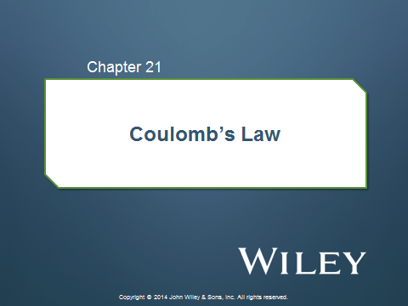

Slide 3
21-1 Coulomb’s Law
Materials classified based on their ability to move charge
Conductors are materials in which a significant number of electrons are free to move. Examples include metals.
The charged particles in nonconductors (insulators) are not free to move. Examples include rubber, plastic, glass.
Semiconductors are materials that are intermediate between conductors and insulators; examples include silicon and germanium in computer chips.
Superconductors are materials that are perfect conductors, allowing charge to move without any hindrance.

Slide 4
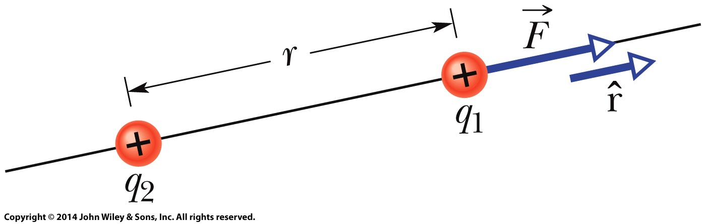

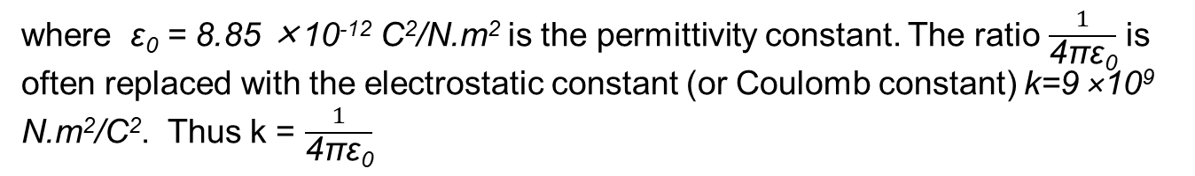
21-1 Coulomb’s Law
Coulomb’s Law
Coulomb's law (electrostatic force) states that the force between two electric charges is proportional to the product of the charges and inversely proportional to their separation squared.
where ε₀ = 8.85 ×10⁻¹² C²/N.m² is the permittivity constant. The ratio $\frac{1}{\text{4}\text{πε}\text{0}}$ is often replaced with the electrostatic constant (or Coulomb constant) k=9 ×10⁹ N.m²/C². Thus k = $\frac{1}{\text{4}\text{πε}\text{0}}$

Slide 5
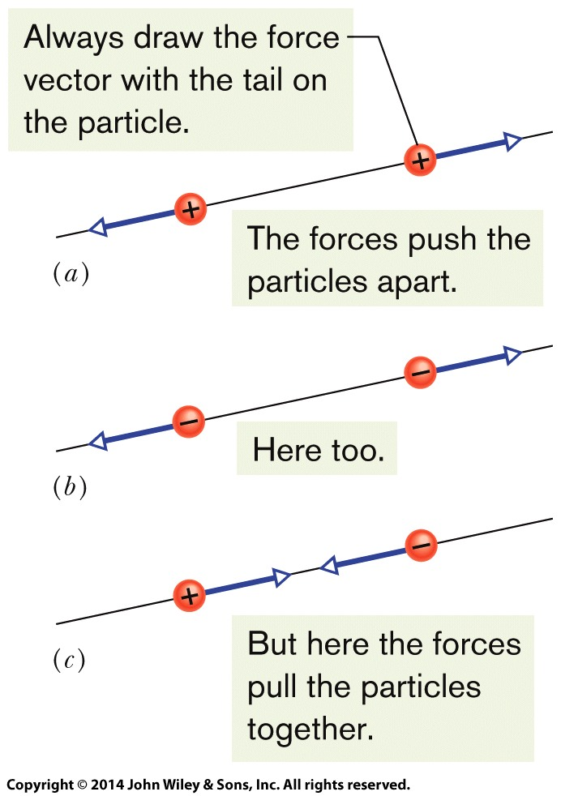
21-1 Coulomb’s Law
Coulomb’s Law
The electrostatic force vector acting on a charged particle due to a second charged particle is either directly toward the second particle (opposite sign of charge) or directly away from it (same sign of charge).
If multiple electrostatic forces act on a particle, the net force is the vector sum (not scalar sum) of the individual forces.
Two charged particles repel each other if they have the same sign of charge, either (a) both positive or (b) both negative. (c) They attract each other if they have opposite signs of charge.

Slide 6
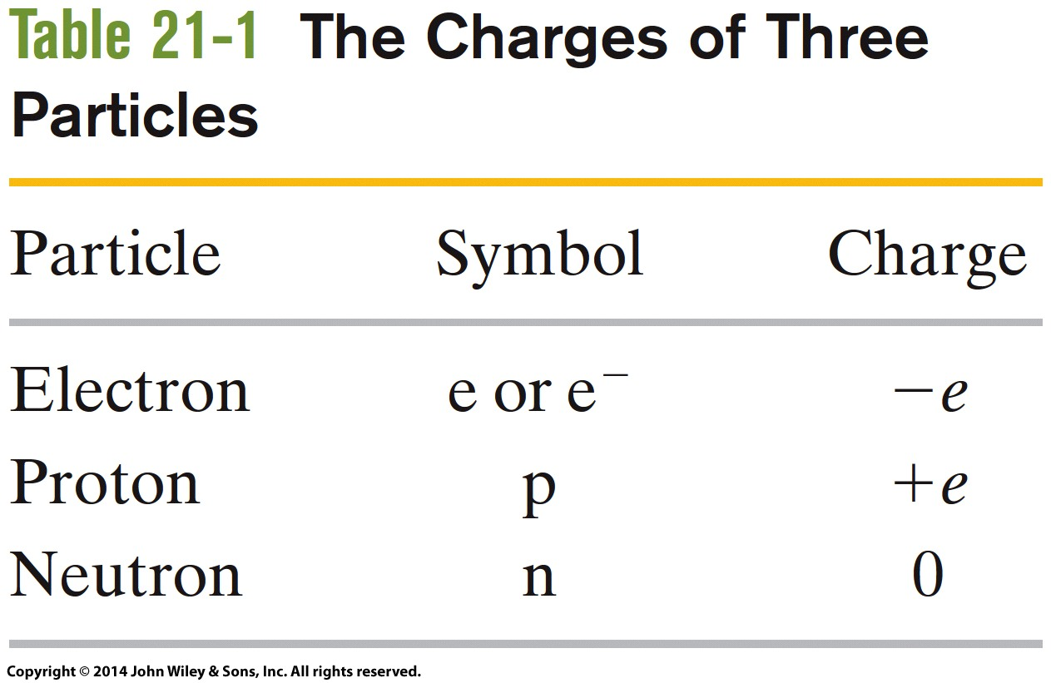
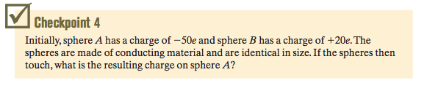
21-2 Charge is Quantized
Electric charge is quantized (restricted to certain values).
  Allowed charges (+10e or -6e).
  Forbidden charges (3.57e).
The charge of a particle can be written as ne, where n is a positive or negative integer and e is the elementary charge.
gain: n (-)
loss: n (+)
in which e, the elementary charge, has the approximate value
Answer: -15e

Slide 7
Electric Fields
Chapter 22

Slide 8

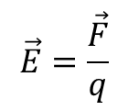
22-1 The Electric Field
The electric field E at any point is defined in terms of the electrostatic force F that would be exerted on a positive test charge q placed there:
$$\vec{E}=\frac{\vec{F}}{q}$$
or
SI unit of E is N/C, another unit for E is V/m

Slide 9

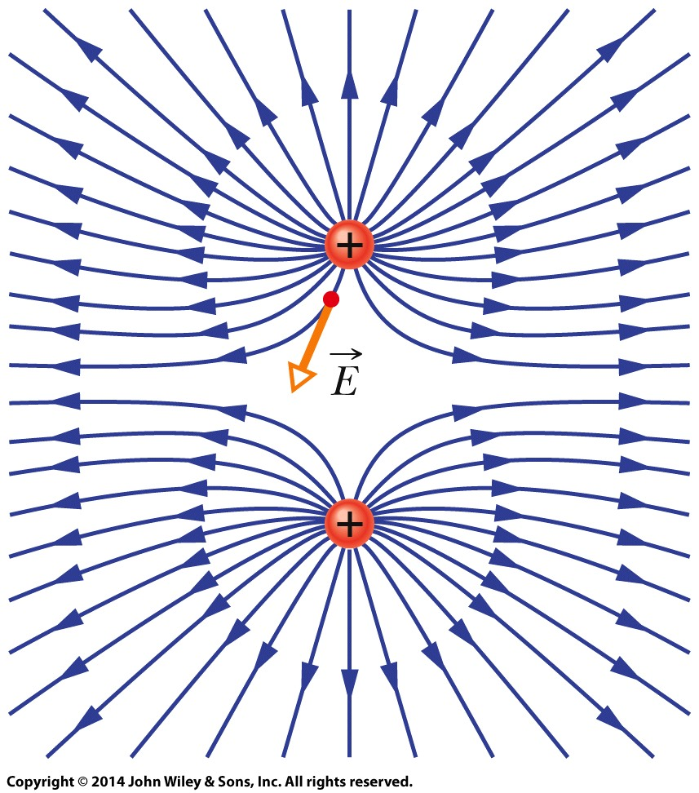
22-1 The Electric Field
Electric Field Lines
The electric field vector at any given point must be tangent to the field line at that point and in the same direction, as shown for one vector.
A closer spacing means a larger field magnitude.

Slide 10
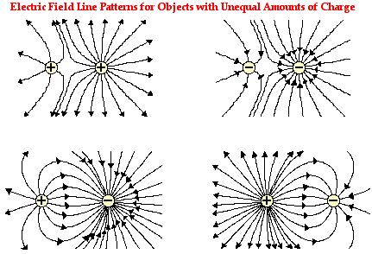
22-1 The Electric Field

Slide 11
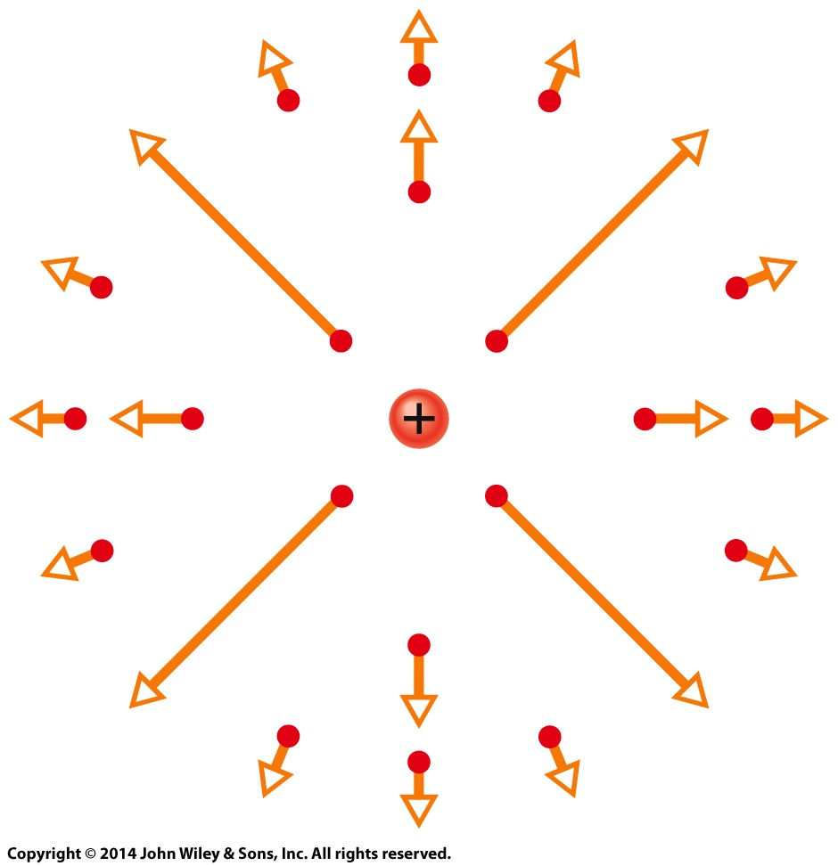

22-2 The Electric Field Due to a Charged Particle
The magnitude of the electric field E set up by a particle with charge q at distance r from the particle is
The electric field vectors set up by a positively charged particle all point directly away from the particle. Those set up by a negatively charged particle all point directly toward the particle.
If more than one charged particle sets up an electric field at a point, the net electric field is the vector sum of the individual electric fields.
The electric field vectors at various points around a positive point charge.

Slide 12
Current and Resistance
Chapter

Slide 13
Insulator x Conductors
insulators | Conductors
-in an insulator it cannot | - In a conductor, electric current can flow freely
most non-metallic solids are said to be good insulators and can be characterized by their high resistivity's Glass 10¹²(ohm/ m) | -most metals are good electrical conductors such as copper and can be characterized by their low resistivity‘s copper 1.7 x 10⁻⁸(ohm/ m)
in an insulator even the outermost electrons are so tightly bound that there is essentially zero electron flow through them with ordinary voltages | Conductor" implies that the outer electrons of the atoms are loosely bound and free to move through the material.
most nonmetals are not | Metals are also generally good heat conductors

Slide 14
Electrical current
Electrical current
is a measure of the amount of electrical charge transferred per unit time. It represents the flow of electrons through a conductive material.
The SI unit of electrical current is the ampere, defined as 1 coulomb/second

Slide 15
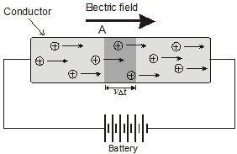
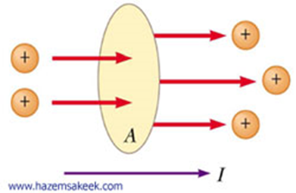
Net movement charge through the dashed area of an electrical wire is calculated from the rate of the passage of electrical charges across the area of ​​cross section through a period of time Δ t.

Slide 16


1 A = 1 C/s
For small time interval
Drift velocity:
The drift velocity is the average velocity that a particle, such as an electron, attains due to an electric field. In general, an electron will 'rattle around' in a conductor at the Fermi velocity randomly. An applied electric field will give this random motion a small net velocity in one direction.

Slide 17

Suppose the number n of electric charge passage unit volume of wire in the direction of electric field from lift to right with drift velocity v in time interval Δt
Electric charge ΔQ = nqvAΔt
Where:
q : the unit charge
A : the cross section area of the wire
v : the drift velocity
n : number of charge

Slide 18

Current density
current density is the electric current per unit area of cross section,
In SI units, the electric current density is measured in amperes per square meter.
density of current has unit A/m²
Example
A copper conductor of square cross section 1mm² on a side carries a constant current of 20A. The density of free electrons is 8×10²⁸ electron per cubic meter. Find the current density and the drift velocity.

Slide 19


Electrical resistance(R): of an electrical element is the opposition to the passage of an electric current through that element;
Electrical conductance (σ) is the case at which an electric current passes .

Slide 20



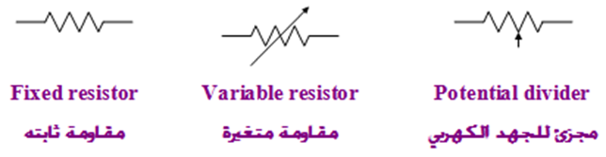

R=
A: cross sectional area
σ:conductivity
l: is the length of the conductor
Resistivity:

Slide 21


Example
Calculate the resistance of a piece of aluminum that is 10cm long and has a cross-sectional area of 10⁻⁴m². What is the resistance of a piece of glass with the same dimensions? ρ_{Al}=2.82×10⁻⁸Ω.m, ρ_{glass}=10¹⁰Ω.m.
Notice that the resistance of aluminum is much smaller than glass.

Slide 22


Example
A 2.4m length of wire that is 3.1x${10}^{−6}$ $m^{2}$ in cross section has a measured resistance of 0.24. Calculate the conductivity of the material
Solution

Slide 23
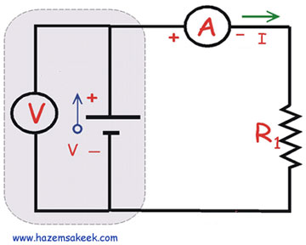
Ohm's law
discovered by Georg Simon Ohm and published in his 1827 paper, The Galvanic Circuit Investigated Mathematically. Ohm's principal discovery was that the amount of electric current through a metal conductor in a circuit is directly proportional to the voltage impressed across it,
In this algebraic expression, voltage (V) is equal to current (I) multiplied by resistance (R).

Slide 24



Example
A 0.90V potential difference is maintained across a 1.5m length of tungsten wire that has a cross-sectional area of 6X${10}^{−7}m^{2}$. What is the current in the wire? ρ=$5.6x{10}^{−8}$Ω.m
Solution:

Slide 25
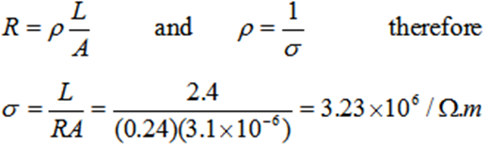

Example :
A 2.4m length of wire that is 3.1x${10}^{−6}$ $m^{2}$ in cross section has a measured resistance of 0.24Ω. Calculate the conductivity of the material
Solution

Slide 26
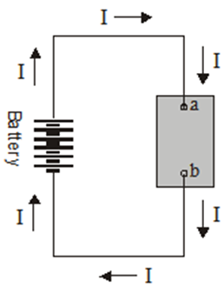

Electrical Energy and Power
Power
Electric power is the rate at which electric is transferred by an electric circuit.
The SI unit of power is the watt
Where: P is the electric power, V the potential difference, and I the electric current
Where: R is the electrical
resistance

Slide 27

Example 1
An electric heater is constructed by applying a potential difference of 110volt to a nichrome wire of total resistance 8. Find the current carried by the wire and the power rating of the heater
Solution: V = IR
The power P is:

Slide 28
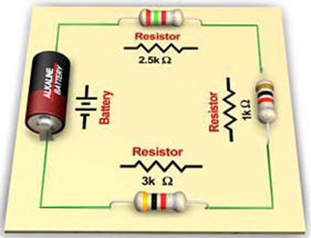
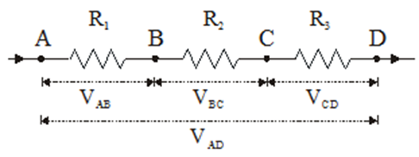
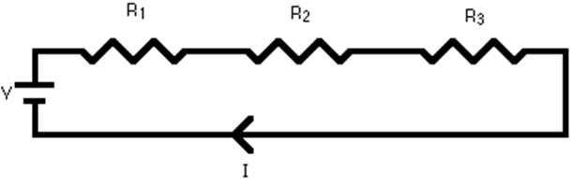
Combination of Resistors
Resistors in Series:
Total resistance:
R = R1 + R2 + R3
Example-1

Slide 29
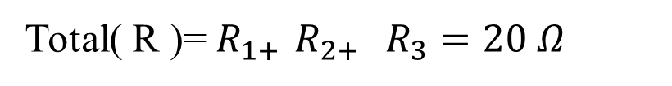

A series circuit is shown in the diagram above. The current flows through each resistor in turn. If the values of the three resistors are: $R_{1=8Ω , }R_{2 =8Ω } ,R_{3=4 Ω}$
With a 10 V battery, find the total current in the circuit?
Solution:
Total( R )=$R_{1+ }R_{2+ } R_{3}=20 Ω$
I = V / R = 10 / 20 = 0.5 A
The current through each resistor would be 0.5 A.

Slide 30
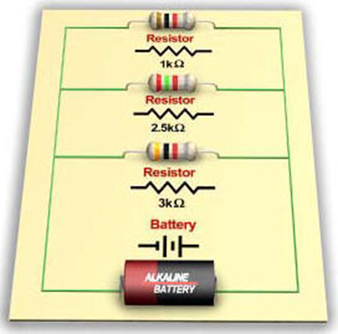
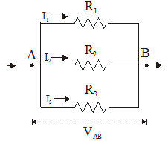

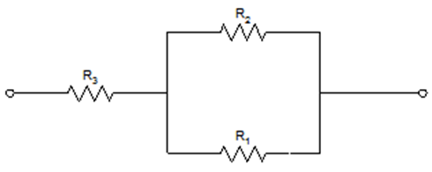
Resistors in Parallel:
Example

Slide 31

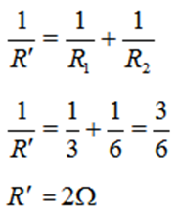
Solution
Resistance R₁ and R₂ are connected in parallel therefore the circuit is simplify as shown below

Slide 32

Then the resultant resistance of R1&R2 are connected in series with resistance R3

