Slide 1
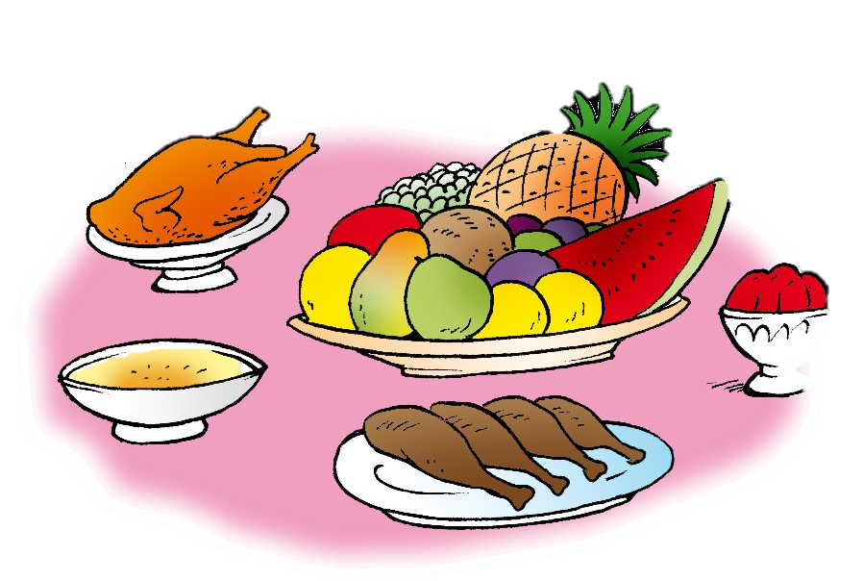
Unit 7- Lesson 6 P 69
Dinnertime!
Family and Friend 2
Grade 2

Slide 2
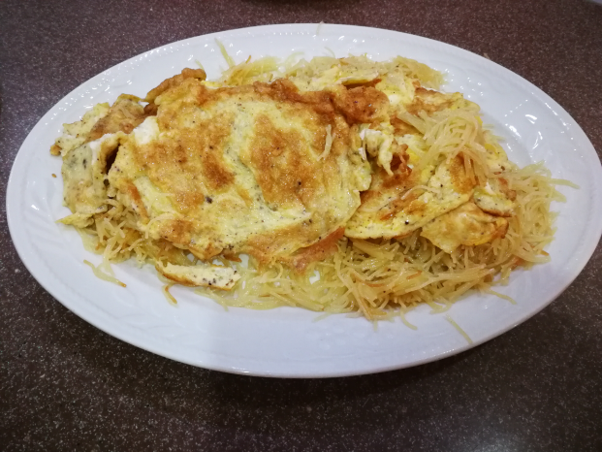
Think !
What is your favourite Bahraini dish?
Why do you like it?
When do you eat it?

Slide 3
Objectives
1. Distinguish between the short and the long form of ( aren’t – isn’t – don’t ).
2. Write about what you like and don’t like.

Slide 4
Remember !
Long form
Short form
Do not
Don’t
Is not
Isn't
Are not
Aren't

Slide 5
Look at the picture and listen.
The cup isn’t under the table.

Slide 6
Look at the picture and listen.
The cups aren’t green.

Slide 7
Look at the picture and listen.
I don’t have a red book.

Slide 8
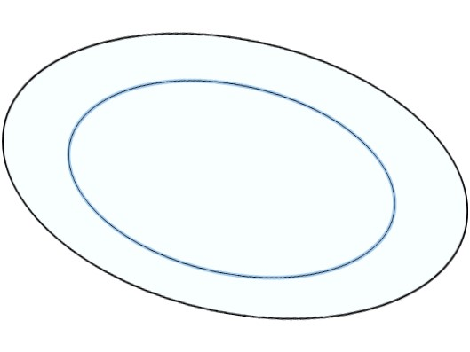
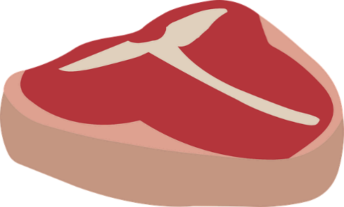
Let’s practice !
Look at the picture, read and fill the gap. Use (isn’t – aren’t – don’t)
isn't
There …………. a fish on my plate.

Slide 9
Let’s practice !
Look at the picture, read and fill the gap. Use (isn’t – aren’t – don’t)
aren't
There …………. bananas on my plate.

Slide 10
Let’s practice !
Look at the picture, read and fill the gap. Use (isn’t – aren’t – don’t)
don’t
I …………. like yogurt.

Slide 11
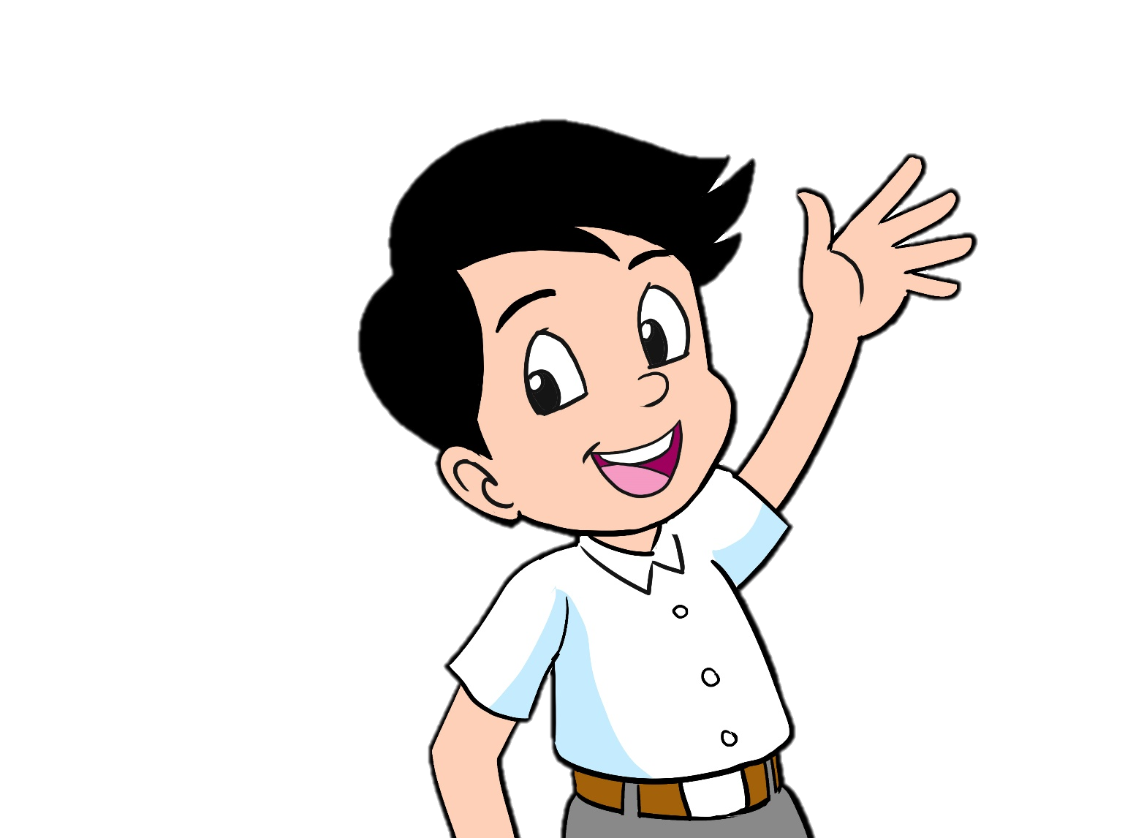
Listen then read the sentences
Hello. I’m Ali.
I like meat and carrots.
I don’t like fish or yogurt.
My favourite food is rice.

Slide 12
Practice !
Fill the gaps about you. Then,
write a short paragraph in your notebook.
Hello. I’m ………...
I like …….. and ………...
I don’t like …….. or ………..
My favourite food is ……...

Slide 13
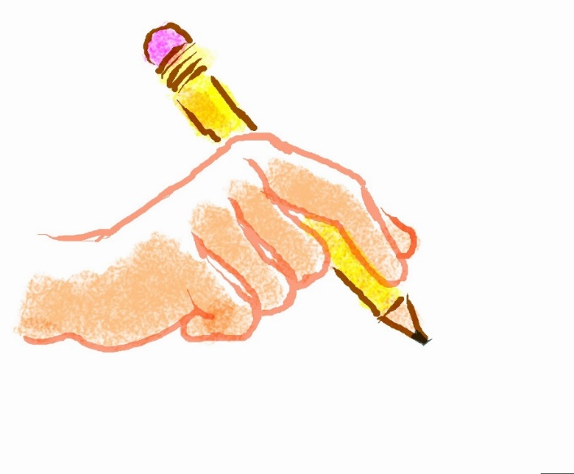
Open your workbook p.67 and answer the questions.
Don’t forget to answer the questions
In the
practice PPT for L6 + The Review.

Slide 14
Take Unit 7 quiz
____________________________________________________________________________________________________________________________________
Ministry of Education-2020

Slide 15
End of the lesson
Good job dear !

