Slide 1
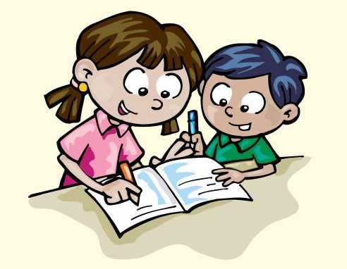
Unit 8
Tidy up !
Grade 2
Practice + Review

Slide 2
Tidy up !
8
Lesson one
Words
rug bed cupboard shelf pillow blanket T-shirt
1- Write
Where’s the blanket ? It’s on the……...... .
Where’s the ........... ? Its on the bed.
Where’s the …………. ? It’s in the cupboard.
Where’s the book ? It’s on the ………... .
Where is the …….….. ? It’s on the shelf.
Where is the teddy ? It’s on the …………... .
pillow T-shirt teddy pen blanket

Slide 3
Tidy up !
8
Lesson one
Words
rug bed cupboard shelf pillow blanket T-shirt
1-Write
Where’s the blanket? It’s on the bed.
Where’s the pillow? Its on the bed.
Where’s the T-shirt? It’s in the cupboard.
Where’s the book? It’s on the shelf.
Where is the pen? It’s on the shelf.
Where is the teddy? It’s on the rug.
pillow T-shirt teddy pen blanket

Slide 4
8
Write
Lesson two Grammar
Read and write
1-(There’s / There are) a bed in my room.
2-( There’s / There are) two cupboards in my bedroom.
3-(There’s / There are) three books on my shelf.
4-(There’s / There are) a blanket on my bed.
5-(There’s / There are ) a T-shirt in my cupboard.

Slide 5
8
Lesson two Grammar
Write
Read and write
1-(There’s / There are) a bed in my room.
There’s a bed in my room.
2-( There’s / There are) two cupboards in my bedroom.
There are two cupboards in my bedroom.
3-(There’s / There are) three books on my shelf.
There are three books on my shelf.
4-(There’s / There are) a blanket on my bed.
There’s a blanket on my bed .
5-(There’s / There are ) a T-shirt in my cupboard.
There’s a T-shirt in my cupboard.

Slide 6
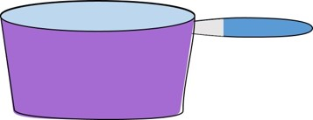
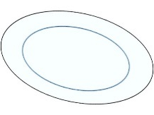
8
Count and write
On the shelf there are four ..……... .There are two ………..
and there are five …… .
On the shelf there are six ….... .There is one ………. and there’s one ………

Slide 7
8
Count and write
On the shelf there are four ..plates. There are two …cups
and there are five …spoons.
On the shelf there are six …forks ..There is one …knife and there’s one …pan.

Slide 8
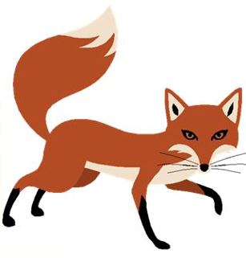
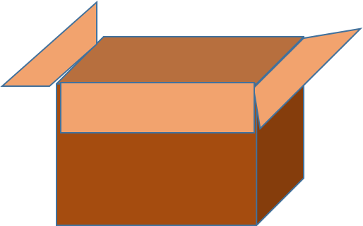
8
1-Say and write the words
Lesson four Phonics
2-Write
The …… is sitting on a ……….
The …….. is sitting in a ………

Slide 9
8
1-Say and write the words
Lesson four Phonics
dog
log
fox
box
2-Write
The dog is sitting on a log.
The fox is sitting in a box.

Slide 10
8
Lesson six
Write
1 Read .underline the ? And .
Where’s your rug ? It’s in my bedroom .
What’s on your bed ? My blanket is on my bed .
Do you like your cupboard? Yes I do .
2 Write the capital letters and the ? Or .
What’s your name ………………………….
What’s on the rug …………………………..
Her name’s Noor ………………………….
What’s on the bed ..…………………………

Slide 11
8
Lesson six
Write
1 Read .underline the ? or .
Where’s your rug ? It’s in my bedroom .
What’s on your bed ? My blanket is on my bed .
Do you like your cupboard ? Yes I do .
2 Write the capital letters and the ? Or .
what’s your name … What’s your name ?
what’s on the rug … What’s on the rug?
her name’s Noor …Her name’s Noor .
what’s on the bed ..What’s on the bed ?

Slide 12
8
Review
Write (There’s / There are) .
1 -There are two cupboards.
2- …………………..two pillows.
3- ………………….one blanket .
4- ………………….one rug.
5-……………………one shelf.
6- ………………….four books .
7- …………………...... three beds.

Slide 13
8
Review
Write (There’s / There are) .
1 -There are two cupboards.
2- There are two pillows.
3- There’s one blanket .
4- There’s one rug.
5- There’s one shelf.
6- There are four books.
7- There are three beds.

