Slide 1
Lecture 3 Mechanics
kinematics is interested in the movement of objects without regard to their causes.
Dynamics is studying the movement of objects and causes such as strength and mass.

Slide 2
Motion along a straight line
Motion
Position and displacement
Average velocity and average speed
Instantaneous velocity and speed
Acceleration
Constant acceleration: A special case
Free fall acceleration

Slide 3
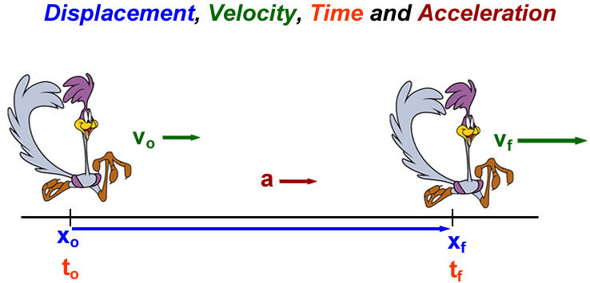
* Basic Quantities in Mechanics

Slide 4
One Dimensional Position x
Motion can be defined as the change of position over time.
The motion of a body is said to be in one dimension or one –dimensional motion if it moves along a straight line in any direction. This type of motion is also called rectilinear or linear motion. Only one position co-ordinate is required to describe the position of the particle in this motion.
Position definition:
Defines a starting point: origin (x = 0), x relative to origin
Direction: positive (right or up), negative (left or down)
It depends on time: t = 0 (start clock), x(t=0) does not have to be zero.
Position has units of [Length]: meters.

Slide 5
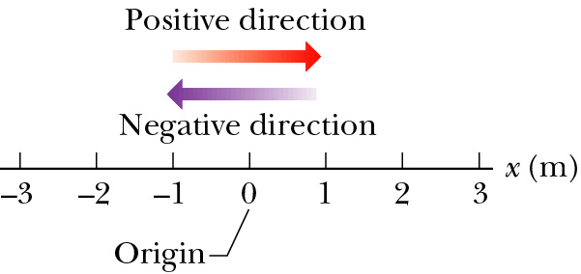
For motion along a straight line, the direction is represented simply by + and – signs.
+ sign: Right or Up.
− sign: Left or Down.
1-D motion can be thought of as a
component of 2-D and 3-D motions.
x = + 2.5 m
x = - 3 m

Slide 6
Quantities in Motion
Any motion involves three concepts
Displacement
Velocity
Acceleration
These concepts can be used to study objects in motion.

Slide 7
Displacement
Displacement is a change of position in time.
Displacement:
f stands for final and i stands for initial.
It is a vector quantity.
It has both magnitude and direction: + or − sign
It has units of [length]: meters.
x₁ (t₁) = + 2.5 m
x₂ (t₂) = - 2.0 m
Δx = -2.0 m - 2.5 m = -4.5 m
x₁ (t₁) = - 3.0 m
x₂ (t₂) = + 1.0 m
Δx = +1.0 m + 3.0 m = +4.0 m

Slide 8
Velocity
Velocity is the rate of change of position.
Velocity is a vector quantity.
Velocity has both magnitude and direction.
Velocity has a unit of [length/time]: meter/second.
We will be concerned with three quantities, defined as:
Average velocity
Average speed
Instantaneous
velocity
displacement
distance
displacement

Slide 9
Uniform Velocity
Uniform velocity is the special case of constant velocity
In this case, instantaneous velocities are always the same, all the instantaneous velocities will also equal the average velocity
Begin with then
x
v
Note: we are plotting velocity vs. time
x(t)
v(t)
x_{f}
v_{x}
x_{i}
0
t
0
t
t_{i}
t_{f}

Slide 10
Average Acceleration
Changing velocity (non-uniform) means an acceleration is present.
Acceleration is the rate of change of velocity.
Acceleration is a vector quantity.
Acceleration has both magnitude and direction.
Acceleration has a dimensions of length/time²: [m/s²].
Definition:
Average acceleration

Slide 11
Instantaneous and Uniform Acceleration
Instantaneous Acceleration
The limit of the average acceleration as the time interval goes to zero
When the instantaneous accelerations are always the same, the acceleration will be uniform. The instantaneous acceleration will be equal to the average acceleration

Slide 12
Kinematic Variables: x, v, a
Position is a function of time:
Velocity is the rate of change of position.
Acceleration is the rate of change of velocity.
Position Velocity Acceleration

Slide 13
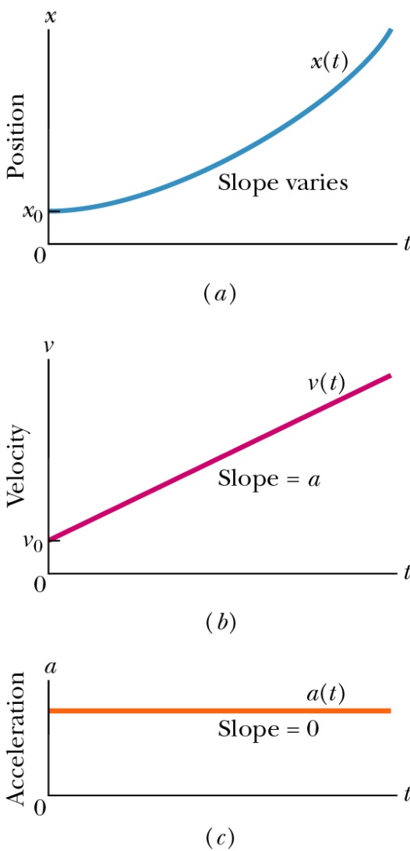
Special Case: Motion with Uniform Acceleration (our typical case)
Acceleration is a constant
Kinematic Equations (which we will derive in a moment)

Slide 14
Example
A cyclist speeds up at a constant rate from rest to 8 m/s in 6s. Find the acceleration of the cyclist.
Answer
vo = 0 m/s [body starts from rest]
v = 8 m/s
t = 6 s
=> a = (v-vo)/t = (8-0)/6 = 4/3 m/s² = 1.33 m/s²
What is the corresponding take-off time?
Notes:
The best way to gain confidence in the use of these equations is to work a number of problems. The following procedure is recommended for solving problems involving acceleration motion.

Slide 15
Example
An electron has a constant acceleration of 3.2 m/s². At a certain instant its velocity is 9.6 m/s. What is its velocity 2.5 seconds earlier?
Answer
a = 3.2 m/s²
v = 9.6 m/s
vo = ?
t = 2.5 s
=> vo = v - at = 9.6 -3.2 x 2.5 = 16 m/s²

Slide 16
Example
A racing car reaches a speed of 50 m/s. At this instant it begins a uniform negative acceleration using a parachute and a braking system and comes to rest 50 s later. How far does the car travel after acceleration starts.
Answer
vo = 50 m/s
v = 0 m/s
t = 50 s
Here we have two unknowns ‘x' and 'a'. So first we will find 'a' using
0 = 50 + a x 5
=> 0 = 50 + 5a
=> a = -50/5 = -10 m/s²
Now, we find the distance travelled
= 50 x 5 + 1/2 x (-10) x 5²)
= 250 -125 = 125 m

Slide 17
Example
A car brakes from a speed of 108 km/h to 72 km/h during a displacement of 100m. What is its acceleration?
Answer
We write down the given data and make the units consistent. All the units should be in SI
vo = 108 km/h = 108 x 1000/(60 x 60) = 108 x 5/18 = 30 m/s
[1 km = 1000 m and 1 h = 60 x 60 = 3600 s]
v = 72 km/h = 72 x 5/18 = 20 m/s
x = 100 m
=> a = (v² - vo²)/(2 x 100) = (400 - 900)/(2 x 100) = -2.5 m/s²

Slide 18
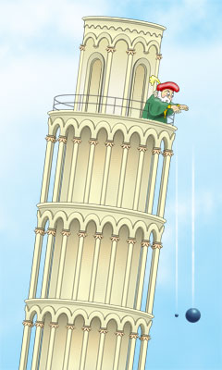
Free Fall Acceleration
y
Earth gravity provides a constant acceleration. Most important case of constant acceleration.
Free-fall acceleration is independent of mass.
Magnitude: |a| = g = 9.8 m/s²
Direction: always downward, so a_{g} is negative if we define “up” as positive,
a = −g = −9.8 m/s²

Slide 19
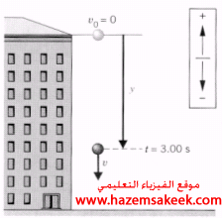
Example
A stone is dropped from rest from the top of a building, as shown in Figure below . After 3s of free fall, what is the displacement y of the stone?
From equation
y = y_{o} + v_{o} t - 1/2 g t²
y = 0 + 0 - 0.5(9.8) × (3)² = -44.1m
Solution

Slide 20
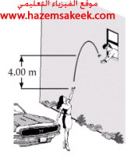
A student throws a set of keys vertically upward to another student in a window 4m above as shown in Figure. The keys are caught 1.5s later by the student.
(a) With what initial velocity were the keys thrown?
(b) What was the velocity of the keys just before they were caught?
-----------------------------------------------
(a) Let y_{o}=0 and y=4m at t=1.5s then we find
y = y_{o} + v_{o} t - 1/2 g t²
4 = 0 + 1.5 v_{o} – 0.5(9.8) (1.5)²
v_{o} = 10 m/s
(b) The velocity at any time t > 0 is given by
v = v_{o} - g t
v= 10 - 9.8 (1.5) = -4.7 m/s

Slide 21
Summary
This is the simplest type of motion
It lays the groundwork for more complex motion
Kinematic variables in one dimension
Position x(t) m L
Velocity v(t) m/s L/T
Acceleration a(t) m/s² L/T²
All depend on time
All are vectors: magnitude and direction vector:
Equations for motion with constant acceleration: missing quantities
t
a

