Slide 1
Units and Dimensions
Lec -1

Slide 2
Proportion of Final Assessment 1010-phy

Slide 3
Topics to be Covered
List of Topics | No of Weeks | Contac t hours
1- Definitions fundamental and derivatives units and measurement system | 1 | 3
Dimensional analysis | 1 | 3
2- Vectors | 2 | 6
3- mechanics(motion along straight line) | 1 | 3
4- force and Newton law of motion | 1 | 3
5-kinetic energy and work | 1 | 3
6- fluid(fluid density and pressure- equation) | 2 | 6
pascal principal-Archimedes principal-equation of continuity- Bernoulli | 2 | 6
7- electric field-current | 1 | 3
8- resistance- | 1 | 3 3
9-electromagnetic wave | 1 | 3
10-nuclear | 1 | 3
total | 15 | 45 h

Slide 4
What is Physics and Why is it Important?
Physics: The science in which matter and energy are studied both separately and in combination with one another.
And a more detailed working definition of physics may be: The science of nature, or that which pertains to natural objects, which deals with the laws and properties of matter and the forces which act upon them. Quite often, physics concentrates upon the forces having an impact upon matter, that is, gravitation, heat, light, magnetism, electricity, and others.
Physics. Range of Fields
Nuclear Physics. Study of the physical properties of the atomic nucleus.
Astrophysics. Study of the physical properties of objects in space.
Biophysics. Study of physics in living systems.
Electromagnetism. Study of electrical and magnetic fields, which are two aspects of the same phenomenon.
Electronics. Study of the flow of electrons, generally in a circuit.
Fluid Dynamics and Fluid Mechanics. Study of the physical properties of "fluids," specifically defined in this case to be liquids and gases.
Geophysics. Study of the physical properties of the Earth.

Slide 5
-High Energy Physics. Study of physics in extremely high energy systems, generally within particle physics.
-Laser Physics. Study of the physical properties of lasers.
-Mathematical Physics. Discipline in which rigorous mathematical methods are applied to solving problems related to physics.
-Mechanics. Study of the motion of bodies in a frame of reference.
-Molecular Physics. Study of physical properties of molecules.
-Nanotechnology. Science of building circuits and machines from single molecules and atoms.
-Optics and Light Physics. Study of the physical properties of light.
-Particle Physics. Study of fundamental particles and the forces of their interaction.
-Quantum Mechanics and Quantum Physics. Study of science where the smallest discrete values, or quanta, of matter and energy become relevant.
-Thermodynamics. Physics of heat.

Slide 6
PHYSICAL QUANTITIES
A quantity that can be measured.
A physical quantities have numerical value and unit of measurement.
For example temperature 30 degrees celcius, 30 is numerical value & ‘degree celcius’ is the unit. Written as 30º C.
Temperature = 30 degree Celcius = 30º c
Physical quantity = numerical value x unit measurement

Slide 7
Physics quantities can be classified into :
Base quantities
derived quantities
Area –volume- acceleration-velocity-force-density- work-power-energy- pressure.
are physical quantities derived from combination of base quantities through multiplication or division or both
are physical quantities that cannot be derived from other physical quantities.
1-length 2-mass 3-time 4-current 5- temperature, 6-amount of substance
7-and luminous intensity

Slide 8
SI units (International System Units). Table 1.1 Shows five base quantities and their respective SI units

Slide 9
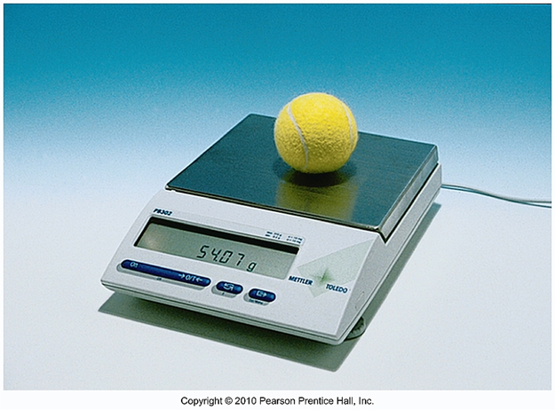
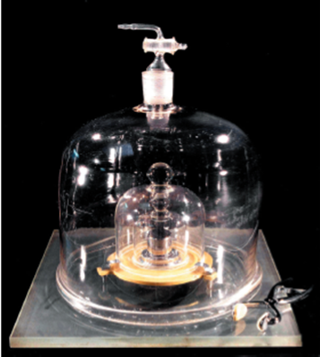
Base quantities 1- Mass: The amount of matter in a body.
SI Units: kilogram (kg)
Common Units:
pounds (lbs) and ounces (oz)
1 kg is approx. 2.2 lbs
1 kg = 1000 g
1 oz = 28.35 g
Kilogram is defined in terms of platinume-iridume standard mass kept near Paris. For measurements on an atomic scale,
the atomic mass unit (U),defined in terms
of an atomcarbon-12,is usually used.
The relation between the units is
u=1.660 538 86x10⁻²⁷kg

Slide 10
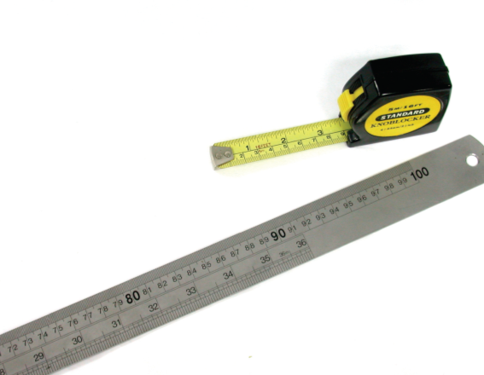
2- Length: A measure of distance.
SI Unit: meter (m)
Common Units: inches (in); miles (mi)
1 in = 2.54 cm = 0.0254 m
1 mi = 1.609 km = 1609 m
The meter is: the length of the path traveled by light in a vacuum during a time interval of $\frac{1}{299792458 }$ of a second

Slide 11
3- Time
Time in physics is defined by its measurement: time is what a clock reads. Time can be combined mathematically with other physical quantities to derive other concepts such as motion.
The second is the time taken by 9,192,631,770 oscillations of the light (of specified wave length)
emitted by a caesium 133 atom.

Slide 12
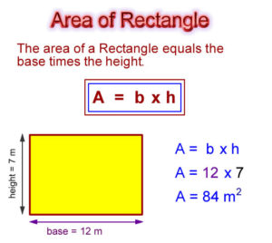
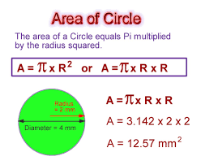
Example of derived quantity 1- area
Area of rectangular = length × width

Slide 13
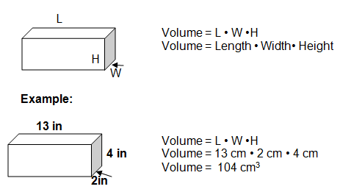
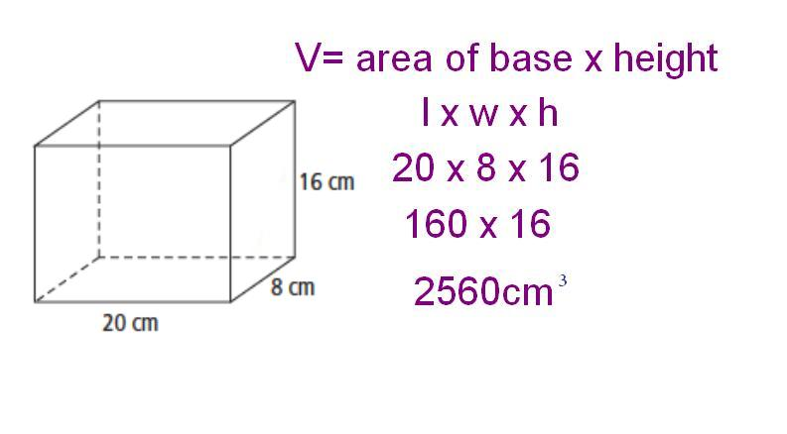
2- Volume: Amount of space occupied by a body.
volume = m × m × m = m³
SI Unit: cubic meter (m³)
Common Units: Liter (L) or milliliter (mL) or cubic centimeter (cm³)
Example

Slide 14
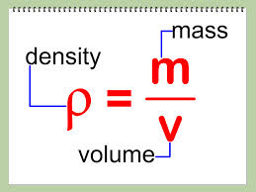
3- Density: Amount of mass per unit volume of a substance.
SI Units of density = kg / m³ = kg m⁻³
Common Units: g/cm³ or g/mL
23-A 2.00x3.00 m plate of aluminum has a mass of 324 kg What is the thickness of the plate? (The density of aluminum is 2.70x10³kg/m³)
Solution: ρ=m/v
V=m/ρ
L.W.h= m/ ρ
h= m/ ρ.L.W
h=324/2.70x10³x2.00x3.00=0.02m

Slide 15
4- Velocity = displacement/ time
Units of speed = m/s
5- acceleration = velocity/time
Units of acceleration = m/$s^{2}$
6- Force = mass × acceleration
Units of force = Kg m/s²
7- Work = Force x Displacement
Units of Work = J = Kg m²/s²
8-Energy = Mass x gravity x high
Units of Energy = J = Kg m²/s²
9- Power = Force x displacement / time
Units of Power = W = Kg m²/s³
10-Pressure = Force / area
Units of Pressure = Kg m /m² s² = Kg m⁻¹/s² = N/m²

Slide 16
Table 1.2 shows some of the derived quantities and their respective derived units
dimension | Derived units | Relationship with base quantities | Symbol | Derived Quantities
L² | m² | Length x Length | A | Area
L³ | m³ | Length x Length x Length | V | Volume
M/L³ | kg/m³ | Mass Length x Length x Length | ρ | Density
L/T | m/s | Displacement Time | v | Velocity
L/T² | m/s² | Velocity Time | a | Acceleration
ML/T² | N | Mass x Acceleration | F | Force
ML²/T² | J | Force x Displacement | W | Work
ML²/T² | J | Mass x gravity x high = ½ x mass x velocity x velocity | E_{p} E_{k} | Energy
ML²/T³ | W | Force x Displacement Time | P | Power
M/LT² | N/m ² | Force Area | p | Pressure

Slide 17
PREFIXES
Value | Symbol | Prefix
10¹⁵ | P | Peta
10¹² | T | tera
10⁹ | G | giga
10⁶ | M | mega
10³ | k | kilo
10² | h | hekto
10 | da | deka
10⁻¹ | d | deci
10⁻² | c | centi
10⁻³ | m | milli
10⁻⁶ | μ | micro
10⁻⁹ | n | nano
10⁻¹² | P | pico
10⁻¹⁵ | F | Femto
PREFIXES:
are used to simplify the description of physical quantities that are either very big or very small

Slide 18
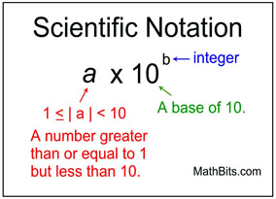
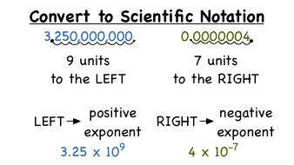

Slide 19
EXAMPLE
For each of the following, express the magnitude using a scientific notation.
1-20000000
2-345000
3-0.0000023
4-0.00000006
5-123402123100
Solution:
1- 2x 10⁷
2- 3.45x 10⁵
3- 2.3x 10⁻⁶
4- 6x 10⁻⁸
5- 1.2 x 10¹¹

Slide 20
Example
1- 2million meters (2,000,000m) written in scientific notation form= or
written using prefix= 2Mm. (2 mega meter) .
2-Fill the table
number | Scientific form | Prefixes form
2900 | 2${.9X10}^{3}$ | 2.9 K
0.000005 | 5X${10}^{−6}$ | 5µ

Slide 21
Dimensional Analysis
The word dimension in physics indicates the physical nature of the quantity. For example the distance has a dimension of length, and the speed has a dimension of length/time.
The dimensional analysis is used to check the formula, since the dimension of the left hand side and the right hand side of the formula must be the same.

Slide 22
Example Using the dimensional analysis check that this equation x = ½ at² is correct, where x is the distance, a is the acceleration and t is the time.
Solution
x = ½ at²
This equation is correct because the dimension of the left and right side of the equation have the same dimensions.

Slide 23
Example Show that the expression v = v_{o} + at is dimensionally correct, where v and v_{o} are the velocities and a is the acceleration, and t is the time
Solution
The right hand side [v] = L/T
The left hand side L/T+L/T =
2 L/T=L/T
Therefore, the expression is dimensionally correct

Slide 24
EXAMPLE

Slide 25
Example Suppose that the acceleration of a particle moving in circle of radius r with uniform velocity v is proportional to the r^{n} and v^{m}. Use the dimensional analysis to determine the power n and m.
Solution
Let us assume a is represented in this expression
a = k r^{n} v^{m}
Where k is the proportionality constant of dimensionless unit.
The right hand side
n+m=1 and m=2 Therefore. n =-1 and the acceleration a is a = k r⁻¹ v²

Slide 26
Exercise Part A: See if you can determine the dimensions of the following quantities: volume acceleration (velocity/time) density (mass/volume) force (mass × acceleration
Check your answers
You are correct if you wrote down:
1.Volume L³
2.acceleration (velocity/time) L/T²
3.density (mass/volume) M/L³
4.force (mass × acceleration) M·L/T²

Slide 27
Now find the dimensions of these: 1-pressure (force/area) 2-(volume)² 3-work (in 1-D, force × distance) 4-energy (e.g., gravitational potential energy = mgh 5.square root of area
answers
1.pressure (force/area) M·L⁻¹·T⁻²
2.(volume)² L⁶
3. work (in 1-D, force × distance) M·L²/T²
4.energy (e.g., gravitational potential energy = mgh = mass × gravitational acceleration × height) M·L²/T²
5.square root of area L

Slide 28
Which one of the following quantities are dimensionless? 1-68 2-sin (68 ) 3-e 4-force 5-6 6-frequency 7-log (0.0034)
What are the dimensions of the following?
[3]
[force]
[height]
[frequency]
[displacement]
[area × volume]
[0.5 × volume]

