Slide 1
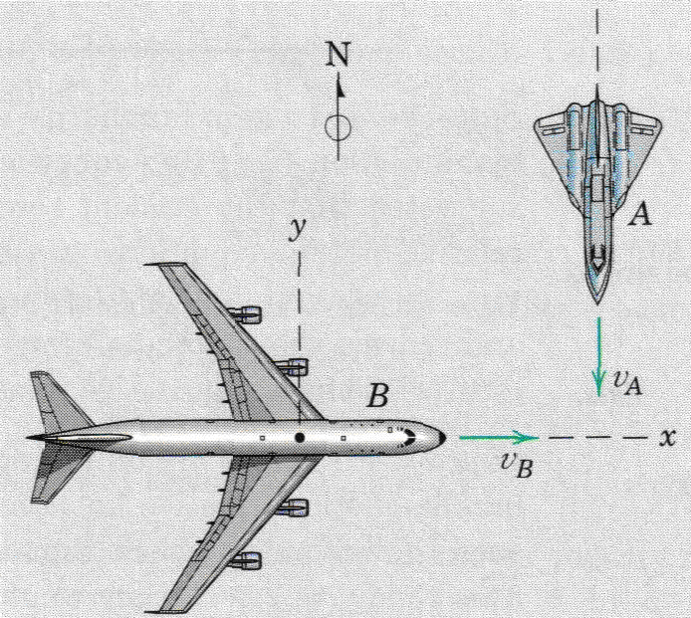
Relative Motion
Lecture VII

Slide 2
Relative Motion
v_{B}
v_{A}
v_{A/B}
In previous lectures, the particles motion have been described using coordinates referred to fixed reference axes. This kind of motion analysis is called absolute motion analysis.
Not always easy to describe or measure motion by using fixed set of axes.
The motion analysis of many engineering problems is sometime simplified by using measurements made with respect to moving reference system.
Combining these measurements with the absolute motion of the moving coordinate system, enable us to determine the absolute motion required. This approach is called relative motion analysis.

Slide 3
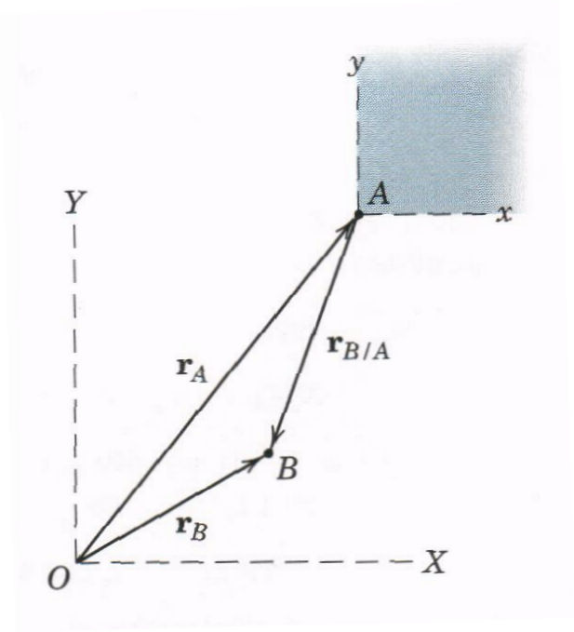
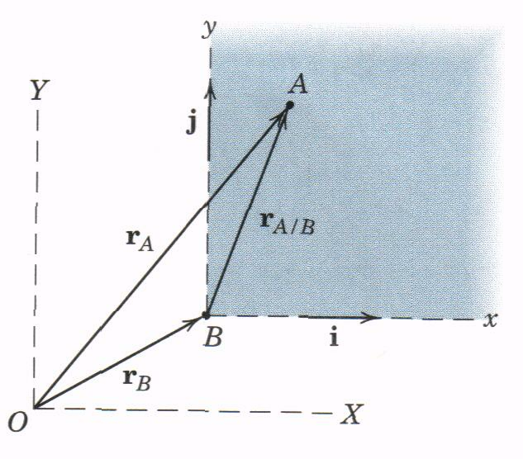
Relative Motion (Cont.)
The motion of the moving coordinate system is specified w.r.t. a fixed coordinate system.
The moving coordinate system should be nonrotating (translating or parallel to the fixed system).
A/B is read as the motion of A relative to B (or w.r.t. B).
The relative motion terms can be expressed in whatever coordinate system (rectangular, polar, n-t).
Path
Path
Moving system
Moving system
Path
Path
Fixed system
Fixed system
Note: r_{A} & r_{B} are measured from the origin of the fixed axes X-Y.
Note: In relative motion analysis, acceleration of a particle observed in a translating system x-y is the same as observed in a fixed system X-Y, when the moving system has a constant velocity.
Note: r_{B/A} = -r_{A/B}
v_{B/A} = -v_{A/B}
a_{B/A} = -a_{A/B}

Slide 4
Relative Motion Exercises

Slide 5
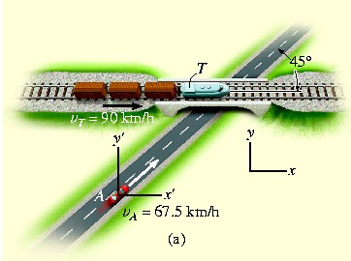
Exercise # 1
A train, traveling at a constant speed of 90km/h, crosses over a road. If automobile A is traveling at 67.5km/h along the road, determine the magnitude and direction of relative velocity of the train with respect to the automobile.

Slide 6
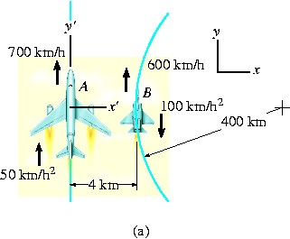
Exercise # 2
Plane A is flying along a straight-line path, while plane B is flying along a circular path having a radius of curvature of ρ_{B} = 400 km. Determine the velocity and acceleration of B as measured by the pilot of A.

Slide 7
Exercise # 3
At the instant shown, the bicyclist at A is traveling at 7 m/s around the curve on the race track while increasing his speed at 0.5 m/s^{2.} The bicyclist at B is traveling at 8.5 m/s along the straight-a-way and increasing his speed at 0.7 m/s2. Determine the relative velocity and relative acceleration of A with respect to B at this instant.

Slide 8
Exercise # 4
The ship travels at a constant speed of v_{s} = 20 m/s and the wind is blowing at a speed of v_{w} ⁼ 10 m/s, as shown. Determine the magnitude and direction of the horizontal component of velocity of the smoke coming from the smoke it appears to a passenger on the ship.

Slide 9
Exercise # 5
An aircraft carrier is traveling forward with a velocity of 50 km/h. At the instant shown, the plane at A has just taken off and has attained a forward horizontal air speed of 200 km/h, measured from still water. If the plane at B is traveling along the runway of the carrier at 175 km/h in the direction shown, determine the velocity of A with respect to B.

