Slide 1

Principles of Microeconomics
Twelfth Edition, Global Edition
Chapter 8
Short-Run Costs and Output Decisions

Slide 2
Chapter Outline and Learning Objectives
8.1 Costs in the Short Run
Be able to describe and graph the major components of firm cost.
8.2 Output Decisions: Revenues, Costs, and Profit Maximization
Discuss how revenues and costs affect the profit-maximizing levels of output in perfectly competitive firms.
Looking Ahead

Slide 3
Chapter 8 Short-Run Costs and Output Decisions (1 of 2)
This chapter focuses on the costs of production.
To calculate costs, a firm must know:
  The quantity of inputs needed
  How much those inputs cost

Slide 4
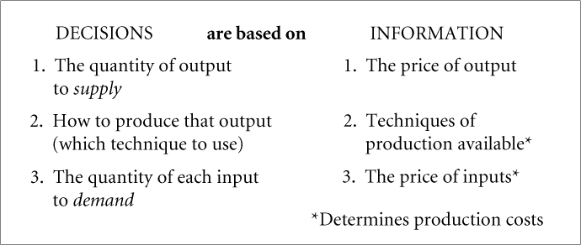
Chapter 8 Short-Run Costs and Output Decisions (2 of 2)
In their quest for profits, firms make three specific decisions involving their production.
FIGURE 8.1 Decisions Facing Firms

Slide 5
Costs in the Short Run
fixed cost Any cost that does not depend on the firm’s level of output. These costs are incurred even if the firm is producing nothing. There are no fixed costs in the long run.
variable cost A cost that depends on the level of production chosen.
total cost (TC) Total fixed costs plus total variable costs.
TC = TFC + TVC

Slide 6
Fixed Costs (1 of 2)
Total Fixed Cost (TFC)
total fixed costs (TFC) or overhead The total of all costs that do not change with output even if output is zero.
TABLE 8.1 Short-Run Fixed Cost (Total and Average) of a Hypothetical Firm
(1) q | (2) TFC | (3) AFC (TFC/q)
0 1 2 3 4 5 | $100 100 100 100 100 100 | $— 100 50 33 25 20

Slide 7
Fixed Costs (2 of 2)
Average Fixed Cost (AFC)
average fixed cost (AFC) Total fixed cost divided by the number of units of output; a per-unit measure of fixed costs.
As output increases, average fixed cost declines because we are dividing a fixed number ($1,000) by a larger and larger quantity.
spreading overhead The process of dividing total fixed costs by more units of output. Average fixed cost declines as quantity rises.

Slide 8
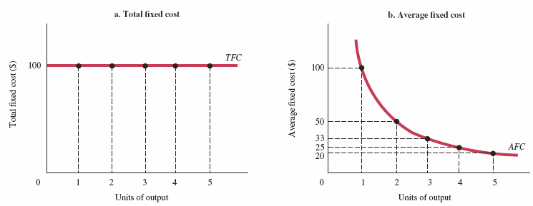

FIGURE 8.2 Short-Run Fixed Cost (Total and Average) of a Hypothetical Firm

Slide 9
Variable Costs (1 of 6)
Total Variable Cost (TVC)
total variable cost (TVC) The total of all costs that vary with output in the short run.
total variable cost curve A graph that shows the relationship between total variable cost and the level of a firm’s output.
A total variable cost curve expresses the relationship between TVC and total output.

Slide 10
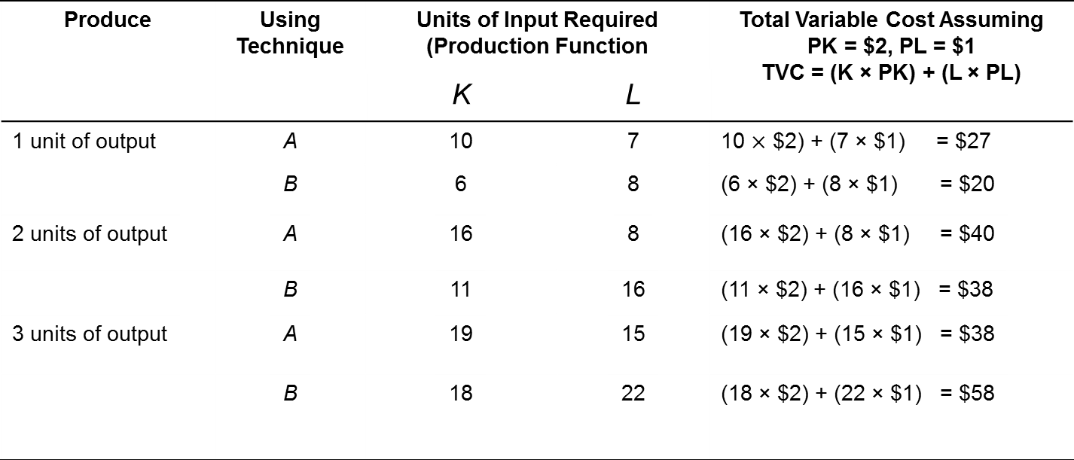
TABLE 8.2 Derivation of Total Variable Cost Schedule from Technology and Factor Prices
Produce | Using Technique | Units of Input Required (Production Function |  | Total Variable Cost Assuming PK = $2, PL = $1 TVC = (K × PK) + (L × PL)
 |  | K | L
1 unit of output | A | 10 | 7 | 10 $×$ $2) + (7 × $1) = $27
 | B | 6 | 8 | (6 × $2) + (8 × $1) = $20
2 units of output | A | 16 | 8 | (16 × $2) + (8 × $1) = $40
 | B | 11 | 16 | (11 × $2) + (16 × $1) = $38
3 units of output | A | 19 | 15 | (19 × $2) + (15 × $1) = $38
 | B | 18 | 22 | (18 × $2) + (22 × $1) = $58
In this table, total variable cost is derived from production requirements and input prices.

Slide 11
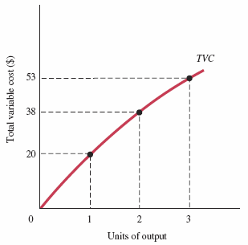
FIGURE 8.3 Total Variable Cost Curve

Slide 12
Variable Costs (2 of 6)
Marginal Cost (MC)
marginal cost (MC) The increase in total cost that results from producing 1 more unit of output. Marginal costs reflect changes in variable costs.

Slide 13
TABLE 8.3 Derivation of Marginal Cost from Total Variable Cost
Units of Output | Total Variable Costs ($) | Marginal Costs ($)
0 | 0
1 | 20 | 20
2 | 38 | 18
3 | 53 | 15

Slide 14
Variable Costs (3 of 6)
The Shape of the Marginal Cost Curve in the
Short Run
In the short run, every firm is constrained by some fixed input that (1) leads to diminishing returns to variable inputs and (2) limits its capacity to produce.
As a firm approaches that capacity, it becomes increasingly costly to produce successively higher levels of output.
Marginal costs ultimately increase with output in the short run.

Slide 15
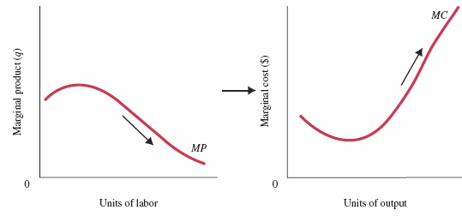
FIGURE 8.4 Declining Marginal Product Implies That Marginal Cost Will Eventually Rise with Output
In the short run, every firm is constrained by some fixed factor of production.
A fixed factor implies diminishing returns (declining marginal product) and a limited capacity to produce. As that limit is approached, marginal costs rise.

Slide 16

Variable Costs (4 of 6)
Graphing Total Variable Costs and Marginal Costs
Total variable costs always increase with output.
Marginal cost is the cost of producing each additional unit.
Thus, the marginal cost curve shows how total variable cost changes with single-unit increases in total output.

Slide 17
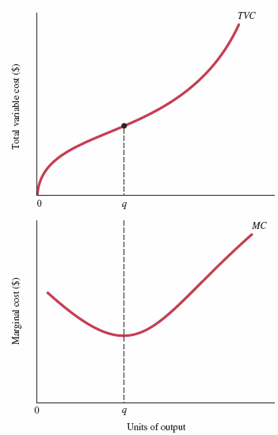
FIGURE 8.5 Total Variable Cost and Marginal Cost for a Typical Firm
Total variable costs always increase with output.
Marginal cost is the cost of producing each additional unit.
Thus, the marginal cost curve shows how total variable cost changes with single-unit increases in total output.

Slide 18

Variable Costs (5 of 6)
Average Variable Cost (AVC)
average variable cost (AVC) Total variable cost divided by the number of units of output; a per-unit measure of variable costs.

Slide 19
TABLE 8.4 Short-Run Costs of a Hypothetical Firm
(1) q | (2) TVC | (3) MC (Δ TVC) | (4) AVC (TVC/q) | (5) TFC | (6) TC (TVC + TFC) | (7) AFC (TFC/q) | (8) ATC (TC/q or AFC + AVC)
0 | $ 0.00 | $ — | $ — | $ 100.00 | $ 100.00 | $ — | $ —
1 | 20.00 | 20.00 | 20.00 | 100.00 | 120.00 | 100.00 | 120.00
2 | 38.00 | 18.00 | 19.00 | 100.00 | 138.00 | 50.00 | 69.00
3 | 53.00 | 15.00 | 17.66 | 100.00 | 153.00 | 33.33 | 51.00
4 | 65.00 | 12.00 | 16.25 | 100.00 | 165.00 | 25.00 | 41.25
5 | 75.00 | 10.00 | 15.00 | 100.00 | 175.00 | 20.00 | 35.00
6 | 83.00 | 8.00 | 13.83 | 100.00 | 183.50 | 16.67 | 30.50
7 | 94.50 | 11.50 | 13.50 | 100.00 | 194.50 | 14.28 | 27.78
8 | 108.00 | 13.50 | 13.50 | 100.00 | 208.00 | 12.50 | 26.00
9 | 128.50 | 20.50 | 14.28 | 100.00 | 228.50 | 11.11 | 25.39
10 | 168.50 | 40.00 | 16.85 | 100.00 | 268.50 | 10.00 | 26.85

Slide 20
Variable Costs (6 of 6)
Graphing Average Variable Costs and Marginal Costs
When marginal cost is below average cost, average cost is declining.
When marginal cost is above average cost, average cost is increasing.
Rising marginal cost intersects average variable cost at the minimum point of AVC.

Slide 21
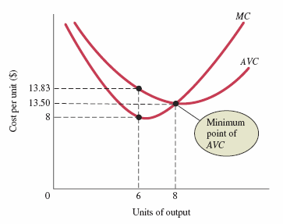
FIGURE 8.6 More Short-Run Costs

Slide 22
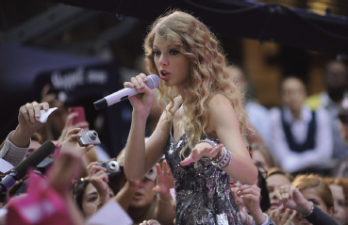
ECONOMICS IN PRACTICE
The Cost Structure of a Rock Concert: Welcome to New York
For a rock concert, the output is the number of seats.
The fixed costs are considerable: the cost of publicity, booking a stadium, instruments on stage, etc.
The variable costs are not zero, but they are low relative to fixed costs: additional tickets sold, and increased security, etc.
THINKING PRACTICALLY
1. Can you think of other products or services that have low marginal costs and high fixed costs and conversely?

Slide 23
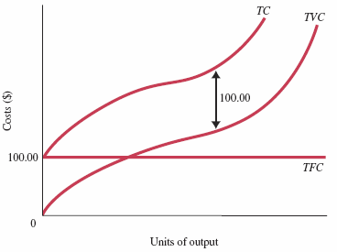
Total Costs (1 of 4)
FIGURE 8.7 Total Cost = Total Fixed Cost + Total Variable Cost

Slide 24
Total Costs (2 of 4)
Adding TFC to TVC means adding the same amount of total fixed cost to every level of total variable cost.
Thus, the total cost curve has the same shape as the total variable cost curve; it is simply higher by an amount equal to TFC.

Slide 25
Total Costs (3 of 4)
Average Total Cost (ATC)
average total cost (ATC) Total cost divided by the number of units of output; a per-unit measure of total costs.

Slide 26
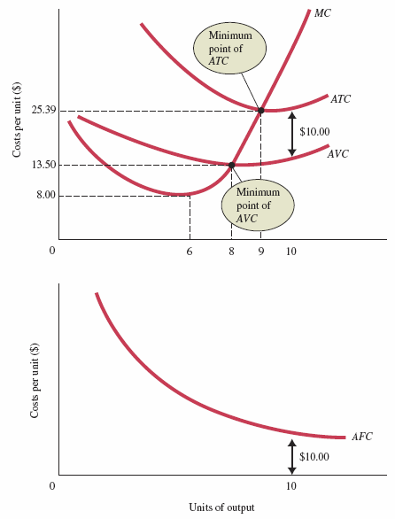
FIGURE 8.8 Average Total Cost = Average Variable Cost + Average Fixed Cost
To get ATC, we add average fixed and average variable costs at all levels of output.
Because average fixed cost falls with output, an ever-declining amount is added to AVC.
Thus, AVC and ATC get closer together as output increases, but the two lines never meet.

Slide 27
Total Costs (4 of 4)
The Relationship between Average Total Cost and Marginal Cost
This relationship is the same as the relationship between AVC and MC.
If MC is below ATC, ATC will decline toward MC.
If MC is above ATC, ATC will increase.
As a result, MC intersects ATC at ATC’s minimum point for the same reason that it intersects the AVC curve at its minimum point.

Slide 28
Short-Run Costs: A Review
TABLE 8.5 A Summary of Cost Concepts
Term | Definition | Equation
Accounting costs | Out-of-pocket costs, or costs as an accountant would define them. Sometimes referred to as explicit costs. | —
Economic costs | Costs that include the full opportunity costs of all inputs. These include what are often called implicit costs. | —
Total fixed costs (TFC) | Costs that do not depend on the quantity of output produced. These must be paid even if output is zero. | —
Total variable costs (TVC) | Costs that vary with the level of output. | —
Total cost (TC) | The total economic cost of all the inputs used by a firm in production. | TC = TFC + TVC
Average fixed costs (AFC) | Fixed costs per unit of output. | AFC = TFC/q
Average variable costs (AVC) | Variable costs per unit of output. | AVC = TVC/q
Average total costs (ATC) | Total costs per unit of output. | ATC = TC/q ATC = AFC + AVC
Marginal costs (MC) | The increase in total cost that results from producing 1 additional unit of output. | MC = ΔTC/Δq

Slide 29
Output Decisions: Revenues, Costs, and Profit Maximization (1 of 2)
Perfect Competition
perfect competition An industry structure in which there are many firms, each small relative to the industry, producing identical products and in which no firm is large enough to have any control over prices. In perfectly competitive industries, new competitors can freely enter the market, and old firms can exit.
homogeneous products Undifferentiated products; products that are identical to, or indistinguishable from, one another.

Slide 30
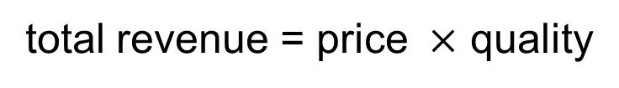
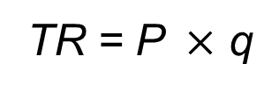
Output Decisions: Revenues, Costs, and Profit Maximization (2 of 2)
Total Revenue and Marginal Revenue
total revenue (TR) The total amount that a firm takes in from the sale of its product: the price per unit times the quantity of output the firm decides to produce
(P × q).

Slide 31
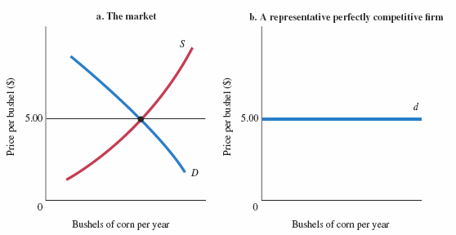
FIGURE 8.9 Demand Facing a Single Firm in a Perfectly Competitive Market
If a representative firm in a perfectly competitive market raises the price of its output above $5.00, the quantity demanded of that firm’s output will drop to zero.
Each firm faces a perfectly elastic demand curve, d.

Slide 32
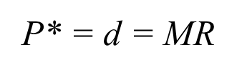
Total Revenue and Marginal Revenue
marginal revenue (MR) The additional revenue that a firm takes in when it increases output by one additional unit. In perfect competition, the marginal revenue is equal to the price.
The marginal revenue curve and the demand curve facing a competitive firm are identical.
The horizontal line in Figure 8.9(b) can be thought of as both the demand curve facing the firm and its marginal revenue curve:

Slide 33
Comparing Costs and Revenues to Maximize Profit (1 of 2)
The Profit-Maximizing Level of Output
As long as marginal revenue is greater than marginal cost, even though the difference between the two is getting smaller, added output means added profit.
Whenever marginal revenue exceeds marginal cost, the revenue gained by increasing output by 1 unit per period exceeds the cost incurred by doing so.
The profit-maximizing perfectly competitive firm will produce up to the point where the price of its output is just equal to short-run marginal cost—the level of output at which

Slide 34

Comparing Costs and Revenues to Maximize Profit (2 of 2)
The Profit-Maximizing Level of Output
The profit-maximizing output level for all firms is the output level where MR = MC.
In perfect competition, however, MR = P, as shown earlier. Hence, for perfectly competitive firms, we can rewrite our profit-maximizing condition as P = MC.
Important note: The key idea here is that firms will produce as long as marginal revenue exceeds marginal cost.

Slide 35
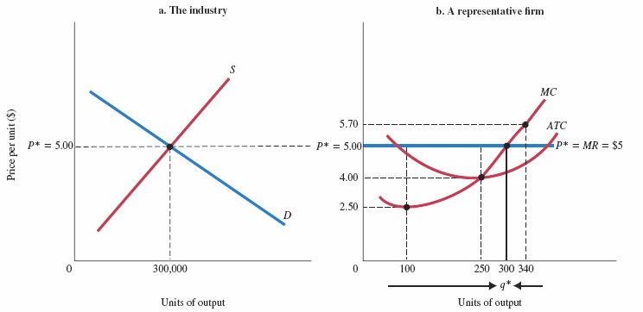
FIGURE 8.10 The Profit-Maximizing Level of Output for a Perfectly Competitive Firm
If price is above marginal cost, as it is at every quantity less than 300 units of output, profits can be increased by raising output; each additional unit increases revenues by more than it costs to produce the additional output because P > MC. Beyond q* = 300, however, added output will reduce profits.
At 340 units of output, an additional unit of output costs more to produce than it will bring in revenue when sold on the market. Profit-maximizing output is thus q*, the point at which P = MC.

Slide 36
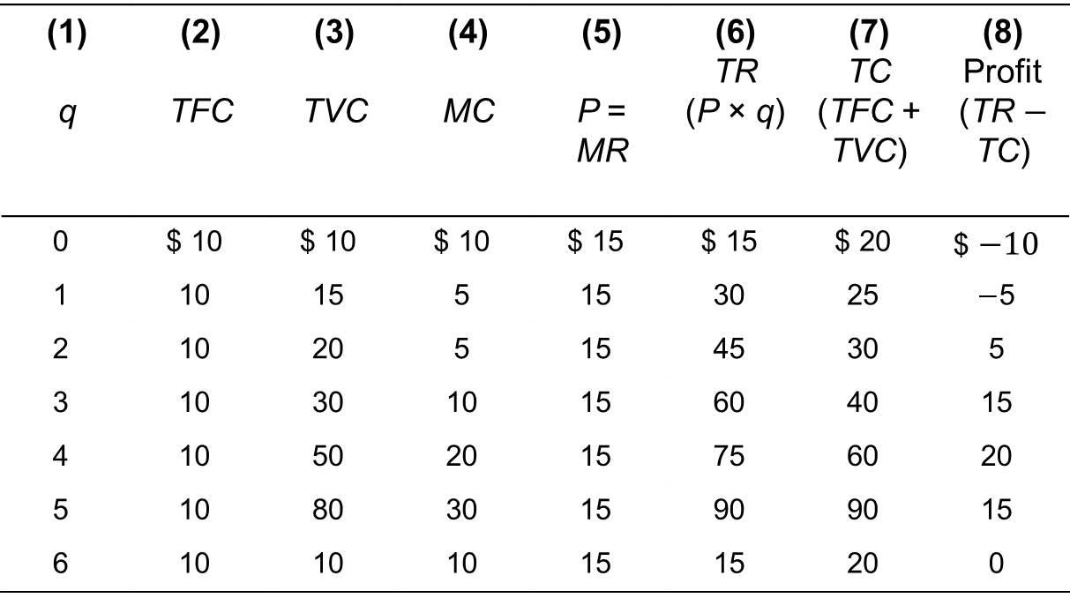
A Numerical Example (1 of 2)
TABLE 8.6 Profit Analysis for a Simple Firm
(1) q | (2) TFC | (3) TVC | (4) MC | (5) P = MR | (6) TR (P × q) | (7) TC (TFC + TVC) | (8) Profit (TR $−$ TC)
0 | $ 10 | $ 10 | $ 10 | $ 15 | $ 15 | $ 20 | $ $−10$
1 | 10 | 15 | 5 | 15 | 30 | 25 | $−$5
2 | 10 | 20 | 5 | 15 | 45 | 30 | 5
3 | 10 | 30 | 10 | 15 | 60 | 40 | 15
4 | 10 | 50 | 20 | 15 | 75 | 60 | 20
5 | 10 | 80 | 30 | 15 | 90 | 90 | 15
6 | 10 | 10 | 10 | 15 | 15 | 20 | 0

Slide 37
A Numerical Example (2 of 2)
If firms can produce fractional units, it is optimal to produce between 4 and 5 units.
The profit-maximizing level of output is thus between 4 and 5 units.
The firm continues to increase output as long as price (marginal revenue) is greater than marginal cost

Slide 38
The Short-Run Supply Curve
At any market price, the marginal cost curve shows the output level that maximizes profit.
Thus, the marginal cost curve of a perfectly competitive profit-maximizing firm is the firm’s short-run supply curve.
This is true except when price is so low that it pays a firm to shut down—a point that will be discussed in Chapter 9.

Slide 39
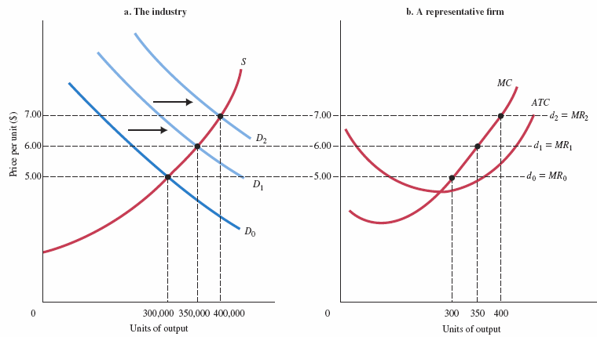
FIGURE 8.11 Marginal Cost Is the Supply Curve of a Perfectly Competitive Firm

Slide 40
REVIEW TERMS AND CONCEPTS
average fixed cost (AFC)
average total cost (ATC)
average variable cost (AVC)
fixed cost
homogeneous products
marginal cost (MC)
marginal revenue (MR)
perfect competition
spreading overhead
total cost (TC)
total fixed costs (TFC) or overhead
total revenue (TR)
total variable cost (TVC)
total variable cost curve
variable cost
Equations:
TC = TFC + TVC
AFC = TFC/q
slope of TVC = MC
AVC = TVC/q
ATC = TC/q = AFC + AVC
TR = P × q
profit-maximizing level of output for all firms: MR = MC
profit-maximizing level of output for perfectly competitive firms: P = MC

