Slide 1
Unit 3
The mind
Next
Main Page
Previous

Slide 2
3 The mind
Reading
Vocabulary & Grammar
Listening
Vocabulary & Grammar
Speaking
Examination practice
Writing
Next
Main Page
Previous

Slide 3
3 The mind
Reading
Next
Main Page
Previous

Slide 4
3 The mind
Reading
Next
Main Page
Previous

Slide 5
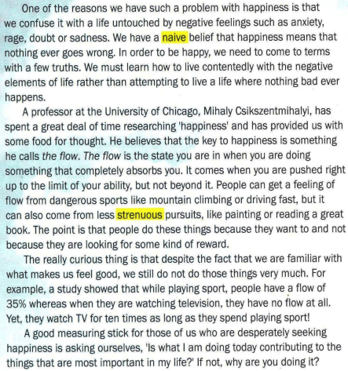
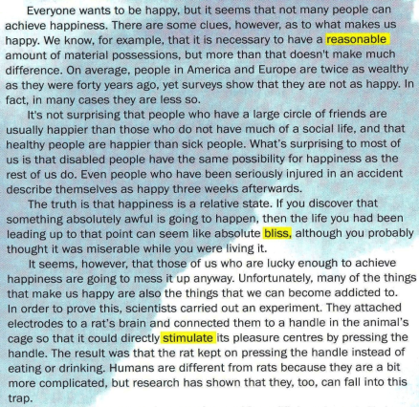
3 The mind
Reading
Next
Main Page
Previous

Slide 6
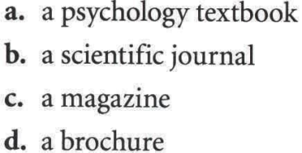
3 The mind
Reading
Next
Main Page
Previous

Slide 7
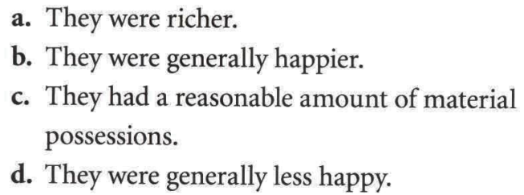
3 The mind
Reading
Next
Main Page
Previous

Slide 8
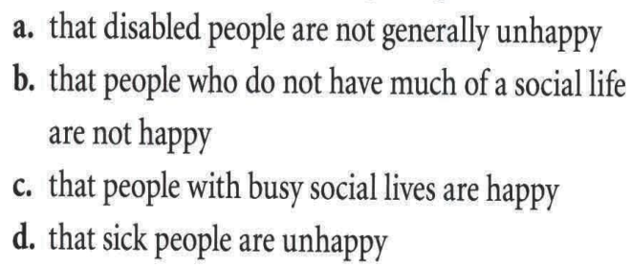
3 The mind
Reading
Next
Main Page
Previous

Slide 9
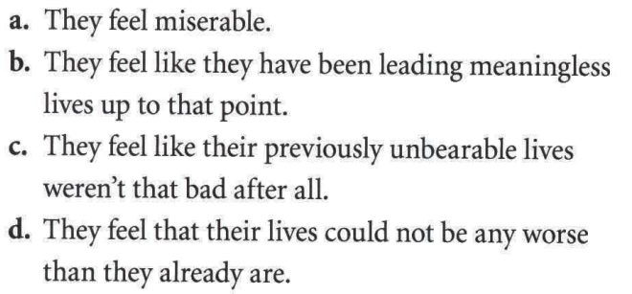
3 The mind
Reading
Next
Main Page
Previous

Slide 10
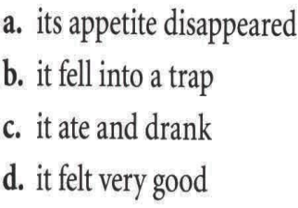
3 The mind
Reading
Next
Main Page
Previous

Slide 11
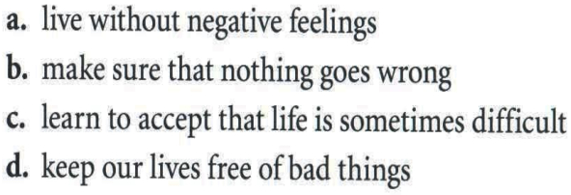
3 The mind
Reading
Next
Main Page
Previous

Slide 12
3 The mind
Reading
Next
Main Page
Previous

Slide 13
3 The mind
Reading
Next
Main Page
Previous

Slide 14
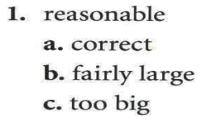
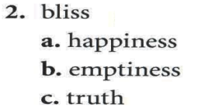
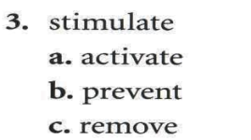
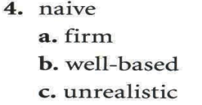
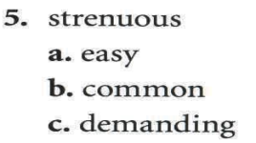
3 The mind
Reading
Next
Main Page
Previous

Slide 15
3 The mind
Reading
Next
Main Page
Previous

Slide 16
3 The mind
Vocabulary & grammar
Vocabulary
from
with
Next
Main Page
Previous

Slide 17
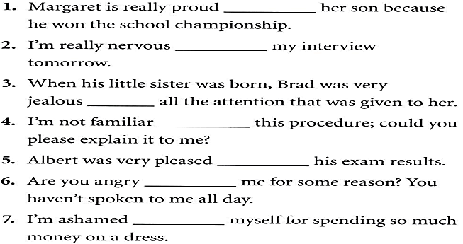
3 The mind
Vocabulary & grammar
Vocabulary
of
about
of
with
about
with
of
Next
Main Page
Previous

Slide 18
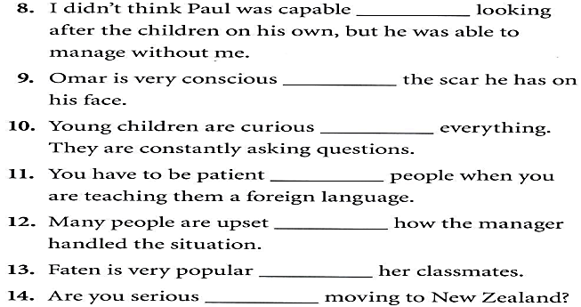
3 The mind
Vocabulary & grammar
Vocabulary
of
of
about
with
about
with
about
Next
Main Page
Previous

Slide 19
3 The mind
Vocabulary & grammar
Vocabulary
come in terms with : reach an agreement or understanding.
Next
Main Page
Previous

Slide 20
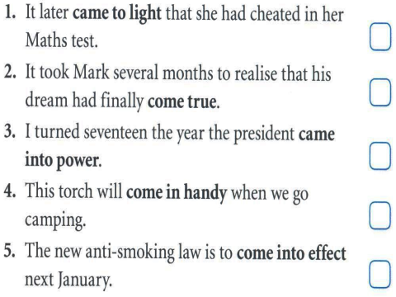
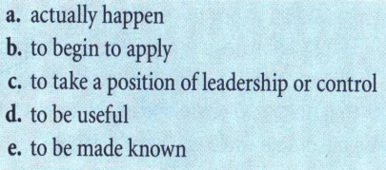
3 The mind
Vocabulary & grammar
Vocabulary
e
a
c
d
b
Next
Main Page
Previous

Slide 21
3 The mind
Vocabulary & grammar
Vocabulary
something worth thinking about seriously
Next
Main Page
Previous

Slide 22
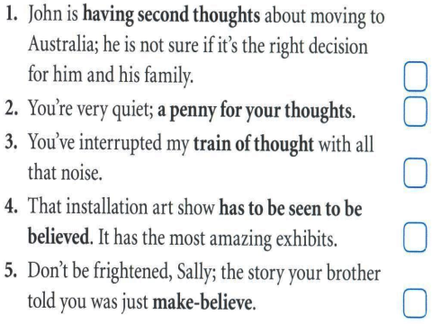
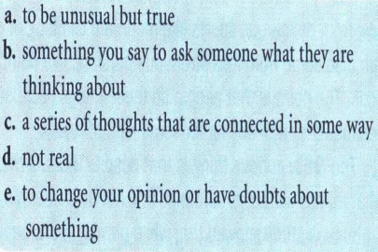
3 The mind
Vocabulary & grammar
Vocabulary
e
b
c
a
d
Next
Main Page
Previous

Slide 23
3 The mind
Vocabulary & grammar
Grammar
are planning
I’m able
Next
Main Page
Previous

Slide 24
3 The mind
Vocabulary & grammar
Grammar
I have made
You will feel
Next
Main Page
Previous

Slide 25
3 The mind
Vocabulary & grammar
Grammar
I can’t
behaved
Next
Main Page
Previous

Slide 26
3 The mind
Vocabulary & grammar
Grammar
We use say when there is no indirect object.
We use tell when there is an indirect object.
announce – claim - add
Next
Main Page
Previous

Slide 27
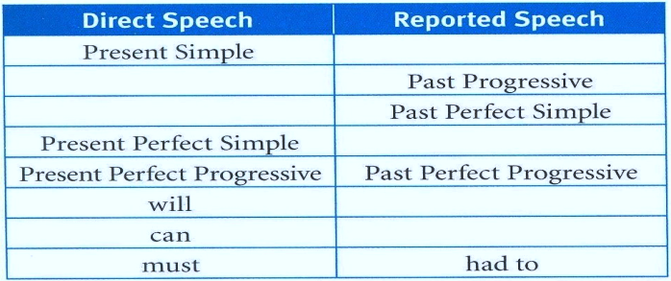
3 The mind
Vocabulary & grammar
Grammar
Past simple
Present progressive
Past simple
Past Perfect simple
would
could
Next
Main Page
Previous

Slide 28
3 The mind
Vocabulary & grammar
Grammar
pay
Don’t interrupt
Next
Main Page
Previous

Slide 29
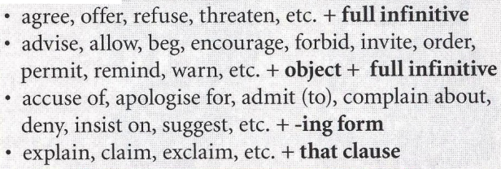
3 The mind
Vocabulary & grammar
Grammar
should do
Next
Main Page
Previous

Slide 30
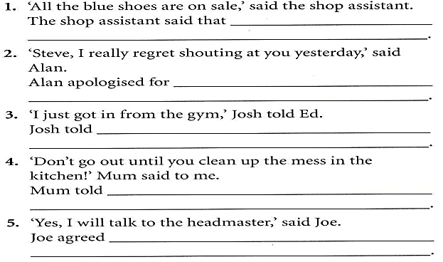
3 The mind
Vocabulary & grammar
Grammar
the blue shoes
were on sale.
shouting at Steve
the night before.
Ed that he had just got in
from the gym.
me not to go out before l clean the
mess in the kitchen.
to talk to the headmaster.
Next
Main Page
Previous

Slide 31
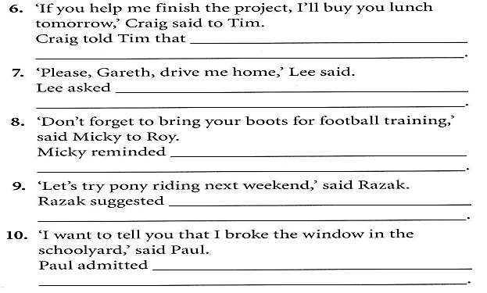
3 The mind
Vocabulary & grammar
Grammar
if he help him finish the
project, he would buy him lunch the next day.
Gareth to drive him home.
Roy to bring his boots for the
football training.
trying pony riding the following
weekend.
breaking the window in the
schoolyard.
Next
Main Page
Previous

Slide 32
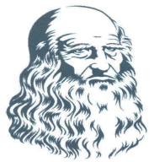
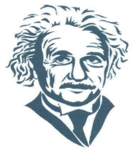
3 The mind
Listening
Next
Main Page
Previous

Slide 33
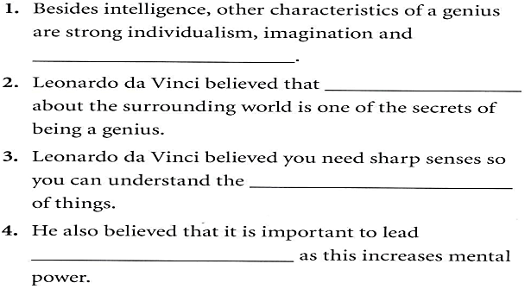
3 The mind
Listening
Next
Main Page
Previous

Slide 34
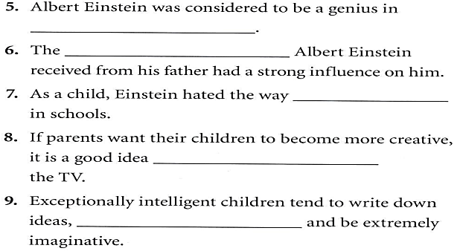
3 The mind
Listening
Next
Main Page
Previous

Slide 35
3 The mind
Listening
Next
Main Page
Previous

Slide 36
3 The mind
Listening
Next
Main Page
Previous

Slide 37
3 The mind
Listening
Next
Main Page
Previous

Slide 38
3 The mind
Listening
Next
Main Page
Previous

Slide 39
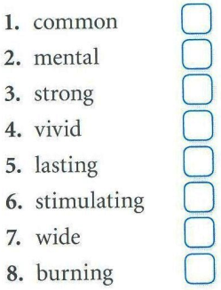
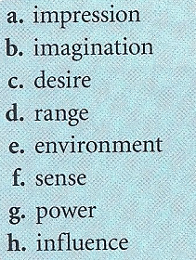
3 The mind
Listening
Next
Main Page
Previous

Slide 40
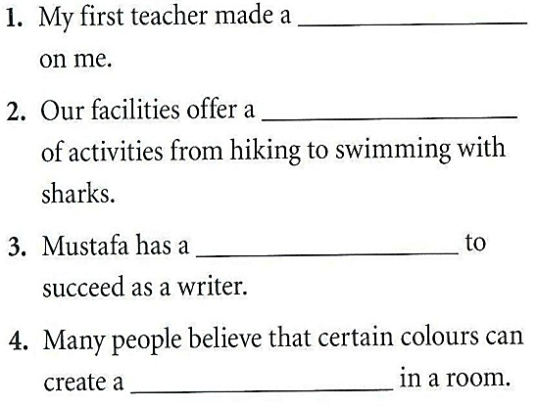
3 The mind
Vocabulary
Next
Main Page
Previous

Slide 41
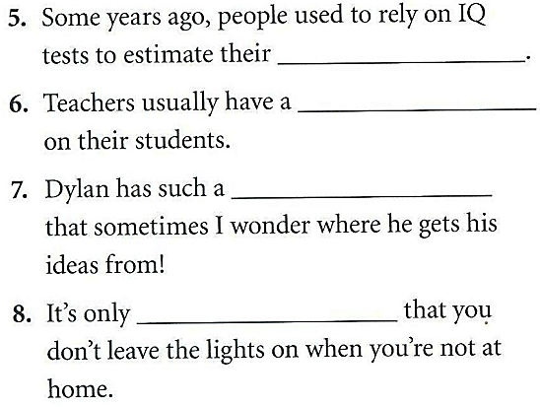
3 The mind
Vocabulary
Next
Main Page
Previous

Slide 42
3 The mind
Grammar
has Leonardo da Vinci enriched himself to develop ………..
Einstein’s genius show itself in early childhood.
Next
Main Page
Previous

Slide 43
3 The mind
Grammar
Next
Main Page
Previous

Slide 44
3 The mind
Grammar
Hugh asked what time the ferry was expected to arrive from Malta.
Terry asked Bill when he had visited the states.
Tina asked me whether I could tell the twins apart.
Peter asked Bill why he was going to buy another pair of jeans.
Next
Main Page
Previous

Slide 45
3 The mind
Grammar
George asked me if I remembered the name of the restaurant where ….
Claire asked Gemma why she was reading an old newspaper.
Jackson asked Michael who had given him permission to use his computer.
David wondered if he would ever be rich.
Next
Main Page
Previous

Slide 46
3 The mind
Speaking
Next
Main Page
Previous

Slide 47
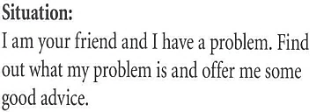
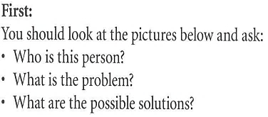
3 The mind
Speaking
Next
Main Page
Previous

Slide 48
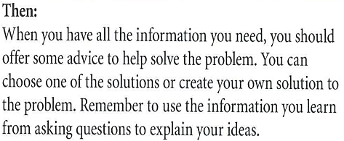
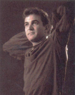
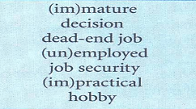
3 The mind
Speaking
Next
Main Page
Previous

Slide 49
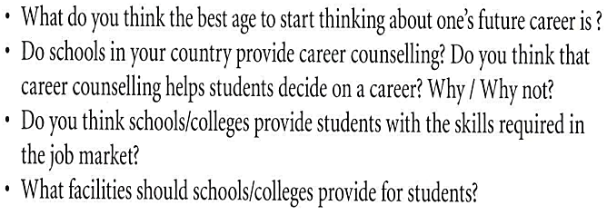
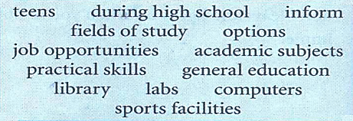
3 The mind
Speaking
Next
Main Page
Previous

Slide 50
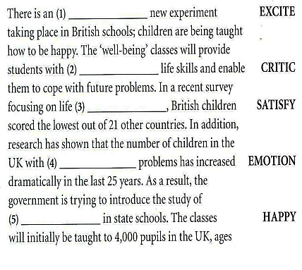
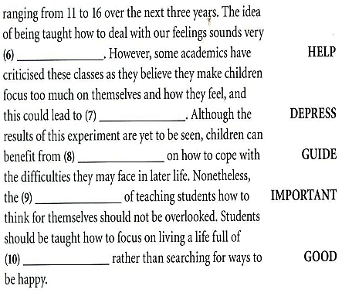
3 The mind
Examination practice
exciting
helpful
critical
satisfaction
depression
guidance
emotional
importance
happiness
goodness
Next
Main Page
Previous

Slide 51
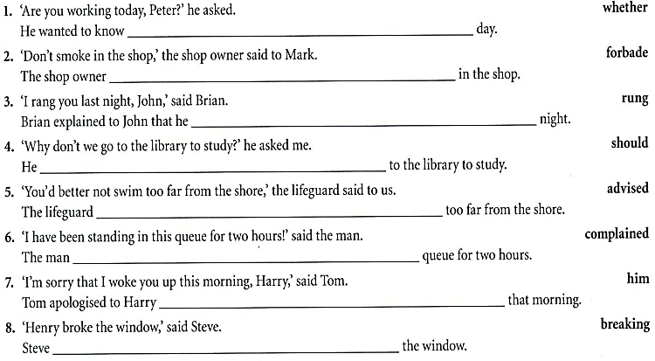
3 The mind
Examination practice
Next
Main Page
Previous

Slide 52
3 The mind
Writing
Next
Main Page
Previous

Slide 53
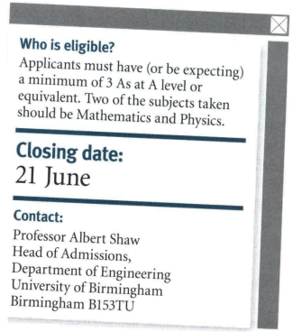
3 The mind
Writing
Next
Main Page
Previous

Slide 54
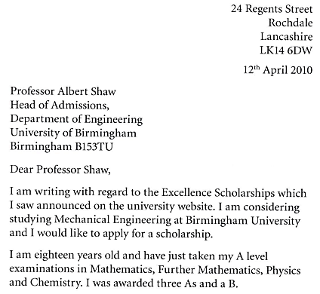
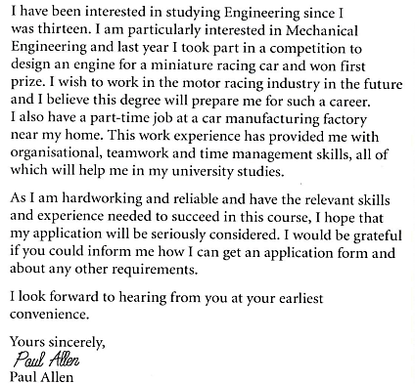
3 The mind
Writing
Next
Main Page
Previous

Slide 55
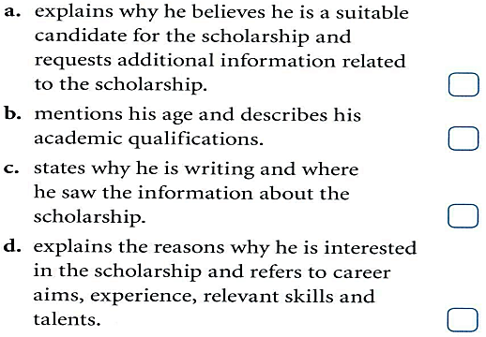
3 The mind
Writing
Next
Main Page
Previous

Slide 56
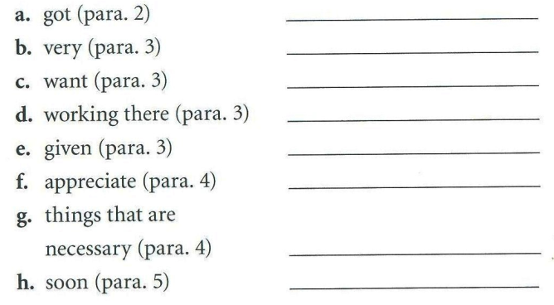
3 The mind
Writing
Next
Main Page
Previous

Slide 57
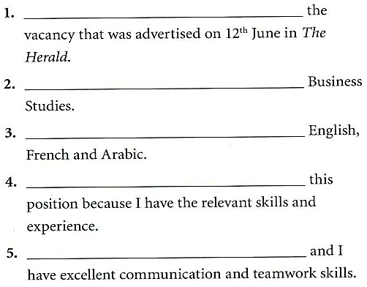
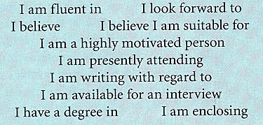
3 The mind
Writing
Next
Main Page
Previous

Slide 58
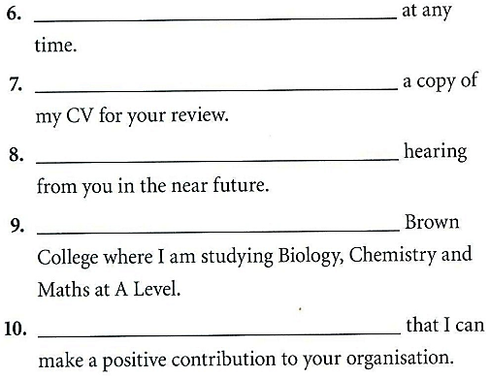
3 The mind
Writing
Next
Main Page
Previous

Slide 59
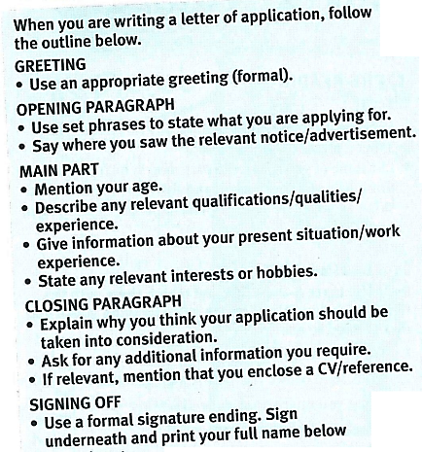
3 The mind
Writing
Next
Main Page
Previous

Slide 60
3 The mind
Writing
Next
Main Page
Previous

Slide 61
3 The mind
Writing
Next
Main Page
Previous

