Slide 1
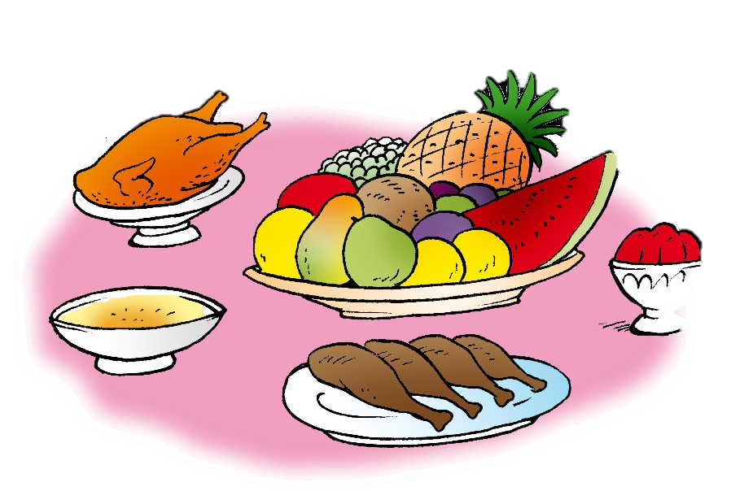
Unit 7- Lesson 3 P 66
Dinnertime!
Family and Friend 2
Grade 2

Slide 2
Objectives
1- Identify five drinks (names).
2- Recognise five drinks (pictures).
____________________________________________________________________________________________________________________________________
Ministry of Education-2020

Slide 3
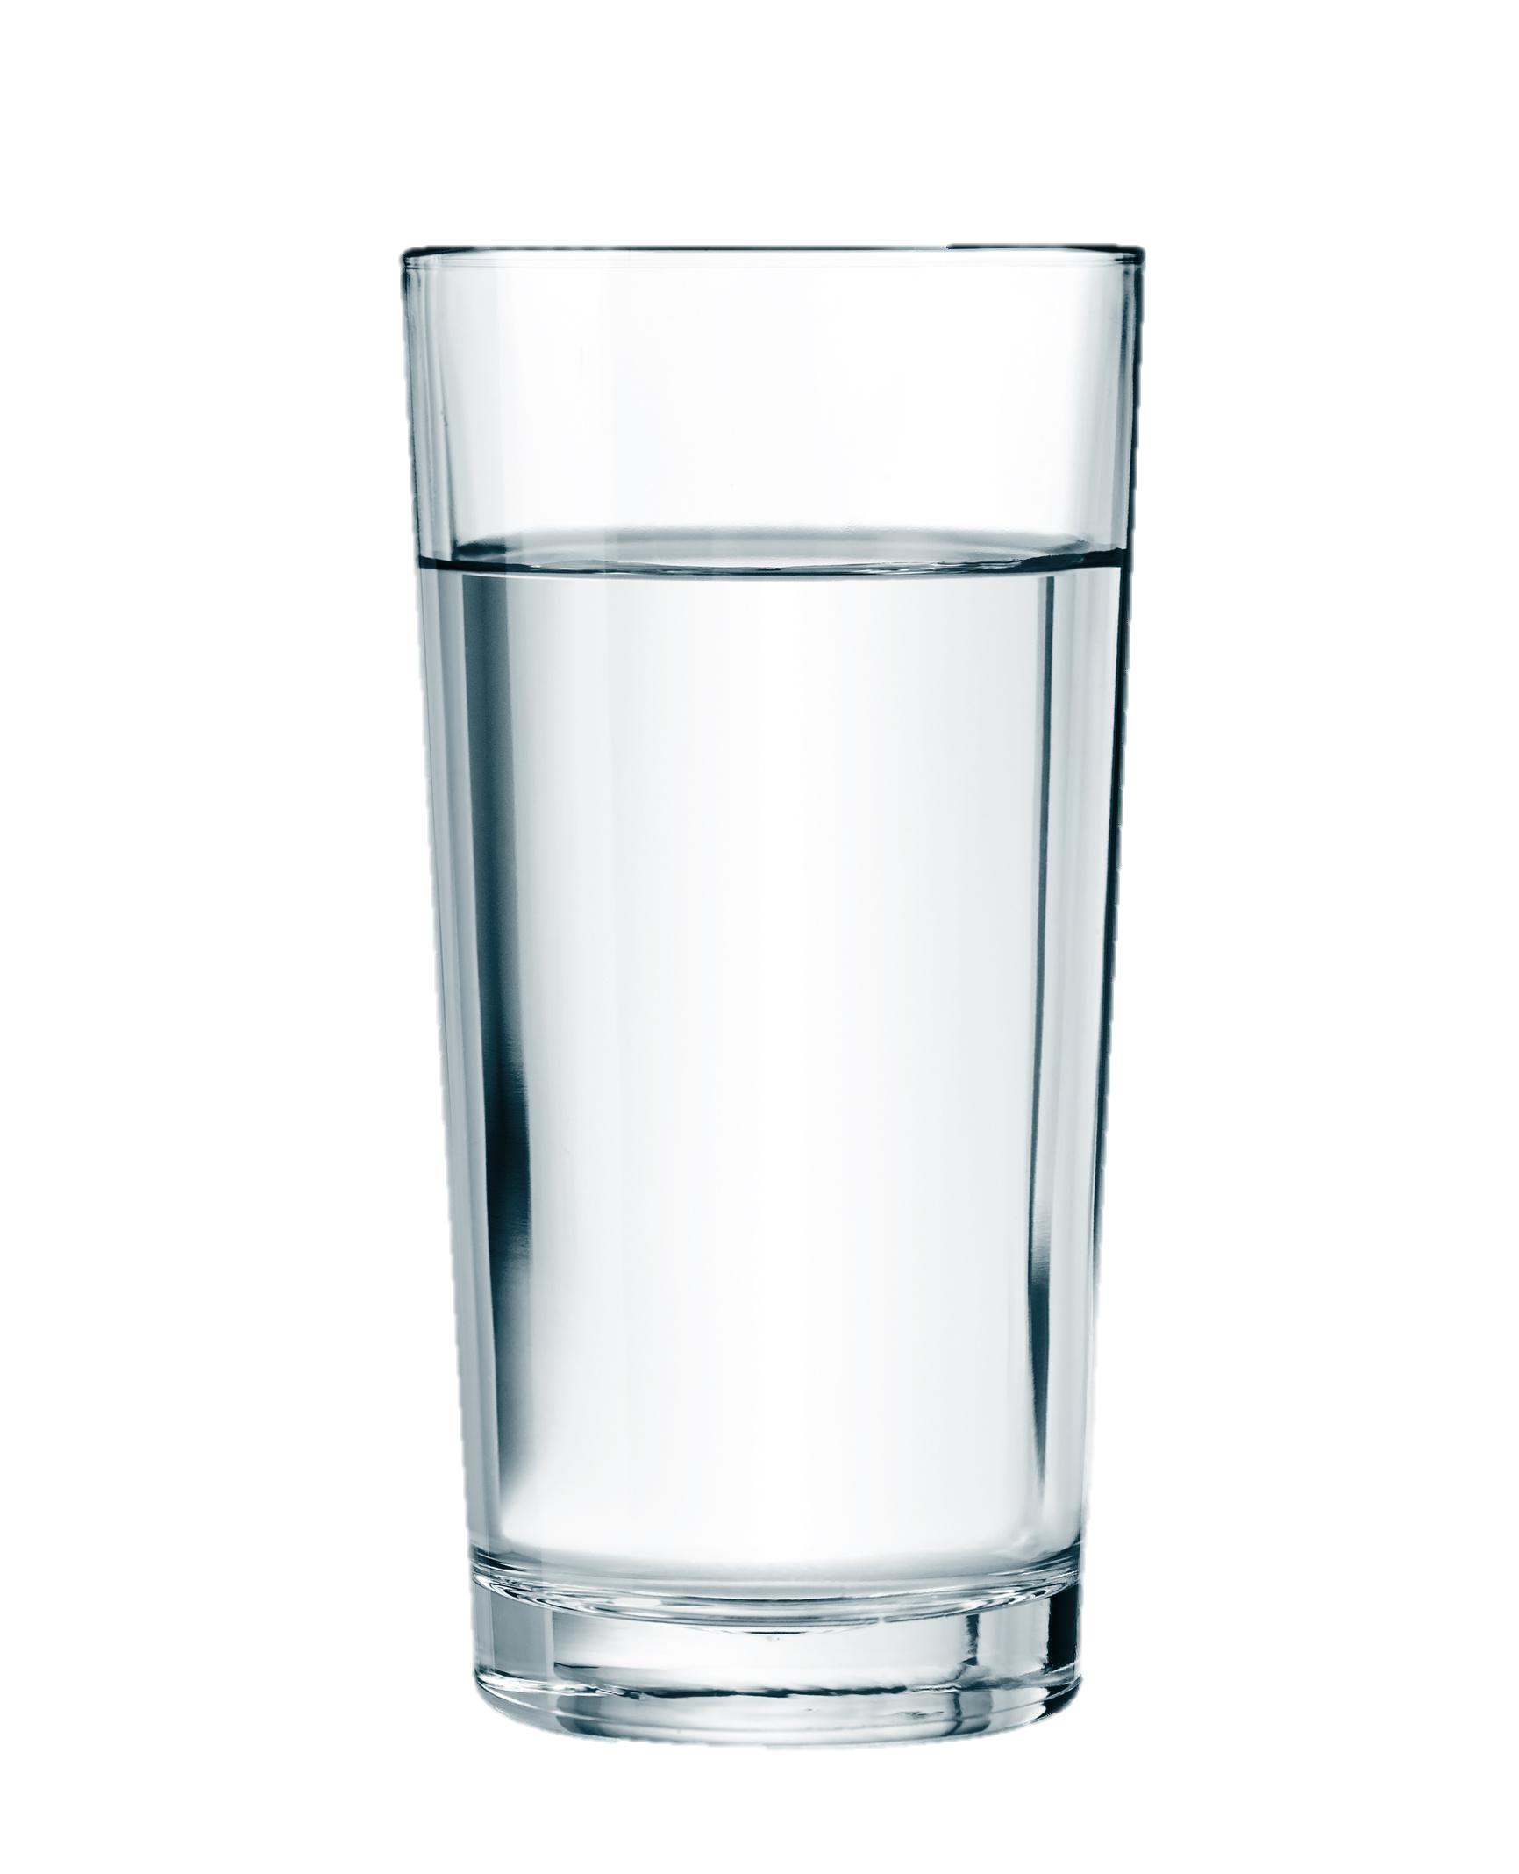
Listen, point and repeat.
Milk
Juice
Water
Hot
chocolate
Tea
____________________________________________________________________________________________________________________________________
Ministry of Education-2020

Slide 4
Read, point and repeat.
Milk
____________________________________________________________________________________________________________________________________
Ministry of Education-2020

Slide 5
Read, point and repeat.
Juice
____________________________________________________________________________________________________________________________________
Ministry of Education-2020

Slide 6
Read, point and repeat.
Water
____________________________________________________________________________________________________________________________________
Ministry of Education-2020

Slide 7
Read, point and repeat.
Hot chocolate
____________________________________________________________________________________________________________________________________
Ministry of Education-2020

Slide 8
Read, point and repeat.
Tea
____________________________________________________________________________________________________________________________________
Ministry of Education-2020

Slide 9
Get your white boards and markers!
Let’s practice!
____________________________________________________________________________________________________________________________________
Ministry of Education-2020

Slide 10
Look at the picture and write the correct answer on your mini-board.
water
milk
____________________________________________________________________________________________________________________________________
Ministry of Education-2020

Slide 11
Look at the picture and write the correct answer on your mini-board.
juice
hot chocolate
____________________________________________________________________________________________________________________________________
Ministry of Education-2020

Slide 12
Look at the picture and write the correct answer on your mini-board.
water
milk
____________________________________________________________________________________________________________________________________
Ministry of Education-2020

Slide 13
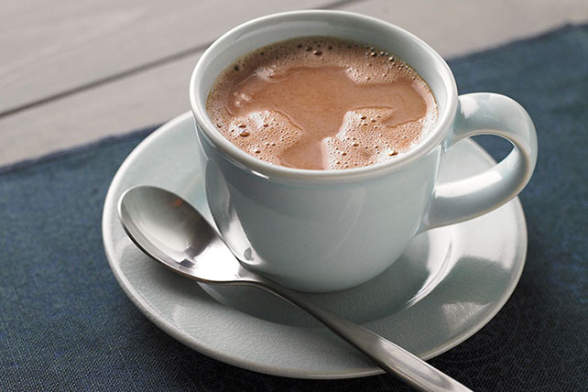
Look at the picture and write the correct answer on your mini-board.
tea
hot chocolate
____________________________________________________________________________________________________________________________________
Ministry of Education-2020

Slide 14
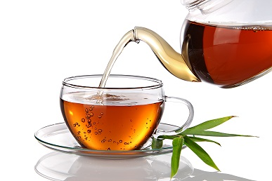
Look at the picture and write the correct answer on your mini-board.
tea
juice
____________________________________________________________________________________________________________________________________
Ministry of Education-2020

Slide 15
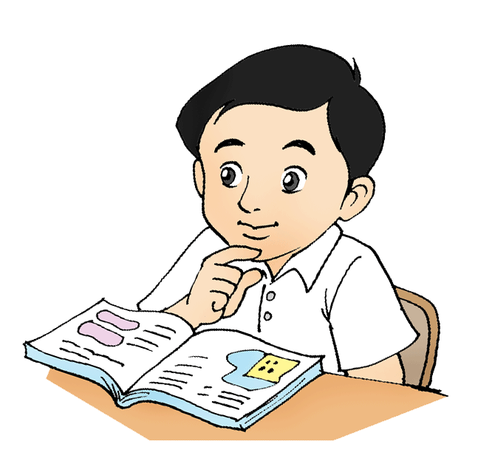
Open your Workbook page 64.
Answer questions 1 and 2.
____________________________________________________________________________________________________________________________________
Ministry of Education-2020

Slide 16
Q1 - Model Answer
1. hot chocolate
2. water
3. milk
4. tea
5. juice
____________________________________________________________________________________________________________________________________
Ministry of Education-2020

Slide 17
Q2 - Model Answer
milk
2. hot chocolate
3. juice
____________________________________________________________________________________________________________________________________
Ministry of Education-2020

Slide 18
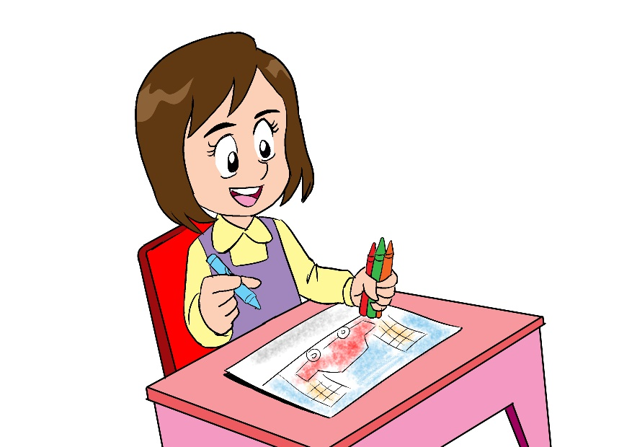
Don’t forget to answer the questions
in the practice PPT for L3.
____________________________________________________________________________________________________________________________________
Ministry of Education-2020

Slide 19
End of the lesson
Good job dear !
____________________________________________________________________________________________________________________________________
Ministry of Education-2020

