Slide 1
Unit 7
Travel
Next
Main Page
Previous

Slide 2
7 Travel
Reading
Vocabulary & Grammar
Listening
Vocabulary & Grammar
Speaking
Examination practice
Writing
Next
Main Page
Previous

Slide 3
7 Travel
Reading
Next
Main Page
Previous

Slide 4
7 Travel
Reading
Next
Main Page
Previous

Slide 5
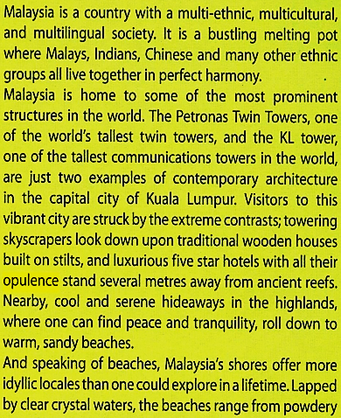
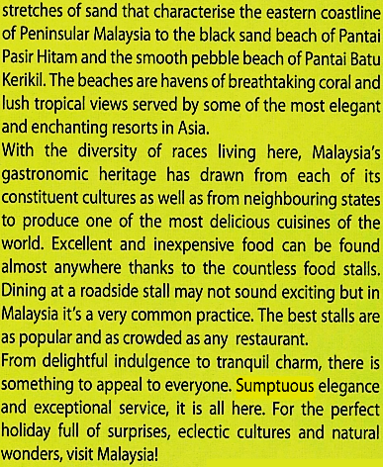
7 Travel
Reading
Next
Main Page
Previous

Slide 6
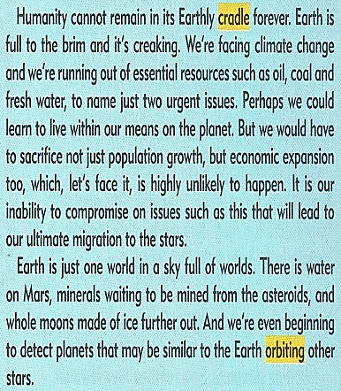
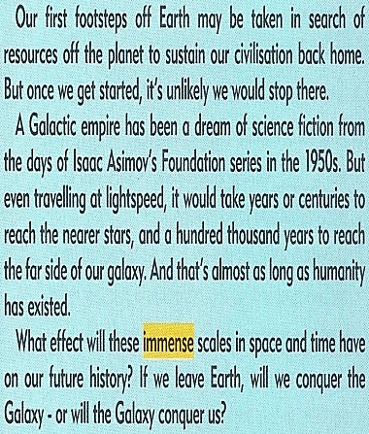
7 Travel
Reading
Next
Main Page
Previous

Slide 7
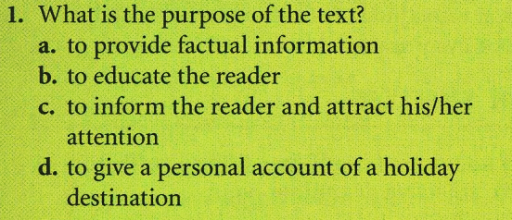
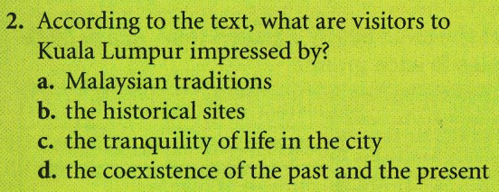
7 Travel
Reading
Next
Main Page
Previous

Slide 8
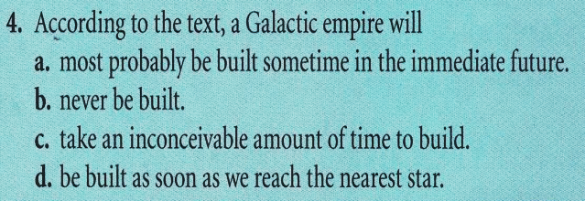
7 Travel
Reading
Next
Main Page
Previous

Slide 9
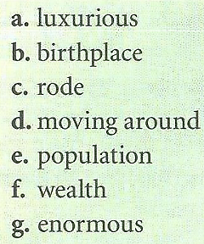
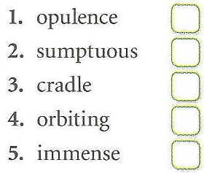
7 Travel
Reading
Next
Main Page
Previous

Slide 10
7 Travel
Reading
Next
Main Page
Previous

Slide 11
7 Travel
Vocabulary & grammar
Vocabulary
Next
Main Page
Previous

Slide 12
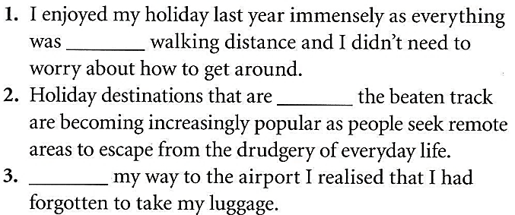
7 Travel
Vocabulary & grammar
Vocabulary
Next
Main Page
Previous

Slide 13
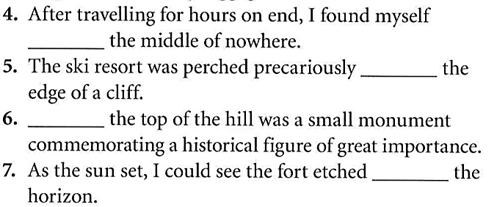
7 Travel
Vocabulary & grammar
Vocabulary
Next
Main Page
Previous

Slide 14
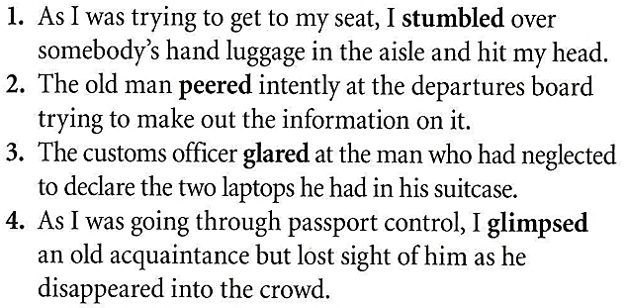
7 Travel
Vocabulary & grammar
Vocabulary
Next
Main Page
Previous

Slide 15
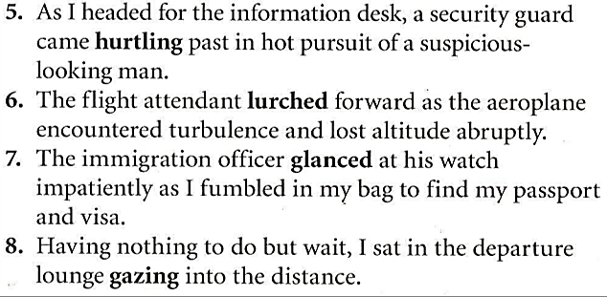
7 Travel
Vocabulary & grammar
Vocabulary
Next
Main Page
Previous

Slide 16
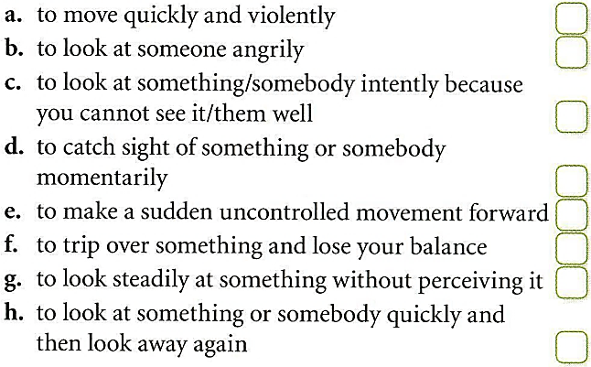
7 Travel
Vocabulary & grammar
Vocabulary
Next
Main Page
Previous

Slide 17
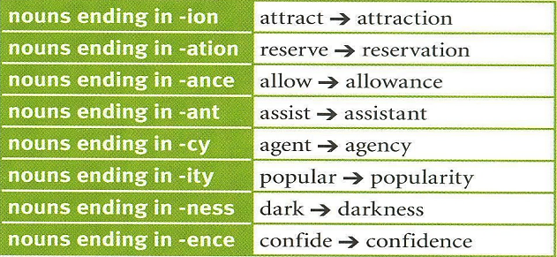
7 Travel
Vocabulary & grammar
Vocabulary
Next
Main Page
Previous

Slide 18
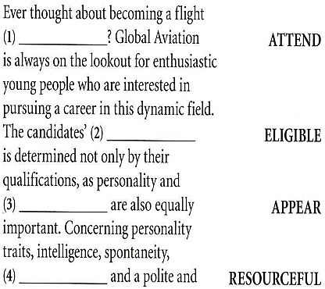
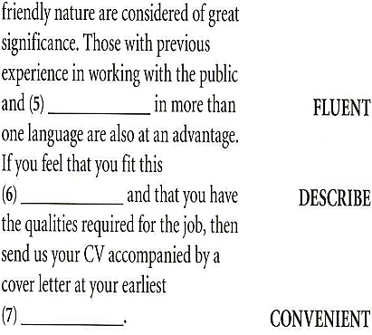
7 Travel
Vocabulary & grammar
Vocabulary
Next
Main Page
Previous

Slide 19
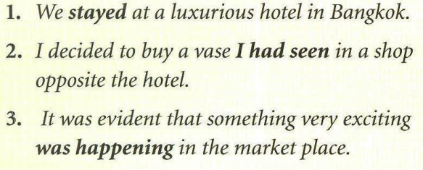
7 Travel
Vocabulary & grammar
Grammar
Next
Main Page
Previous

Slide 20
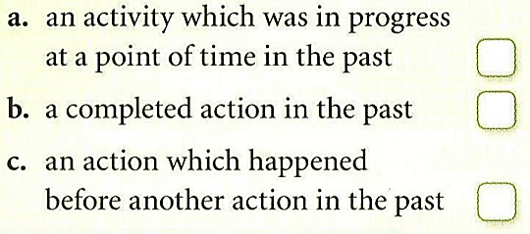
7 Travel
Vocabulary & grammar
Grammar
Next
Main Page
Previous

Slide 21
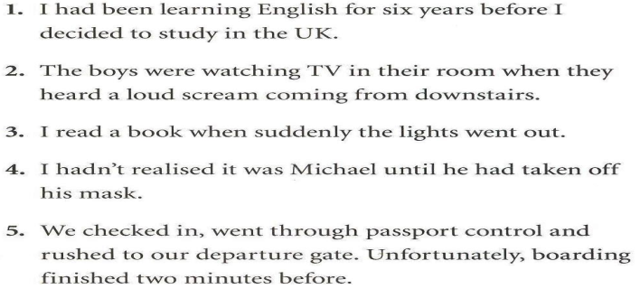
7 Travel
Vocabulary & grammar
Grammar
Next
Main Page
Previous

Slide 22
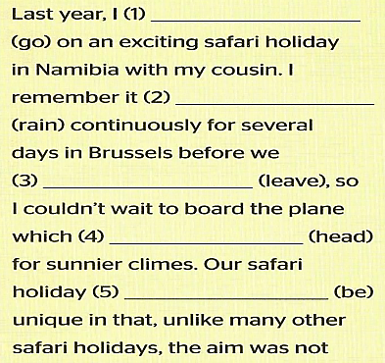
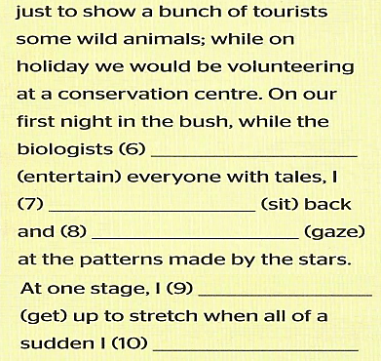
7 Travel
Vocabulary & grammar
Grammar
Next
Main Page
Previous

Slide 23
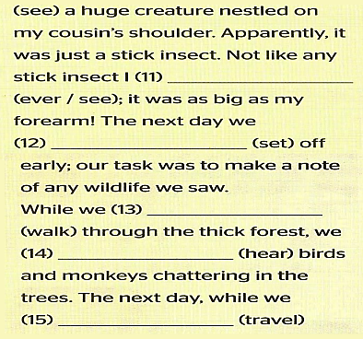
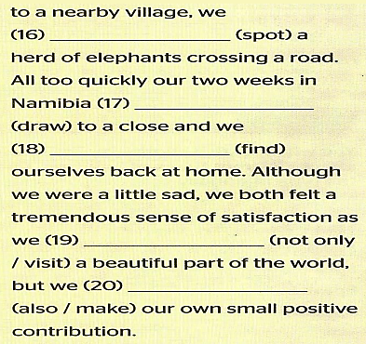
7 Travel
Vocabulary & grammar
Grammar
Next
Main Page
Previous

Slide 24
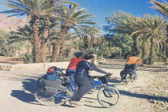
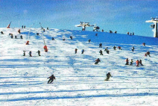
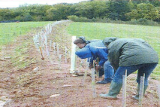
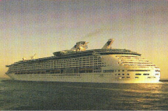
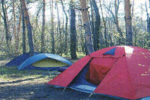
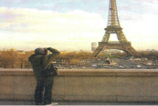
7 Travel
Listening
Next
Main Page
Previous

Slide 25
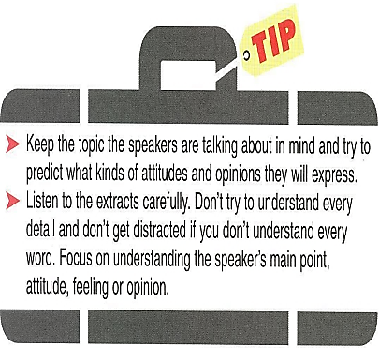
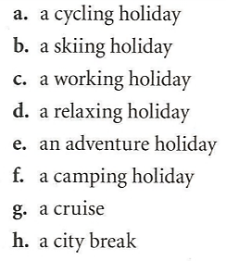
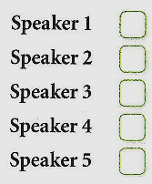
7 Travel
Listening
Next
Main Page
Previous

Slide 26
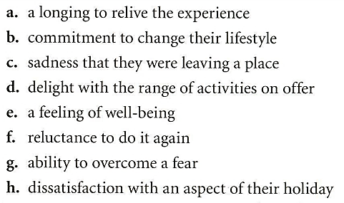
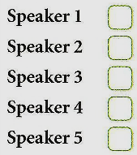
7 Travel
Listening
Next
Main Page
Previous

Slide 27
7 Travel
Vocabulary
Next
Main Page
Previous

Slide 28
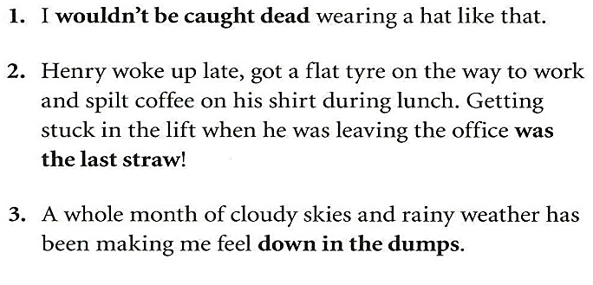
7 Travel
Vocabulary
Next
Main Page
Previous

Slide 29
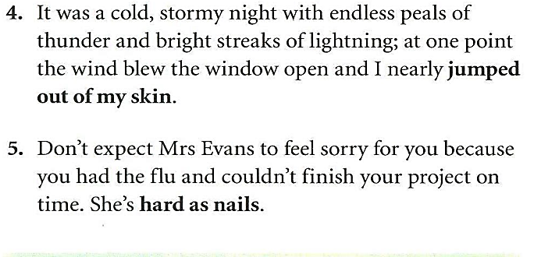
7 Travel
Vocabulary
Next
Main Page
Previous

Slide 30
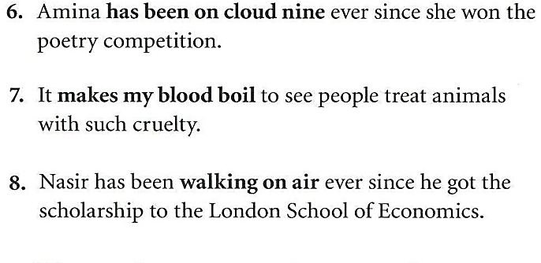
7 Travel
Vocabulary
Next
Main Page
Previous

Slide 31
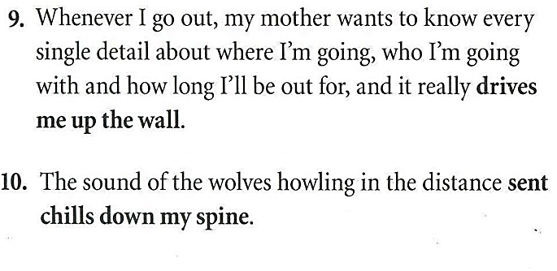
7 Travel
Vocabulary
Next
Main Page
Previous

Slide 32
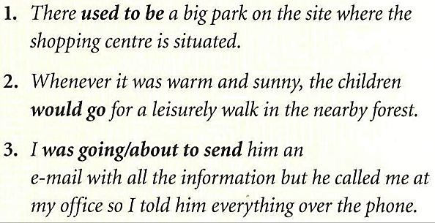
7 Travel
Grammar
Next
Main Page
Previous

Slide 33
7 Travel
Grammar
Next
Main Page
Previous

Slide 34
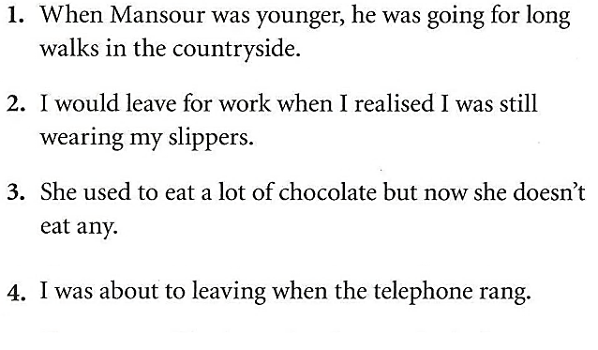
7 Travel
Grammar
Next
Main Page
Previous

Slide 35
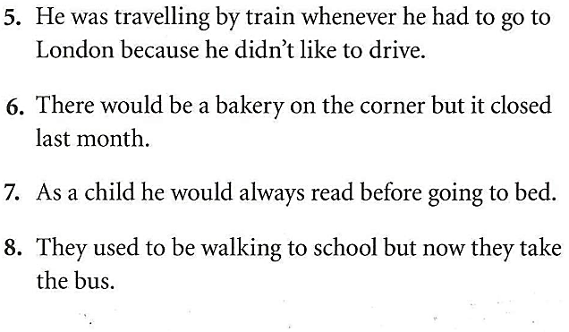
7 Travel
Grammar
Next
Main Page
Previous

Slide 36
7 Travel
Speaking
Next
Main Page
Previous

Slide 37
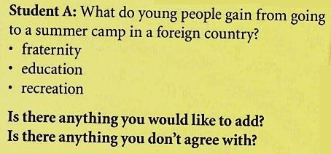
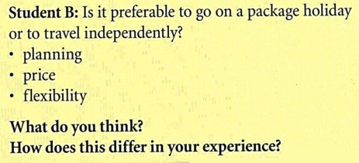
7 Travel
Speaking
Next
Main Page
Previous

Slide 38
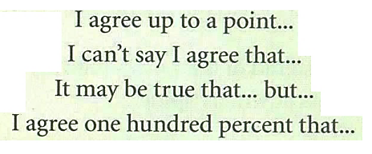
7 Travel
Speaking
Next
Main Page
Previous

Slide 39
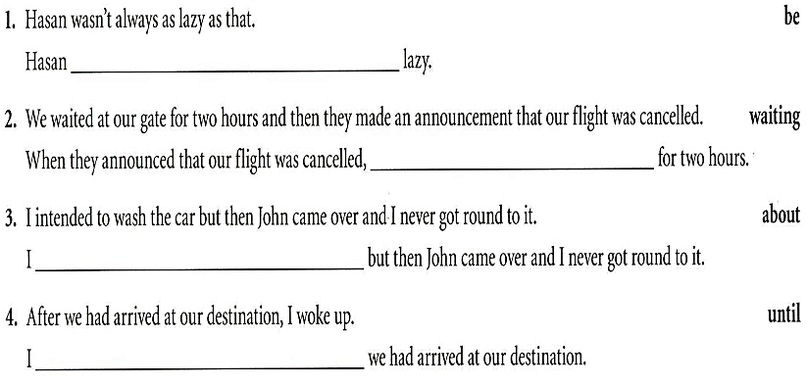
7 Travel
Examination practice
Next
Main Page
Previous

Slide 40
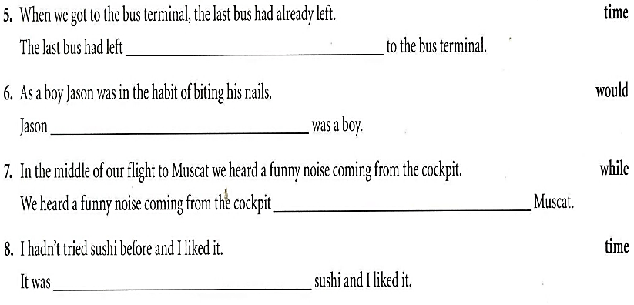
7 Travel
Examination practice
Next
Main Page
Previous

Slide 41
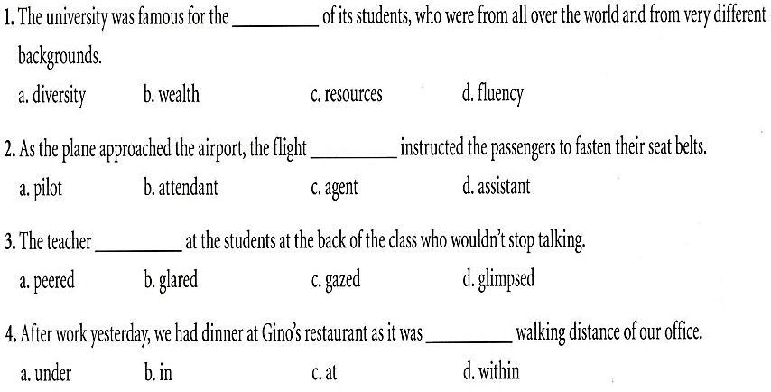
7 Travel
Examination practice
Next
Main Page
Previous

Slide 42
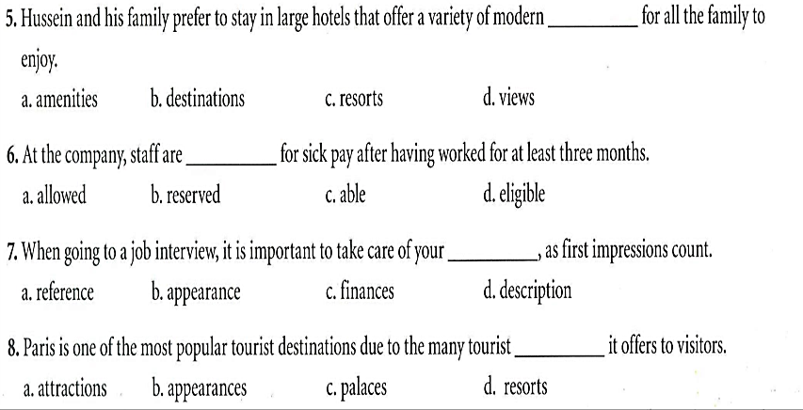
7 Travel
Examination practice
Next
Main Page
Previous

Slide 43
7 Travel
Writing
Next
Main Page
Previous

Slide 44
7 Travel
Writing
Next
Main Page
Previous

Slide 45
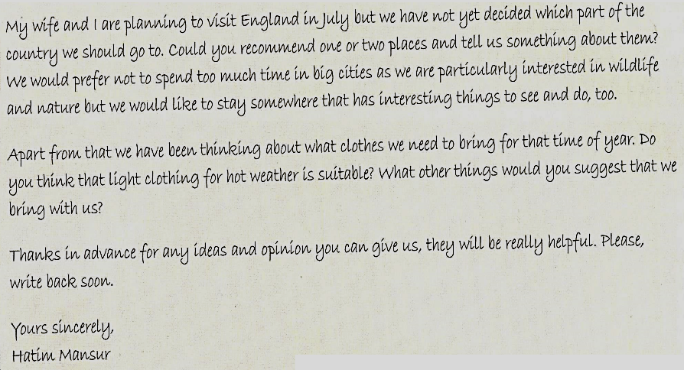
7 Travel
Writing
Next
Main Page
Previous

Slide 46
7 Travel
Writing
Next
Main Page
Previous

Slide 47
7 Travel
Writing
Next
Main Page
Previous

Slide 48
7 Travel
Writing
Next
Main Page
Previous

Slide 49
7 Travel
Writing
Next
Main Page
Previous

