Slide 1
Speaking Practice
Unit 6-8 Book 1
Unit 1-3 Book 2

Slide 2
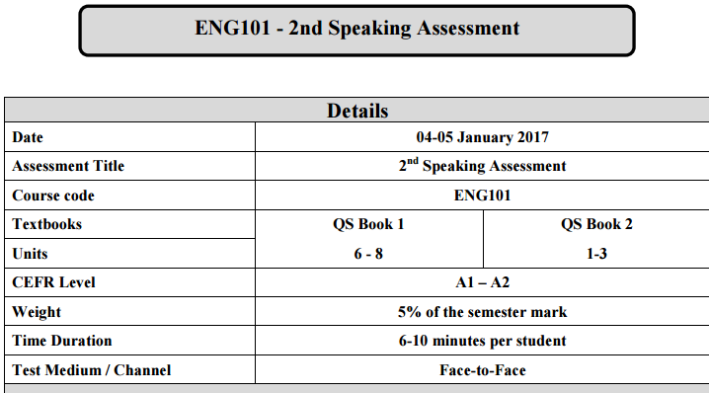

Slide 4
Unit 6
Book 1

Slide 5
Task 1

Slide 6
When is honesty important?
What are some examples of honest things that people do?
Do you think most people lie? Why/why not?
What are some examples of dishonest things that people do?
Do you think it’s OK to be dishonest sometimes?

Slide 7
Some additional questions
What is plagiarism?
How can you avoid it?

Slide 8
Task 2

Slide 10
Task 3

Slide 11
Speaking Skills
What are different ways of sourcing information?

Slide 12
Unit 7
Book 1

Slide 13
Task 1

Slide 14
Is it ever too late to change?
Do you like to make changes in your life or do you prefer things to stay the same?
Do you think old people or young people find it easier to make changes in their lives ? Why?
What was the last big change in your life ? How difficult was it?

Slide 15
Task 2

Slide 17
Task 3

Slide 18
Speaking Skills
How do you check for listener’s understanding?

Slide 19
Unit 8
Book 1

Slide 20
Task 1

Slide 21
When is it good to be afraid? Why?
What kinds of things make you feel afraid? Why?
Do you enjoy the feeling of fear, for example, when you watch a horror movie or take a fast ride in theme park? Why/why not?
What was the last big change in your life ? How difficult was it?

Slide 22
Task 2

Slide 23
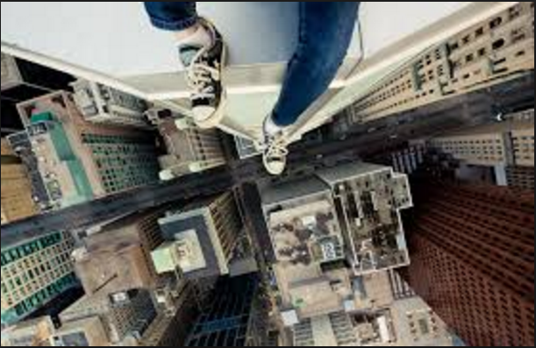

Slide 24
Task 3

Slide 25
Speaking Skills
How do you express feelings of surprise?

Slide 26
Unit 1
Book 2

Slide 27
Task 1

Slide 28
What are current trends in architecture?
Think about a city you know well . Which buildings are the most attractive? The most unattractive? Why?
How important is it for a city to have beautiful architecture?
Do you think the architects should follow the latest trends ? Why or why not?

Slide 29
Task 2

Slide 30
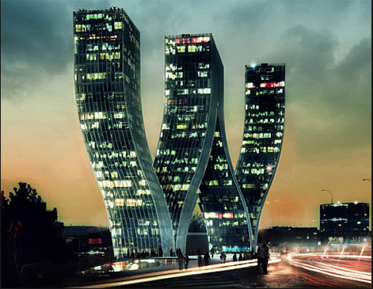

Slide 31
Task 3

Slide 32
Speaking Skills
How do you draw attention to the main ideas?

Slide 33
Unit 2
Book 2

Slide 34
Task 1

Slide 35
How can colours be useful?
Imagine you want to paint your house. What colour would you choose? Why?
Why can wearing dark clothes at night be dangerous ? Why do traffic police in some countries wear orange?
What does the word ‘camouflage’ mean? Give an example.

Slide 36
Task 2

Slide 37
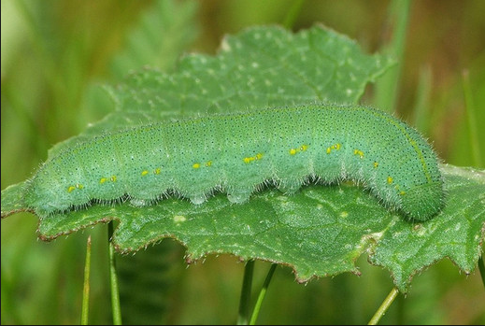

Slide 38
Task 3

Slide 39
Speaking Skills
How do you ask someone for examples?

Slide 40
Unit 3
Book 2

Slide 41
Task 1

Slide 42
Why are good manners important? Give an example.
Do you feel that people are usually polite? Why/why not?
Are you ever unsure about manners in social situations? Give examples.
What do you think is the best way to respond to a rude person?

Slide 43
Task 2

Slide 45
Task 3

Slide 46
Speaking Skills
How do you give advice?

Slide 48
Unit 6
Book 1

Slide 49
Task 1

Slide 50
Do you think cheating is a problem in schools? Why or why not?
Do you think it is possible to stop students from cheating? How?
What is your opinion about these actions? Do you think they are wrong?
Copying a report from the internet
Giving false information on a resume
When is the honesty important?

Slide 51
Task 2

Slide 52
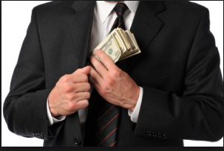

Slide 53
Task 3

Slide 54
How do you source information?

Slide 55
Unit 7
Book 1

Slide 56
Task 1

Slide 57
What is the most important thing for people to do if they want to improve their lives?
What do people think about change in your culture? Is it a positive thing or a negative thing? Do you agree?
Did you ever try to change a habit? What was the habit? Were you successful?
What are some things you would like to change in your life? Why?
What’s your opinion about this statement?
“Older people can’t change.”

Slide 58
Task 2

Slide 59
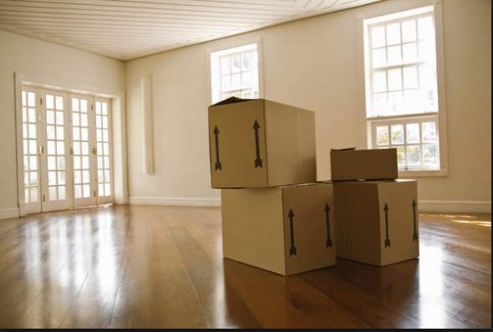

Slide 60
Task 3

Slide 61
How do you check listener’s understanding?

Slide 62
Unit 8
Book 1

Slide 63
Task 1

Slide 64
Do you or someone you know has these types of fear? Give examples.
Panic_______
Anxiety______
Phobia_______
Do you know anyone with a phobia? What can a person do to get over their phobia?
How can some fears be good or bad in your life? Give examples.
OR Why do you think some fears are good and others are bad?
What are some examples of people enjoying fear?

Slide 65
Task 2

Slide 66
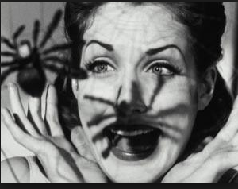

Slide 67
Task 3

Slide 68
How do you express happiness?

Slide 69
Unit 1
Book 2

Slide 70
Task 1

Slide 71
What kinds of buildings do you like/dislike? Why?
A famous architect said, “ Buildings should serve the people not the other way round.” Do you agree? Why/why not?
Why do you think green roofs are becoming popular?
Do you know of any buildings in your community that have a ‘green roof’ ?What is sustai
What are some ways for architects to design sustainable buildings and homes?

Slide 72
Task 2

Slide 73
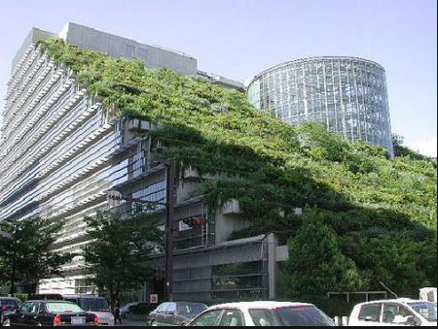

Slide 74
Task 3

Slide 75
How do you draw attention to the main ideas?

Slide 76
Unit 2
Book 2

Slide 77
Task 1

Slide 78
Most large predators like lions, are not brightly coloured . Why?
What colours are popular for houses where you live? Are there many different colours or are they mostly the same?
What does your dream house look like?
What colours do you prefer for your clothing and your home?
What companies do you identify with a particular colour?

Slide 79
Task 2

Slide 80
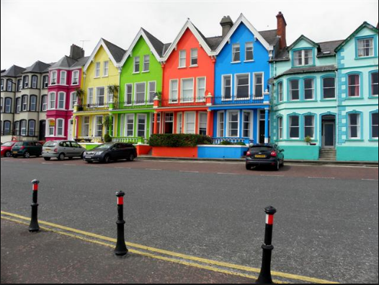

Slide 81
Task 3

Slide 82
How do you give examples?

Slide 83
Unit 3
Book 2

Slide 84
Task 1

Slide 85
Think of a time when someone was rude to you? What did you do and say?
Imagine that you are writing a list of classrooms rules for children in your country? What rules would you include in the list? Why?
Who should teach manners? Parents or teachers? Why?

Slide 86
Task 2

Slide 88
Task 3

Slide 89
How do you make recommendations?

Slide 91
Unit 6
Book 1

Slide 92
Task 1

Slide 93
Is it always better to be honest? Explain.
Give examples of situations when people lie in relationships, for example, parents/child, husband/wife, brother/sister, two best friends etc.
Why do you think people sometimes cheat or are dishonest?
Do you think it’s possible to eliminate lying from our society?
What is your opinion about these statements?
It’s Ok to tell a lie when truth might hurt someone’s feelings.
You have to be a little dishonest to be a successful person.

Slide 94
Task 2

Slide 95
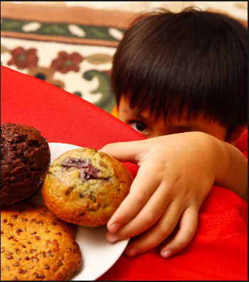

Slide 96
Task 3

Slide 97
How do you source information?

Slide 98
Unit 7
Book 1

Slide 99
Task 1

Slide 100
How are you different now compared to your past?
Describe an important experience you had that changed you or your thinking.
Would you like to try using a life coach ? Why/why not?
What advice will you give to your classmates to make a change in their lives?
Is it easy for you to make big changes in your life, for example, changing your home, school or job? Why/why not?

Slide 101
Task 2

Slide 103
Task 3

Slide 104
How do you check for listener’s understanding?

Slide 105
Unit 8
Book 1

Slide 106
Task 1

Slide 107
Do you believe that it is possible to get over a phobia?
Tell us about a time when you were in a frightening situation? What did you do?

Slide 108
Task 2

Slide 110
Task 3

Slide 111
How do you express sadness?

Slide 112
Unit 1
Book 2

Slide 113
Task 1

Slide 114
What are some trends in modern architecture?
How modern is the city you live in ? How sustainable is the architecture?
Imagine a world without creative architects . What would our cities look like?

Slide 115
Task 2

Slide 117
Task 3

Slide 118
How do you draw attention to the main ideas?

Slide 119
Unit 2
Book 2

Slide 120
Task 1

Slide 121
What are some ways people use colour as camouflage or as a sign of danger?
Do you agree that the architecture of a home can help create a peaceful place?
Think about companies and businesses in your community. What colours do you associate with each one? Are there any colours you think would NOT be good for a company? Why?
Do animals use colours in the same way as people use them? Give examples.

Slide 122
Task 2

Slide 124
Task 3

Slide 125
How do you ask for examples?

Slide 126
Unit 3
Book 2

Slide 127
Task 1

Slide 128
How can you show good manners when you go to someone’s home for dinner?
How did you learn about manners or etiquette? Give examples.
Is it true that parents today are not teaching good manners to their children? Why/why not?

Slide 129
Task 2

Slide 130
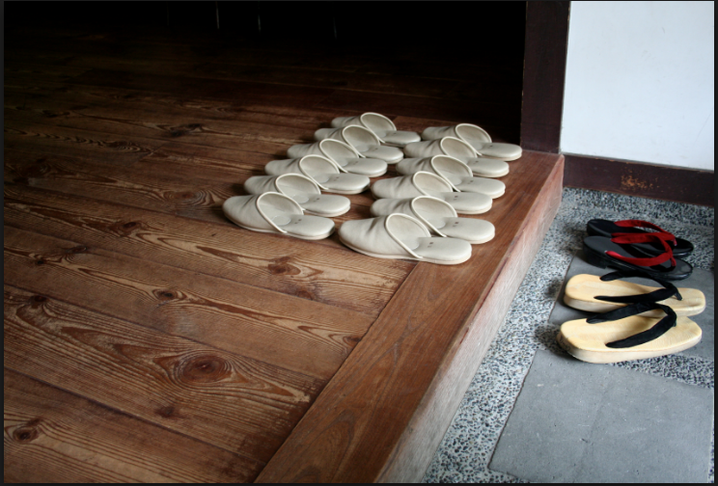

Slide 131
Task 3

Slide 132
How do you give advice?

