Slide 1
Securing Your System: Protecting Your Digital Data and Devices
Chapter 3

Slide 2
Threats to Your Digital Assets
Identity Theft and Hackers
Computer Viruses
Online Annoyances and Social Engineering

Slide 3
Objectives
9.1 Describe how identity theft is committed and the types of scams identity thieves perpetrate.
9.2 List and describe the different types of hackers.
9.3 Describe the various tools hackers use and the types of attacks they might launch against computers.
9.4 Explain what a computer virus is, why they are a threat to your security, how a computing device catches a virus, and the symptoms it may display.
9.5 List the different categories of computer viruses, and describe their behaviors.
9.6 Explain what malware is, and list the common types of malware.
9.7 Define spam, and describe strategies to combat it.
9.8 Explain what cookies are and whether they pose a security threat.
9.9 Describe social engineering techniques, and explain strategies to avoid falling prey to them.

Slide 4
Cybercrime
Cybercrime: Any criminal action perpetrated primarily through the use of a computer
Cybercriminals: Are individuals who use computers network and the internet perpetrate crime

Slide 5
Common types of cybercrimes

Slide 6
Common types of cybercrimes
Government impersonation scam involve people pretending to represent official organization such as FBI
Running auctions of merchandise that do not exist where perpetrators collect funds and disappear without delivering the goods
Advance fee fraud involve convincing people to send money as a "good faith" gesture to enable them to receive larger payment in return
Identity theft involves stealing someone personal information

Slide 7
Identity theft
What is the most financially damaging cybercrime plaguing individuals?
Identity theft occurs when a thief steals personal information such as your name, address, social security number, birth date, bank account number, and credit card information and runs up debts in your name.

Slide 8
Identity Theft
What types of scams do identity thieves perpetrate?
Counterfeiting your existing credit or debit cad
Requesting changes of address or bank account
Opening new credit card in your name
Obtaining medical services under your name
Buying a home with a mortgage under your name

Slide 9
Identity Theft
Other methods thieves use to obtain other’s personal information:
Stealing personal information from your purse or wallet
Stealing mail or looking through trash for bank statement or credit card bills
Tricking people into revealing sensitive information over the phone
Installing skimming devices on ATM that record information

Slide 10
Identity Theft
With all the news coverage about identity theft, and other cybercrimes, aren’t people being more cautions?
M3AAWG: Half of e-mail users have opened spam, some of which are designed to trick you into divulging sensitive information.
46% of them follow links to unsubscribe to unwanted emails (which only brings more emails)
Or because they are interested in the product being offered.

Slide 11
Hacking
What exactly defines a hacker?
Hacker is most commonly defined as anyone who unlawfully breaks into a computer system either an individual computer or a network
Types of hackers
White-hat (ethical hackers)
Black-hat hackers
Grey-hat hackers

Slide 12
Types of hackers
Are there different kinds of hackers?
White-hat hackers break into systems for nonmalicious reasons such as to test system security vulnerabilities or to expose undisclosed weaknesses.
Black-hat hackers break into systems to destroy information or for illegal gain.
Grey-hat hackers illegally break into systems to flaunt their expertise or to attempt to sell their services in repairing security breaches.

Slide 13
Hacking Tools and Attack Types
Could a hacker steal my debit card or bank account number?
Hackers often try to break in to computers or websites that contain credit card information.
If you perform financial transaction online, such as banking or buying goods and services you will be exposing your personal data to cyber criminals.
your information can be stored on your hard drive or on an online business hard drive which can be detectable by a hacker .

Slide 14
Hacking Tools and Attack Types
Personal data can be stored on various websites for example many sites require that you provide a login ID and a password to gain access. Even if this data isn’t stored on your computer a hacker may be able to capture it when you're online by using a packet analyzer (sniffer) or a Key logger.

Slide 15
Hacking Tools and Attack Types
What is a packet analyzer?
Data travels through the Internet in small pieces called packets
The packet are identified with an IP address
Once the packets reach their destination, they are reassembled into cohesive messages.
Packet analyzer (sniffer) is a program deployed by hackers that looks at (or sniffs) each packet as it travels on the Internet.
Keylogger is a program that captures all keystrokes made on a computer

Slide 16
Hacking Tools and Attack Types
What do hackers do with the information they sniff?
Once a hacker has your debit/credit card information he or she can use it to purchase items illegally or can sell it to someone how will. If a hacker can gather enough information they may be able to commit identity theft.
You can protect yourself from packet sniffing by installing a firewall and using data encryption on wireless network.

Slide 17
Trojan Horses and Rootkits
Beside stealing information what other problems can hackers cause if they break in to my computer?
Hackers often use individual computers to commit widespread attacks. For example, hackers need to control many computers at the same time. To do so they often use Trojan horses to install other programs on the victims computer.

Slide 18
Trojan Horses and Rootkits
Trojan horses: is a program that appears to be something useful or desirable, but does something malicious in the background without your knowledge
What damage can Trojan horses do?
Often hackers use a Trojan program to install a backdoor program or a rootkit which allow them to gain access to the victim computer.
Backdoor and Rootkits: Backdoor program that allow hackers to gain access to your computer and take almost complete control of it without your knowledge.
Zombies: Rootkits are A computer that a hacker controls is referred to as a zombie. Zombies are often used to launch denial-of-service attacks on other computers.

Slide 19
Denial-of-Service Attacks
What are denial-of-service attacks?
legitimate users are denied access to a system because a hacker is repeatedly making requests of that system through a computer the hacker has taken over as a zombie.
A computer can handle only a certain number of requests for information at one time.
When it is flooded with requests, it shuts down and refuses to answer any requests for information, even if the requests are from a legitimate user.

Slide 20
Denial-of-Service Attacks
Could not a DoS attack be traced back to the computer that launched it?
Yes, it is easy.
Distributed denial-of-service (DDoS) attack, launches DoS attacks from more than one zombie at the same time.

Slide 21
Denial-of-Service Attacks
Hackers creates many zombies and coordinate them so that they begin sending bogus requests to the same computer at the same time.
Administrative of the victim computer often have a great deal of difficulty stopping the attack because it comes from so many computers.
Often the attacks are coordinated automatically by botnets
Botnet Is a large group of software programs that runs autonomously on zombie computer.
Because it is easy to trace it from a single computer hackers launches DOS attack from more than one zombie at time.

Slide 22
Denial-of-Service Attacks

Slide 23
How can hackers gain computer access
How exactly does a hackers gain access to a computer ?
Direct access: Involve sitting down at a computer and installing hacking software.
Indirect access: exploit kits and internet connection
Many professional hackers use exploit kits.

Slide 24
Exploit kit
Software program that run on servers and search for vulnerability of computers that visit the server.
Exploit kits look for security holes in browsers and operating system that haven’t yet been patched by the user.
They can deliver spyware, bots, backdoor program, or other malicious software to your computer.
Most exploit kits take advantage of known vulnerabilities, so if your antivirus software and operating system is up to date, you should be secure.

Slide 25
Internet Connection
Hackers also can access a computer indirectly through its internet connection.
The internet connection is a two way street. Not only can you access the internet, but people can access you computer.

Slide 26
What are logical ports

Slide 27
What are logical ports
Are virtual not physical communications gateways or paths that allow a computer to organize requests for information, such as web page downloads or e mail routing, from other networks or computers.
Logical ports are numbered and assigned to specific service ex logical port 80 designated for hypertext transfer protocol “HTTP”, the main communication protocol for the web.
All requests for information from your browser to the web flow through logical port 80.
Unless you take precaution to restrict access to your logical port, other people on the internet may be able to access your computer through them.
You can prevent most hacking problems by installing firewall.

Slide 28
Computer Viruses Virus Basics
What is a Computer virus?
Is a computer program that attaches its self to another computer program and spread to other computers when files are exchange.
Why are viruses such a threat to my security?
Viruses are threat because they evade detection, hide within the code of a host program to avoid Detection.
Viruses are not limited to computers. Smartphones, tablet computers, and other devices can be infected.
Apple user
Need to worry about viruses

Slide 29
Virus Basics
What do viruses do?
A virus’s main purpose is to replicate itself and copy its code into as many other host files as possible.
Computer viruses require human interaction to spread.
A virus cant infect your computer until the infected file is opened
The majority of viruses have secondary objectives or side effects.
Downloading and running a file that’s attached to the e-mail are common ways to infect your computer.

Slide 30
Virus Basics
How does my computer catch a virus?
Downloading infected audio and video files
Shared flash drives
Email

Slide 31
Virus Basics

Slide 32
Virus Basics
How can I tell if a computer is infected with a virus?
Existing program icons or files suddenly disappear.
You start your browser and it takes you to an unusual home page.
Odd messages pop ups or images are displayed on the Screen or strange music or sound play.
Data files become corrupted.
Program stop working properly.
Your system shuts down unexpectedly.

Slide 33
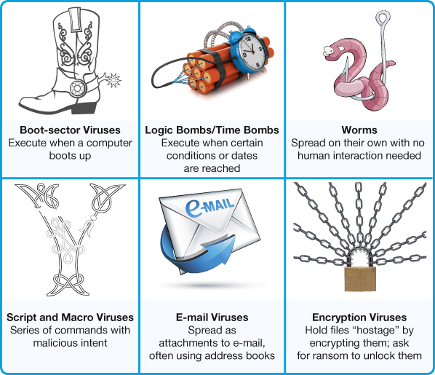
Types of viruses

Slide 34
Boot sector viruses
Replicate itself into a hard drive master boot record.
Master boot record Is a program that execute whenever a computer boots up, ensuring that the virus will be loaded into memory Immediately, even before some virus protection program can load.
Boot sector viruses are often transmitted by flash drive connected to a USB port.
The computer tries to lunch a master boot record from the flash drive which is usually the trigger for the virus to infect the hard drive.

Slide 35
Logic and Time bomb
Logic bomb A computer virus that runs when a certain set of conditions is met, such as when a program is launched a specific number of times.
Time bomb A virus that's triggered by the passage of time or on a certain date..

Slide 36
Worms
Worms an independent program that multiplies itself by copying a segment of itself onto another computer

Slide 37
Worms Vs. Viruses
worm | virus
Take advantage of file transport methods to spread on their own | Require human interaction to spread
Work independently spreading itself And can generate a lot of traffic when trying to spread | Infect a host file and waits until that file is executed to replicate and infect the computer system

Slide 38
Script and Macro viruses
Script: A list of commands that can be executed on a computer without user interaction or knowledge.
script are often used to perform useful legitimate function on websites such as collecting information from customers. However some script are malicious.
Macro virus: Is a virus that attaches itself to a document that uses macros.
Macro: Is a short series of commands that usually automates repetitive tasks.

Slide 39
E mail viruses
E mail viruses Use the address book in the victims e mail system to
Distribute the virus.

Slide 40
Encryption viruses
Encryption viruses (ransomware) They run a program that searches for common type of files, such as Microsoft word files, and compress them using complex encryption key that renders your files unusable. You then receive a message that asks you to send payment to an account if you want to receive the program to decrypt your files. The flaw with this type of virus, which keeps it from being widespread, is that law enforcement officials can trace the payments and catch the perpetrators.

Slide 41
Additional Virus Classification
Viruses can be Classified by methods thy take to avoid detection by antivirus software
Polymorphic viruses changes its own code to avoid detection. Most polymorphic viruses infect a particular type of file.
Multipartite viruses is designed to infect multiple file types in an effort to fool the antivirus software that is looking for it.
Stealth viruses temporarily erase their code from the files where they reside and hide in the active memory of the computer. This help them avoid detection if only the hard drive is being searched for viruses. current antivirus software scans memory as well as the hard drive.

Slide 42
Malware: Adware and Spyware
Malware: is a Malicious software created with the intent.
There are three primary forms of Malware: Adware, Spyware ,and Viruses.

Slide 43
Malware: Adware and Spyware
What is adware?
Adware: software that display sponsored advertisements in a section of your browser window or as pop-up box.
Consider legitimate.
Means of generating revenue for those developers who do not charge for their software or information.

Slide 44
Malware: Adware and Spyware
What is spyware?
Spyware: Is an piggyback program that usually downloads with other software unwanted you install from the Internet and runs in the background of your system, without your knowledge.
Spyware transmit information about you such as your internet surfing habits, to the owner of the program so that the information can be used for marketing purposes.
Many spyware programs use tracking cookies to collect information.

Slide 45
Malware: Adware and Spyware
Cookie: Small text files stored on your computer.
Keystroke logger: Monitors keystrokes with the intent of stealing passwords login IDs Or credit card information.

Slide 46
Malware: Adware and Spyware
Can I prevent spyware from spying on me?
We can prevent spyware by installing anti-spyware programs.

Slide 47
Spam
Spam: is unwanted or junk e-mail.
How can I best avoid spam?
Companies that send out spam find your email address either from a list they purchase or with software that looks for email addresses on the internet.
Unsolicited instant messages are also a form of spam called spim.
If you have used your email address to purchase anything online, open an online account, or participate in a social network such as Facebook your email address eventually will appear on one of the lists that spammers get.

Slide 48
Spam
There are several ways to help avoid spam:
Create a free e-mail address.
Spam filters (is an option you can select in your email account that places known or suspected spam in to special folder called “spam” or “junk mail”).
Buy third-party programs.
Reclassify e-mails that have been misidentified as spam.

Slide 49
Spam
How do spam filters work?
Spam filters and filtering software can catch as much as 95% of spam by checking incoming email addresses against database of known spam.
Spam filters also check your email for frequently used spam patterns and keywords such as “for free” and “over 21”.
Spam filter aren’t perfect, and you should check the spam folder before deleting its contents because legitimate email might end up there by mistake.

Slide 50
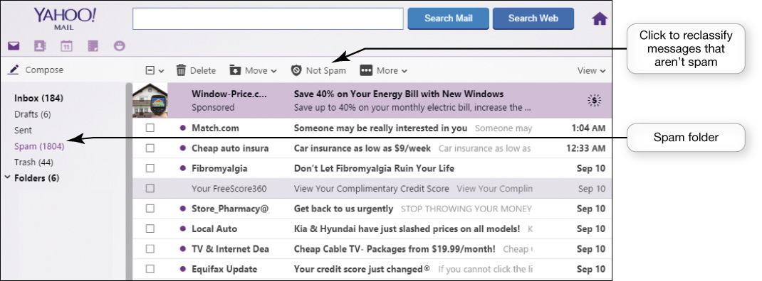
Spam

Slide 51
Spam
How can I prevent spam
Before registering to a website read its privacy policy to see how they uses your email.
Don’t reply to spam.
Subscribe to an e mail forwarding service such as versaforward.com these services screen your email messages forwarding only those messages you designate as being okay to accept.

Slide 52
Cookies
What are cookies?
Cookies are small text files that some websites automatically store on your hard drive when you visit them.
How Internet cookies work?
When you log on to a website that uses cookies a cookie file assigns an ID number to your computer.
The unique ID is intended to make your return visit to a website more efficient.
Every time you log on to the site, the site marks your visit and keeps track of it in its database.

Slide 53
Cookies
What do websites do with cookies information?
It can provide websites with information about your browsing habits, such as the ads you’ve opened, the products you’ve looked at, and the time and duration of your visits.
Companies use this information to determine the traffic flowing through their website and the effectiveness of their marketing strategy.

Slide 54
Cookies
Can company get my personal information when I visit their sites?
Cookies do not go through your hard drive in search of personal information. The only personal information a cookie obtain is the information you supply when you fill out forms online.

Slide 55
Cookies
Do privacy risks exist with cookies?
Web sites can use cookies to gather and sell your personal information to third parties.
Web sites can track your surfing behavior and tie it to your user profile.

Slide 56
Cookies
Should I delete cookies from my hard drive ?
Cookies pose no security threat because it is virtually impossible to hide a virus or malicious software program in a cookie.
Because they take up littlie room on your hard drive, and offer you small conveniences on return visits to web sites, there is no great reason to delete them deleting your cookies files could actually cause you the inconvenience of reentering data you have already entered into a website.

Slide 57
Cookies
Cookies overview:
Help companies determine the effectiveness of their marketing.
Do not search drive for personal information.
May invade your privacy.
Pose no security threat.

Slide 58
Social Engineering
What is social engineering ?
Any technique that uses social skills to generate human interaction that tricks individuals to reveal sensitive information.
Social engineering often doesn't involve use of computer or face to face interaction.

Slide 59
Social Engineering
How dose social engineering work?
Most social engineering use a pretext to lure their victims.
Pretexting: The act of creating an invented scenario to convince someone to divulge information.

Slide 60
Phishing and Pharming
How are phishing schemes conducted?
Phishing :The process of sending email messages to lure internet users into revealing personal information such as credit card or social security numbers or other sensitive information that could lead to identity theft.
Phishing is a cyber attack that uses disguised email as a weapon.
The goal is to trick the email recipient into believing that the message is something they want or need a request from their bank, for instance, or a note from someone in their company and to click a link or download an attachment.

Slide 61
Phishing and Pharming
Is pharming a type of phishing scam?
Pharming: planting malicious code on a computer that alters the browser's ability to find web addresses and directs users to bogus web sites.
Pharming is more insidious than phishing.

Slide 62
Phishing and Pharming
How can I avoid being caught by phishing and pharming scams?
Never reply directly to any email asking you for personal information.
Check with the company asking for information and only give information if your certain it’s needed.
Don’t click on a link in an email to go to a website.
Never give personal information over the internet unless you know the site is secure.
Use phishing filter.

Slide 63
Scareware
What is a Scareware?
A type of malware that is downloaded onto your computer and tries to convince you that your computer is infected with a virus or other type of malware.

Slide 64
Scareware
How do I protect myself against Scareware ?
Install antivirus and anti-malware software package.
Never click on website banner or pop-up boxes that say “ your computer might be infected, click here to scan your files”.

Slide 65
Protecting Your Digital Property
Restricting Access to Your Digital Assets
Keeping Your Data Safe
Protecting Your Physical Computing Assets

Slide 66
Restricting Access to Your Digital Assets
Keeping hackers and viruses away from your computer by:
Preventing them from accessing your computer (usually through your internet connection)
Using techniques to prevent virus infections from reaching your compute.
Protecting your digital information in such a way that it can’t be accessed (e.g. passwords)
Hiding your activities from prying eyes

Slide 67
Firewalls
What is a Firewall?
Is a software program or hardware device designed to protect computer from hackers
Personal firewall: is a firewall specially designed for home network
By using it you can close open logical ports (communication pathways) to invader and potentially make your computer invisible to other computers.

Slide 68
Firewalls
Which is better a software firewall or a hardware firewall ?
One type isn’t better than the other.
You should consider installing both for maximum protection as wearing multiple layers of clothing in winter to keep you warmer than a single layer.

Slide 69
Types of Firewalls
What software firewalls are there?
Firewall that are reliable and comes with the operating system as OS X and Windows (windows Firewall).
Security suites include firewall software such as McAfee Internet Security , Norton Security and Trent Micro Internet Security Suite.
Firewalls included in security suites often come with additional features (e.g. monitoring system that alert you if your computer is under attack)
You can’t run two firewall at the same time because they can conflict with each other and cause your computer to slow down or freeze up
That’s happened when you are using a security suite that includes firewall, the suite should disable the firewall that come with your OS.

Slide 70
Software firewalls– windows firewall status

Slide 71
Types of Firewalls
What are hardware firewalls?
Many routers sold for home network include firewall protection
The setup for Hardware firewalls are just like software firewalls which is designed for novices and the default configuration on most router keep unused logical ports closed.
Documentation accompanying routers can assist more experienced users in adjusting the settings to allow access to specific ports if needed.

Slide 72
How Firewalls Work
Firewalls designed to restrict access to a network and its computers.
How do firewalls protect you from hackers ?
By blocking access to logical ports
By keeping your computer network address secure

Slide 73
How Firewalls Work
How do firewall block access to logical ports?
To block access to logical ports firewall examine data Packet that your computer sends and Receives.
Data Packets contain information such as the address of the sending and receiving computers and the logical port that the packet will use.
Packet filtering Firewalls filter out packets sent to specific logical ports
Logical port blocking Firewalls ignore requests that originate from the internet asking for access to certain ports.
Logical ports: are virtual communications gateways or paths that allow computer to organize requests from other networks or computers

Slide 74
How Firewalls Work
How do firewalls keep your network address secure?
Every computer has a unique address called IP (Internet Protocol address).
Your IP address for your home network is assigned to your router by your internet service provider (ISP).
But each device on your home network also has an IP address.
Firewalls use process called network address translation (NAT): to assign the public IP addresses to your internal IP on a network. (which can be used only on the internal network, so can’t be detected by hackers).

Slide 75
Knowing your Computer Is Secure
How can I tell if my Firewall is protecting my computer?
Visit websites that offer free services that test your computer’s vulnerability.
Visiting Gibson Research Corporation (grc.com)
Clear report: your system is not vulnerable to attack
Not clean report: detects potential vulnerabilities
What If I don’t get a clean report from the testing program?
You don’t have firewall: Install firewall as soon as possible
Already have firewall but common ports are identified as being vulnerable: consult your firewall documentation for instructions on how to close or restrict access to those ports

Slide 76
Knowing your Computer Is Secure
Common Logical Ports

Slide 77
Preventing Virus Infections Antivirus Software
What is the best way to protect my devices form viruses?
Installing antivirus.
Keep your software up to date.
What is the best way to protect my devices from viruses?
Antivirus software : Detects viruses and protects your computer and files from harm.
Symantec, Kaspersky, AVG, and McAfee are among the companies that offer highly rated antivirus software packages.

Slide 78
Antivirus Software
How often do I need to run antivirus software?
You should run an active virus scan on your entire system at least once a week.
Current antivirus programs run scans in the background when your CPU is not being heavily utilized.
You can configure the software to run scans at times when aren’t using your system.(you are sleep but your but your computer is on.
If you suspect a problem, you can launch a scan have it run immediately.

Slide 79
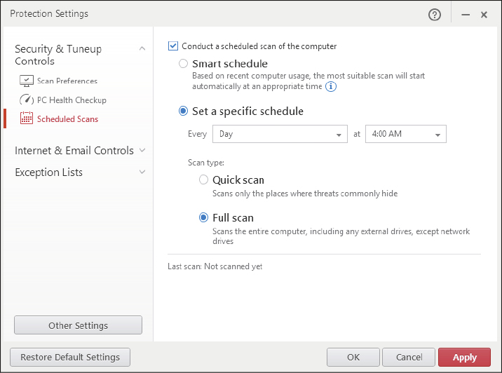
Antivirus Software
Trend Micro Internet Security

Slide 80
Antivirus Software
How does antivirus software work?
Detection
Antivirus software looks for virus signatures in files
Virus signature : is a portion of the virus code that’s unique to a particular computer virus

Slide 81
Antivirus Software
Stopping virus execution
If the antivirus software detects a virus signature or suspicious activity, it stops the execution of the file and virus and notifies you that it has detected a virus.
It also do a Quarantining: a procedure that place the virus in a secure area on your hard drive so that it won’t spread to other files
Give you the choice of deleting or repairing the infected file
Unfortunately, antivirus programs can’t always fix infected files to make them usable again.
Keep backup copies of critical files.

Slide 82
Antivirus Software
3. Prevention of future infection
Most antivirus software will also attempt to prevent infection by inoculating key files on your computer.
Inoculation : the antivirus software records key attribute about your computer files such as file size and data created and keeps these statistics in a safe place on your hard drive
When scanning for viruses, the antivirus software compares the attributes of the files with the attributes it previously recorded to help detect attempts by virus programs to modify your files.

Slide 83
Antivirus Software
Does antivirus software always stop viruses ?
Catches known viruses effectively
New (unknown) viruses are written all the time
modern antivirus programs search for suspicious virus-like activities as well as virus signatures
Keep your antivirus software up to date.

Slide 84
Antivirus Software
My new computer came with antivirus software installed, so shouldn’t I already be protected?
These are usually trial versions that provide updates to the software for a limited period of time (90 or 180 days).
You have buy a full version of the software to ensure you remain protected from new viruses
In windows 10, if there is no third-party antivirus software installed, windows defender will be active by default.

Slide 85
Antivirus Software
How do I make sure my antivirus software is up to date?
Most of antivirus programs have an automatic update feature every time you go online
Usually shows the status of your update subscription.
Many Internet packages offer bonus features such as cloud storage scanners and password managers to provide you with extra protection.

Slide 86
Antivirus Software

Slide 87
Antivirus Software
What should I do if I think my computer is infected with a virus?
Boot up your computer using the antivirus installation disc
Copy the antivirus software files to a DVD if you downloaded from Internet.
If the software detects viruses, you may research them further to determine if you will need to take additional manual steps to eliminate the viruses.
Most antivirus company websites such as Symantec site contain archives of information on viruses and provide step by step solutions for removing them

Slide 88
Antivirus Software
How do I protected my phone from viruses?
Cybercriminals are now hiding viruses in legitimate-looking apps for download to mobile devices
Antivirus software specially designed for mobile devices
The Google Play store offer effective free products to protect Android devices (360 Security and Avast Mobile Security).
Also providing protection from malware such as the ability to wipe your phone’s contents if it is lost or stolen.

Slide 89
Software updates
Why does updating my operating system software help protect me from viruses?
Many viruses exploit weaknesses in operating systems.
Drive by download attack: Malicious websites can be set up to attack your computer by downloading harmful software onto your computer.
Drive by download affects almost 1 in 1000 web pages.
Make sure your OS is up to date and contains the least security patches.

Slide 90
Software updates
Do OS updates only happen automatically?
In windows 10, updates are now downloaded automatically whenever they are provided by Microsoft.
You have the choice to allow Windows to automatically schedule a restart of your computer to apply the updates or pick a more convenient restart time manually.
Mac OS X has a similar utility for gathering updates.
The Advanced Options screen for Windows Update provides a few other options such as the ability to receive updates for other Microsoft products (MS Office).

Slide 91
Software updates

Slide 92
Software updates

Slide 93
Authentication: Passwords and Biometrics
How can I best use passwords to protect my computer?
Creating a strong (secure) passwords ones that are difficult for hackers to guess is more important than ever.
Hackers attack poorly defended sites for passwords because many people use the same password for every site they use.
So, if hackers can get your password from a poorly secured gaming site, they might be able to access your bank account with the same password.

Slide 94
Authentication: Passwords and Biometrics
How to create strong password ?
Strong passwords are difficult for someone to guess.
Guidelines:
Don’t use easily deduced components related to your life (name, address,…)
At least 14 characters long.
Don’t used Words found in the dictionary
Mix Upper and Lower case letters and symbols.
Never tell anyone your password or write it down in a place where others might see.
Change your password in a regular basis
Don’t use the same password for every account you have.
There are many password generator available for free to help you creating secure passwords.(strongpasswordgenerator.com)

Slide 95
Authentication: Passwords and Biometrics

Slide 96
Authentication: Passwords and Biometrics
How can I check the strength of my password?
Use online password strength testers, such as the Password Meter (passwordmeter.com)
How do I restrict access to my computer ?
Windows, OS X and most other OS have built-in password or passcode protection for files as well as the entire desktop.
Your computer is Automatically password locked after a certain period of idle time.
Windows allows you to use picture passwords to work as an additional method for accessing your computer.
Chose a picture then draw three gestures on it either straight lines, circles or taps.
If you forget the gestures, you can always access your computer via the conventional password.

Slide 97
Authentication: Passwords and Biometrics

Slide 98
Managing Your Passwords
How can I remember all of my complex passwords?
Password-management tools (software).
Where can I obtain password management software ?
Most current internet security suites and web browsers make it easy to keep track of password by providing password- management tools (software).
Example: Microsoft Edge will remember your passwords for you.
There are some passwords that you shouldn’t have your browser to remember, such as your online banking password.

Slide 99
Managing Your Passwords

Slide 100
Biometric Authentication Devices
Beside passwords, how else can I restrict the use of my computer?
Biometric authentication device: is a device that reads a unique personal characteristic such as a fingerprint or iris pattern in your eye and converts its pattern to digital code.
These devices provide a high level of security because no two people have the same biometric characteristics.
They eliminate the human error that can occur in password protection.
Example, iPhone and Samsung Galaxy phones have fingerprint readers and facial recognitions systems.

Slide 101
Authentication: Passwords and Biometrics
Fingerprint
Iris pattern in eye
Voice authentication
Face pattern recognition
Provide a high level of security

Slide 102
Anonymous Web Surfing: Hiding from Prying Eyes
Should I be concerned about surfing the internet on shared public or work computer?
You never know what nefarious tools have been installed by hackers on public computers
Many employers routinely review the internet browsing history of employees to ensure workers are spending their time on the Internet productively.

Slide 103
Anonymous Web Surfing: Hiding from Prying Eyes
What tools can I use to keep my browsing activities private when surfing the internet?
The current versions of Mozilla Firefox, Microsoft Edge and Google Chrome include privacy tools (called Private Browsing, InPrivate, and Incognito, respectively).
If you choose to surf anonymous:
a special version of the browser windows will open.
Every records if websites you visit and files you download don’t appear in the web history. also any temporary files generated in that browsing are deleted when you exit the special window.

Slide 104
Anonymous Web Surfing: Hiding from Prying Eyes

Slide 105
Anonymous Web Surfing: Hiding from Prying Eyes
Are there any other tools I could use to protect my privacy?
Portable privacy devices such as Ironkey Personal Flash Drives (ironkey.com)
All sensitive Internet files, such as cookies, passwords, Internet history, and browser caches will be stored on the privacy device, not on the computer you’re using.
Shield your IP address from prying eyes.
Have password management tools that store all your login information and encrypt it.

Slide 106
Anonymous Web Surfing: Hiding from Prying Eyes
Is there anything else I can do to keep my data safe on shared computer?
Take the Linux OS with you on a flash drive and avoid using the public or work computer ‘s OS.
Advantages of using a Linux OS:
Significantly reducing of pick up viruses and other malicious program. Because booting a computer from a flash drive completely eliminates any interaction with the computer’s OS.
Virus and hacking against Linux are far less likely than attacks against Windows.
You don’t leave traces of your activity behind because you avoid reading and writing to the hard disk of the computer.
Pendrivelinux.com excellent resource that offer different versions of Linux.
For Mac, the Elementary OS Luna distro of Linux provides a close approximation of OS X.

Slide 107
Anonymous Web Surfing: Hiding from Prying Eyes
How can I protect sensitive data transmission if I have to use a public wireless network?
Virtual private network are secure networks that are established using the public Internet infrastructure.
Using specialized software, servers and data transmission protocols. (data sent is as secure as sending it on a private network)

Slide 108
Protecting Your Digital Property
Restricting Access to Your Digital Assets
Keeping Your Data Safe
Protecting Your Physical Computing Assets

Slide 109
Protect your personal Information
With cybercrimes like identify theft rampant, you need to take steps to protect your personal information.
What information should I never share on websites?
Reveal as little information as possible, especially if the information would be available to everyone.
Four keys of information needed to steel an identity:
Social security number
Phone number
Date of birth
Street address

Slide 110
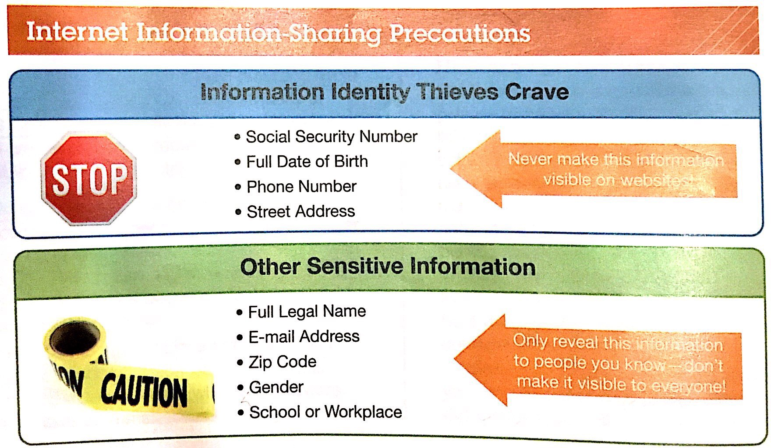
Protect your personal Information
Good guidelines:

Slide 111
Protect your personal Information
How can I tell who can see my information on a social network?
Change the default privacy settings in your profile on Facebook for example, to ensure that you aren’t sharing information more widely than you should.
How I can protect my information on Facebook?
Change your privacy settings in your profile
Set most of the options in your profile’s Basic information section to Friends or to Only Me.
In the Contact Information section, restricting this information only to friends or to yourself is imperative.

Slide 112
Backing up your Data
How might I damage the data on my computer?
Three major threats that the data faces on your computer:
Unauthorized access
Tampering
Destruction
You might lose your data unintentionally:
Accidently deleted files
Drop your laptop on the ground.
Virus from an Email attachment.
Your house catch fire

Slide 113
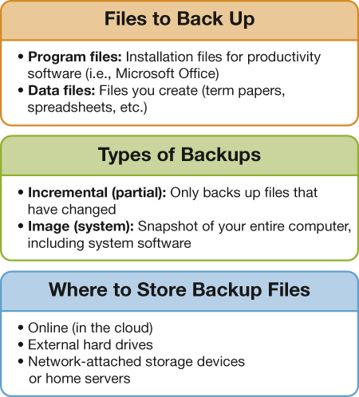
Backing up your Data
Strategy for Backing up your files

Slide 114
Backing up your Data
Backups are copies of files that you can use to replace the originals if they’re lost or damaged.
What type of files do I need to backup ?
Program file: files used to install software
DVD
Downloaded from the Internet.
data file: files you’ve created or purchased (research papers, spreadsheets, music, photo files, contact lists, address books….

Slide 115
Backing up your Data
What type of backup can I perform?
There are two main options for backing up your files:
An incremental backup (partial backup):
Backing up only files that have changed or have been created since the last backup was performed
Save time.
More efficient than image backup.
An image backup (system backup):
All system, application, and data files are backed up, not just the files that changed.
Ensures you capture changes to application files such as automatic software updates which incremental backup might not capture.
Helpful in a total hard drive failure, your computer configured will be exactly the way it was before.

Slide 116
Backing up your Data
Where should I store my backup?
Must be stored away from where your computer is located
Should be stored at least two different places.
Where to back up:
Online (in the cloud)
External hard drives
Network attached storage (NAS) devices and home servers.

Slide 117
Keeping Your Data Safe Backing Up Your Data

Slide 118
Backing up your Data
1. Online (in the cloud):
No need to be at home or lug around your external hard drive.
Secure.
Remote location
Data is much less vulnerable to the disasters.
Free Microsoft OneDrive and Adrive (not enough for image backup).
With Fee: Carbonite and Ibackup: more storage capacity (image backup).

Slide 119
Backing up your Data
2. External hard drives:
Or large capacity flash drives
External hard drives can fail and loss your backed up data
For more safety, better to use an external hard drives in conjunction with an online backup strategy.
3. Network-attached storage (NAS) devices and home services:
They are essentially large hard drives connected to a network of computers instead of one computer.
They can be used to back up multiple computers simultaneously.
Home servers act as high-capacity NAS devices for automatically backing update and sharing files.

Slide 120
Backing up your Data
How often should I back up my data?
Every time you make changes to them (difficult to remember).
Back up software can be configured to do backups automatically.
Example: Windows File History utility.
How often should I create an image backup?
Because your program and OS files don’t change as often as your data files, you can perform image backups on a less frequent basis.
You can do it on a weekly basis
Should definitely perform one after installing new software.

Slide 121
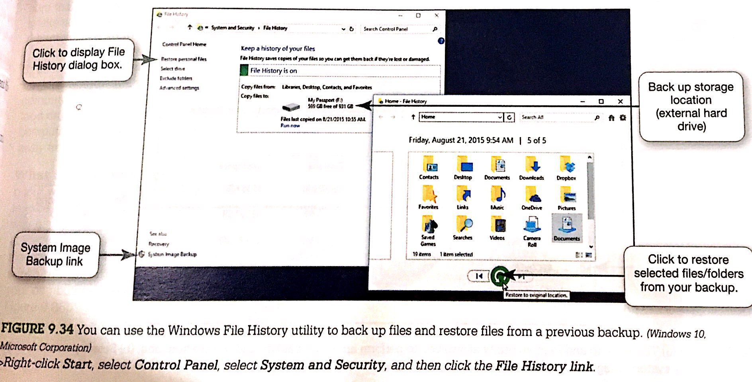
Backing up your Data
System Image Backup utility

Slide 122
Backing up your Data
How do I perform an image backup?
Windows include the System Image Backup utility.
From the File History screen (Windows 10), Backup and Restore (Windows 7).
Need external hard drive or NAS device or network.
Steps:
Click the Create a system image link, select the location, click next.
Select the drives/partitions from your computer to be backed up. Then Windows will back up all data files and system files on all selected drives/partitions.
click start backup to start your system image.
After running the system image for the first time, you can see the result of the last backup and the date of the next scheduled backup. You can change the time. You can create system repair disc in case that contain files used to boot your computer in case of a serious Windows error.

Slide 123
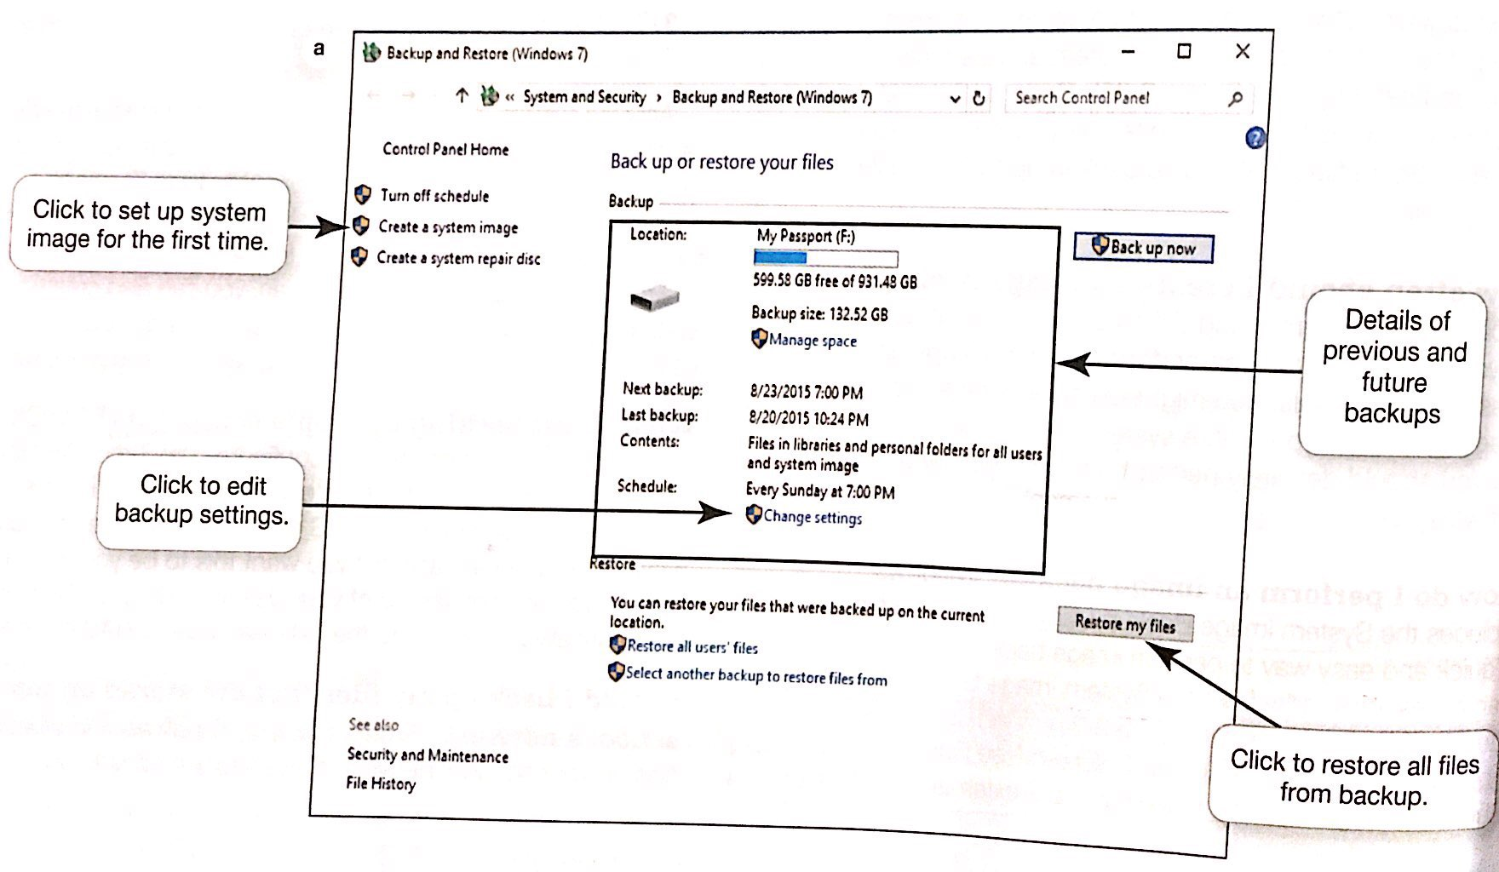
Backing up your Data
System image backup

Slide 124
Backing up your Data

Slide 125
Backing up your Data
What about backing up Apple computer?
Very easy to configure.
Time Machine feature detects when an external hard derive is connected to the computer or NAS device is connected to your network.
Then you will be asked if you want this to be your backup drive.
All files will backed up including OS files if you answered by YES.
Should I back up my files that are stored on my school's network?
If you’re allowed to store files there, they are most likely backed up regularly.
Ask school’s network administrator.
It’s better to keep backups of your files yourself.

Slide 126
Protecting Your Physical Computing Assets
Protecting your computer components, tablet or phones from:
Environmental Factors
Power Surges and Power outages
Theft.

Slide 127
Environmental Factors and Power Surges
Why is the environment critical to the operations of my computer equipment?
Computers are delicate devices and can damaged by the adverse effects of abuse or poor environment.
Protect your computer from sudden movement as fail by: sits the computer on flat level surface. If it’s laptop, carry it in a protective case.
Electronic devices don’t like excessive heat or cold. Don’t leave in car.
Computes generate a lot of heat, that’s why they contain cooling fans. Make sure you place your desktop where the fan’s intake vents are unblocked.
If it’s laptop, use Chill mats that contain cooling fans.
Place your computer in a room that is as clean as possible.
Consume food and beverages away from your computer

Slide 128
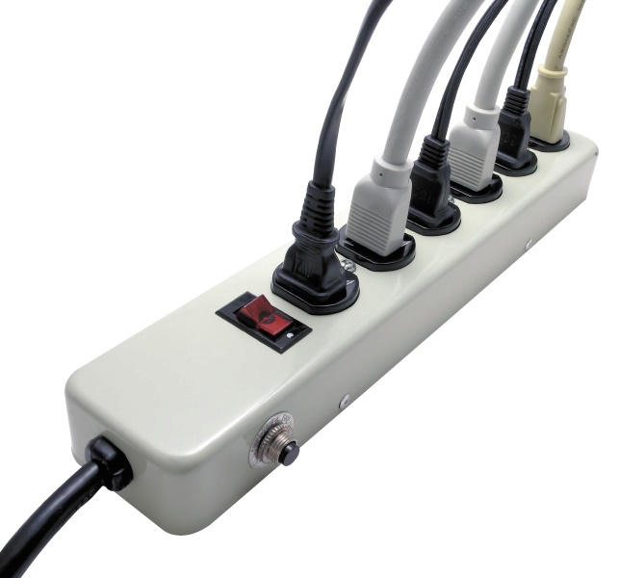
Environmental Factors and Power Surges
What is a power surges?
Power surges occur when:
An electrical current is supplied in excess of normal voltage
Old or faulty wiring
Downed power lines
Lightning strikes
Malfunctions at electric company substations

Slide 129
Environmental Factors and Power Surges
Surge protector
Is a device that protects your computer against power surges
Replace every 2–3 years or after a major surge.
Buy surge protector that include indicator lights.
Besides my computer, what other devices need to be connected to surge protector?
Use with all electronic devices that have solid-state components such as TV, stereos, printers, and smart phones when charging.
More convenient to use a whole house surge protectors that protect all electrical devices in the house

Slide 130
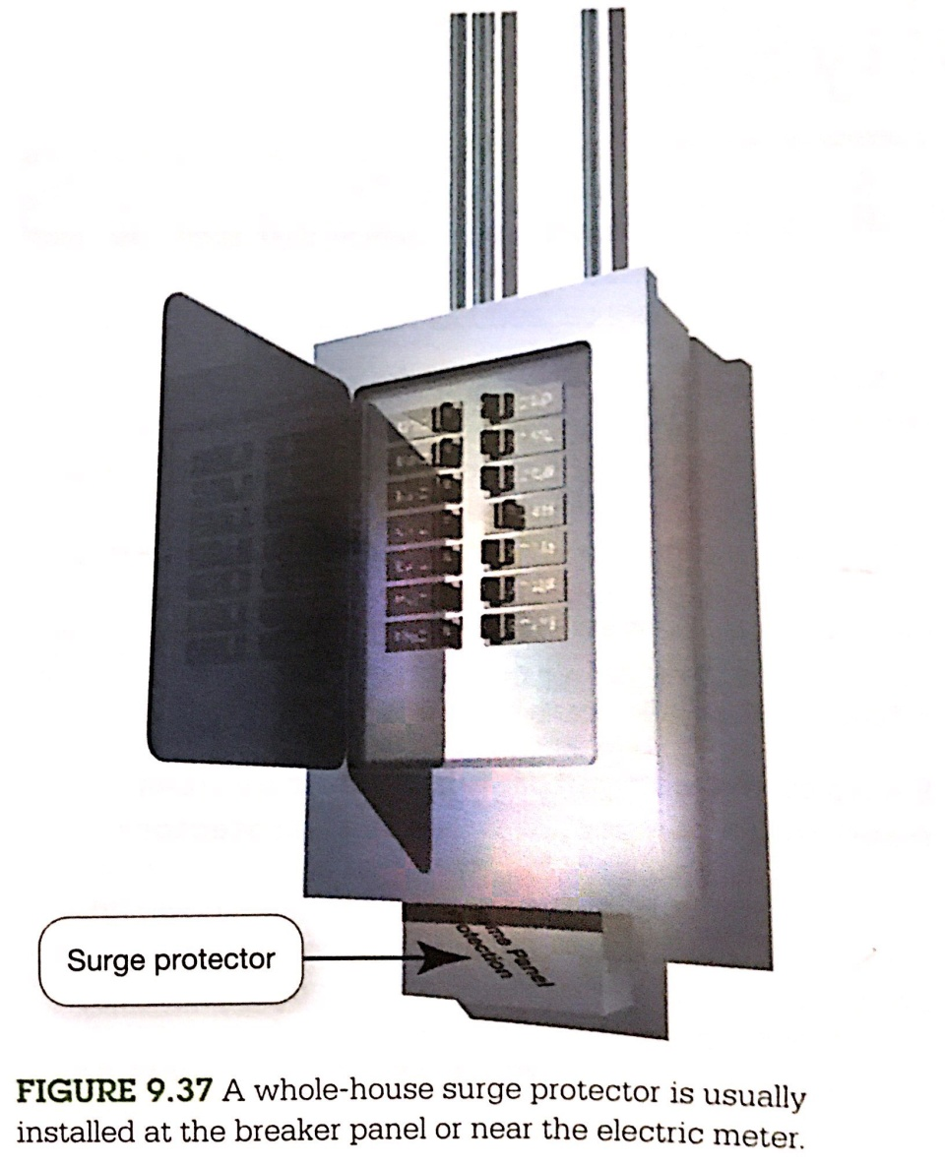
Environmental Factors and Power Surges
Whole-house surge protector

Slide 131
Environmental Factors and Power Surges
Is my equipment 100% safe when plugged into a surge protector?
Lightning strikes can generate such high voltages that they can overwhelm a surge protector.
Unplugging electronic devices during an electrical storm

Slide 132
Preventing and Handling Theft
What do I need to worry about if my computing device is stolen?
Security Concerns for mobile devices:
Keeping them from being stolen.
Keeping data secure in case they are stolen.
Finding a deice if it is stolen
Remotely recovering and wiping data off a stolen device.

Slide 133
Keep Them Safe: Alarms
What type of alarm can I install on my mobile device?
Alarm software either detects motion like your device being picked up or sounds near your device and then sets off an ear – piercing alarm until you enter the disable code.
Types of alarm software you can install:
Motion alarm software is good , inexpensive theft deterrent.
Example of free software:
Lalarm is effective for Laptops.
App such as Motion Alarm and Alarmomatic for iPad and iPhone.

Slide 134
Keeping Mobile Device Data Secure
How can I secure the data on my mobile devices?
Encrypting the data on your mobile device.
Example: Safe is an app (for image and data in iPhone, iPad)
, that provides 256-bit encryption which is very hard to crack
Example; Mobile Strong Box is similar app for Android devices
SensiGuard and SafeHouse are for laptop computers to
provide encryption for files and entire hard drives.

Slide 135
Software Alerts and Data Wipes
How can my computer helps me recover it when it is stolen?
Similar system to LoJack the theft tracking device used in cars is the tracking software as:
Absolute LoJack, PC PhoneHome, and Mac PhoneHome: enables your computer to alert authorities to the computer’s location if it is stolen.
iHound: tracking app for Android and iOS.

Slide 136
Protecting Your Physical Computing Assets
If your device is stolen,
Contact the tracking software’s manufacture which will tracks your device (transmit tracking information) via IP, Wi-Fi hotspot or cell tower location.
That will assist the authorities in locating and retrieving your mobile device.

Slide 137
Protecting Your Physical Computing Assets
What if thieves find the tracking software and delete it?
The tracking software’s files and directories are invisible.
The tracking software can reinstall itself after the
reformatting process.
What if my device can’t be recovered by the authorities?
Software packages for Remote recovery and deleting of files.
Absolute LoJack has these features and allows you to lock your device or to remotely wipe its contents by deleting all your data
Find My iPhone for all iOS devices which is part of iCloud
Where is My Droid for all Android devices.(sending text and reply by location, capture images with front or rear cameras.

Slide 138
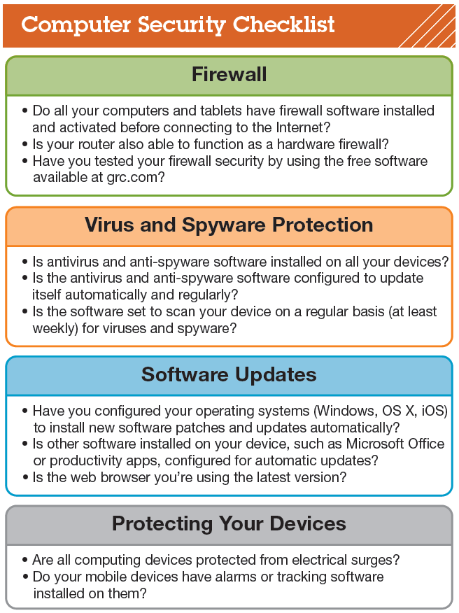
Protecting Your Physical Computing Assets
How can I ensure that I’ve covered all aspects of protecting my digital devices?
A Guide to ensure you haven’t missed critical aspects of security.

