Slide 1
Unit 5
Success
Next
Main Page
Previous

Slide 2
5 Success
Reading
Vocabulary & Grammar
Listening
Vocabulary & Grammar
Speaking
Examination practice
Writing
Next
Main Page
Previous

Slide 3
5 Success
Reading
Next
Main Page
Previous

Slide 4
5 Success
Reading
Next
Main Page
Previous

Slide 5
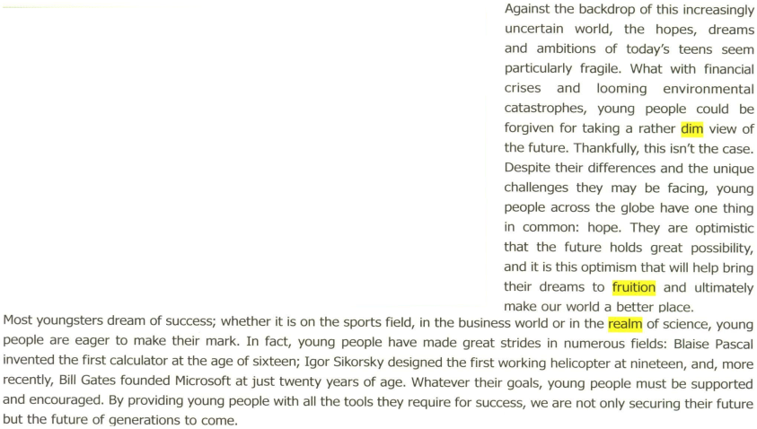
5 Success
Reading
Next
Main Page
Previous

Slide 6
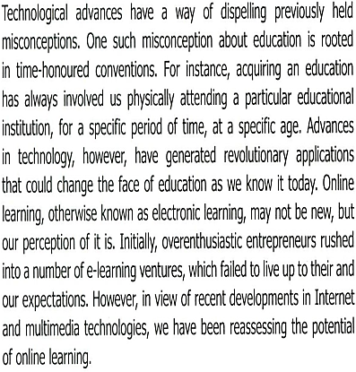
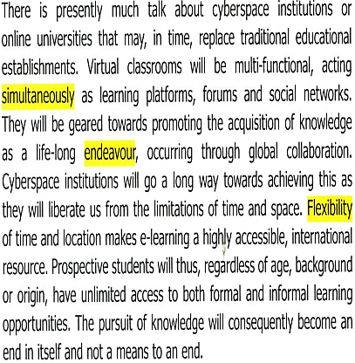
5 Success
Reading
Next
Main Page
Previous

Slide 7
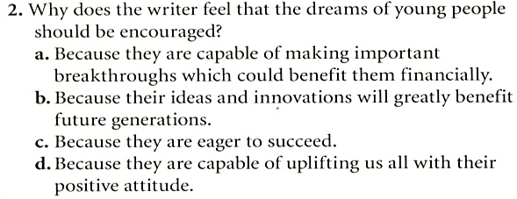
5 Success
Reading
Next
Main Page
Previous

Slide 8
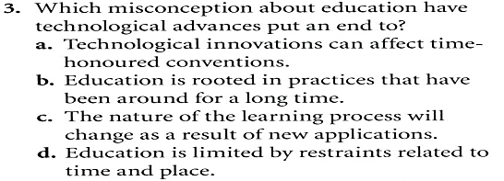
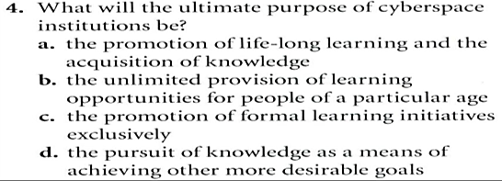
5 Success
Reading
Next
Main Page
Previous

Slide 9
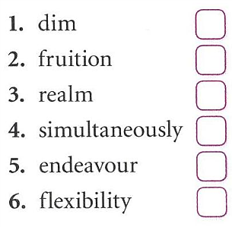
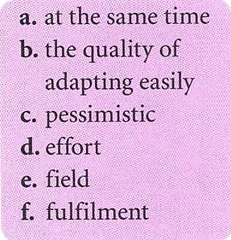
5 Success
Reading
Next
Main Page
Previous

Slide 10
5 Success
Reading
Next
Main Page
Previous

Slide 11
5 Success
Vocabulary & grammar
Vocabulary
Next
Main Page
Previous

Slide 12
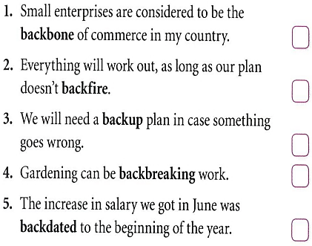
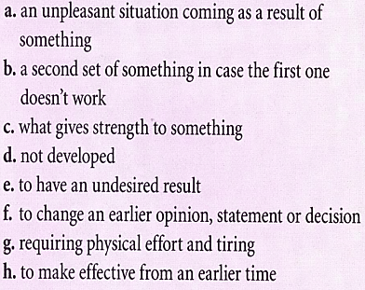
5 Success
Vocabulary & grammar
Vocabulary
Next
Main Page
Previous

Slide 13
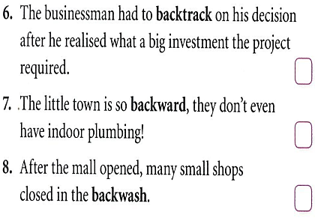
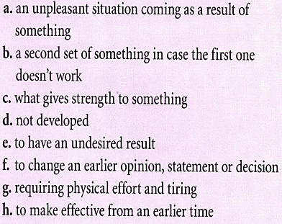
5 Success
Vocabulary & grammar
Vocabulary
Next
Main Page
Previous

Slide 14
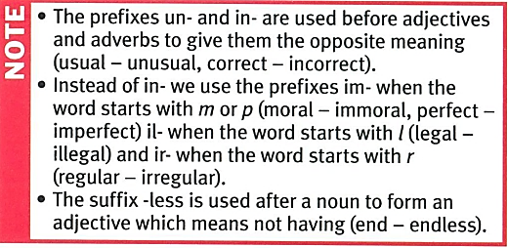
5 Success
Vocabulary & grammar
Vocabulary
Next
Main Page
Previous

Slide 15
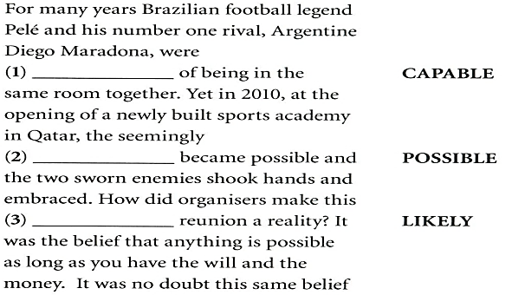
5 Success
Vocabulary & grammar
Vocabulary
Next
Main Page
Previous

Slide 16
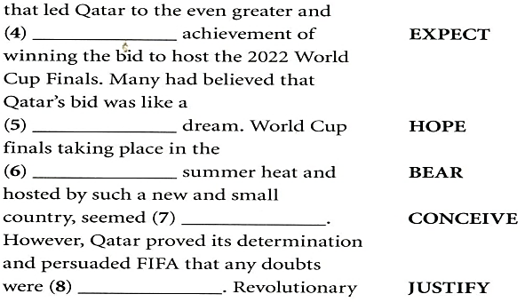
5 Success
Vocabulary & grammar
Vocabulary
Next
Main Page
Previous

Slide 17
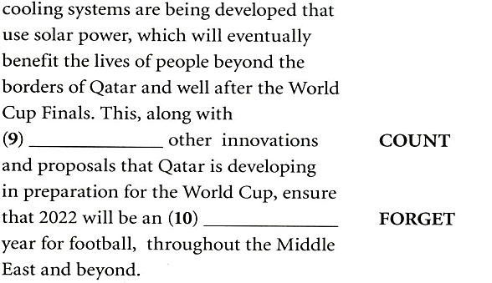
5 Success
Vocabulary & grammar
Vocabulary
Next
Main Page
Previous

Slide 18
5 Success
Vocabulary & grammar
Grammar
Next
Main Page
Previous

Slide 19
5 Success
Vocabulary & grammar
Grammar
Next
Main Page
Previous

Slide 20
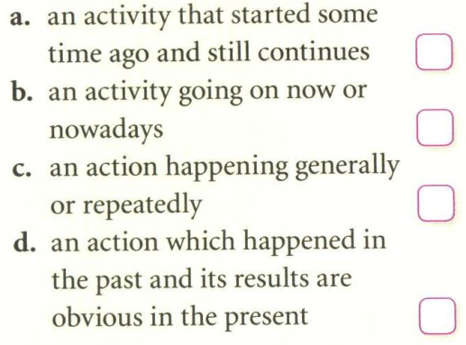
5 Success
Vocabulary & grammar
Grammar
Next
Main Page
Previous

Slide 21
5 Success
Vocabulary & grammar
Grammar
Next
Main Page
Previous

Slide 22
5 Success
Vocabulary & grammar
Grammar
Next
Main Page
Previous

Slide 23
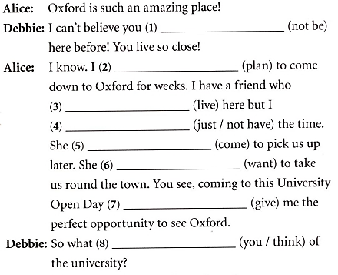
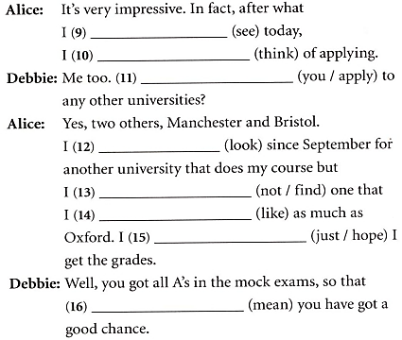
5 Success
Vocabulary & grammar
Grammar
Next
Main Page
Previous

Slide 24
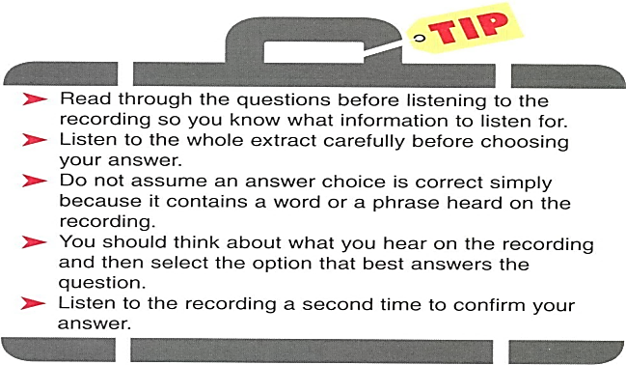
5 Success
Listening
Next
Main Page
Previous

Slide 25
5 Success
Listening
Next
Main Page
Previous

Slide 26
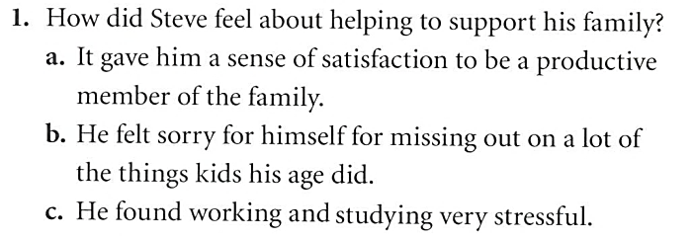
5 Success
Listening
Next
Main Page
Previous

Slide 27
5 Success
Listening
Next
Main Page
Previous

Slide 28
5 Success
Listening
Next
Main Page
Previous

Slide 29
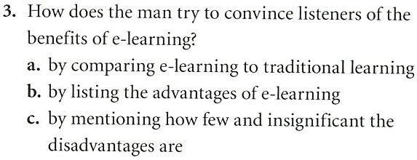
5 Success
Listening
Next
Main Page
Previous

Slide 30
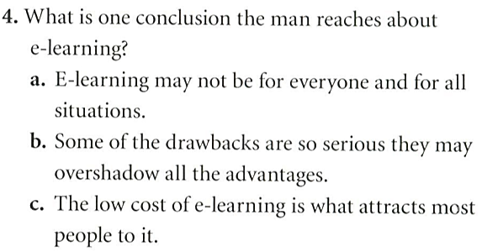
5 Success
Listening
Next
Main Page
Previous

Slide 31
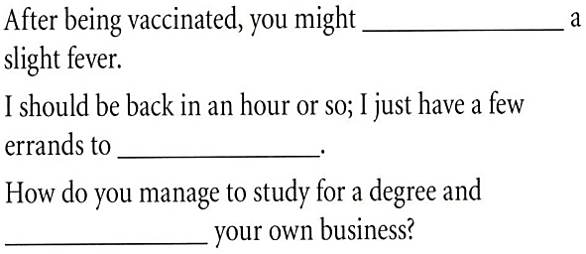
5 Success
Vocabulary
Next
Main Page
Previous

Slide 32
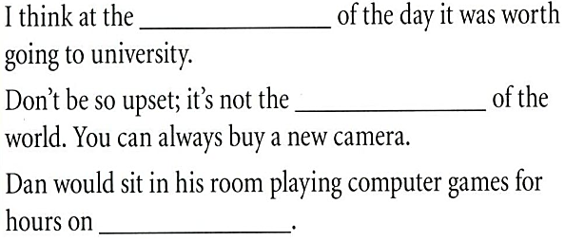
5 Success
Vocabulary
Next
Main Page
Previous

Slide 33
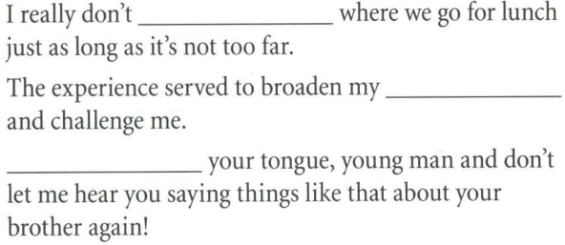
5 Success
Vocabulary
Next
Main Page
Previous

Slide 34
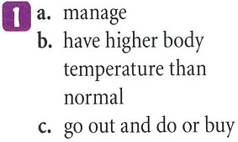
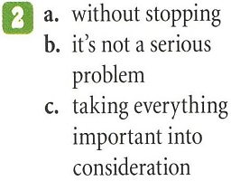
5 Success
Vocabulary
Next
Main Page
Previous

Slide 35
5 Success
Vocabulary
Next
Main Page
Previous

Slide 36
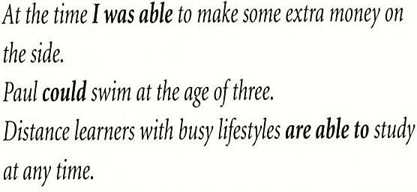
5 Success
Grammar
Next
Main Page
Previous

Slide 37
5 Success
Grammar
Next
Main Page
Previous

Slide 38
5 Success
Grammar
Next
Main Page
Previous

Slide 39
5 Success
Grammar
Next
Main Page
Previous

Slide 40
5 Success
Grammar
Next
Main Page
Previous

Slide 41
5 Success
Speaking
Next
Main Page
Previous

Slide 42
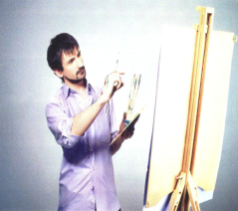
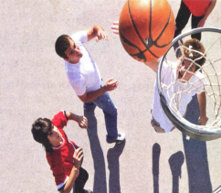
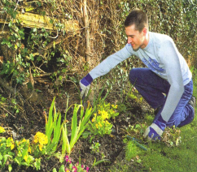
5 Success
Speaking
Next
Main Page
Previous

Slide 43
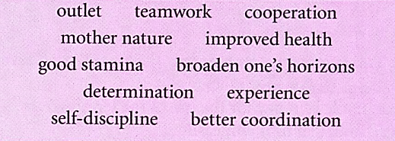
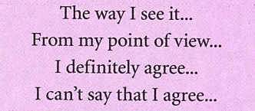
5 Success
Speaking
Next
Main Page
Previous

Slide 44
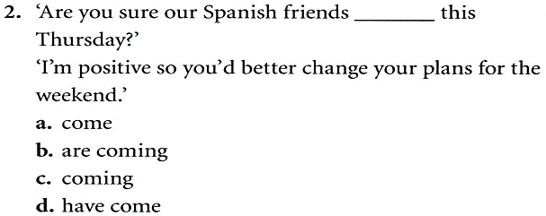
5 Success
Examination practice
Next
Main Page
Previous

Slide 45
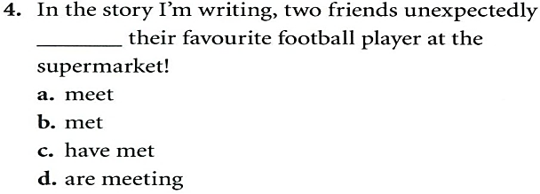
5 Success
Examination practice
Next
Main Page
Previous

Slide 46
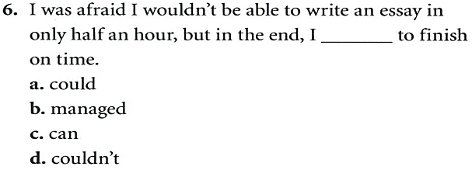
5 Success
Examination practice
Next
Main Page
Previous

Slide 47
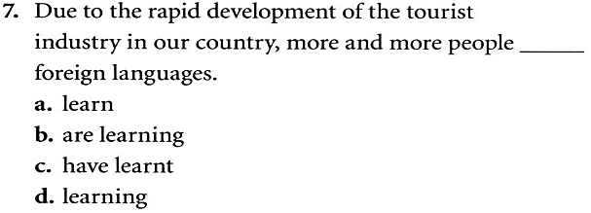
5 Success
Examination practice
Next
Main Page
Previous

Slide 48
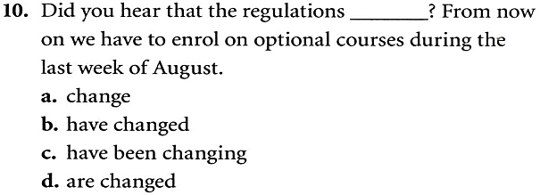
5 Success
Examination practice
Next
Main Page
Previous

Slide 49
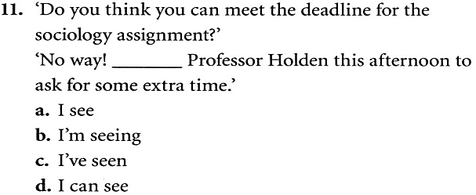
5 Success
Examination practice
Next
Main Page
Previous

Slide 50
5 Success
Writing
Next
Main Page
Previous

Slide 51
5 Success
Writing
Next
Main Page
Previous

Slide 52
5 Success
Writing
Next
Main Page
Previous

Slide 53
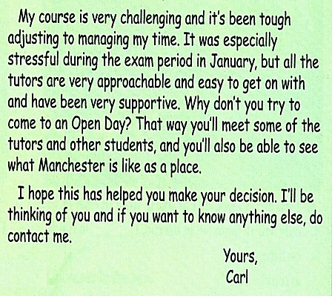
5 Success
Writing
Next
Main Page
Previous

Slide 54
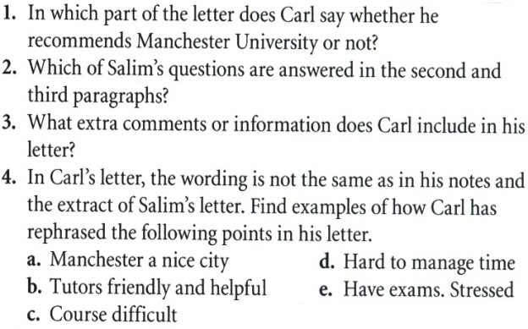
5 Success
Writing
Next
Main Page
Previous

Slide 55
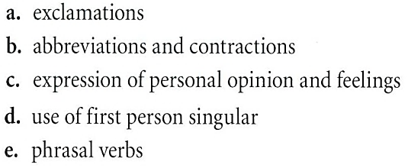
5 Success
Writing
Next
Main Page
Previous

Slide 56
5 Success
Writing
Next
Main Page
Previous

Slide 57
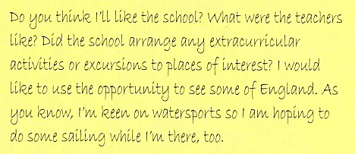
5 Success
Writing
Next
Main Page
Previous

Slide 58
5 Success
Writing
Next
Main Page
Previous

Slide 59
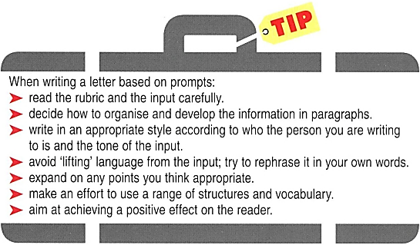
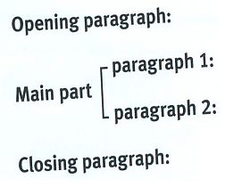
5 Success
Writing
Next
Main Page
Previous

