Slide 1
Unit 6
Work and money
Next
Main Page
Previous

Slide 2
6 Work and money
Reading
Vocabulary & Grammar
Listening
Vocabulary & Grammar
Speaking
Examination practice
Writing
Next
Main Page
Previous

Slide 3
6 Work and money
Reading
Next
Main Page
Previous

Slide 4
6 Work and money
Reading
Next
Main Page
Previous

Slide 5
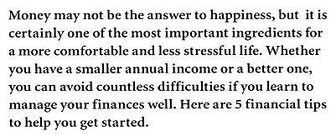
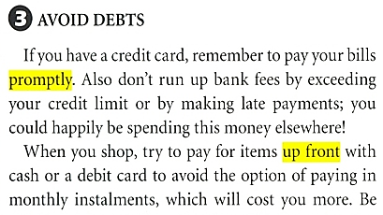
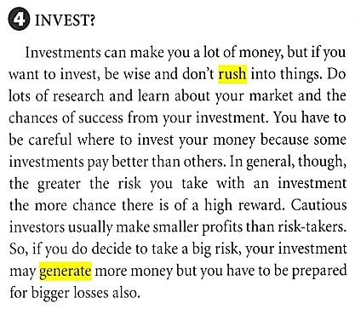
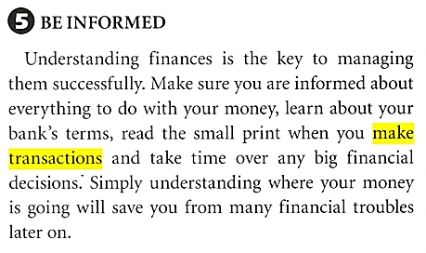
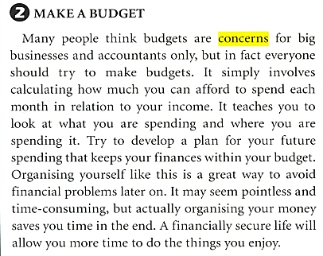
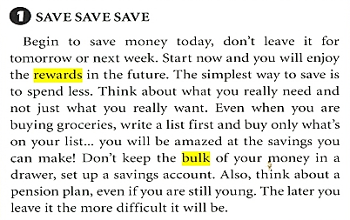
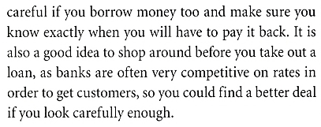
6 Work and money
Reading
Next
Main Page
Previous

Slide 6
6 Work and money
Reading
Next
Main Page
Previous

Slide 7
6 Work and money
Reading
Next
Main Page
Previous

Slide 8
6 Work and money
Reading
Next
Main Page
Previous

Slide 9
6 Work and money
Reading
Next
Main Page
Previous

Slide 10
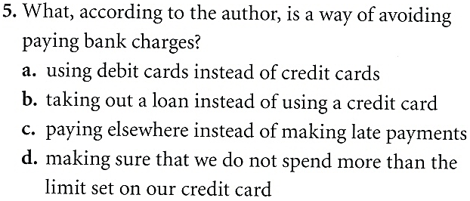
6 Work and money
Reading
Next
Main Page
Previous

Slide 11
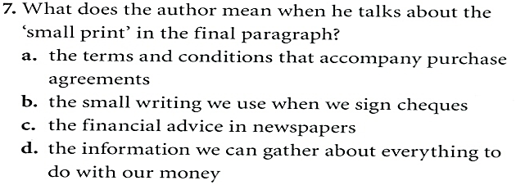
6 Work and money
Reading
Next
Main Page
Previous

Slide 12
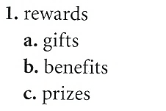
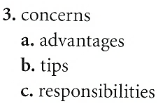
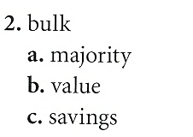
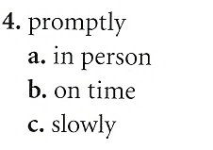
6 Work and money
6 Work and money
Reading
Next
Main Page
Previous

Slide 13
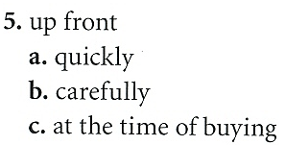
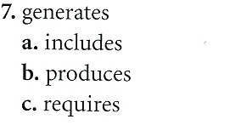
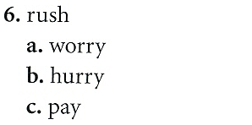
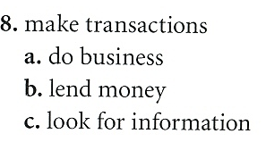
6 Work and money
Reading
Next
Main Page
Previous

Slide 14
6 Work and money
Reading
Next
Main Page
Previous

Slide 15
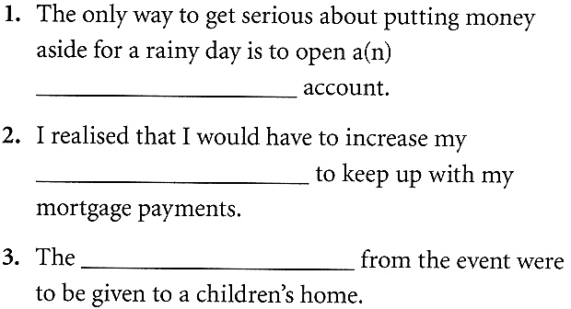
6 Work and money
Vocabulary & grammar
Vocabulary
Next
Main Page
Previous

Slide 16
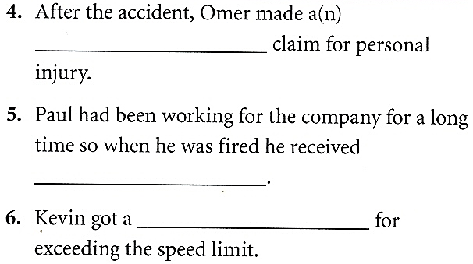
6 Work and money
Vocabulary & grammar
Vocabulary
Next
Main Page
Previous

Slide 17
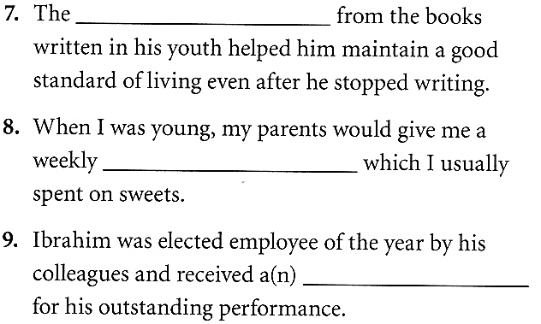
6 Work and money
Vocabulary & grammar
Vocabulary
Next
Main Page
Previous

Slide 18
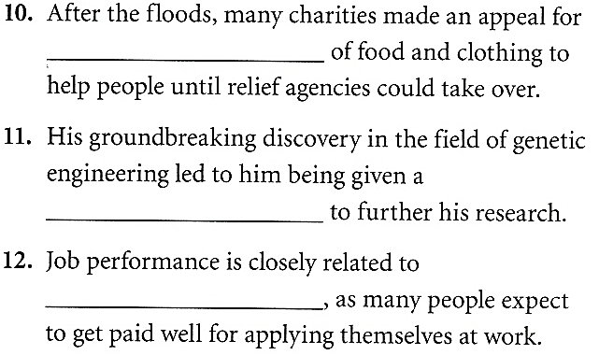
6 Work and money
Vocabulary & grammar
Vocabulary
Next
Main Page
Previous

Slide 19
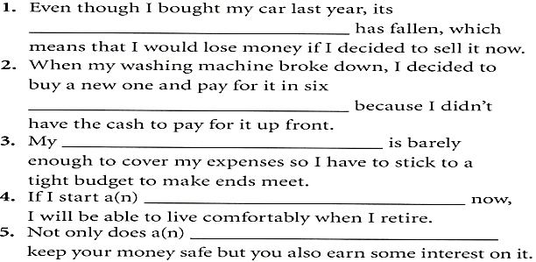
6 Work and money
Vocabulary & grammar
Vocabulary
Next
Main Page
Previous

Slide 20
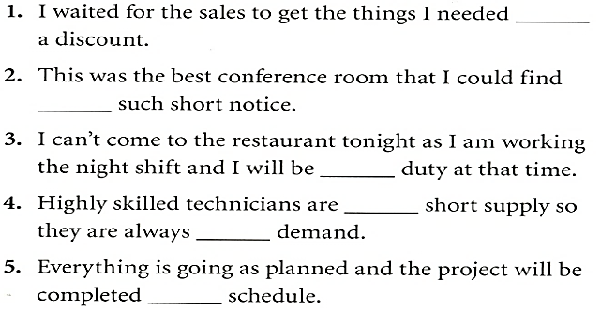
6 Work and money
Vocabulary & grammar
Vocabulary
Next
Main Page
Previous

Slide 21
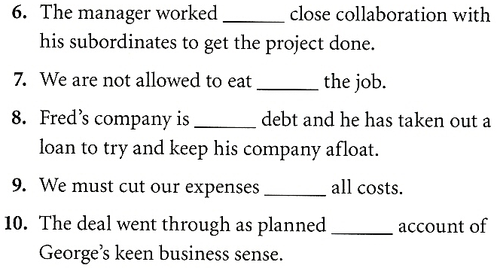
6 Work and money
Vocabulary & grammar
Vocabulary
Next
Main Page
Previous

Slide 22
6 Work and money
Vocabulary & grammar
Grammar
Next
Main Page
Previous

Slide 23
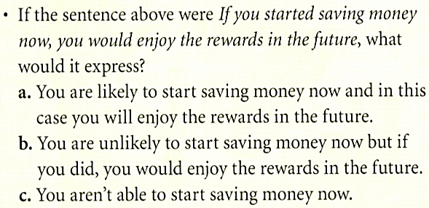
6 Work and money
Vocabulary & grammar
Grammar
Next
Main Page
Previous

Slide 24
6 Work and money
Vocabulary & grammar
Grammar
Next
Main Page
Previous

Slide 25
6 Work and money
Vocabulary & grammar
Grammar
Next
Main Page
Previous

Slide 26
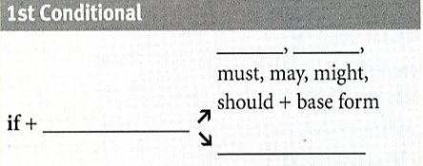
6 Work and money
Vocabulary & grammar
Grammar
Next
Main Page
Previous

Slide 27
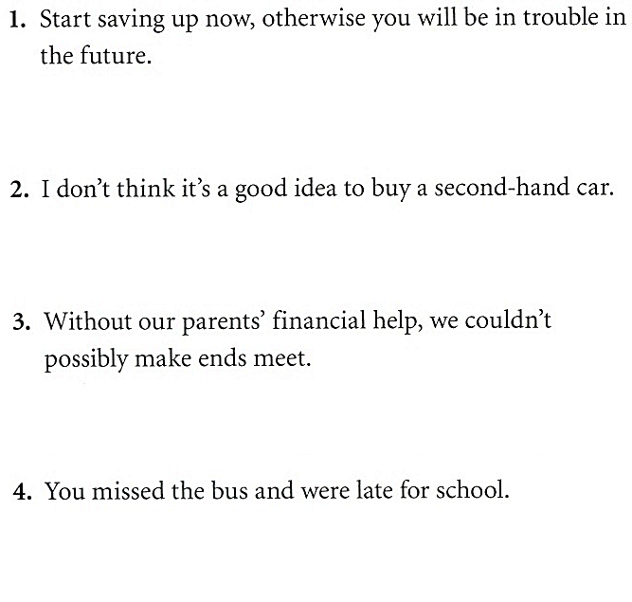
6 Work and money
Vocabulary & grammar
Next
Main Page
Previous

Slide 28
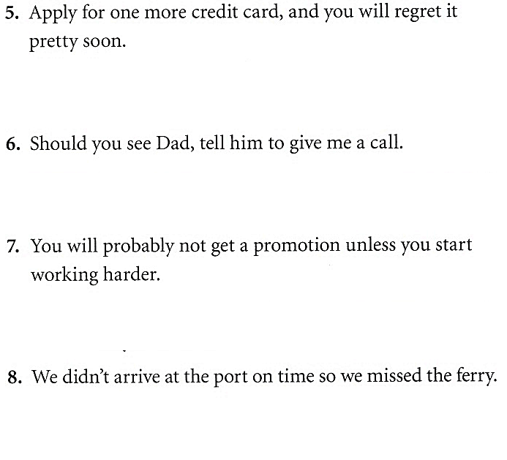
6 Work and money
Vocabulary & grammar
Next
Main Page
Previous

Slide 29
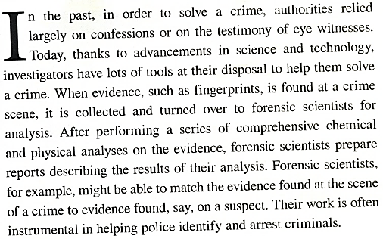
6 Work and money
Listening
Next
Main Page
Previous

Slide 30
6 Work and money
Listening
Next
Main Page
Previous

Slide 31
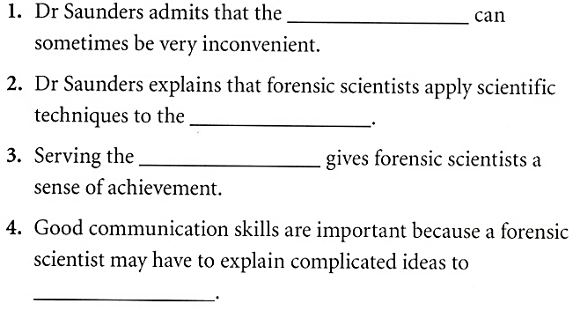
6 Work and money
Listening
Next
Main Page
Previous

Slide 32
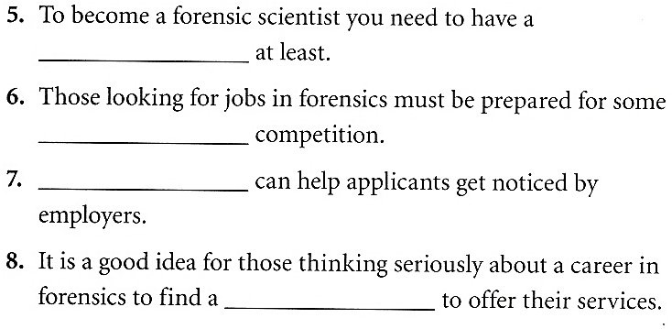
6 Work and money
Listening
Next
Main Page
Previous

Slide 33
6 Work and money
Listening
Next
Main Page
Previous

Slide 34
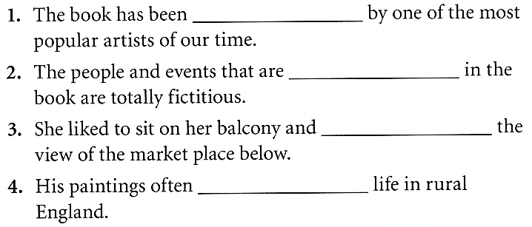
6 Work and money
Vocabulary
Next
Main Page
Previous

Slide 35
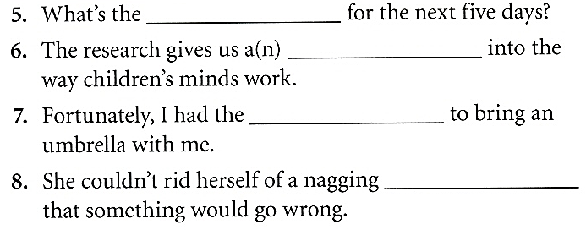
6 Work and money
Vocabulary
Next
Main Page
Previous

Slide 36
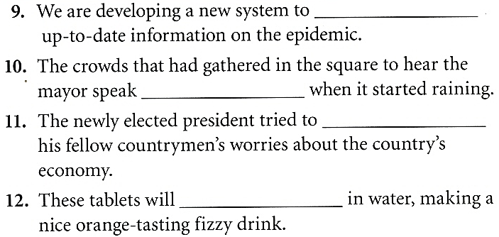
6 Work and money
Vocabulary
Next
Main Page
Previous

Slide 37
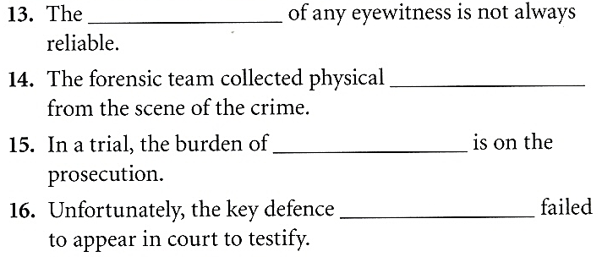
6 Work and money
Vocabulary
Next
Main Page
Previous

Slide 38
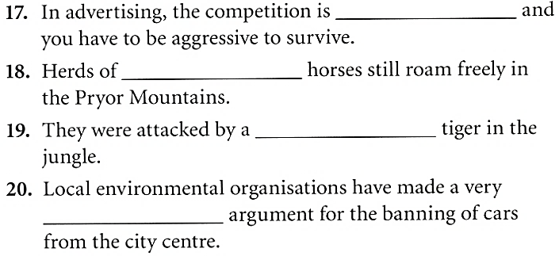
6 Work and money
Vocabulary
Next
Main Page
Previous

Slide 39
6 Work and money
Grammar
Next
Main Page
Previous

Slide 40
6 Work and money
Grammar
Next
Main Page
Previous

Slide 41
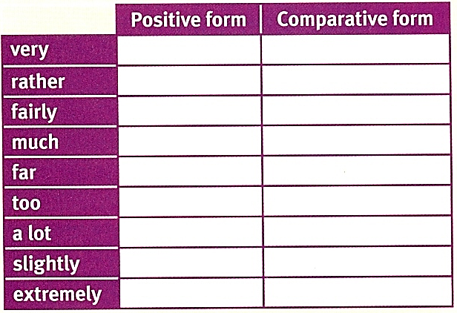
6 Work and money
Grammar
Next
Main Page
Previous

Slide 42
6 Work and money
Grammar
Next
Main Page
Previous

Slide 43
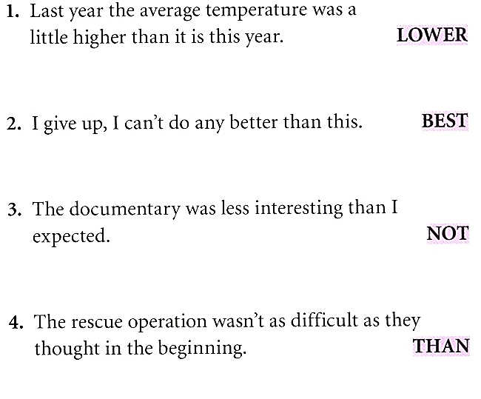
6 Work and money
Grammar
Next
Main Page
Previous

Slide 44
6 Work and money
Speaking
Next
Main Page
Previous

Slide 45
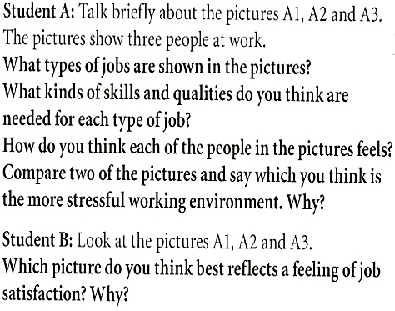
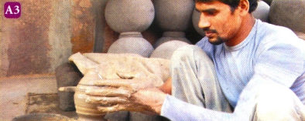
6 Work and money
Speaking
Next
Main Page
Previous

Slide 46
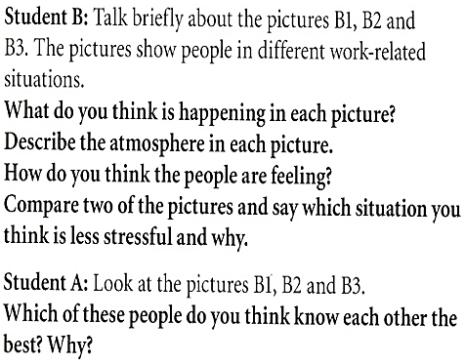
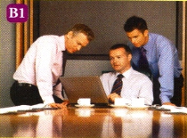
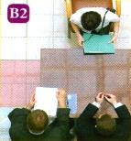
6 Work and money
Speaking
Next
Main Page
Previous

Slide 47
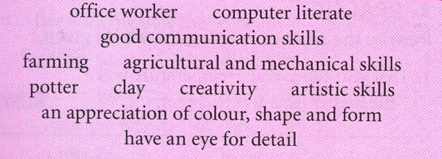
6 Work and money
Speaking
Next
Main Page
Previous

Slide 48
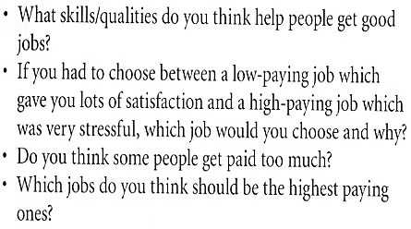
6 Work and money
Speaking
Next
Main Page
Previous

Slide 49
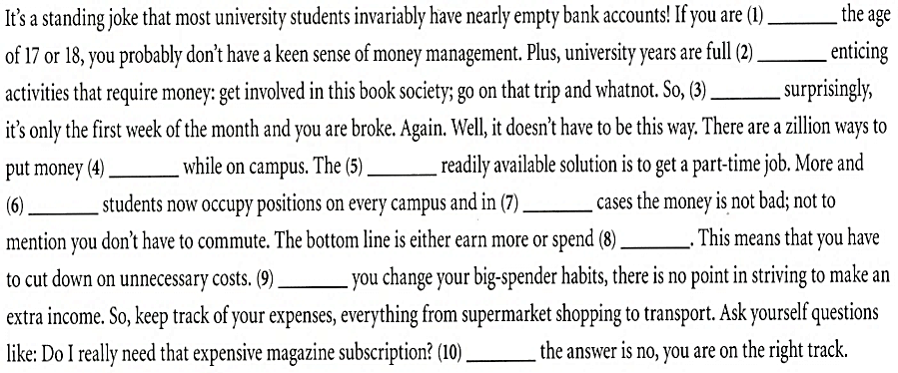
6 Work and money
Examination practice
Next
Main Page
Previous

Slide 50
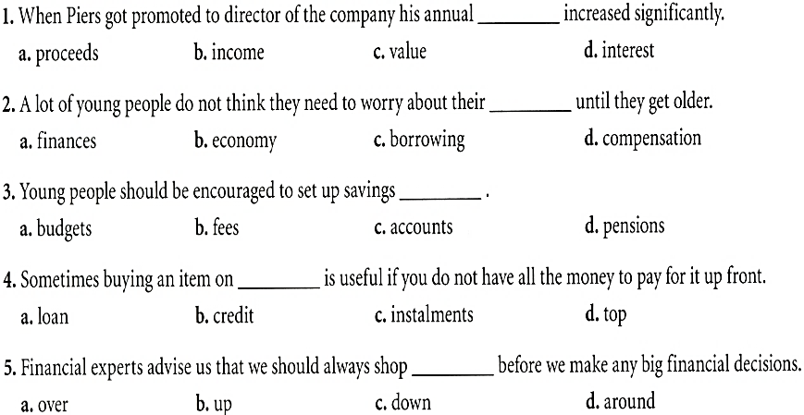
6 Work and money
Examination practice
Next
Main Page
Previous

Slide 51
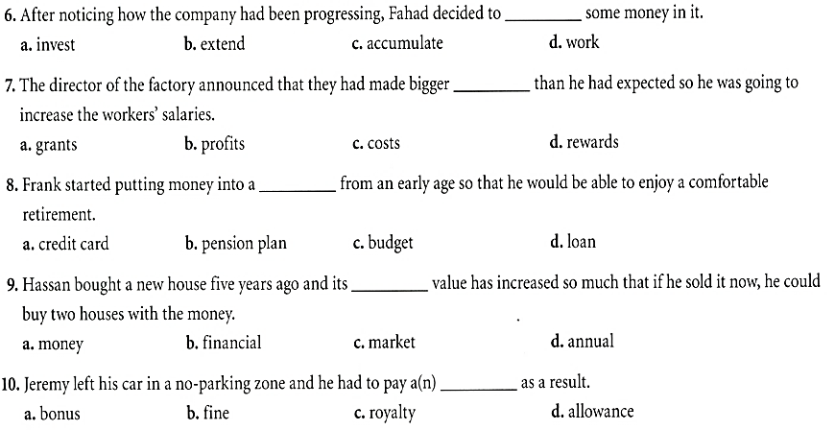
6 Work and money
Examination practice
Next
Main Page
Previous

Slide 52
6 Work and money
Writing
Next
Main Page
Previous

Slide 53
6 Work and money
Writing
Next
Main Page
Previous

Slide 54
6 Work and money
Writing
Next
Main Page
Previous

Slide 55
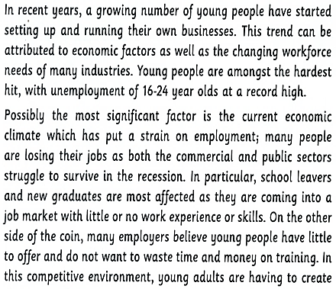
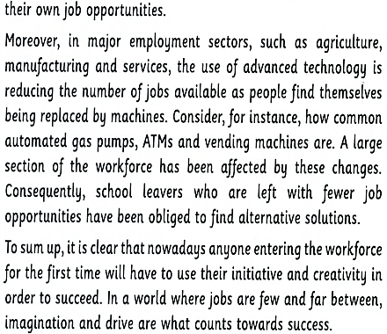
6 Work and money
Writing
Next
Main Page
Previous

Slide 56
6 Work and money
Writing
Next
Main Page
Previous

Slide 57
6 Work and money
Writing
Next
Main Page
Previous

Slide 58
6 Work and money
Writing
Next
Main Page
Previous

Slide 59
6 Work and money
Writing
Next
Main Page
Previous

Slide 60
6 Work and money
Writing
Next
Main Page
Previous

Slide 61
6 Work and money
Writing
Next
Main Page
Previous

Slide 62
6 Work and money
Writing
Next
Main Page
Previous

