Slide 1
Q1) DNA and RNA consisting of a long chains of chemical units called -------------
a)Nucleic acid
b)Nucleotides
c)Nitrogenous bases
d) Pentose sugar
Q2) The nucleotides are joined to one another by -------------------------------------p97
Hydrogenous bond
Covalent bond
Ionic bond
Peptide bond

Slide 2
Q3) The nitrogenous bases in the DNA molecule are connected by ------------
Hydrogenous bond
Covalent bond
Ionic bond
Peptide bond
Q4) The difference between the sugar in DNA and RNA is that DNA sugar is ----------p97
Ribose
Deoxyribose
Hexose
triose

Slide 3
Q5) The pyrimidines nitrogenous bases are -----------------and--------- p98
a)adenine, thymine
b) adenine, guanine
c)thymine, cytosine
d) cytosine, guanine
Q6) The purines nitrogenous bases are -----------------and--------- p98
a)adenine, thymine
b) adenine, guanine
c)thymine, cytosine
d) cytosine, guanine

Slide 4
Q7)------------------------------------ are the scientists who began trying to construct wire model of a double helix of the DNA.
Rosalind franklin
George and edward
Watson and crick
None of the above
Q8) DNA replication occur in-----------------------------
Golgi body
Cytoplasm
Lysosome
nucleus

Slide 5
Q9) The model for DNA replication is known as the -----------------------because half of parental model is conserved in each daughter molecule.
Fluid mosaic model
Double helix model
Semi-conservative model
None of the above

Slide 6
Q x)In protein synthesis:
DNA to protein
DNA to RNA
DNA to mRNA to protein
DNA to DNA
Qxx) DNA transcription occur in
Nucleus
Cytoplasm
Golgi
ribosome
Qxxx) DNA translation occur in
Nucleus
Cytoplasm
Golgi
ribosome

Slide 7
Q10)---p102------------------is the heritable information contained in DNA (genetics makeup).
Genotype
Phenotype
Anatomy
physiology

Slide 8
Q11) p107-----------------is the study of the form of an organisms structures.
Genotype
Phenotype
Anatomy
physiology
Q12) P107------------- is the study of the functions of the organism structures.
Genotype
Phenotype
Anatomy
physiology

Slide 9
Q13) The integrated group of similar cells that perform a common function is called ------------p107
Cell
Tissue
Organ
Organ system
Q14) the smallest structural and functional unit in any living organism is:
Cell
Tissue
Organ
Organ system

Slide 10
Q15) the --------- is made up of two or more types of tissues that together perform a specific task.
Cell
Tissue
Organ
Organ system
Q16) the ----------- consists of multiple organs that together perform a vital body function.
Cell
Tissue
Organ
Organ system

Slide 11
Q17) The tissue that Covers the outside of the body and lines cavities within the body is:
Epithelial
Connective
Muscle
nervous
Q18) the type of tissue that lining esophagus and forming skin is :
Simple squamous epithelial
Stratified squamous epithelial
Simple cuboidal epithelial
Simple columnar epithelial
Q19) the type of tissue that lining intestine is :
Simple squamous epithelial
Stratified squamous epithelial
Simple cuboidal epithelial
Simple columnar epithelial

Slide 12
Q20) the type of tissue that lining the respiratory tract is :
Pseudostratified columnar epithelial
Stratified squamous epithelial
Simple cuboidal epithelial
Simple columnar epithelial
Q21) the type of tissue that forming the tube in the kidney and glands is :
Pseudostratified columnar epithelial
Stratified squamous epithelial
Simple cuboidal epithelial
Simple columnar epithelial

Slide 13
Q22) the type of tissue that connects binds and supports, or separates different types of tissues and organs of the body is :
Epithelial
Connective
Muscle
nervous
Q23) the type of tissue that forming the tendons and ligaments is :
Loose connective
Fibrous connective
Adipose connective
Cartilage connective
Q24) ------------ has a matrix of collagen fibers embedded in a hard mineral substance made of calcium, magnesium and phosphate :
Bone
Fibrous connective tissue
Adipose tissue
blood

Slide 14
Q25) the type of tissue that pads and insulates your body and stores fat is :
Loose connective
Fibrous connective
Adipose connective
Cartilage connective
Q26) the most widespread connective tissue in your body is :
Loose connective
Fibrous connective
Adipose connective
Cartilage connective
Q27) The tissue that functions in movement is:
Epithelial
Connective
Muscle
nervous

Slide 15
Q28) The type of muscle that attaches to your bones by tendons and is responsible for voluntary movements of your body:
Skeletal muscle.
Cardiac muscle.
Smooth muscle.
All of the above.
Q29) The type of muscle that forms the contractile tissue of your heart is:
Skeletal muscle.
Cardiac muscle.
Smooth muscle.
All of the above.
Q30) The type of muscle that is found in the walls of your digestive tract , arteries and internal organs is:
Skeletal muscle.
Cardiac muscle.
Smooth muscle.
All of the above.

Slide 16
Q31) The structural and functional unit of nervous tissue is:
Neuron.
Cardiac muscle.
Nephron.
All of the above.
Q32) The tissue that forms a communication network is:
Epithelial tissue
Connective tissue
Muscle tissue
Nervous tissue

Slide 17
Q33) Minimum energy a resting animal requires each day energy needed to live is:
Metabolism
Malnourishment
Metabolic rate
Basal metabolic rate
Q34) Omnivores are:
Plant eater
Meat eater
Eat both plants and meat
None of the above
Q35) Food is processed in four stages:
Ingestion and suspension
Ingestion and digestion
Absorption and elimination
A+ C
None of the above
B+C

Slide 18
Q36) the salivary glands secrete saliva that hydrolyze -------------
Starch
Lipid
Protein
Cellulose
Q37) ---------------is a muscular tube connects between pharynx and stomach.
Oral cavity
Esophagus
Small intestine
rectum
Q38) esophagus moves food by waves of muscle contraction and relaxations called :
peristalsis
systole
diastole
All of the above

Slide 19
Q39) ------------------is a muscular, hollow, dilated part of the digestive system located between the esophagus and the small intestine.
Oral cavity
Esophagus
stomach
rectum
Q40) stomach produce ----------- that digest -------------.
Bile , fat
Amylase, starch
Bile, protein
Pepsin, protein
Q41) Gastric acid is a digestive fluid, formed in the stomach, It composed of:
Bile , pepsin
Amylase, acid
pepsin, Acid
Pepsin, amylase

Slide 20
Q42) What prevents the gastric juices from digesting the walls of the stomach?
Mucus helps protect against HCl and pepsin
The water that you drink
HCL is not a strong acid, so it doesn’t digest the stomach
All of the above
Q43) Small intestine is so named for its -------------
Shorter Length
Smaller size
Smaller diameter
None of the above
Q44) bile is made by:
Small intestine
Liver
Gall bladder
stomach

Slide 21
Q45) bile digest -------- into --------------------
Protein , amino acid
Starch, monosaccharide
Fat, fatty acids and glycerol
Nucleic acid, nucleotides
Q46)Surface area of the intestine for absorption is increased by:
Small size
Villi and microvilli
Cartilage rings
All of the above
Q47) The liver performs many functions :
synthesizes many proteins
produces bile
changes toxins to less toxic
Converts glucose to glycogen
All of the above

Slide 22
Q48) Diarrhea occurs when:
too little water is reclaimed by large intestine.
too much water is reclaimed by large intestine.
water is reclaimed by large intestine
None of the above
Q49) A diet that missing one or more essential nutrients results in:
Under-nutrition
Malnutrition
Nourishment
None of the above
Q50) Why is food chemically broken down?
To be liquid
To be small enough to pass through cell membranes
A+B
None of the above

Slide 23
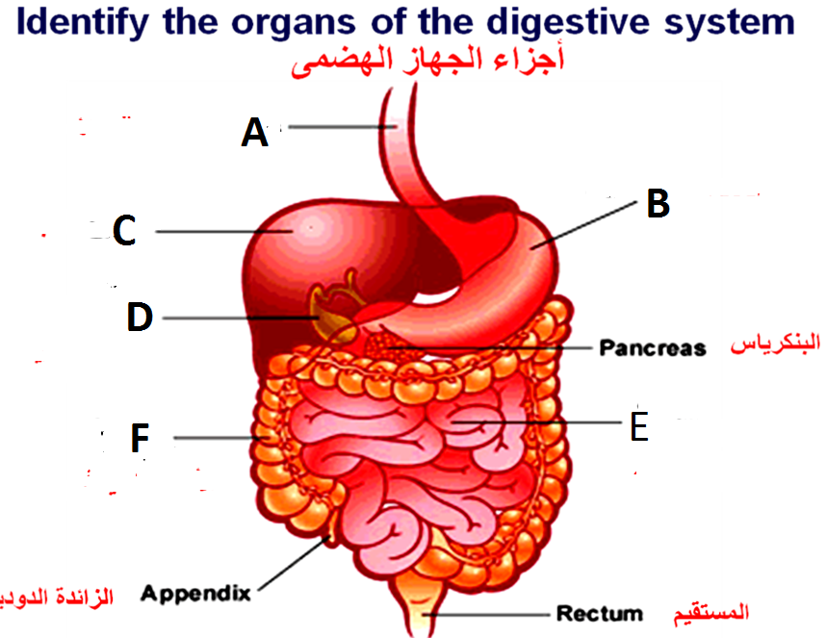
Label A,B,C,D,E,F

Slide 24
1 (a) --------- are digested into amino acids, (b) ----- are digested to fatty acids and glycerol, (c) --------- is digested to glucose.
2 -------- reduces food to portions small enough to be swallowed and increases the surface area of the food for digestive enzymes to act on.
3The -------- in saliva is ------------and it acts on -------.
5 ------ are partially digested in the stomach.

Slide 25
4. The ------- in gastric juice is pepsin.
5. --------releases pancreatic juice (alkaline) into the duodenum.
6. The enzymes which act on: proteins (-------), starch (------) and fat (--------).
7. ------ emulsifies fats (breaks fats into small droplets).
10 The absorbing surface of the small intestine is increased by: (a) being very long, (b) having internal folds, (c) having villi

Slide 26
Q51) Earthworms exchange O2 and CO2 across:
Body surface
Tracheal system
Gills
lung
Q51) Earthworms exchange O2 and CO2 across:
Body surface
Tracheal system
Gills
lung
Q52) fish exchange O2 and CO2 across:
Body surface
Tracheal system
Gills
lung

Slide 27
Q53) insects exchange O2 and CO2 across:
Body surface
Tracheal system
Gills
lung
Q53) reptiles and mammals exchange O2 and CO2 across:
Body surface
Tracheal system
Gills
lung

Slide 28
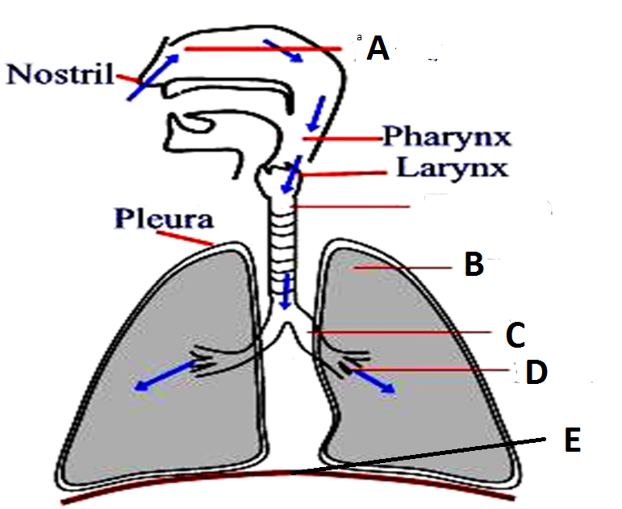
Q54) Label A,B.C,D

Slide 29
Q55) bronchioles dead-ended in grapelike cluster of air sacs called:
Trachea
Bronchi
Bronchioles
alveoli
Q56) the part of an animals body where gas exchange occurs is called the:
a) Respiratory surface
b) Bronchi
c) Bronchioles
d) alveoli
Q57) the exchange of gases between capillaries and the cells around them occur by:
Osmosis
Facilitated diffusion
Diffusion
Active transport

Slide 30
Q58) the exchange of gases between alveoli and the capillaries around them occur by:
Osmosis
Facilitated diffusion
Diffusion
Active transport
Q59) the molecule that carries O2, helps transport CO2 and buffers the blood is
Hemoglobin
Wight blood cell
Platelet
lymphocyte
Q60) O2 in the blood is transported bound to-------------within ------------------
Hemoglobin, WBC
Lymphocyte, WBC
Hemoglobin, RBC
Lymphocyte, RBC

Slide 31
Q61) CO2 is mainly transported as -------------- ion within the plasma
Hydrogen
Carbonic acid
CO2
Bicarbonate
Q62) when you inhale the diaphragm:
Relaxes and move upward
Relaxes and move downward
contracts and move upward
Contracts and move downward
Q63) Gases in the alveoli have ---------------- than gases in the blood :
more O2 and less CO2
more O2 and more CO2
less O2 and less CO2
less O2 and more CO2

Slide 32
Q63) Gases in the tissues have ---------------- than gases the blood :
more O2 and less CO2
more O2 and more CO2
less O2 and less CO2
less O2 and more CO2

Slide 33
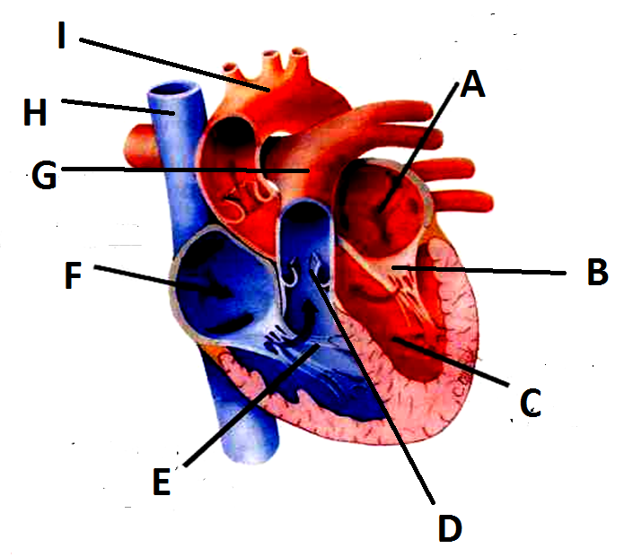
Label A,B,C,D,E,F,G,H,I

Slide 34
Q64) the circulatory system where the fluid is pumped through open ended vessels is called:
Open circulatory system
Closed circulatory system
Double circulation
Single circulation
Q65) The main function of circulatory system is:
To digest foods
To filtrate gases
To facilitate exchange with all body tissue
All of the above
Q66) which side of the heart pumps blood from body to lungs?
Left side
Right side
Upper champers
Lower champers

Slide 35
Q67) The right ventricle pumps oxygen poor blood to the lungs via:
Vena cava
Pulmonary veins
Pulmonary arteries
aorta
Q68) The left ventricle pumps oxygen rich blood to the body tissues via:
Coronary arteries
Pulmonary veins
Pulmonary arteries
aorta
Q69) The blood vessel which supply blood to the heart muscle itself is:
Vena cava
Coronary arteries
Pulmonary arteries
aorta

Slide 36
Q70) the largest blood vessel in human body is:
Vena cava
Coronary arteries
Pulmonary arteries
aorta
Q71) the contraction phase of the cardiac cycle is called
Heart rate
Cardiac output
Diastole
systole
Q72) the relaxation phase of the cardiac cycle is called
Heart rate
Cardiac output
Diastole
systole

Slide 37
Q73) the volume of blood that each ventricle pumps per minute is:
Heart rate
Cardiac output
Diastole
Cardiac cycle
Q74) the rhythmic sequence of contraction and relaxation of the heart is called:
Heart rate
Cardiac output
Diastole
Cardiac cycle
Q75) which of these animals has one circuit?
Human
Fish
Turtle
snake

Slide 38
Q76) which of these animals has a heart of two chambers?
Human
Fish
Turtle
birds
Q77) which of these animals has a heart of three chambers?
Human
Fish
Turtle
birds
Q78) which of these animals has a heart of four chambers?
snakes
Fish
Turtle
birds

Slide 39
Q79) which part of the heart receives O2 rich blood?
Right atrium
Left atrium
Right ventricle
Left ventricle
Q80) which part of the heart pumps O2 rich blood?
Right atrium
Left atrium
Right ventricle
Left ventricle
Q81) which part of the heart receives O2 poor blood?
Right atrium
Left atrium
Right ventricle
Left ventricle

Slide 40
Q82) which part of the heart pumps O2 poor blood?
Right atrium
Left atrium
Right ventricle
Left ventricle
Q83) which type of blood vessels carries blood away from the heart:
Vein
Artery
Capillary
All of the above
Q84) which type of blood vessels carries blood towards the heart :
Vein
Artery
Capillary
All of the above

