Slide 1
Unit 1
Education

Slide 2
1 Education
Reading
Vocabulary & Grammar
Listening
Vocabulary & Grammar
Speaking
Examination practice
Writing
Next
Main Page
Previous

Slide 3
1 Education
Reading
Next
Main Page
Previous

Slide 4
1 Education
Reading
Next
Main Page
Previous

Slide 5
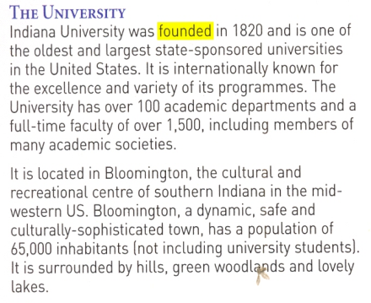
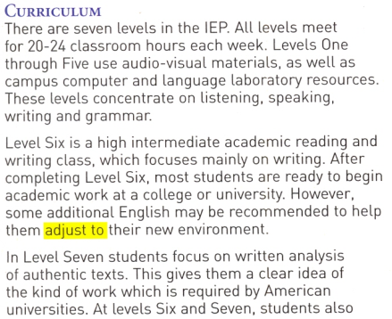
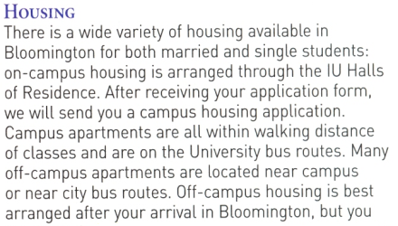
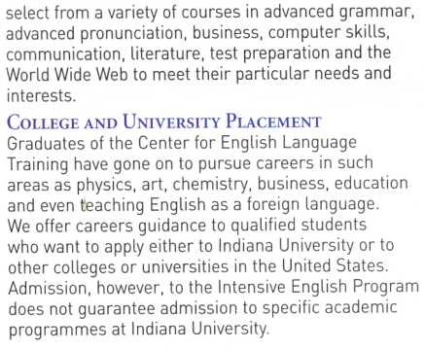
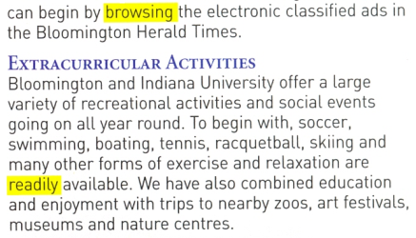
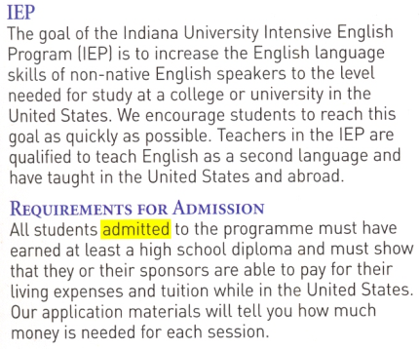
1 Education
Reading
Next
Main Page
Previous

Slide 6
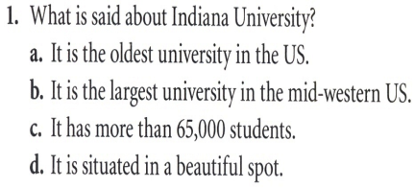
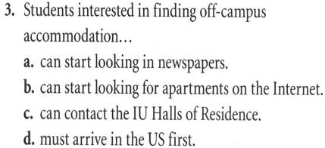
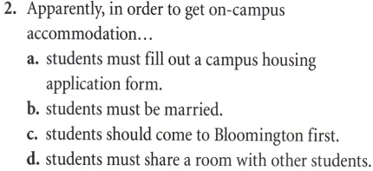
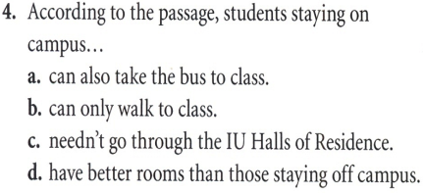
1 Education
Reading
Next
Main Page
Previous

Slide 7
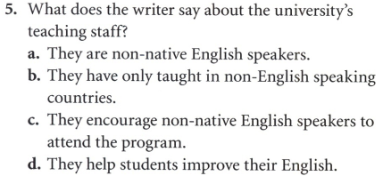
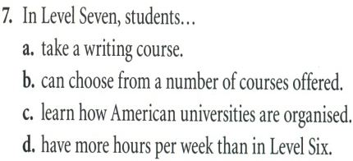
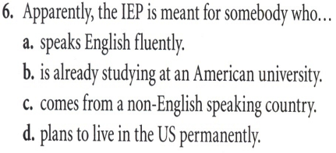
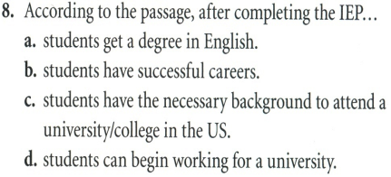
1 Education
Reading
Next
Main Page
Previous

Slide 8
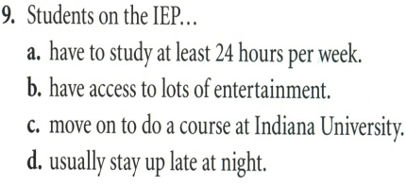
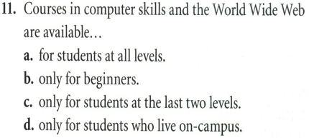
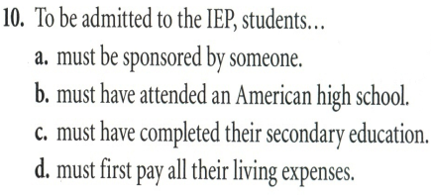
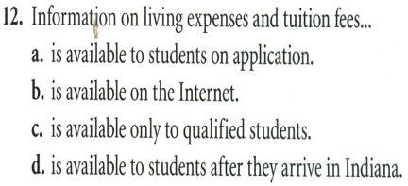
1 Education
Reading
Next
Main Page
Previous

Slide 9
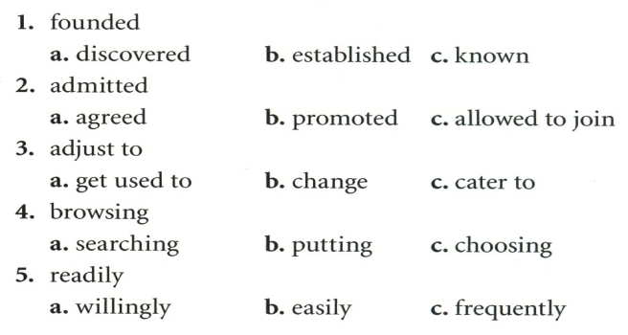
1 Education
Reading
Next
Main Page
Previous

Slide 10
1 Education
Reading
Next
Main Page
Previous

Slide 11
1 Education
Vocabulary & grammar
Vocabulary
quality
excellence
perfection
Next
Main Page
Previous

Slide 12
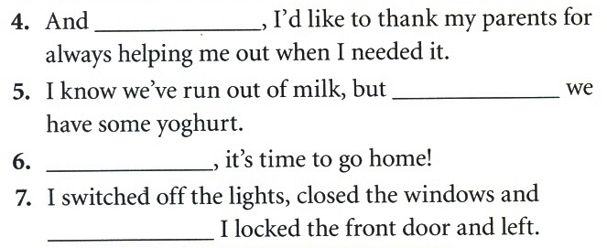
1 Education
Vocabulary & grammar
Vocabulary
at last
at least
Lastly
but not least
Next
Main Page
Previous

Slide 13
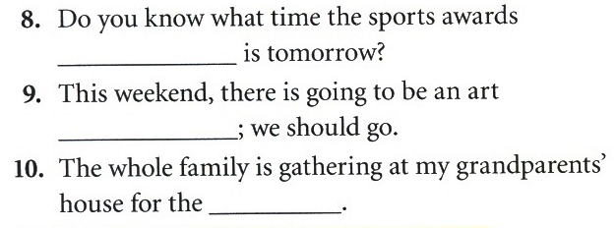
1 Education
Vocabulary & grammar
Vocabulary
ceremony
festival
celebration
Next
Main Page
Previous

Slide 14
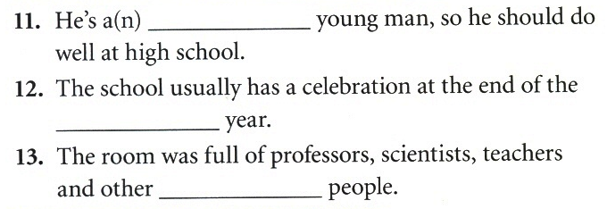
1 Education
Vocabulary & grammar
Vocabulary
intellectual
academic
studious
Next
Main Page
Previous

Slide 15
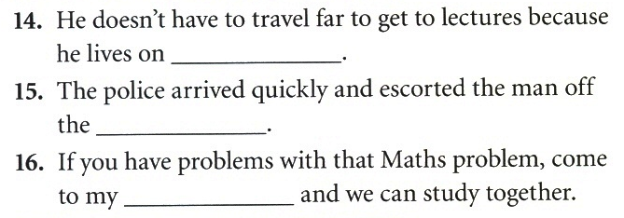
1 Education
Vocabulary & grammar
Vocabulary
campus
premises
dorm
Next
Main Page
Previous

Slide 16
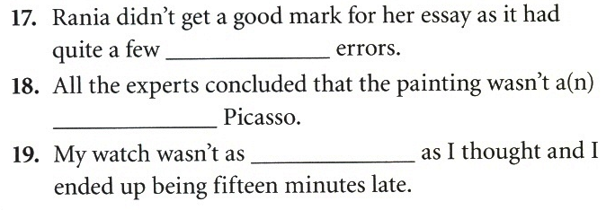
1 Education
Vocabulary & grammar
Vocabulary
factual
authentic
accurate
Next
Main Page
Previous

Slide 17
1 Education
Vocabulary & grammar
Vocabulary
continue
Next
Main Page
Previous

Slide 18
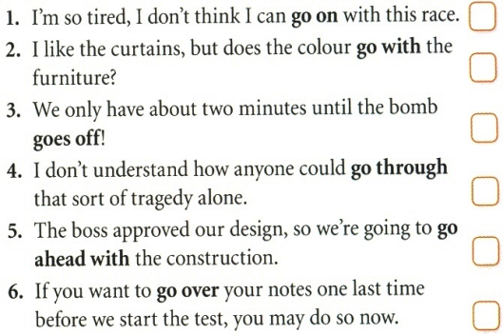
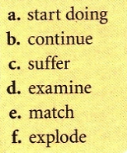
1 Education
Vocabulary & grammar
Vocabulary
b
e
f
c
a
d
Next
Main Page
Previous

Slide 19
1 Education
Vocabulary & grammar
Vocabulary
inhabit
Next
Main Page
Previous

Slide 20
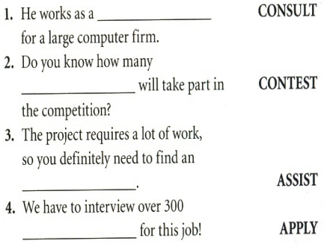
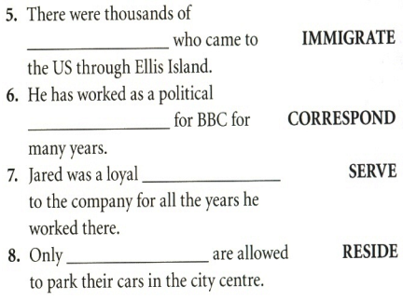
1 Education
Vocabulary & grammar
Vocabulary
consultant
immigrants
contestants
correspondent
servant
assistant
residents
applicants
Next
Main Page
Previous

Slide 21
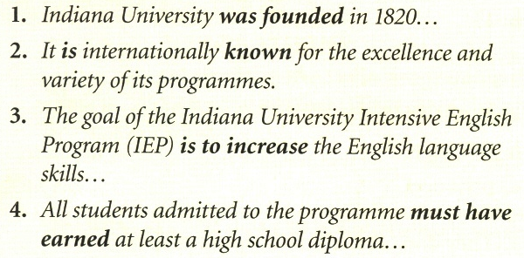
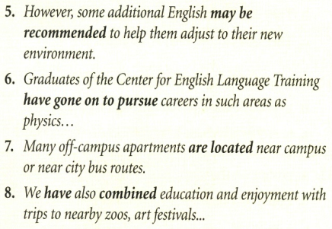
1 Education
Vocabulary & grammar
Grammar
Next
Main Page
Previous

Slide 22
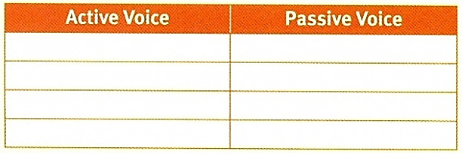
1 Education
Vocabulary & grammar
Grammar
3
1
4
2
6
5
8
7
Next
Main Page
Previous

Slide 23
1 Education
Vocabulary & grammar
Grammar
The action itself
Verb to be + P.P
Next
Main Page
Previous

Slide 24
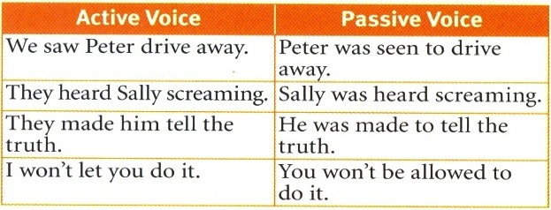
1 Education
Vocabulary & grammar
Grammar
Next
Main Page
Previous

Slide 25
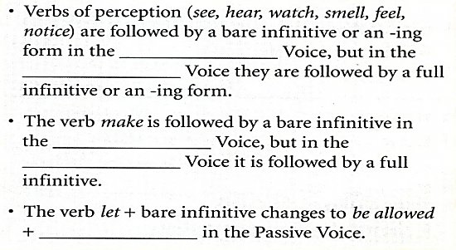
1 Education
Vocabulary & grammar
Grammar
active
passive
active
passive
infinitive
Next
Main Page
Previous

Slide 26
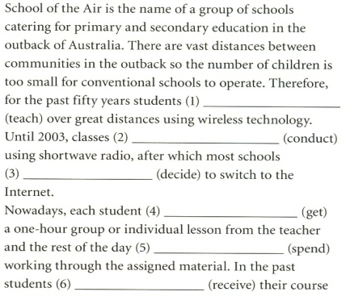
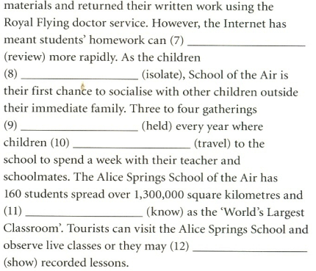
1 Education
Vocabulary & grammar
Grammar
be reviewed
are isolated
were taught
were conducted
are held
travel
decided
gets
is known
is spent
be shown
received
Next
Main Page
Previous

Slide 27
1 Education
Listening
Next
Main Page
Previous

Slide 28
1 Education
Listening
Next
Main Page
Previous

Slide 29
1 Education
Listening
Next
Main Page
Previous

Slide 30
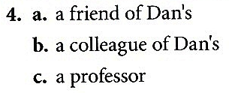
1 Education
Listening
Next
Main Page
Previous

Slide 31
1 Education
Listening
Next
Main Page
Previous

Slide 32
1 Education
Listening
Next
Main Page
Previous

Slide 33
1 Education
Listening
Next
Main Page
Previous

Slide 34
1 Education
Listening
Next
Main Page
Previous

Slide 35
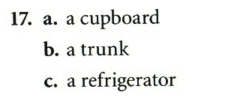
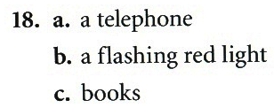
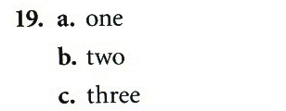
1 Education
Listening
Next
Main Page
Previous

Slide 36
1 Education
Vocabulary
Next
Main Page
Previous

Slide 37
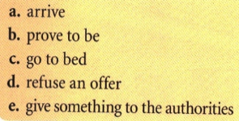
1 Education
Vocabulary
c
d
a
e
b
Next
Main Page
Previous

Slide 38
1 Education
Vocabulary
Next
Main Page
Previous

Slide 39
1 Education
Vocabulary
Next
Main Page
Previous

Slide 40
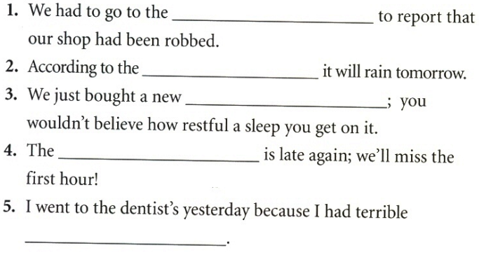
1 Education
Vocabulary
police station
weather forecast
waterbed
school bus
toothache
Next
Main Page
Previous

Slide 41
1 Education
Grammar
Posters on the walls
We don’t know.
Next
Main Page
Previous

Slide 42
1 Education
Grammar
which is
Next
Main Page
Previous

Slide 43
1 Education
Grammar
is being designed
Next
Main Page
Previous

Slide 44
1 Education
Grammar
The suspects are being questioned at the moment.
Professor Swan is believed to be very strict.
A shopping centre is being built on the outskirts of the city.
Next
Main Page
Previous

Slide 45
1 Education
Grammar
It is said that the French founded this town in the 17th century.
Next
Main Page
Previous

Slide 46
1 Education
Speaking
Next
Main Page
Previous

Slide 47
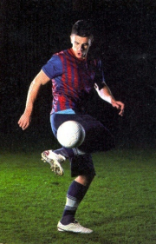
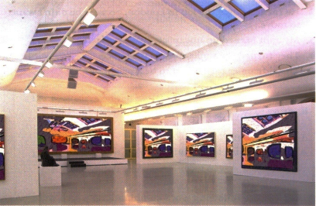
1 Education
Speaking
Next
Main Page
Previous

Slide 48
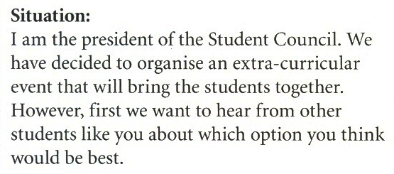
1 Education
Speaking
Next
Main Page
Previous

Slide 49
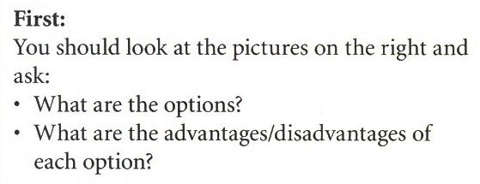
1 Education
Speaking
Next
Main Page
Previous

Slide 50
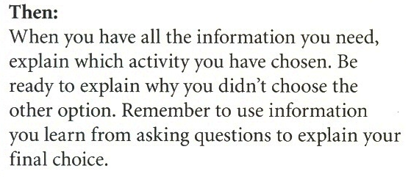
1 Education
Speaking
Next
Main Page
Previous

Slide 51
1 Education
Speaking
Next
Main Page
Previous

Slide 52
1 Education
Speaking
Next
Main Page
Previous

Slide 53
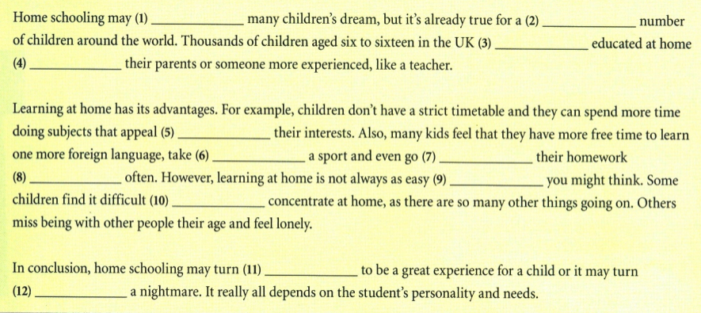
1 Education
Examination practice
Next
Main Page
Previous

Slide 54
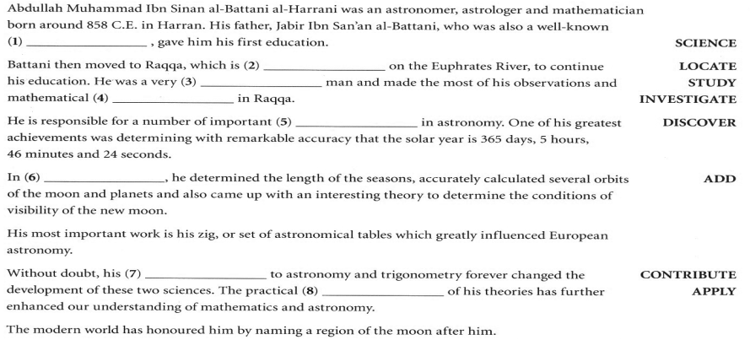
1 Education
Examination practice
scientist
located
investigations
discoveries
addition
contributions
applications
Next
Main Page
Previous

Slide 55
1 Education
Writing
Next
Main Page
Previous

Slide 56
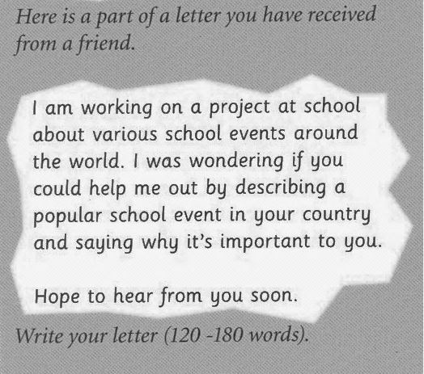
1 Education
Writing
Next
Main Page
Previous

Slide 57
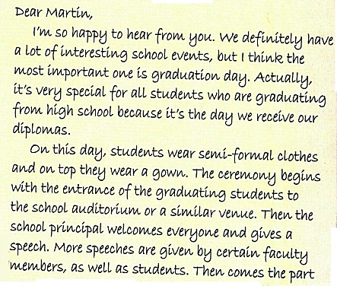
1 Education
Writing
Next
Main Page
Previous

Slide 58
1 Education
Writing
√
√
√
Next
Main Page
Previous

Slide 59
1 Education
Writing
Next
Main Page
Previous

Slide 60
1 Education
Writing
Next
Main Page
Previous

Slide 61
1 Education
Writing
Next
Main Page
Previous

