Slide 1

Chapter 4
Chemical Bonding and Chemical Reactions

Slide 2
Chapter 4
Chemical Bonding and Chemical Reactions
Page:79-122
Reaction Stoichiometry.
Limiting Reagents, theoretical yield and percent Yield.
Concentration of Solutions: The Molarity and Dilution.
Types of Aqueous Solutions and Solubility
Precipitation Reactions
Lewis dot symbols
Types of Chemical Bonds.
Ionic bonding.
Covalent bonding.
Electronegativity and bond polarity.

Slide 3
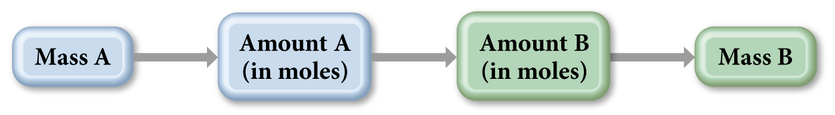
Chapter 4: Chemical Bonding and Chemical Reactions
4.1 Reaction Stoichiometry
Two important questions:
1- How much product will be formed from specific amount of reactants?
e.g. 6.0 g reactant→ ? Product
2- How much starting reactants must be used to obtain a specific amount of product?
e.g. ? reactant → 6.0 g product

Slide 4
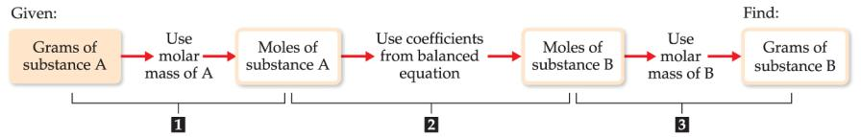
Chapter 4: Chemical Bonding and Chemical Reactions
4.1 Reaction Stoichiometry
Write balanced chemical equation
Convert quantities of known substances into moles
Use coefficients in balanced equation to calculate the number of moles of the sought quantity
Convert moles of sought quantity into desired units

Slide 5
Example:
Chapter 4: Chemical Bonding and Chemical Reactions
4.1 Reaction Stoichiometry
If 856g of C₆H₁₂O₆ is consumed by a person over a certain period, what is the mass of CO₂ produced?
C₆H₁₂O₆(s) + 6 O₂(g) → 6 CO₂(g) + 6 H₂O(l)
1- Write balanced chemical equation:
C₆H₁₂O₆(s) + 6 O₂(g) → 6 CO₂(g) + 6 H₂O(l)
2- Convert quantities of known substances into moles:
convert grams of C₆H₁₂O₆ → moles of C₆H₁₂O₆
Balanced!

Slide 6
Example:
Chapter 4: Chemical Bonding and Chemical Reactions
4.1 Reaction Stoichiometry
If 856g of C₆H₁₂O₆ is consumed by a person over a certain period, what is the mass of CO₂ produced?
C₆H₁₂O₆(s) + 6 O₂(g) → 6 CO₂(g) + 6 H₂O(l)
3- Use coefficients in balanced equation to calculate the number of moles of the sought quantity → mole ratio (from the balanced equation):
1 mole C₆H₁₂O₆ → 6 mole CO₂
4.754 mole C₆H₁₂O₆ → ? mole CO₂

Slide 7
Example:
Chapter 4: Chemical Bonding and Chemical Reactions
4.1 Reaction Stoichiometry
If 856g of C₆H₁₂O₆ is consumed by a person over a certain period, what is the mass of CO₂ produced?
C₆H₁₂O₆(s) + 6 O₂(g) → 6 CO₂(g) + 6 H₂O(l)
4-Convert moles of sought quantity into desired units:
convert the moles of CO₂ → grams of CO₂
Summary: grams of C₆H₁₂O₆ → moles of C₆H₁₂O₆ → moles of CO₂ → grams of CO₂
7

Slide 8
Example:
Chapter 4: Chemical Bonding and Chemical Reactions
4.1 Reaction Stoichiometry
How many grams of Li are needed to produce 9.89g of H₂?
Strategy:
grams of H₂ → moles of H₂ → moles of Li→ grams of Li
Solution:
1- Write balanced chemical equation:
2- convert grams of H₂ to moles of H₂
8

Slide 9
Example:
Chapter 4: Chemical Bonding and Chemical Reactions
4.1 Reaction Stoichiometry
How many grams of Li are needed to produce 9.89g of H₂?
Strategy:
grams of H₂ → moles of H₂ → moles of Li→ grams of Li
Solution:
3- Mole ratio (from the balanced equation) → Moles of Li
2 mole of Li → 1 mole H₂
?mole of Li → 4.927 mole H₂
→
4- Convert the moles of Li → grams of Li
9

Slide 10

Chapter 4: Chemical Bonding and Chemical Reactions
Chapter 4: Chemical Bonding and Chemical Reactions
4.1 Reaction Stoichiometry
Example:
Consider the combustion of carbon monoxide (CO) in oxygen gas: 2CO(g) + O₂(g) → 2CO₂(g) Starting with 3.60 moles of CO, calculate the number of moles of CO₂ produced if there is enough oxygen gas to react with all of the CO.
A. | 7.20 mol
B. | 44.0 mol
C. | 3.60 mol
D. | 1.80 mol
Notes:
c

Slide 11
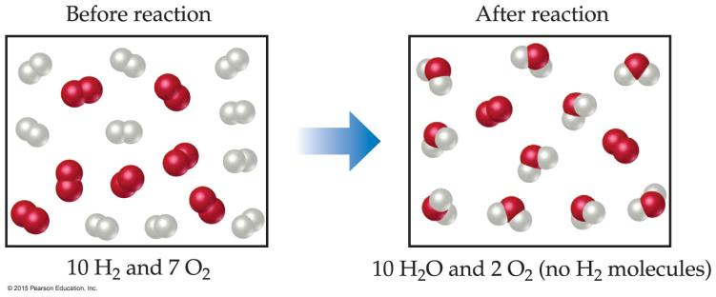
Chapter 4: Chemical Bonding and Chemical Reactions
4.2 Limitting reactant ( limiting Reagent):
The limiting reactant (الكاشف المحدد)is the reactant present in the smallest stoichiometric amount.
  In other words, it’s the reactant you’ll run out of first (in this case, the H₂).
In the example above, the O₂ would be the excess reagent (الكاشف الفائض).

Slide 12
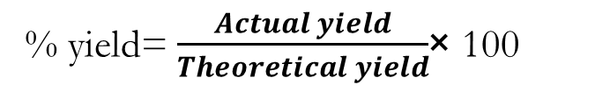
Chapter 4: Chemical Bonding and Chemical Reactions
4.2 Limitting reactant ( limiting Reagent):
The theoretical yield: is the amount of product that can be made in a chemical reaction based on the amount of limiting reactant.
The actual yield: is the amount of product actually produced by a chemical reaction.
% yield= $\frac{Actual yield}{Theoretical yield}$× 100

Slide 13
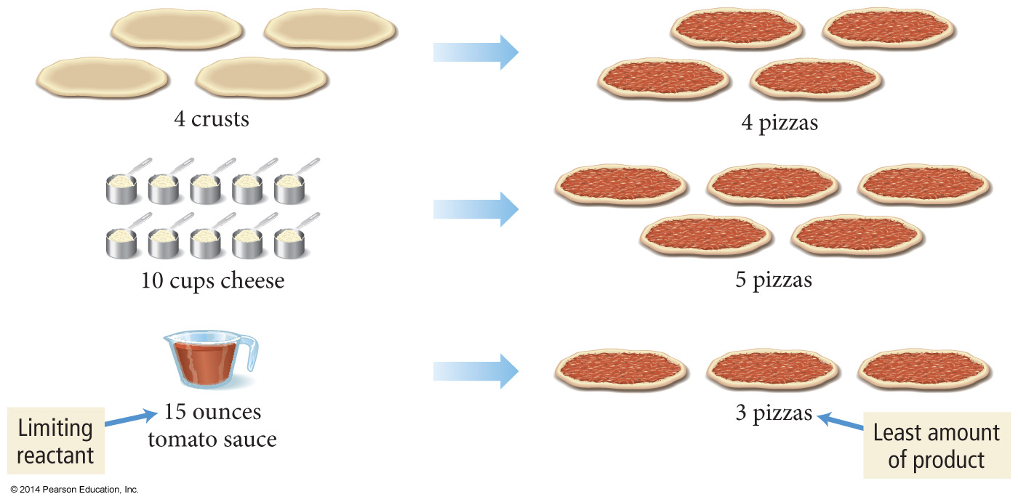
Chapter 4: Chemical Bonding and Chemical Reactions
4.2 Limitting reactant ( limiting Reagent):
Assume we use the following pizza recipe:
1 curst + 5 ounces tomato sauce + 2 cups cheese → 1 pizza
Suppose that we have 4 crust, 10 cups of cheese, and 15 ounces of tomato sauce.
How many pizza can we make?

Slide 14
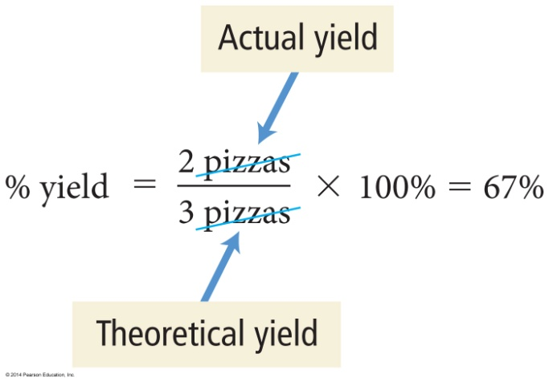
Chapter 4: Chemical Bonding and Chemical Reactions
4.2 Limitting reactant ( limiting Reagent):
The maximum number of pizzas we can make In chemical reactions, we call this the theoretical yield
Assume that while making pizzas, we burn a pizza, drop one on the floor, or other uncontrollable events happen so that we only make two pizzas.
The actual amount of product made in a chemical reaction is called the actual yield.
We can determine the efficiency of making pizzas by calculating the percentage of the maximum number of pizzas we actually make.
In chemical reactions, we call this the percent yield.

Slide 15
Chapter 4: Chemical Bonding and Chemical Reactions
4.2 Limitting reactant ( limiting Reagent):
Example 3.54 x10⁷g of TiCl₄ are reacted with 1.13x 10⁷g of Mg. Calculate the theoretical yield of Ti in grams ?
grams of TiCl₄ → moles of TiCl₄ → moles of Ti
Mole ratio:
1 mole TiCl₄ → 1 mole Ti
1.97 x10⁵ mole → ?n Ti
n(Ti) =1.87 x10⁵ mol
How to Identify the Limiting Reactant
كيف يتم تحديد الكاشف المحدد
1-حساب عدد المولات للمواد المتفاعلة وذلك بقسمة الوزن بالجرام على الكتلة المولارية
2- تقسم عدد مولات كل مادة متفاعلة على عدد مولاتها الموجودة في المعادلة.
3- المادة اللي تكون ناتجها أقل هي الكاشف المحدد.
4-حساب كمية المادة الناتجة بناء على الكاشف المحدد
5- يستخدم الكاشف المحدد لحساب كمية المادة الناتجة المطلوبة تبعا للمعادلة الموزونة

Slide 16
Chapter 4: Chemical Bonding and Chemical Reactions
4.2 Limitting reactant ( limiting Reagent):
Example 3.54 x10⁷g of TiCl₄ are reacted with 1.13x 10⁷g of Mg. Calculate the theoretical yield of Ti in grams ?
grams of Mg → moles of Mg → moles of Ti
Mole ratio:
2 mole Mg → 1 mole Ti
4.64 x10⁶ mole → ?n Ti
n(Ti) is the less number of moles (limiting reagent) = 1.87 x10⁵ mol
Moles of Ti → grams of Ti
mass of Ti = theoretical yield of Ti = m =nM

Slide 17
Chapter 4: Chemical Bonding and Chemical Reactions
4.2 Limitting reactant ( limiting Reagent):
Example: Nitrogen dioxide NO₂ can be synthesized by the reaction:
N₂(g) + 2 O₂(g) → 2 NO₂(g)
Starting with 46.3 g N₂ and 92.0 g O₂, find the theoretical yield of NO₂ in grams.
*grams of N₂ → moles of N₂ → moles of NO₂
Mole ratio:
1 mole N₂ → 2 mole NO₂
1.65 mole → ?n NO₂
n(NO₂) =3.307 mol
*grams of O₂→ moles of O₂ → moles of NO₂
Mole ratio:
2 mole O₂ → 2 mole NO₂
2.87 mole → ?n NO₂
n(NO₂)=2.87 mol
n(NO₂) is limiting reagent = 2.87 mol
Moles of NO₂ → grams of NO₂
mass of NO₂ = theoretical yield of NO₂ = m =nM

Slide 18
Chapter 4: Chemical Bonding and Chemical Reactions
4.3 Concentration of solutions (Molarity and Dilution )
The solution (المحلول)is a homogenous mixture of 2 or more substances
The solute (المذاب)is(are) the substance(s) present in the smaller amount(s)
The solvent(المذيب) is the substance present in the larger amount and the majority component of a solution.
Solution
Solvent
Solute
Soft drink (l)
H₂O
Sugar, CO₂

Slide 19
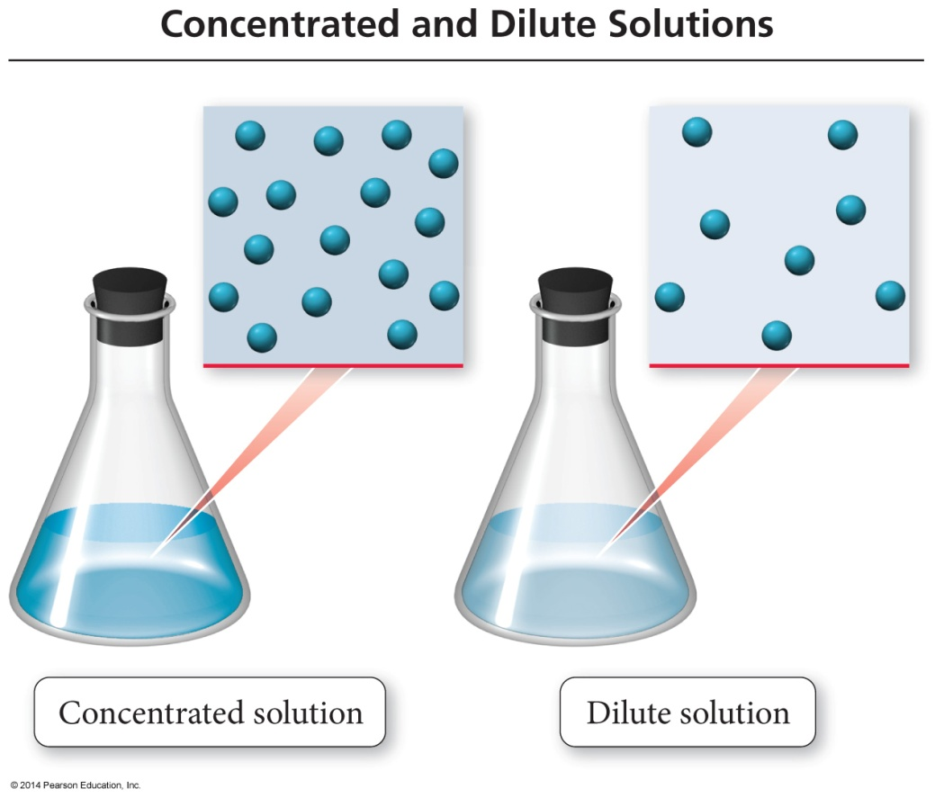
Chapter 4: Chemical Bonding and Chemical Reactions
4.3 Concentration of solutions (Molarity and Dilution )
Solutions are often described quantitatively, as dilute or concentrated.
Concentrated solutions have a large amount of solute compared to solvent.
Dilute solutions have a small amount of solute compared to solvent.

Slide 20
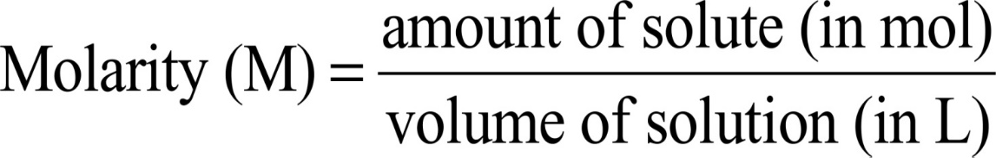
Chapter 4: Chemical Bonding and Chemical Reactions
4.3 Concentration of solutions (Molarity and Dilution )
A common way to express solution concentration is molarity (M).
  Molarity is the amount of solute (in moles) divided by the volume of solution (in liters).
n (amount of solute) = M (molarity) × V (L)

Slide 21
Chapter 4: Chemical Bonding and Chemical Reactions
4.3 Concentration of solutions (Molarity and Dilution )
Example
1-What is the molarity of an 85 ml ethanol C₂H₅OH solution containing 1.77g of ethanol?
Molar mass C₂H₅OH
M = 46.068 g/mol OR M.wt = 46.068 g/mol
m (g) = M.wt × M × V (L)
1.77 g = (46.068 g/mol )× M × (85 ml/1000L)
M = 0.452 M

Slide 22
Chapter 4: Chemical Bonding and Chemical Reactions
4.3 Concentration of solutions (Molarity and Dilution )
Example
2-What is the volume (in ml) of 0.315M NaOH solution contains 6.22g of NaOH?
Molar mass NaOH= 40 g/mol
m (g) = M.wt × M × V (L)
6.22 g = (40 g/mol )× (0.315 M)× V
V = 0.4937 L
V = (0.4937 × 1000) = 493.7 mL ≈ 494 mL

Slide 23
Chapter 4: Chemical Bonding and Chemical Reactions
4.3 Concentration of solutions (Molarity and Dilution )
3-What mass of KI is required to make 500 mL of a 2.80 M KI solution?
m (g) = M.wt × M × V (L)
M.wt of KI = 39.10 + 126.9
= 166 g
m = (166 g/mol)× 2.80 (M)× (500 ml/1000 L)
m = 232.4 g

Slide 24
Chapter 4: Chemical Bonding and Chemical Reactions
4.3 Concentration of solutions (Molarity and Dilution )
Often, solutions are stored as concentrated stock solutions.
To make solutions of lower concentrations from these stock solutions, more solvent is added.
  The amount of solute doesn’t change, just the volume of solution:
  moles solute in solution 1 = moles solute in solution 2
The concentrations and volumes of the stock and new solutions are inversely proportional:
M₁∙V₁ = M₂∙V₂
قبل التخفيف
بعد التخفيف

Slide 25
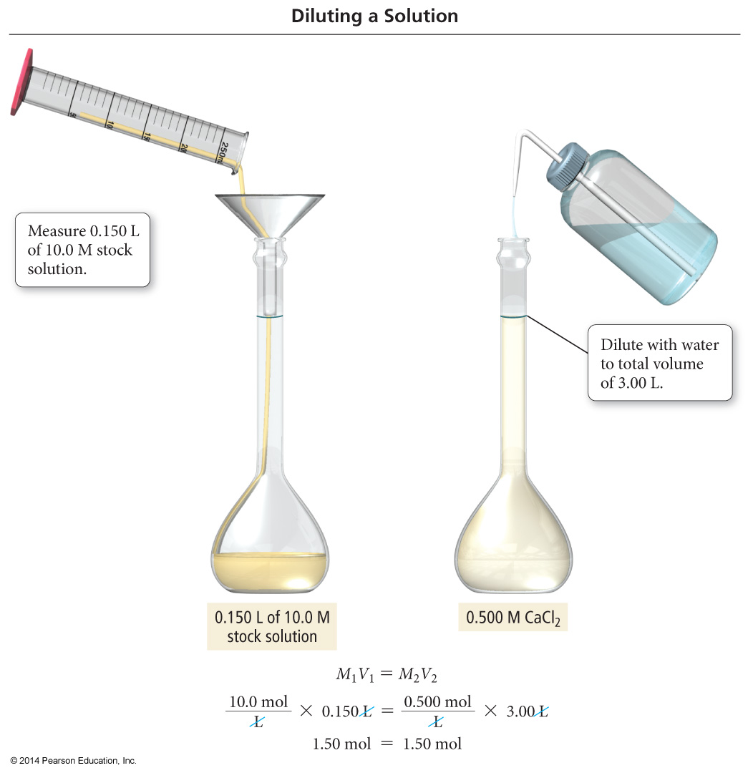
Chapter 4: Chemical Bonding and Chemical Reactions
4.3 Concentration of solutions (Molarity and Dilution )

Slide 26
Chapter 4: Chemical Bonding and Chemical Reactions
4.3 Concentration of solutions (Molarity and Dilution )
Example:
1-How would you prepare 60.0 mL of 0.200 M HNO₃ from a stock solution of 4.00 M HNO₃?
M_{i}V_{i} = M_{f}V_{f}
M₁ = 4.00
M₂ = 0.200
V₂ = 0.06 L
V₁ = ? L
The units of V₁ & V₂ must be the same (ml or L)
M₂V₂
0.200 x 0.06
V₁ =
=
= 0.003 L = 3 mL
M₁
4.00
3 mL of acid
+ 57 mL of water
= 60 mL of solution

Slide 27
Chapter 4: Chemical Bonding and Chemical Reactions
4.3 Concentration of solutions (Molarity and Dilution )
Example:
2-How many mL of 5.0 M K₂Cr₂O₇ solution must be diluted to prepare 250 mL of 0.10 M solution?
V₁ = ?
M₁ = 5.0M
V₂ = 250 mL
M₂ = 0.10M
M₁
=
M₂V₂ / V₁
V₁ = 250 ml ×0.1M /5ml = 5 ml

Slide 28
Chapter 4: Chemical Bonding and Chemical Reactions
4.3 Concentration of solutions (Molarity and Dilution )
Example:
3- If 10.0 mL of a 10.0 M stock solution of NaOH is diluted to 250 mL, what is the concentration of the resulting solution?
M₂= ?
V₁= 10.0 mL
M₁ = 10.0M
V₂ = 250 mL
M₁
=
M₂V₂/V₁
M₁ = 10ml ×10M /250ml = 0.4 M

Slide 29
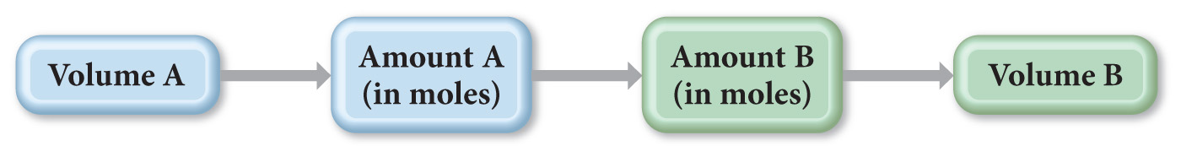
Chapter 4: Chemical Bonding and Chemical Reactions
4.3 Concentration of solutions (Molarity and Dilution )
since molarity relates the moles of solute to the liters of solution
it can be used to convert between amount of reactants and/or products in a chemical reaction

Slide 30
Chapter 4: Chemical Bonding and Chemical Reactions
4.3 Concentration of solutions (Molarity and Dilution )
Example:
What volume of 0.150 M KCl is required to completely react with 0.150 L of 0.175 M Pb(NO₃)₂ :
2 KCl(aq) + Pb(NO₃)₂(aq) → PbCl₂(s) + 2 KNO₃(aq)

Slide 31
Chapter 4: Chemical Bonding and Chemical Reactions
4.3 Concentration of solutions (Molarity and Dilution )
Example:
What volume of 0.150 M KCl is required to completely react with 0.150 L of 0.175 M Pb(NO₃)₂ :
2 KCl(aq) + Pb(NO₃)₂(aq) → PbCl₂(s) + 2 KNO₃(aq)
litter of Pb(NO₃)₂→ moles of Pb(NO₃)₂ → moles of KCl → litter of Pb(NO₃)₂
1- find mole of Pb(NO₃)₂
3- find volume of KCl
2-find mole of KCl (Mole ratio):
1 mole Pb(NO₃)₂ → 1 mole KCl
0.026 mole → ? mole KCl
n(KCl) =0.052mol

Slide 32
Chapter 4: Chemical Bonding and Chemical Reactions
H.W
Page: 116-117
2 (A), 5(B and C), 7 (A), 13 (B and C)

Slide 33
Chapter 4: Chemical Bonding and Chemical Reactions
4.4. Types of Aqueous Solutions and Solubility
Consider two familiar aqueous solutions: salt water and sugar water.
  Salt water is a homogeneous mixture of NaCl and H₂O.
  Sugar water is a homogeneous mixture of C₁₂H₂₂O₁₁ and H₂O.
As you stir either of these two substances into the water, it seems to disappear.
  How do solids such as salt and sugar dissolve in water?

Slide 34
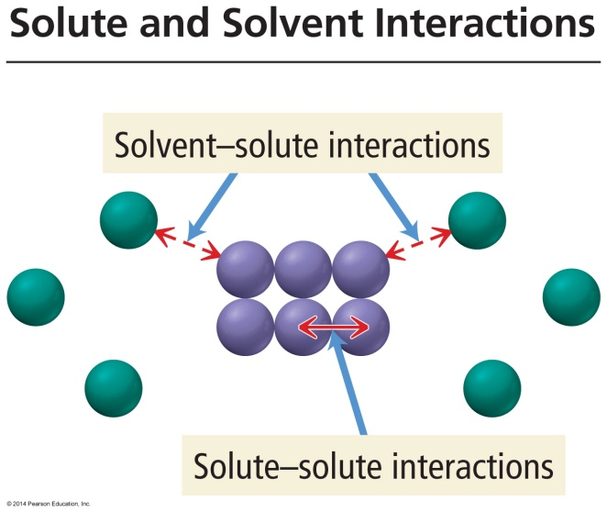
Chapter 4: Chemical Bonding and Chemical Reactions
4.4. Types of Aqueous Solutions and Solubility
What Happens When a Solute Dissolves?
There are attractive forces between the solute particles holding them together.
There are also attractive forces between the solvent molecules.
When we mix the solute with the solvent, there are attractive forces between the solute particles and the solvent molecules.
If the attractions between solute and solvent are strong enough, the solute will dissolve.

Slide 35
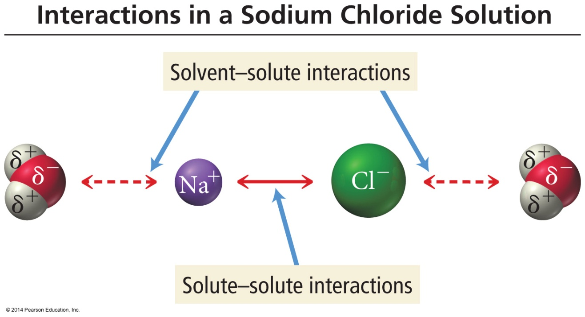
Chapter 4: Chemical Bonding and Chemical Reactions
4.4. Types of Aqueous Solutions and Solubility
Solute And Solvent Interactions In A Sodium Chloride Solution
When sodium chloride is put into water, the attraction of Na⁺ and Cl– ions to water molecules competes.
with the attraction among the oppositely charged ions themselves.

Slide 36
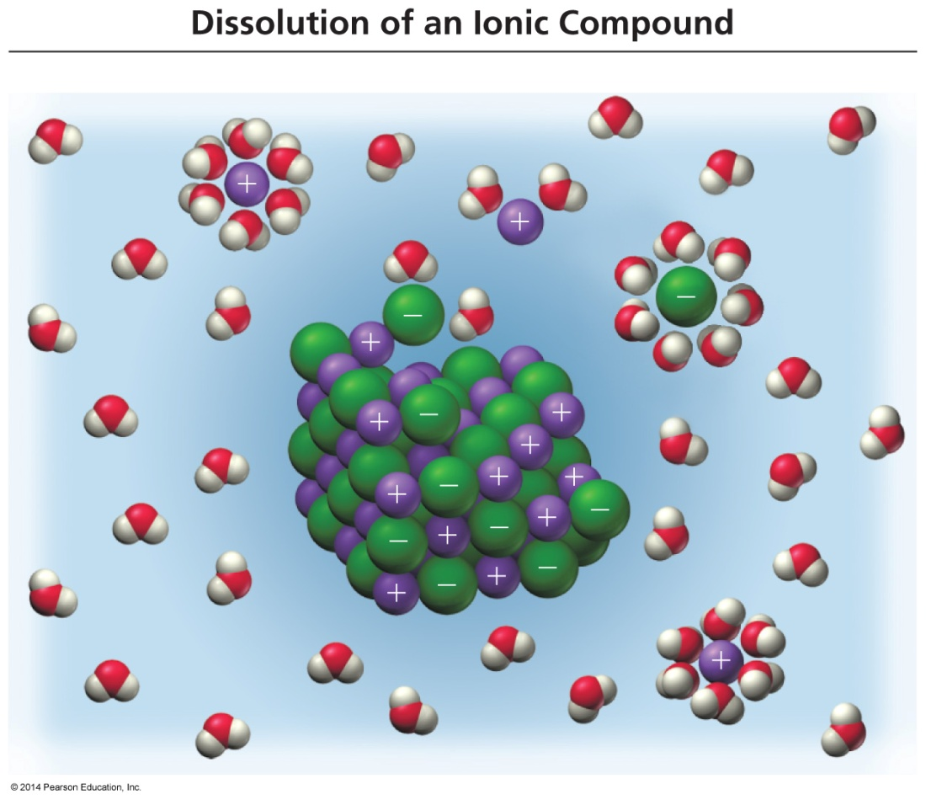
Chapter 4: Chemical Bonding and Chemical Reactions
4.4. Types of Aqueous Solutions and Solubility
Sodium Chloride Dissolving in Water
Each ion is attracted to the surrounding water molecules and pulled off and away from the crystal.
When it enters the solution, the ion is surrounded by water molecules, insulating it from other ions.
The result is a solution with free moving charged particles able to conduct electricity.

Slide 37
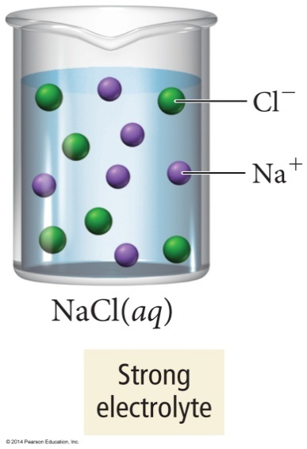
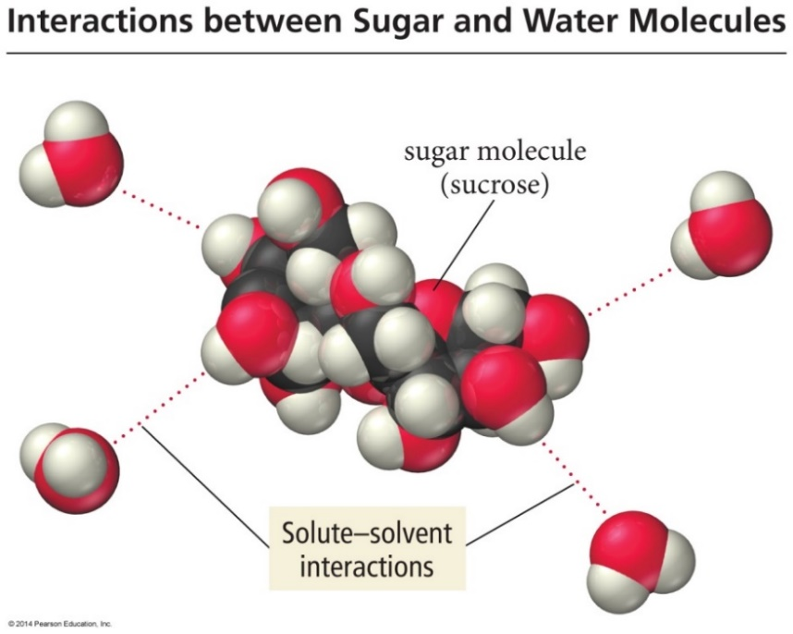
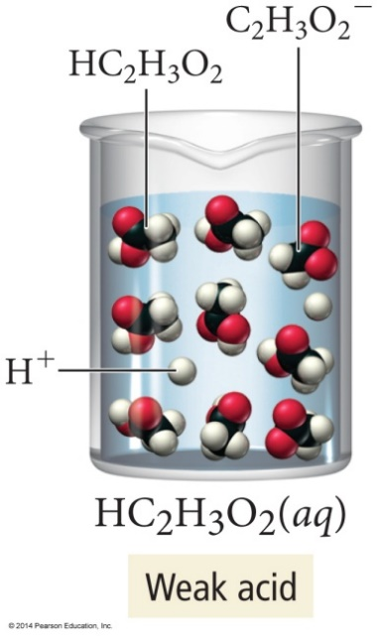
Electrolyte And Nonelectrolyte Solutions
Chapter 4: Chemical Bonding and Chemical Reactions
4.4. Types of Aqueous Solutions and Solubility
Ionic substances such as sodium chloride that completely dissociate into ions when they dissolve in water are strong electrolytes.
In contrast to sodium chloride, sugar is a molecular compound.
Most molecular compounds (except for acids), dissolve in water as intact molecules.

Slide 38
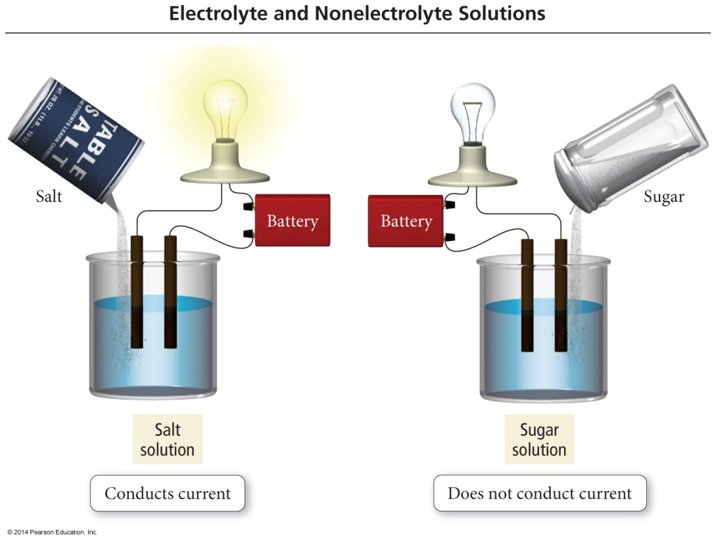
Electrolyte And Nonelectrolyte Solutions
Chapter 4: Chemical Bonding and Chemical Reactions
4.4. Types of Aqueous Solutions and Solubility
Materials that dissolve in water to form a solution that will conduct electricity are called electrolytes.
Materials that dissolve in water to form a solution that will not conduct electricity are called nonelectrolytes.
A solution of salt (an electrolyte) conducts electrical current. A solution of sugar (a nonelectrolyte) does not.

Slide 39
Chapter 4: Chemical Bonding and Chemical Reactions
4.4. Types of Aqueous Solutions and Solubility
Acids are molecular compounds that ionize when they dissolve in water.
  The molecules are pulled apart by their attraction for the water.
  When acids ionize, they form H⁺ cations and also anions.
The percentage of molecules that ionize varies from one acid to another.
Acids that ionize virtually 100% are called strong acids.
HCl(aq) → H⁺(aq) + Cl⁻(aq)
Acids that only ionize a small percentage are called weak acids.
HF(aq) ⇔ H⁺(aq) + F⁻(aq)

Slide 40
Chapter 4: Chemical Bonding and Chemical Reactions
4.4. Types of Aqueous Solutions and Solubility
Strong electrolytes are materials that dissolve completely as ions.
  Ionic compounds and strong acids
  Solutions conduct electricity well
Weak electrolytes are materials that dissolve mostly as molecules, but partially as ions.
  Weak acids
  Solutions conduct electricity, but not well
When compounds containing a polyatomic ion dissolve, the polyatomic ion stays together.
HC₂H₃O₂(aq) ⇔ H⁺(aq) + C₂H₃O₂⁻(aq)

Slide 41
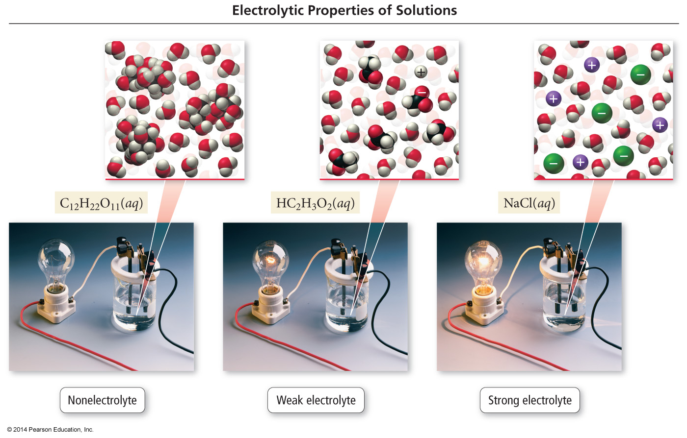
Classes Of Dissolved Materials
Chapter 4: Chemical Bonding and Chemical Reactions
4.4. Types of Aqueous Solutions and Solubility

Slide 42
Chapter 4: Chemical Bonding and Chemical Reactions
4.4. Types of Aqueous Solutions and Solubility
Strong acids and bases
Soluble ionic compounds
Weak acids and bases
Insoluble ionic compounds
Strong electrolytes
Weak electrolytes
Non-electrolytes
Molecular compound

Slide 43
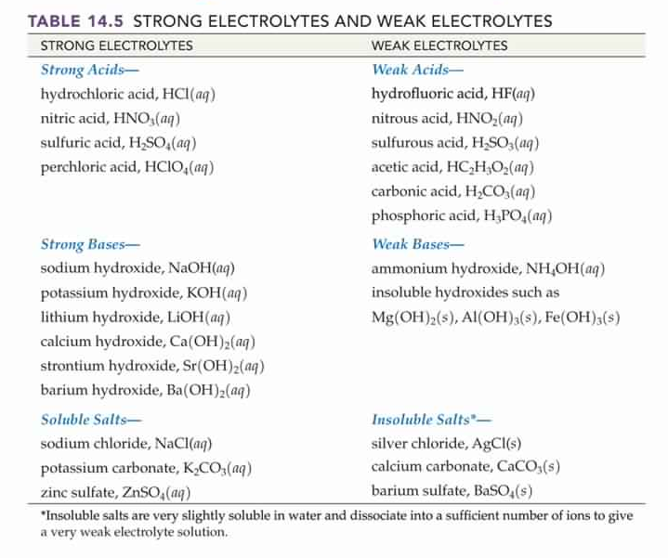
Chapter 4: Chemical Bonding and Chemical Reactions
4.4. Types of Aqueous Solutions and Solubility

Slide 44
Chapter 4: Chemical Bonding and Chemical Reactions
4.4. Types of Aqueous Solutions and Solubility
1-Which of the following is considered a strong electrolyte?
A) NH₄NO₃
B) C₁₂H₂₂O₁₂
C) PbCl₂
D) HC₂H₃O₂
2-Which of the following is not a strong electrolyte?
A) CaS
B) LiSO₄
C) NH₄OH
D) CH₃CH₂CH₃

Slide 45
Chapter 4: Chemical Bonding and Chemical Reactions
4.4. Types of Aqueous Solutions and Solubility
1-Which of the following is considered a strong electrolyte?
A) NH₄NO₃
B) C₁₂H₂₂O₁₂
C) PbCl₂
D) HC₂H₃O₂
2-Which of the following is not a strong electrolyte?
A) CaS
B) LiSO₄
C) NH₄OH
D) CH₃CH₂CH₃

Slide 46
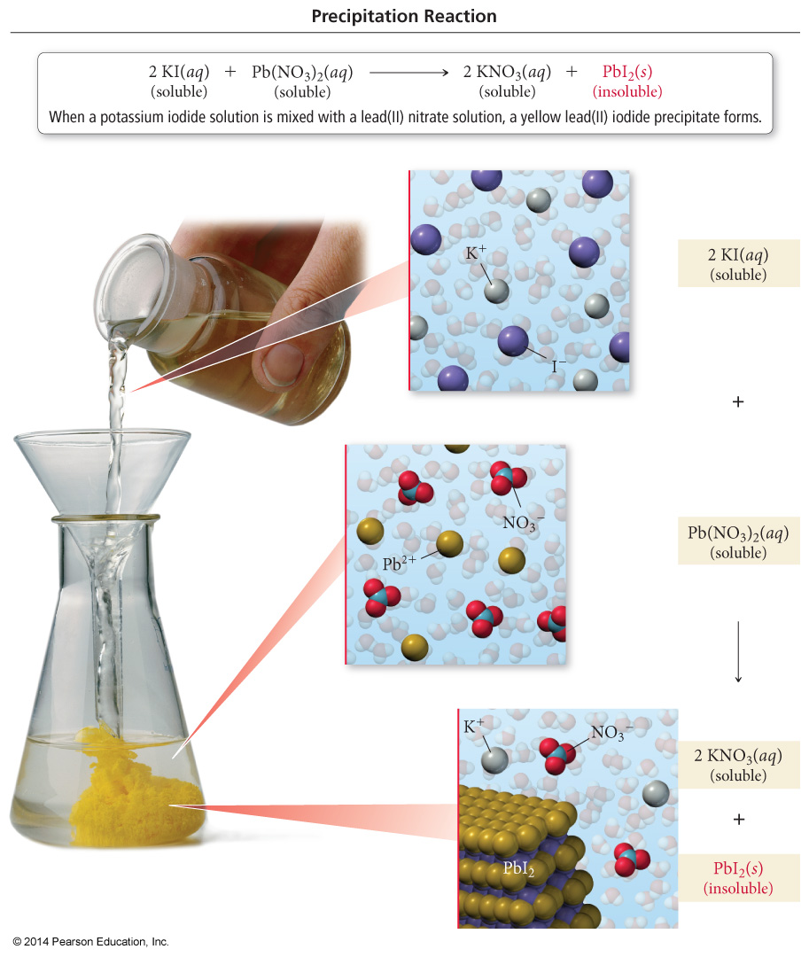
Chapter 4: Chemical Bonding and Chemical Reactions
4.5 Precipitation Reactions
Precipitation of Lead(II) Iodide
Precipitation reactions are reactions in which a solid forms when we mix two solutions.
  Reactions between aqueous solutions of ionic compounds produce an ionic compound that is insoluble in water.
  The insoluble product is called a precipitate.

Slide 47
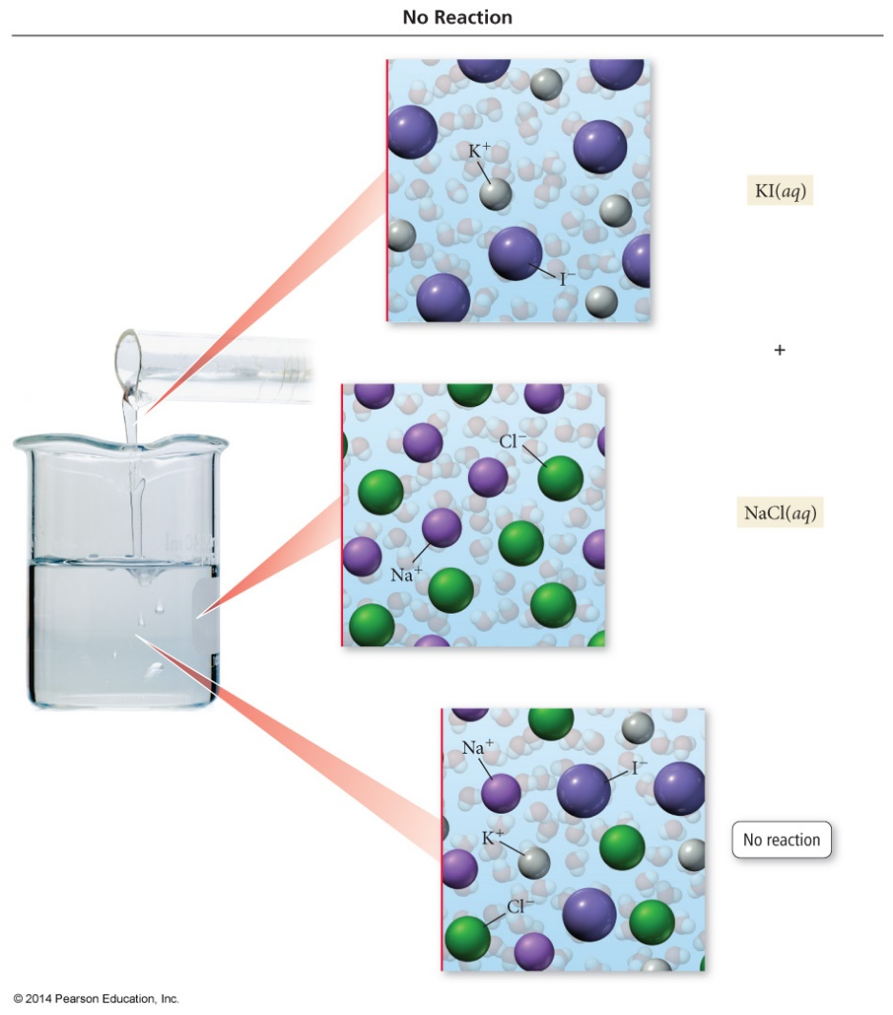
No Precipitation Means No Reaction
Chapter 4: Chemical Bonding and Chemical Reactions
4.5 Precipitation Reactions
Precipitation reactions do not always occur when two aqueous solutions are mixed.
  Combine solutions of KI and NaCl and nothing happens.
KI(aq) + NaCl(aq) → No Reaction

Slide 48
Predicting Precipitation Reactions
Chapter 4: Chemical Bonding and Chemical Reactions
4.5 Precipitation Reactions
1. Determine what ions each aqueous reactant has.
2. Determine formulas of possible products.
  Exchange ions.
    (+) ion from one reactant with (–) ion from other
  Balance charges of combined ions to get the formula of each product.
3. Determine solubility of each product in water.
  Use the solubility rules.
  If product is insoluble or slightly soluble, it will precipitate.
If neither product will precipitate, write no reaction after the arrow.
5. If any of the possible products are insoluble, write their formulas as the products of the reaction using (s) after the formula to indicate solid. Write any soluble products with (aq) after the formula to indicate aqueous.
6. Balance the equation.
  Remember to only change coefficients, not subscripts.

Slide 49
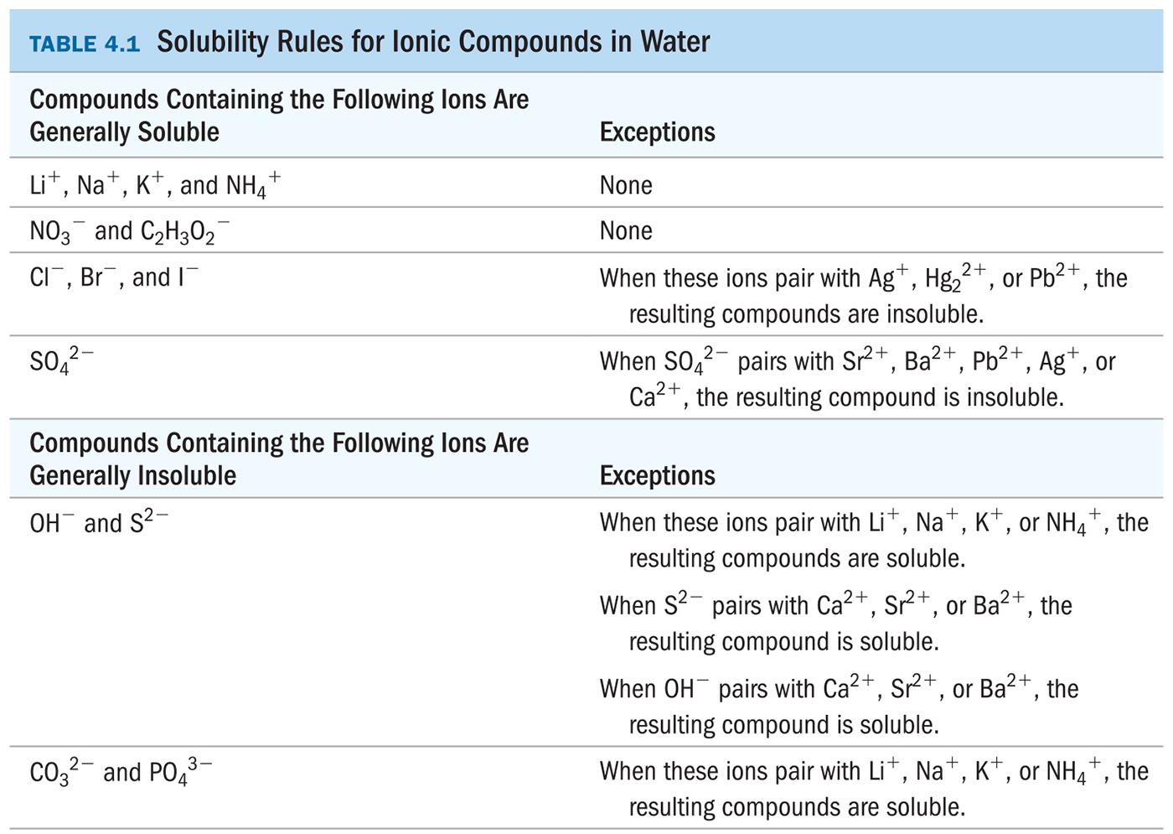
Predicting Precipitation Reactions
Chapter 4: Chemical Bonding and Chemical Reactions
4.5 Precipitation Reactions

Slide 50
Example 4.7 p93: write equations for Precipitation Reactions:
Chapter 4: Chemical Bonding and Chemical Reactions
4.5 Precipitation Reactions
K₂CO₃(aq)+NiCl₂ (aq) → ?

Slide 51
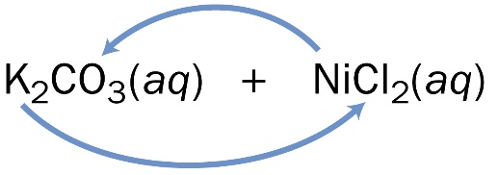
Example 4.7 p93: write equations for Precipitation Reactions:
Chapter 4: Chemical Bonding and Chemical Reactions
4.5 Precipitation Reactions
K₂CO₃(aq)+NiCl₂ (aq) → ?
1-Determine the possible products
a)Determine the ions present
  (K⁺ + CO₃²⁻) + (Ni²⁺ + Cl⁻) →
  b)Exchange the Ions
  Write the formulas of the products cross charges and reduce
  K₂CO₃(aq) + NiCl₂(aq) → KCl + NiCO₃
2-Determine the solubility of each product
  KCl is soluble
  NiCO₃ is insoluble
3- Write (aq) next to soluble products and (s) next to insoluble products
K₂CO₃(aq) + NiCl₂(aq) → KCl(aq) + NiCO₃(s)
4- Balance the Equation
K₂CO₃(aq) + NiCl₂(aq) → 2 KCl(aq) + NiCO₃(s)
→ (K⁺ + Cl⁻) + (Ni²⁺ + CO₃²⁻)

Slide 52
Example :
1-write equations for Precipitation Reactions:
NO reaction
Chapter 4: Chemical Bonding and Chemical Reactions
4.5 Precipitation Reactions
NaNO₃(aq)+LiSO₄ (aq) → ?
2-Which of the following pairs of aqueous solutions will react to produce a precipitate?
A) NH₄NO₃ + Li₂CO₃ → NO reaction
B) Hg₂(NO₃)₂ + 2LiI → Hg₂I₂ +2LiNO₃
C) NaCl + Li₃PO₄ → NO reaction
D) AgC₂H₃O₂ + Cu(NO₃)₂ → NO reaction

Slide 53
Chapter 4: Chemical Bonding and Chemical Reactions
4.6 Representing Aqueous Reactions
1-Molecular Equation.
An equation showing the complete neutral formulas for each compound in the aqueous reaction as if they existed as molecules is called a molecular equation.
2 KOH(aq) + Mg(NO₃)₂(aq) → 2 KNO₃(aq) + Mg(OH)₂(s)
In actual solutions of soluble ionic compounds, dissolved substances are present as ions. Equations that describe the material’s structure when dissolved are called complete ionic equations.

Slide 54
2-Ionic Equation
Chapter 4: Chemical Bonding and Chemical Reactions
4.6 Representing Aqueous Reactions
Rules of writing the complete ionic equation:
  Aqueous strong electrolytes are written as ions.
    Soluble salts, strong acids, strong bases
  Insoluble substances, weak electrolytes, and nonelectrolytes are written in molecule form.
    Solids, liquids, and gases are not dissolved, hence molecule form
2 K⁺_{(aq)} + 2 OH⁻_{(aq)} + Mg²⁺_{(aq)} + 2 NO₃⁻_{(aq)} → 2 K⁺_{(aq)} + 2 NO₃⁻_{(aq)} + Mg(OH)_{2(s)}

Slide 55
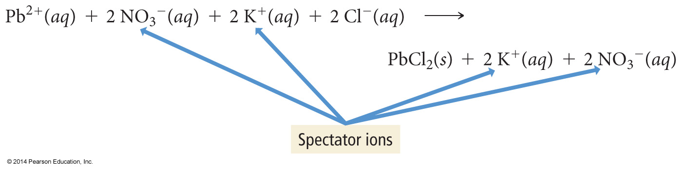
2-Ionic Equation
Chapter 4: Chemical Bonding and Chemical Reactions
4.6 Representing Aqueous Reactions
Notice that in the complete ionic equation, some of the ions in solution appear unchanged on both sides of the equation.
These ions are called spectator ions because they do not participate in the reaction.

Slide 56
Chapter 4: Chemical Bonding and Chemical Reactions
4.6 Representing Aqueous Reactions
3-Net Ionic Equation
An ionic equation in which the spectator ions are removed is called a net ionic equation.
2 K⁺_{(aq)} + 2 OH⁻_{(aq)} + Mg²⁺_{(aq)} + 2 NO₃⁻_{(aq)} → 2 K⁺_{(aq)} + 2 NO₃⁻_{(aq)} + Mg(OH)_{2(s)}
2 OH⁻_{(aq)} + Mg²⁺_{(aq)} → Mg(OH)_{2(s)}

Slide 57
Examples
Chapter 4: Chemical Bonding and Chemical Reactions
4.6 Representing Aqueous Reactions
Write the ionic and net ionic equation for each of the following:
1. K₂SO₄(aq) + 2 AgNO₃(aq) → 2 KNO₃(aq) + Ag₂SO₄(s)
2. Na₂CO₃(aq) + 2 HCl(aq) → 2 NaCl(aq) + CO₂(g) + H₂O(l)

Slide 58
Examples
Chapter 4: Chemical Bonding and Chemical Reactions
4.6 Representing Aqueous Reactions
Write the ionic and net ionic equation for each of the following:
1. K₂SO₄(aq) + 2 AgNO₃(aq) → 2 KNO₃(aq) + Ag₂SO₄(s)
2 K⁺(aq) + SO₄²⁻(aq) + 2 Ag⁺(aq) + 2 NO₃⁻(aq) → 2 K⁺(aq) + 2 NO₃⁻(aq) + Ag₂SO₄(s)
2 Ag⁺(aq) + SO₄²⁻(aq) → Ag₂SO₄(s)
Na₂CO₃(aq) + 2 HCl(aq) → 2 NaCl(aq) + CO₂(g) + H₂O(l)
2 Na⁺(aq) + CO₃²⁻(aq) + 2 H⁺(aq) + 2 Cl⁻(aq) → 2 Na⁺(aq) + 2 Cl⁻(aq) + CO₂(g) + H₂O(l)
CO₃²⁻(aq) + 2 H⁺(aq) → CO₂(g) + H₂O(l)

Slide 59
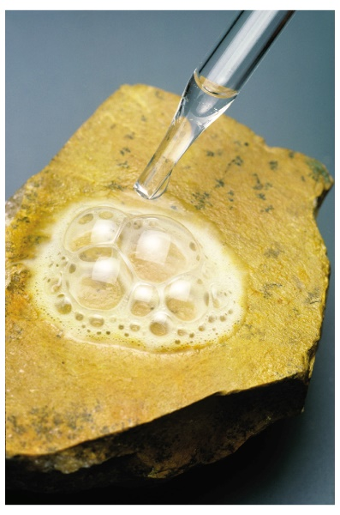
Chapter 4: Chemical Bonding and Chemical Reactions
4.8. Acid–Base and Gas-Evolution Reactions
Classes of reactions that occur in aqueous solution are:
  1.acid–base reactions
  2. gas-evolution reactions.
1-Acid–base Reaction:
  An acid–base reaction is also called a neutralization reaction.
  An acid reacts with a base and the two neutralize each other, producing water.
  2-Gas-evolution reactions
  In a gas-evolution reaction, a gas forms, resulting in bubbling.
In both acid–base and gas-evolution reactions the reactions occur when the anion from one reactant combines with the cation of the other.
  Many gas-evolution reactions are also acid–base reactions.

Slide 60
1- Acid–base Reactions
Chapter 4: Chemical Bonding and Chemical Reactions
4.8. Acid–Base and Gas-Evolution Reactions
Arrhenius Definitions:
Base: Substance that produces OH⁻ ions in aqueous solution.
  NaOH(aq) → Na⁺(aq) + OH–(aq)
Acid: Substance that produces H⁺ ions in aqueous solution.
  HCl(aq) →H⁺(aq) + Cl–(aq)
  Some acids—called polyprotic acids
    These acids contain more than one ionizable proton and release them sequentially.
    Example, sulfuric acid, H₂SO₄ is a diprotic acid.
    H₂SO₄ aq) →H⁺(aq) + HSO₄– (aq)
    HSO₄– aq) ↔H⁺(aq) + SO₄²⁻ (aq)

Slide 61
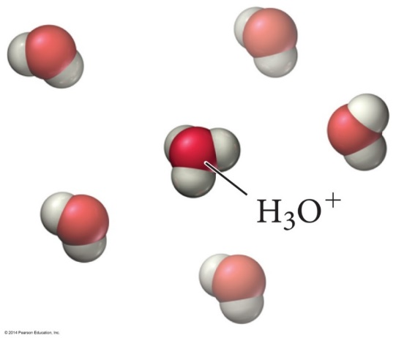
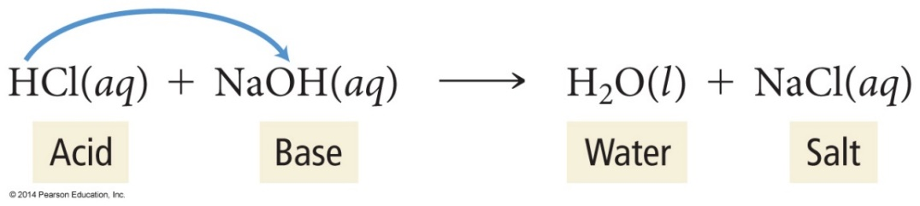
1- Acid–base Reactions
Chapter 4: Chemical Bonding and Chemical Reactions
4.8. Acid–Base and Gas-Evolution Reactions
The H from the acid molecule is donated to a water molecule to form hydronium ion, H₃O⁺.
In the reaction of an acid with a base, the H⁺ from the acid combines with the OH⁻ from the base to make water.
The cation from the base combines with the anion from the acid to make the salt.

Slide 62
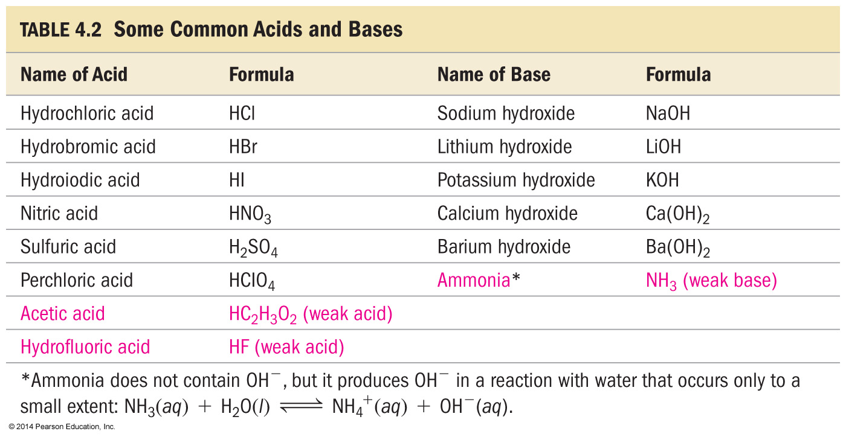
1- Acid–base Reactions
Chapter 4: Chemical Bonding and Chemical Reactions
4.8. Acid–Base and Gas-Evolution Reactions

Slide 63
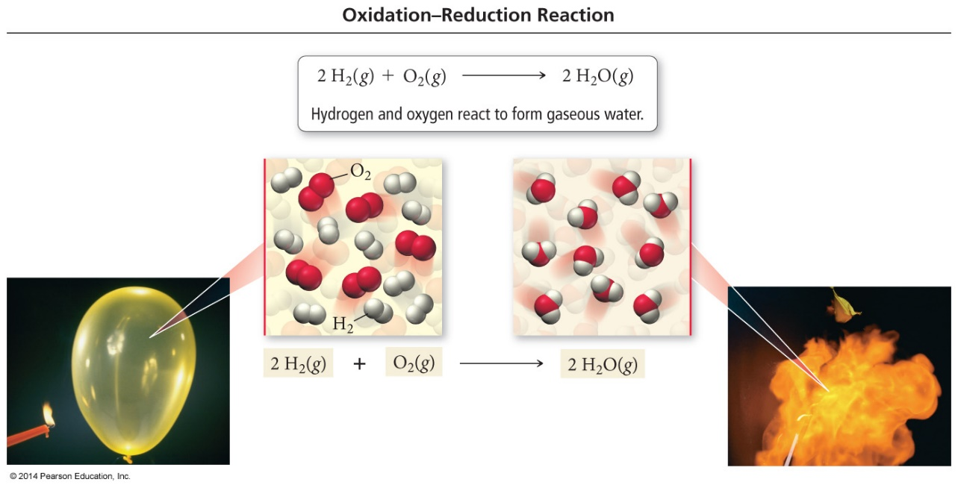
Chapter 4: Chemical Bonding and Chemical Reactions
4.8. Oxidation–Reduction Reactions
The reactions in which electrons are transferred from one reactant to the other are called oxidation-reduction reactions. (redox reactions)
  Many redox reactions involve the reaction of a substance with oxygen.
  Example:
  4 Fe(s) + 3 O₂(g) → 2 Fe₂O₃(s) (rusting)
  2 H₂(g) + O₂(g) → 2 H₂O(g)

Slide 64
Chapter 4: Chemical Bonding and Chemical Reactions
4.8. Oxidation–Reduction Reactions
Consider the following reactions:
4 Na(s) + O₂(g) → 2 Na₂O(s)
2 Na(s) + Cl₂(g) → 2 NaCl(s)
The reactions involve a metal reacting with a nonmetal.
In addition, both reactions involve the conversion of free elements into ions.
4 Na(s) + O₂(g) → 2 Na⁺₂O^{2–} (s)
2 Na(s) + Cl₂(g) → 2 Na⁺Cl–(s)

Slide 65
Chapter 4: Chemical Bonding and Chemical Reactions
4.8. Oxidation–Reduction Reactions
The transfer of electrons does not need to be a complete transfer (as occurs in the formation of
an ionic compound) for the reaction to qualify as oxidation–reduction.
  For example, consider the reaction between hydrogen gas and chlorine gas:
  H₂(g) + Cl₂(g) →2 HCl(g)
When hydrogen bonds to chlorine, the electrons are unevenly shared, resulting in
    an increase of electron density (reduction) for chlorine
    a decrease in electron density (oxidation) for hydrogen.

Slide 66
Chapter 4: Chemical Bonding and Chemical Reactions
4.8. Oxidation–Reduction Reactions
To convert a free element into an ion, the atoms must gain or lose electrons.
Reactions where electrons are transferred from one atom to another are redox reactions.
Atoms that lose electrons are being oxidized (اكسدة)
while atoms that gain electrons are being reduced (أختزال)
2 Na(s) + Cl₂(g) → 2 Na⁺Cl–(s)
Na → Na⁺ + 1 e– (oxidation)
Cl₂ + 2 e– → 2 Cl– (reduction)

Slide 67
Chapter 4: Chemical Bonding and Chemical Reactions
Oxidation States
For reactions that are not metal + nonmetal, or do not involve O₂, we need a method for determining how the electrons are transferred?
Chemists assign a number to each element in a reaction called an oxidation state that allows them to determine the electron flow in the reaction.
  Even though they look like them, oxidation states are not ion charges!
    Oxidation states are imaginary charges assigned based on a set of rules.
    Ion charges are real, measurable charges.

Slide 68
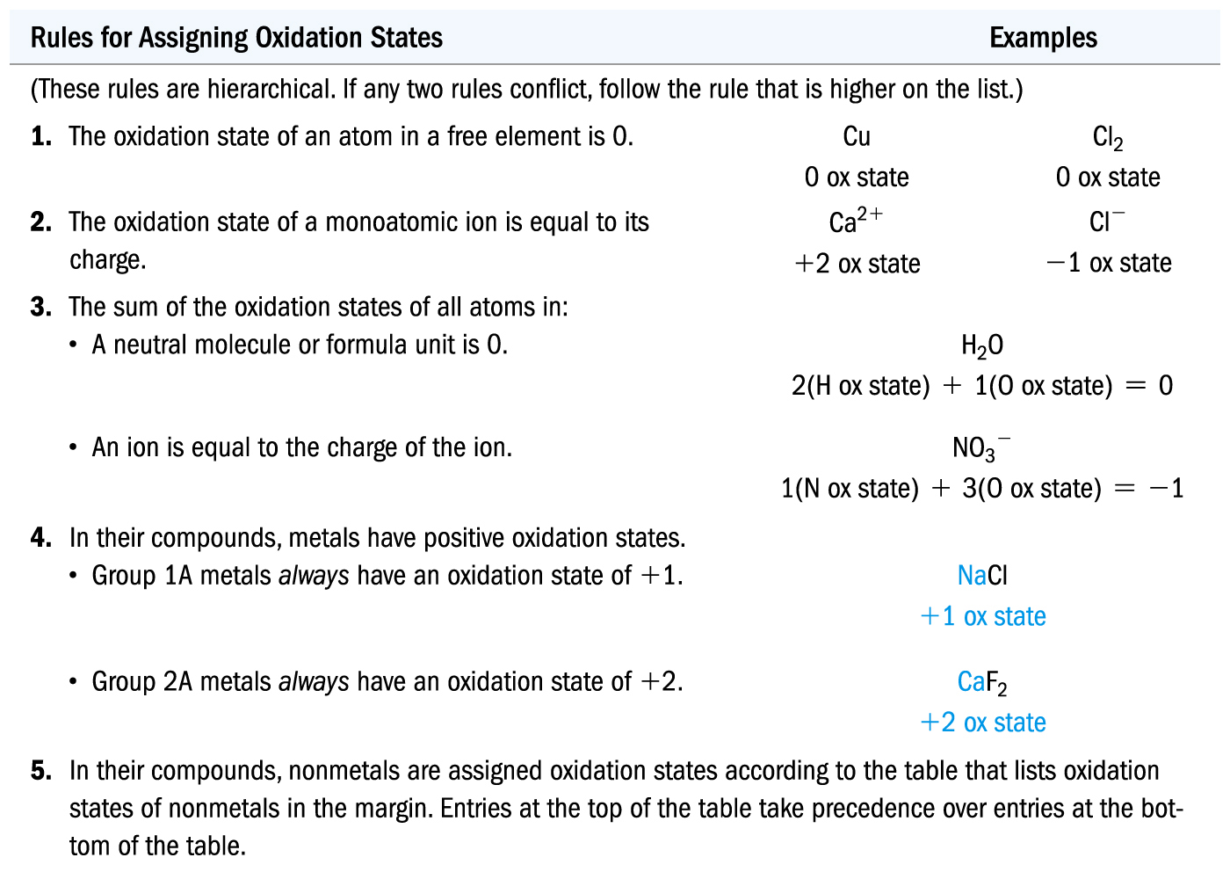
Chapter 4: Chemical Bonding and Chemical Reactions
Oxidation States

Slide 69
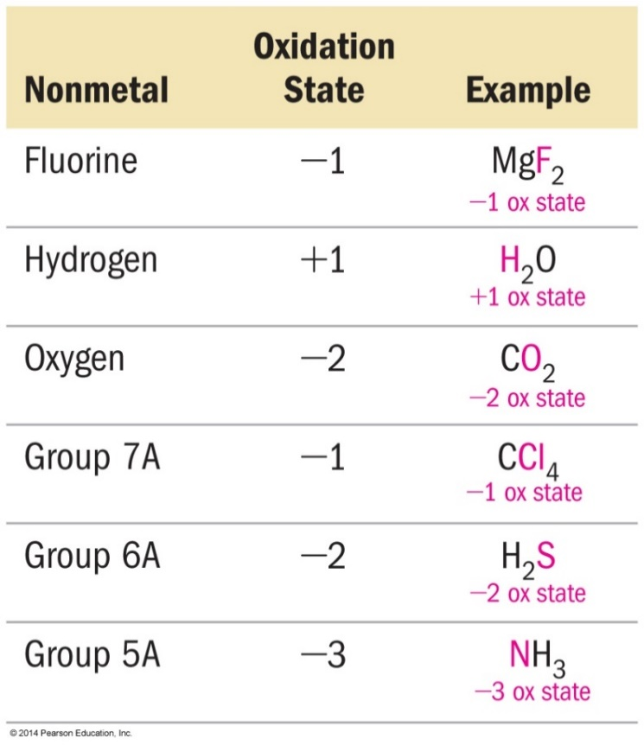
Chapter 4: Chemical Bonding and Chemical Reactions
4.8. Oxidation–Reduction Reactions

Slide 70
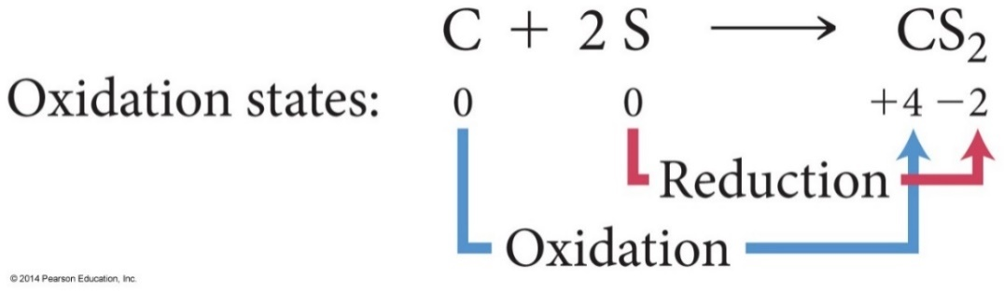
Chapter 4: Chemical Bonding and Chemical Reactions
Identifying Redox Reactions
Oxidation: An increase in oxidation state
Reduction: A decrease in oxidation state
  Carbon changes from an oxidation state of 0 to an oxidation state of +4.
    Carbon loses electrons and is oxidized.
  Sulfur changes from an oxidation state of 0 to an oxidation state of –2.
    Sulfur gains electrons and is reduced.

Slide 71
Chapter 4: Chemical Bonding and Chemical Reactions
Identifying Redox Reactions
Oxidation and reduction must occur simultaneously.
  If an atom loses electrons another atom must take them.
The reactant that reduces an element in another reactant is called the reducing agent.
  The reducing agent contains the element that is oxidized.
The reactant that oxidizes an element in another reactant is called the oxidizing agent.
  The oxidizing agent contains the element that is reduced.
  Example:
2 Na(s) + Cl₂(g) → 2 Na⁺Cl–(s)
Na is oxidized, while Cl is reduced.
Na is the reducing agent, and Cl₂ is the oxidizing agent.

Slide 72
Chapter 4: Chemical Bonding and Chemical Reactions
H.W
Page: 117
21, 23(a,d), 24(a), 25(a),30 (a,b,c,d), 32(b)

Slide 73
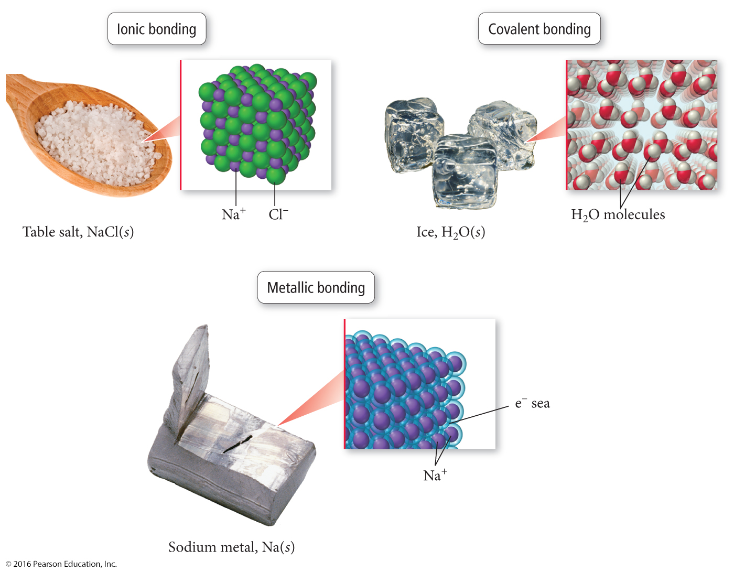
Chapter 4: Chemical Bonding and Chemical Reactions
4.9 Types of Chemical Bonds
Chemical bond is the force that holds the atoms together in a molecule,
Types of Chemical Bonds
ionic bond
covalent bond
metallic bonding

Slide 74
Chapter 4: Chemical Bonding and Chemical Reactions
4.9 Types of Chemical Bonds
Type of Bond | Types of Atoms | Bond Characteristic
Ionic | Metals + Nonmetals | Electrons transferred
Covalent | Nonmetals +Nonmetals Nonmetals + Metalloid | Electrons shared
Metallic | Metal + Metal | Electron pooled

Slide 75
Chapter 4: Chemical Bonding and Chemical Reactions
4.9 Types of Chemical Bonds
1-Ionic bond
When a metal atom loses electrons it becomes a cation.
Metals have low ionization energy, making it relatively easy to remove electrons from them.
When a nonmetal atom gains electrons it becomes an anion.
Nonmetals have high electron affinities, making it advantageous to add electrons to these atoms.
The oppositely charged ions are then attracted to each other, resulting in an ionic bond.

Slide 76
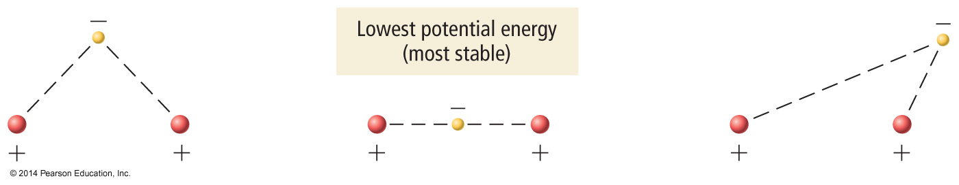
Chapter 4: Chemical Bonding and Chemical Reactions
4.9 Types of Chemical Bonds
2- covalent bond:
Nonmetal atoms have relatively high ionization energies, so it is difficult to remove electrons from them.
When nonmetals bond together, it is better in terms of potential energy for the atoms to share valence electrons.
  Potential energy is lowest when the electrons are between the nuclei.
Shared electrons hold the atoms together by attracting nuclei of both atoms.

Slide 77
Chapter 4: Chemical Bonding and Chemical Reactions
4.9 Types of Chemical Bonds
3- Metallic bond:
The relatively low ionization energy of metals allows them to lose electrons easily.
The simplest theory of metallic bonding involves the metal atoms releasing their valence electrons to be shared as a pool by all the atoms/ions in the metal.
  An organization of metal cation islands in a sea of electrons
  Electrons delocalized throughout the metal structure
Bonding results from attraction of cation for the delocalized electrons.

Slide 78

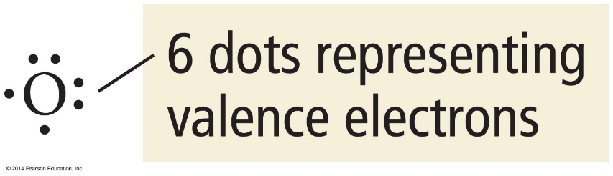
Chapter 4: Chemical Bonding and Chemical Reactions
4.10 Lewis Dot Symbols نظام النقط للويس
Lewis Dot Representation: the valence electrons of an atom are represented by dots.
The Octet Rule القاعدة الثمانية : atoms usually gain, lose or share electrons until they have 8 in the outer shell to reach the same electronic configuration of the noble gasses (ns2 np6).
H
Cl
H
Cl
•
Lone pair
bonding pair

Slide 79
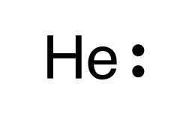
Chapter 4: Chemical Bonding and Chemical Reactions
4.10 Lewis Dot Symbols نظام النقط للويس
Exception:
He = two valence electrons, a duet.
Lewis structural of He is always paired
Because n=1 fills with 2 electrons.

Slide 80
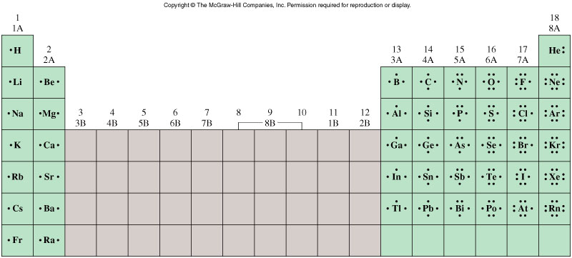
Chapter 4: Chemical Bonding and Chemical Reactions
4.10 Lewis Dot Symbols نظام النقط للويس

Slide 81
Chapter 4: Chemical Bonding and Chemical Reactions
4.10 Lewis Dot Symbols نظام النقط للويس
1-The Lewis dot symbol for the chloride ion is
write the electron configuration of atom or ion
2-The Lewis dot symbol for the lead atom is
determine the valence electrons
3-The Lewis dot symbol for the calcium ion is
draw the Lewis dot structure
Ca²⁺
4-The Lewis dot symbol for the S²⁻ ion is

Slide 82
Chapter 4: Chemical Bonding and Chemical Reactions
4.10 Lewis Dot Symbols نظام النقط للويس
1-The Lewis dot symbol for the chloride ion is
write the electron configuration of atom or ion
2-The Lewis dot symbol for the lead atom is
determine the valence electrons
3-The Lewis dot symbol for the calcium ion is
draw the Lewis dot structure
Ca²⁺
4-The Lewis dot symbol for the S²⁻ ion is

Slide 83


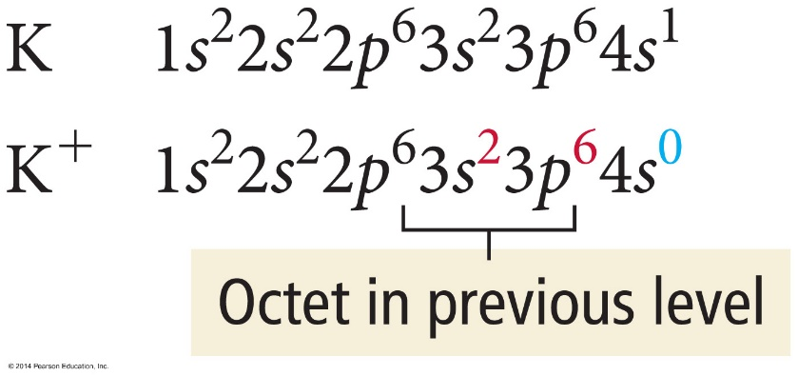
Chapter 4: Chemical Bonding and Chemical Reactions
4.11 Ionic bonding:
In Lewis theory, we represent ionic bonding by moving electron dots from the metal to the nonmetal.
Example, potassium and chlorine have the Lewis structures:
When potassium and chlorine bond, potassium transfers its valence electron to chlorine

Slide 84


Chapter 4: Chemical Bonding and Chemical Reactions
4.11 Ionic bonding:
Example: The Lewis structures for sodium and sulfur are:
Sodium must lose one valence electron to obtain an octet,
while sulfur must gain two electrons to obtain an octet.
The compound that forms between Na and S requires two Na atoms to every one S atom.
The Lewis structure is:
The correct chemical formula is: Na₂S.

Slide 85
Chapter 4: Chemical Bonding and Chemical Reactions
4.11 Ionic bonding:
The ionization energy of the metal is endothermic.
  Na(s) → Na⁺(g) + 1 e ─ ΔH° = +496 kJ/mol
The electron affinity of the nonmetal is exothermic.
  ½Cl₂(g) + 1 e ─ → Cl─(g) ΔH° = −244 kJ/mol
The heat of formation of most ionic compounds is exothermic and generally large.
  Na(s) + ½Cl₂(g) → NaCl(s) ΔH°_{f} = −411 kJ/mol

Slide 86
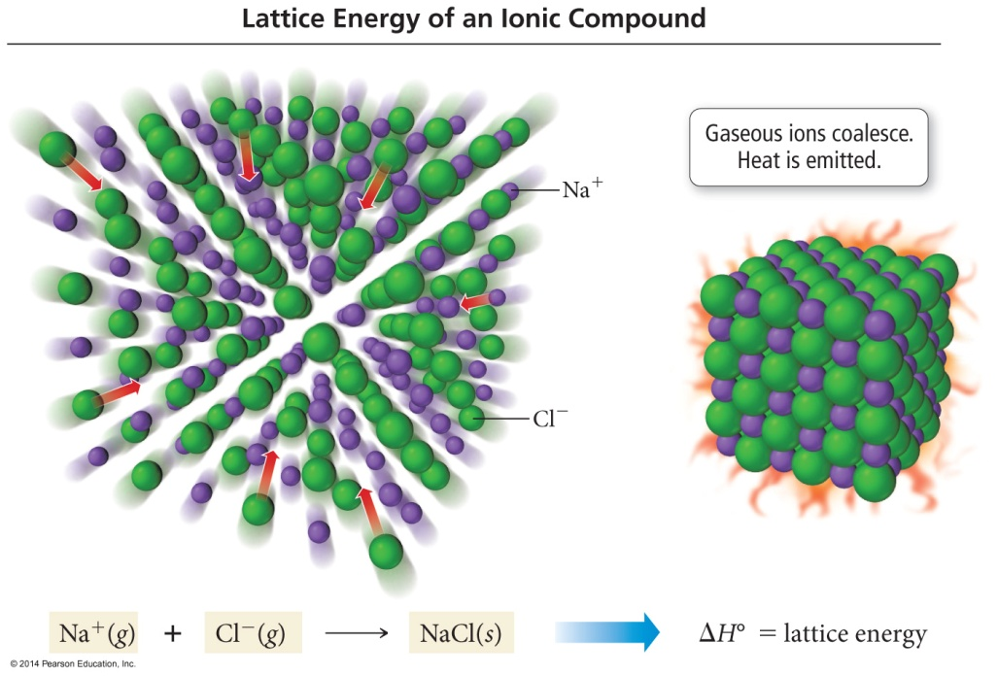
Chapter 4: Chemical Bonding and Chemical Reactions
4.11 Ionic bonding:
The extra energy that is released comes from the formation of a structure in which every cation is surrounded by anions, and vice versa.
This structure is called a crystal lattice.
The crystal lattice is held together by the electrostatic attraction of the cations for all the surrounding anions.
Electrostatic attraction is nondirectional

Slide 87
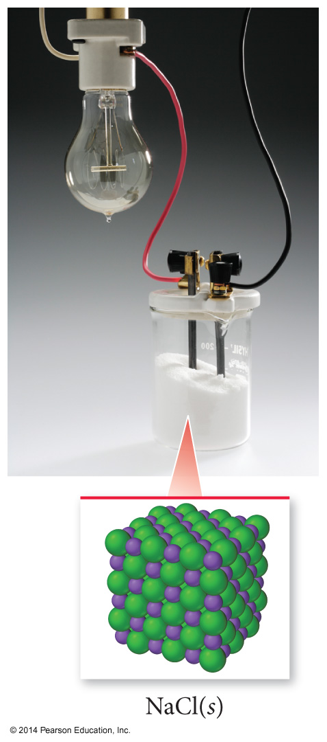
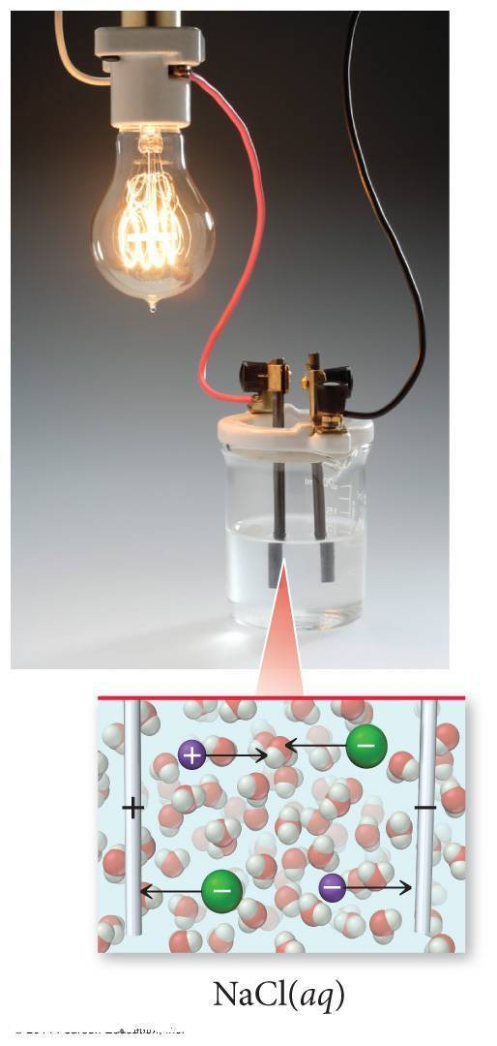
Chapter 4: Chemical Bonding and Chemical Reactions
4.11 Ionic bonding:
Conductivity of NaCl
In NaCl(s), the ions are stuck in position and not allowed to move to the charged rods.
In NaCl(aq), the ions are separated and allowed to move to the charged rods.

Slide 88
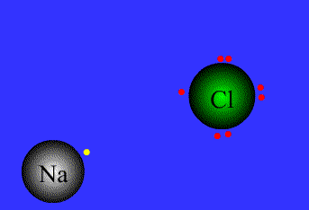

Slide 89
Chapter 4: Chemical Bonding and Chemical Reactions
4.15 bonding in metals
The low ionization energy of metals allows them to lose electrons easily.
The simplest theory of metallic bonding involves the metal atoms releasing their valence electrons to be shared by all atoms/ions in the metal.
  An organization of metal cation islands in a sea of electrons
  Electrons delocalized throughout the metal structure
Bonding results from attraction of the cations for the delocalized electrons.

Slide 90
Chapter 4: Chemical Bonding and Chemical Reactions
4.15 bonding in metals
Properties of metallic compound:
1- Metallic solids do conduct electricity well.
Because electrical conductivity takes place when charged particles (such as electrons) are able to move through the structure.
2-Metallic solids are malleable and ductile
3-Metallic solids do conduct heat well.

Slide 91
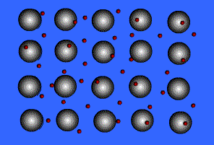
Chapter 4: Chemical Bonding and Chemical Reactions
4.15 bonding in metals

Slide 92
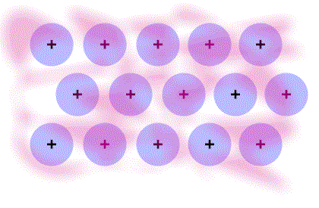
Chapter 4: Chemical Bonding and Chemical Reactions
4.15 bonding in metals

Slide 93
Chapter 4: Chemical Bonding and Chemical Reactions
H.W
Page: 117
35 (a,b), 36(a)

Slide 94
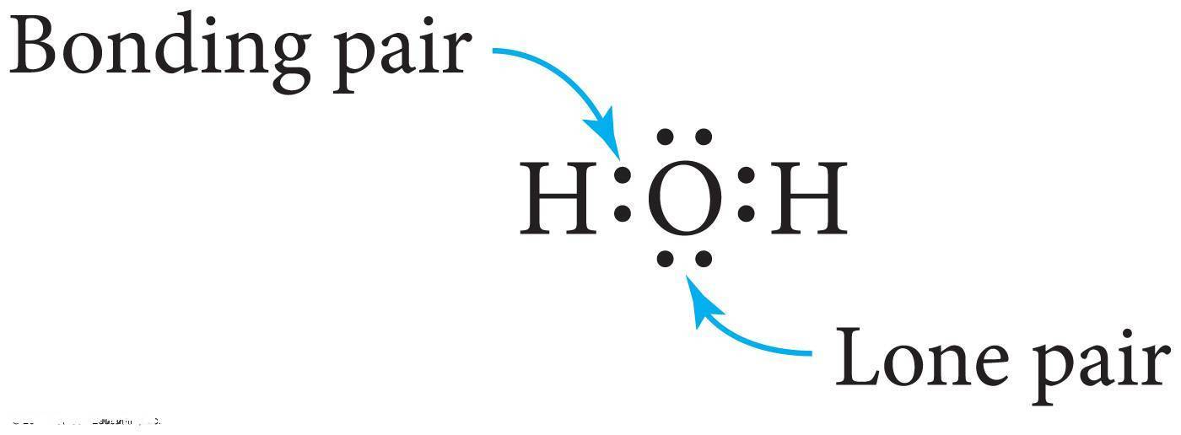
Chapter 4: Chemical Bonding and Chemical Reactions
4.12 Covalent Bonding
Valence electrons is to share their valence electrons with other atoms.
The shared electrons would then count toward each atom’s octet.
The sharing of valence electrons is called covalent bonding.
Electrons that are shared by atoms are called bonding pairs.
Electrons that are not shared by atoms but belong to a particular atom are called lone pairs.
  Also known as nonbonding pairs

Slide 95

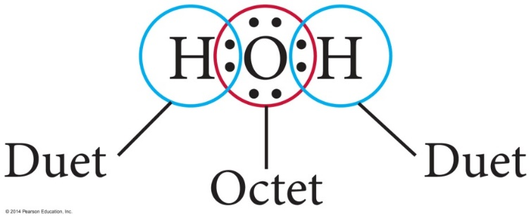

Chapter 4: Chemical Bonding and Chemical Reactions
4.12 Covalent Bonding
When two atoms share one pair of electrons, it is called a single covalent bond.
  Two electrons
One atom may use more than one single bond to fulfill its octet.
  To different atoms
  H only duet
or
H
O
H

Slide 96
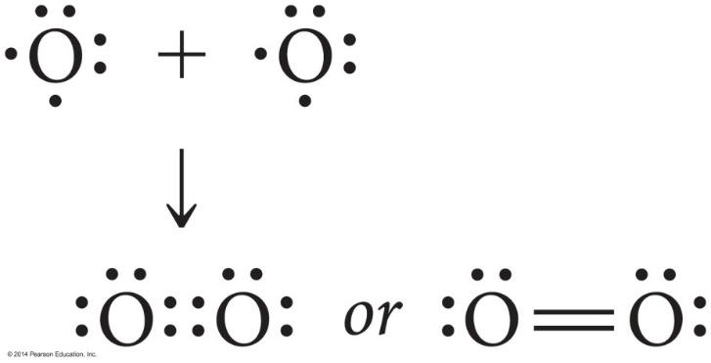

Chapter 4: Chemical Bonding and Chemical Reactions
4.12 Covalent Bonding
When two atoms share two pairs of electrons the result is called a double covalent bond.
  Four electrons
When two atoms share three pairs of electrons the result is called a triple covalent bond.
  Six electrons

Slide 97
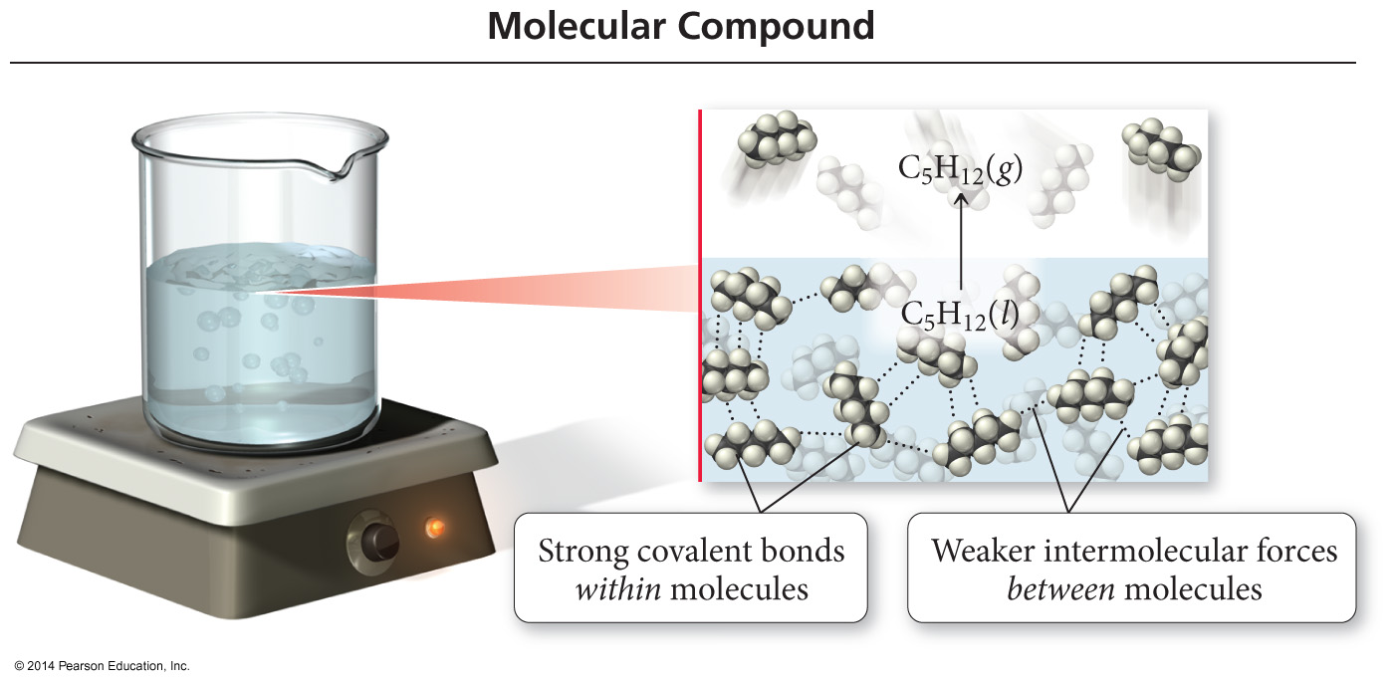
Chapter 4: Chemical Bonding and Chemical Reactions
4.12 Covalent Bonding
Lewis theory of covalent bonding implies that the attractions between atoms are directional.
  The shared electrons are most stable between the bonding atoms.
Therefore, Lewis theory predicts covalently bonded compounds will be found as individual molecules.
  Rather than an array like ionic compounds
Compounds of nonmetals are made of individual molecule units.

Slide 98
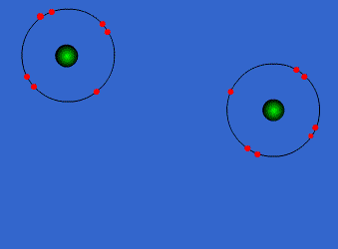
Covalent Bonds

Slide 99
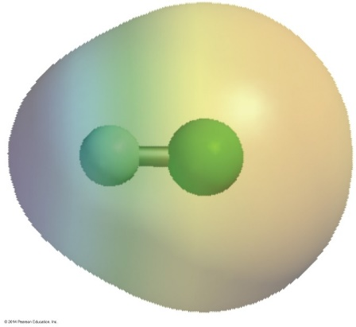
Chapter 4: Chemical Bonding and Chemical Reactions
4.13 Electronegativity and Bond Polarity:
Covalent bonding between unlike atoms results in unequal sharing of the electrons.
  One atom pulls the electrons in the bond closer to its side.
  One end of the bond has larger electron density than the other.
The result is a polar covalent bond.
  Bond polarity
  The end with the larger electron density gets a partial negative charge.
  The end that is electron deficient gets a partial positive charge.
δ+
δ−
•
•
H F
or H−F

Slide 100
Chapter 4: Chemical Bonding and Chemical Reactions
4.13 Electronegativity and Bond Polarity:
The ability of an atom to attract bonding electrons to itself is called electronegativity.
Increases across period (left to right) and decreases down group (top to bottom)
  Fluorine is the most electronegative element.
  Francium is the least electronegative element.
  Noble gas atoms are not assigned values.
  Opposite of atomic size trend.
The larger the difference in electronegativity, the more polar the bond.
  Negative end toward more electronegative atom.

Slide 101

Chapter 4: Chemical Bonding and Chemical Reactions

Slide 102

Chapter 4: Chemical Bonding and Chemical Reactions
General Trend in Electronegativity
Increasing Electronegativity
Decreasing Electronegativity

Slide 103

Chapter 4: Chemical Bonding and Chemical Reactions
4.13 Electronegativity and Bond Polarity:
If the difference in electronegativity between bonded atoms is 0, the bond is pure covalent.
If the difference in electronegativity between bonded atoms is 0.1 to 0.4, the bond is nonpolar covalent.
If the difference in electronegativity between bonded atoms is 0.5 to 1.9, the bond is polar covalent.
If difference in electronegativity between bonded atoms is larger than or equal to 2.0, it will be ionic.

Slide 104

Chapter 4: Chemical Bonding and Chemical Reactions
4.13 Electronegativity and Bond Polarity:

Slide 105

Chapter 4: Chemical Bonding and Chemical Reactions
4.13 Electronegativity and Bond Polarity:
Dipole moment, μ, is a measure of bond polarity.
  A dipole is a material with a + and − end.
  it is directly proportional to the size of the partial charges and directly proportional to the distance between them.
    μ = (q)(r)
    Measured in Debyes, D
Generally, the more electrons two atoms share and the larger the atoms are, the larger the dipole moment.

Slide 106
Chapter 4: Chemical Bonding and Chemical Reactions
Example
Classify the following bonds as ionic, polar covalent, or covalent:
1-The bond in CsCl:
ΔEN of Cs= – 0.7
ΔEN of Cl= – 3.0
3.0 – 0.7 = 2.3
Ionic
2- The bond in H₂S
ΔEN of H = – 2.1
ΔEN of S= – 2.5
2.5 – 2.1 = 0.4
Non-Polar Covalent
3- The NN bond in H₂NNH₂
ΔEN of N= – 3.0
ΔEN of N= – 3.0
3.0 – 3.0 = 0
Covalent

Slide 107

Chapter 4: Chemical Bonding and Chemical Reactions
Which choice below correctly lists the elements in order of increasing electronegativity?
C < N < O < F
N < C < O < F
N < C < F < O
C < N < F < O
Increasing Electronegativity
Decreasing Electronegativity

Slide 108
Chapter 4: Chemical Bonding and Chemical Reactions
4.14. Bond energies and bond lengths
Chemical reactions involve breaking bonds in reactant molecules and making new bonds to create the products.
The ΔH°_{reaction} can be estimated by comparing the cost of breaking old bonds to the income from making new bonds.
The amount of energy it takes to break one mole of a bond in a compound is called the bond energy.
  Cl₂(g) → 2Cl(g) ΔH = 243 kJ/mol
  C≡C (837 kJ) > C═C (611 kJ) > C—C (347 kJ)

Slide 109

Chapter 4: Chemical Bonding and Chemical Reactions
4.14. Bond energies and bond lengths
Trends in Bond Energies
In general, the more electrons two atoms share, the stronger the covalent bond.
  Must be comparing bonds between like atoms
  C≡C (837 kJ) > C═C (611 kJ) > C—C (347 kJ)
  C≡N (891 kJ) > C ═ N (615 kJ) > C—N (305 kJ)
In general, the shorter the covalent bond, the stronger the bond.
  Must be comparing similar types of bonds
  Br—F (237 kJ) > Br—Cl (218 kJ) > Br—Br (193 kJ)
  Bonds get weaker down the column.
  Bonds get stronger across the period.

Slide 110


Chapter 4: Chemical Bonding and Chemical Reactions
4.14. Bond energies and bond lengths
Bond length is the distance between the nuclei of two bonded atoms.
Bond length depends on
  1- the size of the atoms in the bond.
    Length is measured in Angstroms. (1 Å = 1 × 10^{–2} pm)
  2- The electronegativity of the atoms in the bond.
  3-The number of electrons between the atoms.
      Single > double > triple
Increasing length
Decreasing length

Slide 111

Chapter 4: Chemical Bonding and Chemical Reactions
4.14. Bond energies and bond lengths

Slide 112
Chapter 4: Chemical Bonding and Chemical Reactions
H.W
Page: 118
42 (a,b), 44

