Slide 1

Chapter 7
Organic and Biological Chemistry

Slide 2
Chapter 7
Organic and Biological Chemistry
Page:175-189
7.1 Introduction
7.2 Alkenes alkynes and aromatic hydrocarbon
7.3 organic functional groups
7.4 Introduction to biochemistry
7.5 proteins
7.6 carbohydrates
7.7 lipids
7.8 Nucleic acids
Most of the next slides were quoted from Dr. Nuha Wazzan website

Slide 3
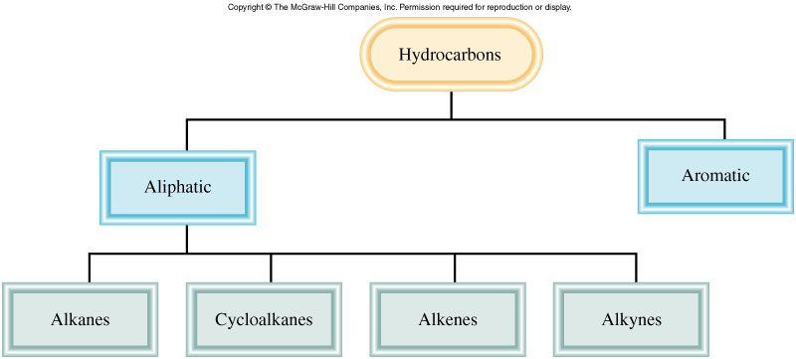
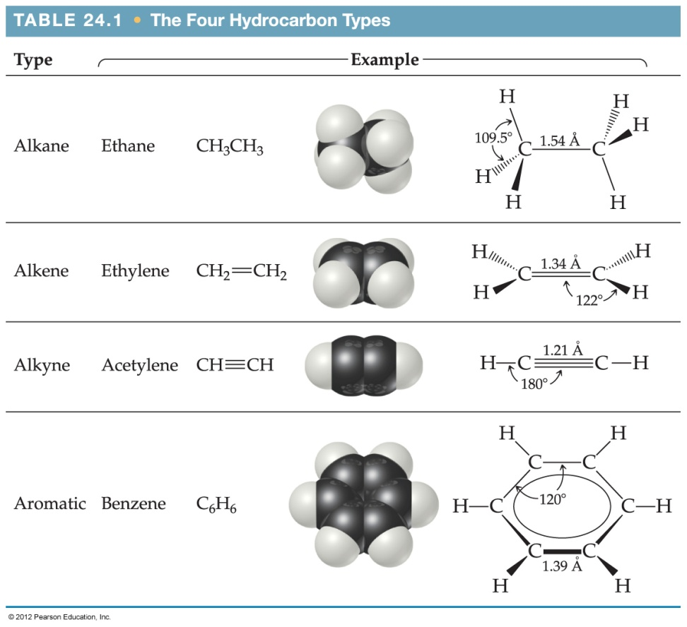
Classes of Organic Compounds
Chapter 7: Organic and Biological Chemistry
7.1 Introduction to hydrocarbons
Organic Chemistry: is the chemistry of carbon compounds.
Carbon has the ability to form long chains and ring structure.
Hydrocarbons: compounds made of carbon and hydrogen only
Do not contain benzene group
contain benzene group
أليفاتية
عطرية

Slide 4
Chapter 7: Organic and Biological Chemistry
7.1 Introduction to hydrocarbons
Nomenclature of Alkanes
Aliphatic hydrocarbons divided into:
1-Alkanes:
2-Cycloalkanes:
3-Alkenes:
4- Alkynes:
Only single covalent bonds are present,
alkanes whose carbon atoms are joined in rings,
contain at least one carbon-carbon double bond,
contain at least one carbon-carbon triple bond,
general formula
C_{n}H_{2n+2}, n = 1, 2, ….
general formula
C_{n}H_{2n}, n = 3, 4, ….
general formula
C_{n}H_{2n}, n = 2, 3 ….
general formula
C_{n}H_{2n-2}, n = 2, 3….

Slide 5
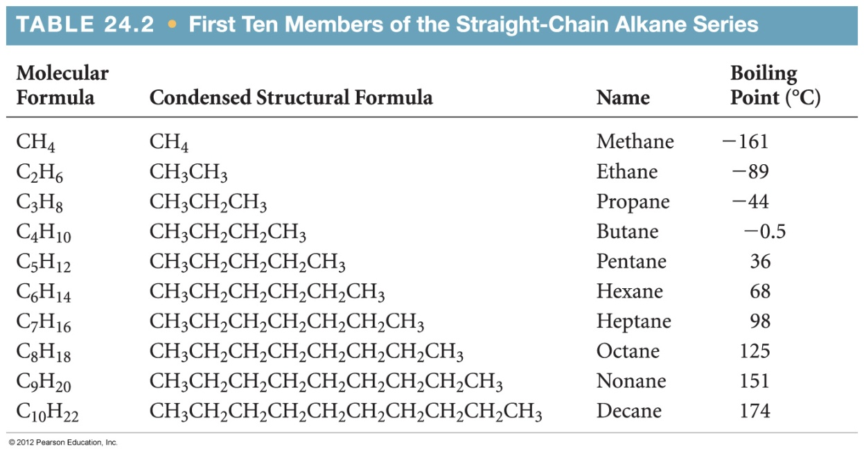
Chapter 7: Organic and Biological Chemistry
Nomenclature of Alkanes
1- Alkanes:
The general formula C_{n} H_{2n +2} where n = 1,2,3,… Carbon atoms are joined by single σ bonds. It is a Saturated hydrocarbons
Boiling point increase
Molecular weight increase

Slide 6
Chapter 7: Organic and Biological Chemistry
7.1 Introduction to hydrocarbons
Q: C₁₀H₂₂ is the formula of an:
alkane.
alkene.
alkyne.
aromatic hydrocarbon.
Q: A molecule with the formula C₃H₈ is a(n):
hexane
propane
decane
butane
ethane

Slide 7
Chapter 7: Organic and Biological Chemistry
7.1 Introduction to hydrocarbons
Q: C₁₀H₂₂ is the formula of an:
alkane.
alkene.
alkyne.
aromatic hydrocarbon.
Q: A molecule with the formula C₃H₈ is a(n):
hexane
propane
decane
butane
ethane

Slide 8
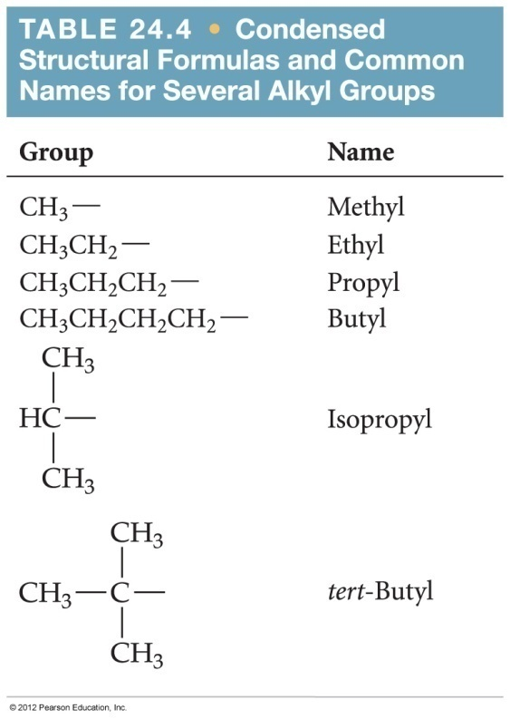
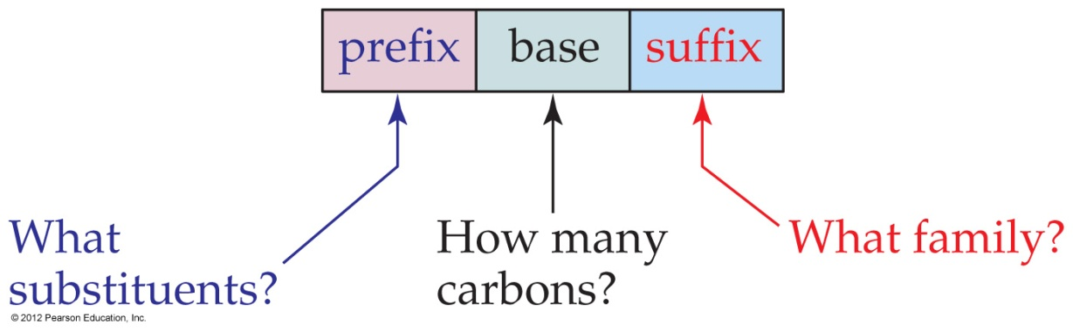
Organic Nomenclature
Chapter 7: Organic and Biological Chemistry
7.1 Introduction to hydrocarbons
There are three parts to a compound name:
  Base: This tells how many carbons are in the longest continuous chain.
  Suffix: This tells what type of compound it is.
  Prefix: This tells what groups are attached to the chain.
IUPAC: International Union of Pure and Applied Chemistry
الاتحاد الدولي للكيمياء البحتة والتطبيقية

Slide 9
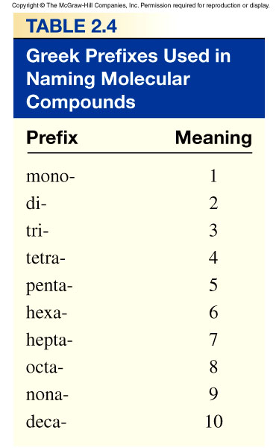
Chapter 7: Organic and Biological Chemistry
Alkanes Nomenclature
Find the longest continuous chain of carbon atoms, and use the name of this chain with changing the end of the name with –ane.
Number the carbon atoms in the longest chain, beginning with the end nearest a substituent.
Name each substituent.
Begin the name with the number(s) of the carbon(s) to which each substituent is bonded.
When two or more substituents are present, list them in alphabetical order. If there are more than one of the same substituent, use the prefixes di-, tri-, ..
CH₃
CH₃
CH₂
CH₂
CH
CH₂
CH₂
CH₃
1
2
3
4
5
6
7
4-methylheptane

Slide 10
Chapter 7: Organic and Biological Chemistry
7.1 Introduction
Alkanes Nomenclature
2- ابدأ بترقيم ذرات الكربون في السلسلة من الجهة الأقرب للتفرع.
CH₃
CH₃
CH
CH₂
CH₂
CH₃
1
2
3
4
5
2-methylpentane
CH₃
CH₃
CH₂
CH₂
CH
CH₃
1
2
3
4
5
4-methylpentane

Slide 11
Chapter 7: Organic and Biological Chemistry
7.1 Introduction
Alkanes Nomenclature
3- في حال وجود أكثر من مجموعة متفرعة من نفس النوع،
نستخدم prefixes di-, tri-, tetra-,
ضعي علامة (-) بين الرقم والحرف وضعي فاصلة بين الأرقام.
CH₃
CH₃
CH₃
CH
CH
CH₂
CH₂
CH₃
1
2
3
4
5
6
2,3-dimethylhexane
CH₃
CH₃
CH
C
CH₂
CH₂
CH₃
1
2
3
4
5
6
CH₃
3,3-dimethylhexane

Slide 12
Chapter 7: Organic and Biological Chemistry
7.1 Introduction
Alkanes Nomenclature
4- إذا وجد تفرع متساوي من الجهتين للسلسلة، فإننا نرقم من الجهة الأقرب للمشتق الأول في الحروف الانجليزية.
Br
CH₃
CH₃
CH
CH₂
CH₂
CH
CH₃
2-bromo-5-methylhexane

Slide 13
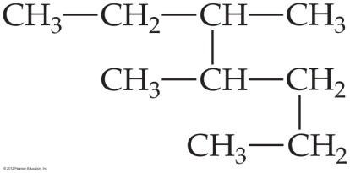
Chapter 7: Organic and Biological Chemistry
7.1 Introduction
Example:
Give the IUPAC name of the following compound:
Solution:

Slide 14
Chapter 7: Organic and Biological Chemistry
7.1 Introduction
Example:
Give the IUPAC name of the following compound:
Solution:
1
2
3
4
5
7
6
3,4-dimethylheptane

Slide 15
Chapter 7: Organic and Biological Chemistry
7.1 Introduction
Example:
Write the structural formula of
3-ethyl-2,2-dimethylpentane
Solution:

Slide 16
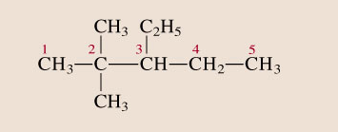
Chapter 7: Organic and Biological Chemistry
7.1 Introduction
Example:
Write the structural formula of
3-ethyl-2,2-dimethylpentane
Solution:

Slide 17
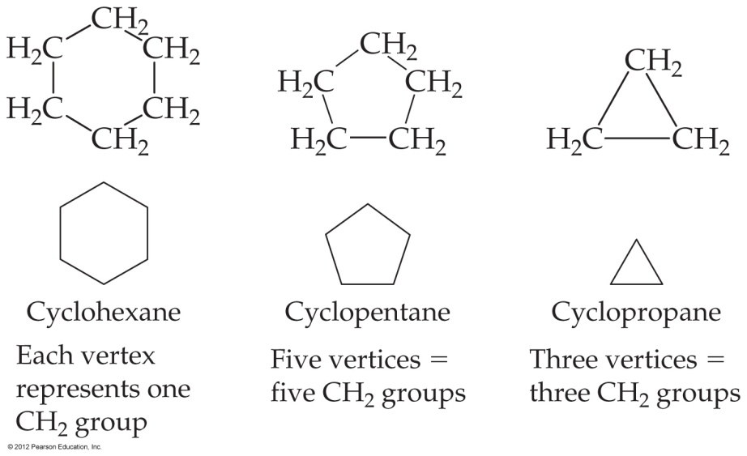

Chapter 7: Organic and Biological Chemistry
2- Cycloalkanes
Alkanes whose carbon atoms are joined in rings are called cycloalkanes.
The general formula: is C_{n}H_{2n} where n = 3,4,…
Reactions of Alkanes
Most alkanes are relatively unreactive. One of their most commercially important reactions is combustion of ethane as follows;
2C₂H₆ (g) + 7 O₂ (g) 4 CO₂ (g) + 6H₂O (g) ΔH = -2855 kJ

Slide 18
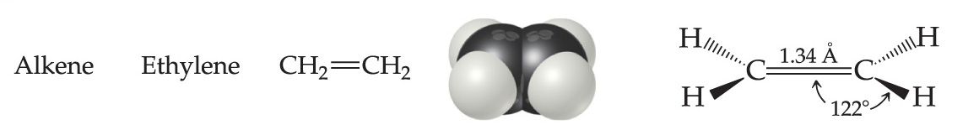
3-Alkenes
Chapter 7: Organic and Biological Chemistry
7.2 Alkenes alkynes and aromatic hydrocarbon
Alkenes: (also none as olefins) contain at lease one C=C double bond is present.
the types of the two bonds in the double bond are one σ bond and the other π-bond.
The general formula: is C_{n}H_{2n} where n = 2,3,4,…
Unsaturated hydrocarbons
π-bond
σ bond
CH₂
CH
CH₂
CH₃
CH₃
CH
CH
CH₃
1-butene
2-butene

Slide 19
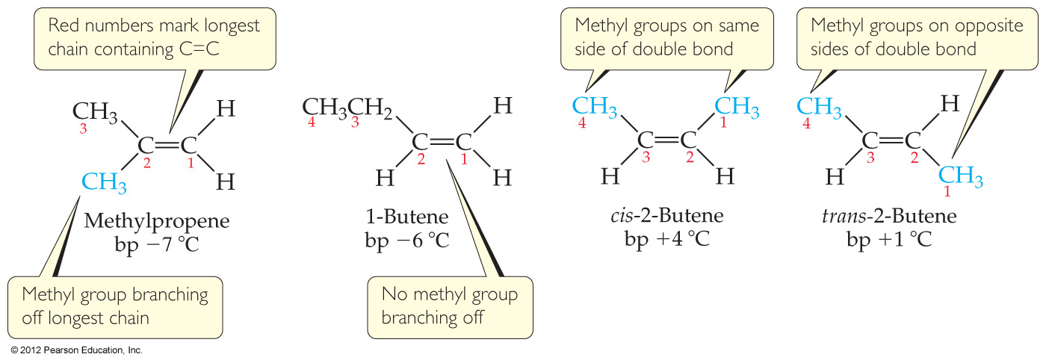
Chapter 7: Organic and Biological Chemistry
7.2 Alkenes alkynes and aromatic hydrocarbon
التشكل البنائي: هي أشكال مختلفة لمركبات لها نفس الصيغة الجزيئية ولكنها تختلف في الصيغة البنائية.
Structural isomers: are molecules which differ from each other in the spatial arrangement of groups about the double bond. For example C₄H₈ has four structure isomers as shown;

Slide 20

Chapter 7: Organic and Biological Chemistry
7.2 Alkenes alkynes and aromatic hydrocarbon
Geometric Isomers of Alkenes
المتشكلات الهندسية للألكينات
سس وترانس (متشكلات هندسية)
يعني وجود مجموعات متشابة على طرفي الرابطة الثنائية, بالتالي ننظر هل هما في نفس الاتجاه (سس)
او: في اتجاهين متعاكسين (ترانس)
Cl
Cl
Cl
H
C
C
C
C
H
H
H
Cl
cis-dichloroethylene
trans-dichloroethylene
نفس الاتجاه
عكس

Slide 21
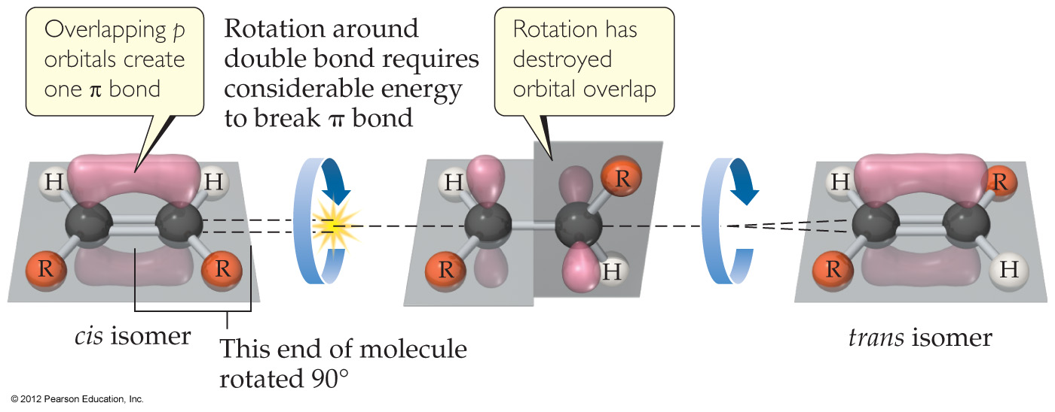
Chapter 7: Organic and Biological Chemistry
7.2 Alkenes alkynes and aromatic hydrocarbon
Structure of Alkenes
Unlike alkanes, alkenes cannot rotate freely about the double bond.
  The side-to-side overlap in the π-bond makes this impossible without breaking the π-bond.

Slide 22
Chapter 7: Organic and Biological Chemistry
7.2 Alkenes alkynes and aromatic hydrocarbon
4-Alkynes
Alkynes: at lease one C C triple bond is present.
The general formula: is C_{n}H_{2n-2} where n = 2,3,4,…
The types of the triple bonds are one σ bond and the other two bonds are π-bonds.
Unsaturated hydrocarbons
CH
C
CH₂
CH₃
CH₃
C
C
CH₃
1-butyne
2-butyne

Slide 23
Chapter 7: Organic and Biological Chemistry
7.2 Alkenes alkynes and aromatic hydrocarbon
Alkene and Alkyne Nomenclature
Find the longest continuous chain of carbon atoms that contains the double or triple bond, and use the name of this chain with changing the end of the name with –ene or –yne respectively.
Number the carbon atoms in the longest chain, beginning with the end nearest to the double or triple bond.
The location of the double or triple bond is indicated by a prefix number.
If a substance contains two or more double bonds, the location of each is indicated by a numerical prefix, and the ending of the name is altered to identify the number of double bonds ; diene (two), triene (three), and so on…
Begin the name with the number(s) of the carbon(s) to which each substituent is bonded.
When two or more substituents are present, list them in alphabetical order. If there are more than one of the same substituent, use the prefixes di-, tri-, ..

Slide 24
Chapter 7: Organic and Biological Chemistry
Alkene Nomenclature
3-methyl-2-heptene
CH₃
CH
C
CH₂
CH₂
CH₂
CH₃
CH₃
CH₃
CH
CH
CH CH₃
CH₂
CH
CH₂
CH CH₂
Br
4-bromo-2-pentene
1, 4-pentadiene

Slide 25
Chapter 7: Organic and Biological Chemistry
Alkyne Nomenclature
3-methyl-1-hexyne
CH
C
CH
CH₂
CH₂
CH₃
CH₃
CH₃
C
C
CH CH₃
CH₃
4-methyl-2-pentyne

Slide 26
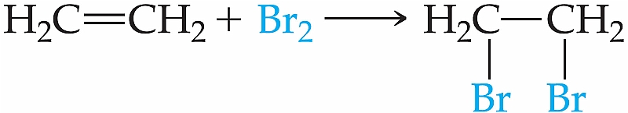
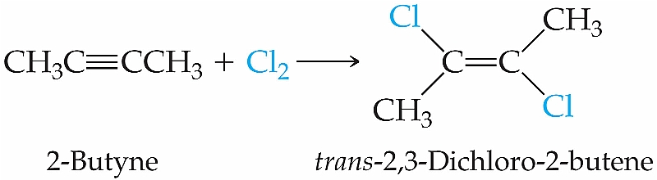
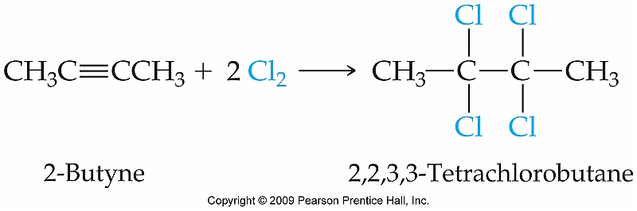
Chapter 7: Organic and Biological Chemistry
7.2 Alkenes alkynes and aromatic hydrocarbon
Addition reactions of Alkenes and Alkynes:تفاعل الاضافة
These occur in alkenes and alkynes.

Slide 27
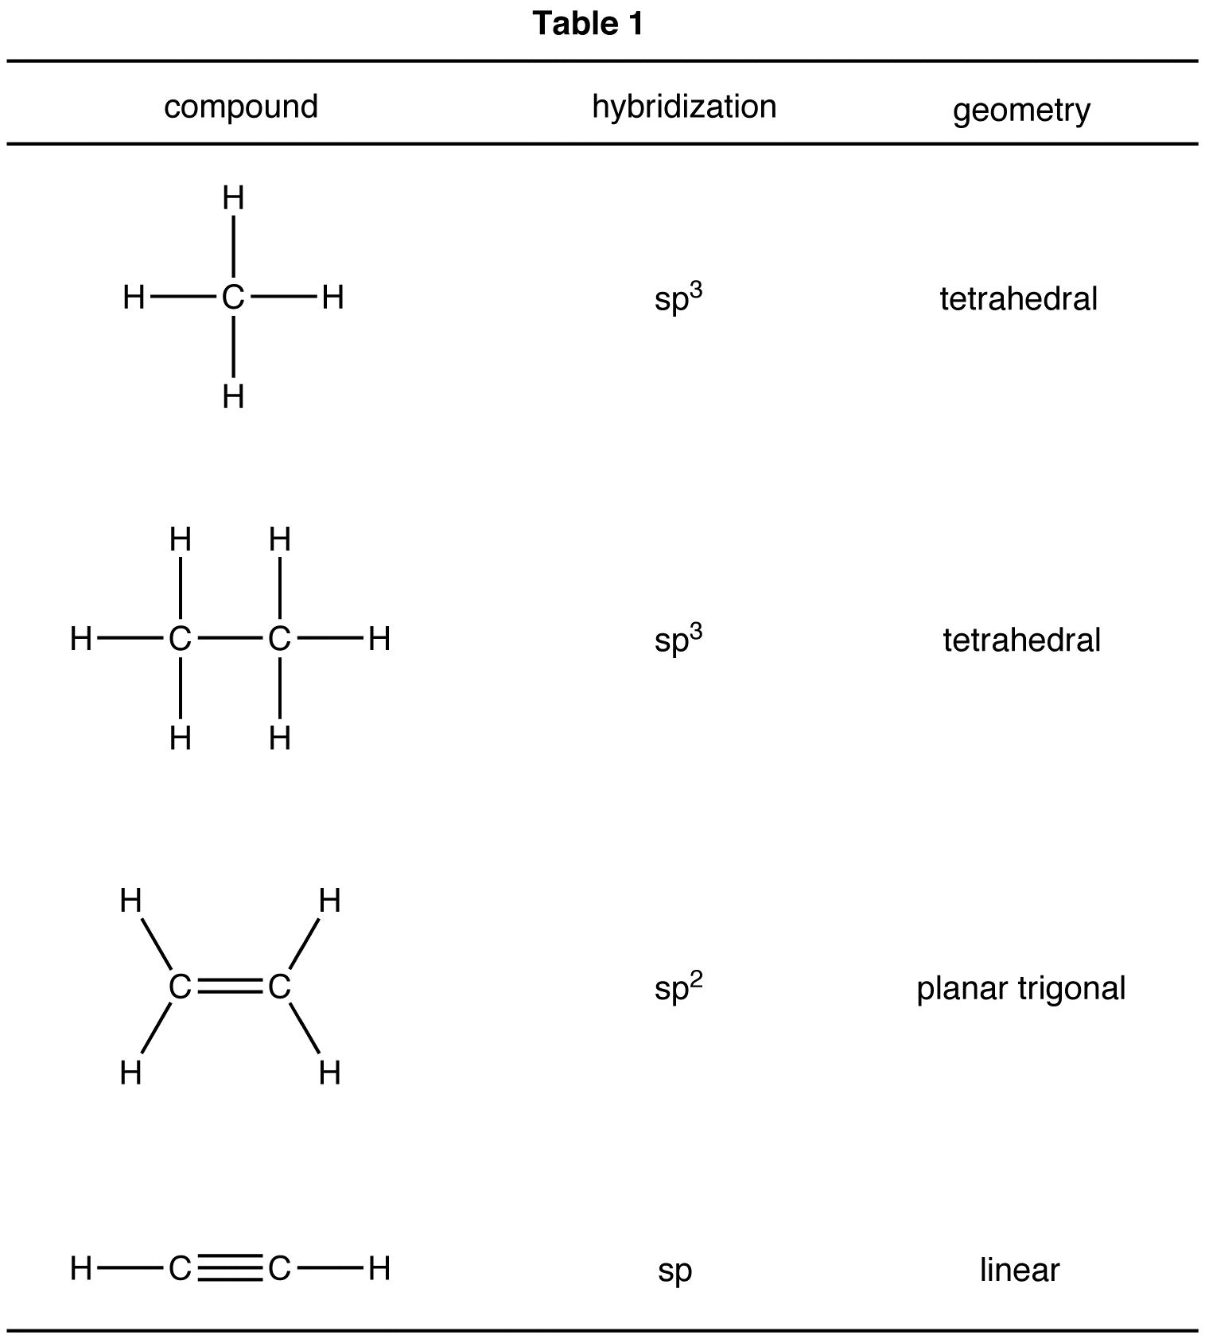
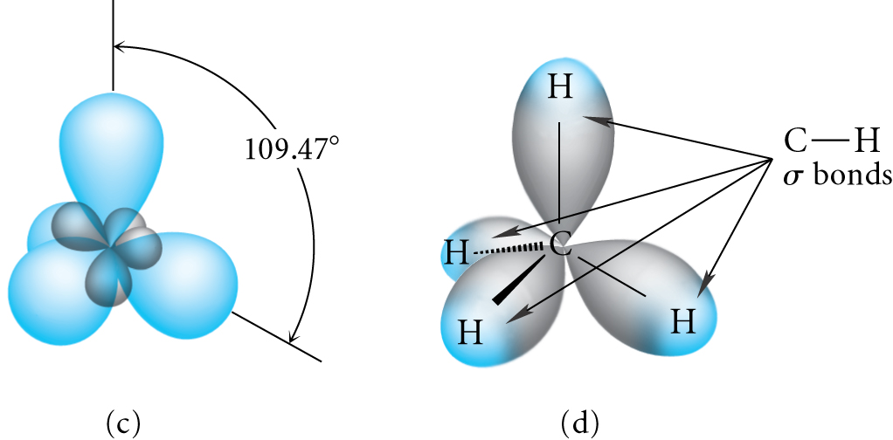
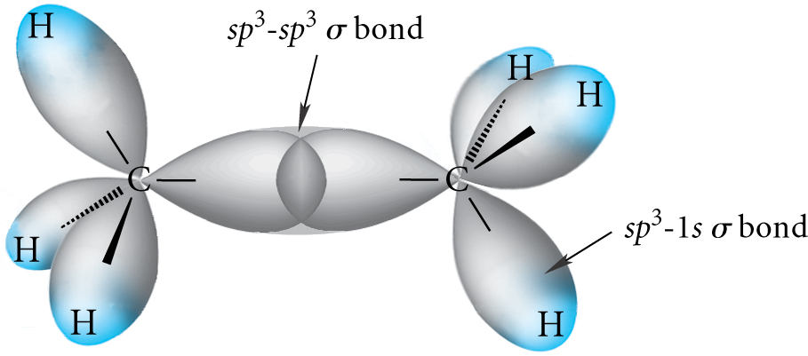
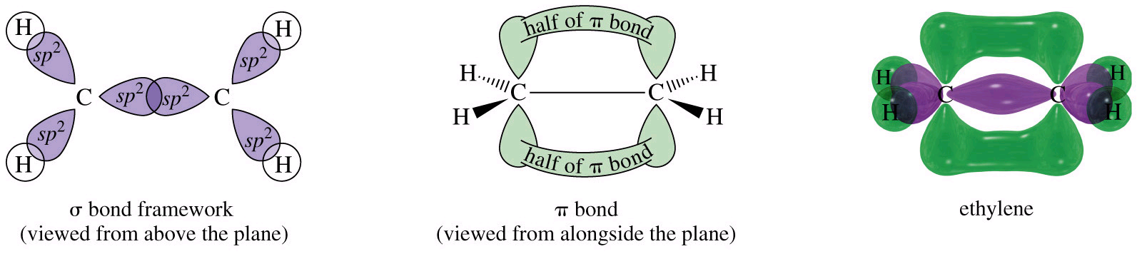
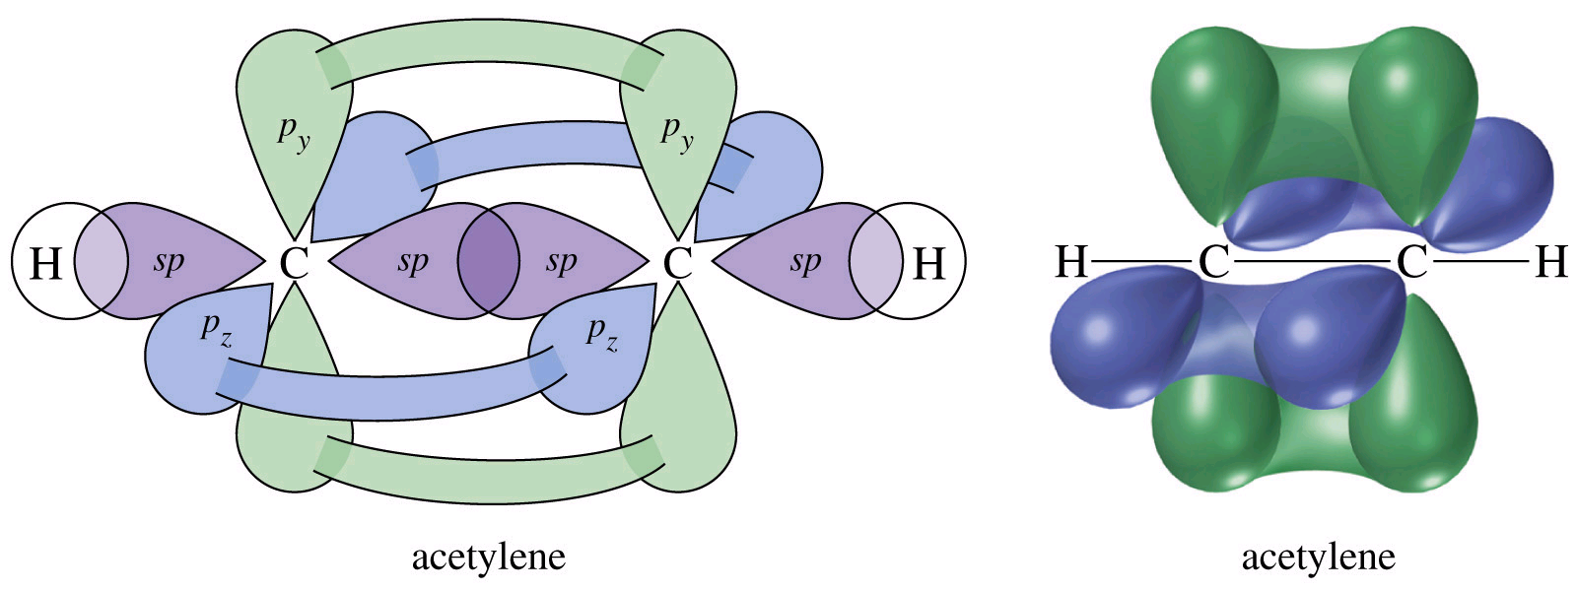

Slide 28
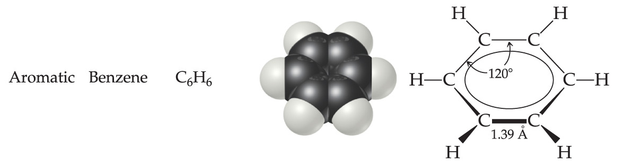
Chapter 7: Organic and Biological Chemistry
7.2 Alkenes alkynes and aromatic hydrocarbon
Aromatic Hydrocarbons
Aromatic compound: contain one or more benzene ring. Unsaturated hydrocarbons
H
H
H
C
H
H
C
H
C
C
C
C
C
C
C
C
H
H
C
H
H
C
H
H

Slide 29
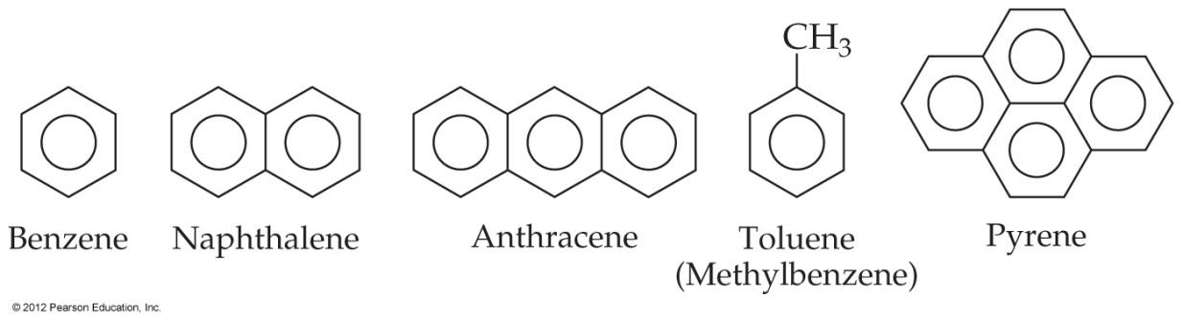
Aromatic Nomenclature
Chapter 7: Organic and Biological Chemistry
7.2 Alkenes alkynes and aromatic hydrocarbon
Aromatic Hydrocarbons
Many aromatic hydrocarbons are known by their common names.

Slide 30
Chapter 7: Organic and Biological Chemistry
7.3 organic functional groups
Functional Groups
Groups that are responsible for most of the reactions of the parent compounds.
المجموعات الوظيفية
تعرف المجموعة الوظيفية بأنها مجموعة من الذرات التي تمثل الموضع المهم والنشط في التفاعلات الكيميائية للمركب الذي يحتوي عليها.
Different Functional Groups forms:
Alcohol
Ethers
Aldhyde
Ketones
Carboxylic acid
Esters
Amines
Aminoacid

Slide 31
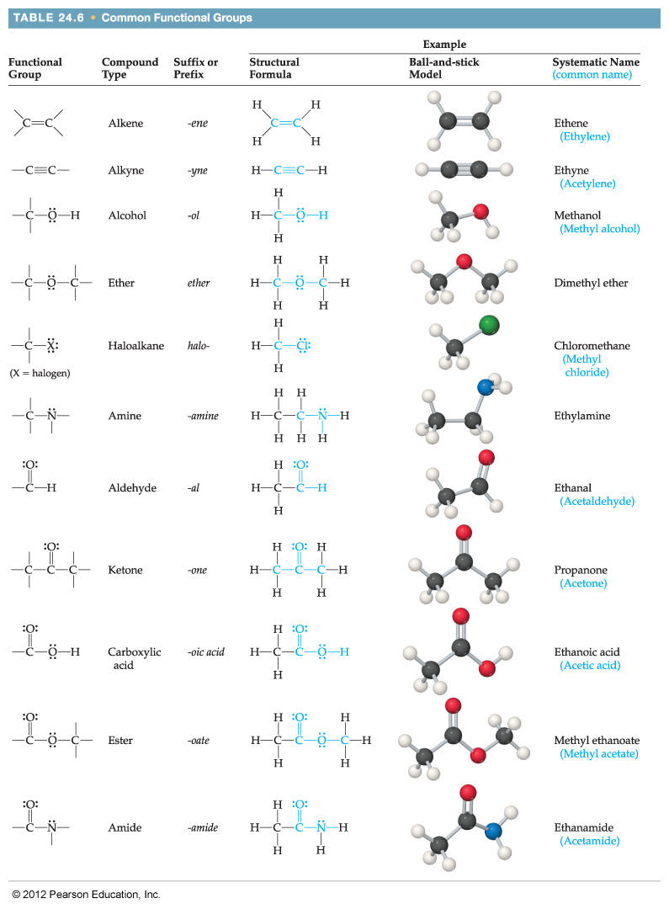

Slide 33
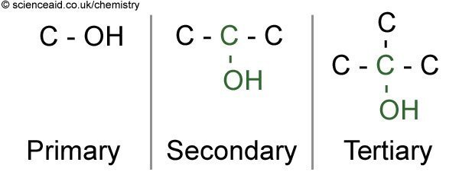
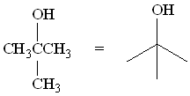
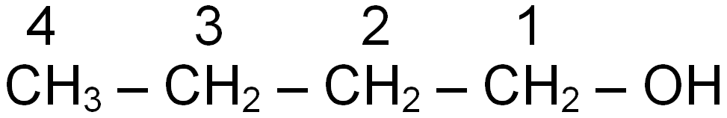
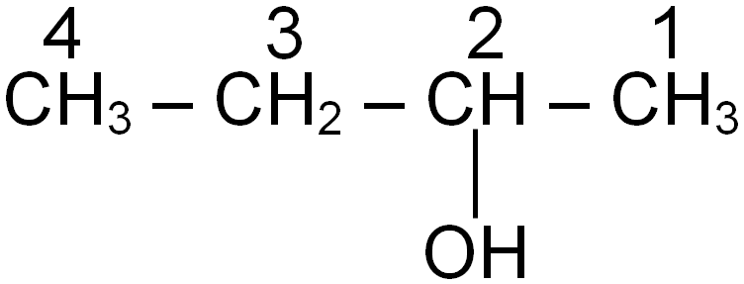
Chapter 7: Organic and Biological Chemistry
7.3 organic functional groups
1-Alcohols: contain the hydroxyl functional group and have the general formula R-OH.
Alcohols classified into 3 classes
Butan-1-ol, 1⁰
Butan-2-ol, 2⁰
2-methyl-propan-2-ol, 3⁰

Slide 34
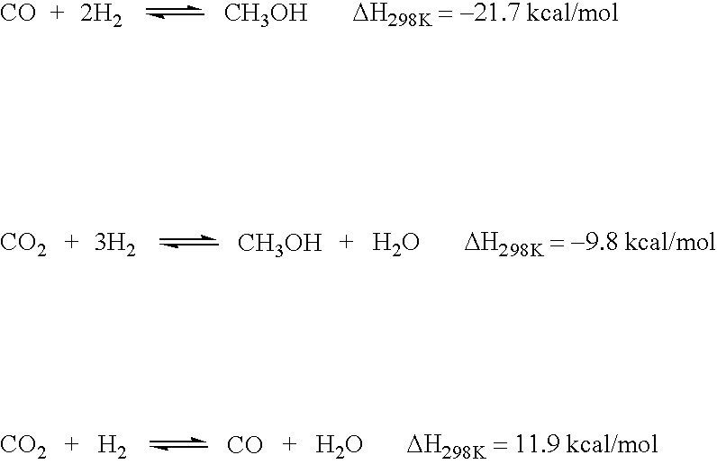
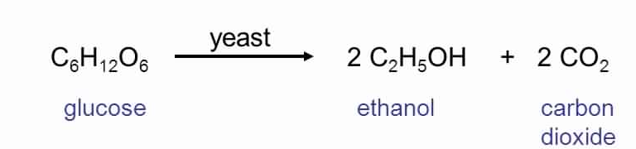
Formation of alcohols:
Chapter 7: Organic and Biological Chemistry
7.3 organic functional groups
formation of methanol
200-300 atm
400 C⁰
methanol
formation of ethanol

Slide 35
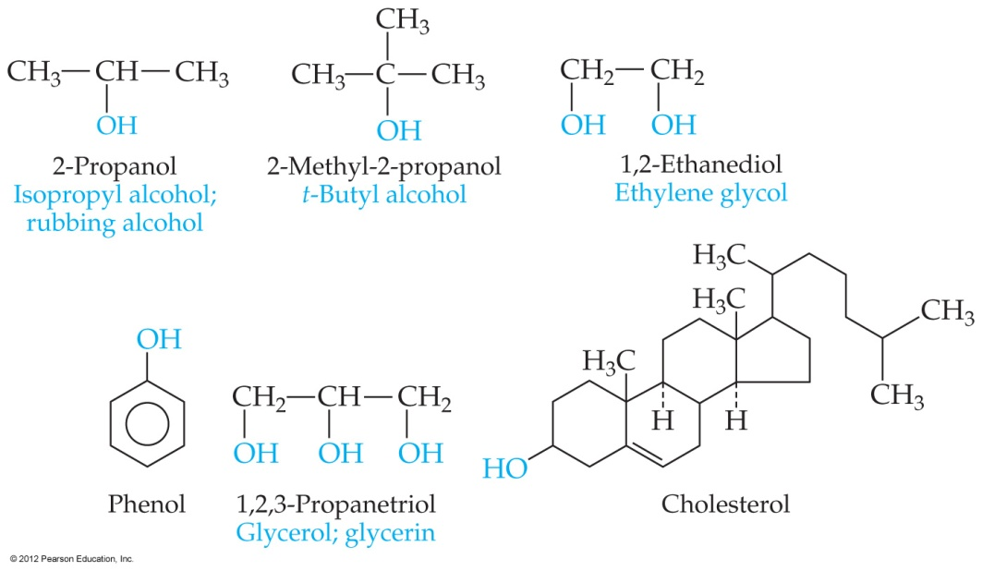
Properties and Uses of Alcohols
Chapter 7: Organic and Biological Chemistry
7.3 organic functional groups
Alcohols are much more acidic than hydrocarbons.
  pK_{a} ~15 for most alcohols.
  Aromatic alcohols have pK_{a} ~10.
Methanol: used as a fuel additive.
Ethanol: in alcoholic beverages
Ethylene glycol: in antifreeze (في التجميد)
Glycerol: cosmetic skin softener and food moisturizer (مستحضرات التجميل)
Phenol: making plastics and dyes; topical anesthetic in throat sprays
Cholesterol: important biomolecule in membranes, but can precipitate and form gallstones or block blood vessels.
(جزيء حيوي مهم في الأغشية، ولكن يمكن أن يترسب ويشكل حصى في المرارة)

Slide 36
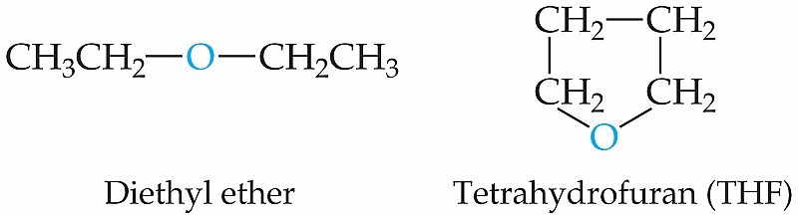
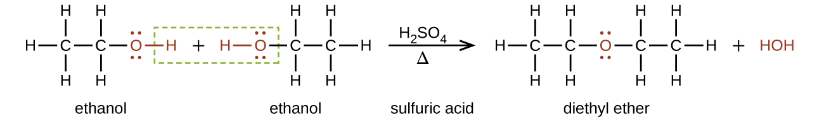
Chapter 7: Organic and Biological Chemistry
7.3 organic functional groups
2-Ethers: have the general formula R-O-R’.
CH₃OCH₃
Dimethyl ether
Condensation reaction:

Slide 37
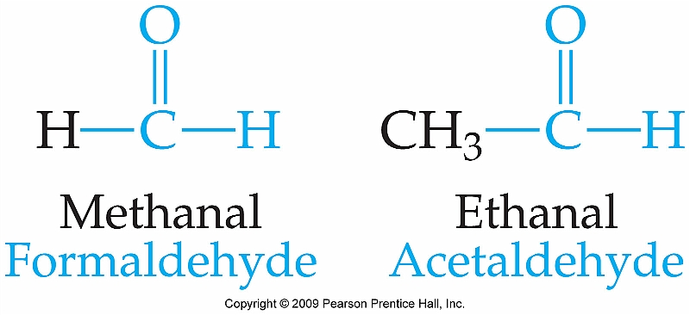
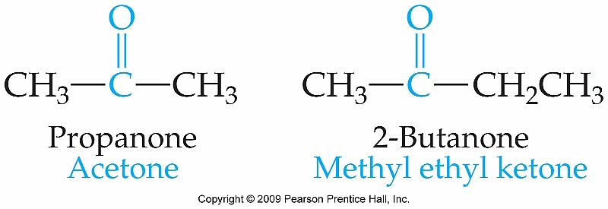
Chapter 7: Organic and Biological Chemistry
7.3 organic functional groups
3-Aldehydes and Ketones: Contain the Carbonyl functional group
C = O
Aldehyde: has the general formula:
Ketone: has the general formula:
R
C = O
H
R
C = O
R’

Slide 38
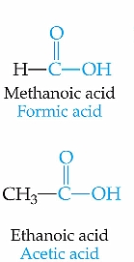
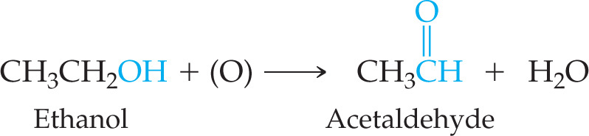
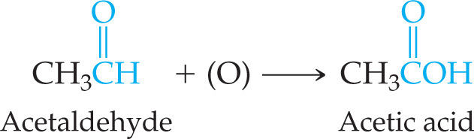

Chapter 7: Organic and Biological Chemistry
7.3 organic functional groups
4-Carboxylic acids: contain the carboxyl ( -COOH ) functional group.
H on the hydroxyl group is weakly acidic.
Important in manufacturing polymers for films, fibers, and paints
عملية اكسدة
+

Slide 39
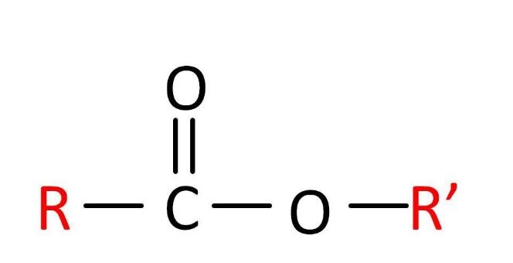
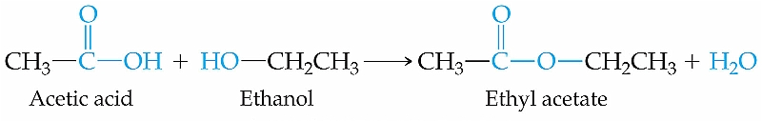
Chapter 7: Organic and Biological Chemistry
7.3 organic functional groups
5-Esters: have the general formula R’COOR, where R is a hydrocarbon group, and R’ can be H or a hydrocarbon.
The odour of fruits is due to the ester compounds they contain.
_{Pentyl acetate (banana)}
CH₃COO[CH₂]₄CH₃
Formation of esters:

Slide 40
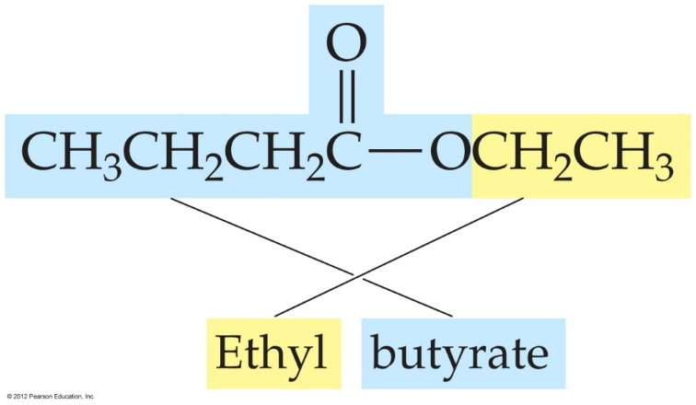

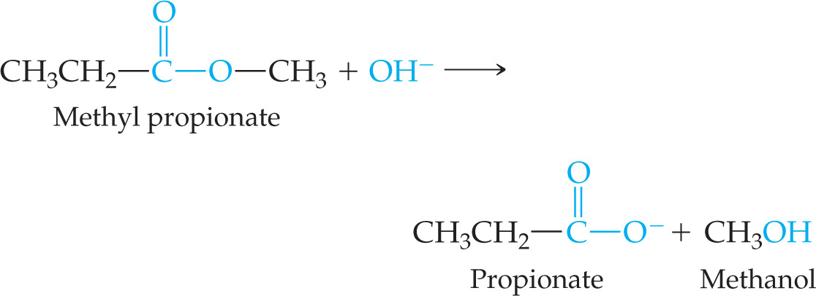
Chapter 7: Organic and Biological Chemistry
7.3 organic functional groups
5-Esters:
Name of esters:
لتسمية الاستر نضع اسم الجزء الكحلي اولا ثم الجزء الحمضي مع استبدال المقطع
ic by ate
Decomposition of esters
Ester treated with acid or base in aqueous solution is hydrolyzed that is molecule is split into alcohol and carboxylic acid or its anion.
Heating an ester in the presence of a base results in saponification (making soap).

Slide 41
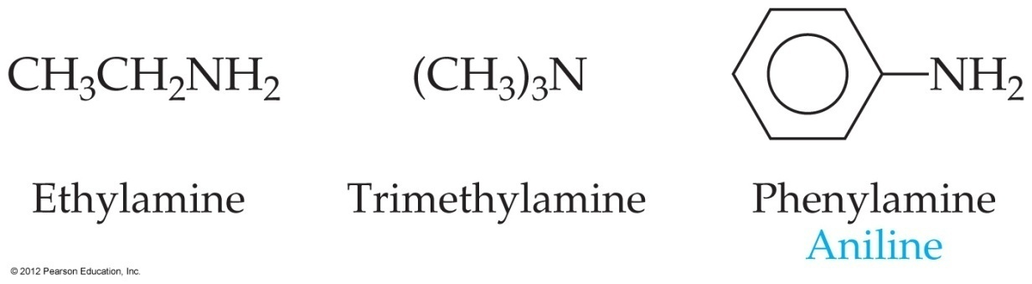
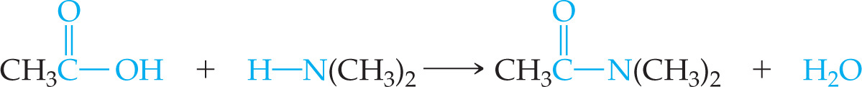
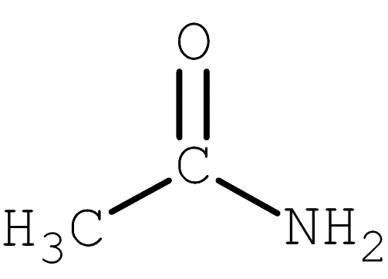
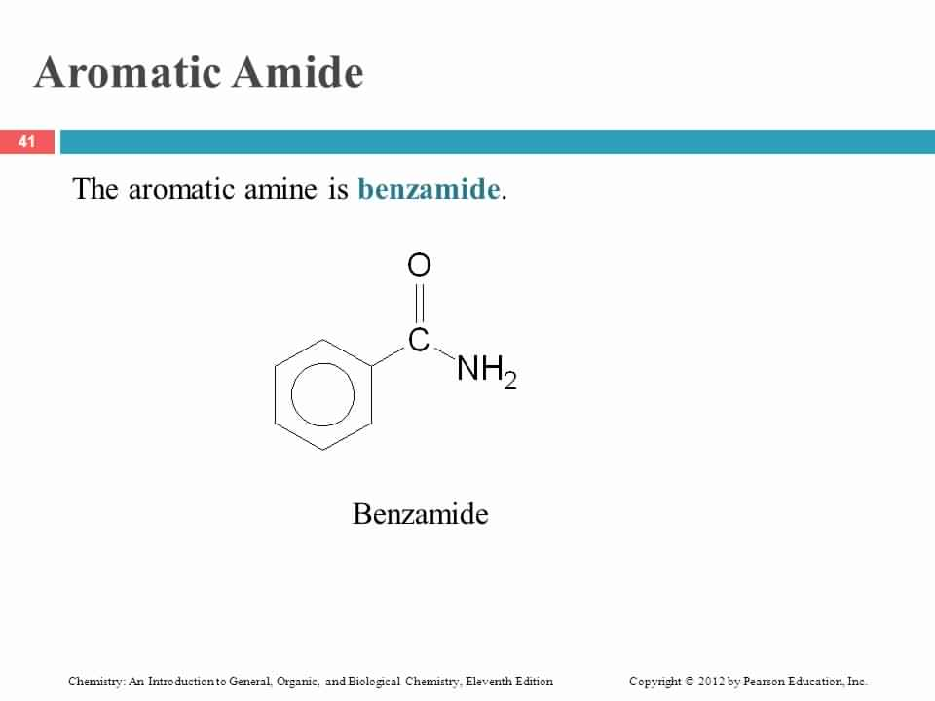
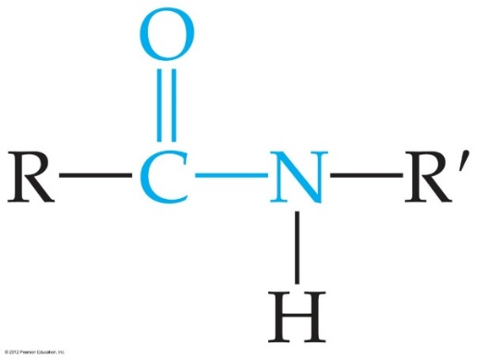
Chapter 7: Organic and Biological Chemistry
7.3 organic functional groups
6-Amines and amides: are organic bases with the general formula R₃N.
Amines are derivatives of ammonia (NH₃).
One, two, or all three H atoms can be replaced by R groups (the same or different R groups).
If H in NH₃ or an amine is replaced by a carbonyl group (N directly attached to C=O), an amide is formed.
CH₃NH₂
Methyl amine
Amides are formed by the reaction of carboxylic acids with amines.
Ethanamide

Slide 42
Chapter 7: Organic and Biological Chemistry
7.4. introduction to Biomolecules
Biopolymers (large biological molecules built from small molecules)
Biopolymers
Proteins
Polysaccharides (carbohydrates)
Nucleic acids
Lipids are large biomolecules, but they are NOT polymers

Slide 43
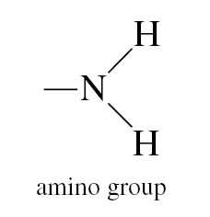
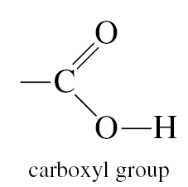
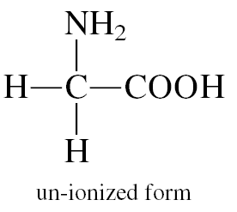
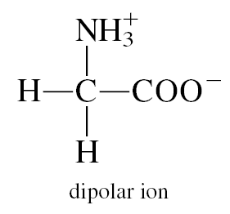
Chapter 7: Organic and Biological Chemistry
7.5. Proteins
Proteins are polymers of α-amino acids.
The basic structural unit of protein is amino acids
Amino acids: are the basic structural units of proteins.
  Contain at least one amino group (-NH₂)
  And at least one carboxyl group (-COOH)
Amino acid

Slide 44


Chapter 7: Organic and Biological Chemistry
7.5. Proteins
Polypeptides and proteins
A condensation reaction between the amine end of one amino acid and the acid end of another produces a peptide bond, which is an amide linkage.

Slide 45

Chapter 7: Organic and Biological Chemistry
7.6. Carbohydrates
The name comes from an empirical formula for sugars: C_{x}(H₂O)_{y}—for the simplest sugars, x = y.
Simple sugars (monosaccharaides) are polyhydroxy aldehydes or ketones. They are often drawn as chains but most frequently exist as rings in solution.

Slide 46

Monosaccharides
Chapter 7: Organic and Biological Chemistry
7.6. Carbohydrates
The two most common monosaccharides are glucose and fructose.
Glucose is an aldehyde; fructose is a ketone.
Polysaccharides
Dehydration can create long-chain polysaccharides.
The three most common are starch, glycogen, and cellulose.
  Starch consists of many different-sized and various branching chains of glucose prepared by plants to store energy.

Slide 47

Fats
Chapter 7: Organic and Biological Chemistry
7.7. Lipids
Lipids are a broad class of nonpolar bioorganic molecules.
They are grouped because they are insoluble in water.
They are used biologically to store energy (fats, oils) and for biological structure (phospholipids in cell membranes).
Fats and oils are made from long-chain carboxylic acids and glycerol.
Fats have only saturated carboxylic acids. They are solids. These are often called the “bad” fats in your diet.
Essential fatty acids (with double bonds) must be included in our diet.
Our bodies can’t produce them. They are often called omega-3 and omega-6 fatty acids.

Slide 48

Chapter 7: Organic and Biological Chemistry
7.8. Nucleic Acids
Class of biopolymers that are chemical carriers of genetic information
Nucleic Acid types:
Deoxyribonucleic acid
(DNA)
Ribonucleic acid
(RNA)

Slide 49
Comparing Nucleic Acid Types
Chapter 7: Organic and Biological Chemistry
7.8. Nucleic Acids
DNA
RNA
Huge molecules (6 to 16 million amu)
Primarily in nucleus of the cell
Stores genetic information
Specifies which proteins the cell can synthesize
Smaller molecules (20,000–40,000 amu)
Mostly outside of nucleus (in cytoplasm)
Carries stored info from DNA into cytoplasm
Information is used in protein synthesis outside of nucleus

Slide 50

Chapter 7: Organic and Biological Chemistry
7.8. Nucleic Acids
The monomers of nucleic acids, called nucleotides, consist of three parts:
1. A phosphoric acid molecule, H₃PO₄
2. A five-carbon sugar
3. A nitrogen-containing organic base

Slide 51
Chapter 7: Organic and Biological Chemistry
Review
Q: What is the IUPAC name of the following compound?
CH₃
C₂H₅
CH₃
CH
CH₂
CH
CH₂
CH₂
CH₂
CH₃
1
2
3
4
5
6
7
8
4-ethyl-2-methyloctane
Q: What is the structure of 2-propyl-4-methylhexane?
C₃H₇
CH₃
CH₃
CH
CH₂
CH
CH₂
CH₃
1
2
3
4
5
6

Slide 52


Chapter 7: Organic and Biological Chemistry
Example:
Give the IUPAC name of the following compound:
Solution:
2,2,4-trimethylhexane

Slide 53
Chapter 7: Organic and Biological Chemistry
Example:
Q: The systematic name for
is Answer: 3,3-dimethylpentane
Notes:
1-ethyl-2-methylbutane. False

Slide 54
Chapter 7: Organic and Biological Chemistry
Q: Name the following compound:
CH₂
CH
CH₂ CH CH₂
1,4-pentadiene
Q: Which one of these formulas is that of an unsaturated hydrocarbon?
A. CH₃ – CH₂ – CH₃
B. CH₃ – CH = CH₂
C. CH₃ – CH₂ – OH

Slide 55
Chapter 7: Organic and Biological Chemistry
Q: Which of the following compounds has geometrical isomer?
H
Cl
H
Cl
C
C
C
C
H
H
H
Cl
NO₂
Cl
NO
NO
C
C
H
H
NO₂
Cl
Cl
Cl
yes
C
C
C
C
H
Cl
H
H
NO
yes

Slide 56
Chapter 7: Organic and Biological Chemistry
Q: For which of the compounds below are cis-trans isomers possible?
CH₃CH=CH₂ | CH₃CH=CHCH₂CH₃ | CH₃CH=CHCH₃
(1) | (2) | (3)
only 2
both 1 and 2
both 2 and 3
all three only 3

Slide 57
Chapter 7: Organic and Biological Chemistry
Q: Which of the following does NOT exhibit geometric isomerism?
(Hint: draw them!)
4-octene
2-pentene
3-hexene
1-hexene
Q: Which of these is the systematic name for the compound represented below?
CH₃ – CH₂ – CH – CH₃
CH = CH₂
A. 2-ethylbutane
B. 3-methyl-1-hexene
C. 3-methyl-1-pentene

Slide 58
Chapter 7: Organic and Biological Chemistry
Q: Write the structural formulas for the following compounds:

Slide 59
Chapter 7: Organic and Biological Chemistry
Q: A protein is:
A) a polymer of amino acids
B) a fatty acid ester of glycerol
C) a polysaccharide
D) an addition polymer
E) a polymer of fatty acids

Slide 60
Chapter 7: Organic and Biological Chemistry
Q: Classify each of the following molecules as:
alcohol, aldehyde, ketone, carboxylic acid, ether, or amino acid

Slide 61
Chapter 7: Organic and Biological Chemistry
Q: The formula
CH₃CH₂CH₂CH₂CH ₂CH₂CH₂ OH
represents:
an alcohol
an alkene
an alkyne
an unsaturated hydrocarbon
Q: Which of the following is a ketone?
CH₃CH₂COCH₃
CH₃CH₂CHO
CH₃OCH₃
CH₃CH₂COOH
H₂C=C=CH₂

Slide 62

Chapter 7: Organic and Biological Chemistry
Q: Which type of functional group does not include a carbonyl group in its structure?
carboxylic acid
ether
ketone
aldehyde
ester
Q: Vanillin is used as a flavoring agent. Identify the functional group circled.
aldehyde
ketone
carboxylic acid
Alcohol

