Slide 2
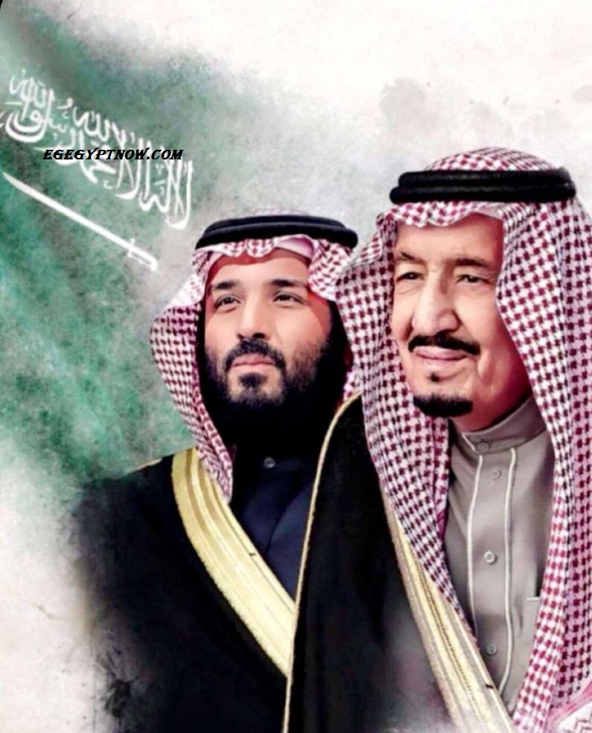

Slide 3
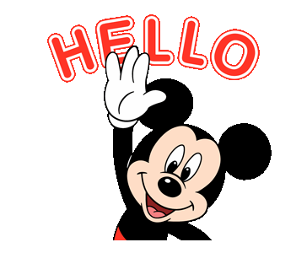

Slide 4
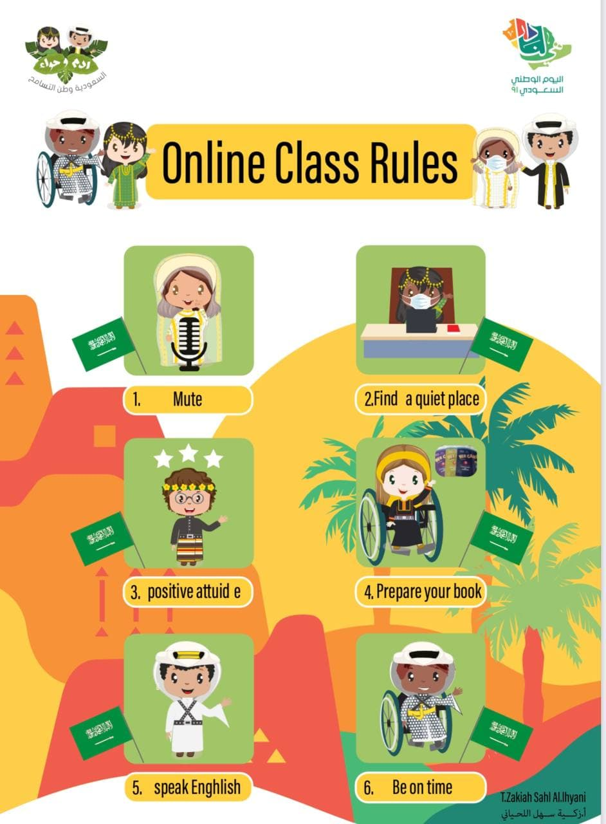
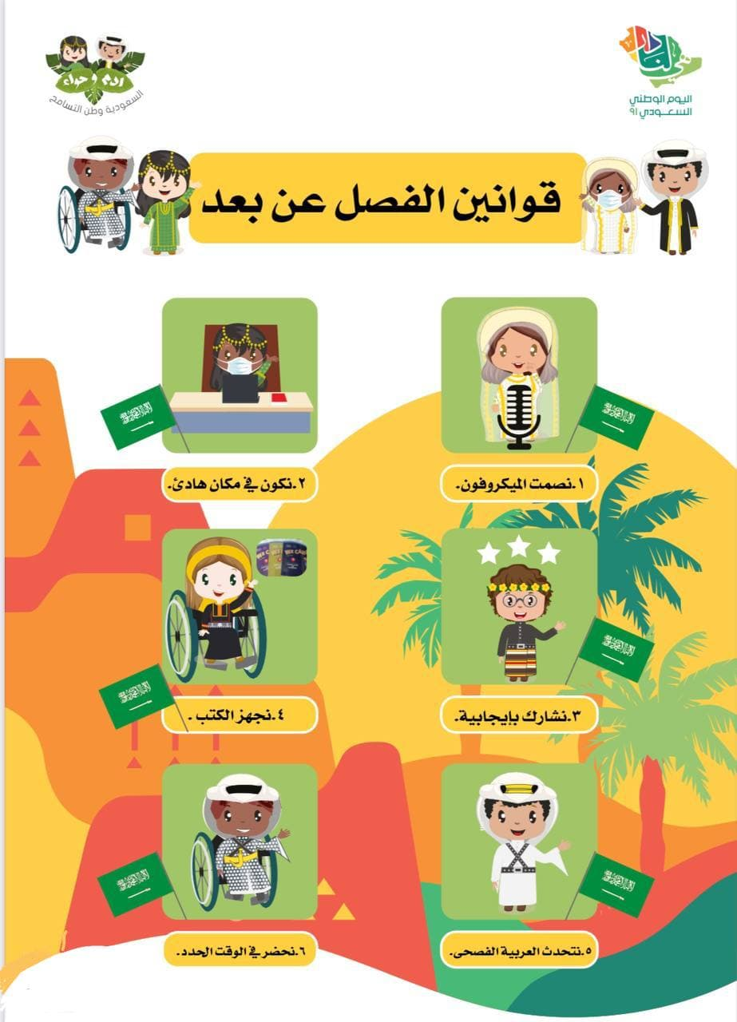

Slide 6
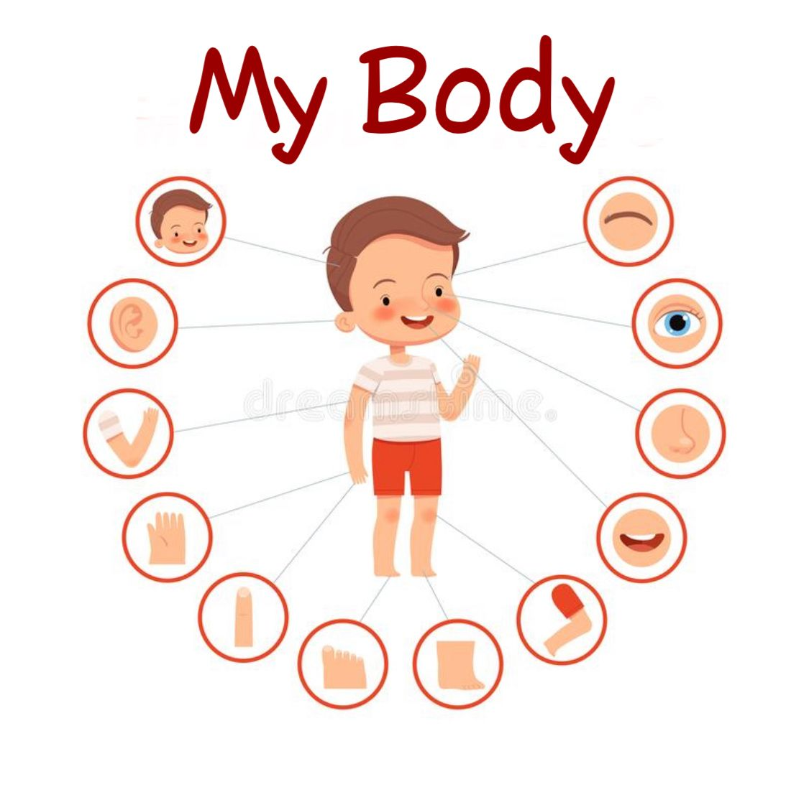
1
My Body
جسدي
Talk Time
وقت التحدث

Slide 7
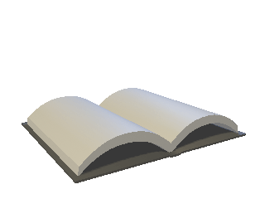
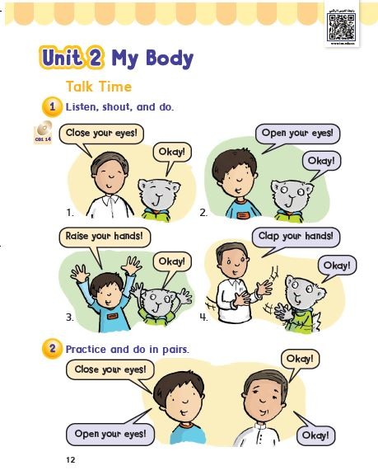
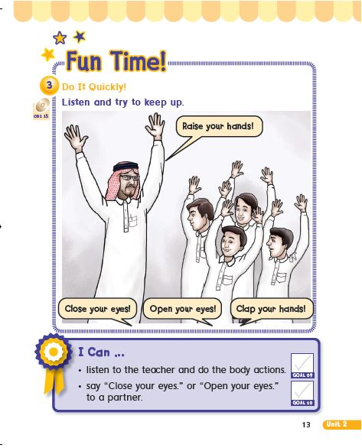
Open your book to pages 12-13

Slide 8
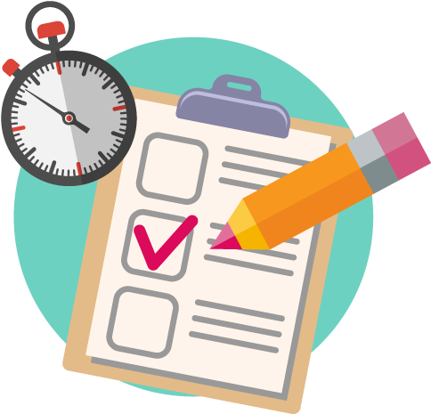
الهدف :
أن يستمع الطالب لمعلمه ويكرر الحركات
أن يطبق الطالب الحركات مع زميله

Slide 10
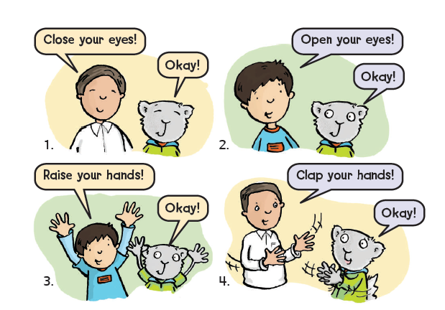
1
Listen shout and do.

Slide 11
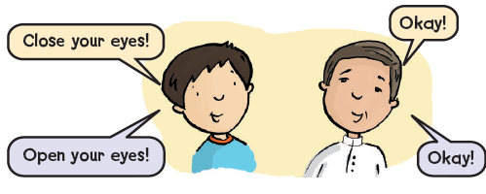
2
Practice and do in pairs.

Slide 12
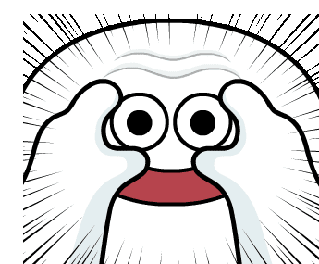
open

Slide 13
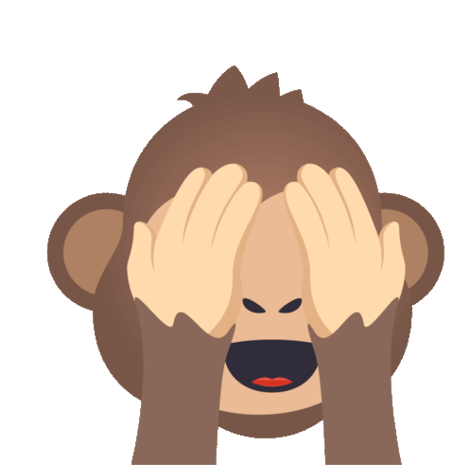
close

Slide 14
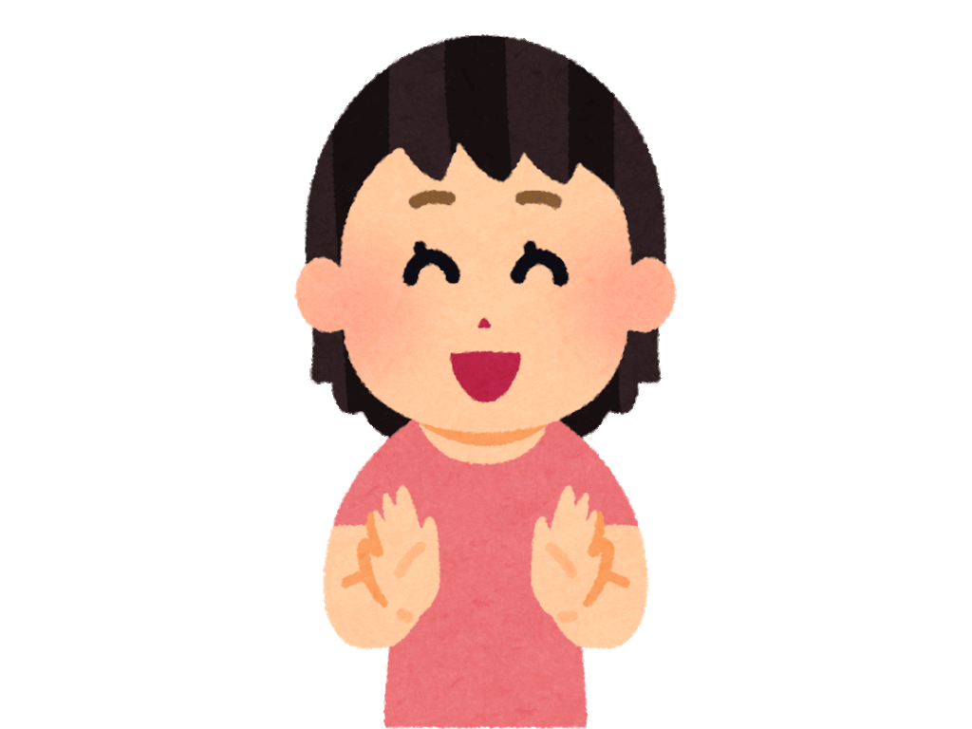
clap

Slide 15
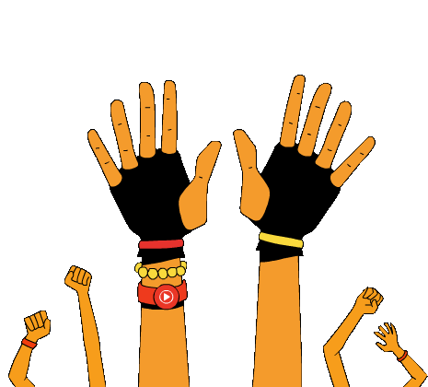
raise

Slide 16
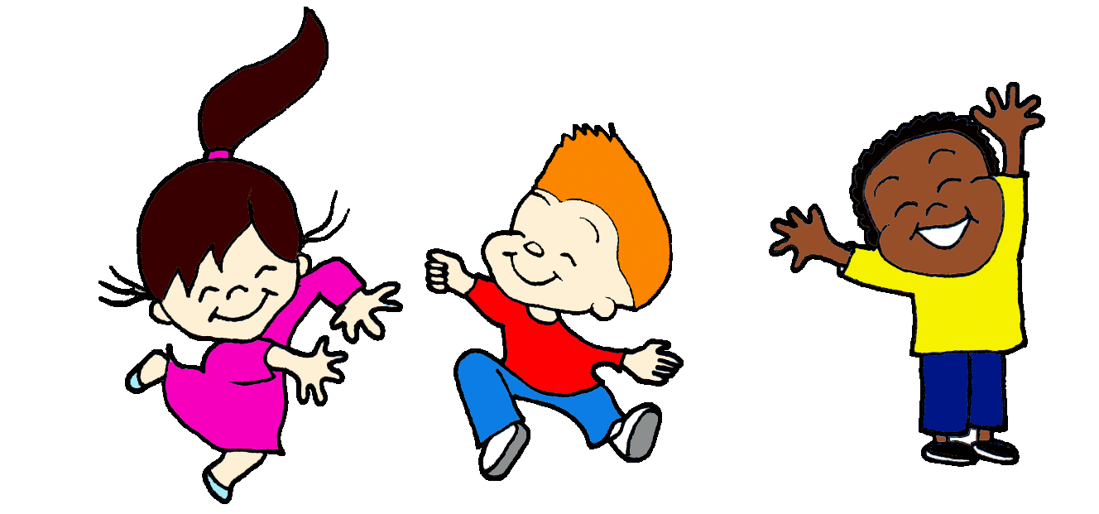

Slide 17
Choose:
A- Close your eyes
B- Raise your hand.
C- Open your eyes.
D-Clap your hands.

Slide 18
Choose:
A- Close your eyes
B- Raise your hand.
C- Open your eyes.
D- Clap your hands.

Slide 19
Choose:
A- Close your eyes
B- Raise your hand.
C- Open your eyes.
D- Clap your hands.

Slide 20
Choose:
A- Close your eyes
B- Raise your hand.
C- Open your eyes.
D- Clap your hands.

Slide 21
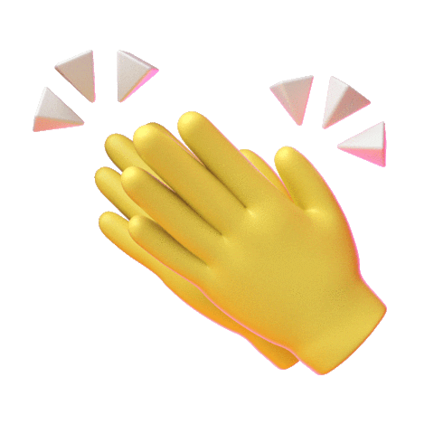

Slide 22
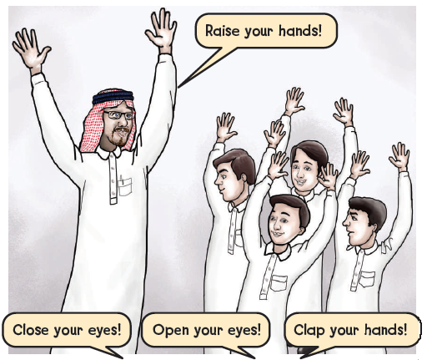
3
Do it Quickly
Listen and try to keep up .

Slide 23
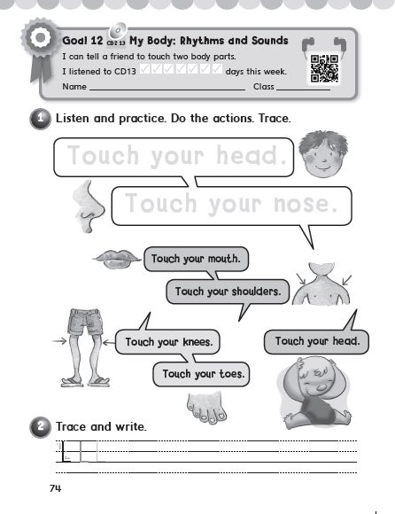
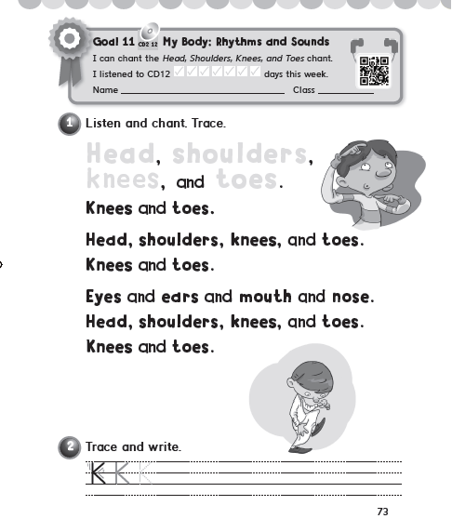
P. 71-72

