Slide 1
Curvilinear Motion
Lecture IV

Slide 2
Topics Covered in Curvilinear Motion
Plane curvilinear motion
Coordinates used for describing curvilinear motion
  Rectangular coords
  n-t coords
  Polar coords

Slide 3
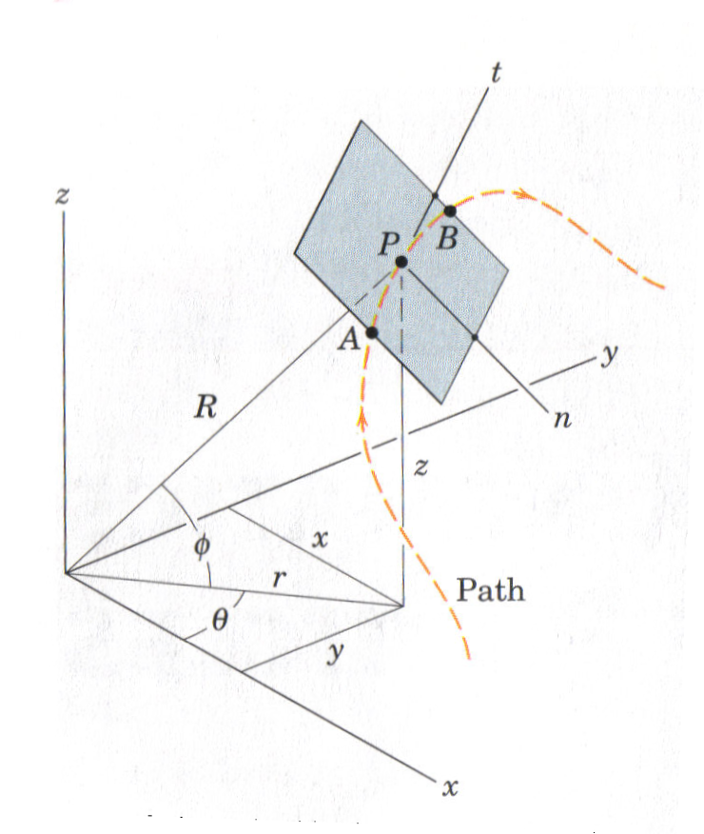
Plane curvilinear Motion
Studying the motion of a particle along a curved path which lies in a single plane (2D).
This is a special case of the more general 3D motion.
3D

Slide 4
Plane curvilinear Motion – (Cont.)
If the x-y plane is considered as the plane of motion; from the 3D case, z and ϕ are both zero, and R becomes as same as r.
The vast majority of the motion of particles encountered in engineering practice can be represented as plane motion.

Slide 5
Coordinates Used for Describing the Plane Curvilinear Motion
Rectangular coordinates
Normal-Tangential coordinates
Polar coordinates
P_{C}
Path
t
y
y
Path
θ
r
n
Path
n
P
P_{A}
P
n
r
t
t
P_{B}
θ
x
O
x
O

Slide 6
Plane Curvilinear Motion – (Displacement)
Actual distance traveled by the particle (it is s scalar)
Note: Since, here, the particle motion is described by two coordinates components, both the magnitude and the direction of the position, the velocity, and the acceleration have to be specified.
The vector displacement of the particle
Δs
(Δt)
Note: If the origin (O) is changed to some different location, the position r(t) will be changed, but Δr(Δt) will not change.
or r(t)+Δr(Δt)

Slide 7
Plane Curvilinear Motion – (Velocity)
Note: v_{av} has the direction of Δr and its magnitude equal to the magnitude of Δr divided by Δt.
Average velocity (v_{av}):
Instantaneous velocity (v): as Δt approaches
zero in the limit,
Note: the average speed of the particle is the scalar Δs/Δt. The magnitude of the speed and v_{av} approach one another as Δt approaches zero.
Note: the magnitude of v is called the speed, i.e. v=|v|=ds/dt= s..
Note: the velocity vector v is always tangent to the path.

Slide 8
Plane Curvilinear Motion – (Acceleration)
Average Acceleration (a_{av}):
Instantaneous Acceleration (a): as Δt approaches
zero in the limit,
Note: a_{av} has the direction of Δv and its magnitude is the magnitude of Δv divided by Δt.
Note: in general, the acceleration vector a is neither tangent nor normal to the path. However, a is tangent to the hodograph.
P
V₁
C
V₁
Hodograph
P
V₂
V₂
a₂
a₁

Slide 9
The description of the Plane Curvilinear Motion in the Rectangular Coordinates (Cartesian Coordinates)

Slide 10
Plane Curvilinear Motion - Rectangular Coordinates
y
v
v_{y}
θ
P
v_{x}
Path
j
r
O
i
x
a
a_{y}
Note: the time derivatives of the unit vectors are zero because their magnitude and direction remain constant.
a_{x}
P
Note: if the angle θ is measured counterclockwise from the x-axis to v for the configuration of the axes shown, then we can also observe that dy/dx = tanθ = v_{y}/v_{x}.

Slide 11
Plane Curvilinear Motion - Rectangular Coordinates (Cont.)
The coordinates x and y are known independently as functions of time t; i.e. x = f₁(t) and y = f₂(t). Then for any value of time we can combine them to obtain r.
Similarly, for the velocity v and for the acceleration a.
If is a given, we integrate to get v and integrate again to get r.
The equation of the curved path can obtained by eliminating the time between x = f₁(t) and y = f₂(t).
Hence, the rectangular coordinate representation of curvilinear motion is merely the superposition of the components of two simultaneous rectilinear motions in x- and y- directions.

Slide 12
Plane Curvilinear Motion - Rectangular Coordinates (Cont.) – Projectile Motion
y
v_{y}
v
v_{x}
v_{x}
v_{o}
g
v_{y}
v
Path
(v_{y})_{o} = v_{o} sinθ
θ
x
(v_{x})_{o} = v_{o} cosθ
Note:
If final velocity is not needed, equations (2) and (4) would not be needed

Slide 13
Exercises

Slide 14
Exercise # 1
The velocity of a particle is v = {3i + (6 - 2t)j} m/s, where t is in seconds. If r = 0 when t = 0, determine the displacement of the particle during the time interval t = 1 s to t = 3 s. Also, determine the acceleration at t = 3 s.

Slide 15
Exercise # 2

Slide 16
Exercise # 3
A roofer tosses a small tool to the ground. What minimum magnitude v₀ of horizontal velocity is required to just miss the roof corner B? Also determine the distance d.

Slide 17
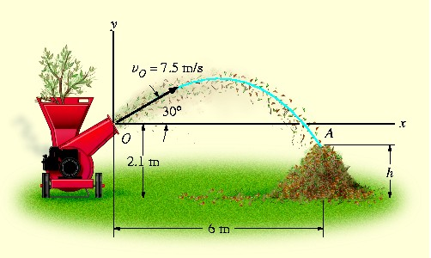
Exercise # 4
The chipping machine is designed to eject wood at chips v_{O} = 7.5 m/s. If the tube is oriented at 30° from the horizontal, determine how high, h, the chips strike the pile if they land on the pile 6 m from the tube.

Slide 18
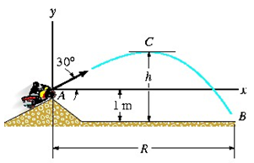
Exercise # 5
The track for this racing event was designed so that the riders jump off the slope at 30°, from a height of 1m. During the race, it was observed that the rider remained in mid air for 1.5 s. Determine the speed at which he was traveling off the slope, the horizontal distance he travels before striking the ground, and the maximum height he attains. Neglect the size of the bike and rider.

Slide 19
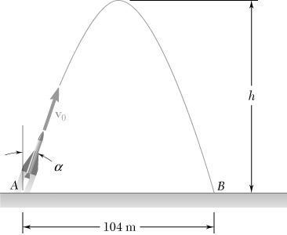
Exercise # 6
A model rocket is launched from point A with an initial velocity of 86 m/s. If the rocket’s descent parachute does not deploy and the rocket lands 104 m from A, determine (a) the angle that forms with the vertical, (b) the maximum height h reached by the rocket, (c) the duration of the flight.

Slide 20
Exercise # 7
Determine the minimum initial velocity v₀ and the corresponding angle θ₀ at which the ball must be kicked in order for it to just cross over the 3-m high fence.

