Slide 1
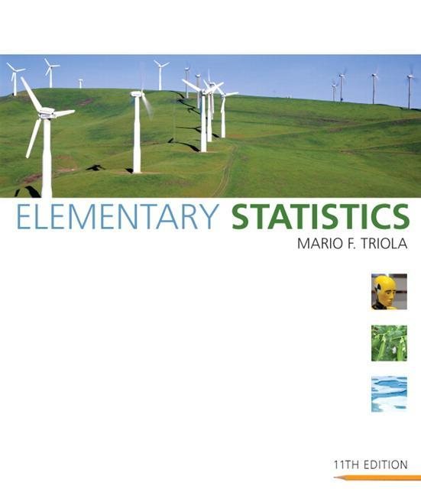
Lecture Slides
Elementary Statistics Eleventh Edition
and the Triola Statistics Series
by Mario F. Triola

Slide 2
Chapter 3 Statistics for Describing, Exploring, and Comparing Data
3-1 Review and Preview
3-2 Measures of Centerمقاييس النزعة المركزيه
3-3 Measures of Variation مقاييس التشتت
3-4 Measures of Relative Standing and Boxplots مقاييس المكان

Slide 3
Section 3-1
Review and Preview
Created by Tom Wegleitner, Centreville, Virginia

Slide 4
Review
Chapter 1 Distinguish between population and sample, parameter and statistic Good sampling methods: simple random sample, collect in appropriate ways
Chapter 2 Frequency distribution: summarizing data Graphs designed to help understand data Center, variation, distribution, outliers, changing characteristics over time

Slide 5
Preview
Important Statistics مقاييس النزع المركزيه
Mean, median, standard deviation, variance
Understanding and Interpreting
these important statistics

Slide 6
Preview
Descriptive Statistics
In this chapter we’ll learn to summarize or describe the important characteristics of a known set of data
Inferential Statistics
In later chapters we’ll learn to use sample data to make inferences or generalizations about a population

Slide 7
Section 3-2
Measures of Center

Slide 8
Key Concept
Characteristics of center. Measures of center, including mean and median, as tools for analyzing data. Not only determine the value of each measure of center, but also interpret those values.
Notes:
قياس المركز

Slide 9
Part 1
Basics Concepts of Measures of Center

Slide 10
Measure of Center
Measure of Center
the value at the center or middle of a data set

Slide 11
Arithmetic Mean
Arithmetic Mean (Mean)الوسيط الحسابي
the measure of center obtained by adding the values and dividing the total by the number of values
What most people call an average.

Slide 12
Notation
Σ denotes the sum of a set of values.
x is the variable usually used to represent the individual data values.
n represents the number of data values in a sample.
N represents the number of data values in a population.

Slide 13
Notation
x
is pronounced ‘x-bar’ and denotes the mean of a set of sample values
Σ x
x =
n
µ is pronounced ‘mu’ and denotes the mean of all values in a population
Σ x
µ =
N

Slide 14
Mean
Advantages Is relatively reliable, means of samples drawn from the same population don’t vary as much as other measures of center Takes every data value into account
Disadvantage Is sensitive to every data value, one extreme value can affect it dramatically; is not a resistant measure of center

Slide 15
Median
Median
the middle value when the original data values are arranged in order of increasing (or decreasing) magnitude
often denoted by x (pronounced ‘x-tilde’)
~
is not affected by an extreme value - is a resistant measure of the center

Slide 16
Finding the Median
First sort the values (arrange them in order), the follow one of these
1. If the number of data values is odd, the median is the number located in the exact middle of the list.
2. If the number of data values is even, the median is found by computing the mean of the two middle numbers.

Slide 17
5.40 1.10 0.42 0.73 0.48 1.10
0.42 0.48 0.73 1.10 1.10 5.40
(in order - even number of values – no exact middle
shared by two numbers)
0.73 + 1.10
MEDIAN is 0.915
2
5.40 1.10 0.42 0.73 0.48 1.10 0.66
0.42 0.48 0.66 0.73 1.10 1.10 5.40
(in order - odd number of values)
exact middle MEDIAN is 0.73

Slide 18
Mode
Mode the value that occurs with the greatest frequency
Data set can have one, more than one, or no mode
Bimodal two data values occur with the same greatest frequency
Multimodal more than two data values occur with the same greatest frequency
No Mode no data value is repeated
Mode is the only measure of central tendency that can be used with nominal data
Notes:
هو القيمة الأكثر تكراراً في مجموعة من البيانات، أو في فضاء احتمالي.
المنوال

Slide 19
Mode - Examples
a. 5.40 1.10 0.42 0.73 0.48 1.10
b. 27 27 27 55 55 55 88 88 99
c. 1 2 3 6 7 8 9 10
Mode is 1.10
Bimodal - 27 & 55
No Mode

Slide 20
Definition
Midrange the value midway between the maximum and minimum values in the original data set
maximum value + minimum value
Midrange =
2

Slide 21
Midrange
Sensitive to extremes because it uses only the maximum and minimum values, so rarely used
Redeeming Features
(1) very easy to compute
(2) reinforces that there are several ways to define the center
(3) Avoids confusion with median

Slide 22
Round-off Rule for
Measures of Center
Carry one more decimal place than is present in the original set of values.

Slide 23
Critical Thinking
Think about whether the results are reasonable.
Think about the method used to collect the sample data.

Slide 24
Part 2
Beyond the Basics of Measures of Center

Slide 25
Mean from a Frequency
Distribution
Assume that all sample values in each class are equal to the class midpoint.

Slide 26
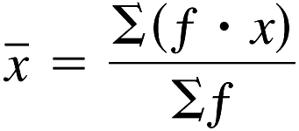
Mean from a Frequency
Distribution
use class midpoint of classes for variable x

Slide 27
Weighted Mean
When data values are assigned different weights, we can compute a weighted mean.
Σ (w • x)
x =
Σ
w

Slide 28
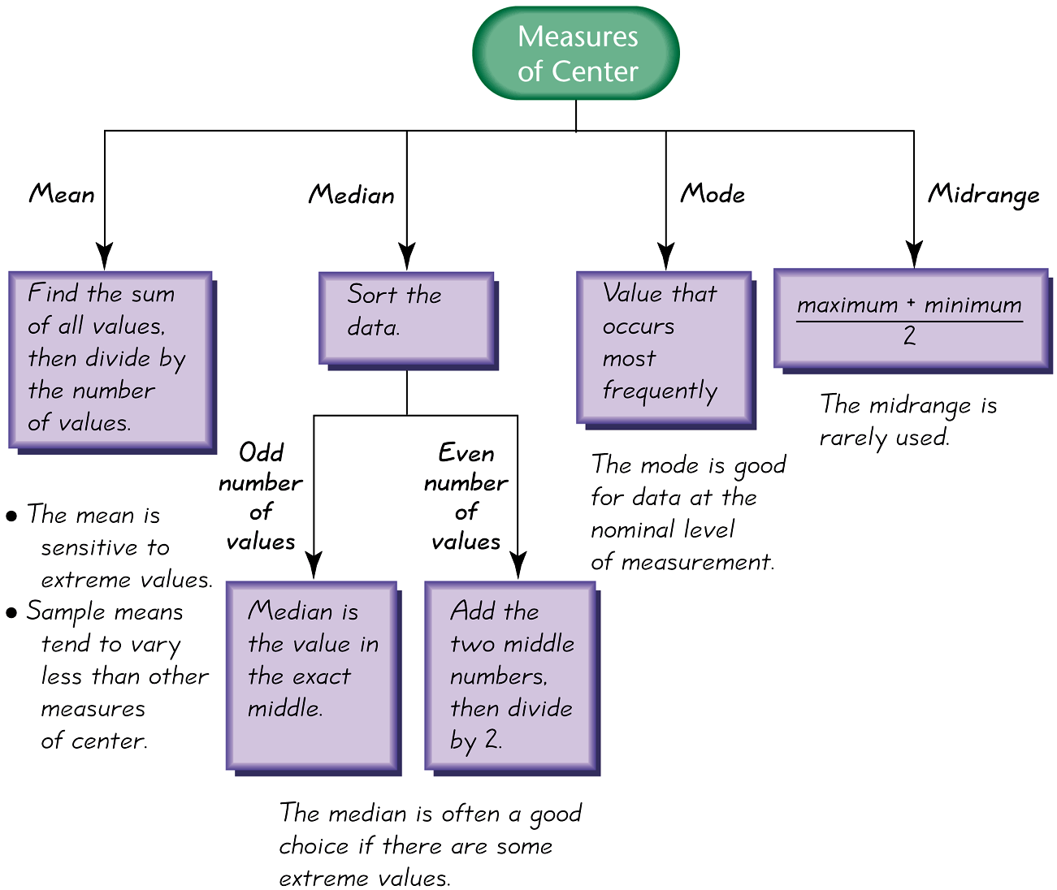
Best Measure of Center

Slide 29
Skewed and Symmetric
Symmetric
distribution of data is symmetric if the left half of its histogram is roughly a mirror image of its right half
Skewed
distribution of data is skewed if it is not symmetric and extends more to one side than the other

Slide 30
Skewed Left or Right
Skewed to the left
(also called negatively skewed) have a longer left tail, mean and median are to the left of the mode
Skewed to the right
(also called positively skewed) have a longer right tail, mean and median are to the right of the mode

Slide 31
Shape of the Distribution
The mean and median cannot always be used to identify the shape of the distribution.

Slide 32
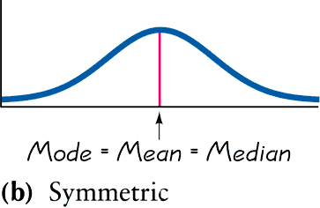
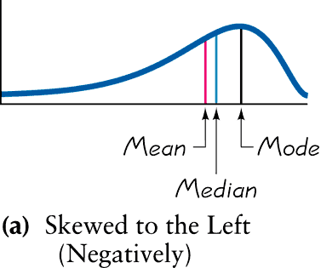
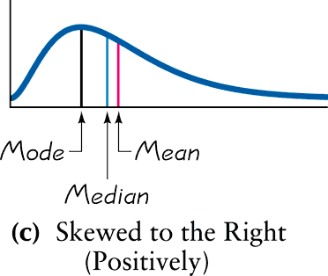
Skewness

Slide 33
Recap
In this section we have discussed:
Types of measures of center
Mean
Median
Mode
Mean from a frequency distribution
Weighted means
Best measures of center
Skewness

Slide 34
Section 3-3
Measures of Variation
Copyright © 2010 Pearson Education

Slide 35
Key Concept
Discuss characteristics of variation, in particular, measures of variation, such as standard deviation, for analyzing data.
Make understanding and interpreting the standard deviation a priority.
Copyright © 2010 Pearson Education

Slide 36
Part 1
Basics Concepts of Measures of Variation
Copyright © 2010 Pearson Education

Slide 37
Definition
The range of a set of data values is the difference between the maximum data value and the minimum data value.
Range = (maximum value) – (minimum value)
It is very sensitive to extreme values; therefore not as useful as other measures of variation.
Copyright © 2010 Pearson Education

Slide 38
Round-Off Rule for Measures of Variation
When rounding the value of a measure of variation, carry one more decimal place than is present in the original set of data.
Round only the final answer, not values in the middle of a calculation.
Copyright © 2010 Pearson Education

Slide 39
Definition
The standard deviation of a set of sample values, denoted by s, is a measure of variation of values about the mean.
الانحراف المعياري هي بعد كل القيم عن الميل او الوسط
Copyright © 2010 Pearson Education

Slide 40
Sample Standard Deviation Formula
Σ (x – x)²
s =
n – 1
Copyright © 2010 Pearson Education

Slide 41
Sample Standard Deviation (Shortcut Formula)
nΣ(x²) – (Σx)²
s =
n (n – 1)
Copyright © 2010 Pearson Education

Slide 42
Standard Deviation -
Important Properties
The standard deviation is a measure of variation of all values from the mean.
The value of the standard deviation s is usually positive.
The value of the standard deviation s can increase dramatically with the inclusion of one or more outliers (data values far away from all others).
The units of the standard deviation s are the same as the units of the original data values.
Copyright © 2010 Pearson Education

Slide 43
Comparing Variation in Different Samples
It’s a good practice to compare two sample standard deviations only when the sample means are approximately the same.
When comparing variation in samples with very different means, it is better to use the coefficient of variation, which is defined later in this section.
Copyright © 2010 Pearson Education

Slide 44
Population Standard Deviation
Σ (x – µ)
2
σ =
N
This formula is similar to the previous formula, but instead, the population mean and population size are used.
Copyright © 2010 Pearson Education

Slide 45
Variance
The variance of a set of values is a measure of variation equal to the square of the standard deviation.
Sample variance: s² - Square of the sample standard deviation s
Population variance: σ ² - Square of the population standard deviation σ
Copyright © 2010 Pearson Education

Slide 46
Unbiased Estimator
The sample variance s² is an unbiased estimator of the population variance σ ², which means values of s² tend to target the value of σ ² instead of systematically tending to overestimate or underestimate σ ².
Copyright © 2010 Pearson Education

Slide 47
Variance - Notation
s = sample standard deviation
s² = sample variance
σ = population standard deviation
σ ² = population variance
Copyright © 2010 Pearson Education

Slide 48
Part 2
Beyond the Basics of Measures of Variation
Copyright © 2010 Pearson Education

Slide 49
Range Rule of Thumb
is based on the principle that for many data sets, the vast majority (such as 95%) of sample values lie within two standard deviations of the mean.
Copyright © 2010 Pearson Education

Slide 50
Range Rule of Thumb for Interpreting a Known Value of the Standard Deviation
Informally define usual values in a data set to be those that are typical and not too extreme. Find rough estimates of the minimum and maximum “usual” sample values as follows:
=
Minimum “usual” value (mean) – 2 × (standard deviation)
=
Maximum “usual” value (mean) + 2 × (standard deviation)
Copyright © 2010 Pearson Education

Slide 51
Range Rule of Thumb for Estimating a Value of the Standard Deviation s
To roughly estimate the standard deviation from a collection of known sample data use
where
range = (maximum value) – (minimum value)
range
4
s ≈
Copyright © 2010 Pearson Education

Slide 52
Properties of the Standard Deviation
Measures the variation among data values
Values close together have a small standard deviation, but values with much more variation have a larger standard deviation
Has the same units of measurement as the original data
Copyright © 2010 Pearson Education

Slide 53
Properties of the Standard Deviation
For many data sets, a value is unusual if it differs from the mean by more than two standard deviations
Compare standard deviations of two different data sets only if the they use the same scale and units, and they have means that are approximately the same
Copyright © 2010 Pearson Education

Slide 54
Empirical (or 68-95-99.7) Rule
For data sets having a distribution that is approximately bell shaped, the following properties apply:
About 68% of all values fall within 1 standard deviation of the mean.
About 95% of all values fall within 2 standard deviations of the mean.
About 99.7% of all values fall within 3 standard deviations of the mean.
Copyright © 2010 Pearson Education

Slide 55
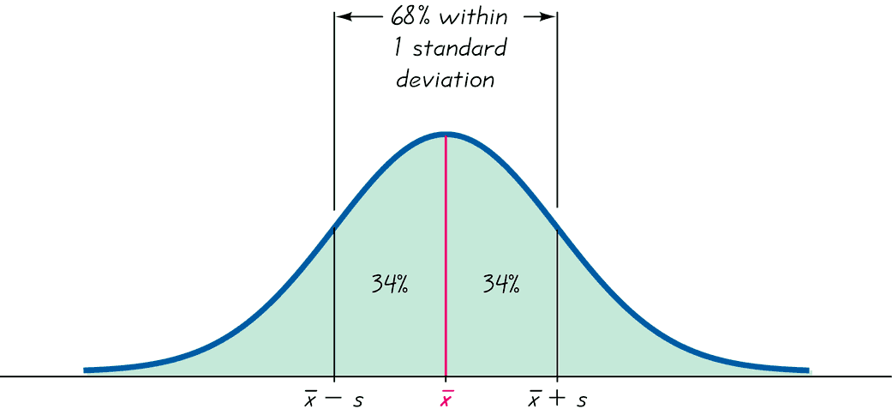
The Empirical Rule
Copyright © 2010 Pearson Education

Slide 56
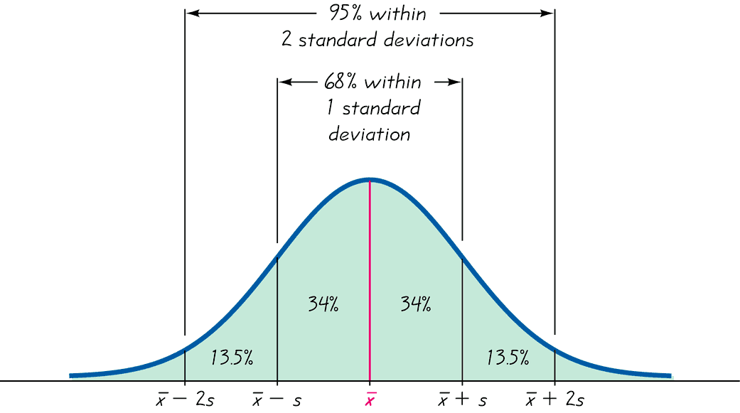
The Empirical Rule
Copyright © 2010 Pearson Education

Slide 57
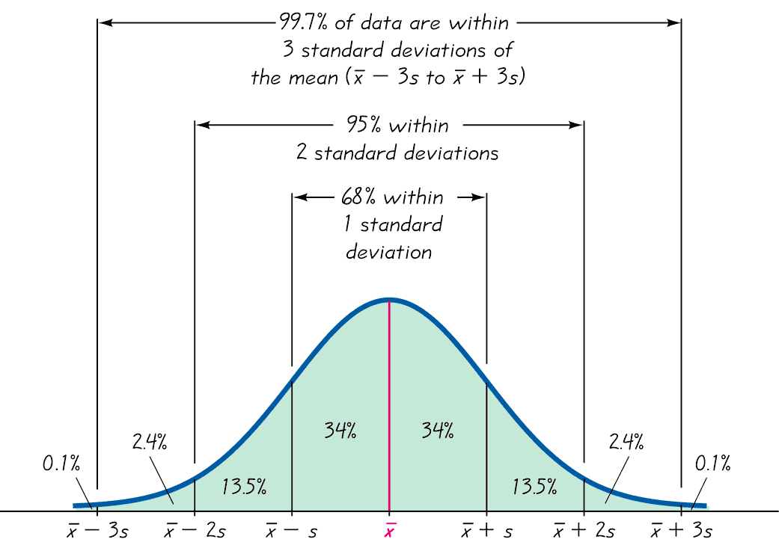
The Empirical Rule
Copyright © 2010 Pearson Education

Slide 58
Chebyshev’s Theorem
The proportion (or fraction) of any set of data lying within K standard deviations of the mean is always at least 1–1/K², where K is any positive number greater than 1.
For K = 2, at least 3/4 (or 75%) of all values lie within 2 standard deviations of the mean.
For K = 3, at least 8/9 (or 89%) of all values lie within 3 standard deviations of the mean.
Copyright © 2010 Pearson Education

Slide 59
Rationale for using n – 1 versus n
There are only n – 1 independent values. With a given mean, only n – 1 values can be freely assigned any number before the last value is determined.
Dividing by n – 1 yields better results than dividing by n. It causes s² to target σ ² whereas division by n causes s² to underestimate σ ².
Copyright © 2010 Pearson Education

Slide 60
Coefficient of Variation
The coefficient of variation (or CV) for a set of nonnegative sample or population data, expressed as a percent, describes the standard deviation relative to the mean.
Sample
Population
σ
s
∙
100%
∙
100%
CV =
CV =
x
μ
Copyright © 2010 Pearson Education

Slide 61
Recap
In this section we have looked at:
Range
Standard deviation of a sample and population
Variance of a sample and population
Range rule of thumb
Empirical distribution
Chebyshev’s theorem
Coefficient of variation (CV)
Copyright © 2010 Pearson Education

Slide 62
Section 3-4
Measures of Relative Standing and Boxplots

Slide 63
Key Concept
This section introduces measures of relative standing, which are numbers showing the location of data values relative to the other values within a data set. They can be used to compare values from different data sets, or to compare values within the same data set. The most important concept is the z score. We will also discuss percentiles and quartiles, as well as a new statistical graph called the boxplot.

Slide 64
Part 1
Basics of z Scores, Percentiles, Quartiles, and Boxplots

Slide 65
Z score
z Score (or standardized value)
the number of standard deviations that a given value x is above or below the mean

Slide 66
Measures of Position z Score
Sample
Population
x – x
x – µ
z =
z =
s
σ
Round z scores to 2 decimal places

Slide 67
Interpreting Z Scores
Whenever a value is less than the mean, its corresponding z score is negative
Ordinary values: –2 ≤ z score ≤ 2
Unusual Values: z score < –2 or z score > 2

Slide 68
Percentiles
are measures of location. There are 99 percentiles denoted P₁, P₂, . . . P₉₉, which divide a set of data into 100 groups with about 1% of the values in each group.

Slide 69
Finding the Percentile
of a Data Value
number of values less than x
Percentile of value x = • 100
total number of values

Slide 70
Converting from the kth Percentile to the Corresponding Data Value
Notation
n total number of values in the data set
k percentile being used
L locator that gives the position of a value
P_{k} kth percentile
k
L = • n
100

Slide 71
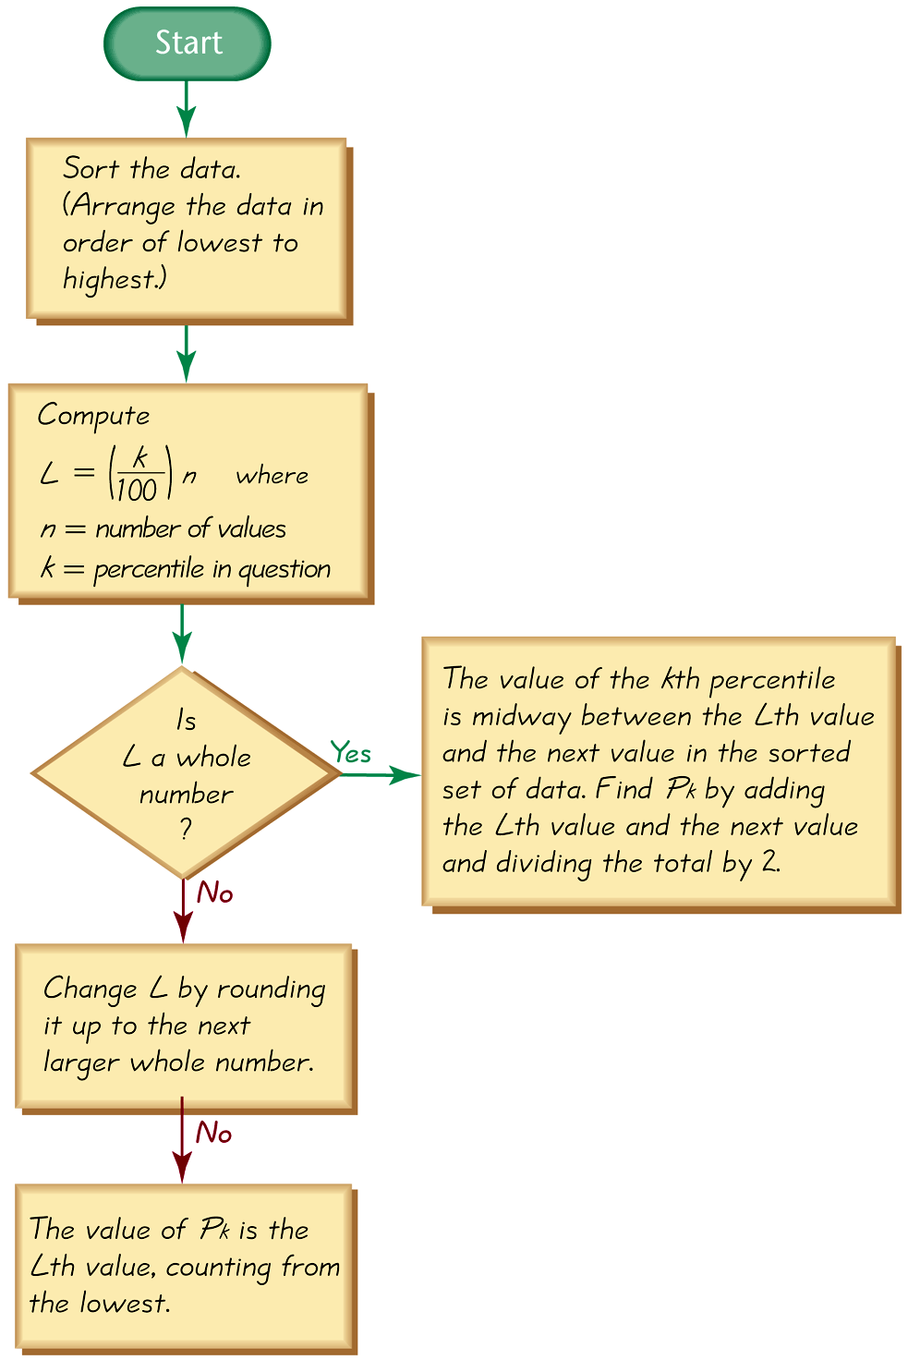
Converting from the
kth Percentile to the
Corresponding Data Value

Slide 72
Quartiles
Are measures of location, denoted Q₁, Q₂, and Q₃, which divide a set of data into four groups with about 25% of the values in each group.
Q₁ (First Quartile) separates the bottom 25% of sorted values from the top 75%.
Q₂ (Second Quartile) same as the median; separates the bottom 50% of sorted values from the top 50%.
Q₃ (Third Quartile) separates the bottom 75% of sorted values from the top 25%.

Slide 73
Quartiles
Q₁, Q₂, Q₃
divide ranked scores into four equal parts
25%
25%
25%
25%
Q₁
Q₂
Q₃
(minimum)
(maximum)
(median)

Slide 74
Some Other Statistics
Interquartile Range (or IQR): Q₃ – Q₁
Q₃ – Q₁
Semi-interquartile Range:
2
Q₃ + Q₁
Midquartile:
2
10 - 90 Percentile Range: P₉₀ – P₁₀

Slide 75
5-Number Summary
For a set of data, the 5-number summary consists of the minimum value; the first quartile Q₁; the median (or second quartile Q₂); the third quartile, Q₃; and the maximum value.

Slide 76
Boxplot
A boxplot (or box-and-whisker-diagram) is a graph of a data set that consists of a line extending from the minimum value to the maximum value, and a box with lines drawn at the first quartile, Q₁; the median; and the third quartile, Q_{3.}

Slide 77
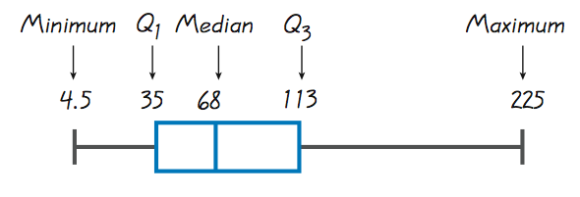
Boxplots
Boxplot of Movie Budget Amounts

Slide 78
Boxplots - Normal Distribution
Normal Distribution: Heights from a Simple Random Sample of Women

Slide 79
Boxplots - Skewed Distribution
Skewed Distribution: Salaries (in thousands of dollars) of NCAA Football Coaches

Slide 80
Part 2
Outliers and Modified Boxplots

Slide 81
Outliers
An outlier is a value that lies very far away from the vast majority of the other values in a data set.

Slide 82
Important Principles
An outlier can have a dramatic effect on the mean.
An outlier can have a dramatic effect on the standard deviation.
An outlier can have a dramatic effect on the scale of the histogram so that the true nature of the distribution is totally obscured.

Slide 83
Outliers for Modified Boxplots
For purposes of constructing modified boxplots, we can consider outliers to be data values meeting specific criteria.
In modified boxplots, a data value is an outlier if it is . . .
above Q₃ by an amount greater than 1.5 × IQR
or
below Q₁ by an amount greater than 1.5 × IQR

Slide 84
Modified Boxplots
Boxplots described earlier are called skeletal (or regular) boxplots.
Some statistical packages provide modified boxplots which represent outliers as special points.

Slide 85
Modified Boxplot Construction
A modified boxplot is constructed with these specifications:
A special symbol (such as an asterisk) is used to identify outliers.
The solid horizontal line extends only as far as the minimum data value that is not an outlier and the maximum data value that is not an outlier.

Slide 86
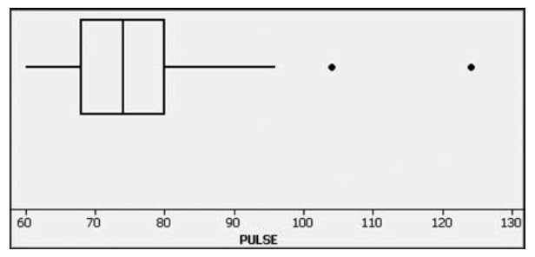
Modified Boxplots - Example
Pulse rates of females listed in Data Set 1 in Appendix B.

Slide 87
Recap
In this section we have discussed:
z Scores
z Scores and unusual values
Percentiles
Quartiles
Converting a percentile to corresponding data values
Other statistics
5-number summary
Boxplots and modified boxplots
Effects of outliers

Slide 88
Putting It All Together
Always consider certain key factors:
Context of the data
Source of the data
Sampling Method
Measures of Center
Measures of Variation
Distribution
Outliers
Changing patterns over time
Conclusions
Practical Implications

