Slide 1
Unit 4
What’s that?
Lesson 4

Slide 2
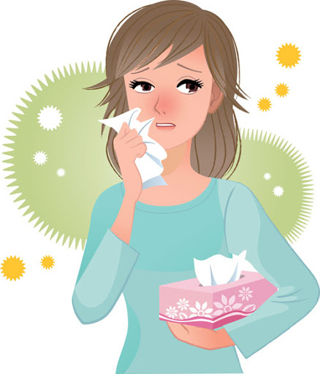
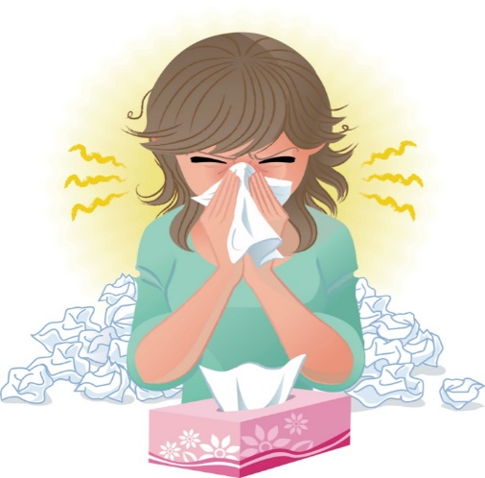
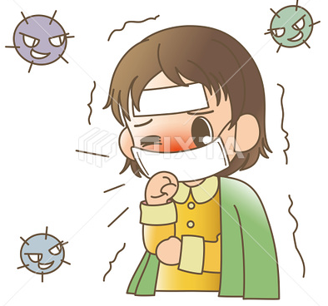
☺Avoid gathering !
Covid 19
☺wear a mask before going out.
☺Social distancing is not a choice, it is a must!
☺Keep a distance of 2 meters to avoid accountability
☺wash hands constantly.

Slide 3
بسم الله الرحمن الرحيم
Day:
Date:

Slide 4
Learning Objectives
associate given information to questions
complete students’ information forms
make a poster about their country
use punctuations correctly

Slide 7
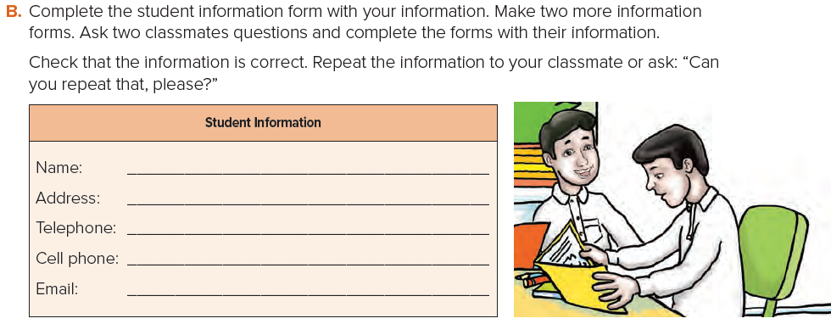

Slide 8
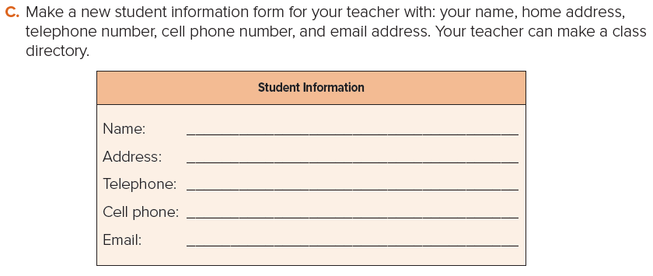

Slide 9
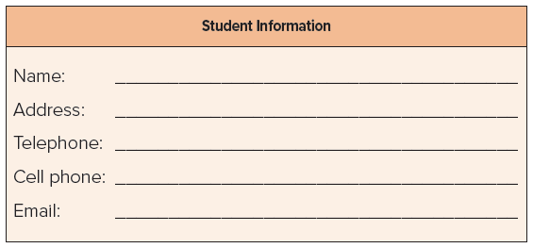

Slide 10
Home Work
Workbook page 104

Slide 11
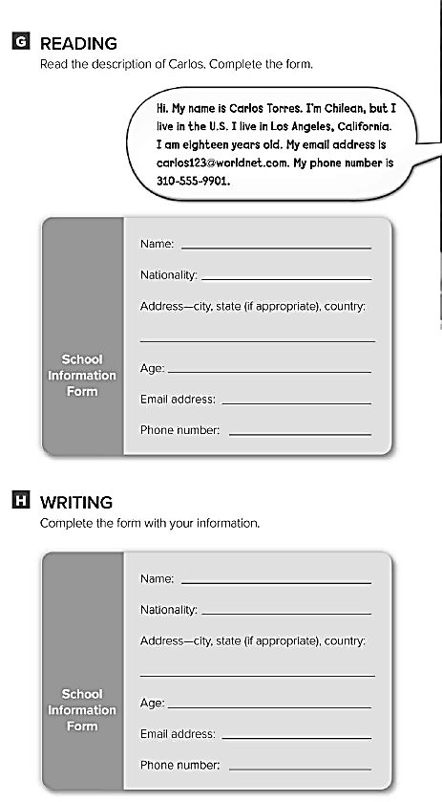
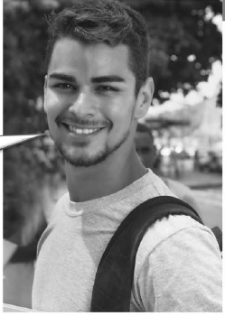
Carlos Torres
Chilean
Los Angeles, California, U.S.
18
carlos123@worldnet.com
310-555-9901

Slide 12
USA
PERU
EUROPE
AUSTRALIA

