Slide 1

General Chemistry
CHEM 101
(3+1+0)

Slide 2
Chapter 3
Mass Relationships in Chemical Reactions

Slide 3
In this chapter,
Chemical structure and formulas in studying the mass relationships of atoms and molecules.
To explain the composition of compounds and the ways in which composition changes.

Slide 4
Atomic Mass: Average Atomic Mass
The mass of an atom depends on the number of electrons, protons, and neutrons it contains.
Knowledge of an atom’s mass is important in laboratory work.
Micro World
atoms & molecules
Macro World
grams
Atomic mass (atomic weight) is the mass of an atom in atomic mass units (amu).
By definition:
1 atom ¹²C “weighs” 12 amu
On this scale
¹H = 1.008 amu
¹⁶O = 16.00 amu

Slide 5
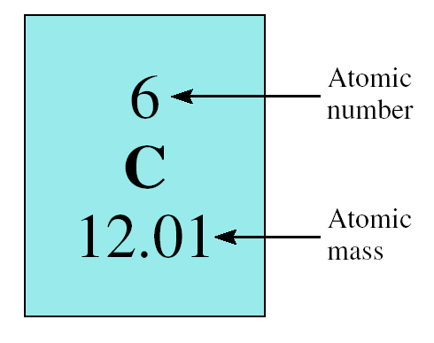
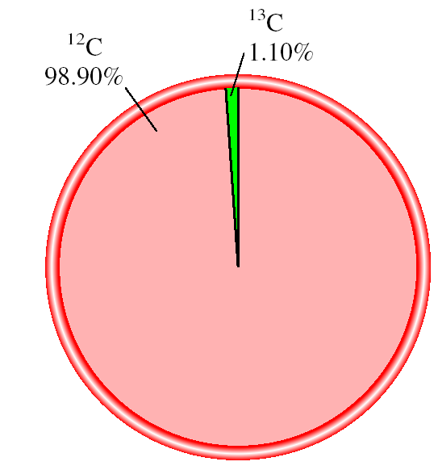
Atomic Mass: Average Atomic Mass
The average atomic mass is the weighted average of all of the naturally occurring isotopes of the element.

Slide 6
Atomic Mass: Average Atomic Mass
Naturally occurring lithium is:
7.42% ⁶Li (6.015 amu)
92.58% ⁷Li (7.016 amu)
Average atomic mass of lithium:
7.42 x 6.015 + 92.58 x 7.016
= 6.941 amu
100

Slide 7
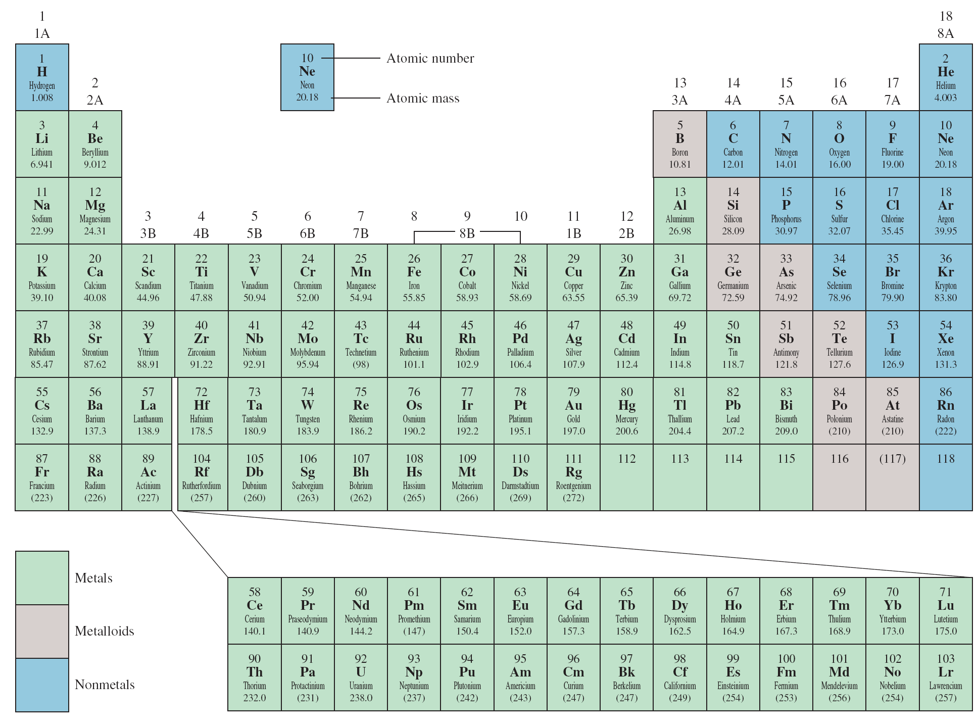
Atomic Mass: Average Atomic Mass

Slide 8
Atomic Mass: Average Atomic Mass

Slide 9
Avogadro's Number and the Molar Mass of an Element
The mole (mol): A unit to count numbers of particles
Dozen = 12
Pair = 2
The mole (mol) is the amount of a substance that contains as many elementary entities as there are atoms in exactly 12.00 grams of ¹²C
This number is expressed by the Avogadro’s number (N_{A})
1 mol = N_{A} = 6.0221367 x 10²³

Slide 10
Avogadro's Number and the Molar Mass of an Element
Molar mass (M) is the mass of 1 mole of atoms in grams.
1 mole ¹²C atoms = 6.022 x 10²³ atoms = 12.00 g
1 ¹²C atom = 12.00 amu
1 mole ¹H atoms = 6.022 x 10²³ atoms = 1.00 g
1 ¹H atom = 1.00 amu
For any element
atomic mass (amu) = molar mass (grams)

Slide 11
Avogadro's Number and the Molar Mass of an Element
Unit is the amu mass.
  atomic unit
  1 amu = 1.66 x 10⁻²⁴g
We define the masses of atoms in terms of atomic mass units
  1 Carbon atom = 12.01 amu,
  1 Oxygen atom = 16.00 amu
  1 O₂ molecule = 2(16.00 amu) = 32.00 amu

Slide 12
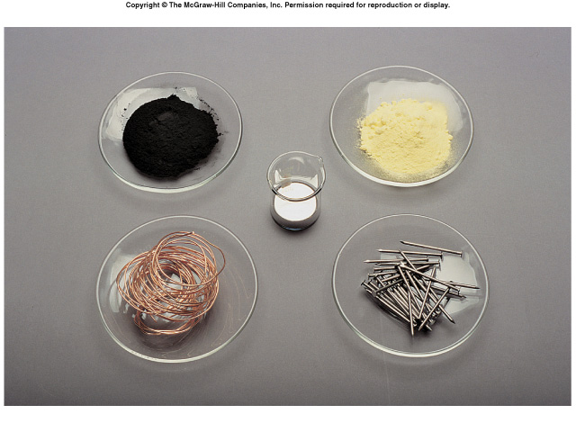
Avogadro's Number and the Molar Mass of an Element
One Mole of:
C
S
Hg
Cu
Fe

Slide 13
Avogadro's Number and the Molar Mass of an Element
For example:
Molar mass of ¹²C is 12.01 g and there are 6.022 X 10²³ ¹²C atoms in 1 mole of the substance;
The mass of one ¹²C atom is given by
12.00 g ¹²C atoms
6.022 x 10²³ ¹²C atoms
Mass of g ¹²C atom
1 ¹²C atom
12.00 g ¹²C atoms
=
1.993 x 10⁻²³ g
6.022 x 10²³ ¹²C atoms

Slide 14
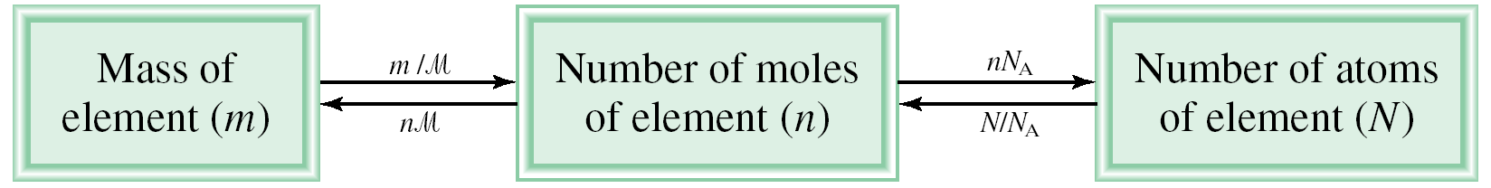
Avogadro's Number and the Molar Mass of an Element
Avogadro’s number can be used to convert from the atomic mass units to mass in gram and vice versa.
The mass of every ¹²C atom = 12 amu
The number of atomic mass units equivalent to 1 g is
1 ¹²C atom
12.00 g
1.66 x 10⁻²⁴ g
x
=
12.00 amu
6.022 x 10²³ ¹²C atoms
1 amu
1 amu = 1.66 x 10⁻²⁴ g or 1 g = 6.022 x 10²³ amu
M
= molar mass in g/mol
N_{A} = Avogadro’s number

Slide 15
Avogadro's Number and the Molar Mass of an Element

Slide 16
Avogadro's Number and the Molar Mass of an Element

Slide 17
Avogadro's Number and the Molar Mass of an Element

Slide 18
Avogadro's Number and the Molar Mass of an Element
How many atoms are in 0.551 g of potassium (K) ?
1 mol K = 39.10 g K
1 mol K = 6.022 x 10²³ atoms K
1 mol K
6.022 x 10²³ atoms K
0.551 g K
x
x
=
39.10 g K
1 mol K
8.49 x 10²¹ atoms K

Slide 19
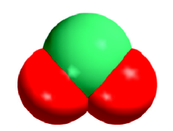
Molecular Mass
Molecular mass (or molecular weight) is the sum of the atomic masses (in amu) in a molecule.
1S
32.07 amu
2O
+ 2 x 16.00 amu
SO₂
SO₂
64.07 amu
For any molecule
molecular mass (amu) = molar mass (grams)
1 molecule SO₂ = 64.07 amu
1 mole SO₂ = 64.07 g SO₂
Molecular mass of H₂O is

Slide 20
Molecular Mass

Slide 21
Molecular Mass

Slide 22
Molecular Mass

Slide 23
Molecular Mass
How many H atoms are in 72.5 g of C₃H₈O ?
1 mol C₃H₈O = (3 x 12) + (8 x 1) + 16 = 60 g C₃H₈O
1 mol C₃H₈O molecules = 8 mol H atoms
1 mol H = 6.022 x 10²³ atoms H
1 mol C₃H₈O
8 mol H atoms
6.022 x 10²³ H atoms
72.5 g C₃H₈O
x
x
x
=
60 g C₃H₈O
1 mol C₃H₈O
1 mol H atoms
5.82 x 10²⁴ atoms H

Slide 24
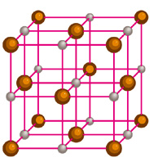
Molecular Mass
Formula mass is the sum of the atomic masses (in amu) in a formula unit of an ionic compound.
1Na
22.99 amu
NaCl
1Cl
+ 35.45 amu
NaCl
58.44 amu
For any ionic compound
formula mass (amu) = molar mass (grams)
1 formula unit NaCl = 58.44 amu
1 mole NaCl = 58.44 g NaCl

Slide 25
Molecular Mass
What is the formula mass of Ca₃(PO₄)₂ ?
1 formula unit of Ca₃(PO₄)₂
3 Ca
3 x 40.08
2 P
2 x 30.97
8 O
+ 8 x 16.00
310.18 amu

Slide 26
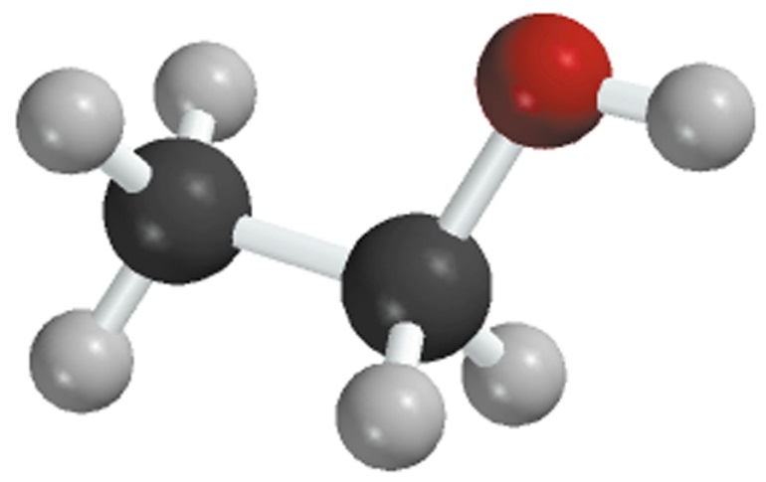
Percent Composition of Compounds
The percent composition by mass is the percent by mass of each element in a compound.
n is the number of moles of the element in 1 mole of the compound
2 x (12.01 g)
%C =
x 100% = 52.14%
46.07 g
6 x (1.008 g)
%H =
x 100% = 13.13%
46.07 g
1 x (16.00 g)
%O =
x 100% = 34.73%
46.07 g
C₂H₆O
52.14% + 13.13% + 34.73% = 100.0%

Slide 27
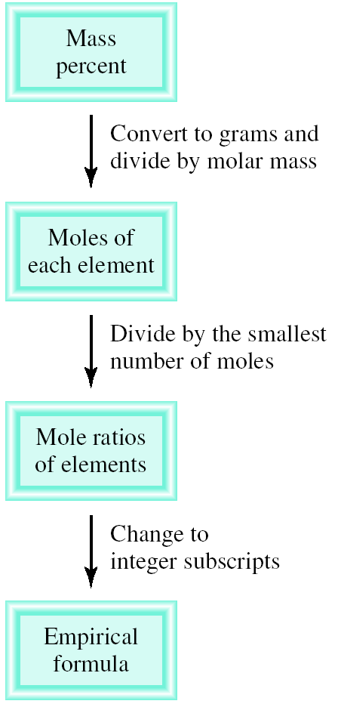
Percent Composition of Compounds
Given the percent composition by mass of a compound, we can determine the empirical formula of the Compound.

Slide 28
Percent Composition of Compounds
Percent Composition and Empirical Formulas
Given the percent composition by mass of a compound, we can determine the empirical formula of the Compound.
Determine the empirical formula of a compound that has the following percent composition by mass: K 24.75, Mn 34.77, O 40.51 percent.
1 mol K
n_{K} = 24.75 g K x
= 0.6330 mol K
39.10 g K
1 mol Mn
n_{Mn} = 34.77 g Mn x
= 0.6329 mol Mn
54.94 g Mn
1 mol O
n_{O} = 40.51 g O x
= 2.532 mol O
16.00 g O

Slide 29
Percent Composition of Compounds
Percent Composition and Empirical Formulas
n_{K} = 0.6330, n_{Mn} = 0.6329, n_{O} = 2.532
0.6330
K :
~
1.0
~
0.6329
0.6329
Mn :
= 1.0
0.6329
2.532
O :
~
4.0
~
0.6329
KMnO₄

Slide 30
Percent Composition of Compounds
Percent Composition and Empirical Formulas

Slide 31
Percent Composition of Compounds
Percent Composition and Empirical Formulas

Slide 32
Percent Composition of Compounds
To know the actual mass of an element in a certain mass of a compound.

Slide 33
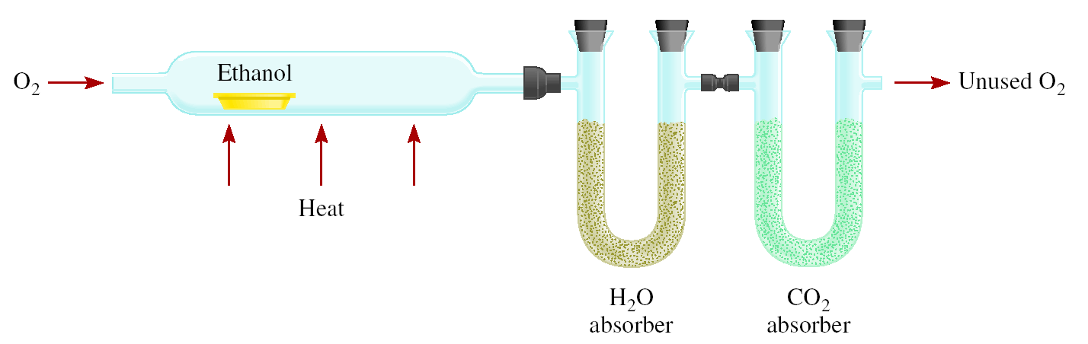
Experimental Determination of Empirical Formulas
Combust 11.5 g ethanol
Collect 22.0 g CO₂ and 13.5 g H₂O
g CO₂
mol CO₂
mol C
g C
6.0 g C = 0.5 mol C
g H₂O
mol H₂O
mol H
g H
1.5 g H = 1.5 mol H
g of O = g of sample – (g of C + g of H)
4.0 g O = 0.25 mol O
Empirical formula C_{0.5}H_{1.5}O_{0.25}
Divide by smallest subscript (0.25)
Empirical formula C₂H₆O

Slide 34
Experimental Determination of Empirical Formulas
Thus, 11.5 g of ethanol contains 6.00 g of carbon and 1.51 g of hydrogen. The remainder must be oxygen, whose mass is
The number of moles of each element present in 11.5 g of ethanol is

Slide 35
Experimental Determination of Empirical Formulas
“empirical” means “based only on observation and measurement.”
Ex: The empirical formula of ethanol is determined from analysis of the compound in terms of its component elements.
No knowledge of how the atoms are linked together in the compound is required.

Slide 36
Experimental Determination of Empirical Formulas
Determination of Molecular Formulas
To calculate the actual, molecular formula we must know
the approximate molar mass of the compound
its empirical formula.

Slide 37
Experimental Determination of Empirical Formulas
Determination of Molecular Formulas

Slide 38
Experimental Determination of Empirical Formulas
Determination of Molecular Formulas

Slide 39
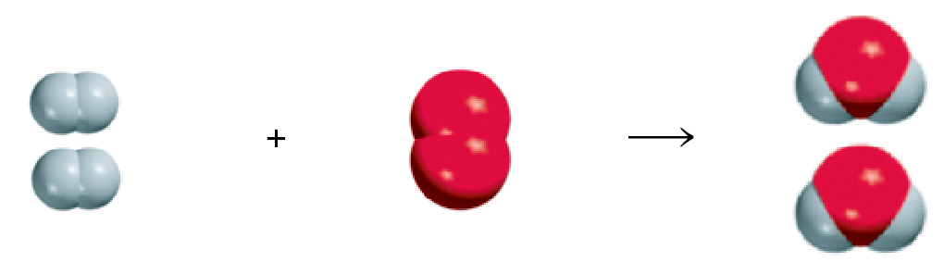
Chemical Reactions and Chemical Equations
A process in which one or more substances is changed into one or more new substances is a chemical reaction
A chemical equation uses chemical symbols to show what happens during a chemical reaction
reactants
products
3 ways of representing the reaction of H₂ with O₂ to form H₂O

Slide 40
How to “Read” Chemical Equations
Chemical Reactions and Chemical Equations
2 Mg + O₂ 2 MgO
2 atoms Mg + 1 molecule O₂ makes 2 formula units MgO
2 moles Mg + 1 mole O₂ makes 2 moles MgO
48.6 grams Mg + 32.0 grams O₂ makes 80.6 g MgO
NOT
2 grams Mg + 1 gram O₂ makes 2 g MgO

Slide 41
Chemical Reactions and Chemical Equations
Balancing Chemical Equations
Write the correct formula(s) for the reactants on the left side and the correct formula(s) for the product(s) on the right side of the equation.
Ethane reacts with oxygen to form carbon dioxide and water
C₂H₆ + O₂
CO₂ + H₂O
Change the numbers in front of the formulas (coefficients) to make the number of atoms of each element the same on both sides of the equation. Do not change the subscripts.
2C₂H₆
NOT
C₄H₁₂

Slide 42
Chemical Reactions and Chemical Equations
Balancing Chemical Equations
Start by balancing those elements that appear in only one reactant and one product.
C₂H₆ + O₂
CO₂ + H₂O
start with C or H but not O
2 carbon
on left
1 carbon
on right
multiply CO₂ by 2
C₂H₆ + O₂
2CO₂ + H₂O
6 hydrogen
on left
2 hydrogen
on right
multiply H₂O by 3
C₂H₆ + O₂
2CO₂ + 3H₂O

Slide 43
Chemical Reactions and Chemical Equations
Balancing Chemical Equations
Balance those elements that appear in two or more reactants or products.
7
C₂H₆ + O₂
2CO₂ + 3H₂O
multiply O₂ by
2
2 oxygen
on left
4 oxygen
(2x2)
+ 3 oxygen
(3x1)
= 7 oxygen
on right
7
remove fraction
multiply both sides by 2
C₂H₆ + O₂
2CO₂ + 3H₂O
2
2C₂H₆ + 7O₂
4CO₂ + 6H₂O

Slide 44
Chemical Reactions and Chemical Equations
Balancing Chemical Equations
Check to make sure that you have the same number of each type of atom on both sides of the equation.
2C₂H₆ + 7O₂
4CO₂ + 6H₂O
4 C (2 x 2)
4 C
12 H (2 x 6)
12 H (6 x 2)
14 O (7 x 2)
14 O (4 x 2 + 6)
Reactants
Products
4 C
4 C
12 H
12 H
14 O
14 O

Slide 45
Chemical Reactions and Chemical Equations
Balancing Chemical Equations

Slide 46
Chemical Reactions and Chemical Equations
Balancing Chemical Equations

Slide 47
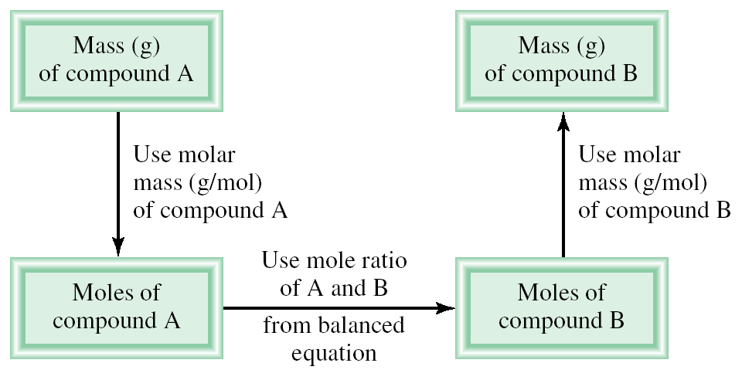
Amounts of Reactants and Products
Write balanced chemical equation
Convert quantities of known substances into moles
Use coefficients in balanced equation to calculate the number of moles of the sought quantity
Convert moles of sought quantity into desired units

Slide 48
Amounts of Reactants and Products
Methanol burns in air according to the equation
2CH₃OH + 3O₂ 2CO₂ + 4H₂O
If 209 g of methanol are used up in the combustion, what mass of water is produced?
grams CH₃OH
moles CH₃OH
moles H₂O
grams H₂O
molar mass
CH₃OH
coefficients
chemical equation
molar mass
H₂O
1 mol CH₃OH
4 mol H₂O
18.0 g H₂O
209 g CH₃OH
x
x
x
=
32.0 g CH₃OH
2 mol CH₃OH
1 mol H₂O
235 g H₂O

Slide 49
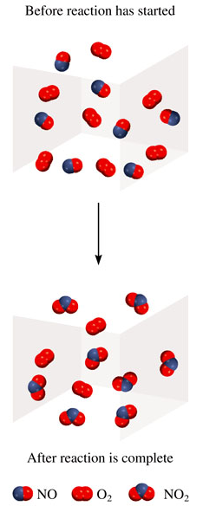
Limiting Reagents
Reactant used up first in the reaction.
2NO + O₂ 2NO₂
NO is the limiting reagent
O₂ is the excess reagent

Slide 50
Limiting Reagents
In one process, 124 g of Al are reacted with 601 g of Fe₂O₃
2Al + Fe₂O₃ Al₂O₃ + 2Fe
Calculate the mass of Al₂O₃ formed.
g Al
mol Al
mol Fe₂O₃ needed
g Fe₂O₃ needed
OR
g Fe₂O₃
mol Fe₂O₃
mol Al needed
g Al needed
1 mol Al
1 mol Fe₂O₃
160. g Fe₂O₃
124 g Al
x
x
x
=
367 g Fe₂O₃
27.0 g Al
2 mol Al
1 mol Fe₂O₃
Start with 124 g Al
need 367 g Fe₂O₃
Have more Fe₂O₃ (601 g) so Al is limiting reagent

Slide 51
Limiting Reagents
Use limiting reagent (Al) to calculate amount of product that
can be formed.
g Al
mol Al
mol Al₂O₃
g Al₂O₃
2Al + Fe₂O₃ Al₂O₃ + 2Fe
1 mol Al
1 mol Al₂O₃
102. g Al₂O₃
124 g Al
x
x
x
=
234 g Al₂O₃
27.0 g Al
2 mol Al
1 mol Al₂O₃
At this point, all the Al is consumed and Fe₂O₃ remains in excess.

Slide 52
Reaction Yield
Theoretical Yield is the amount of product that would
result if all the limiting reagent reacted.
Actual Yield is the amount of product actually obtained
from a reaction.
Actual Yield
% Yield =
x 100%
Theoretical Yield

Slide 53
Reaction Yield

Slide 54
Reaction Yield

